Slide 1













Corporate Finance
Corporate Finance Leadership Team
February 2018
Org chart 1
Chief Financial Officer (Executive Director)
Director Corporate Financial Planning & Strategy
Director Corporate Financial
Management
Director Corporate Finance Policy
and Office of the CFO
Director Corporate Finance
Systems Improvement
Director Finance Shared Services
Director Schools Finance
Executive Director Strategic Resource Management External Affairs and Regulation
Chief Financial Officer NESA
Manager Business Strategy Aboriginal Affairs
Office Management
Office Mgr/EA to CFO
Finance Manager Strategy and Evaluation
Executive Assistant CL3/4 x3

Slide 2
Enterprise financial planning tool (efpt): UPDATE
June 2018

Slide 3
What we’ll cover
eFPT background and overview
About eFPT Release 2
Training approach
Training feedback
Next steps and questions

Slide 4
efpt and it’s aims
Enterprise Financial Planning Tool (eFPT) aims to support better managed schools to deliver quality learning outcomes for students
It will contribute to this outcome by providing a user-friendly system that support Principals, SAMs and Business Managers to carry out effective financial planning for schools
eFPT is built based on best practice budget and financial management principles, but adapted to schools’ needs and departmental finance policies

Slide 5
who were engaged with
User Reference Group – A group of Principals and SAMs referred by the PPA and SPC
Integral to the development of eFPT and were involved in the design and testing of eFPT
PPA FARG and the SPC FARG
RAM Principals Working Party
PSA and Industrial Relations
LSLD Steering Committee

Slide 6
Overview
School BPC was replaced by the interim excel-based Enterprise Financial Planning Tool (eFPT) in Term 4, 2017
The interim solution was replaced by a SAP integrated eFPT because it:
was not a dynamic real-time interface with the backend accounting system (SAP)
has limited staff and financial planning functionality
was expensive to maintain and support in comparison to web-based options
The SAP integrated eFPT is made up of three sections:
An overview landing page which gives a snapshot of the current plan for the school
A staff planning page where schools enter and vary their staffing costs. This section has a number of tools to assist principals such as the staff calculator
A financial planning page where schools enter and edit their non staff costs. In this section they can also spread planed costs easily by selecting options
Each page displays the schools current plan which updates dynamically as the user allocates funds
The SAP integrated eFPT went live on 30 April 2018.

Slide 7
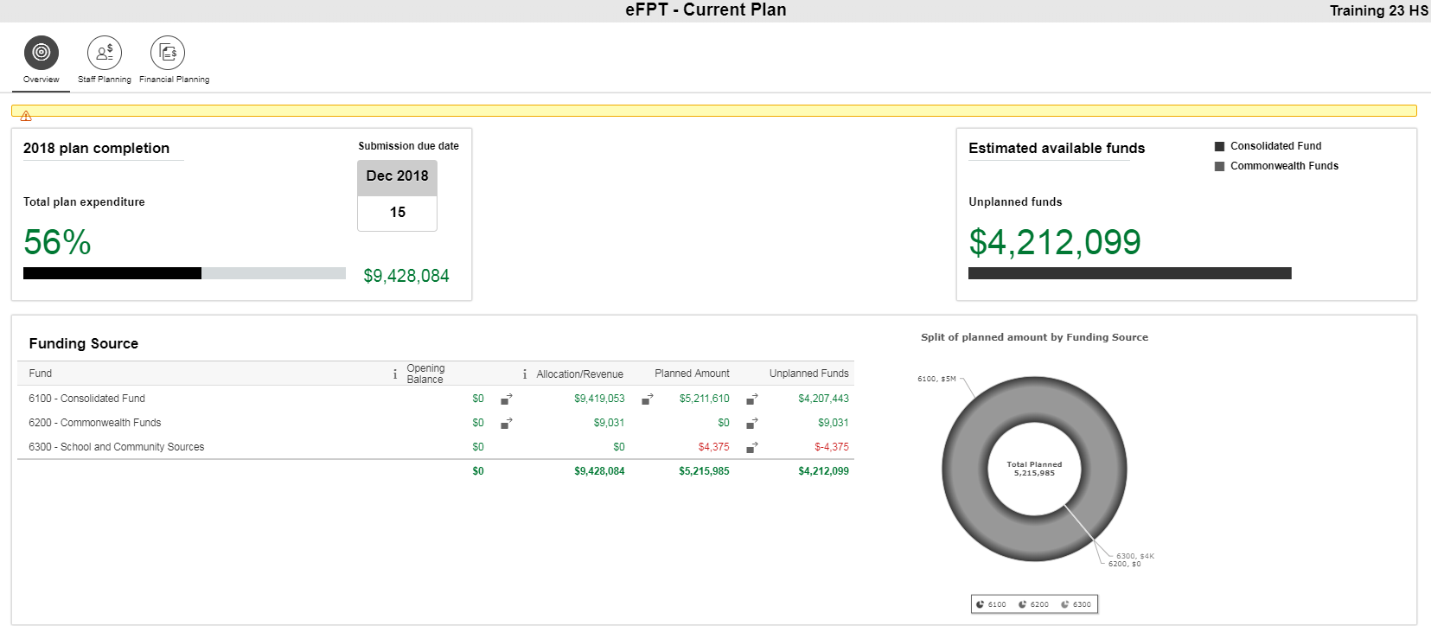
eFPT Release 2
The enhanced tool is a user-friendly web-based solution.
It is a dynamic interface; accessing information from the organisation’s backend accounting system (SAP).
It will guide users through the financial planning process – making these activities easier and less time consuming for schools

Slide 8
Training approach
Training delivery was through virtual rooms with targeted sessions covering theory (Finance Essentials) and two Systems based sessions (Systems Staff Planning and Systems Financial Planning).
This allowed more flexibility for attendees as to the time and date of sessions and attendees did not need to travel from their schools
There were two types of Systems based training offered depending on the profile of the school:
Primary (included Primary, Infant, Environmental Ed, Specific Purposes Schools)
Secondary (included Secondary and Central & Community Schools, Intensive English Centres, distance Ed Centres)
This allowed for the sessions to be tailored to the needs of these school types and was the result of feedback on training in the interim eFPT.

Slide 9
Training statistics
School participation
96% of schools enrolled in one or more sessions (92 schools did not attend any training)
As of 20 June
Sessions | Nº of Enrolments | Nº Attendees
eFPT Finance Essentials Training | 2,834 | 2,832
eFPT Systems Financial Planning | 4,206 | 4,203
eFPT Systems Staff Planning | 4,193 | 4,190
eFPT Webinars | 887 | 887
Total | 12,120 | 12,112

Slide 10
Training Feedback
General Training Feedback (as at 21 May)
82% of survey respondents agreed the trainer provided a high level of engagement
81% of respondents reported experiencing no technical issues (in relation to virtual training rooms)
91% of respondents indicated that there was sufficient time to interact and ask questions during their session
System: Staff Planning Modules Feedback
92% of respondents agreed that the session helped them understand how to navigate the eFPT for staff planning
91% agreed that the scenarios & examples helped support their understanding of staff planning
92% agreed that the content was consistent with objectives
77% agreed that they found the eFPT for staff planning very user friendly
System: Financial Planning Modules Feedback
86% of respondents agreed that the session helped them understand how to navigate the eFPT for financial planning
82% agreed that the scenarios & examples helped support their understanding of staff planning
87% agreed that the content was consistent with objectives
69% agreed that they found the eFPT for staff planning very user friendly

Slide 11
Training Feedback
Qualitative Comments
A number of participants requested full copy of the slides post the session
Participants requesting more webinars be made available once schools have access to the revised eFPT and face-to-face support and coaching after the training period
Some participants saying pace of sessions too fast and that there is a lot of assumed knowledge – this feedback coming across Staff Planning, Financial Planning and Finance Essentials
Technical issues were reported in the qualitative feedback – some of these appear to be related to school internet connections (with audio or sessions dropping out and screen freezing) and a fair number relate to issues with training links

Slide 12
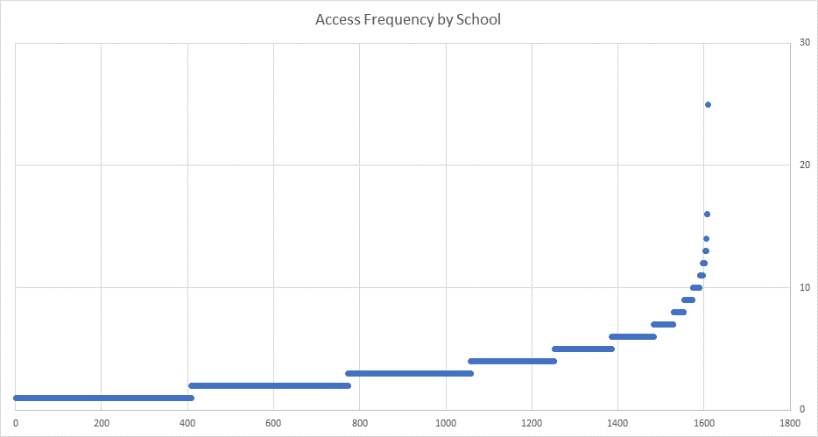
EFPT System usage and Feedback

Slide 13
EFPT Systems issues
Why do we need to plan/budget? Why is eFPT so complicated?
Why weren’t those defects found in SIT & UAT
Was there anything we could have done to prevent them before go live?
Schools Overview Report and eFPT – they do not reconcile
OMSEE 4 vs Approved SBAR
Hard to balance SBAR and identify Equity funded FTEs
Training was inadequate
Wrong data loaded from interim tool to phase 2
QRGs – not well written, schools can’t follow
What should I do with my variances?

Slide 14
EFPT next steps
Bite size learning recordings to assist in:
Planning for Professional Learning, Beginning Teachers, New arrivals and other funding using casual salaries
How to phase my plan over the school calendar year
WBS funded staff (flexible funding or not)
Variance analysis
Budget adjustments

Slide 15
eFPT Coaching Support Process Flowchart
Identification of Coaching Need
Level 0 – 1 Support EDConnect
Virtual Support - eFPT Schools Business Partners
Coaching - eFPT Schools Business Partners
Key
People
Principal, SAM, BM
EDConnect Contact Centre Request
EDConnect Online Reqest Form
Phone Coaching / Screen Sharing
Level 3 Schools Business Partners
EDConnect Contact Centre
Level 2 & 3 Support
EDConnect Website Online Form Request
Coaches
General Webinar
Short Phone Coaching
Schools Business Partners
eFPT Business Partners
Directors Educational Leadership
Special Topic Webinar
Staff Planning Webinar
Extended / Follow Up Phone Coaching
Financial Planning Webinar
Group Online Coaching
Email / Call to LSLD Training Team
Drop In Workshops
Request for Support from Directors, Educational Leadership
1:1 School Visit

Slide 16
Sick & facs leave model (SFLM) briefing
Replacement of Shared Risk Model (SRM) from 2018

Slide 17
INTRODUCTION
The Shared Risk Model (SRM) has been used to support leave reimbursements for fully deployed schools for the past 4 years.
The SRM was discontinued in 2018 and replaced with a new model known as Sick & FACS Leave Model (SFLM).
Notes:
Last update in SchoolBiz was Week 1 of Term 2 (27 April)

Slide 18
What is sflm?
SFLM is a budget management model which provides Sick & FACS leave budget allocations to schools to meet the cost of relief if they decide to replace staff on approved Sick & FACS leave.
Under SFLM, Schools are not required to pay Shared Risk Model premiums and no budget reimbursements will be required.
The SFLM budget allocation will be in addition to the School Operational Funding (SOF) as advised in the School Budget Allocation Report (SBAR).
Out of Scope
Sick leave without pay – It is not a cost to schools.
Above Centrally Identified Positions (ACIP) – schools are responsible for the leave related expenses when creating permanent and temporary ACIP.
Accident leave – It is managed by Work Health & Safety (WHS) Directorate, as the relief costs for accident leave is not funded by SFLM budget.

Slide 19
How does sflm work?
The SFLM uses 3-year rolling average of actual Sick and FACS leave days taken per school, and moderated against a state-wide benchmark provided by HR, to derive the baseline budget for each school at the commencement of each calendar year.
The budget for Sick & FACS leave (i.e. SFLM baseline budget) is a combined total of two components:
Operating funding notional budget for short term relief: It covers the short-term Sick and FACS leave, and is included in SBAR and can be accessed as same as before.
SFLM Budget: It covers the balance of Sick and FACS leave. It is the component to replace SRM, schools will receive this budget for the 1st time as a budget adjustment during Term 2 of 2018. In future, it will be included in SBAR.
Example:
School A will need $200k for Sick & FACS leave budget based on the 3-year sick and FACS leave days taken.
School A would have received $60k in SOF that can be used for relief, based on the short term relief budget formula used in Globals.
School A will receive $140k (i.e. $200k-$60k) at the beginning of the school year.
SFLM Baseline Budget
SFLM Budget (Moderated)
Operational funding notional budget for short term relief
Notes:
SFLM Baseline Budget can be explained in two ways:
Based on the additional funding given to schools on top of what was provided in the SOF
Based on the formula using the 3 year average per FTE, adjusted by moderation and multiplied by FTE and the casual daily rate

Slide 20
How does sflm work? (Contd.)
Key inputs to “SFLM baseline budget”
Moderation
Moderation is applied to ensure the schools that are lower or at benchmark (less days/FTE) won’t be penalised, and at the same time, those higher than the benchmark (more days/FTE) will get budget closer to benchmark.
School Fact Sheet
A fact sheet will be generated to each school as a step by step guide of SFLM baseline budget allocation.
SFLM Baseline Budget
Moderated Sick & FACS Leave Taken Days per FTE
FTE
Casual Daily Rate

Slide 21
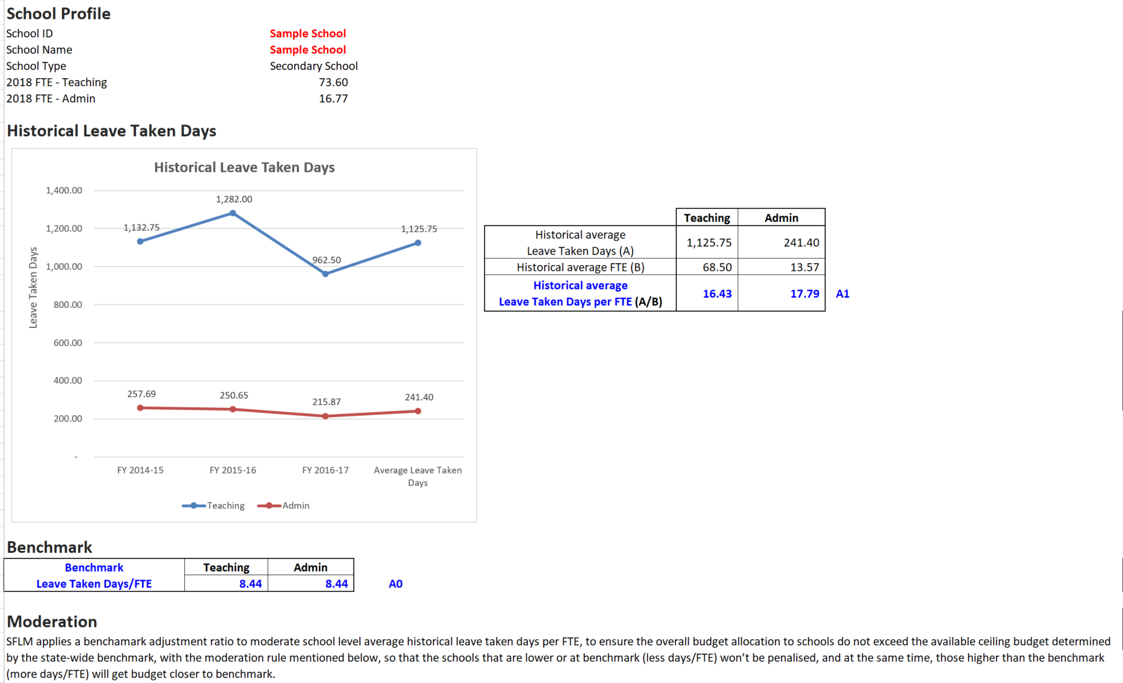
Sample School fact sheet (1/2)

Slide 22
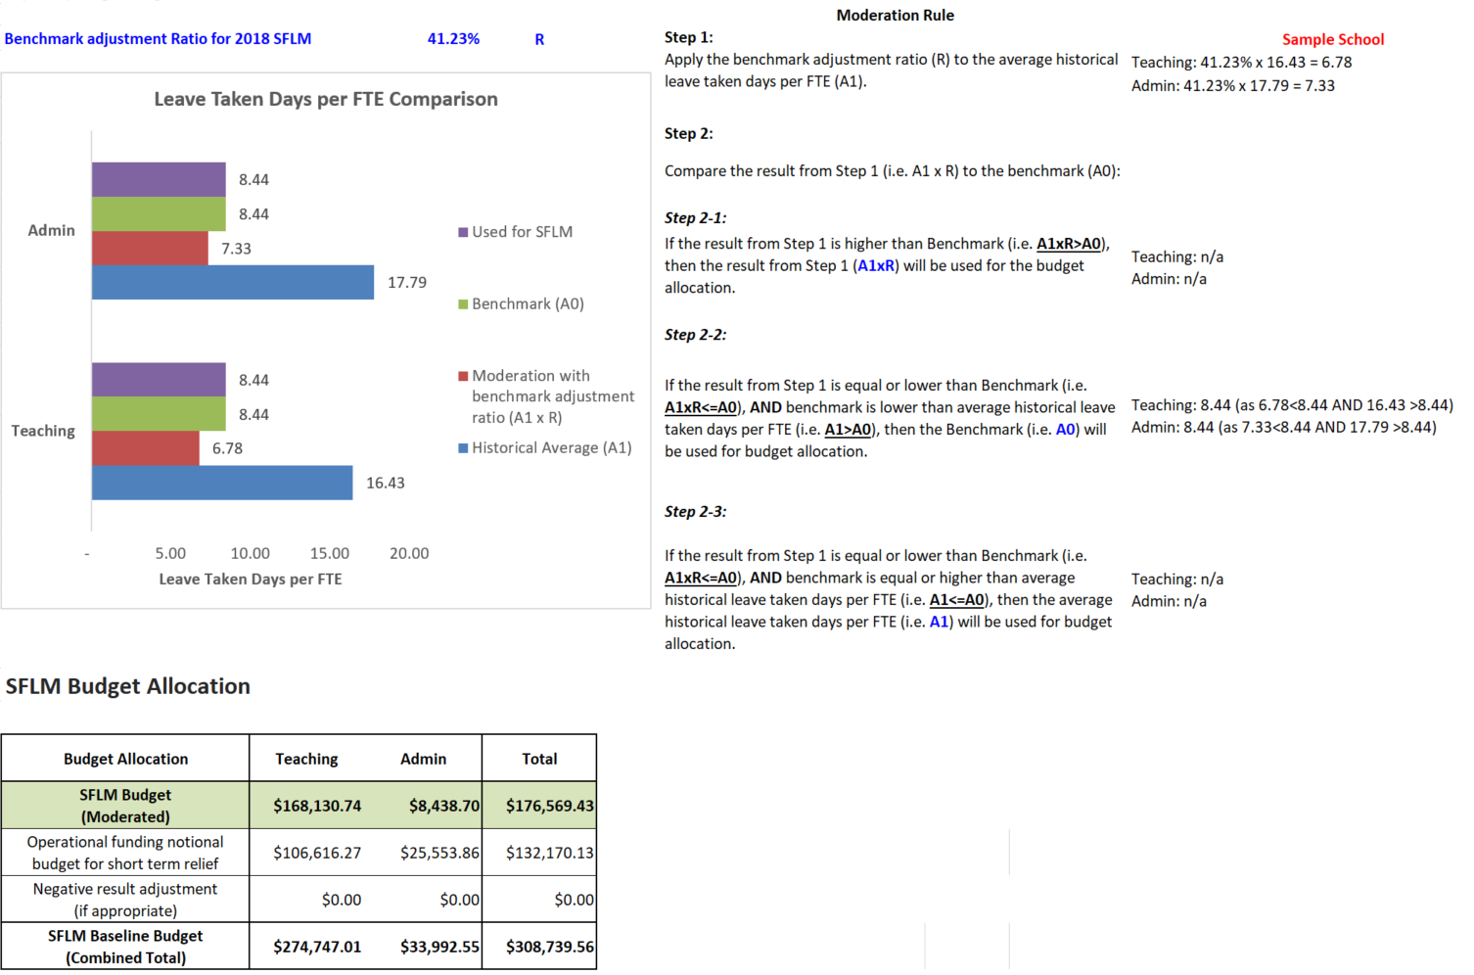
Sample School fact sheet (2/2)

Slide 23
How to manage the budget stress
Threshold Test
Corporate Finance will undertake a monitoring process each month for staff taking more than 20 working days of Sick & FACS leave (planned or unplanned) across all schools. (NB: Sick leave without pay is excluded)
If schools have staff meet / exceed the threshold, schools will only need to pay the first 15 days of Sick & FACS leave taken for that staff, the leave cost over and above 15 days will be provided as budget adjustment to top up for schools.
Budget Adjustment
It is based on standard cost, not casual daily rate.
It will be processed on an incremental basis, where required.

Slide 24
How to manage the budget stress (Contd.)
Example:
One classroom teacher goes on 32 days of sick leave, 7 days out of 32 are for sick leave without pay, and the standard daily rate is $515.41.
Step 1: This School has passed the threshold test (i.e. 32-7=25 >20).
Step 2: Budget Adjustment
Employee ID | Designation | Daily Rate (Standard Cost) | LT Days meet Threshold |  | First 15 Days (paid by schools) |  | LT Days for Budget Adjustment |  | $ for Budget Adjustment
 |  |  | Teaching | Admin | Teaching | Admin | Teaching | Admin | Teaching | Admin
 |  | A | B1 | B2 | If applicable | If applicable | C1=B1-15 | C2=B2-15 | A x C1 | A x C2
XXXXX | Classroom Teacher | $515.41 | 25 | 0 | 15 | 0 | 10 | 0 | $5,154.1 | $0
LT Days: Sick and FACS leave taken days

Slide 25
HOW TO MANAGE UNDERS AND OVERS
Unders and overs were discussed with SFLM Reference Group prior to endorsement. The agreed transitional arrangements are:
In 2018 calendar year, schools will follow the existing carry forward policies (i.e. remaining funds will rollover to 2019 calendar year), and SFLM budget will be released as operational budget.
From 2019 calendar year onwards, SFLM budget will be provided as staffing budget, and these funds will not rollover to following calendar year.

Slide 26
ADDITIONAL INFORMATION
The budget is based on leave taken days, NOT relief days, schools are expected to utilise the budget to cover Sick & FACS leave, it’s schools’ decision if they want to hire a temporary staff to cover all types of leave (planned or unplanned).
Corporate Finance’s role is to support the SFLM budget adjustments, HR’s existing role within the department remain unchanged. Schools should continue to replace staff on Sick & FACS leave in accordance with the department ‘s policy and applicable legislation.

