Slide 1
LITERACY AND NUMERACY UPDATE
NSWPPA Term 2 State Council Meeting
21 June 2018

Slide 2
OUR FOCUS
Aspiration
All NSW students have the essential literacy and numeracy skills they need for success in learning and in life.
Goals
Teachers have an increased understanding of students' literacy and numeracy learning needs
Teachers have increased skill in responding to students' literacy and numeracy learning needs
Parents have clear, more regular and more immediate feedback about progress.
21 June 2018

Slide 3
Early Action for Success (530 schools + 40 self funded)
IMPLEMENTATION IN 2018
TERM 2
TERM 3
TERM 4
&
No systemic data collection required
Monitor 5-10 students in each class from K-2 against the Learning Progressions for the 7 identified sub-elements
Monitor all K-2 students against just 1 literacy and 1 numeracy sub-element
Ensure assessment information is entered in PLAN2 by the end of the term, noting that it is advisable to enter data in the system as you go.
OR
Notes:
As we mentioned at the start of the day, this professional learning is geared to support a gradual implementation of the progressions into schools, other than Early Action for Success schools who have already begun using the progressions.
[Walk through diagram, showing the professional learning offered across the top row and the supporting school action in the second row]. How does this assist you in determining your next steps? How will you share today's learning in your school to support all staff to become familiar with the progressions?
[Explain resources available on Literacy & Numeracy website (currently a link to this folder of resources will be emailed to participants following the event): slide packs, videos and supporting resources for sessions on Introduction to the Progressions, Introduction to the Literacy Progression, Introduction to the Numeracy Progression, Text Complexity and School Planning & Reflection] – could you deliver some of these professional learning activities through staff meetings? Faculty meetings? Stage meetings? Literacy or Numeracy Team meetings? Learning Support Team meetings? How else could you start building staff familiarity with the progressions?
[Encourage participants to add to their Next Steps]

Slide 4
Supplementary (96 opt-in schools)
IMPLEMENTATION IN 2018
TERM 2
TERM 3
TERM 4
No systemic data collection required
No systemic data collection required
Update T1 baseline data
Notes:
As we mentioned at the start of the day, this professional learning is geared to support a gradual implementation of the progressions into schools, other than Early Action for Success schools who have already begun using the progressions.
[Walk through diagram, showing the professional learning offered across the top row and the supporting school action in the second row]. How does this assist you in determining your next steps? How will you share today's learning in your school to support all staff to become familiar with the progressions?
[Explain resources available on Literacy & Numeracy website (currently a link to this folder of resources will be emailed to participants following the event): slide packs, videos and supporting resources for sessions on Introduction to the Progressions, Introduction to the Literacy Progression, Introduction to the Numeracy Progression, Text Complexity and School Planning & Reflection] – could you deliver some of these professional learning activities through staff meetings? Faculty meetings? Stage meetings? Literacy or Numeracy Team meetings? Learning Support Team meetings? How else could you start building staff familiarity with the progressions?
[Encourage participants to add to their Next Steps]

Slide 5
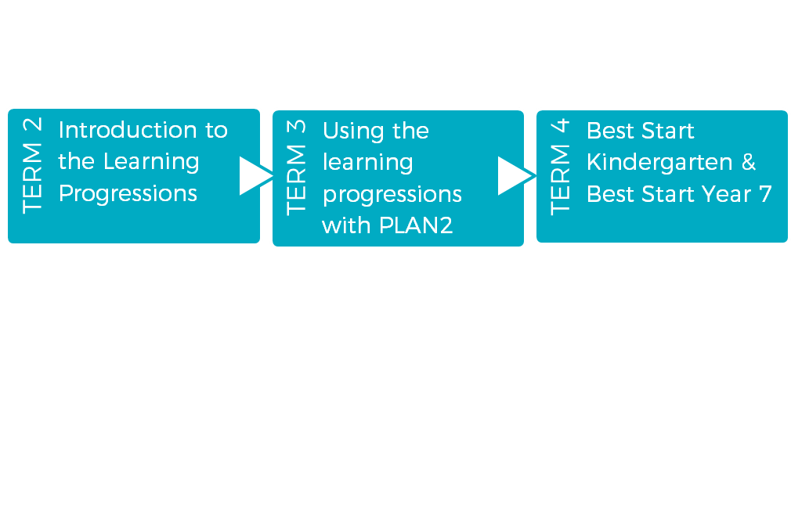
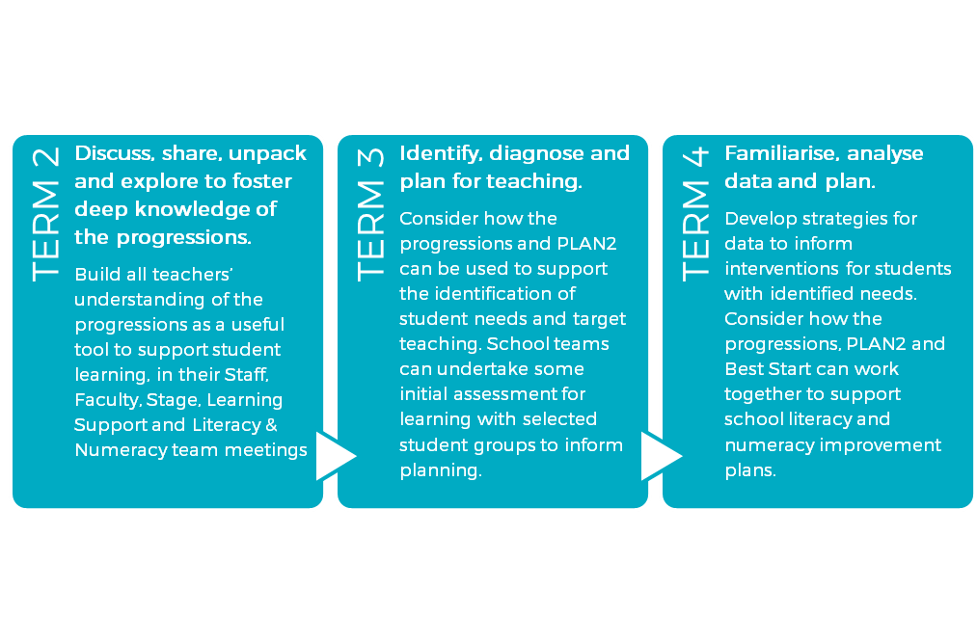
Getting ready for 2019 implementation
Face to face professional learning for school teams
IMPLEMENTATION IN 2019
Resources will be provided during the professional learning to support schools with suggested approaches to school based PL.
Notes:
As we mentioned at the start of the day, this professional learning is geared to support a gradual implementation of the progressions into schools, other than Early Action for Success schools who have already begun using the progressions.
[Walk through diagram, showing the professional learning offered across the top row and the supporting school action in the second row]. How does this assist you in determining your next steps? How will you share today's learning in your school to support all staff to become familiar with the progressions?
[Explain resources available on Literacy & Numeracy website (currently a link to this folder of resources will be emailed to participants following the event): slide packs, videos and supporting resources for sessions on Introduction to the Progressions, Introduction to the Literacy Progression, Introduction to the Numeracy Progression, Text Complexity and School Planning & Reflection] – could you deliver some of these professional learning activities through staff meetings? Faculty meetings? Stage meetings? Literacy or Numeracy Team meetings? Learning Support Team meetings? How else could you start building staff familiarity with the progressions?
[Encourage participants to add to their Next Steps]

Slide 6
Why use the learning progressions?
Provide a common language to described observed behaviours
Allow teachers to more accurately indicate a student’s current literacy and numeracy knowledge, understanding and skills
Support planning, programming and assessment across the curriculum
Support the literacy and numeracy aspirations articulated in School Plans
Notes:
As we mentioned at the start of the day, this professional learning is geared to support a gradual implementation of the progressions into schools, other than Early Action for Success schools who have already begun using the progressions.
[Walk through diagram, showing the professional learning offered across the top row and the supporting school action in the second row]. How does this assist you in determining your next steps? How will you share today's learning in your school to support all staff to become familiar with the progressions?
[Explain resources available on Literacy & Numeracy website (currently a link to this folder of resources will be emailed to participants following the event): slide packs, videos and supporting resources for sessions on Introduction to the Progressions, Introduction to the Literacy Progression, Introduction to the Numeracy Progression, Text Complexity and School Planning & Reflection] – could you deliver some of these professional learning activities through staff meetings? Faculty meetings? Stage meetings? Literacy or Numeracy Team meetings? Learning Support Team meetings? How else could you start building staff familiarity with the progressions?
[Encourage participants to add to their Next Steps]

Slide 7
Why record our observations in plan2?
The main reason to gather this information is to improve learning.
For the system, the data helps us to understand what support we need to provide for the ongoing professional growth of our teachers.
Notes:
As we mentioned at the start of the day, this professional learning is geared to support a gradual implementation of the progressions into schools, other than Early Action for Success schools who have already begun using the progressions.
[Walk through diagram, showing the professional learning offered across the top row and the supporting school action in the second row]. How does this assist you in determining your next steps? How will you share today's learning in your school to support all staff to become familiar with the progressions?
[Explain resources available on Literacy & Numeracy website (currently a link to this folder of resources will be emailed to participants following the event): slide packs, videos and supporting resources for sessions on Introduction to the Progressions, Introduction to the Literacy Progression, Introduction to the Numeracy Progression, Text Complexity and School Planning & Reflection] – could you deliver some of these professional learning activities through staff meetings? Faculty meetings? Stage meetings? Literacy or Numeracy Team meetings? Learning Support Team meetings? How else could you start building staff familiarity with the progressions?
[Encourage participants to add to their Next Steps]

Slide 8
Key messages
The NSW syllabuses set the expectation for student achievement at a point in time.
The content and achievement standards of the NSW syllabuses continue to be the focus for planning, programming, teaching, learning and assessment.
The learning progressions are a tool to support students in accessing the literacy and numeracy capabilities required across all learning areas.
Use of the progressions should support the literacy and numeracy aspirations articulated in School Plans.
§t the expectation for student achievement at a point in time.
Notes:
[Outline key messages listed here – they will be elaborated upon through the day]

Slide 9
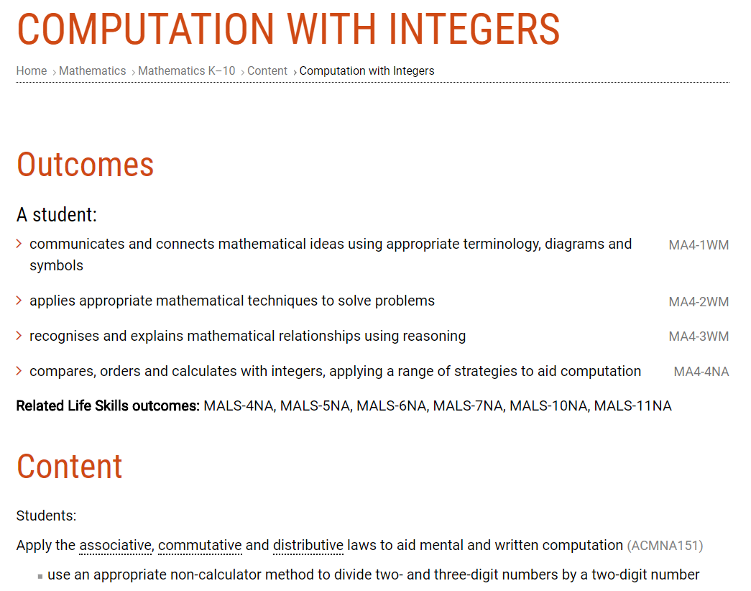
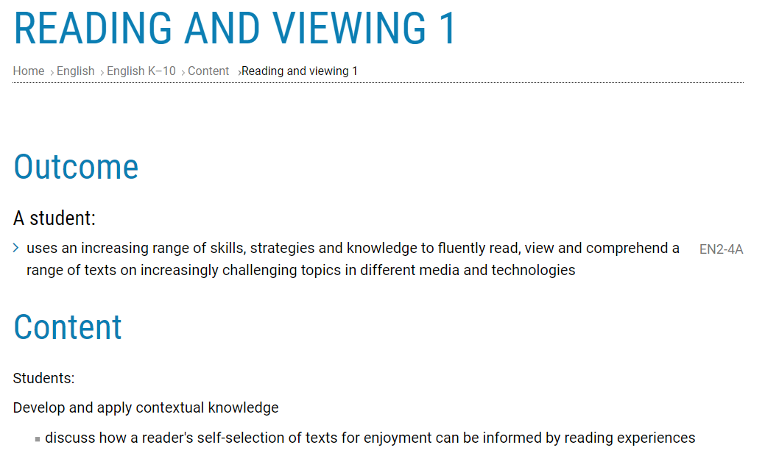

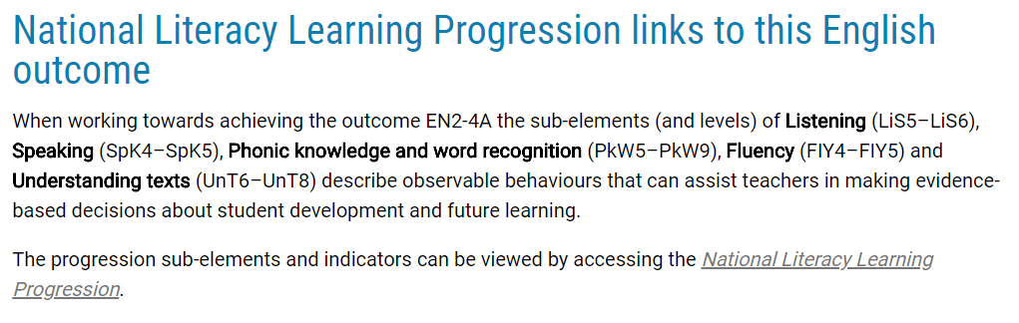
NESA mapping of learning progressions to NSW syllabuses
Notes:
For particular outcomes in the English and mathematics syllabuses the links between the progressions and the outcome are shown at the end of the content related to that outcome. The text that you see at the bottom of the screen on the left shows the relevant sub elements and levels of the numeracy progression that can aid teachers in making evidence-based decisions about student development and future learning of the Stage 4 mathematics outcome MA4-4NA compares, orders and calculates with integers, applying a range of strategies to aid computation. The text that you see at the bottom of the screen on the right shows the relevant sub elements and levels of the literacy progression that can aid teachers in making evidence-based decisions about student development and future learning of the Stage 2 English outcome EN2-4A uses and increasing range of skills, strategies and knowledge to fluently read, view and comprehend a range of texts on increasingly challenging topics in different media and technologies. Note that in both examples a range of levels for some sub elements are included to suggest that there is a development sequence associated with the achievement of the outcome.

Slide 10
evaluations

Slide 11
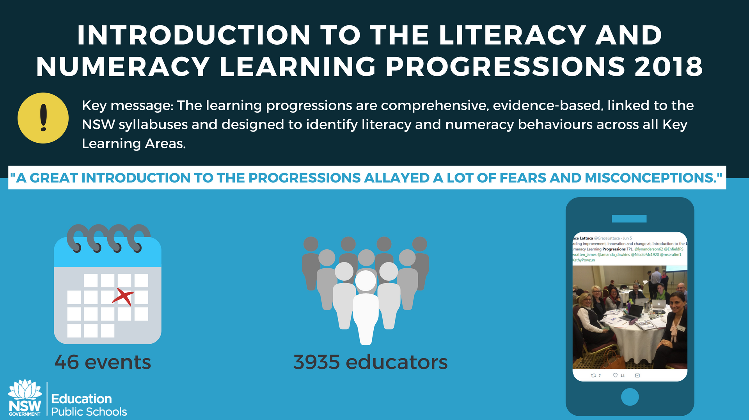
Notes:
Tweet from Grace Lattuca: Leading improvement, innovation and change at, Introduction to the Literacy and Numeracy Learning Progressions TPL.

Slide 12
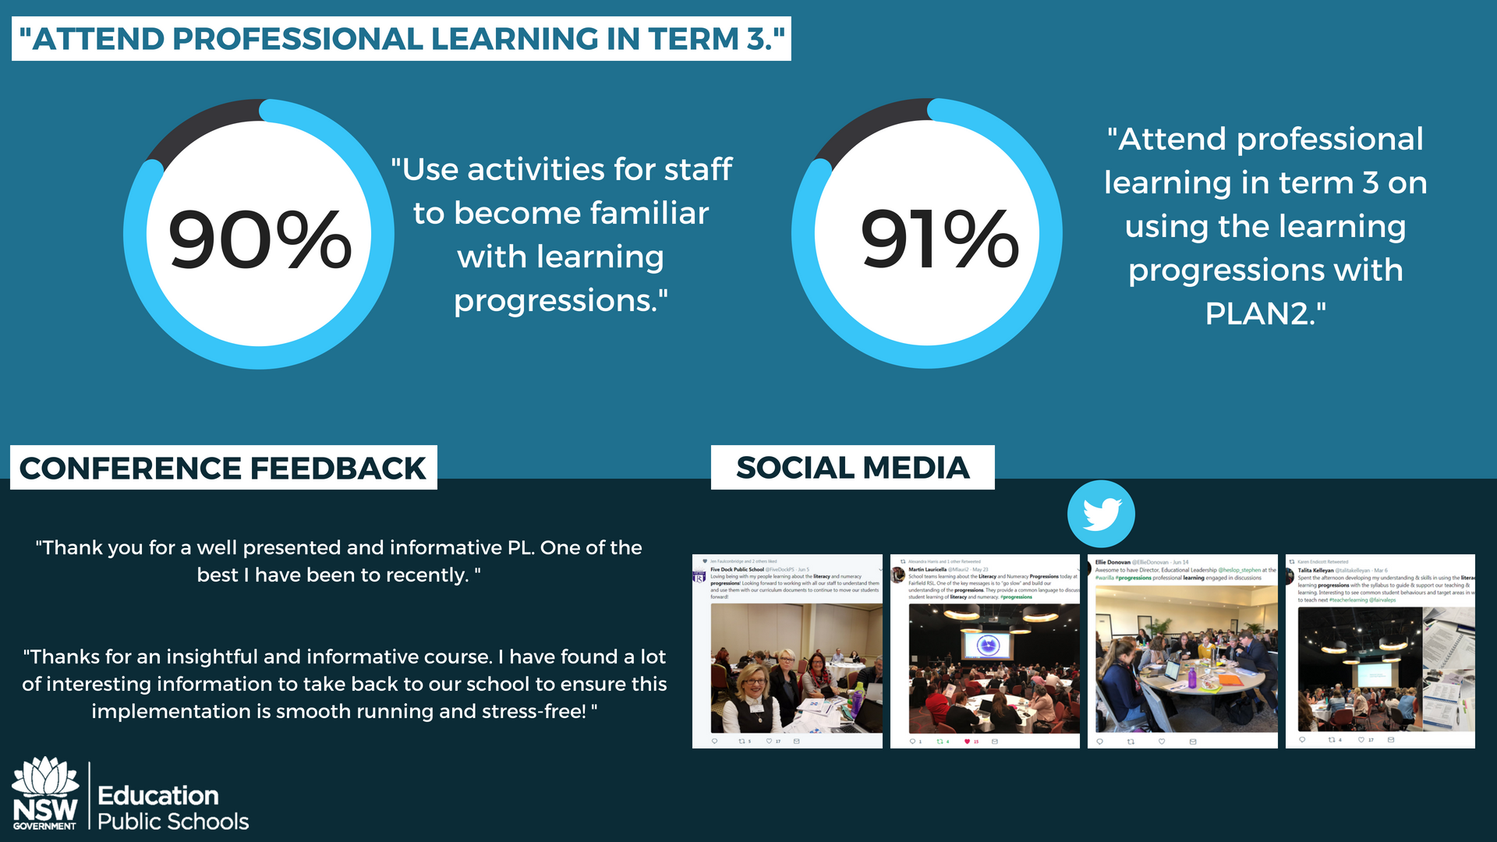
Notes:
Tweet from Five Dock Public School: Loving being with my people learning about the literacy and numeracy progressions. Looking forward to working with all our staff to understand them and use them with our curriculum documents to continue to move our students forward.
Tweet from Martin Lauricella: School teams learning about the literacy and numeracy progressions today at Fairfield RSL. One of the key messages is to ‘go slow’ and build our understanding of the progressions. They provide a common language to discuss student learning of literacy and numeracy.
Tweet from Ellie Donovan: Awesome to have Director, Educational Leadership Stephen Heslop at the Warilla progressions professional learning engaged in discussions.
Tweet from Talita Kelleyan: Spent the afternoon developing my understanding and skills in using the literacy learning progressions with the syllabus to guide and support our teaching and learning. Interesting to see common student behaviours and target areas in what to teach next.

Slide 13
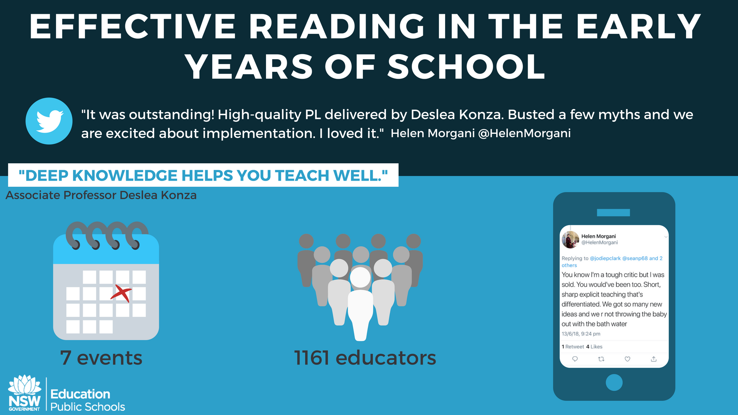
Notes:
Tweet from Helen Morgani: You know I’m a tough critic but I was sold. You would’ve been too. Short, sharp explicit teaching that’s differentiated. We got so many new ideas and we are not throwing the baby out with the bath water.

Slide 14
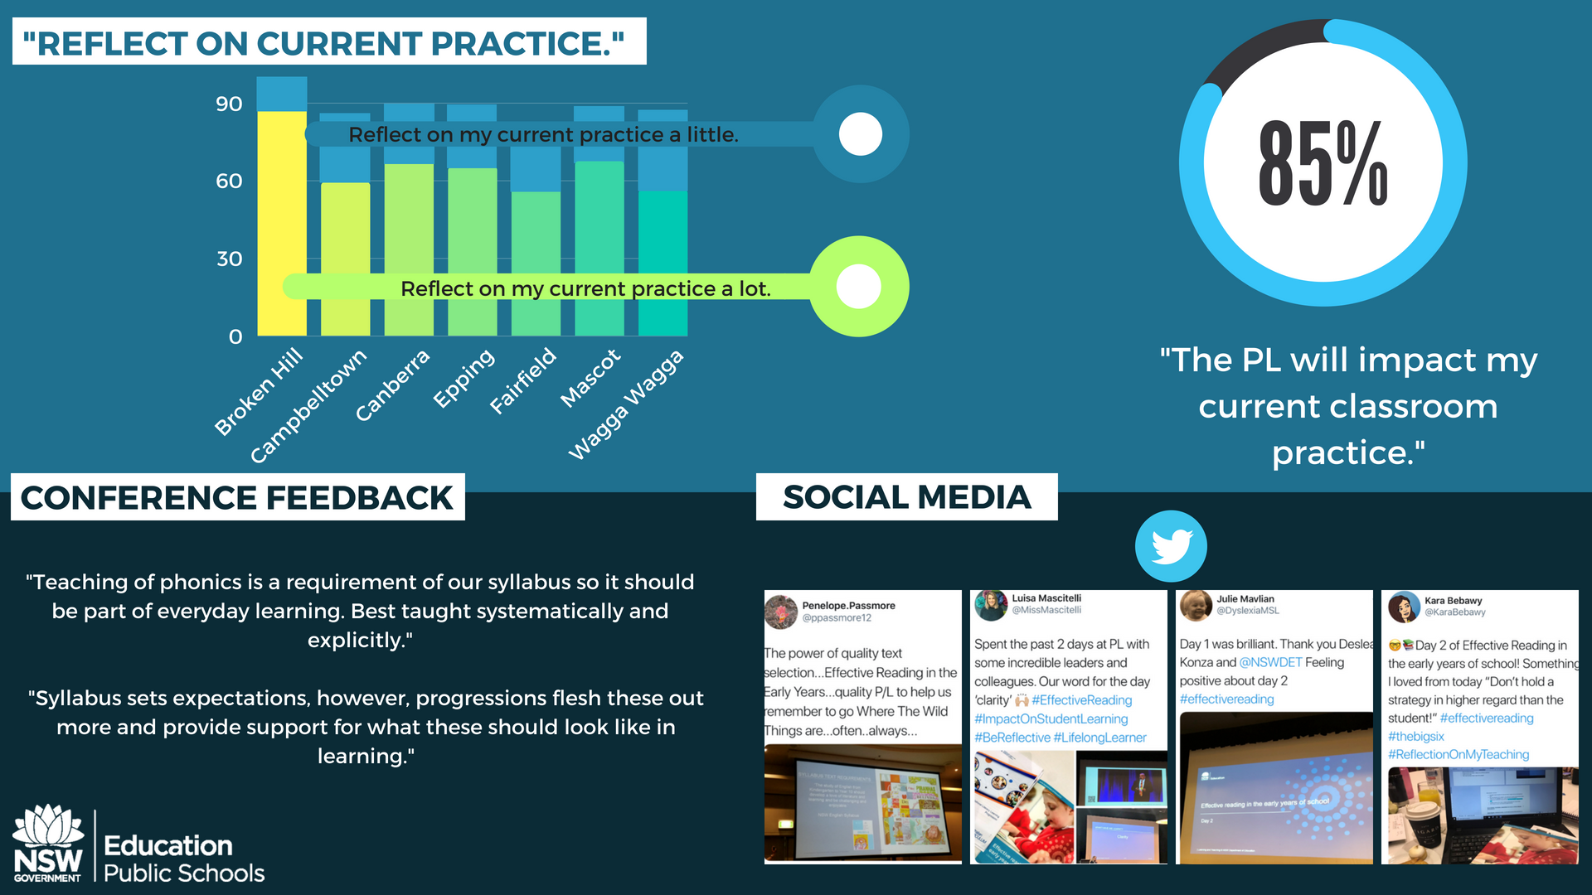
Notes:
Tweet from Penelope Passmore: The power of quality text selection…Effective reading in the early years…quality PL to help us remember to go ‘Where the Wild Things are’…often…always
Tweet from Luisa Mascitelli: Spent the past two days at PL with some incredible leaders and colleagues. Our word for the day, ‘clarity’.
Tweet from Julie Mavlian: Day 1 was brilliant. Thank you Deslea Konza and NSW education. Feeling positive about day two.
Tweet from Kara Bebawy: Day two of Effective reading in the early years of school. Something I loved from today, “don’t hold a strategy in higher regard than the student!”

Slide 15
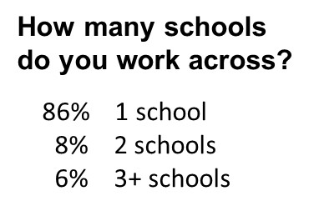
EAfS Professional learning – T1 evaluation

Slide 16
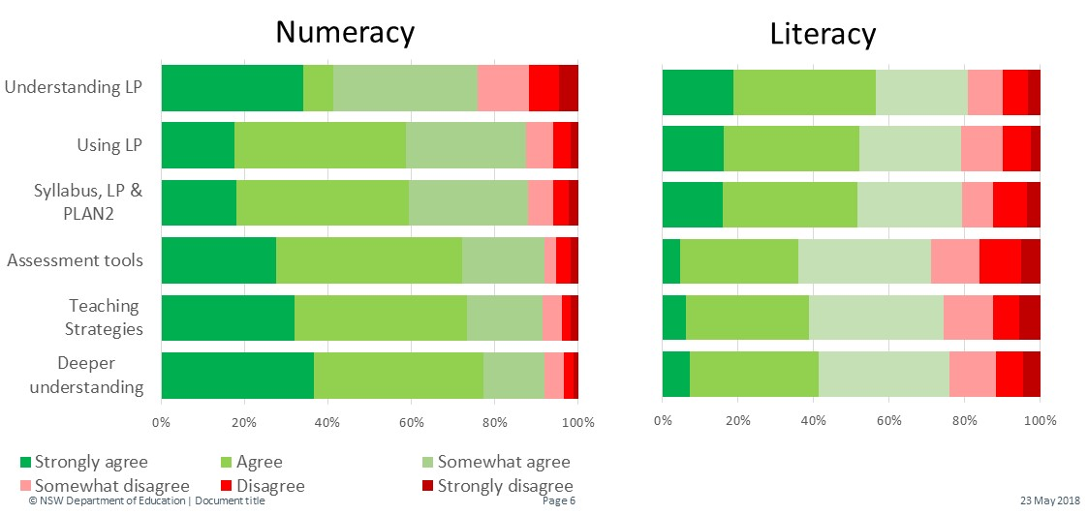
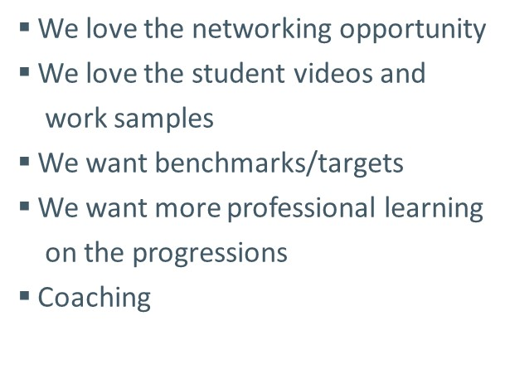
EAfS Professional learning – T1 evaluation
Notes:
The Term 1 Roadshow:
Met my needs in terms of understanding the LP
Met my needs in using the LP to support student learning
The Lit/Num presentation enhanced my understanding of how to support student learning through the use of the English/Maths syllabus, LP and PLAN2 together.
The Roadshows assist me to support student learning by providing
New or refined assessment tools
New or refined teaching strategies
Deeper understanding of how students develop literacy/numeracy

Slide 17





Business as usual

Slide 18
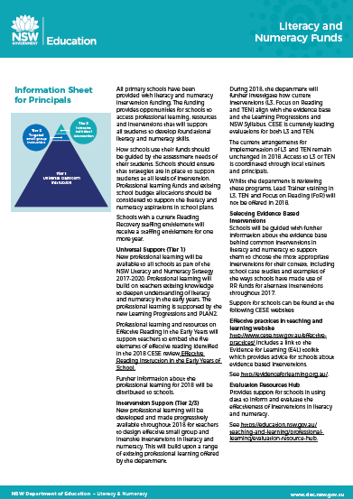
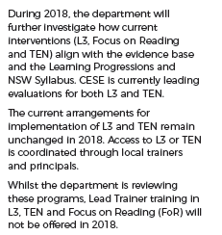
L3, TEN, Focus on Reading

Slide 19

‘Focus on reading’
The Literacy Team are leading the development of professional learning that updates and repackages all of the beneficial pedagogy of ‘Focus on Reading 3-6’ into a new ‘Understanding Texts’ module.
The professional learning emphasises the explicit and systematic teaching of reading in alignment with the Literacy & Numeracy Strategy’s call for “clear guidance on explicit teaching”

Slide 20

education.nsw.gov.au/literacy-and-numeracy-strategy

