Slide 1
STRIVING FOR EXCELLENCE
Our service improvement journey
Primary Principals’ Association State Council

Slide 2
UPDATE ON SCHOOL SUPPORT IMPROVEMENTS
Georgina Harrisson and Murat Dizdar
Notes:
Hello welcome etc. Today we want to talk about how we’re working to make our support for schools better.
There’s a range of projects underway to achieve that but one in particular has a very clear partnership with our colleagues in SO&P.
So I’ve asked Murat to join me to speak to this priority first – which is our new operation model for School Services.

Slide 3
RECAP - HOW DO WE KNOW WHAT NEEDS TO IMPROVE?
    As part of our commitment to continuous improvement, we asked over 1200 principals and stakeholders:
      What support matters to improve student outcomes?
      Is our current focus on the support that matters?
      Is the support we provide high in quality? If not, where are the gaps?
      How good is the experience for school leaders in accessing support services?
Notes:
Before we do, let’s pan out slightly and just recap on how Educational Services has arrived at service improvement projects, such as the school services model.
You’ll all recall this work is guided by the Striving for Excellence review, conducted last year and in which 1200+ of you kindly gave your time and opinions.
We wanted to know…..(read slide points)…

Slide 4

Striving for Excellence
An examination of Educational Services from the school perspective.
Notes:
The purpose of the review was to assess how well we are delivering our support to schools – as measured from your perspective at the school end of the transaction.
After all, that’s the measure that counts in service delivery – and I want you to keep that in mind as we go through our projects today. While we are talking about our work, we want to refocus that work on making it work for you.

Slide 5
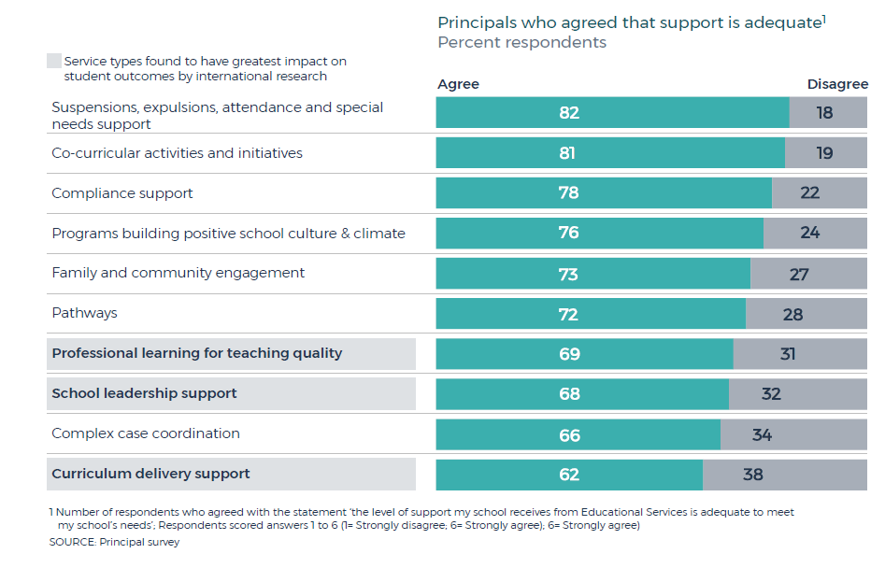
Notes:
What you told us is fundamentally positive about the quality and professionalism of the support, guidance and advice we offer. And looking across the quantitative ratings of our services – many are doing well.
But in my mind those rankings also show there is great potential to improve our delivery.

Slide 6

Notes:
And that leads us to this graphic, and why you see it a lot when we come to speak to you.
It is a visual representation of Secretary Mark Scott’s summation of why we’re all here. As he put it – in this Department we’re either working to help children, or working to help those who do.
There are over 1,500 people in my Division, and we have only one mission – to help those like you who teach our children and improve their educational outcomes.
I know from my staff want to make that positive impact, so together, we are going to make changes to our service delivery so we can better support you.

Slide 7
A Recap of our improvement priorities
Quality teaching to improve every student
Tailored support to improve every school
Prioritising teaching time
Leading the improvement journey
Because we know
this makes the
greatest difference
to student success
Because we want teachers focused on
what they came to do. Less regulation /
more education!
Because as communities evolve so will the needs of their schools.
There is no ‘status quo’ in a great school system.
Because our
2,200 schools are not ‘one size fits all’
Notes:
With that vision in mind, and with your feedback from the review, we distilled four key priorities, or pillars, for improvement. (Speak to slide and “why” statements)

Slide 8
10 service projects to support those priorities
Quality teaching to improve every student
Curriculum support – Literacy and Numeracy
Early career teacher journeys
Tailored support to improve every school
Strategic planning process and tailored support to schools
Prioritising teaching time
Policy review
Leading the improvement journey
Curriculum support – New syllabus implementation
Quality professional learning
Service Navigator
Consistent wellbeing
Workforce strategy
Communication and engagement
Notes:
GEORGINA : So, those four pillars of improvement are shown here against the 10 priority projects that we believe will deliver those priority outcomes.
Today we will be talking about the ones that we think are of most interest to you:
* numeracy and literacy
* curriculum support
* consistent wellbeing
* quality professional
* and a key early initiative under the banner of Tailored Support, which is our operating model.

Slide 9

In Partnership with the School Leadership Strategy and informed by the principal workload study
Notes:
MURAT TO SPEAK: and these priorities and projects fit perfectly with the priorities of our strategic plan, and they work in tandem with the School Leadership Strategy.
In fact if I draw your minds back to the priorities identified in the Principal Workload Study, we have an excellent fit - especially around the first three priorities of:
Streamline communications and ensure consistent messaging
Forward timelines for known changes and consideration for typical school rhythms
More time for teaching and learning – observing classrooms, engaging with staff and students and supporting staff, professional learning etc

Slide 10
School Leadership Strategy
Provide quality leadership preparation and development
Strengthen collegial support for school leaders
Improve the quality of services and support to schools
Notes:
MURAT
And when I review the four pillars and 10 projects George has just outlined, with our three priorities under the SLS – the mutual support of these aims is very clear.
So I can say with confidence that Georgina’s team are working directly with the improvements that SO&P has outlined.
This is very much a team effort – as you’ll see with the operating model.

Slide 11
You, as Principals, maintain accountability for your school - we will be here to support you – and to support you better – so you can do what you do best
Notes:
MURAT CONTINUES: So, what does that mean for you? And what can you expect to see?
It means we will support Georgina’s division to transform and improve the services the department provides you, as part of our shared vision for NSW public education to be the best education system in Australia.
It means that while you, as Principals, maintain accountability for your school - we continue to will be here to support you – and to support you better – so you can do what you do best.
It means your dedicated Director, Educational Leadership will remain your key partner, supporting the needs of your school, and helping you to navigate support options.
In particular, they will help you with the complex problems early. I was really struck by the Principal Workload Study finding that principals are attempting to solve first, then ask for help later.
I want our Directors to be trusted and proactive partners when things are challenging. They will help you find the right options and solutions you so you can stay focused on leading your school.

Slide 12
Directors, Educational Leadership
Key components
1. Differentiated professional growth of principals
2. Contextualised support for school improvement
Notes:
MURAT
In fact, the DEL positions are right at the centre of the operating model we have started to roll out this term.
The relationships that we are looking to build with these positions will allow us to achieve two important are related aims – more bespoke professional support for principals, and in turn, more bespoke support for the schools they lead.

Slide 13
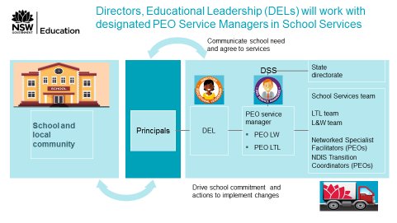
NEW school services operating model
Notes:
MURAT TO SPEAK:
While this model commenced at the start of Term 2, it represents some six months of work behind the scenes between our divisions.
SO&P and ED Services have worked together to develop this model.
I also want to stress that the model is intended to provide support to schools wherever they are in their improvement journey.
We have been asking Directors to consider schools across the school excellence framework for the piloting of this model

Slide 14
How we will tailor support to schools
Relationship with DEL provides shoulder to shoulder support on matters in your school community
High quality services and reliable professional advice to support your students and develop staff
Grow our capacity to support whole-school initiatives and priorities, aligned to the SEF
Notes:
MURAT:
also, the new operating model is a change to what you might call our primary support for schools. And I mean that in the primary, secondary and tertiary sense that we usually think of with health care – not education. ☺
This model is about improving the first line of support – getting that support more forward focussed and proactive. It’s about increasing our ability to tailor support through building great relationships with your DEL’s as the first point of contact.
As I said before, the DELs will be your shoulder to shoulder support.
GEORGE:
But they are not your only support nor the only improvements we are making.
At the next level, which in want of a better word might be our “branch office” level, we have projects in train to provide better consistent and high quality services to our support teams, so that they can provide them to you.
These are projects about improving the quality and consistency of support and advice – and we will be speaking to some of this today.
And finally there are the system wide improvements we need to make – or in some cases influence as they are beyond our divisions – to strengthen our capability to provide strategic products like whole school support and better support for teacher performance. These include initiatives life EAFS, Bump it UP, and support for formative assessment.

Slide 15

Our video, explaining the change…
Notes:
MURAT:
So that’s where the operating model fits in the context of the many things we want to improve for schools and principals.
But perhaps the best thing to do now is show you how it works in detail, and for that, we have a great video, which is also available on the department’s website for you or any of your staff to refer to.
Let’s have a look.
[Click anywhere on the TV to start youtube version of video.]

Slide 16
questions
Georgina Harrisson and Murat Dizdar
Notes:
GH AND MD take questions on model and implementation

Slide 17
Our other service improvements
Georgina Harrisson and the Educational Services team
Notes:
MURAT DEPARTS/SITS
GEORGE – so, as discussed, the operating model fits into the context of a range of other service changes we are making in my division.
I’d like to unpack of few of those now, and invite members of my team to assist with that.

Slide 18

One should not need to know the system in order to get the service...
Notes:
Before I do though, I just want to clarify that I’m aware that we’re not talking about our challenges to make them your challenges.
Indeed, it’s my view that many of the challenges schools face arise for department services that – while high quality – are department centric, not user centric. It’s resulted in services that rely on either deep personal relationships or serious efforts by schools and teachers to get things done.
The above image is a great analogy of what I mean. Put those parts together and you could call anyone in the world. But no one ever asked you to assemble it did they? You just made call.
My point is while we are talking about the workings of educational services today, we are doing so to show you how we are trying to make those workings seamless and easy to use.
We’re not there yet, we have some way to go. But we’re on the way.
With that – let’s turn to the priorities that you’ve identified for us to speak to – starting with curriculum support.

Slide 19
Curriculum support –
New syllabus Implementation
This is about: supporting schools and teachers better during curriculum changes
Because we want: teachers to approach every class with confidence to deliver their best
Notes:
CHERYL BEST TO SPEAK

Slide 20
support for schools
Short term
3 syllabuses to implement in K-6
12 month plans developed for T3, 2018 to T2, 2019
Support materials and professional learning (face-to-face workshops and online learning)
Long term
A predictable and consistent framework of support for new syllabuses in all NSW public schools.

Slide 21
Consultation
Familiarisation and planning
Start teaching
Syllabuses | Consultation DoE consultation with teachers & stakeholders, DoE response to draft syllabuses, preliminary planning & analysis | Published | Introductory PL Adobe Connect series Newsletter updates Website content Resources for mapping | Professional learning F2F, online courses | Resources Sample units of work Scope and sequences Sample assessment tasks How to program | Network support Subject expertise Resource sharing | Implementation First Phase
Science & Technology K-6 | Early 2017 | Term 4, 2017 | Term 2, 2018 300+ teachers participated to date | From Term 3, 2018 18 workshops state wide (in SchoolBiz by end of T2) | From Term 3, 2018 | Ongoing | Day 1, 2019 ➔
PDPHE K-10 | Mid 2017 | Term 1, 2018 | Term 2, 2018 100+ teachers participated to date | From Term 2, 2018 94 teachers attended F2F to date (more workshops scheduled T3) | From Term 3, 2018 | Ongoing | Day 1, 2020 ➔ (optional for K-6 in 2019)
Languages K-6 Chinese, French, German, Indonesian, Italian, Japanese, Korean and Spanish | Mid 2017 | Term 4, 2017 | From Term 2, 2018 | From Term 3, 2018 (in SchoolBiz by end of T2) | From Term 3, 2019 | Ongoing | Day 1, 2019 ➔ (if implementing)
Creative Arts K-6 | Term 2, 2018 | TBC | - | - | - | - | -










Slide 22
Where are we up to?
12 month support plan (beginning Term 3, 2018)
By end of term 2 – mapped/analysed syllabus changes, developed and publicised professional learning and support materials for new syllabuses being implemented in 2019
Learning and Teaching Directorate liaising closely with School Services Directorate
Our other service improvements

Slide 23
Features of the draft support model
Tailored
support to
improve
every school
Adobe Connect unpacking the syllabus sessions
Online modules
Co-design and deliver PL and resources that are tailored to the different needs of schools
Face to Face Workshops
Tailored syllabus support for contexts and teacher groups
Make the professional learning offering consistent across the state in both quality and availability
Adapt professional learning delivery to incorporate adult learning principles
Learning and teaching materials
Collaborative expertise networks and leaders

Slide 24








Syllabus | Teachers | Change classified as | Programming | Assessment | Pedagogy | Subject knowledge
Science and Technology K-6 | All primary teachers | Redevelopment
PDPHE K-10 | All primary teachers and secondary PDPHE teachers | Redevelopment
Languages K-6 Chinese French German Indonesian Italian Japanese Korean Spanish | All primary language teachers (if implementing) | Redevelopment
Creative Arts K-6 | All primary teachers | Redevelopment | TBC | TBC | TBC | TBC
Amount of support required
Programming | Assessment | Pedagogy | Subject knowledge

Slide 25
Draft PHASES OF SYLLABUS IMPLEMENTATION
Flexible and responsive modes of implementation based on the degree of syllabus change
1 Develop
Stage 1 of syllabus implementation refers to the time leading up to the publication of a new syllabus by NESA, including consultation. The department commences development of support for schools.
2 Prepare
3 Teach
4 Refine
Schools are required to commence teaching the new syllabus. Continued development and delivery of targeted professional learning and resources will occur to support schools.
In the second year of syllabus implementation, teachers’ professional knowledge is enhanced through professional learning and resources that encourage and develop syllabus content expertise.
This stage is marked by the formal publication and release of a new syllabus by NESA. Preparation involves the design and delivery of professional learning and resources that will support familiarisation of the new syllabus.

Slide 26
Consistent wellbeing
This is about: delivering wellbeing services that are quality assured, proactive, and easy to navigate.
Because we want: our principals to feel supported with complex cases, and for as many students as possible to get help before issues become enmeshed or intractable.
Notes:
ROBYN BALE TO SPEAK

Slide 27
Consistent wellbeing services
Projects
Quality assure wellbeing services Commenced Term 1 2018
Access requests Commenced Term 2 2018
Complex case coordination Commenced Term 2 2018
Project Outcomes – Access Requests
Processes, gaps and inconsistencies throughout the state are mapped.
Identify what works effectively and what doesn’t
A streamlined system to improve the access request process.

Slide 28
Project – access requests
What has been done in Term 2:
Process map for Access Requests (completed T2 W5)
Initial enhancements to Access Request System (completed with ITD T1 W10) with further enhancements in progress (to be completed by T2 W10)
Consultation process with Access Request users commenced:
Consultations and Disability Learning and Support (completed T2 W5)
Consultations with School Services commenced – Metropolitan South (completed T2 W6) and Metropolitan North (in progress)
Notes:
Talk to the work we’re doing (this is the stuff in the background)
Rubric of services – providing schools with a warrant of quality, whether on line or face to face
We’ve started work on access requests – we’re right in the scoping phase – we want to hear from you – looking to trial in 2019

Slide 29
Project – access requests
What is next
Establish governance group including Principals, School Services, Disability Learning and Support and ITD to drive delivery of streamlined and improved access request process (T3 W1-2)
Consultation process with Access Request users to continue:
Principals and school executive (T3 W1-5)
School counselling service (T3 W1-5)
Identify improvements to streamline Access Requests process (T3 W6)
Notes:
Talk to the work we’re doing (this is the stuff in the background)
Rubric of services – providing schools with a warrant of quality, whether on line or face to face
We’ve started work on access requests – we’re right in the scoping phase – we want to hear from you – looking to trial in 2019

Slide 30
Quality professional learning
This is about: creating PL offerings that are quality assured, easy to access, and focused on teaching quality
Because we want: every teacher to know how get the learning they need; and for that learning to benefit their students
Notes:
GEORGE:
Finally, just two more projects that you did not request but we want to mention them briefly.
These are two that we thing will also make a big difference to schools and teachers.
The first is quality professional learning – this is about really standardizing the quality and quite frankly reducing the quantity of PL offers to teachers.
We don’t want teachers overwhelmed by a range of PL options that are a minefield to navigate.
We want PL prioritised by the learning needs that the profession has identified.
And we want every course a teacher leaves their classroom for to be HIGH VALUE.
When teacher time is this precious it can not be squandered.

Slide 31
POLICY REVIEW
This is about: reducing and improving our policies and guidance to schools
Because we want: to minimise time taken away from teaching (and teaching mentoring) as much as we can
Notes:
The second is policy review, which is all about reducing the administrative burden on schools.
[GH – I think you should just riff to this, talk about the policy on policies and the overseas excursions policy]

Slide 32
JUST A REMINDER OF THE FULL Ten Projects…
Quality teaching to improve every student
Curriculum support – Literacy and Numeracy
Early career teacher journeys
Tailored support to improve every school
Strategic planning process and tailored support to schools
Prioritising teaching time
Policy review
Leading the improvement journey
Curriculum support – New syllabus implementation
Quality professional learning
Service Navigator
Consistent wellbeing
Workforce strategy
Communication and engagement
Our other service improvements
Notes:
So that’s it. I hope we’ve given you some useful context of what we are trying to achieve and how it is focussed on making our services work FOR SCHOOLS.

Slide 33
Notes:
Questions thanks etc

