Slide 1
Supporting our schools
Delivery Unit Update

Slide 2
Executive Summary
Reducing the administrative burden
Disability strategy
Staffing methodology review

Slide 3
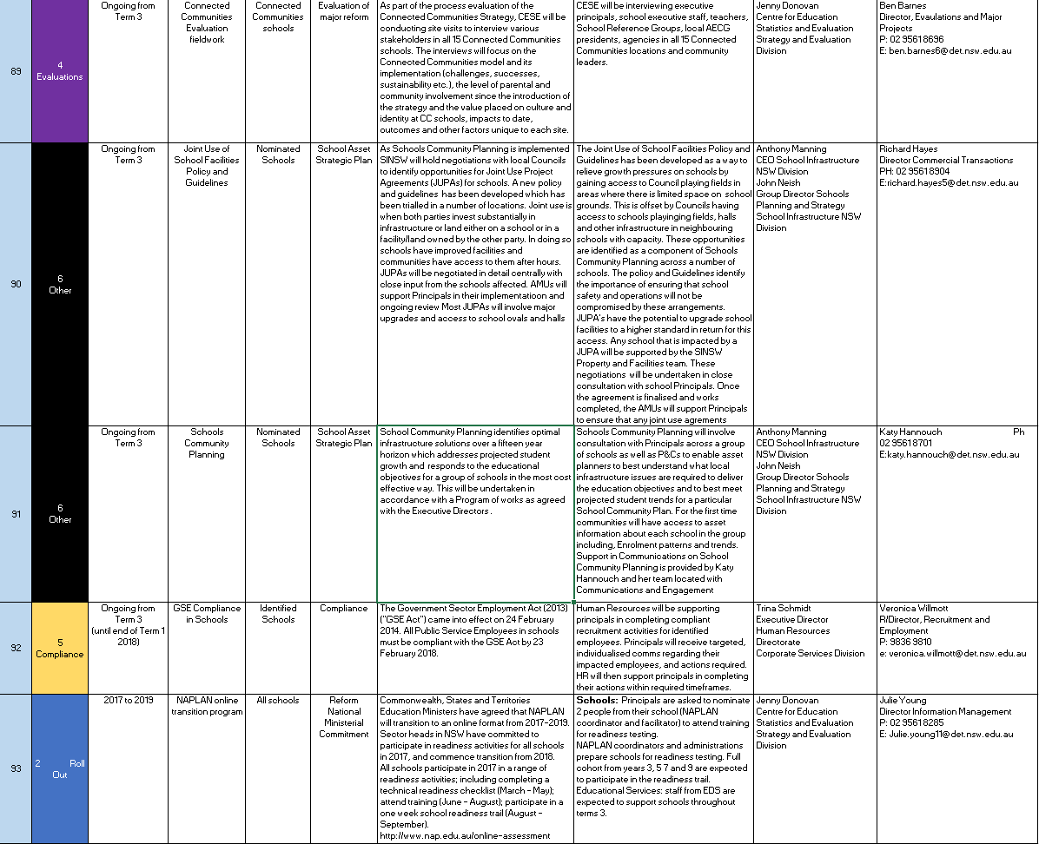
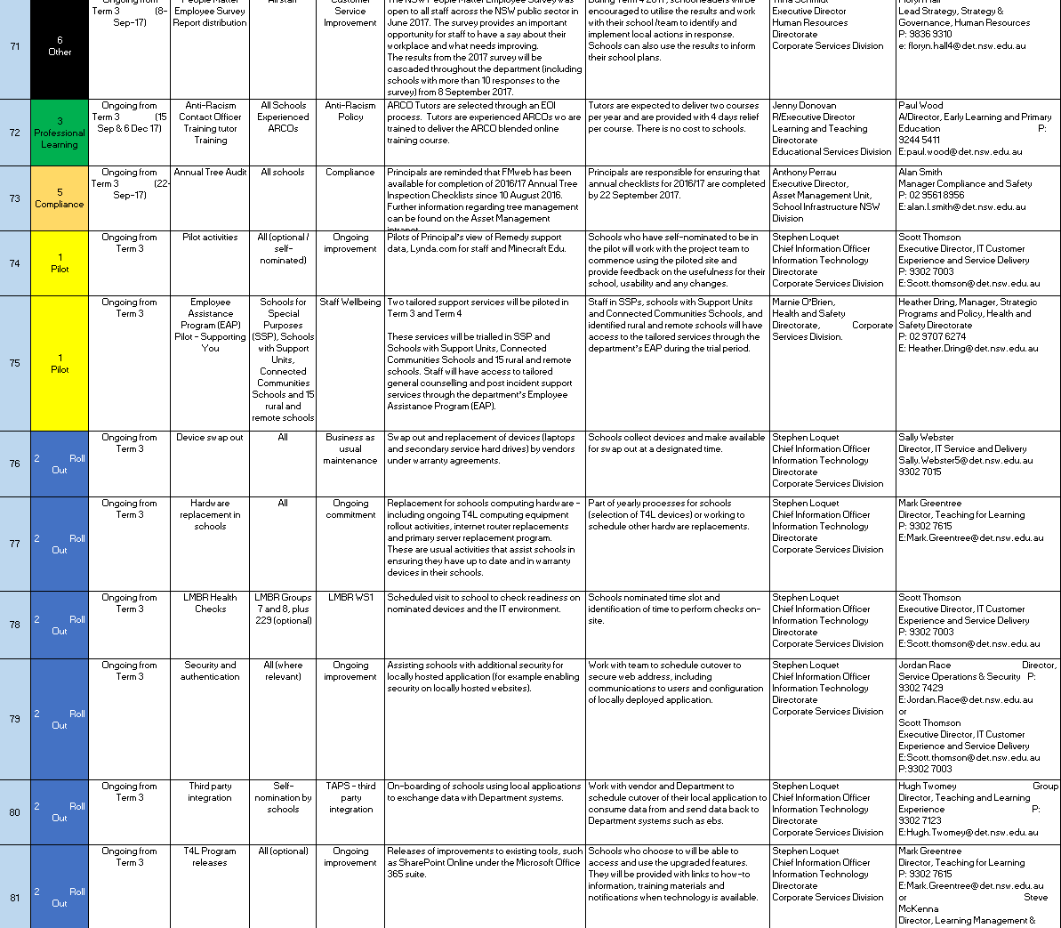
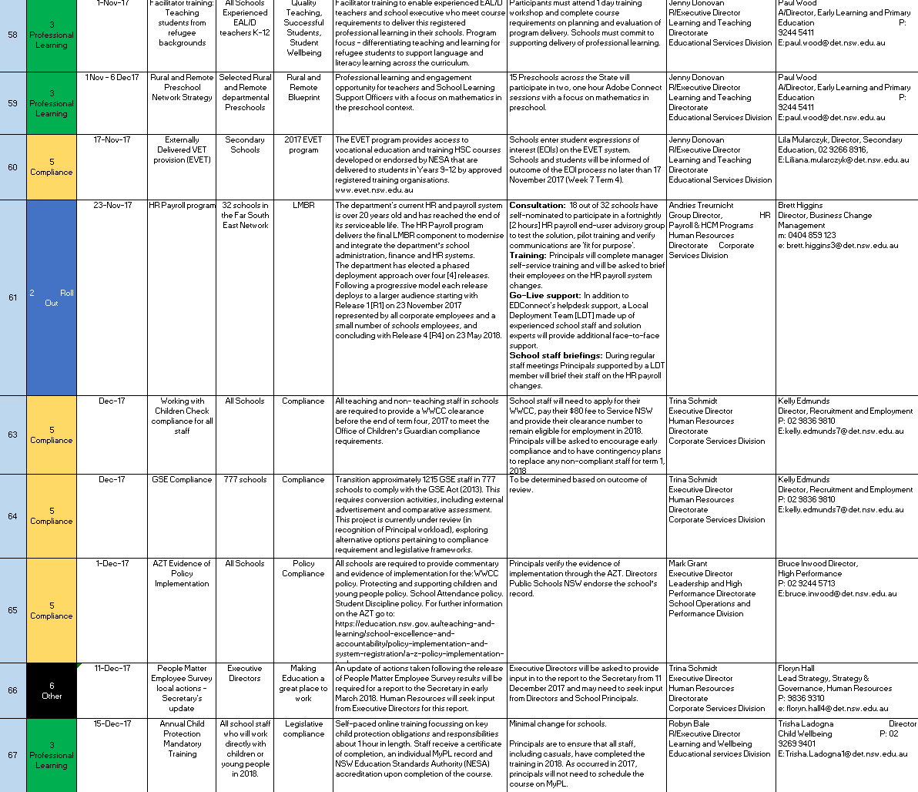
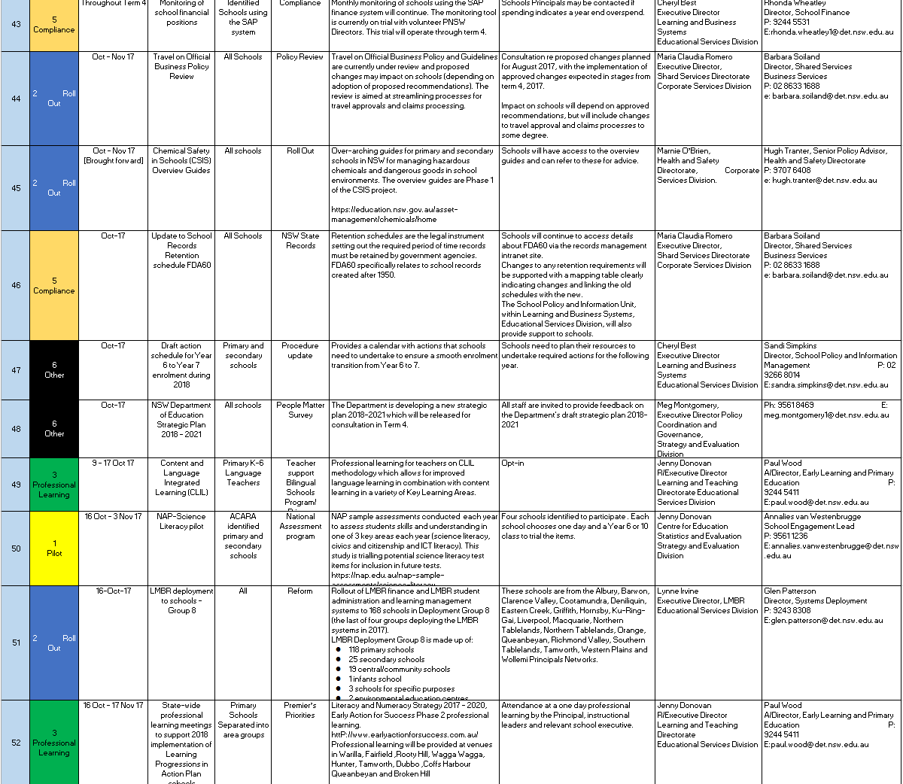
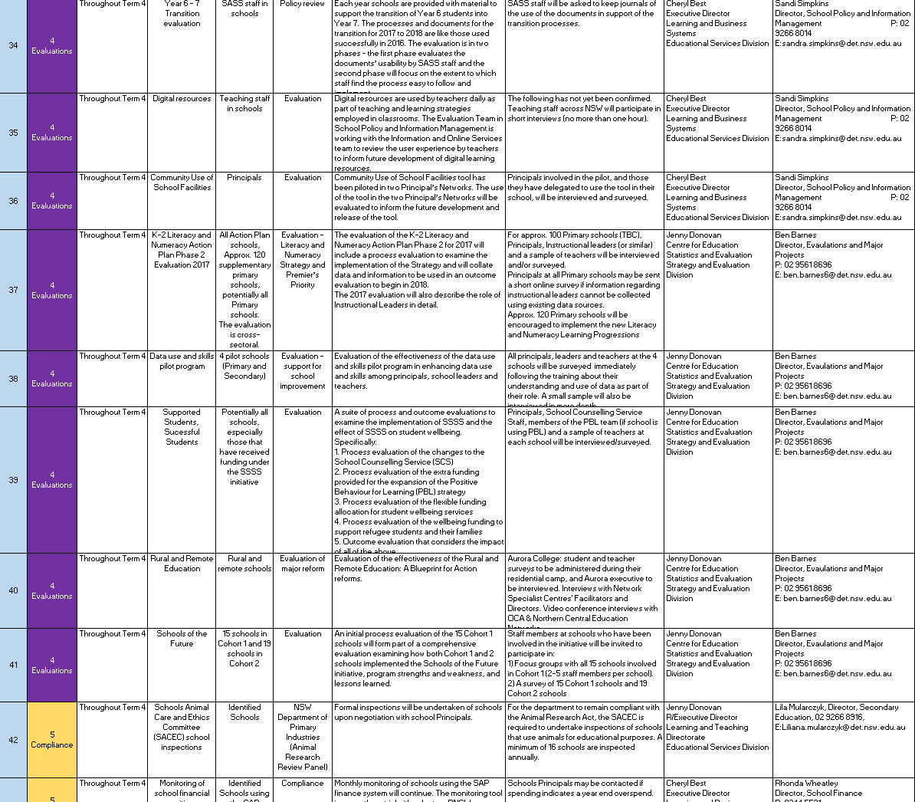
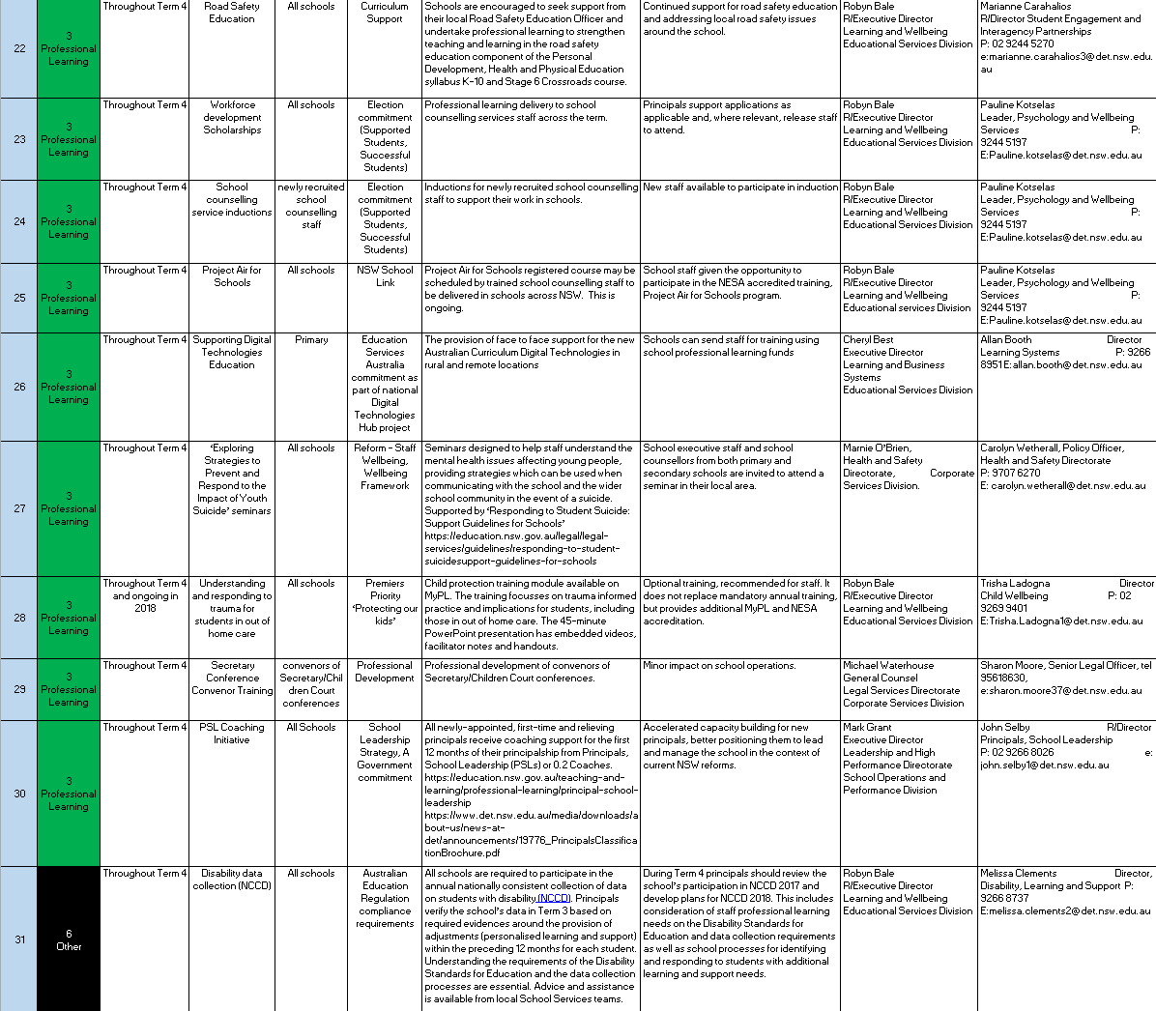
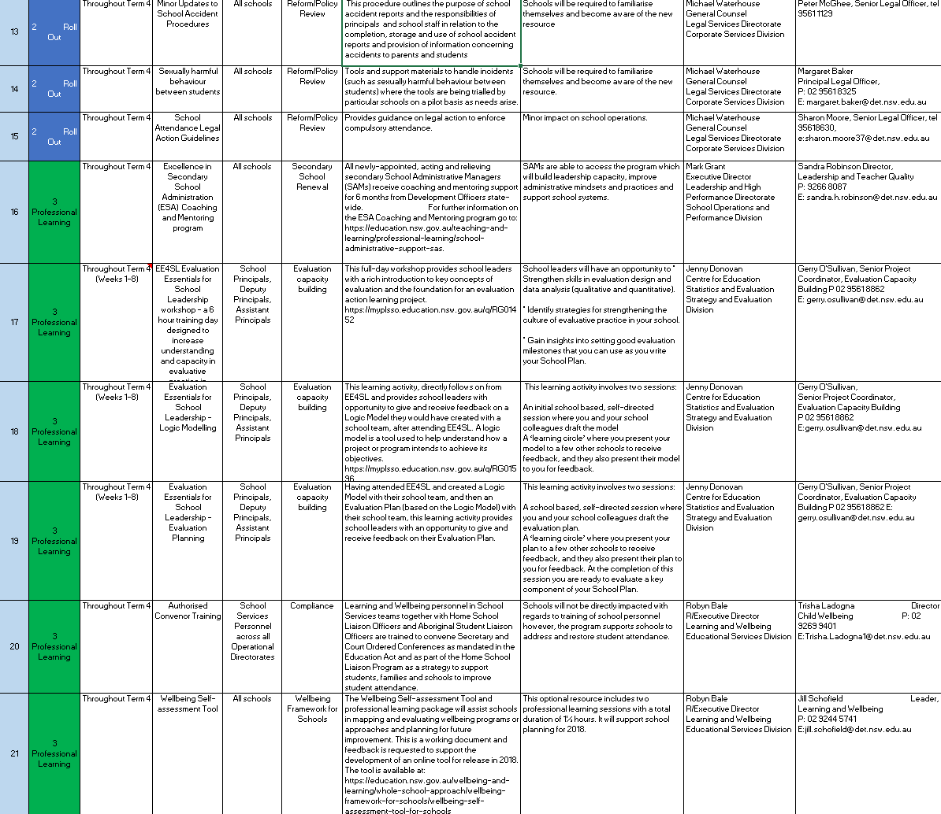
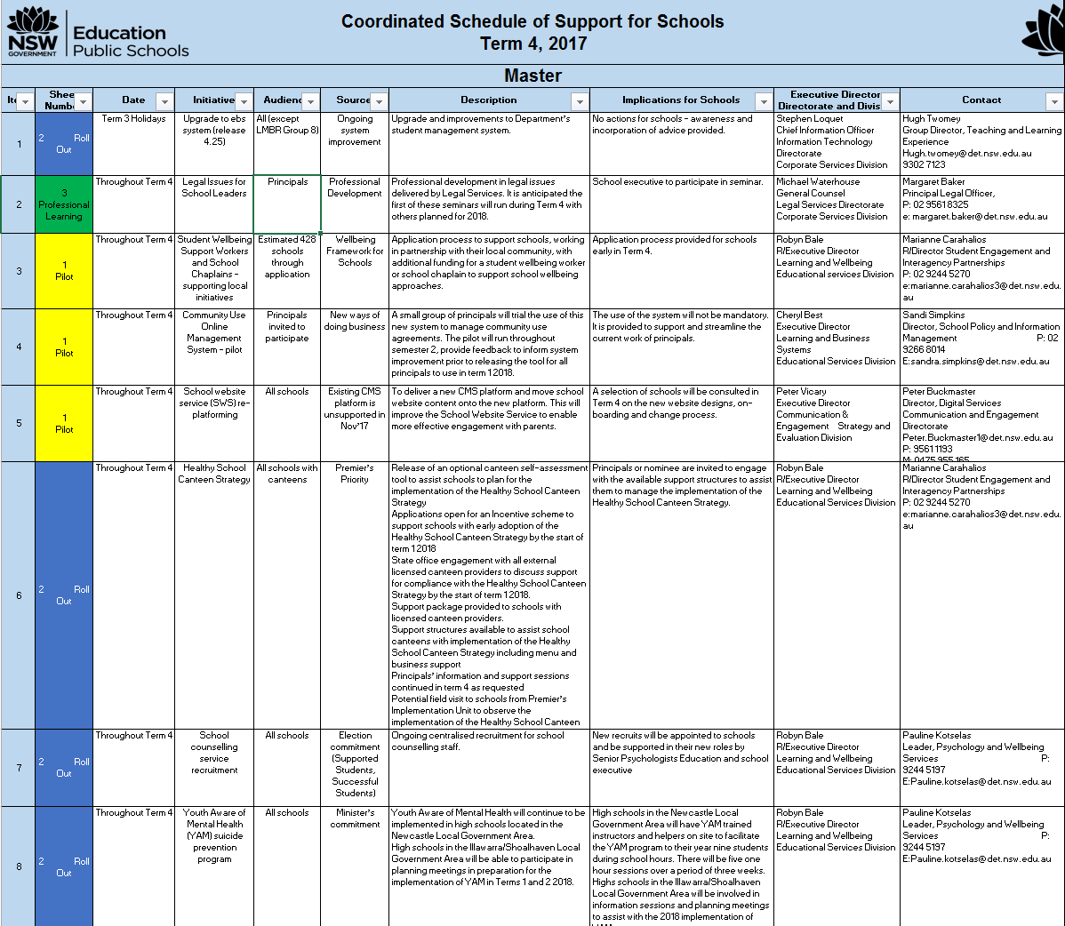
Coordinate Schools Schedule
Version 2
Version 3
Still to come..
Version 1
Separated by terms;
Ordered by type of school and week of roll-out
Separating out professional learning
Required vs. optional highlighted
Key contacts & links
Time to
Printable on A4
Detailed executive review leading to far less content
Just 3 mandatory (those in body of email)
Separated into clearer categories
Calendar
Tailored content
Including NESA/other commitments
Mandatory link closely to key priorities

Slide 4
Time saved department-wide to date
TAB A
System-wide
time saved (est.)
Area
Impact
Owner
School Profile – confirmed that schools no longer required to do school profile unless a Minister visit is requested. Directors will be required to support consolidation of information to limit impact on schools
~ 2-5 hours per principal per year to complete profile
MO has agreed to change in process
Murat Dizdar
~ 4,900 – 12,000 hours per year saved
Scout – rollout to all teachers (30,000 initially up to 50,000);
Reduced 60 minute compliance/access training for all teachers to 15-20 minutes;
Ongoing efforts to enhance functionality and improve ease of use
Solution in train to reduce wait time from approval to access from 3 days to 0 days.
Saving 40 – 45 minutes per teacher; removal of 3 day wait period
Approx 10.5 hours saved per school (based on 30,000 teachers) -
Approx 17 hours saved per school (based on 50,000 teachers)
Jenny Donovan
~ 20,000 - 33,000 hours saved
~40,000 hours saved
Bullying of Students – Prevention and Response Policy Updated policy to reduce time to comply from ~20 hours to 2 hours
Simplified and streamlined tools and materials, overhauling policy
18 hours per school saved
Georgina Harrison
Min ~ 15,000 hours saved
Sports and Physical Activity Policy
Updated policy to reduce time to comply. Reduced number of clicks from 44 to 2, consolidated location of policies, simplified website, provided plug and play examples to comply.
Simplified and streamlined tools and materials, overhauling policy
7 hours per school saved (3 hours saved in initial implementation and 1 hour per term saved)
Georgina Harrison

Slide 5
Work in progress
TAB A
Potential time saving
Areas of focus
Update
School Website Service – new website service being rolled out on Adobe experience platform
Up to 18 hrs for 50%+ of schools
Finalising options for schools that wish to ‘just migrate’ and alternate service options
Imminent
Cash Management Process – daily banking process; cancelled receipts & cash refunds (initiated due to principals printing, signing and filing blank reports for 7 years)
Minimum
3 mins/day = 10 hrs/yr per principal
Identified inefficiencies throughout entire cash management process, associated time savings to be quantified as a result. Cross-department process re-design commenced – looking for short & long term solutions
‘Take off the desk’ – key
frustrations
SPaRO – frustrations re lack of flexibility and issues with copying & pasting into system
Est ~2-4 hrs/yr per principal
SPaRO – frustrations re lack of flexibility and issues with copying & pasting
Substantial improvements to the system complete and more underway. Exploring flexible/tailored approach.
A-Z – compliance driven activity that increases school workload. Value to schools is unclear
Est ~4-6 hrs/yr per principal
New policies not required in A-Z, further updates today
Schools Coordinated Schedule of Support – ongoing iteration and improvement, critical is prioritisation of activities
Est ~4-8hrs /yr per principal
Prioritised list, and reduced content substantially; now streamlining delivery solution
Prevention
Governance Workshop – 18th May
Conducting workshop (approx. 40 attendees across DoE)
Dramatic reduction in total number of roll-outs
Building on feedback from initial workshop and principles to define a governance and prioritisation approach for the department

Slide 6


Proposed governance approach – combines local prioritisation with central oversight
Gate 1 –
Idea generation
Gate 2 –
Design within “rules of the game”, prioritise locally
Gate 3 –
Prototype, iterate and govern
Final gate –
(Go/No Go)
Implement &
Monitor
Local Idea
Linked to DoE priority
One visible schedule
BIG
“the jewels”
Central
Central
Schools
“
Block out periods
T1
T
T2
T3
T4
4
Capped time impact
“
Small
Local
Agreed limits
Max time impact on schools per term
Local
prioritisation
“
Capped time impact
Max changes per term
Small
Local
Common language
“
t
Metrics & measures
Capped time impact
Definitions
Small
Local
“
Principles
Capped time impact
Ideas generated by schools, directorate, exec.
Demonstrable school impact required
Proposals are reviewed, iterated and prioritised locally against a common set of guidelines set centrally (e.g. fit within the common schedule)
Proposals governed according to type
Smaller projects have a local approach; larger are managed centrally
Capped time impact per division – and department-wide (can be traded)
All projects required to pass a final central gate before release to schools. Ongoing monitoring

Slide 7


Proposed gateways
Gateway 1:
Idea generation
Gateway 2:
Design within “rules of the game”, prioritise locally
Gateway 3:
Prototype, iterate and govern
Final Gateway:
‘Go/no-go’
Does this really solve an issue?
Is it a school-centred solution?
Rapid pro-typing and iteration
Structured final approval for all projects.
Prototype
Refine
Test
Feedback & assessment
Why--new service, improvement, compliance?
No duplication?
Schools say this is a priority?
Evidence ofof hool appetite (e.g. signatures of school principals)?
Will it improve student outcomes?
Will it free up time to teach/lead?
Is it fully accessible?
Is this a priority shared by a range of school types?
Will this have a large time impact on schools?
Can it be implemented within the current schedule of activities – not breaching the cap?
Did schools like it?
Did it save time?
Did it meet design specs?
Were there errors?
How can it be simplified?
High-quality?
Defects fixed?
Appropriate training?
Schools still want this?
Opt-in where possible?
Time impact?
Underpinned by key principles
*Students at the centre * With schools not to schools * School time counts * Keep it simple * Better than last, every time
* Make a difference not a change * Do it less, do it better * Common sense

Slide 8
Executive Summary
Reducing the Administrative Burden
Disability strategy
Staffing methodology review

Slide 9
Objectives of this strategy
How can the NSW Department of Education become Australia’s best education system for children and young people with disability, preparing them for rewarding lives?
How might we design the most effective system from the perspective of children and young people with disability and their families?
What support should children and young people with disability and their families expect?
Workforce – how can we ensure we have the right people in the right places with the right skills?
Tools and supports – what can we provide teachers and other school staff to make it easier for them to education and support students?
Transitions – how can we support effective transitions from early childhood services into school, between schools, and from school to post-school activity?
Assets – how can the built environment support the education of children and young people with disability?
What might we put in place outside the school gate to best support learning?
System
Support
Outside School Gate

Slide 10
How we are developing the strategy
Current system: Understand, gather data and facts
Develop long-term vision and identify & cost short-term priorities
Forward plan of work
Initiative 1
Literature review: understand evidence and other systems
Initiative 2
Initiative 3
Co-design with broad set of stakeholders including end-users

Slide 11
Emerging priorities
Align outcome measurements/assessments
Improve parent navigation
Increase funding flexibility
Create department & NESA “checklist” for accessibility (assets, policy, assessments et.c)
Facilitating teacher/parent connection by student needs
Strengthening professional development esp. in mainstream context & for autism
More effective support for schools to disseminate best-practice

Slide 12
Executive Summary
Reducing the administrative burden
Disability strategy
Staffing methodology review

Slide 13
DISCUSSION DRAFT
1. Staffing Methodology Review
Outcomes
Issues
Process
Schools have the resources they need to innovate and effectively respond to student needs.
Schools want more flexibility to make staffing decisions.
Benchmarking how high performing systems staff their schools (Jun – Aug 2018).
‘Hard-to-staff’ locations have difficulty attracting and retaining quality staff.
Stakeholder engagement to canvass options for change and test ideas for improvement (Aug – Sept 2018).
Principals have more time to dedicate to teaching and learning and engage with their communities.
Teachers are being staffed in administrative roles.
Discovery and co-design solutions including a revised staff resourcing model, local decision making balanced with system stability, and better systems and processes (Oct – Dec 2018).
There is an administrative burden on schools predicting enrolments.
The quality of teaching and the learning environment improve.
Schools should be accountable for performance management.
Test and develop solutions (Jan – Mar 2018).
Students are more engaged and achieve better outcomes.
Schools face challenges sourcing the teaching skills they need.

