Slide 1
Resilience & Wellbeing Programs Rosie Connor Director of Education

Slide 2





Introducing BTS Spark
We help people to unlock their natural leadership spark.
We believe leaders should access targeted professional learning when and where they need it – so we offer 1:1 coaching, group coaching, webinars, online learning and workshops.
Our programs help education leaders to develop their leadership – drawing on our bitesize leadership curriculum of 34 mindset shifts.
Our parent company BTS won 13 global learning awards last year and works with nearly half of the world’s top companies.
We are a non-profit making practice reaching thousands of education leaders worldwide each year.

Slide 3
The Statistics Are Clear…
A survey of nearly 20,000 people at work found that only 10% of people have all four of their core needs met at work - namely, emotional, physical, mental and spiritual wellbeing.
Decoding Leadership Research, Queens School of Business, 2014
01
Phillips and Sen reported that, “work related stress was higher in education than across all other industries… with work-related mental ill-health almost double the rate for all industry”.
Phillips, S., & Sen, D. (2011). Stress in Head Teachers. In J. Langan-Fox & C. L. Cooper (Eds.), Handbook of Stress in the Occupations (pp. 177-201). Cheltenham, UK: Edward Elgar Publishing.
02
Wellbeing of leaders can increase staff retention and reduce absence: one study found that staff are twice as likely to stay in their jobs if they have leaders who role model sustainable working.
Unilever Wellbeing Framework, 2015 (Unilever are considering one of the foremost companies with regard to their own staff wellbeing)
03
Phil Riley’s longitudinal study of 3,500 Australian Principals and Deputy/ Assistant Principals found that half of respondents work upwards of 56 hours per week during term. One in eight work over 66 hours per week.
Occupational Health, Safety & Wellbeing Survey 2011 – 2014 Data, Dr P. Riley, 2014
04
So, what can we do to help?

Slide 4
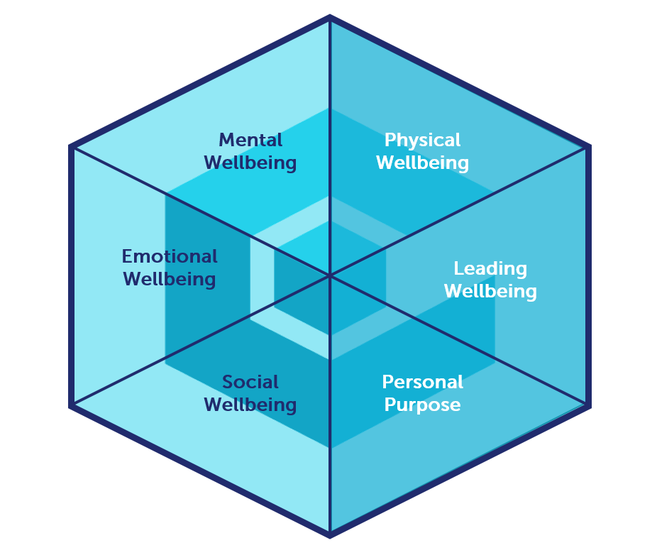
The many dimensions of wellbeing

Slide 5
Mindset Map
Think
Be
Innovator
“Failure is the key to success”
Insight creator
“I can find the pattern”
Sense Making
“Analysis unlocks meaning”
Finding my power
“I can claim my authority”
Breaking unhelpful patterns
“I can change”
Owning my impact
“I can be myself…and shape who I am”
Decisiveness
“After balanced consideration, I decide”
Overcoming limiting beliefs
“Old patterns become new strength”
Challenging the way things are done
“There must be a better way”
Action orientation
“I get on and make things happen”
Emotionally in touch
“My feelings and emotions are helpful”
Choose your attitude
“I can choose my response”
Presence and Impact:
“I’m proud of and project a powerful personality”
Inquisitiveness
“What’s beyond the obvious?”
Thinking more broadly
“I don’t need to be an expert to lead”
Investigating
“I seek alternatives”
Telling moving stories
“Vulnerability inspires”
Mastering the difficult message
“I’m OK, you’re OK”
A flexible approach
“Different people need different approaches”
Visioning
“I know where I am going”
Personal Purpose
“I know why I’m here”
Co-creation and collaboration
“We are better together”
Creating a shift in others
“I hold the tension for others to grow”
Championing Feedback
“It’s something we both want ”
Leading Transformation
“Holding the dream and flexing the response”
Empathy and connection
“I want to be close to you”
Comfort with conflict
“Challenge leads to deeper trust”
Stepping into another’s shoes
“I can experience other’s worlds”
Committed listening
“I’m here with you”
Making people feel seen
“You matter, we matter, it matters”
Knowing what I stand for
“I know what is important to me”
Leading in Uncertainty
“If it’s not me then who?”
Creating Meaning
“I lead through purpose”
Relate
Inspire
Empowerment
“I am willing to let go and trust”

Slide 6
Resilience mindsets
Overcoming limiting beliefs
“Old patterns become new strength”
Finding my power
“I can claim my authority”
Emotionally in touch
“My feelings and emotions are helpful”
Choose your attitude
“I can choose my response”

Slide 7




‘From Surviving to Thriving’
Overview of Learning Day
This Learning Day focuses on three areas within your control that can make all the difference:
Managing your state: developing your self-awareness, understanding what Mindtraps can derail you Managing relationships: having the courage and skills to have difficult conversations with others, whilst developing a personal network to sustain you through the more challenging times Finding your spark: understanding deep down what drives you and knowing how to bring your unique spark into your everyday work
Outcomes
To build your personal resilience and resourcefulness To learn how to manage your state To try out some practical tools to build more positive relationships with key people To identify your spark and how to bring this more into your life To reflect on your overall wellbeing and start to build your own ‘balance wheel’
Course format
We deliver our learning days across the full range of school settings. Our facilitators are professional leadership coaches.
Who is this for?
Line managers
This Learning Day can be delivered to PPA clusters, school leadership teams or whole school staff – from 10 to 100+ people

Slide 8


Coaching for Wellbeing
Course Overview
Maintain your resilience and lead for a balanced life through this coaching program designed around getting the most out of your energy and resourcefulness.
What modules are covered?
How do I sustain a balanced life? What stops me achieving my objectives? Maximising my energy and happiness
Outcomes
To become clear on how you want to lead your life To understand what stops you making the choices you want to and how to break out of this To get clear on what fulfils you and how to use this to bring greater energy into your day to day To develop sustainable habits
Course format
This course is designed to provide individual support to apply the learning after our ‘From Surviving to Thriving’ Resilience Learning Day. 3 month program including 3 hourlong one-to-one phone coaching sessions with a personal coach. Access to online leadership resource materials.
Who is this for?
Line managers
NSW PPA members seeking a more balanced life – this coaching is offered as follow on support from our Resilience Learning Day

Slide 9

Coaching for Wellbeing
Coaching Session
One
How do I Sustain a Balanced Life?
Coaching Session
Two
What Stops Me from Achieving Balance?
Coaching Session
Three
Maximising My Happiness
A new winning formula
The purpose of this coaching session is to work with your personal Coach to integrate and apply the insights you have gained from the Resilience Workshop into a new ‘winning formula’ for life, which is at the heart of your solution for a better work-life balance.
Five core skills
We will also be highlighting the five core life skills that are the building blocks to refining and sustaining these decisions, which will act as the cornerstones to help you maintain a balanced life.
What is holding me back?
What prevents my personal and lifestyle goals from becoming achievements? Why do I not see things through for myself?
We will look at what undermines our best intentions and prevents us from achieving our goals. Your Coach will help you to identify the specific Mindtraps or beliefs that prevent you from breaking out of this unhelpful pattern, and we will offer a practical tool to help you loosen the impact of the Mindtraps to help you move towards achieving your goals and therefore moving towards a more balanced situation.
Knowing what I want
Your Coach will help you rediscover what fulfils you and will look at ways to bring that into everyday life. What do I need to do ‘less of’ and ‘more of’ in the future?
With support from your Coach, you will create a sense of possibility and belief that you can make changes for the better... and rediscover what fulfils you.
You will also look at what values are important to you as this is key to ensuring we live our lives for our own success and happiness instead of someone else’s version.

Slide 10
Spark
Course Overview
Coaching for Principals and senior leaders to find their leadership purpose, personal resilience and develop followership in the organisation.
What modules are covered?
Diagnosing your leadership Finding my spark (that represents you at your best) Leaving a legacy Resilience and resourcefulness Inspiring your team
Outcomes
Find your spark and learn how to be impactful and inspirational much more of the time get clear on the changes you want to make and how to bring them about significantly increase your impact on others engage and inspire those who work with you
Course format
5 one-to-one phone coaching sessions with a personal coach. Access to online leadership resource materials. Enrol at any time for this 4-5 month program. $995+GST (30 mins sessions); $1,595 +GST (60 mins)
Who is this for?
Line managers
Principals and senior leaders who want to become more inspiring and authentic.

Slide 11

Re-energise
Course Overview
The Re-energise program is designed for those who have just been through a stressful leadership experience. It aims to help you reflect on your experience over the last months, optimise your learnings and support you with recovery and renewal.
What modules are covered?
Adapting to stress Rediscovering my purpose Recognising and learning from the positives Letting go of unfinished business Energy management Building new ways of working
Outcomes
To be able to bounce back from a difficult period To let go of any negative feelings and maximise the learning from what you've been through To be better able to manage your energy To integrate the learning and find a new sense of purpose.
Course format
5 one-to-one phone coaching sessions with a personal coach. Access to online leadership resource materials. Enrol at any time for this 4-5 month program. $1,595 +GST (60 mins coaching sessions)
Who is this for?
Line managers
Those who have just been through a stressful or difficult leadership experience

Slide 12
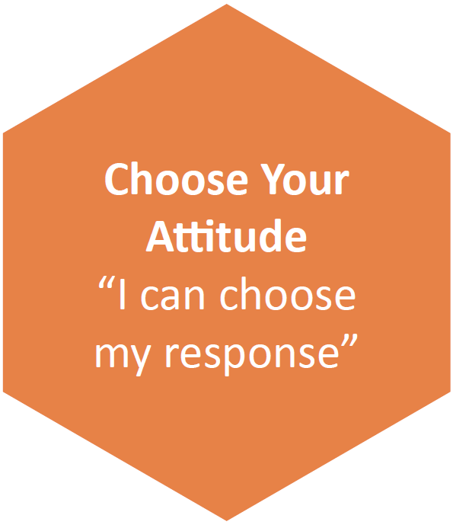
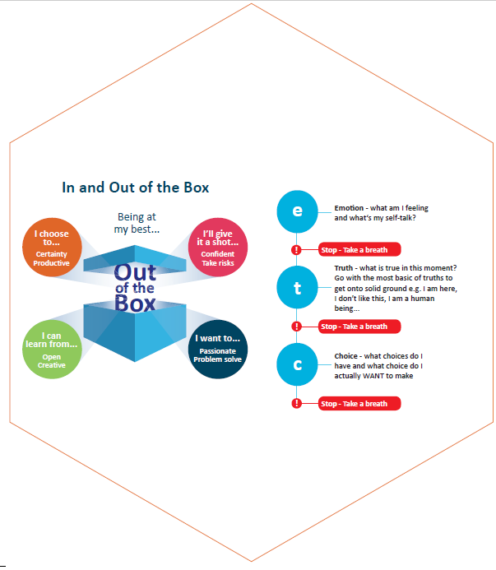
How do we support mindset change?
34 Leadership Mindsets
And for each mindset….
Insights
Exercises
Tools
Transformational Processes

