Slide 1
Casual Teacher Availability
Friday, August 24, 2018

Slide 2
656
Total Responses
Date Created: Monday, July 02, 2018
Complete Responses: 656

Slide 3
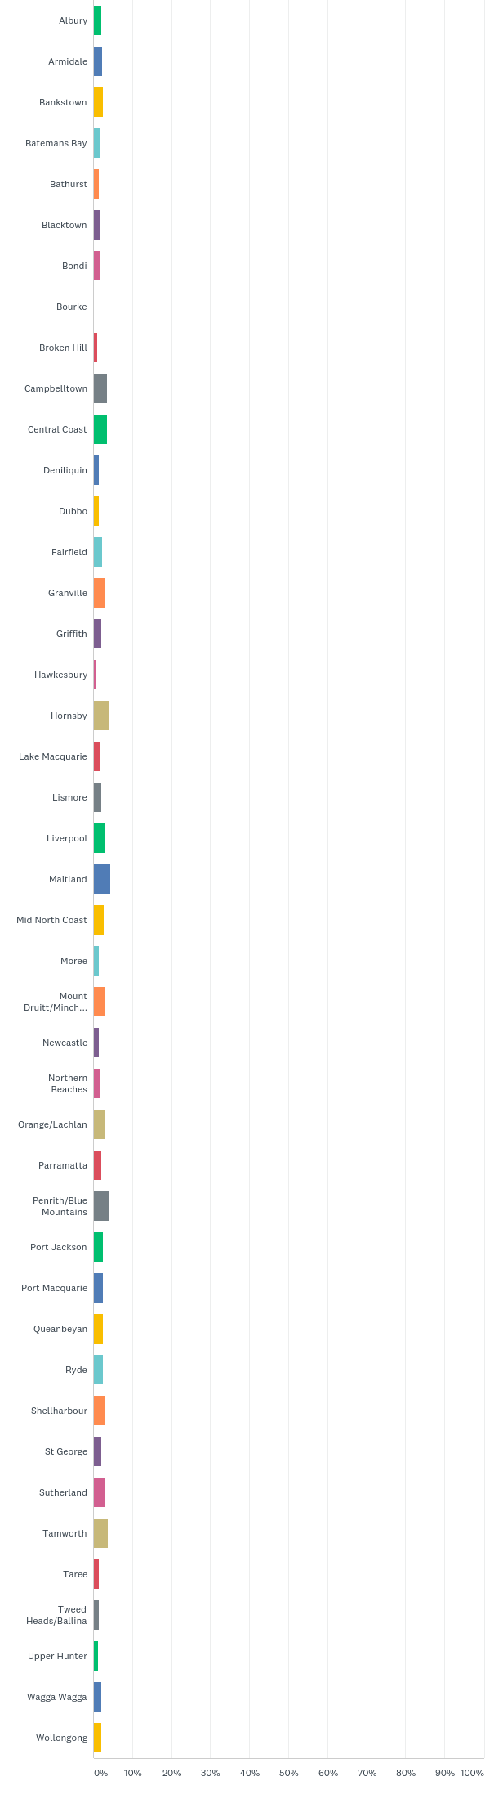
Q1: Which NSWPPA Area Council do you belong to?
Answered: 657 Skipped: -1

Slide 4
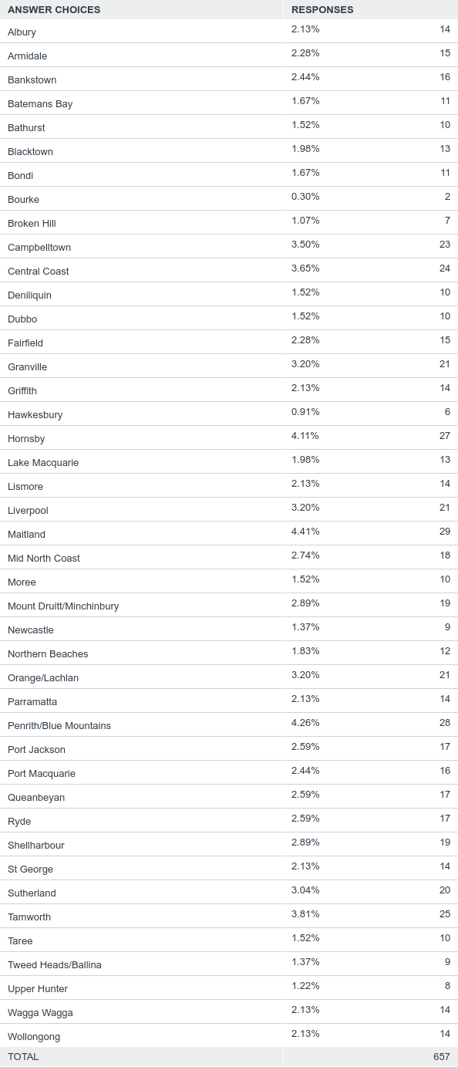
Q1: Which NSWPPA Area Council do you belong to?
Answered: 657 Skipped: -1

Slide 5
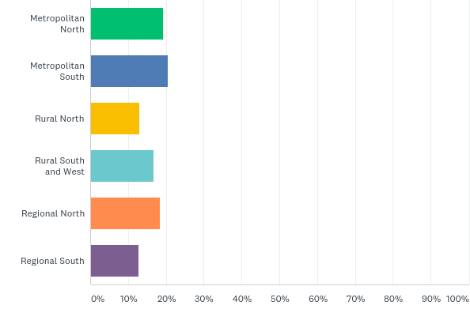
Q2: Which DoE Operational Directorate do you belong to?
Answered: 657 Skipped: -1

Slide 6
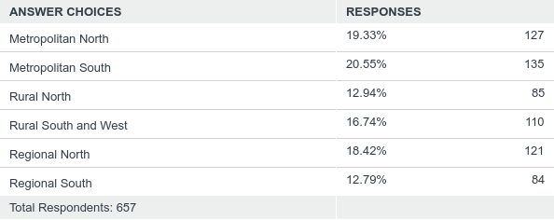
Q2: Which DoE Operational Directorate do you belong to?
Answered: 657 Skipped: -1

Slide 7
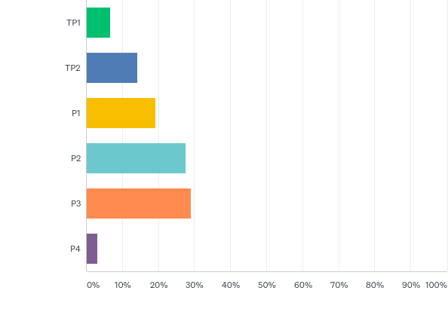
Q3: Principal Classification
Answered: 652 Skipped: 4

Slide 8
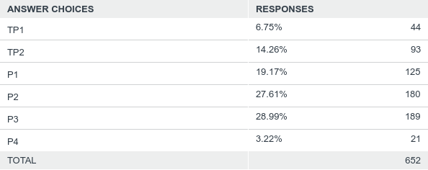
Q3: Principal Classification
Answered: 652 Skipped: 4

Slide 9
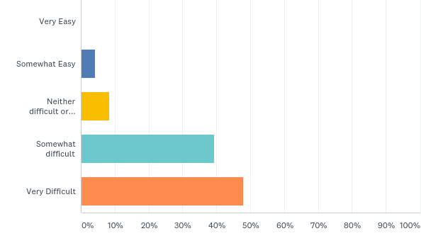
Q4: Generally how hard is it for you to find quality replacement teachers for long term leave such as maternity or LSL?
Answered: 657 Skipped: -1

Slide 10
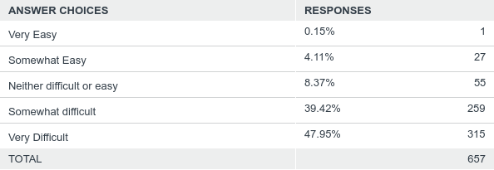
Q4: Generally how hard is it for you to find quality replacement teachers for long term leave such as maternity or LSL?
Answered: 657 Skipped: -1

Slide 11
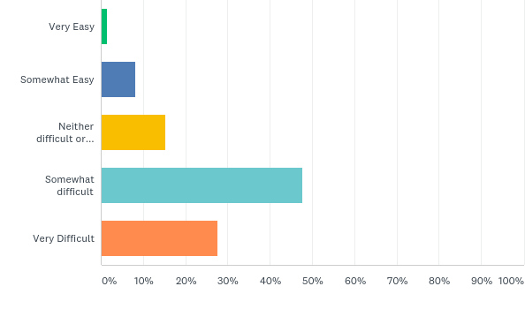
Q5: Generally how hard is it for you to find any replacement teachers for long term leave such as maternity or LSL?
Answered: 657 Skipped: -1

Slide 12
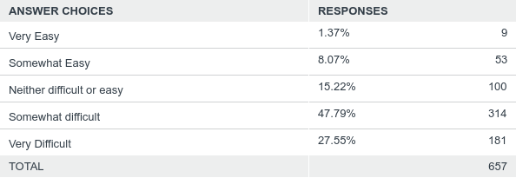
Q5: Generally how hard is it for you to find any replacement teachers for long term leave such as maternity or LSL?
Answered: 657 Skipped: -1

Slide 13
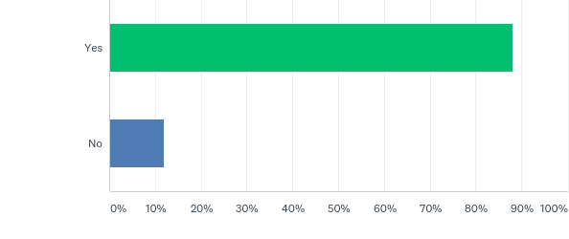
Q6: Have you had to split classes on any day this year?
Answered: 657 Skipped: -1

Slide 14
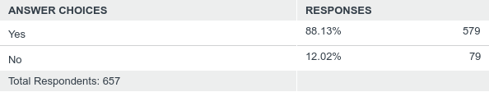
Q6: Have you had to split classes on any day this year?
Answered: 657 Skipped: -1

Slide 15
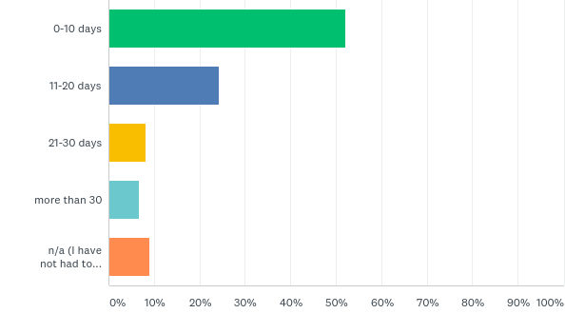
Q7: If so how many times this year have you split a class
Answered: 657 Skipped: -1

Slide 16
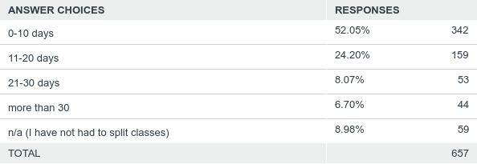
Q7: If so how many times this year have you split a class
Answered: 657 Skipped: -1

Slide 17
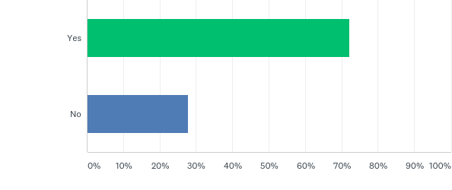
Q8: Have you had to collapse a program or professional learning because you couldn't find casual teachers?
Answered: 645 Skipped: 11

Slide 18
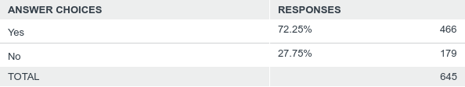
Q8: Have you had to collapse a program or professional learning because you couldn't find casual teachers?
Answered: 645 Skipped: 11

Slide 19
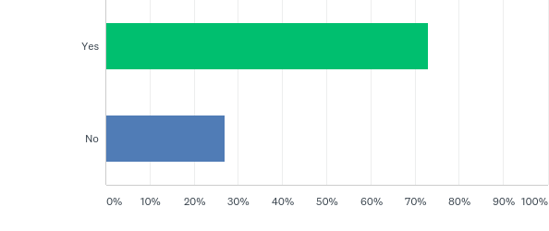
Q9: Have you had to collapse an RFF program because you couldn't find a casual teacher?
Answered: 647 Skipped: 9

Slide 20
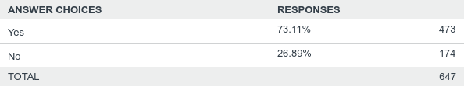
Q9: Have you had to collapse an RFF program because you couldn't find a casual teacher?
Answered: 647 Skipped: 9

Slide 21
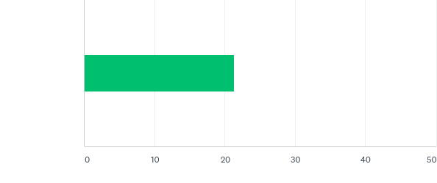
Q10: On a scale of 1-10 (1 being poor and 10 being excellent) how serious do you think the current situation is in getting casuals/temps in your school?
Answered: 644 Skipped: 12

Slide 22

Q10: On a scale of 1-10 (1 being poor and 10 being excellent) how serious do you think the current situation is in getting casuals/temps in your school?
Answered: 644 Skipped: 12

Slide 23
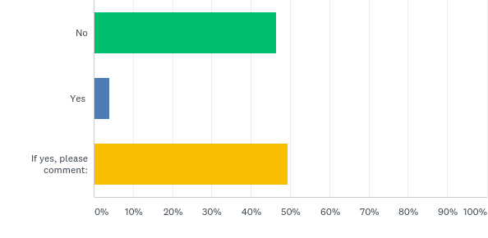
Q12: We also realise there are special circumstances when splitting class is impossible due to the nature of the school or the disability of the students. Has this happened at your school this year and what were some of the possible solutions you came up with to make the class viable?
Answered: 649 Skipped: 7

Slide 24
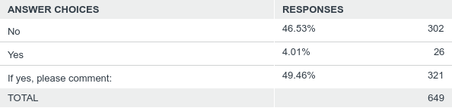
Q12: We also realise there are special circumstances when splitting class is impossible due to the nature of the school or the disability of the students. Has this happened at your school this year and what were some of the possible solutions you came up with to make the class viable?
Answered: 649 Skipped: 7

