Slide 1
Supporting our schools
Delivery Unit Update

Slide 2
Executive Summary
Disability strategy
Reducing the administrative burden

Slide 3
Process
Seek input from a broad range of stakeholders including families
Current system: Understand, gather data and facts
Continue system design
Commence forward
Program of work
Develop vision and potential direction
Develop vision and potential direction
Literature review: understand evidence and other systems
Initiative 1
Initiative 2
Initiative 3
Quantify the scenarios: Develop and refine possible scenarios for
possible future student numbers, assets, costs, workforce

Slide 4
Outcomes
Outcomes for all children and young people
Learning growth
Students demonstrate progress in learning against the curriculum, with tools to support assessment of progress at all levels
There is shared ambition for all children and young people
Wellbeing
Children and young people have good physical, emotional and mental health
Independence
Young people have the skills to live a post-school life that is as independent as possible
Outputs
Participation
Children and young people participate in school life to the fullest extent possible
Children and young people are consistently involved in decisions about their education
Inclusion
Children, young people and parents express a sense of belonging
Children and young people are included in their classroom, in their school, and in their wider community
Improving Outcomes for Children and Young People with Disability

Slide 5
When we are at our best…
Students with disability are learning to their fullest capability
Parents / carers / families are partners
Teachers are confident, skilled and supported
School leaders proactively support and enable inclusive practices
Specialists work alongside and support educators
Improving Outcomes for Children and Young People with Disability
Improving Outcomes for Children and Young People with Disability

Slide 6
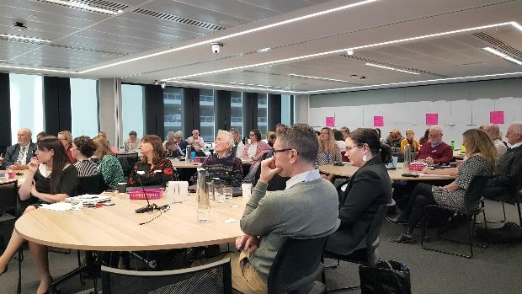
Most recent workshop 70 participants
Improving Outcomes for Children and Young People with Disability
Notes:
Liana

Slide 7






Broad range of external stakeholders
Advocacy groups & NGOs
Those with lived experiences & parents
Allied Health & Paediatricians
Principals & department staff
Academics
Other government agencies
Improving Outcomes for Children and Young People with Disability
Notes:
Liana
- Risks (complex, volatile, legal consequences, experienced trauma)
Divergent views (us and them)

Slide 8

Recap: Around 2 in 10 students have disability
3%
In Schools for Specific
Purposes (SSPs)
12%
85%
In support classes in mainstream schools
In mainstream classes
Improving Outcomes for Children and Young People with Disability
Notes:
Our data is continuously being refined

Slide 9
Recap: Number of students accessing targeted individual support has grown faster than public school enrolments
Annual enrolment trends in NSW Public Schools
4%
At this rate→50% more students needing support in next 10 yrs
1%
Overall annual growth in enrolments in NSW public schools
Annual growth of students accessing Integration Funding Support, support classes, SSPs
Improving Outcomes for Children and Young People with Disability

Slide 10
We have work underway to improve the system
6 KB
Supporting schools with NDIS roll out
Strengthening personalised learning and support through the NCCD
Review of access request process for specialist supports
All state-wide professional learning disability-related courses meet the new standard – now further review to identify additional options
Curriculum review
Staffing methodology review
Behaviour strategy (for all students)
Strengthened support for complex cases
Innovative future learning spaces

Slide 11
DISCUSSION DRAFT
Potential future priorities include
Build outcomes measures (priority: learning assessments)
Improve parent navigation
Develop departmental accessibility checklist (policy, transitions, assets, assessments etc.)
Support flexible approaches to using resources
Help schools disseminate best-practice
Policy and support for new builds and major upgrades – to be more inclusive

Slide 12
Executive Summary
Disability strategy
Reducing the administrative burden

Slide 13
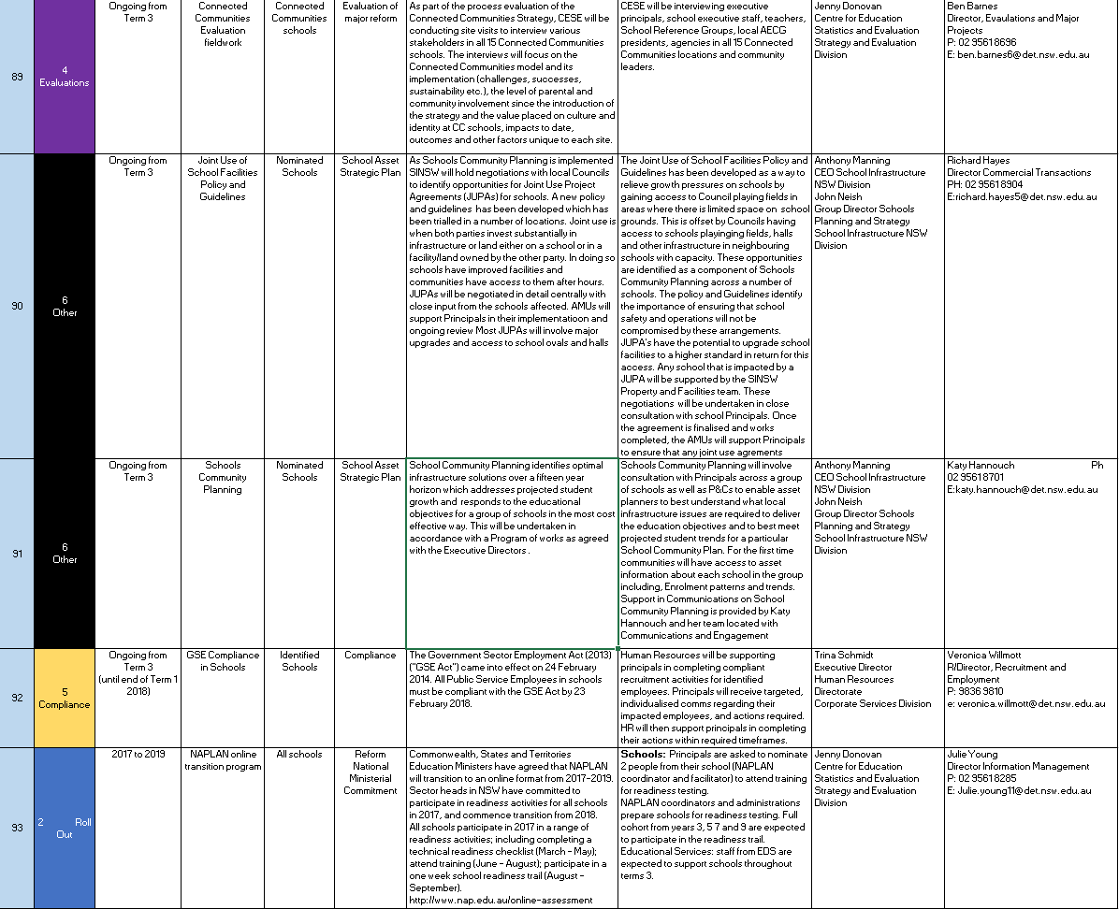
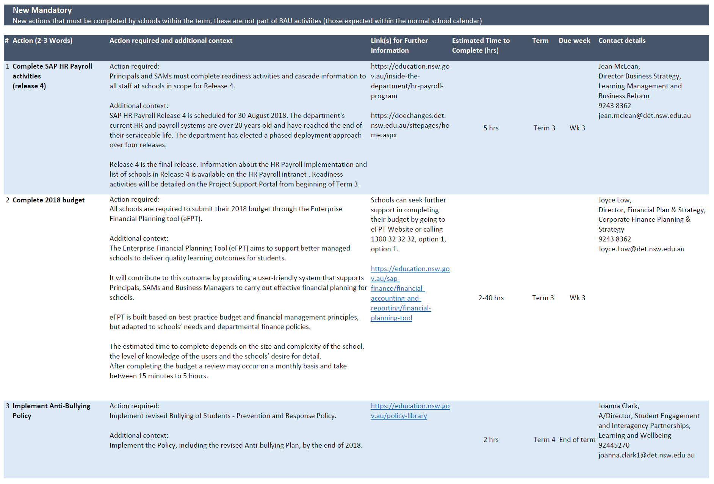
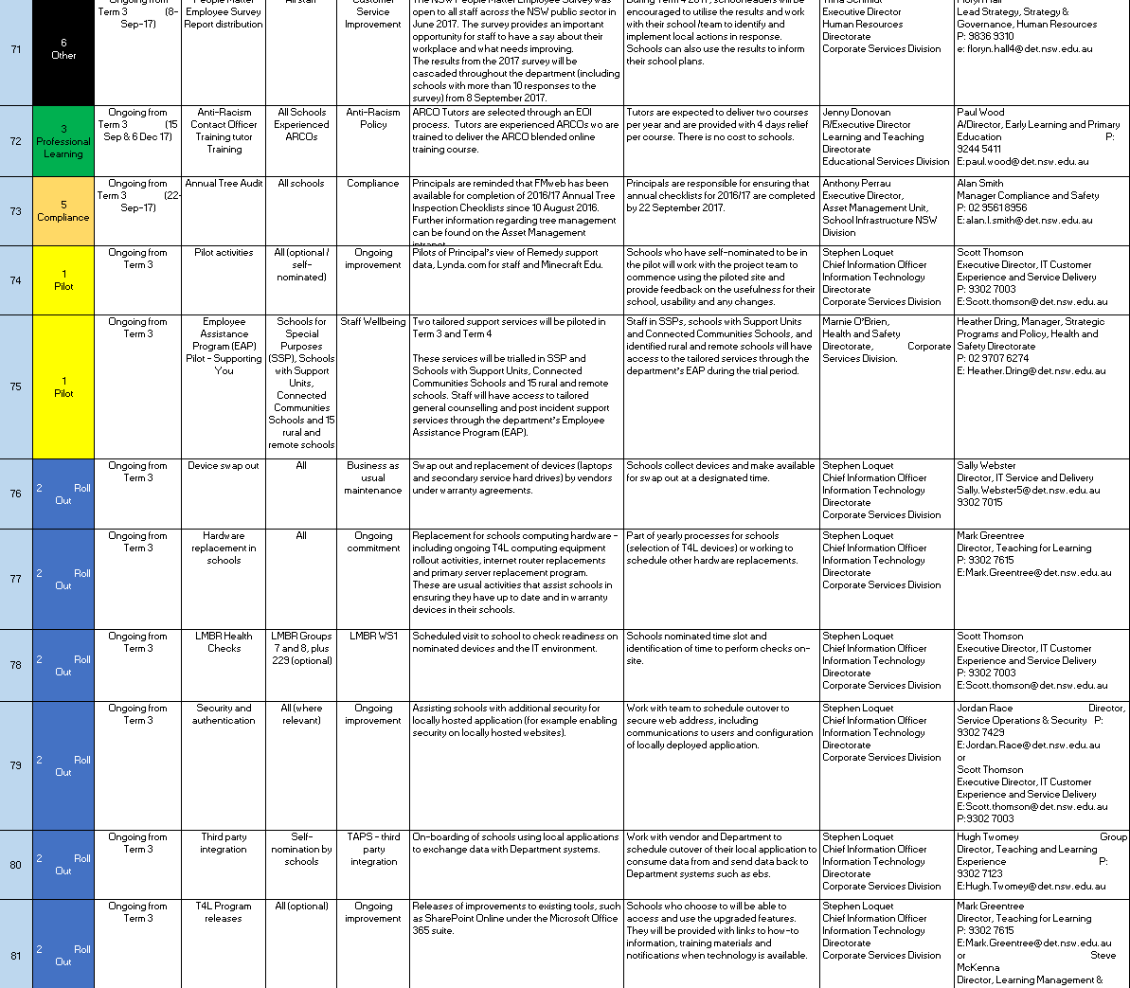
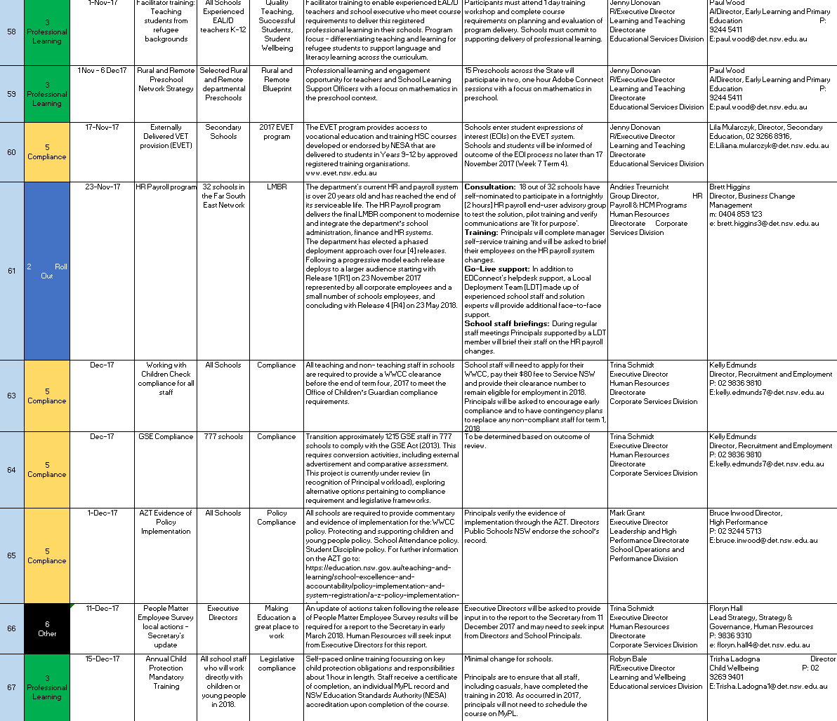
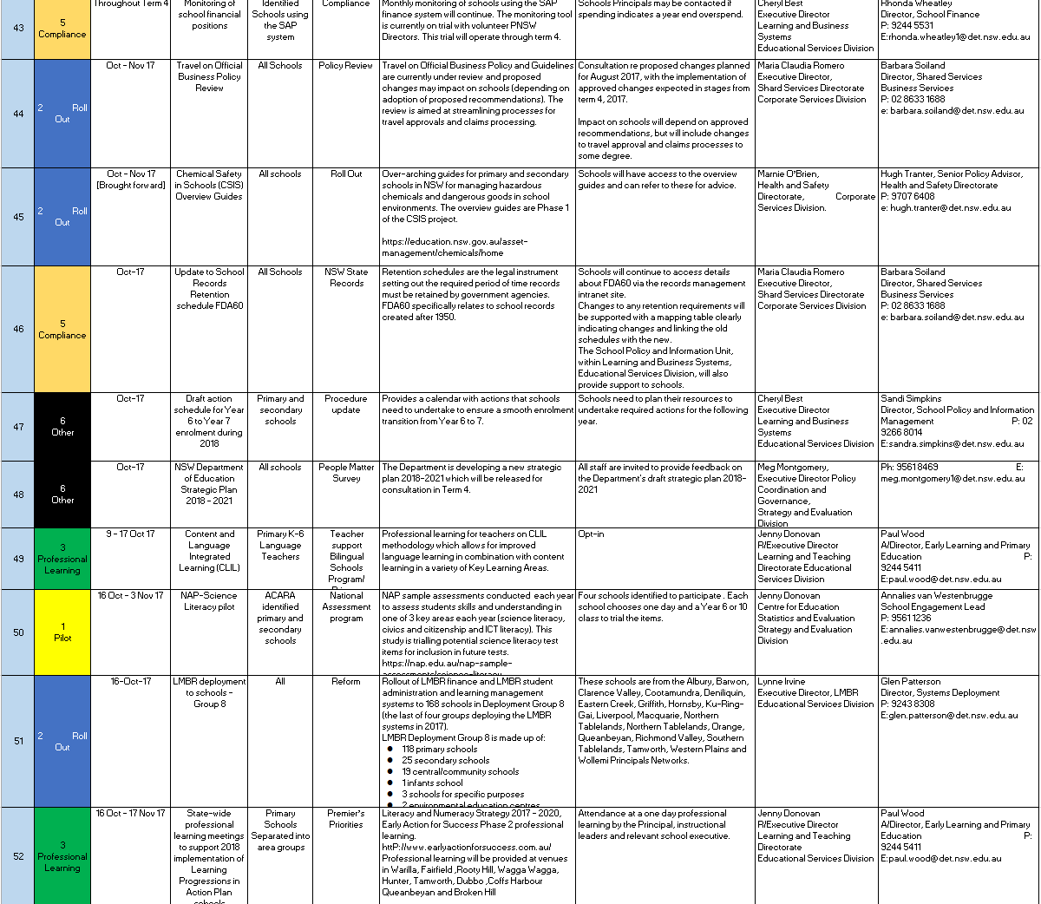
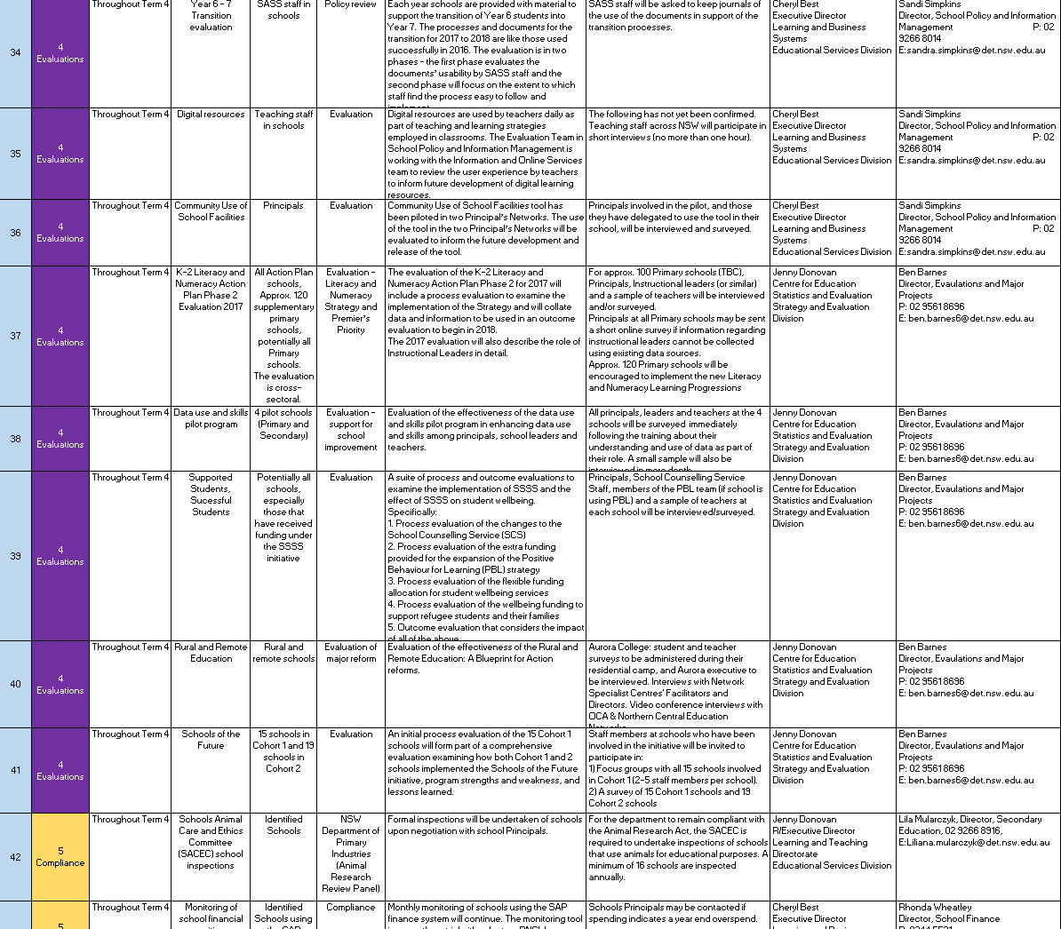
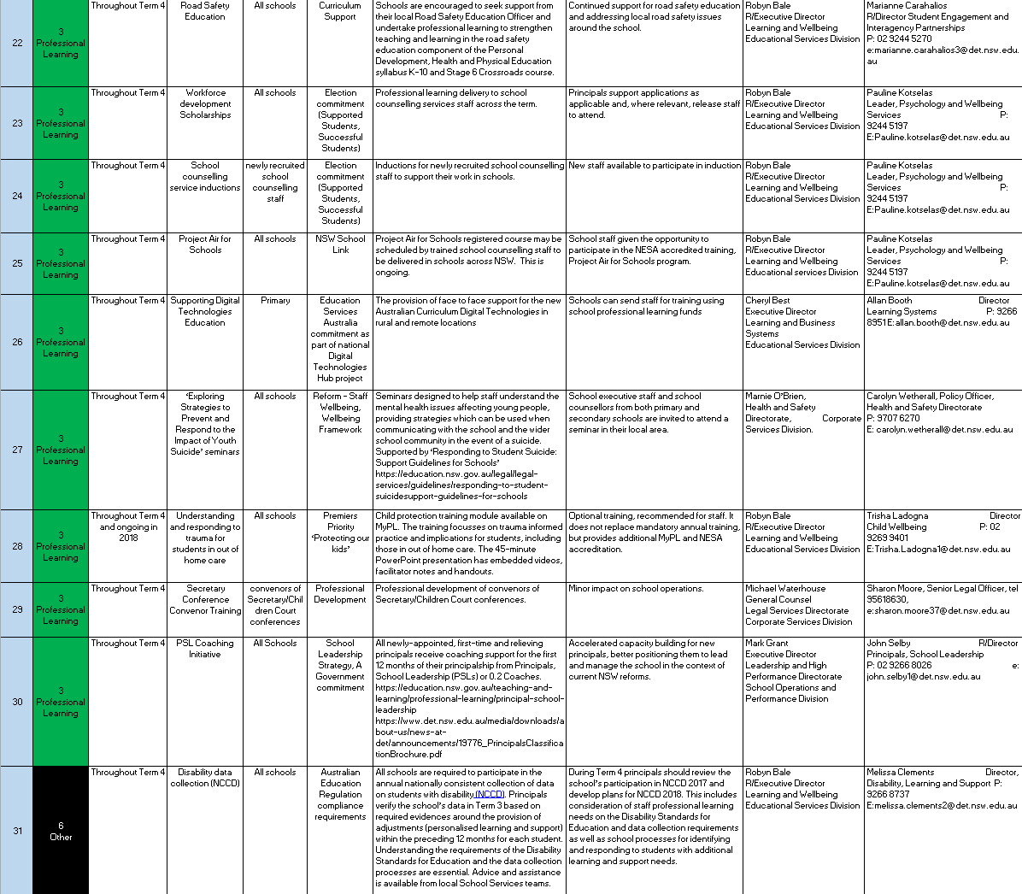
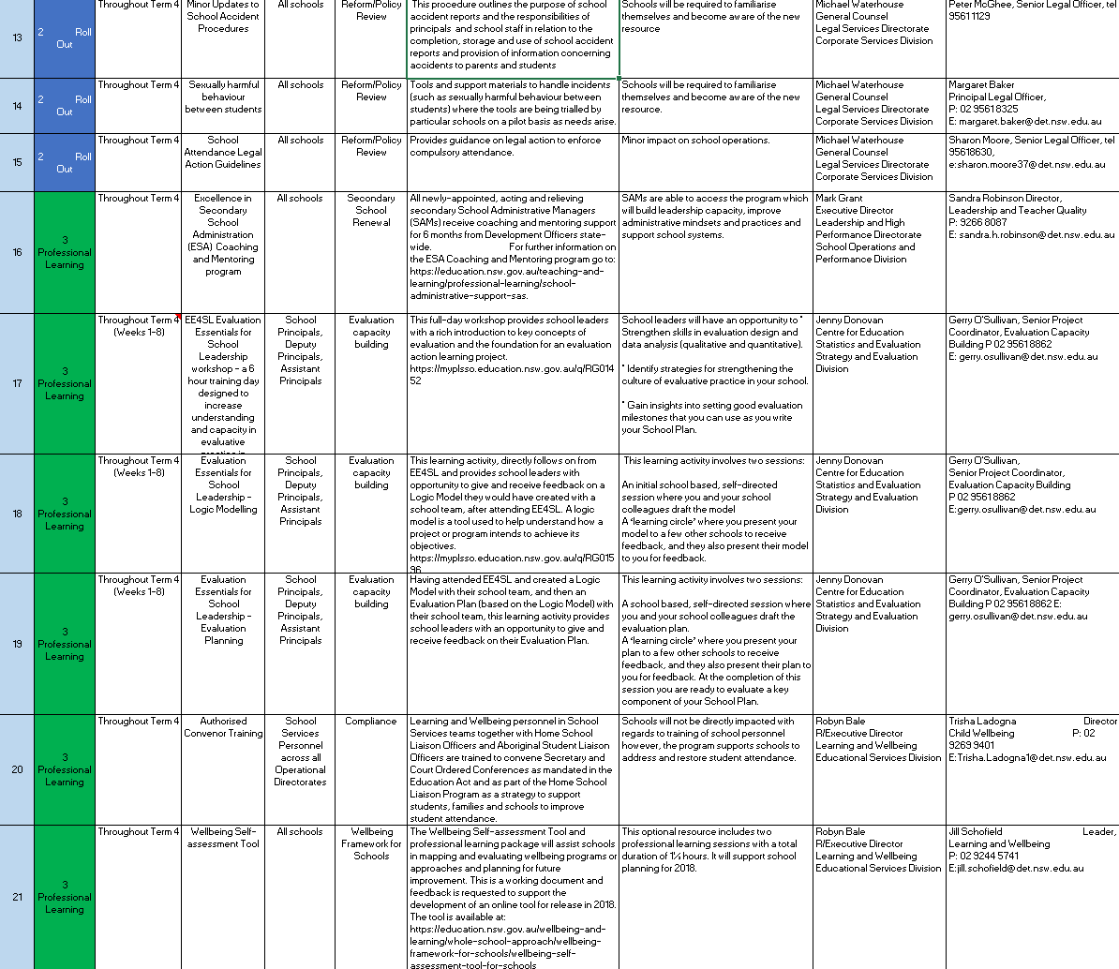
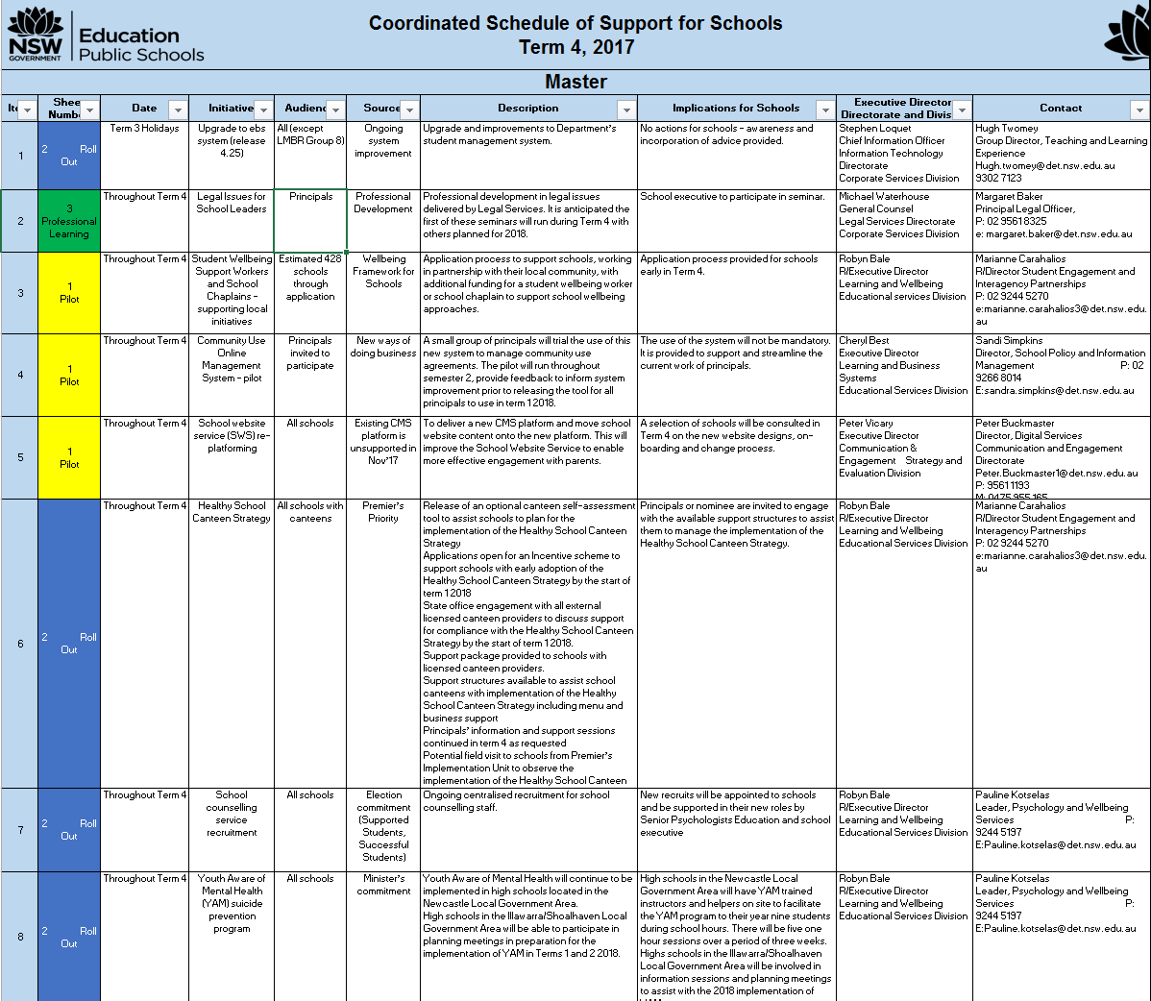
Consolidated Schools Schedule
Version 1
Version 2
Version 3
You should see..
Separated by terms;
Ordered by type of school and week of roll-out
Separating out professional learning
Required vs. optional highlighted
Key contacts & links
Time to
Clearer writing
Improved categorisation
Time required
Key BAU activities
Better coordination
Process, Owners, Supporting technology
Upcoming:
Including NESA/other commitments
Mandatory link closely to key priorities
Printable on A4
Just 3 mandatory (those in body of email)
Separated into clearer categories

Slide 14
PPA identified 13 change-free weeks and SPC 18 change-free weeks
Preferred change-free weeks
Would like to be change-free weeks (flexible)
Potential change roll-out weeks
PPA
SPC
13
5
22
180
3
19
Wk 1
Wk 2
Wk 3
Wk 4
Wk 5
Wk 6
Wk 7
Wk 8
Wk 9
Wk 10
Wk 1
Wk 2
Wk 3
Wk 4
Wk 5
Wk 6
Wk 7
Wk 8
Wk 9
Wk 10
Term 1
First 5
wks
First 6
wks
Last
wk
of term
First
4-6
wks
First
4-6
wks
Last
wk
of term
Term 2
r
NAPLAN
wk 1
NAPLAN
wk 2
Last
wk
of term
First
wk
of term
xxx
NAPLAN
wk 1
NAPLAN
wk 2
SPC
conf.
xxx
Last
wk
of term
Term 3
r
Edu wk
Last
wk
of term
First
wk
of term
xxx
Edu wk
xxx
Yr 12
leaving
Term 4
r
PPA
conf.
r
Last 5
wks
First
wk
of term
Last 3 weeks

Slide 15
Other feedback from SPC & PPA discussions
Feedback on differentiation between school types
Other comments to note
“The earlier you can give us notice the better, I plan the year in advance and the department disrupts this”
“The most important thing is that the change/ product works, we can actually deal with everything else”
“The time saving is well beyond just my x mins as a principal, it really has a flow on effect”
“Mapping the major BAU events and avoiding them is helpful”
“Opt-in changes are helpful as schools do plan differently”
Teaching vs. non-teaching principals is important to consider
Primary vs Secondary have slightly different calendars
SSPs different needs should be considered
Remember that Western schools start later
Principals would like to be treated equally, as much as possible
Notes:
“"

Slide 16
Key work in progress areas (1/2)
Potential time saving
(hrs/yr)
Areas of current focus
Update
Purchasing Cards (Pcard) –removing prior approval requirement for Pcard purchases for teachers and admin staff
~ 12 per affected school (~800 schools)
Approved by Minister and change is imminent – new guidelines written and pending implementation subject to School Operation and Performance approval to ensure change is understandable for schools
Cash Management Process – daily banking process; cancelled receipts & cash refunds (initiated due to principals printing, signing and filing blank reports for 7 years)
~ 10 per principal + admin staff time
Deciding on best time to roll-out immediate solution to shift cancelled & adjusted fees ‘blank’ report from daily to monthly.
Completed EBS4 system upgrade complete reducing time to print and improving log in time
Working on other solutions to streamline cash reports and procedures, along with longer term solution to improve PoP
‘Take off the desk’ – key
frustrations
MyPL – frustrations from various stakeholders regarding usability of the system
~42,000 across the system
Focusing on system enhancements to deliver usable dashboards, improved course mgmt., enrolment and course creation
Testing design of MyPL dashboard with schools as first step
PLAN2/ Learning Progressions – frustrations re user experience and time requirement
TBD
Ongoing professional learning for progressions
Continuing further development of PLAN2 tool and how to make reporting and assessing easier
Clarification regarding school requirement to complete – EAFS
DoE Portal – focus on a more mobile friendly solution and minimising change impact
TBD
Conducted successful user testing with great input from 2 schools, which will change design and highlighted other challenge areas
Planning pilot with several schools to test impact of changes with intention to use feedback for further design changes

Slide 17
Key work in progress areas (2/2)
Potential time saving
(hrs/yr)
Areas of current focus
Update
Governance & Prioritisation Approach - Increasing quality & reducing number of rollouts to schools
TBD
Deciding on change-free periods for schools after consultation with PPA & SPC
Deciding on change caps per term/per year for schools
Creating a Master schedule of all change to schools for next 18 months, including NESA. This is being drafted and intention is to prioritise and phase the major/critical changes based on change-free periods and change caps decision
Continuing shift of culture to ensure school time and voice is always considered for every change/project
Prevention
Schools Consolidated Schedule of Support – ongoing iteration and improvement, prioritisation of activities continues
Est ~4-8hrs per principal
Improved term 3 & 4 schedule, length and format
Improving content of term 4 & 1 schedule to be easier to understand and action, while also decreasing the volume.

Slide 18
If needed

Slide 19
Objectives of this strategy
How can the NSW Department of Education become Australia’s best education system for children and young people with disability, preparing them for rewarding lives?
How can we measure progress and outcomes for students with disability at individual and system levels?
Outcomes
How might we design a system that provides the best outcomes for children and young people with disability and their families?
System
What support can the system provide to schools and teachers in order to achieve the best outcomes for children and young people with disability?
Workforce
Tools and technology
Assets
Support
What might we put in place outside the school gate to best support learning?
Transitions
Partnership with other agencies
Outside school gate

Slide 20
Staffing Methodology
Lead by HR, supported by Delivery Unit
Trina coming back with full report on this and other HR projects in Term 4
Benchmarking being finalised, reviewed
Interviews commencing – thank you for your guidance and sharing key materials

Slide 21


We will combine local prioritisation with central oversight
PPA/SPC Update
Design within “rules of the game”
Local prioritization (progress, re-do, halt)
Final gate –
(Go/No Go)
Implement &
Monitor
Idea generation
Prototype, iterate and refine
Local Idea
Linked to DoE priority
One visible schedule
BIG
“critical”
Central
Central – Executive
Schools
“
Change-free periods
T1
T
T2
T3
T4
4
Capped time impact
“
Small
Local
Central – Release & Transition Board
Agreed limits
Max time impact on schools per term
Local
prioritisation
“
Capped time impact
Max changes per term
Small
Local
Common language
“
t
Metrics & measures
Capped time impact
Definitions
Small
Local
“
Principles
Capped time impact
Ideas generated by schools, directorate, exec.
Demonstrable school impact required
Change impact considered
Proposals are developed, iterated and prioritised locally against a common set of guidelines set centrally (e.g. fit within the common schedule)
Change impact assessment
Proposals governed according to type
Smaller projects have a local approach; larger are managed centrally
Capped time impact per division – and department-wide (can be traded)
Change impact assessment
All projects required to pass a final central gate before release to schools.
Ongoing change management
Monitoring of outcomes

Slide 22



Gateways – ensuring a schools focus
Gateway 2:
Design within “rules of the game”,
prioritise locally
Post
Implementation
Gateway
Gateway 1:
Idea generation
Gateway 3:
Prototype, iterate and govern
Final Gateway:
‘Go/no-go’
Does this really solve an issue?
Is it a school-centred solution?
Rapid pro-typing and iteration
Structured final approval for all projects.
Outcome review
for all projects
Prototype
Refine
Test
Feedback & assessment
Why--new service, improvement, compliance?
No duplication?
Schools say this is a priority?
Evidence of school appetite (e.g. signatures of school principals)?
Change impact considered
Will it improve student outcomes?
Will it free up time to teach/lead?
Is it fully accessible?
Is this a priority shared by a range of school types?
Will this have a large time impact on schools?
Can it be implemented within the current schedule
of activities – not breaching the cap?
Change impact assessment?
Did schools like it?
Did it save time?
Did it meet design specs?
Were there errors?
How can it be simplified?
What is the change impact?
High-quality?
Defects fixed?
Implementation/change plan incl. training developed?
Schools still want this?
Opt-in where possible?
Time impact?
Were outcomes
achieved? i.e. student
outcomes
Lessons learnt
What was the time
impact for schools?
Underpinned by key principles
*Students at the centre * With schools not to schools * School time counts * Keep it simple * Better than last, every time
* Make a difference not a change * Do it less, do it better * Common sense

