Slide 1
some thoughts on curriculum design
Notes:
I want to talk today about the role of evidence in teaching.
I’m going to argue that, in addressing this topic, we need to think broadly about how teachers use evidence in their work.
The term ‘evidence-based practice’ has its origins in medicine.
One of the earliest and most widely cited definitions of evidence-based practice was provided by DAVID SACKETT…

Slide 2
Notes:
We find that the most advanced 10% of students in any given year of school are about 5 to 6 years ahead of the least advanced 10% of students in their reading development.
As this graph (based on national NAPLAN results) shows, the most advanced readers in Year 3 are already reading at the levels of the average student in Years 7 .
Some of the least advanced readers in Year 9 are still reading at the level of the average Year 5 student.
I’ve used reading here, but the same conclusion is reached in mathematics, and in fact, in any area of learning for which we have good data to do this – the most advanced 10% of students in any year of school start (and end) the school year five to six years ahead of the least advanced 10% of students.
I will use reading to illustrate everything I want to say today, but the principles are quite general, and I hope that you’ll be able to see how they apply to other areas of learning.

Slide 3
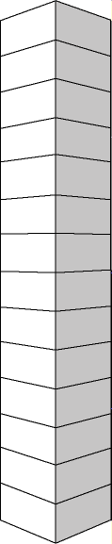

Interrogate complex texts
Interpret many aspects of complex texts
Interpret texts with substantial complexities
Interpret texts with a key aspect of complexity
Interpret some complexities & manage competing information
Make inferences and manage low-level competing information
Make simple interpretations of simple texts
Locate information using synonyms
Locate information using direct word matching
Read some sentences
Read some words and the pictures
Read the pictures
Recognise familiar print
Notice print
Notes:
We’ve attached shorthand labels to the 14 levels, which by themselves, don’t convey very much, but they provide a sense of increasing reading ability.
And, not surprisingly, you can see links to the previous slide.
Reading ability begins with pre-reading activities,
then recognising and reading aloud letters,
being able to recognise phonetically regular words,
finding explicitly stated information,
Moving on to understanding and interpreting complex texts.
This is just shorthand, for example...

Slide 4
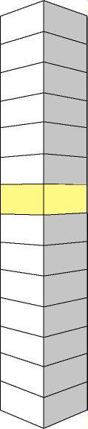
Interrogate complex texts
Interpret many aspects of complex texts
Interpret texts with substantial complexities
Interpret texts with a key aspect of complexity
Interpret some complexities & manage competing information
Make inferences and manage low-level competing information
Make simple interpretations of simple texts
Locate information using synonyms
Locate information using direct word matching
Read some sentences
Read some words and the pictures
Read the pictures
Recognise familiar print
Notice print
Notes:
What is a ‘simple’ interpretation? What is ‘simple text’.
We have described level 8 in more detail.
Here is some of this greater detail…

Slide 5
Interrogate complex texts
Interpret many aspects of complex texts
Interpret texts with substantial complexities
Interpret texts with a key aspect of complexity
Interpret some complexities & manage competing information
Make inferences and manage low-level competing information
Make simple interpretations of simple texts
Locate information using synonyms
Locate information using direct word matching
Read some sentences
Read some words and the pictures
Read the pictures
Recognise familiar print
Notice print
Level 8
- match synonymous words to locate
information
- link information across sentences
and make simple inferences when
clues are prominent, in a range of
simple texts
- make plausible predictions and
interpretations
- explain the purpose of familiar text
types and recognise obvious reasons
for a writer's choice of words
Notes:
Notice here that there are different kinds of skills being described:
Matching words
Linking information across sentences
Making simple inferences
Making predictions and interpretations
Explain the purpose of text
In mapping reading development, we have identified and described a few broad categories of skill types…

Slide 6
reading
aloud
retrieving
information
interpreting
information
reflecting
on text
8
8
8
8
Notes:
When we describe level 8, we do that by describing different kinds of skills at level 8:
Reading aloud skills
Retrieving information skills
Interpreting information skills and
Reflecting on text skills
These are inter-related – we do this just to make the point that the development of reading ability involves the development of different kinds of skills.
Notice that we haven’t attempted to describe reading aloud skills above level 8. From that point on, further improvements in reading proficiency are mainly improvements in reading comprehension (retrieving etc)
So, in our mapping, we describe these different types of skills. For example…

Slide 7
reading
aloud
retrieving
information
interpreting
information
reflecting
on text
interpreting skills include
- link pieces of related, prominent
information in several adjacent
sentences (when there is a little
competing information) to
compare or generalise about
events or ideas
8
8
8
Notes:
Skills in interpreting information include …
But even this is open to interpretation, so to be clearer, we provide examples…

Slide 8
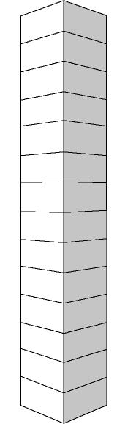
reading
aloud
retrieving
information
interpreting
information
reflecting
on text
example
Tooh
I usually take leftovers for my lunch.
Mum makes a little more for dinner
in the evenings and there is some
food left for my lunch next day.
I don’t mind eating leftovers cold.
Question
When does Tooh’s mum make the
food for his lunch?
8
8
8
Notes:
Here is an example.
Obviously students have to understand the concept of ‘leftovers’.
There is a little interpretation required here. Students also have to link ideas across the three sentences.
So this is an example of what many students are level 8 are still learning to do.

Slide 9
reading
aloud
retrieving
information
interpreting
information
reflecting
on text
Notes:
In our mapping of reading acquisition, we pay attention to growth (vertically), but also to different kinds of skills that are developing as students become more proficient readers (horizontally).
In mathematics, this horizontal structure reflects increasing knowledge, understandings and skills in:
Number and Algebra
Measurement and Geometry
Data and Probability
Once we have a map of this kind, the role of assessment is to…

Slide 10
reading
aloud
retrieving
information
interpreting
information
reflecting
on text
Assessment is the process of drawing inferences about where individuals are
in their learning from samples of their performance/work.
Notes:
Two key features of educational assessment identified here are:
Assessments are based on samples. It’s not necessary to try to assess everything in a comprehensive way. Assessments are based on well designed samples of performance and work in a learning domain.
Assessment is, by its nature, an inferential process. It’s a process of drawing inferences or conclusions from samples of evidence.
ACER’s Progressive Achievement Tests (eg, PAT Reading) are designed to provide samples of evidence fro a learning domain.
For example, PAT Reading provides samples of evidence across the three reading comprehension skill categories, enabling an inference to be drawn about the level at which a student is working…

Slide 11
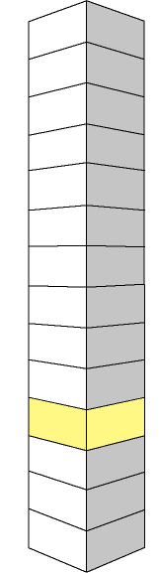
reading
aloud
retrieving
information
interpreting
information
reflecting
on text
Students at level 4 often have difficulty distinguishing a familiar word from other words with similar features.
4
Notes:
In our research we find that students at Level 4 in reading ability often have difficulty…

Slide 12
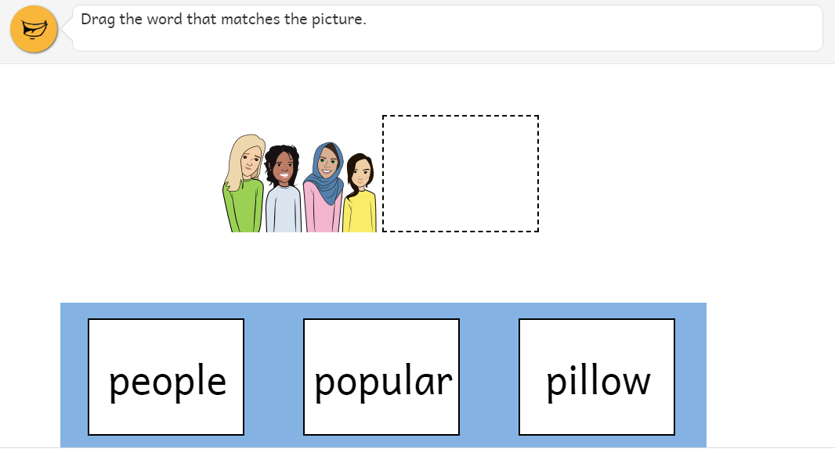
Level 4
example
63% 21% 15% na 1%
Notes:
This is an example of a Level 4 reading task from the Progressive Achievement Tests.
Using a tablet, students are asked to drag the word that matched the picture.
Of the children this task has been given to, 63% …
… suggesting that more than a third of children who attempted this task were unable to decode these words.
Students at this level are likely to benefit from systematic, targeted teaching that focuses on letter-sound relationships and putting letters together to make words…

Slide 13
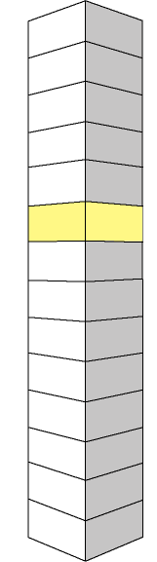
reading
aloud
retrieving
information
interpreting
information
reflecting
on text
Students at level 9 often
have difficulty drawing an inference by linking several dispersed clues in a short piece of text that includes competing information.
9
Notes:
often have difficulty ….

Slide 14
Level 9
example
I use chalk to play lots of games outside. You can play four square if you have a ball. Ask your grandmother about hopscotch. My favourite game is drawing obstacles that my friends and I have to ride around on our bikes. We love swerving around man-eating sharks and long-toothed alligators.
Ashran
What are the man-eating
sharks Ashran talks about?
A toys
B friends
C models
D pictures
na
16%
16%
7%
60%
1%
Notes:
For example…
40% of the students who attempted this question were unable to answer it correctly.

Slide 15
Level 9 – targeted teaching
example
I use chalk to play lots of games outside. You can play four square if you have a ball. Ask your grandmother about hopscotch. My favourite game is drawing obstacles that my friends and I have to ride around on our bikes. We love swerving around man-eating sharks and long-toothed alligators.
Ashran
inference
The connection between drawn obstacles and sharks is not stated directly.
Notes:
This is largely because it involves an inference, The reader needs to make a connection that is not stated explicitly between drawn objects and sharks – and earlier, to the word ‘chalk’.
This is more difficult than if the connection had been stated directly.
Students at this level are likely to benefit from systematic, targeted teaching about inferences.

Slide 16
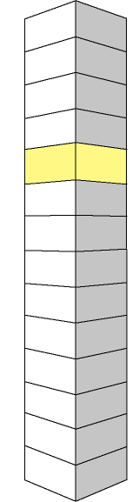
reading
aloud
retrieving
information
interpreting
information
reflecting
on text
Students at level 10 often have difficulty relating pronouns and nouns in dense and unfamiliar texts.
10
Notes:
Often have difficulty…

Slide 17
example
Constellations are imaginary pictures people make in the night sky by joining stars together. The constellation Crux (Latin for cross) is the smallest of the constellations, but also one of the most distinctive. It is more commonly known as the Southern Cross. Acrux is the principal star in Crux. It is at the bottom of the cross. Acrux is actually a double star, but the two stars are so far away that we see them as one. Acrux is the fourteenth brightest star in the whole sky.
Level 10
Gacrux
Gamma Crucis
Mimosa
Beta Crucis
Delta Crucis
Hadar
Beta Centauri
Acrux
Alpha Crucis
Rigil
Kentaurus
Alpha Centauri
Southern Cross is another name for
A Crux
B Acrux
C Mimosa
D Centaurus
na
81%
10%
3%
3%
3%
Notes:
This is an example of a reading task at Level 10 …
Written language tends to draw on a larger vocabulary and more complex grammar than spoken language, often making it more difficult for students to negotiate.
Almost 20% of students given this reading item were unable to answer it correctly.
It requires students to connect Crux to Southern Cross through the pronoun ‘It’.
It also requires students to interpret the phrase ‘more commonly known as’ – which is a less common expression in spoken language.

Slide 18
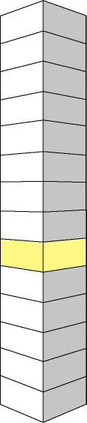
Dear Parent
Henry is now reading at Level 6.
He has made excellent progress over
the past six months. There have been
improvements in the fluency of his
reading and in his ability to scan text
and recognise words. He can read
and understand short stories with
simple sentences and familiar words.
Henry enjoys reading story books
and should be encouraged to read
at home, although he may need help
with more difficult words such as
‘does’, ‘laugh’, ‘again’, ‘because’
and ‘should’.
Notes:
If a child was at Level 6, his report might read something like this…

Slide 21
minimum

Slide 22
minimum

Slide 23
minimum

Slide 24
minimum

Slide 25
minimum

Slide 26
minimum

Slide 27
minimum

