Slide 1
School Leadership Institute update
Joanne jarvis, A/director, nsw school leadership institute
Primary Principals Association - 6 September 2018

Slide 2
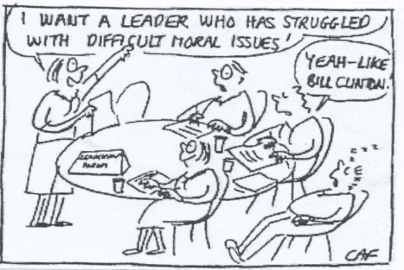
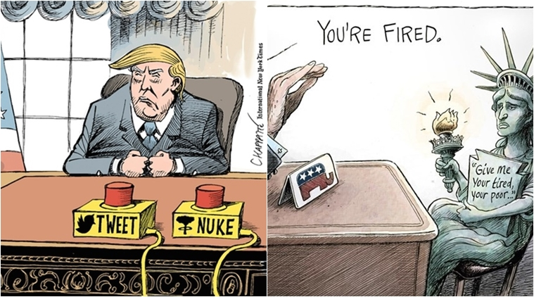
In this session, we will…
Share lessons from the selection process for the ‘Aspiring Principals Leadership Program’
Share information about Principal Facilitator role
Next steps

Slide 3
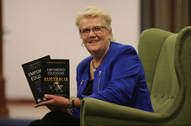
The leadership and teaching quality imperative
  Excellence in teaching is the single most powerful in-school influence on student achievement.
  The second most powerful in-school influence on student achievement is school leadership.

Slide 4
What do effective leaders do?
  The most successful school leaders:
  set directions and feedback mechanisms
  align school systems to achieve directions
  actively focus on the learning of teachers as well as students.
They are evidence informed, collaborative learners and great teachers, who influence others with integrity, self awareness and a strong moral purpose.

Slide 5

Why the digital story?
Create a digital story no longer than 2 minutes in duration answering:
  What core beliefs motivate you to want to be a leader of a NSW public school?
  How are these beliefs evidenced in what you do?

Slide 6
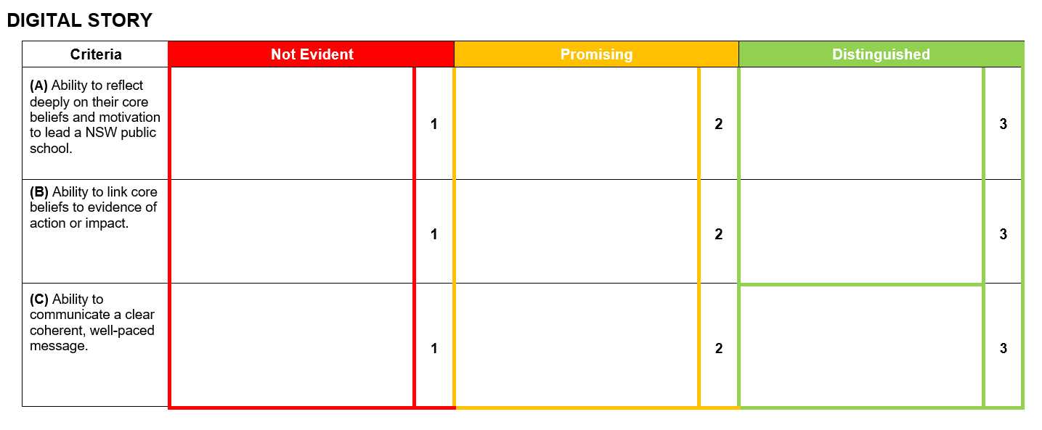

Slide 7
Application criteria
1.Leadership Impact
Outline an evidence-informed process where you have collaboratively led improvement, innovation and change in your educational setting to improve teaching and learning. Include details about:
  a. the issue you were seeking to address for your context and why;
  b. the evidence you used to inform your process;
  c. your experience in leading colleagues to plan, implement and review the effectiveness of their practice;
  d. the impact on both student and teacher learning and how this was assessed;
  e. what you learned about your leadership; how you influenced the practice of your colleagues and the impact of this learning for your future development.

Slide 8
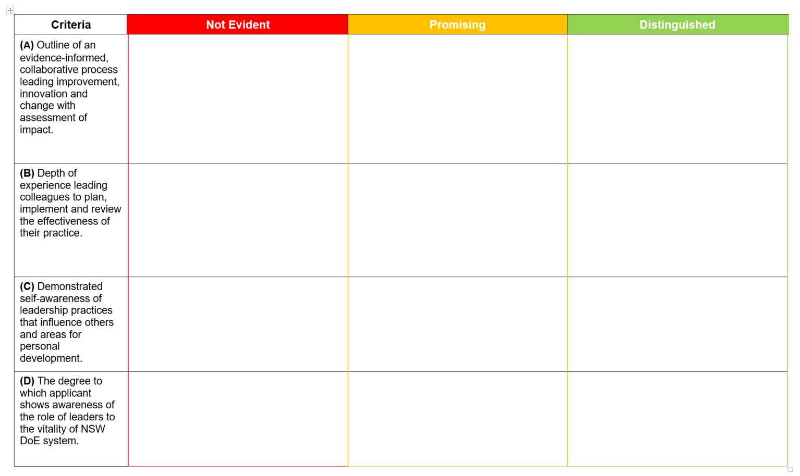

Slide 9
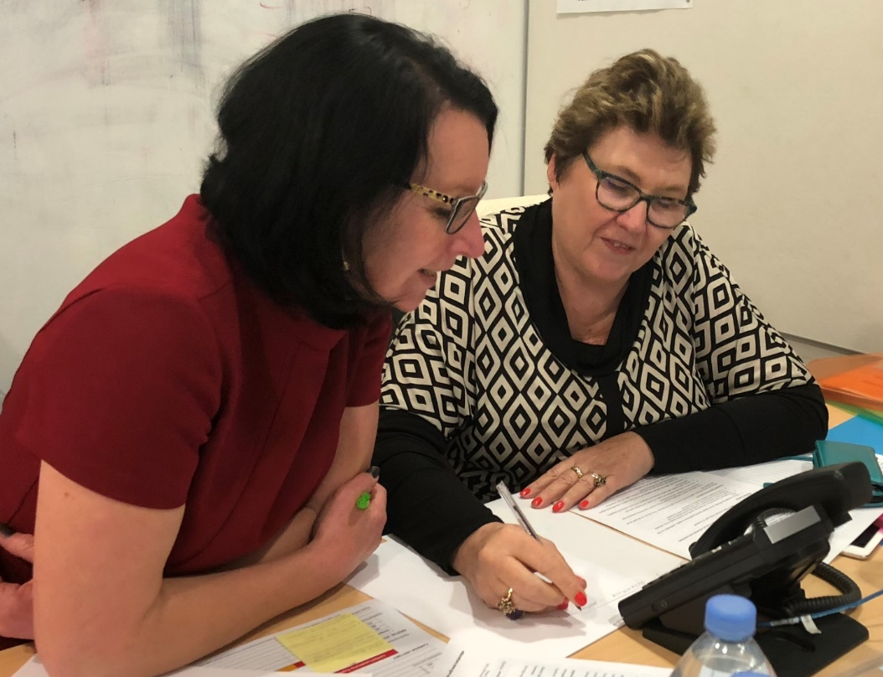
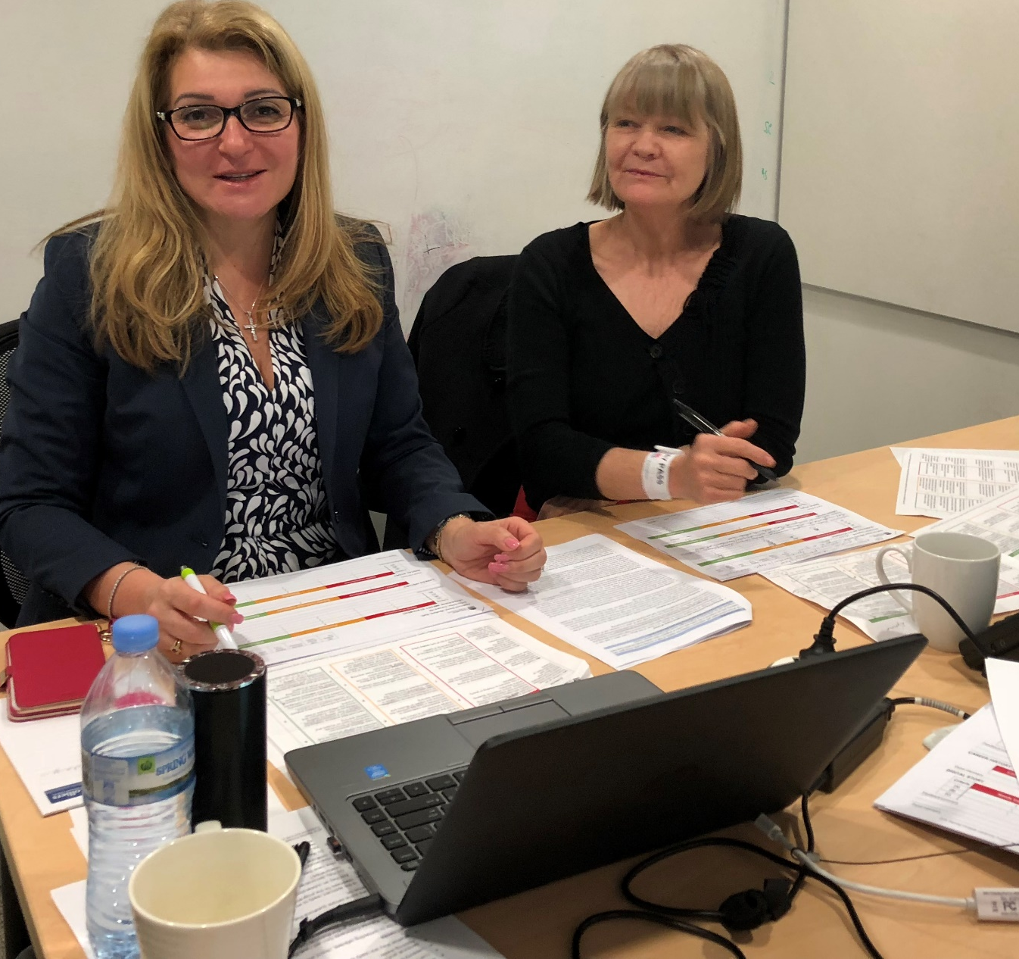
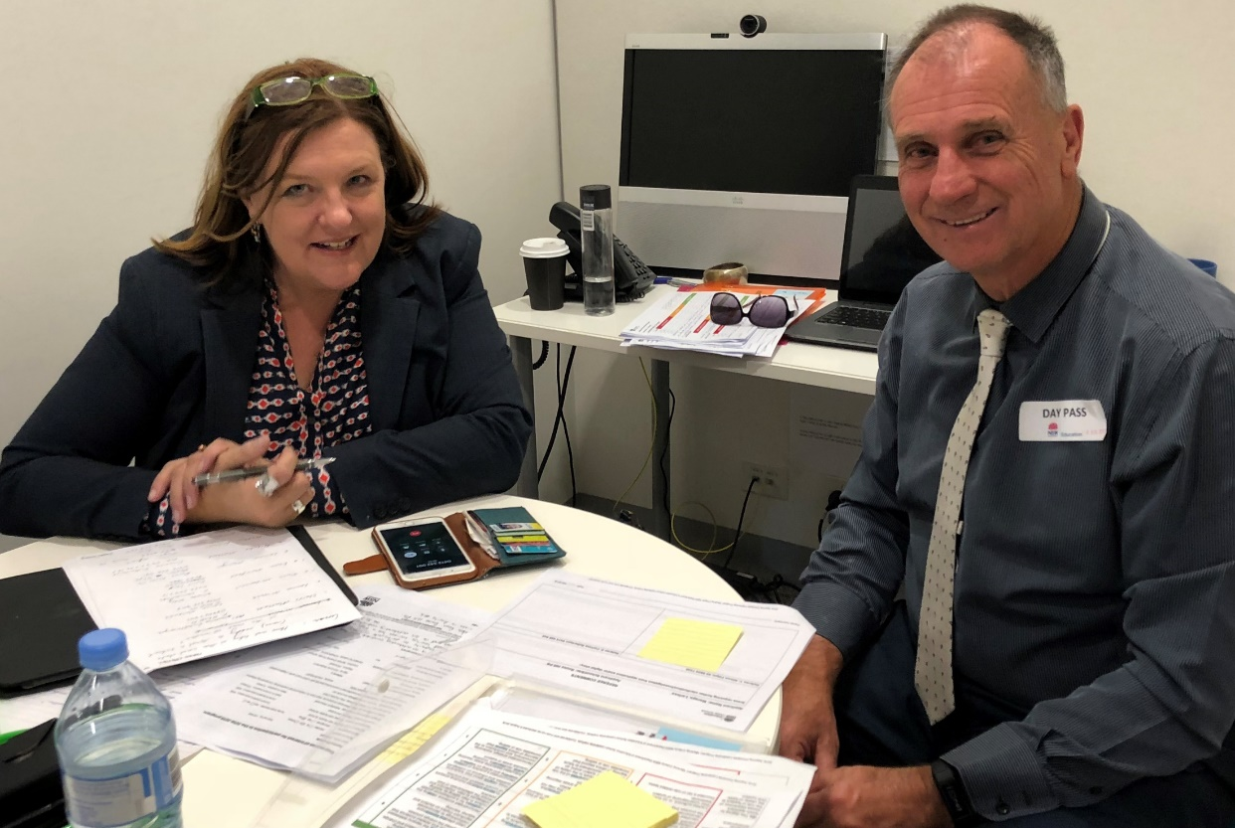

Slide 10
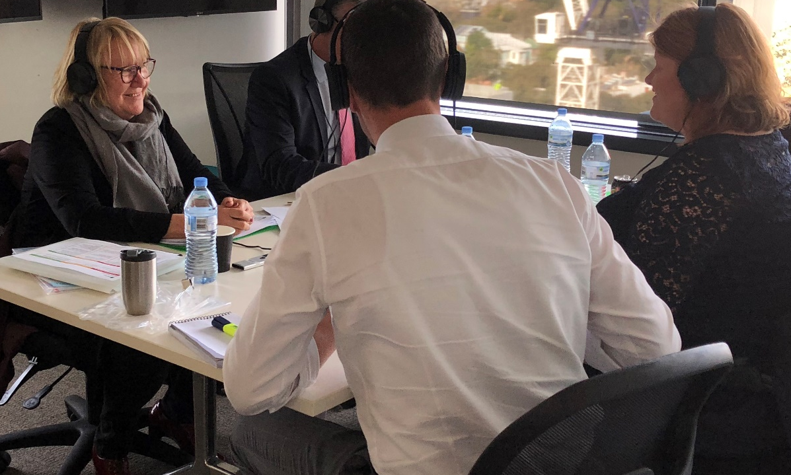
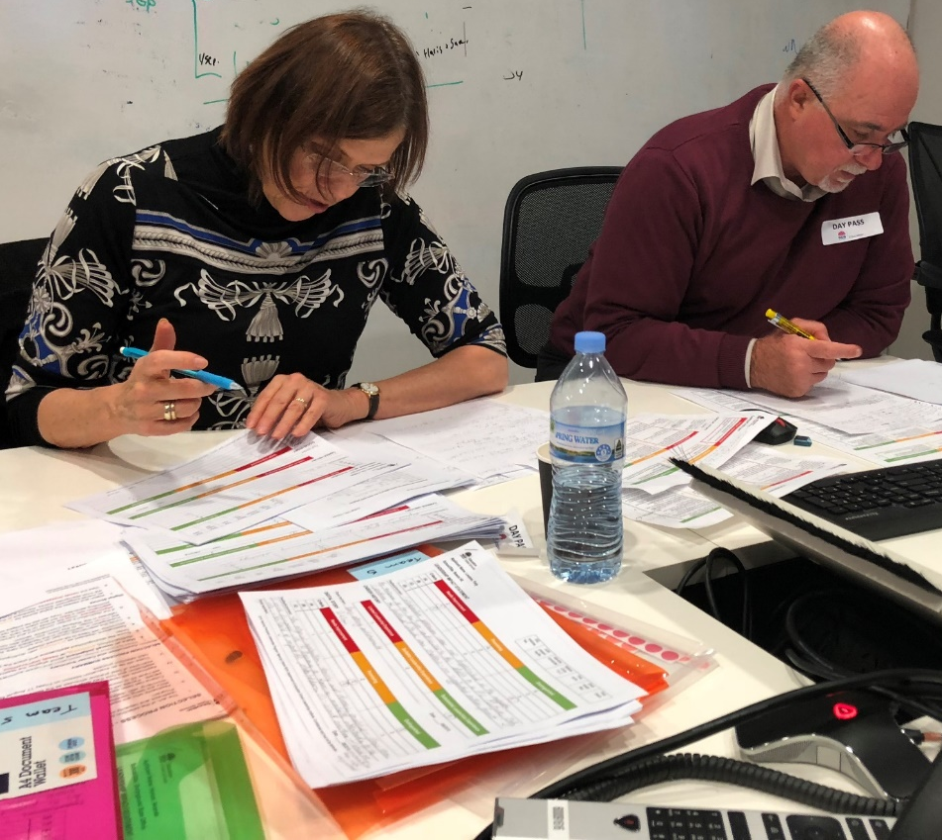
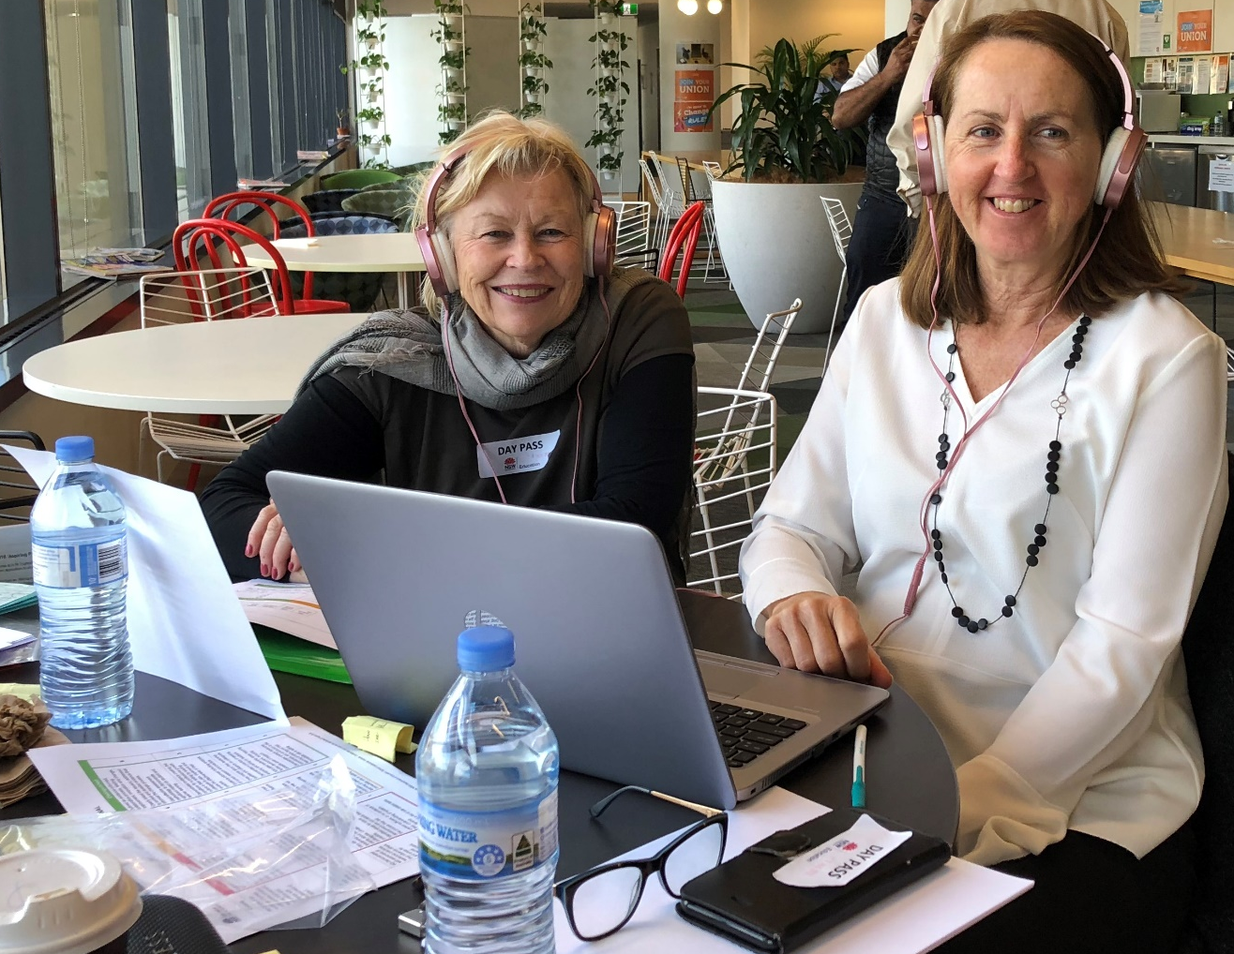

Slide 11
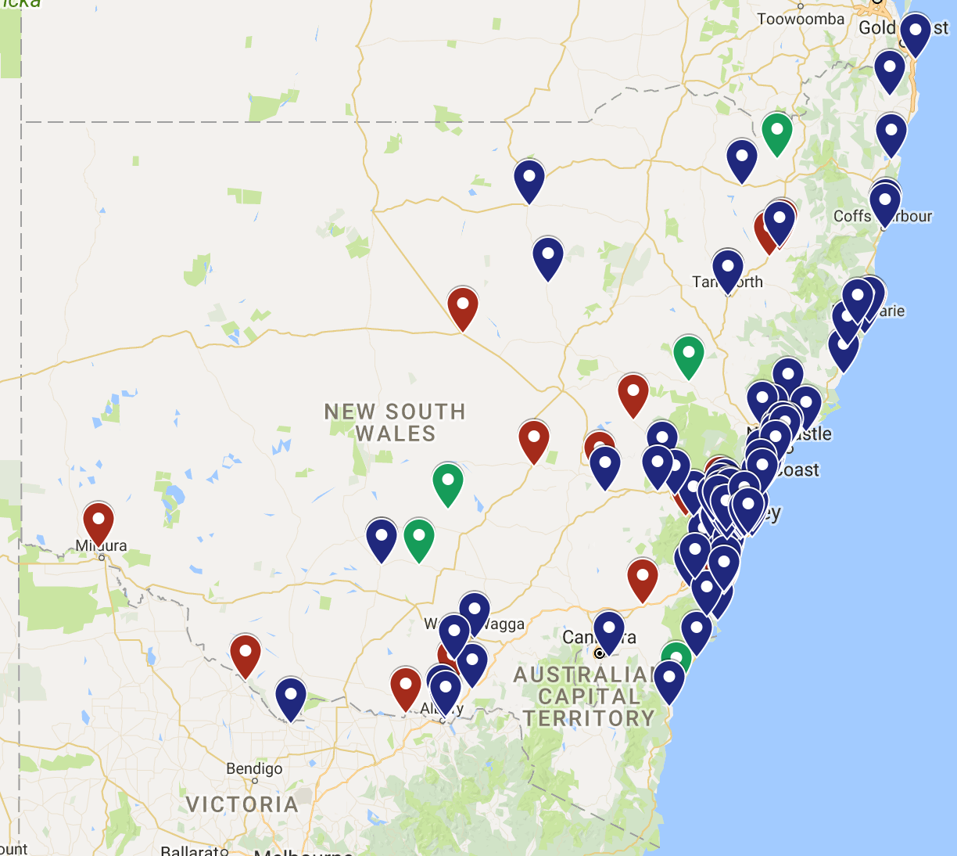
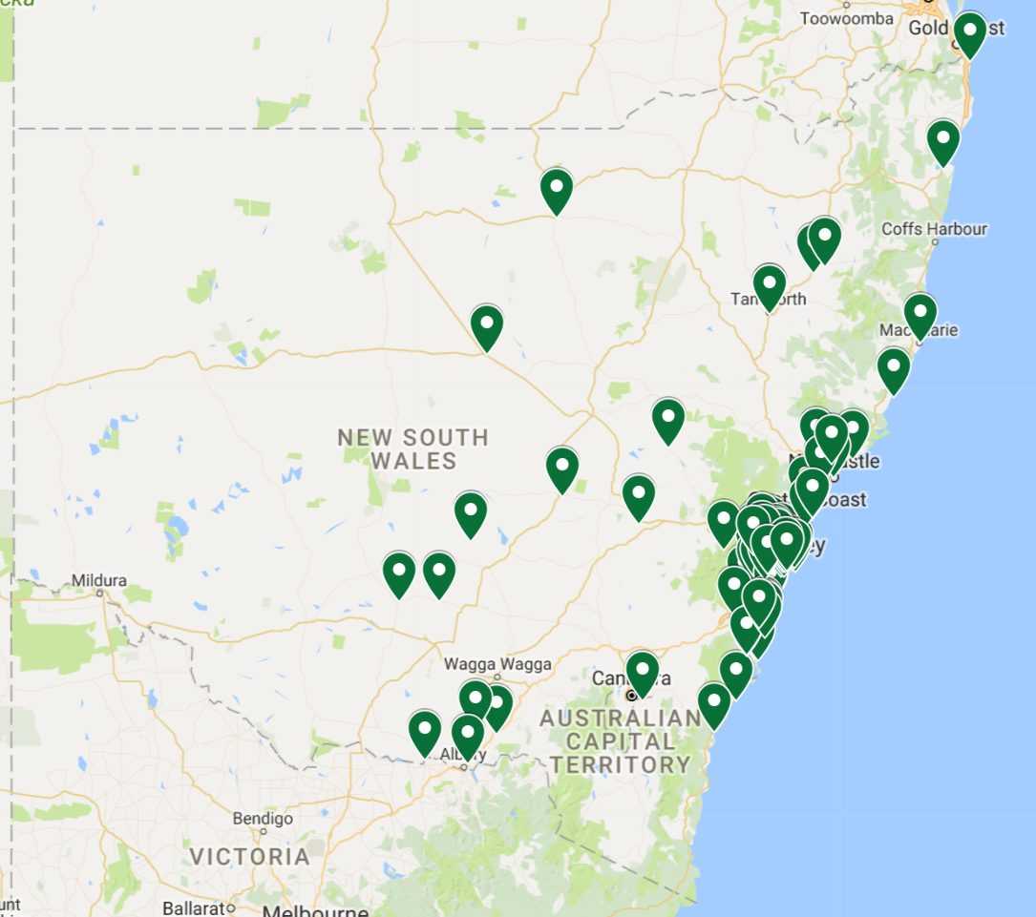
Over 200 applications across NSW
Successful applicants

Slide 12
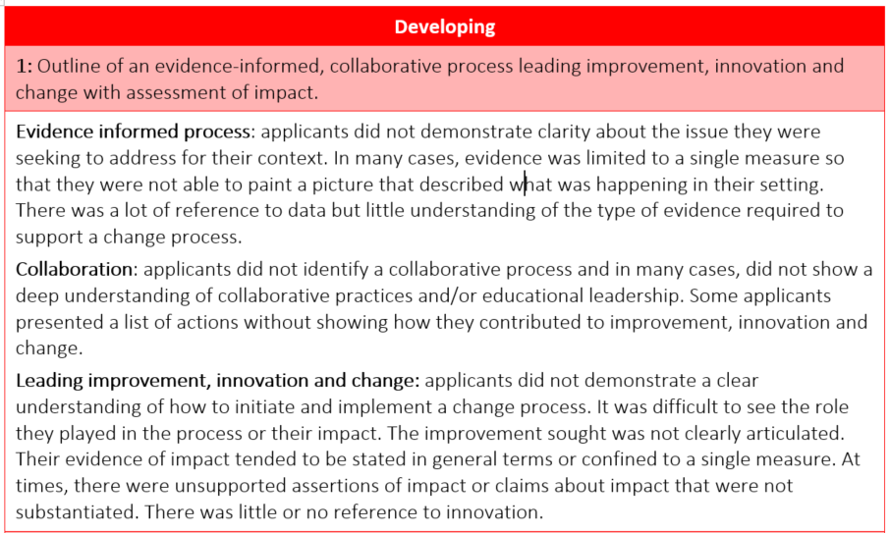
Confidential at this stage

Slide 13
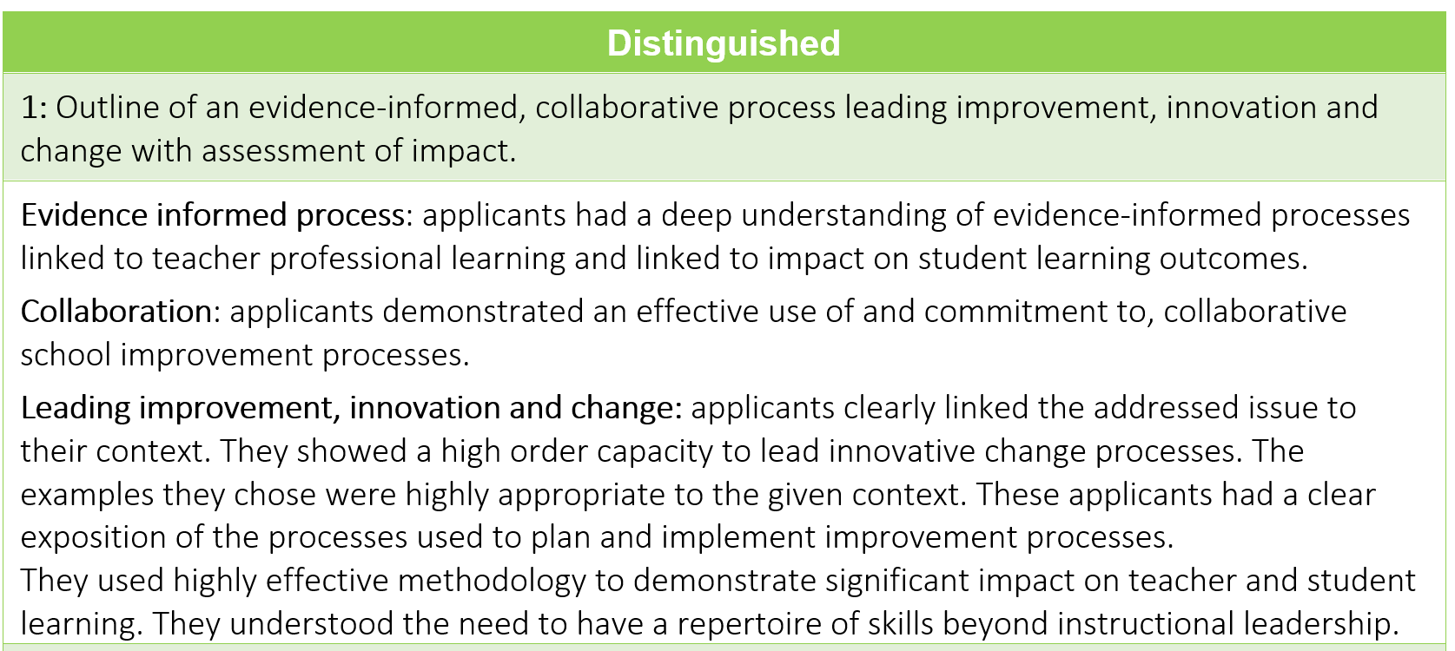
Confidential at this stage

Slide 14
Application evaluation
The combination of a written component, a digital story, referee checks and an on-line professional conversation worked very well.
The next application will include clarification about the digital story. We will also replace the term “interview” with “professional conversation”.
‘System leadership’ was misinterpreted by some. Change to “contribution to learning of others beyond your setting”.
Role of DELs and Principals to whole-heatedly discern an applicant’s impact, self-awareness and openness to learning is important.

Slide 15
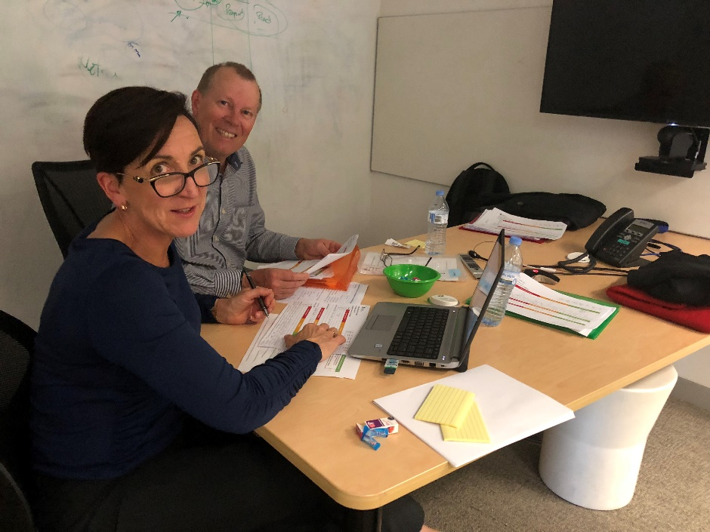
Professional Conversations
The purpose of the interview phase was to discern an applicant’s openness to learning from an analysis of their practice and their level of self-awareness.
Free-flowing conversations where panels could ask specific questions of both referees and applicants were regarded as highly effective.
Applicants were more willing to share their insights and what they hoped to learn from the program when the interview phase was conducted as a professional conversation.

Slide 16
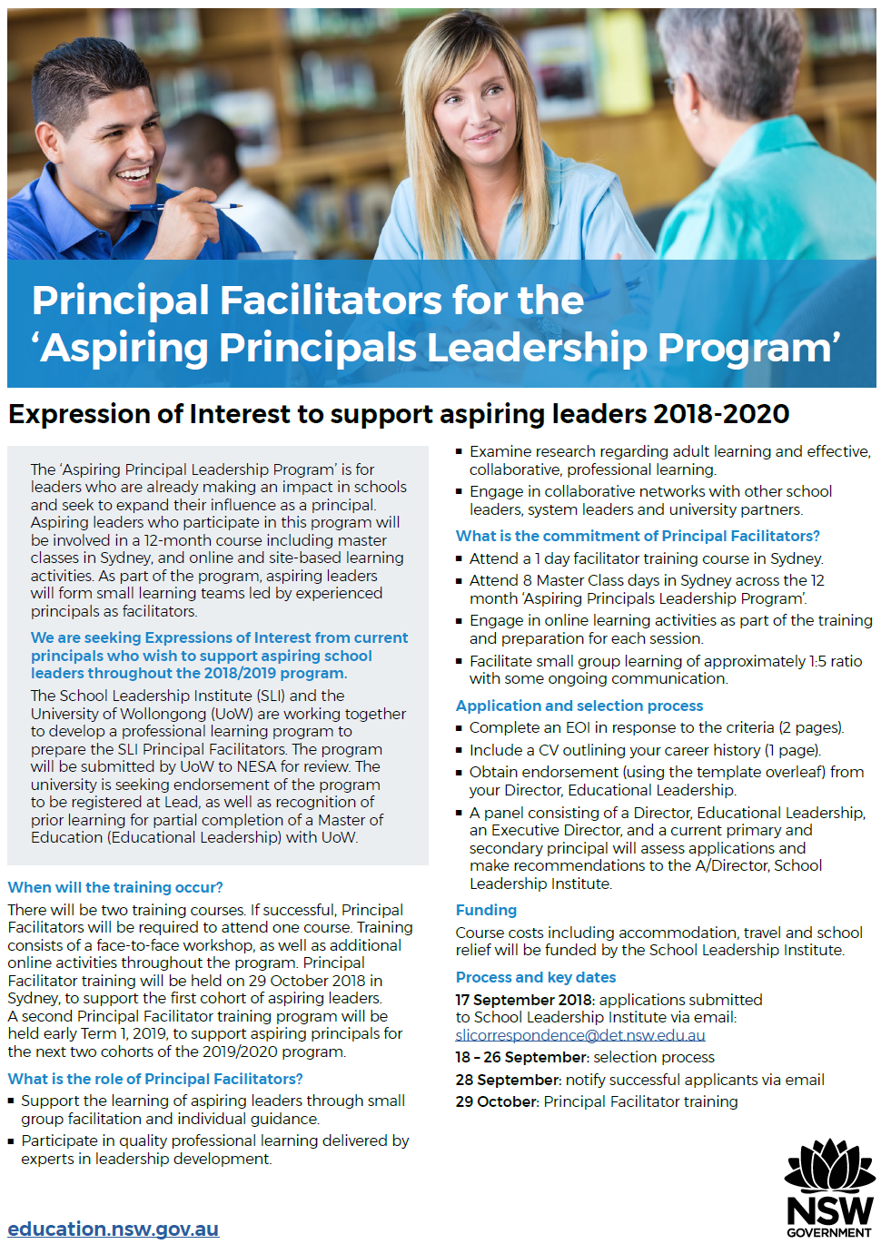
Principal Facilitators
We are seeking Expressions of Interest from current principals who wish to support aspiring school leaders throughout the 2018/2020 program.
An Expression of Interest for ‘Principal Facilitators’ was sent last week to Principals.
UoW has advised that hours will be accredited with NESA at Lead level. Seeking accreditation towards a partial Master (Ed Leadership)

Slide 17
Principal Facilitator Criteria
Demonstrated educational leadership with significant impact on student learning outcomes
Demonstrated understanding of how aspiring school leaders learn to lead with influence
Demonstrated self-awareness of leadership practices that have a positive impact on the learning of teacher leaders
Demonstrated commitment to the learning of others within the system.

Slide 18
Next steps and role of DELs
Determine Principal Facilitators (PFs)
Advise first 2 cohorts their start date (some will be in cohort 3)
Newsletter 2 will be in School Biz next week
Feedback delivered in the next two weeks.
Continue co-design of program, including program for PFs.
Identify final cohort - application process will begin Term 1, 2019
Program will start 12-13 November and then March/April; and June/July 2019.

