Slide 1
STRIVING FOR EXCELLENCE
PPA Executive meeting update
Educational Services Division
6 September 2018

Slide 2
JUST A REMINDER OF THE FULL twelve projects…
Quality teaching to improve every student
Curriculum support – Literacy and Numeracy
Early career teacher journeys
Tailored support to improve every school
Strategic planning process and tailored support to schools
Prioritising teaching time
Policy review
Leading the improvement journey
Curriculum support – New syllabus implementation
Quality professional learning
Service Navigator
Consistent wellbeing
Workforce strategy
Communication and engagement
Support packages
Streamline customer service

Slide 3
CURRICULUM SUPPORT: NEW SYLLABUS TIMELINE
Science and Technology K-6
2018: Continue teaching current syllabus, familiarisation and planning for new syllabus
2019: Implementation of new syllabus in all stages
Languages
Implementation of new syllabuses in K-6 if implementing a languages program.
PDHPE K-10 (K-6)
2018: Continue teaching the current syllabus, familiarisation and planning for new K-10 syllabus
2019: Continue teaching the current syllabus, optional implementation of new K-10 syllabus in K-6
2020: Implementation of new K-10 syllabus in all stages

Slide 4
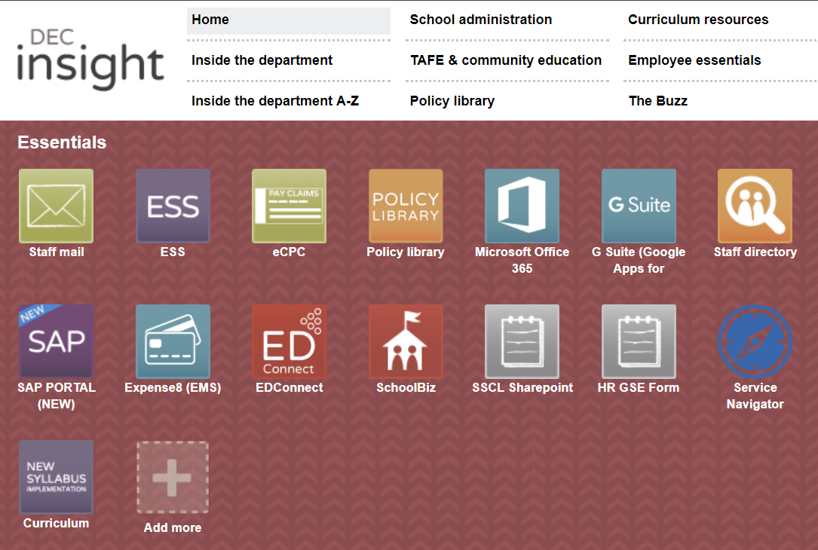
Curriculum Support: implementation tile

Slide 5
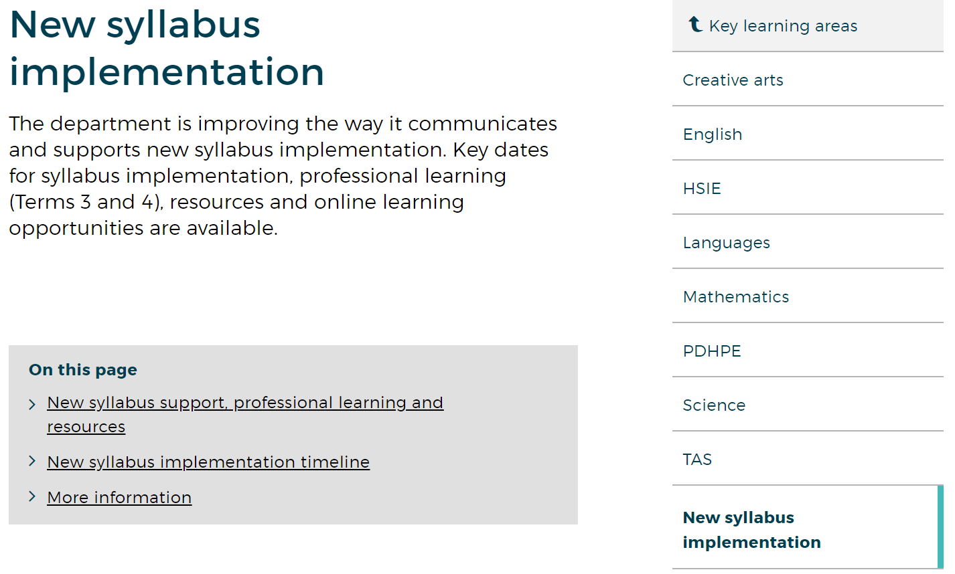
https://education.nsw.gov.au/teaching-and-learning/curriculum/key-learning-areas/new-syllabus-implementation

Slide 6
Best Start kindergarten assessment
© NSW Department of Education | PPA Advice August 2018

Slide 7
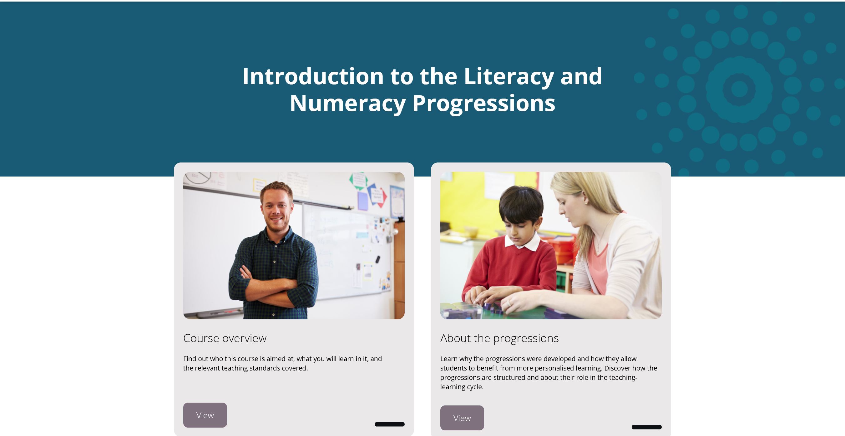
Professional learning
New eLearning released

Slide 8
USING THE PROGRESSIONS WITH PLAN2 (K-6)
The progressions can be used without PLAN2​.​
PLAN2 is a tool available to support schools in recording evidence of student literacy and numeracy progress identified in using the progressions​.​
PLAN2 can be used to monitor learning and growth.​​
Information in PLAN2 is most useful when it informs planning for teaching and learning across the curriculum.

Slide 9
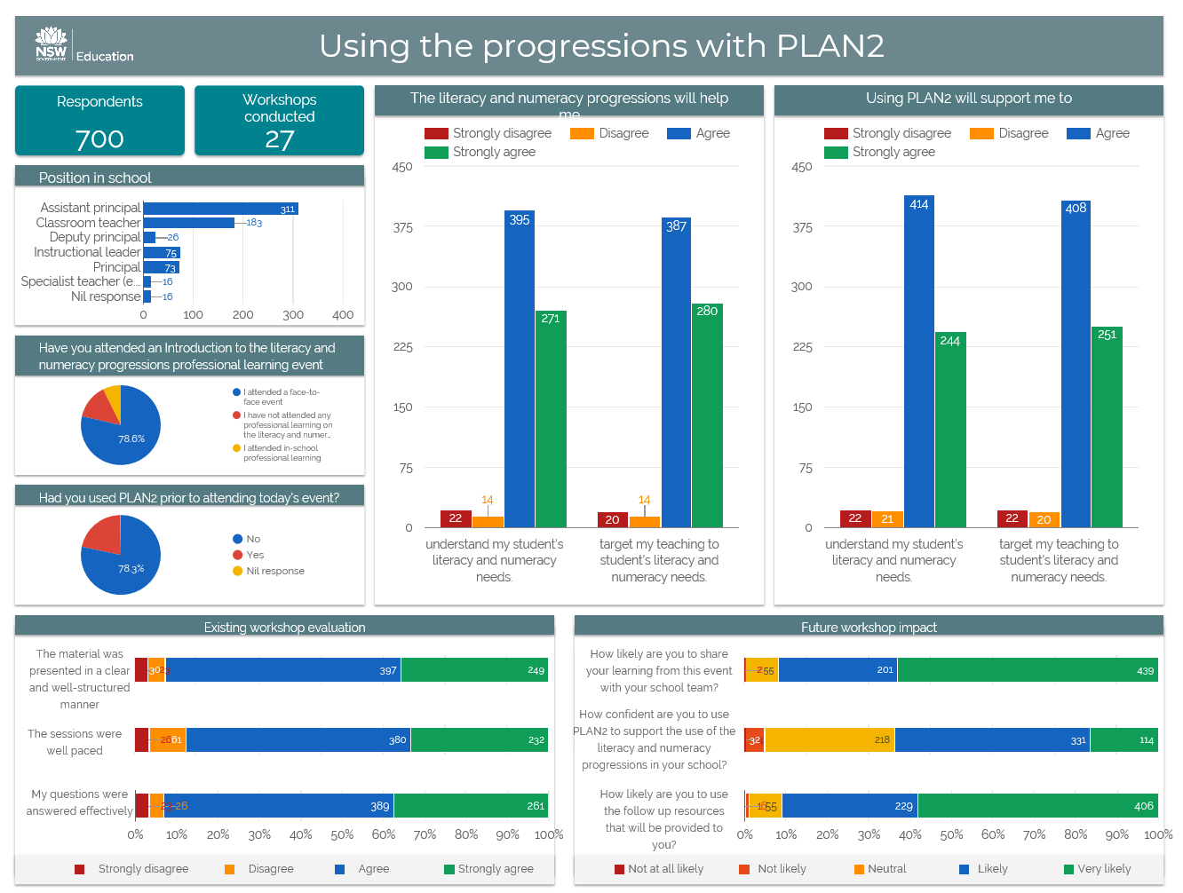

Slide 10

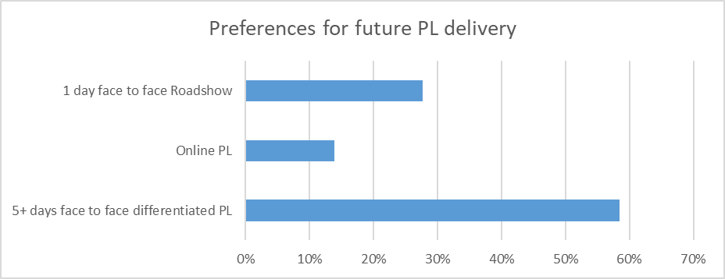
EARLY ACTION FOR SUCCESS
APs and DPs
Instructional Leaders
40% response rate
Principals
387 responses
The design of the Term 3 professional learning reflects feedback:
Three day intensive professional learning days for the 530 instructional leaders.
Provision of 16 workshops for differentiated learning on leadership, utilising the learning progressions for planning, teaching and assessing for K-2 student progress and achievement in literacy and numeracy.

Slide 11
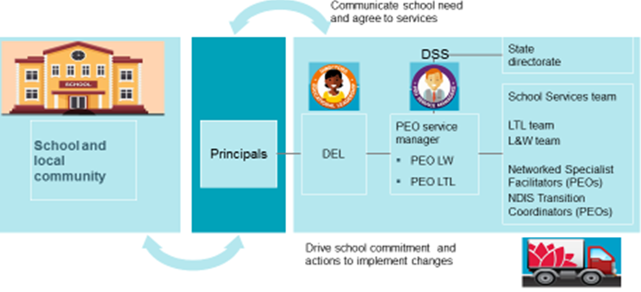
School Services Strategic Planning Process
A repository for resources has been established for each of the 22 strategic initiatives across the pilot schools.
Commenced work on evaluating the model and planning for expansion of the model across the remainder of schools.
Recruitment of 64 additional positions.

Slide 12

Support Resources
Co-designed and developed in partnership with experts from across the department.
Support the strategic planning process.
Informed by the priorities from the agreements of service.
Formative Assessment has been finalised and is being used.
Classroom Management and Differentiation package are under development.

Slide 13

Customer relationship manager
A customer relations management system (CRM) is being designed to assist with communication, engagement and data collection with school communities.
The CRM will assist to provide evidence to measure impacts on outcomes and assist to inform future resourcing and priority areas for planning.
The full role out of the Strategic Model of School Services has some dependencies on the delivery of the CRM.

Slide 14

Aboriginal education and communities
STEM camps are a big hit with schools. Negotiations with the NSW AECG and ATSIMA regards the 2019 roll out.
In partnership with the NSW AECG, offering schools the opportunity to engage in Language and Culture camps.
H4 Consultancy has been engaged to develop a data base to capture key information pertaining to the teaching and learning of Aboriginal languages within the Aboriginal Language and Culture Nests.

Slide 15
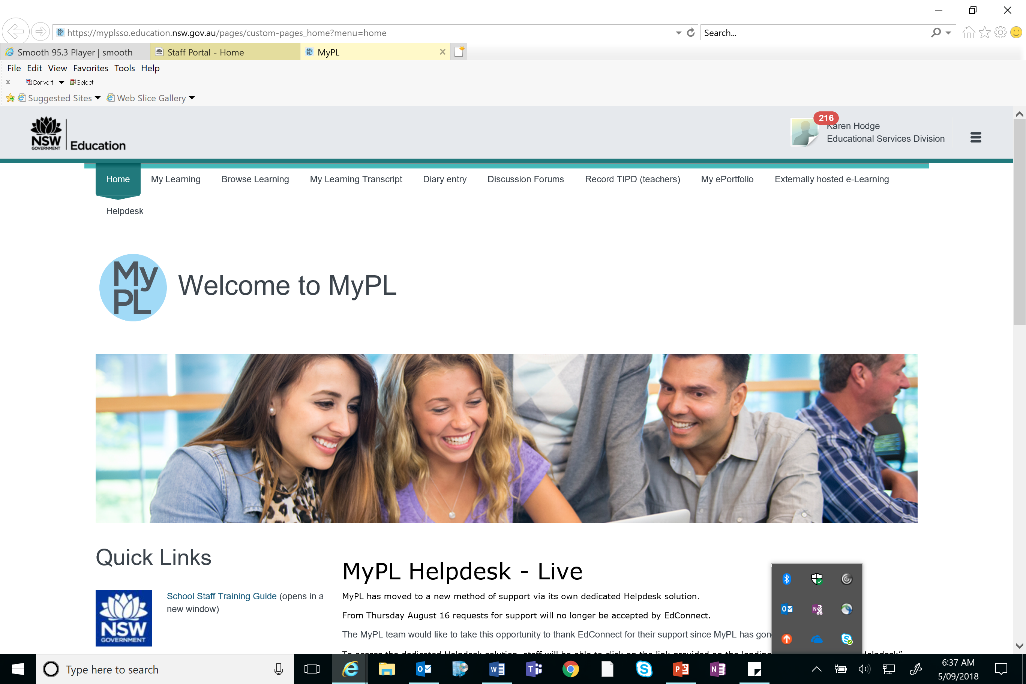
MyPL – THE IMPROVEMENT JOURNEY
more intuitive
easy to complete tasks for principals.
different “landing page” for different user types, which shows them information and activities they are likely to need to do. This approach was developed as a result of feedback from users and on the training recently conducted.
some volunteers needed to check the approach and later being involved in some more detailed testing of a prototype.

