Slide 1
PPA Scout Update
Business Intelligence for Education
Daniel French – School Engagement Lead
September 2018
education.nsw.gov.au/about-us/educational-data/scout
Notes:
Edit name and month on this slide before presentation.

Slide 2
In today’s presentation
NAPLAN Results
Scout Roadmap
Training for Executive and Teachers
New Reports
Notes:
Edit presentation outline as required – add, delete, rearrange

Slide 3
NAPLAN Results
Notes:
Section Title Page – About Scout: Business Intelligence for Education

Slide 4
2018 NAPLAN
Information session with Murat and Jenny
File from ACARA
User Acceptance Testing
For those who completed NAPLAN Online, approach and consider data carefully
Support with Scout and interpreting data
Video with Mark Scott and Murat Dizdar
Notes:
Overview of Scout tool and purpose

Slide 5
Scout Roadmap
Notes:
Section Title Page – About Scout: Business Intelligence for Education

Slide 6
2018 and Beyond
VALID 6
PLAN 2
Best Start Kindergarten
Prioritisation and Information Governance Group
Notes:
Overview of Scout tool and purpose

Slide 7
Scout Access and Training
Notes:
Section Title Page – About Scout: Business Intelligence for Education

Slide 8
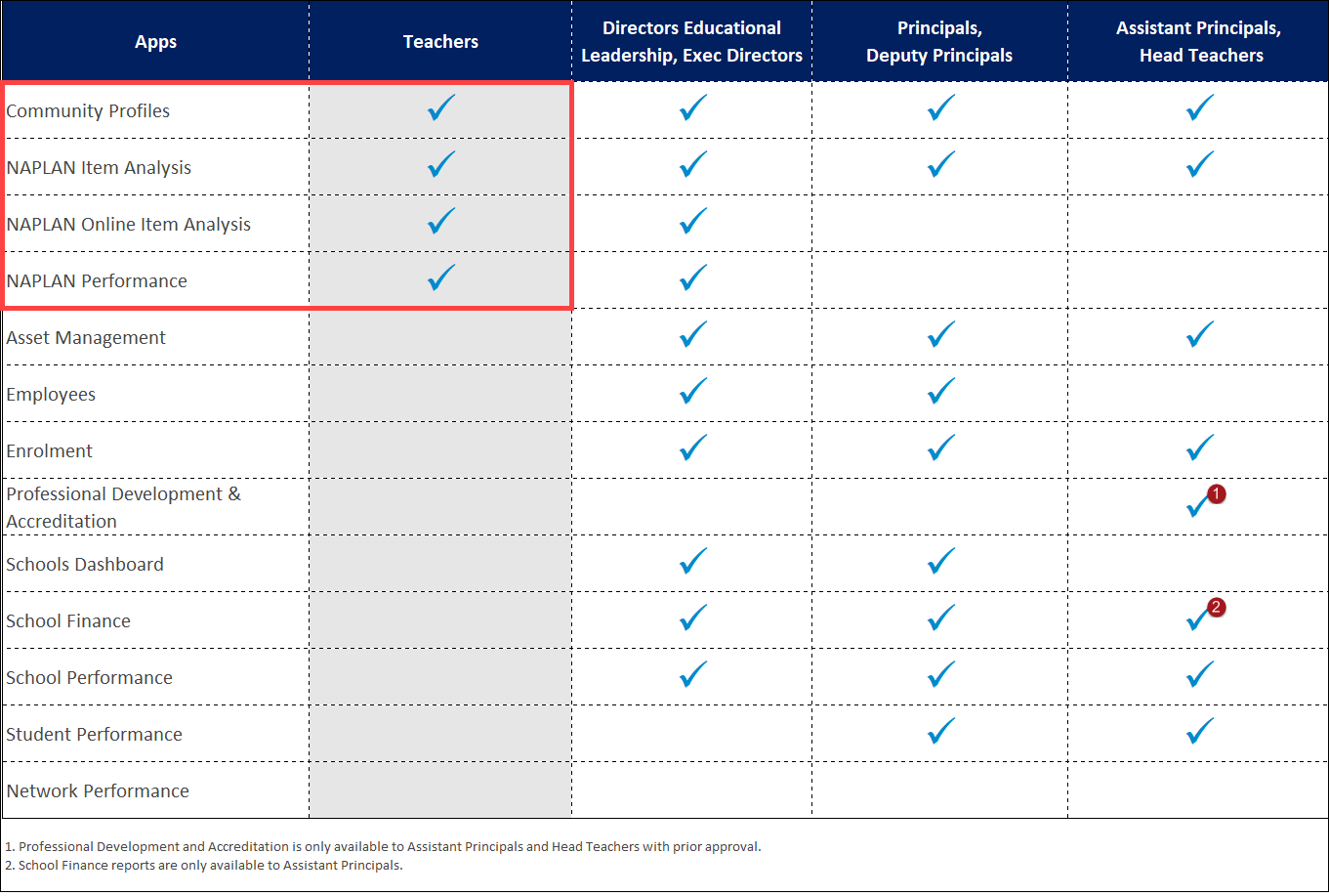
Report Access
Notes:
APs & HTs may get access to Professional Development and Accreditation reports. Upon approval of the Access Approval form which is to be submitted by their Principal.

Slide 9
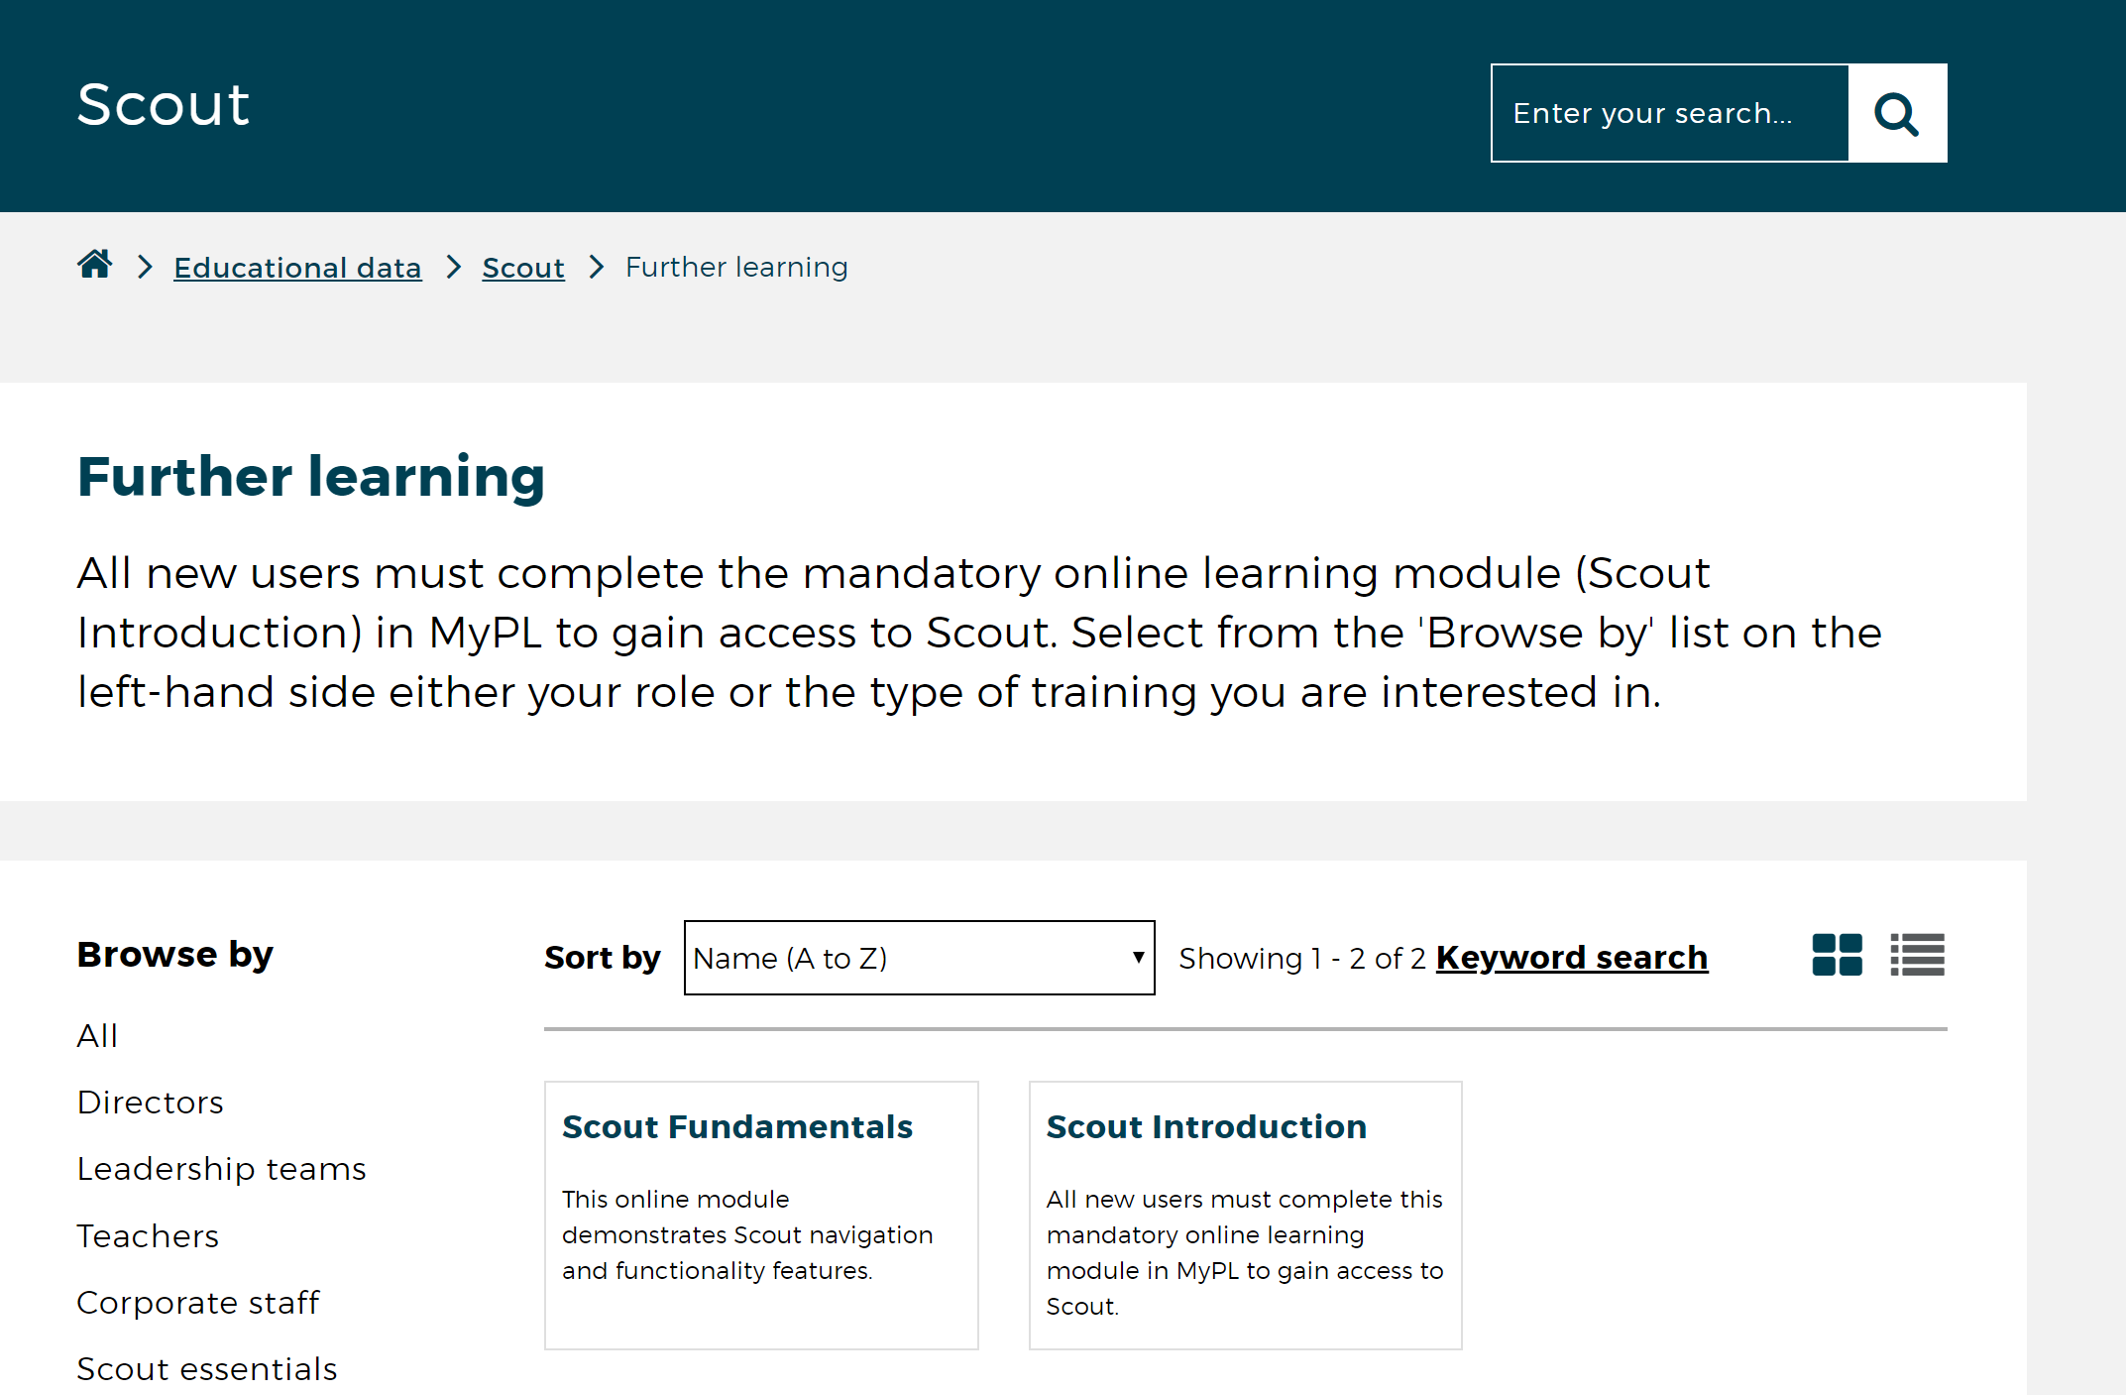
Mandatory Online Training for Access
Notes:
Scout website:
About section holds approval form…

Slide 10
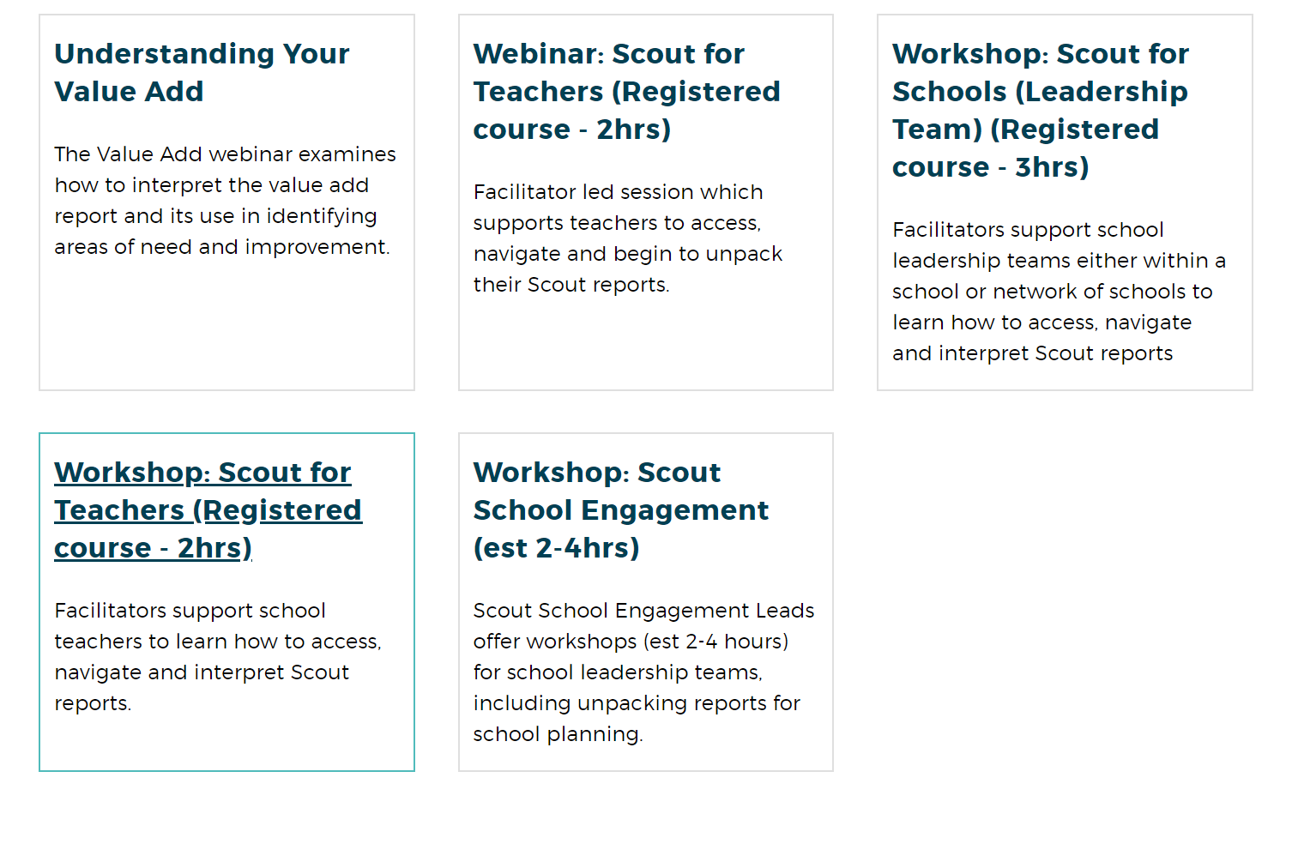
Optional Workshops
Notes:
Scout website:
About section holds approval form…

Slide 11
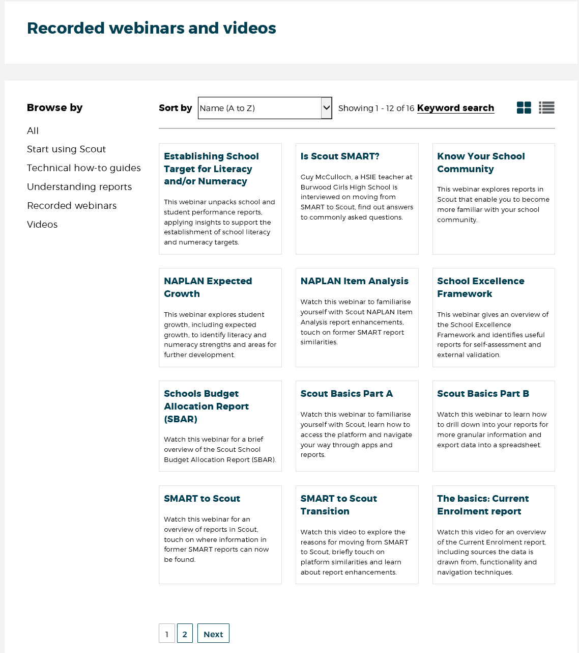
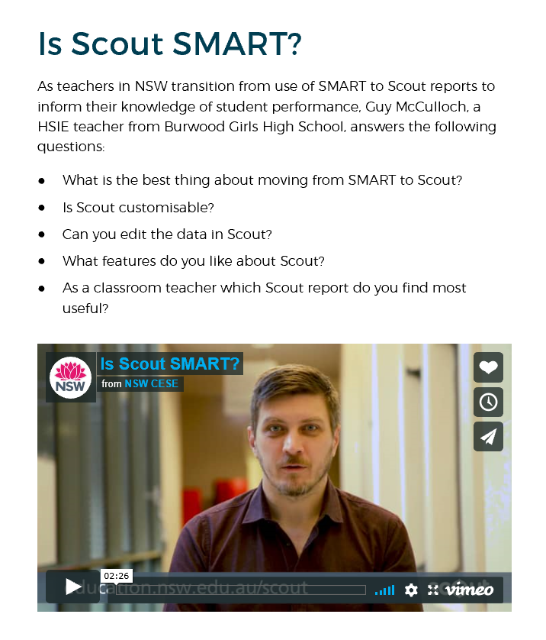
Scout website – Recorded webinars and videos
Notes:
Scout website:
About section holds approval form…

Slide 12
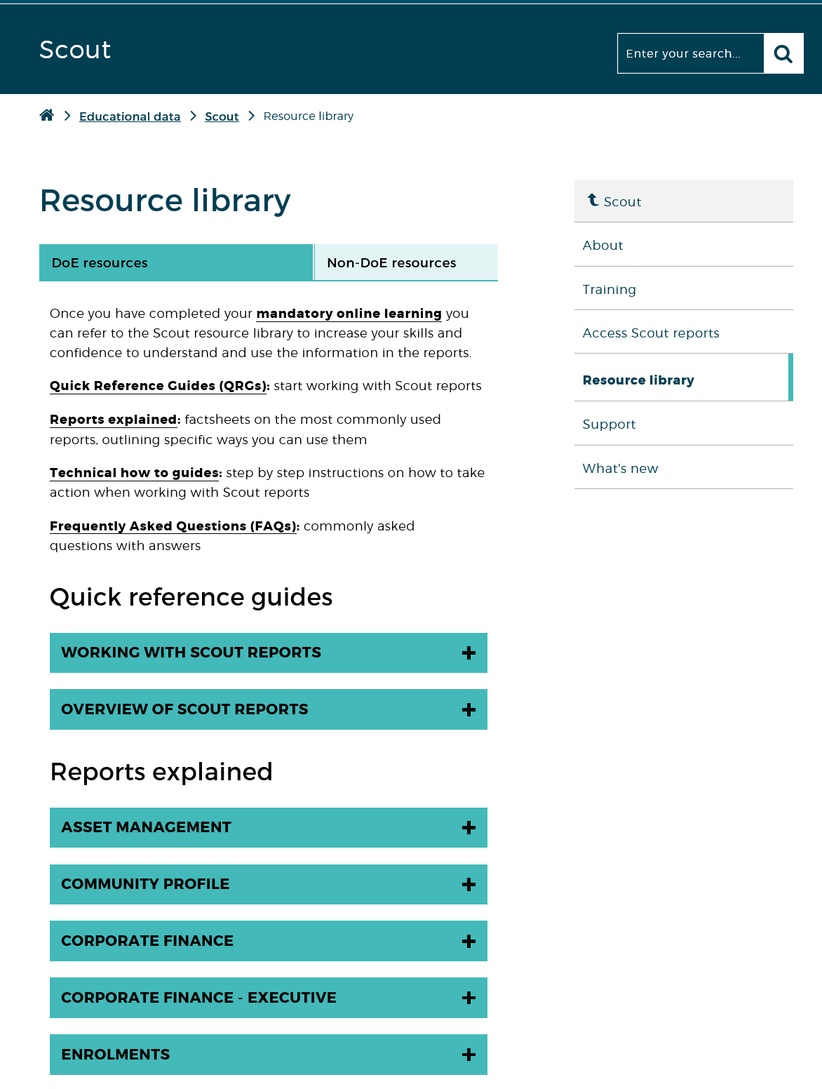
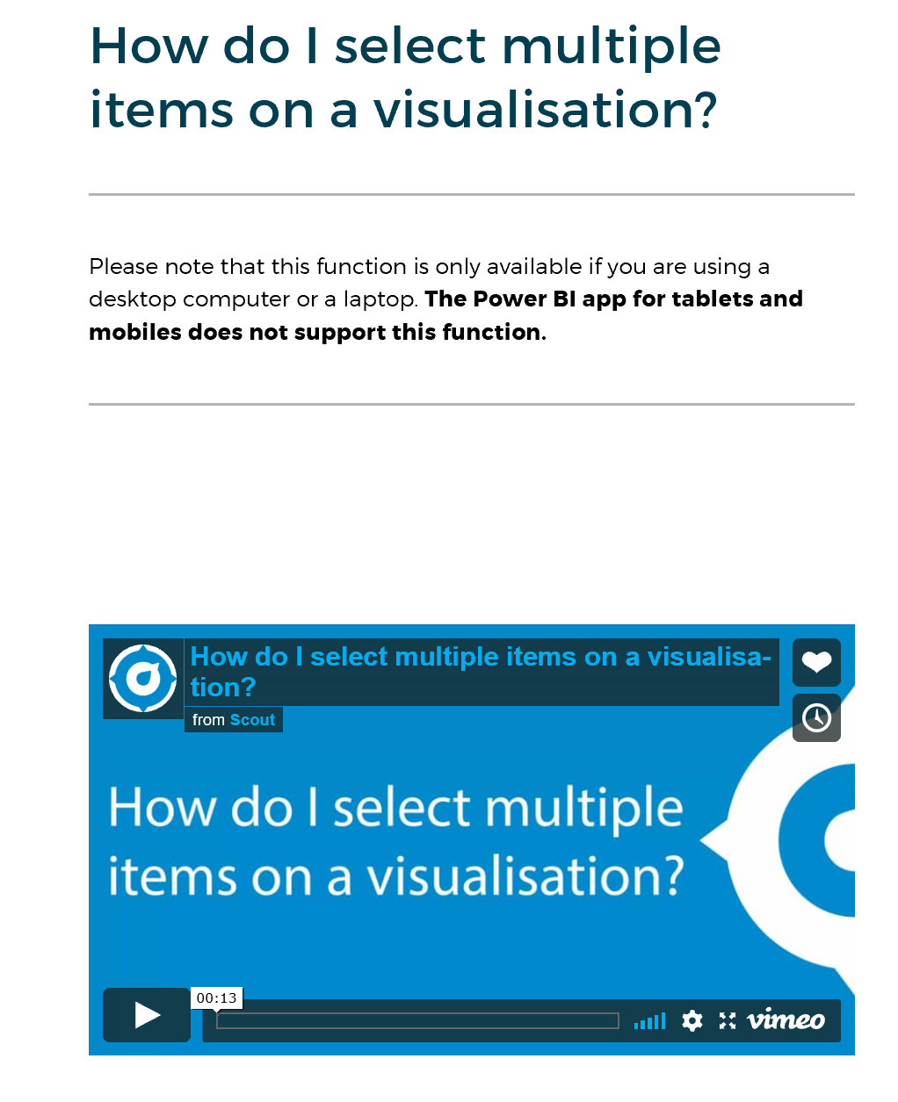
Scout website - Resources
Notes:
Scout website:
About section holds approval form…

Slide 13
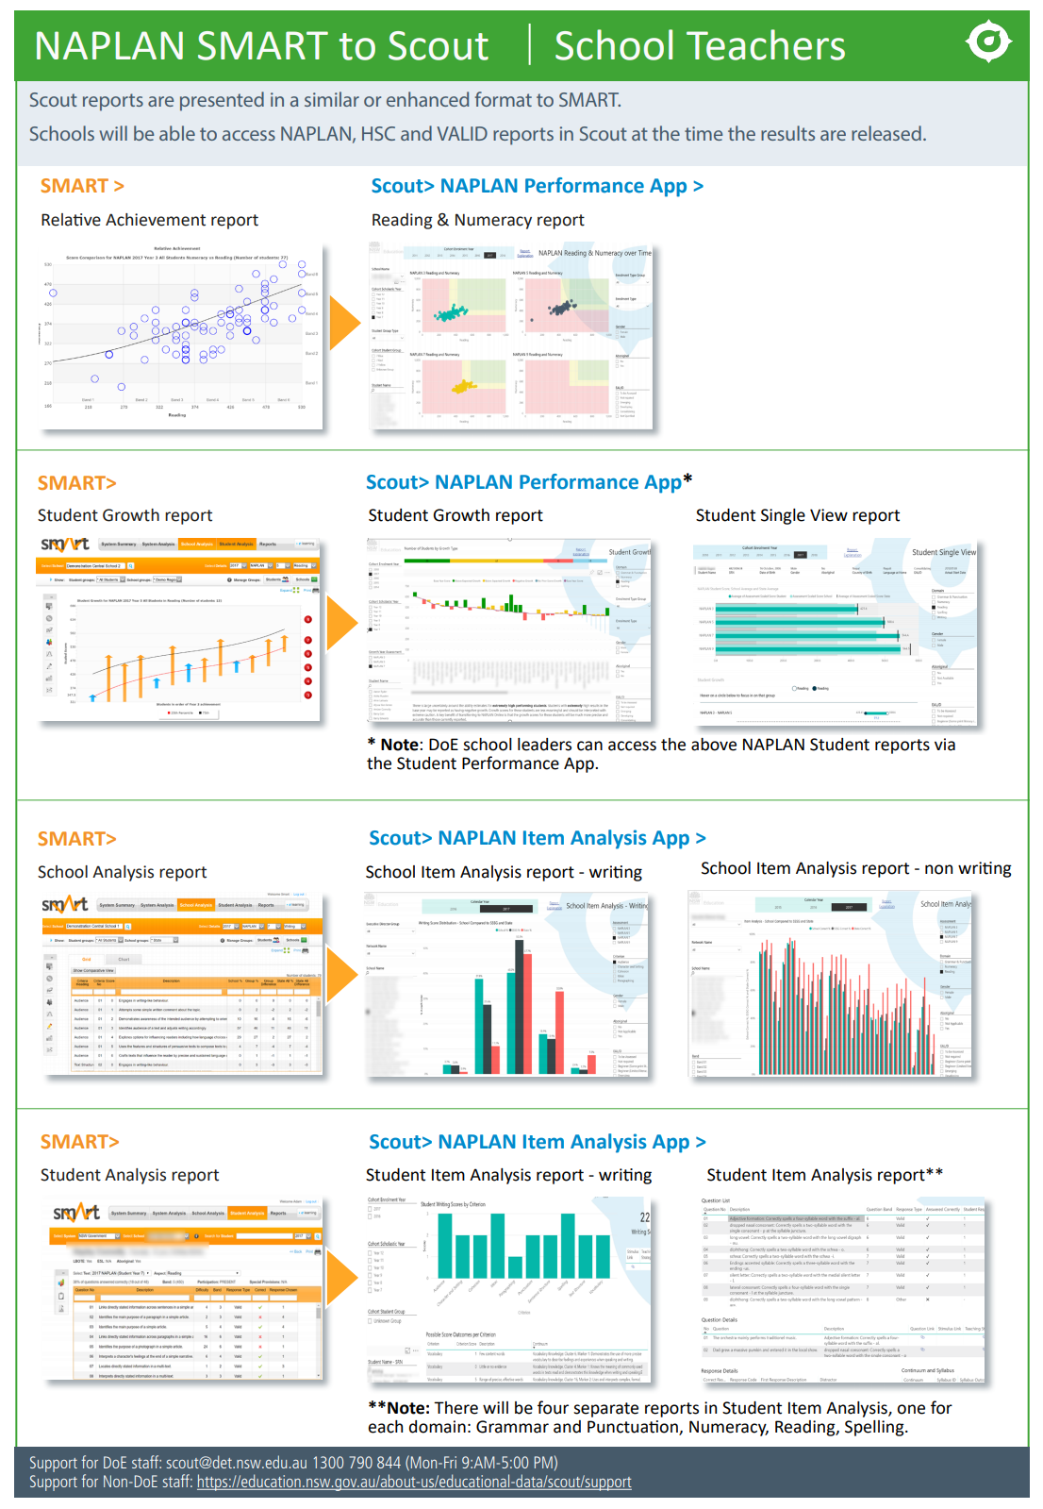
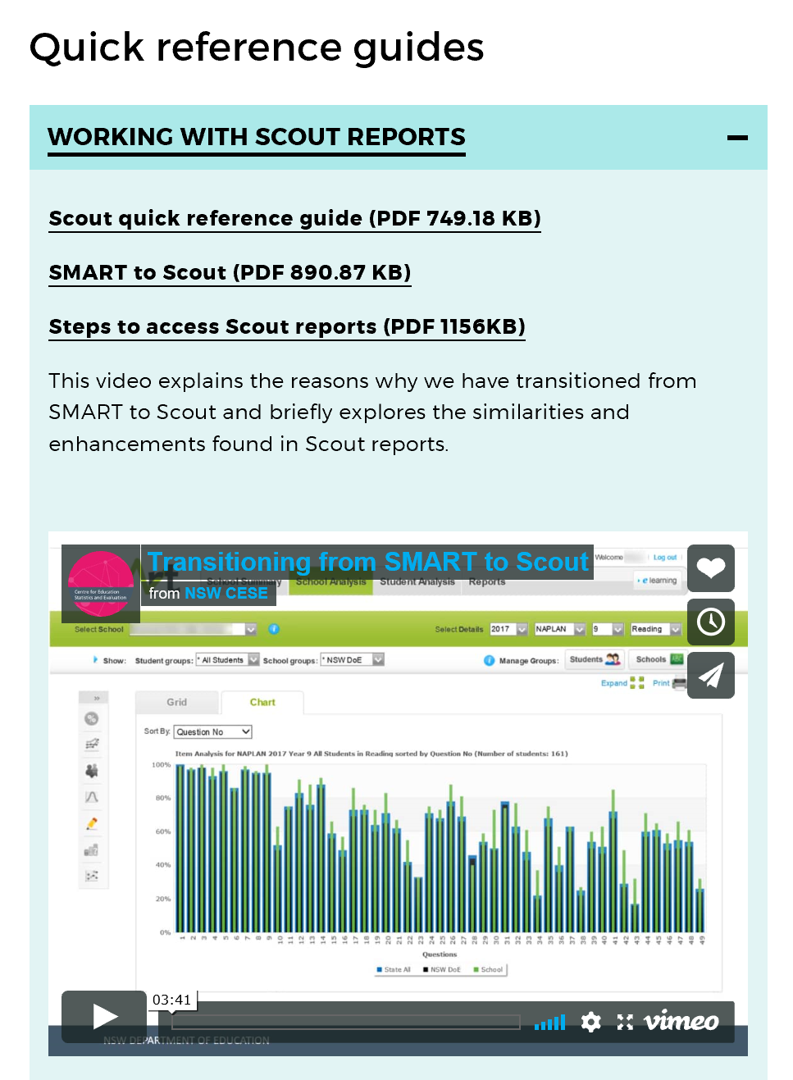
Notes:
On the Scout website there are lots of resources to help you access your reports and navigate the Scout tool.
This is the quick reference guide showing the comparison between the reports you used in SMART, and will now find in Scout.

Slide 14
New Reports
Notes:
Section Title Page – Scout Reports for Senior School Executive (Principals & Deputy Principals)

Slide 15
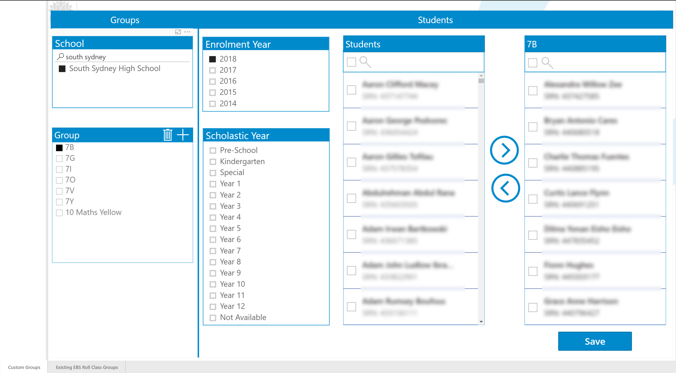
Groups App is coming soon

Slide 16
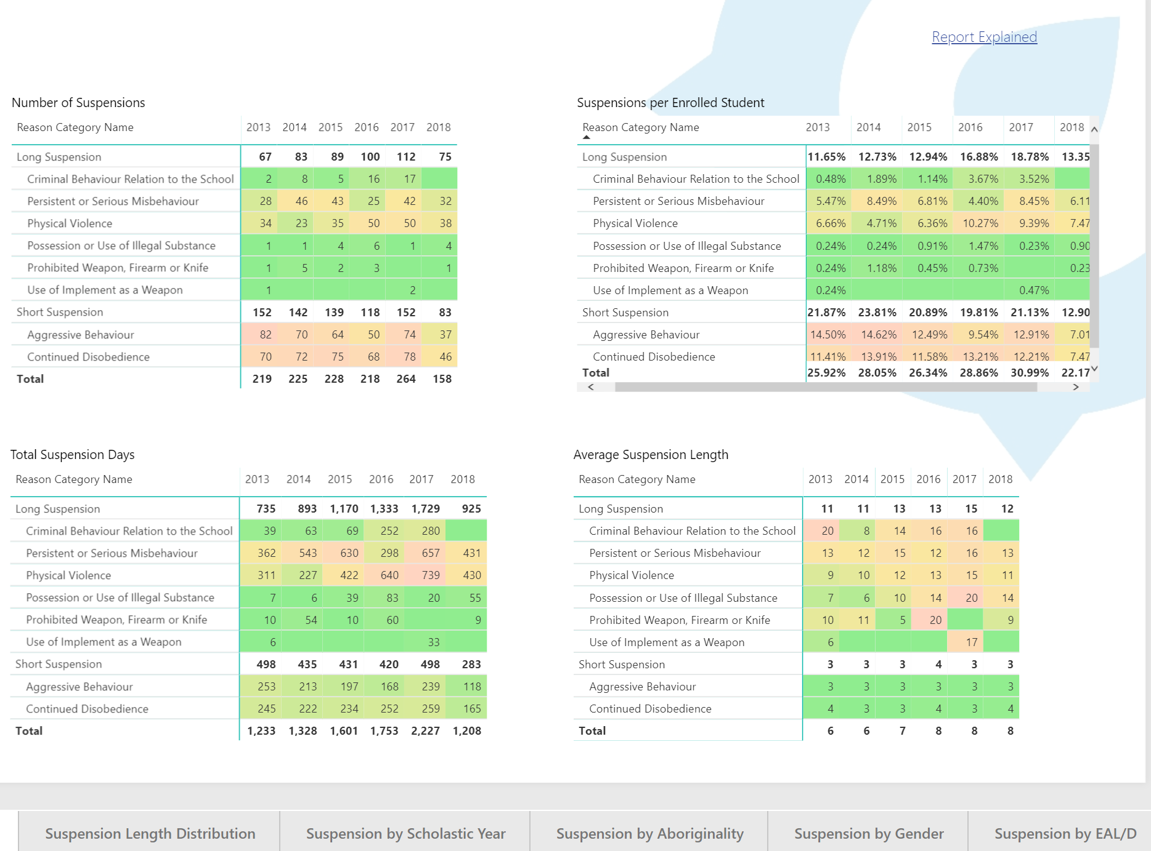
Suspension App
Suspension Report Tabs:
Suspension Overview
Suspension Length Distribution
Suspension by Scholastic Year
Suspension by Aboriginality
Suspension by Gender
Suspension by EAL/D
Suspensions by Length
Notes:
An aggregate view of your data for each type of short and long suspensions, with data on length of suspension and scholastic years.
Can also drill down into gender, Aboriginality and EAL/D level to get a clearer picture of students with specific needs in your school.
DELs can see data for their whole network.

Slide 17
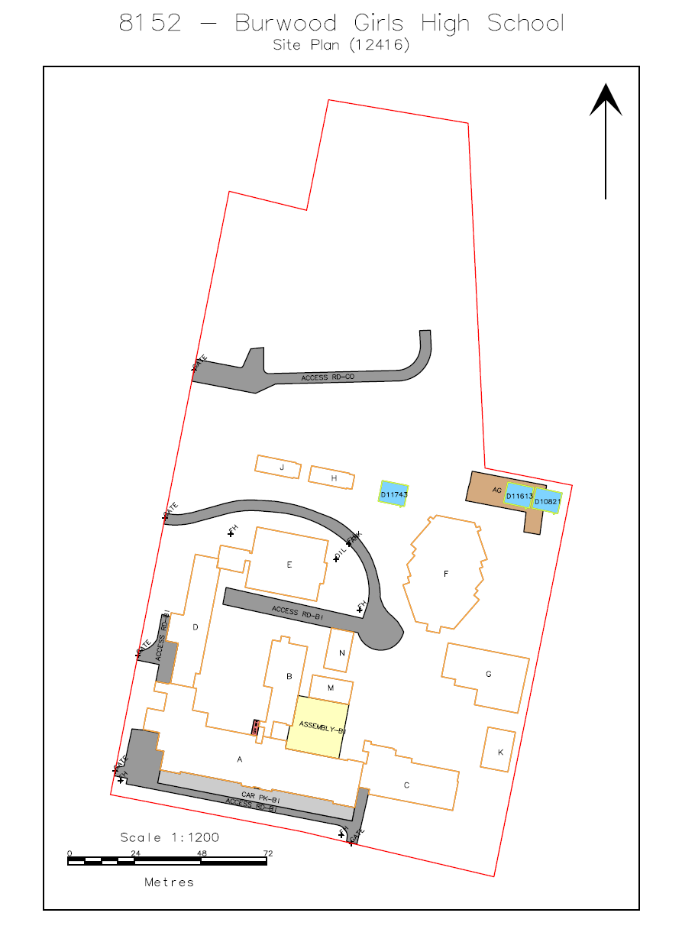
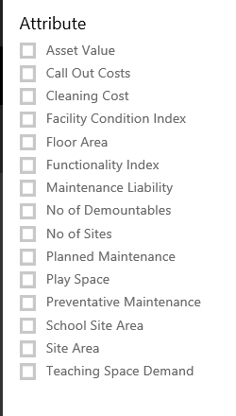
Site Maps

Slide 18
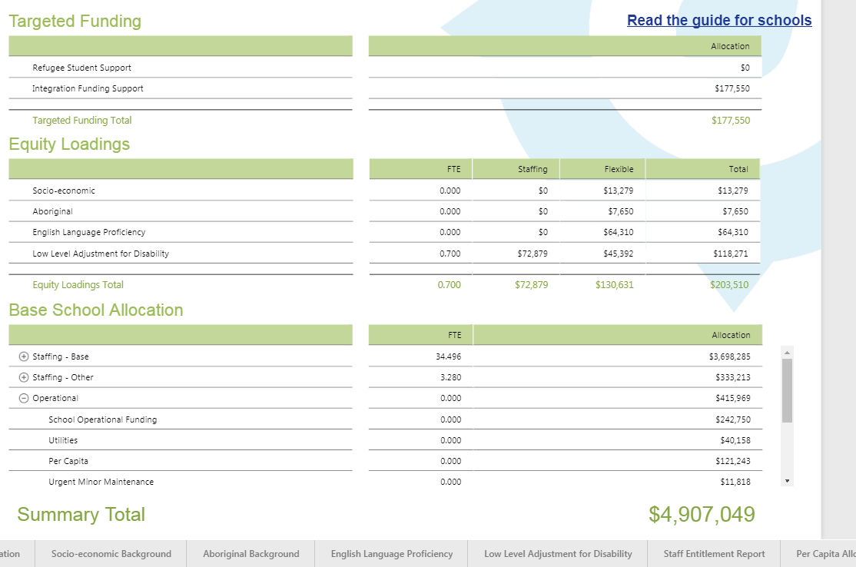
School Budget Allocation

Slide 19
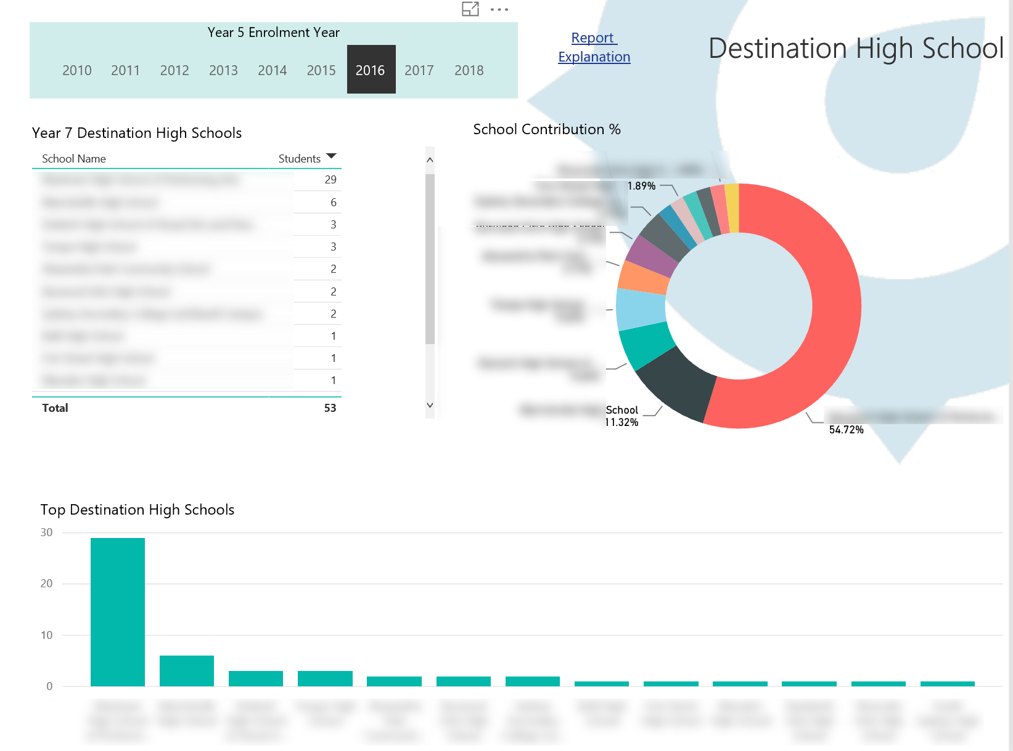
Primary School Transition
Do you have transition programs in place with all relevant local
high schools?

Slide 20
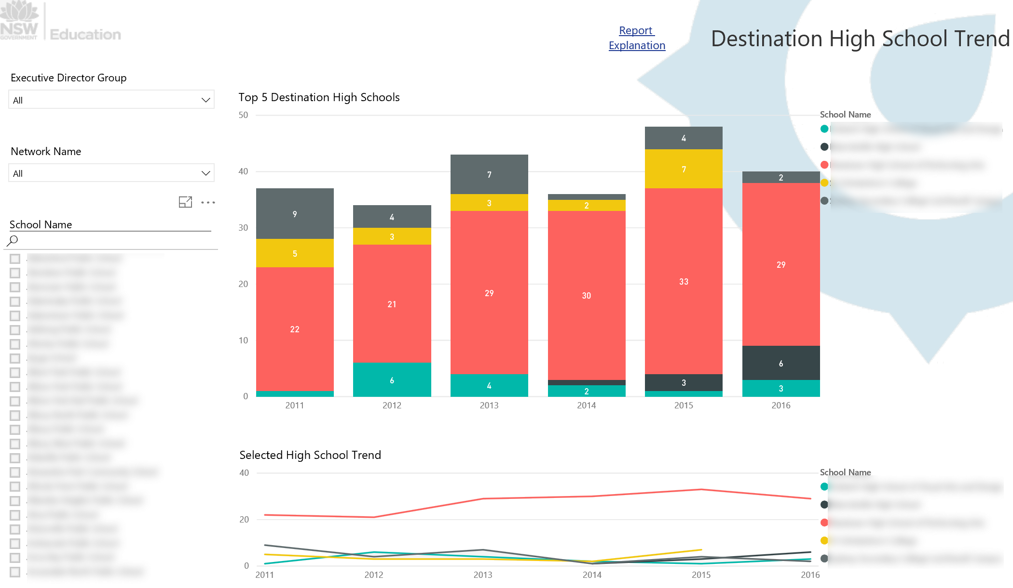
Primary School Transition
Have there been any changes in trends for destination high schools?
Why?

Slide 21
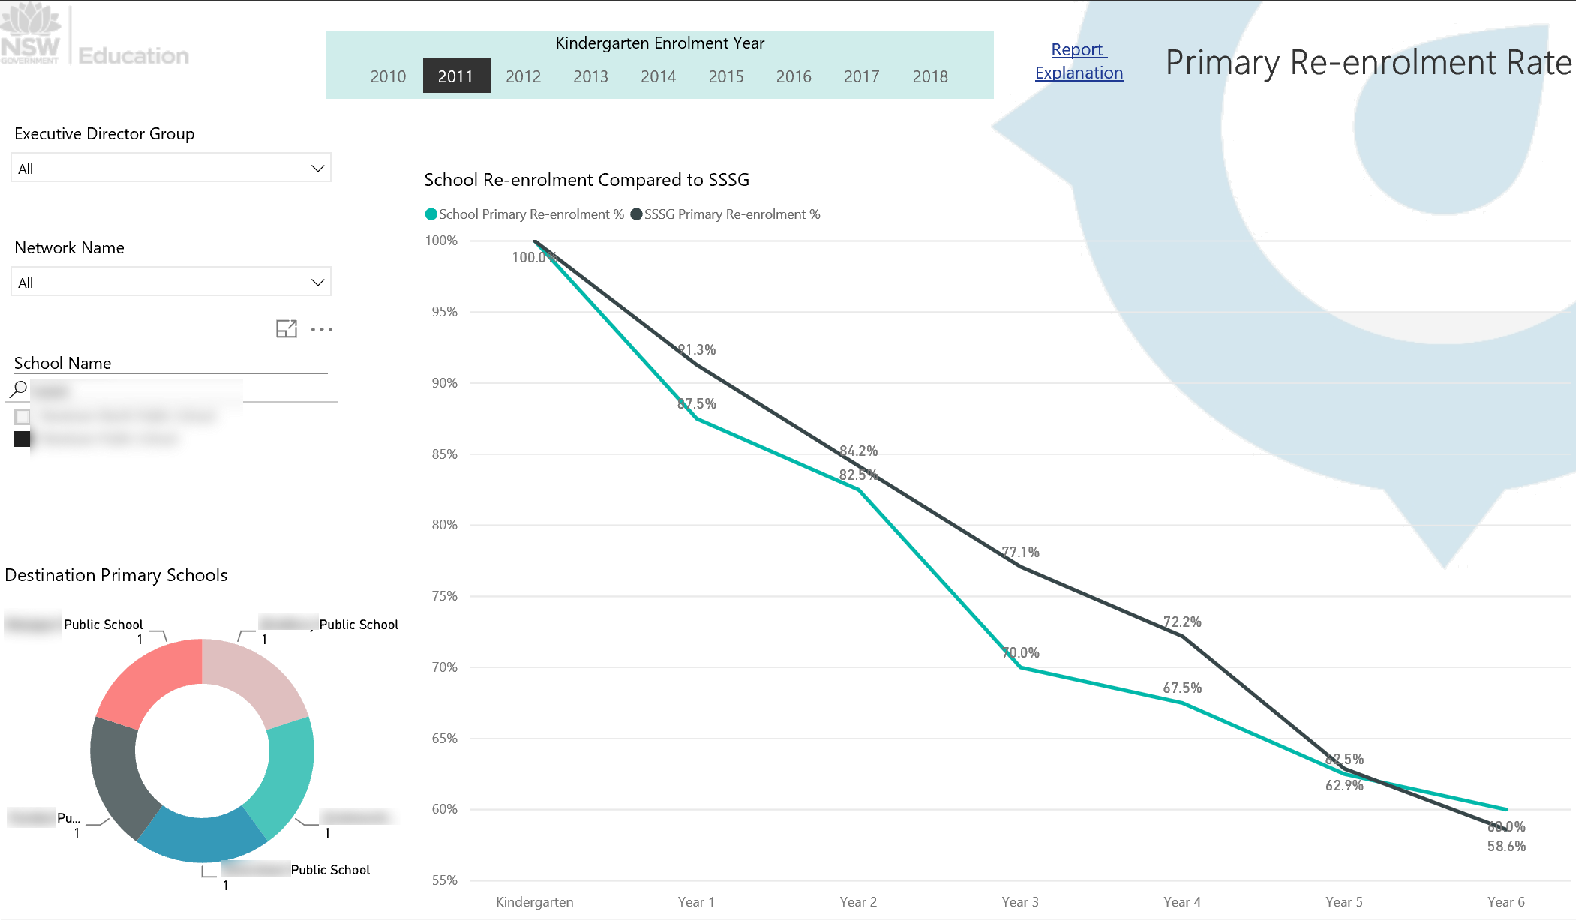
Primary School Transition
Are your students and families relocating or moving to another local school?

Slide 22
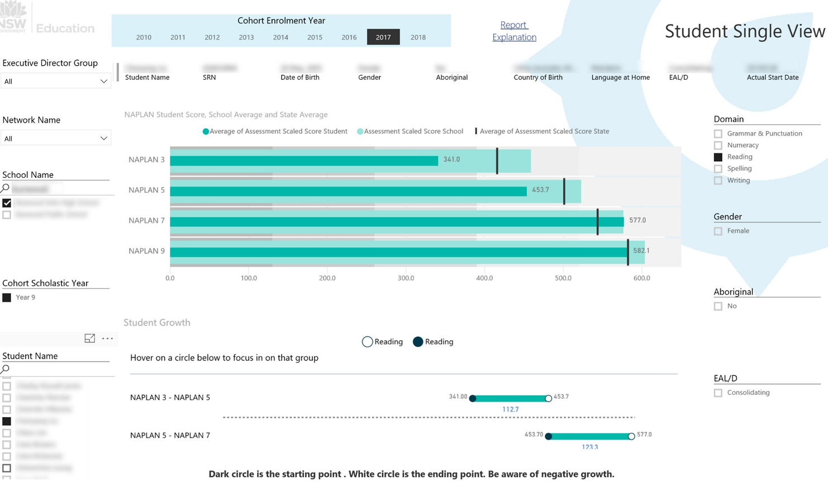
Notes:
One of my favourite reports in Scout is the Student Single View, which is also found in the NAPLAN Performance App.
This is an excellent report to explore as you get to know your students better. At the top of the page you can see important background information such as gender, date of birth, Aboriginality, country of birth, language at home, EAL/D level and enrolment date.
The first chart shows the student’s scaled NAPLAN score in comparison to the average school and state scaled scores. It is possible to drill down into each domain of NAPLAN to explore your students’ strengths and areas for development in literacy and numeracy.
Of particular use is the chart at the bottom that shows the rate of growth for each student; this could be useful in discussions with both students (dependent on age) and parents when reviewing learning outcomes.

Slide 23
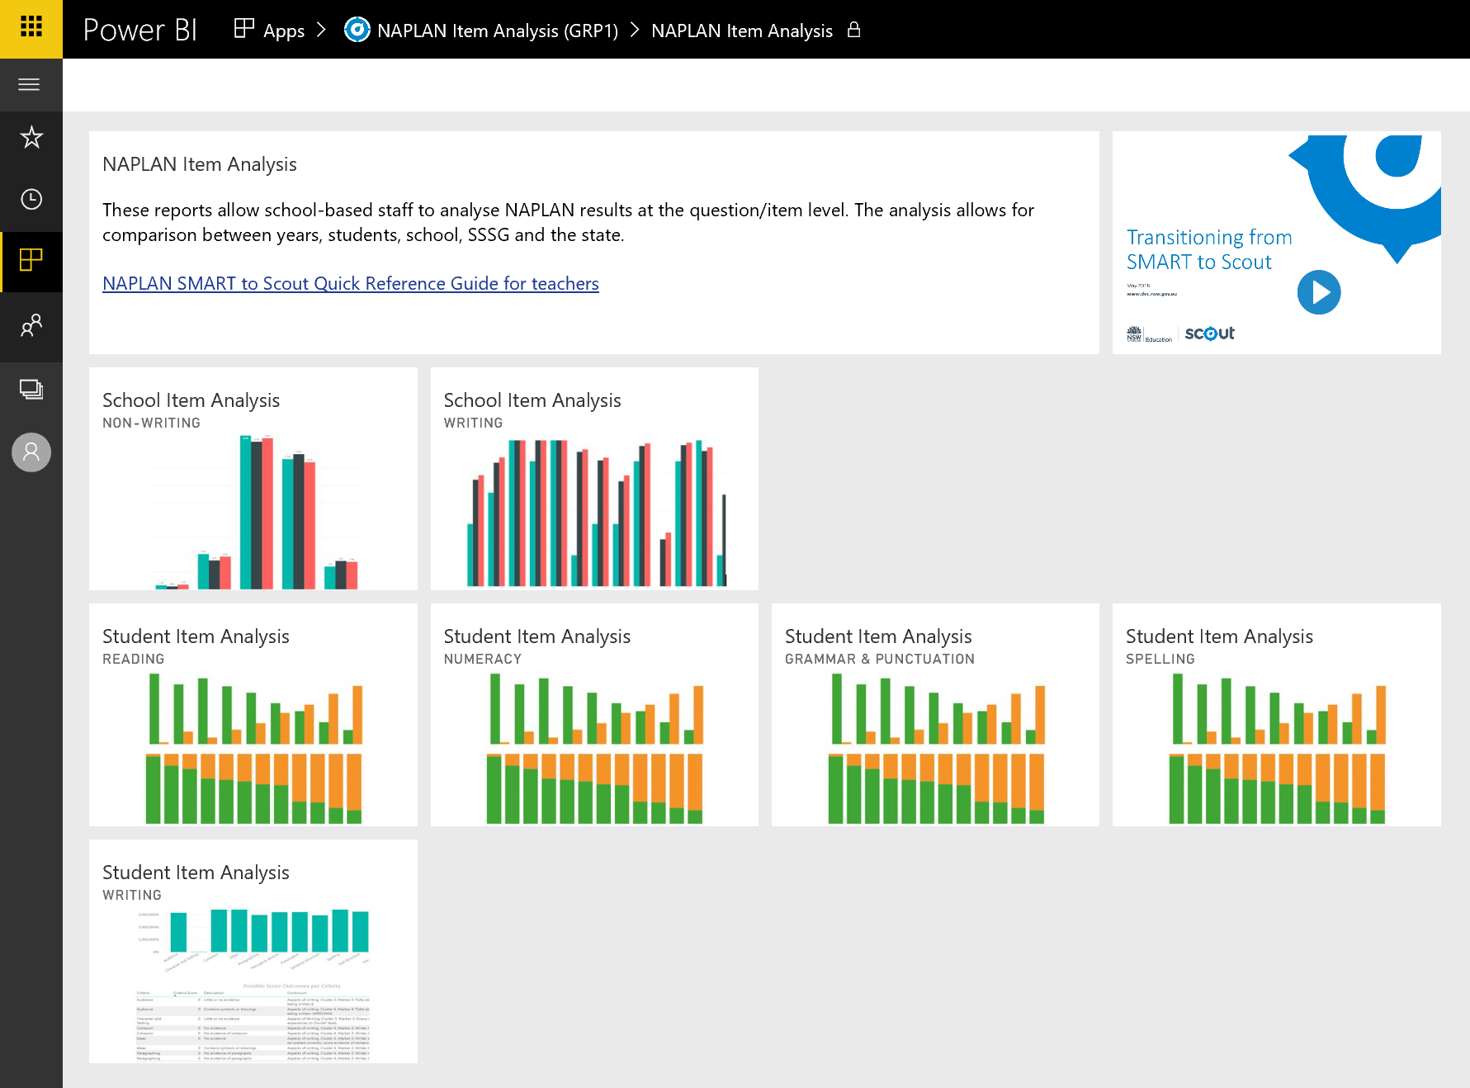
NAPLAN Item Analysis (Teacher)
NSW DEPARTMENT OF EDUCATION

Slide 24
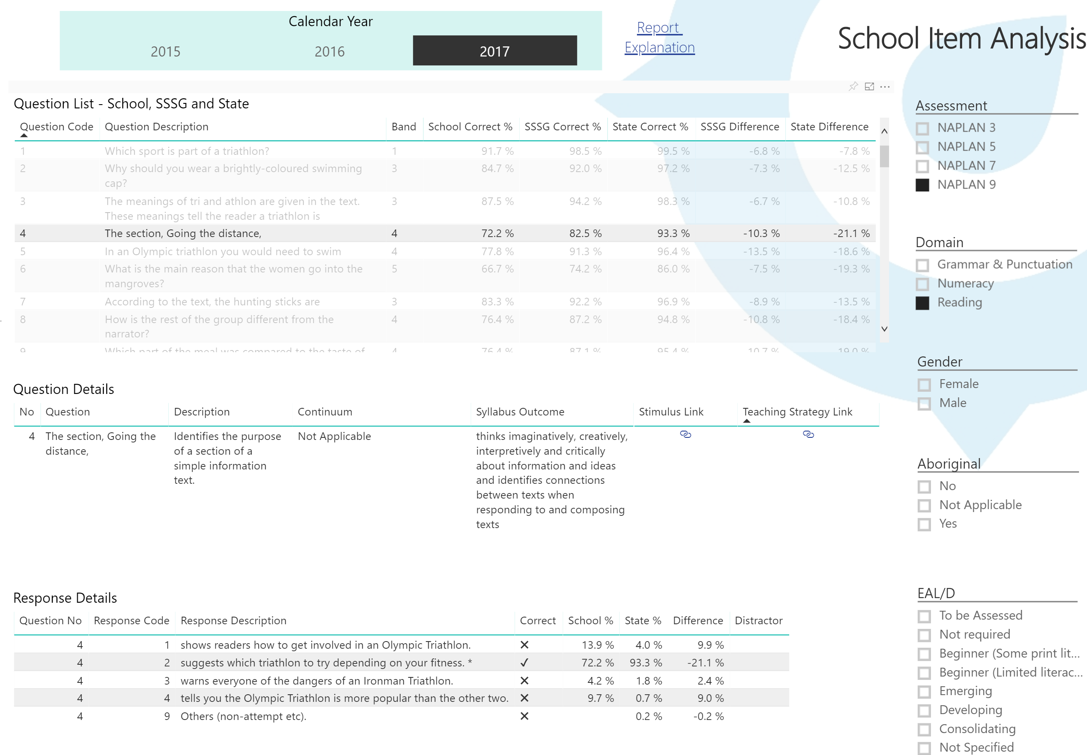
NAPLAN Item Analysis
School Item Analysis

Slide 25
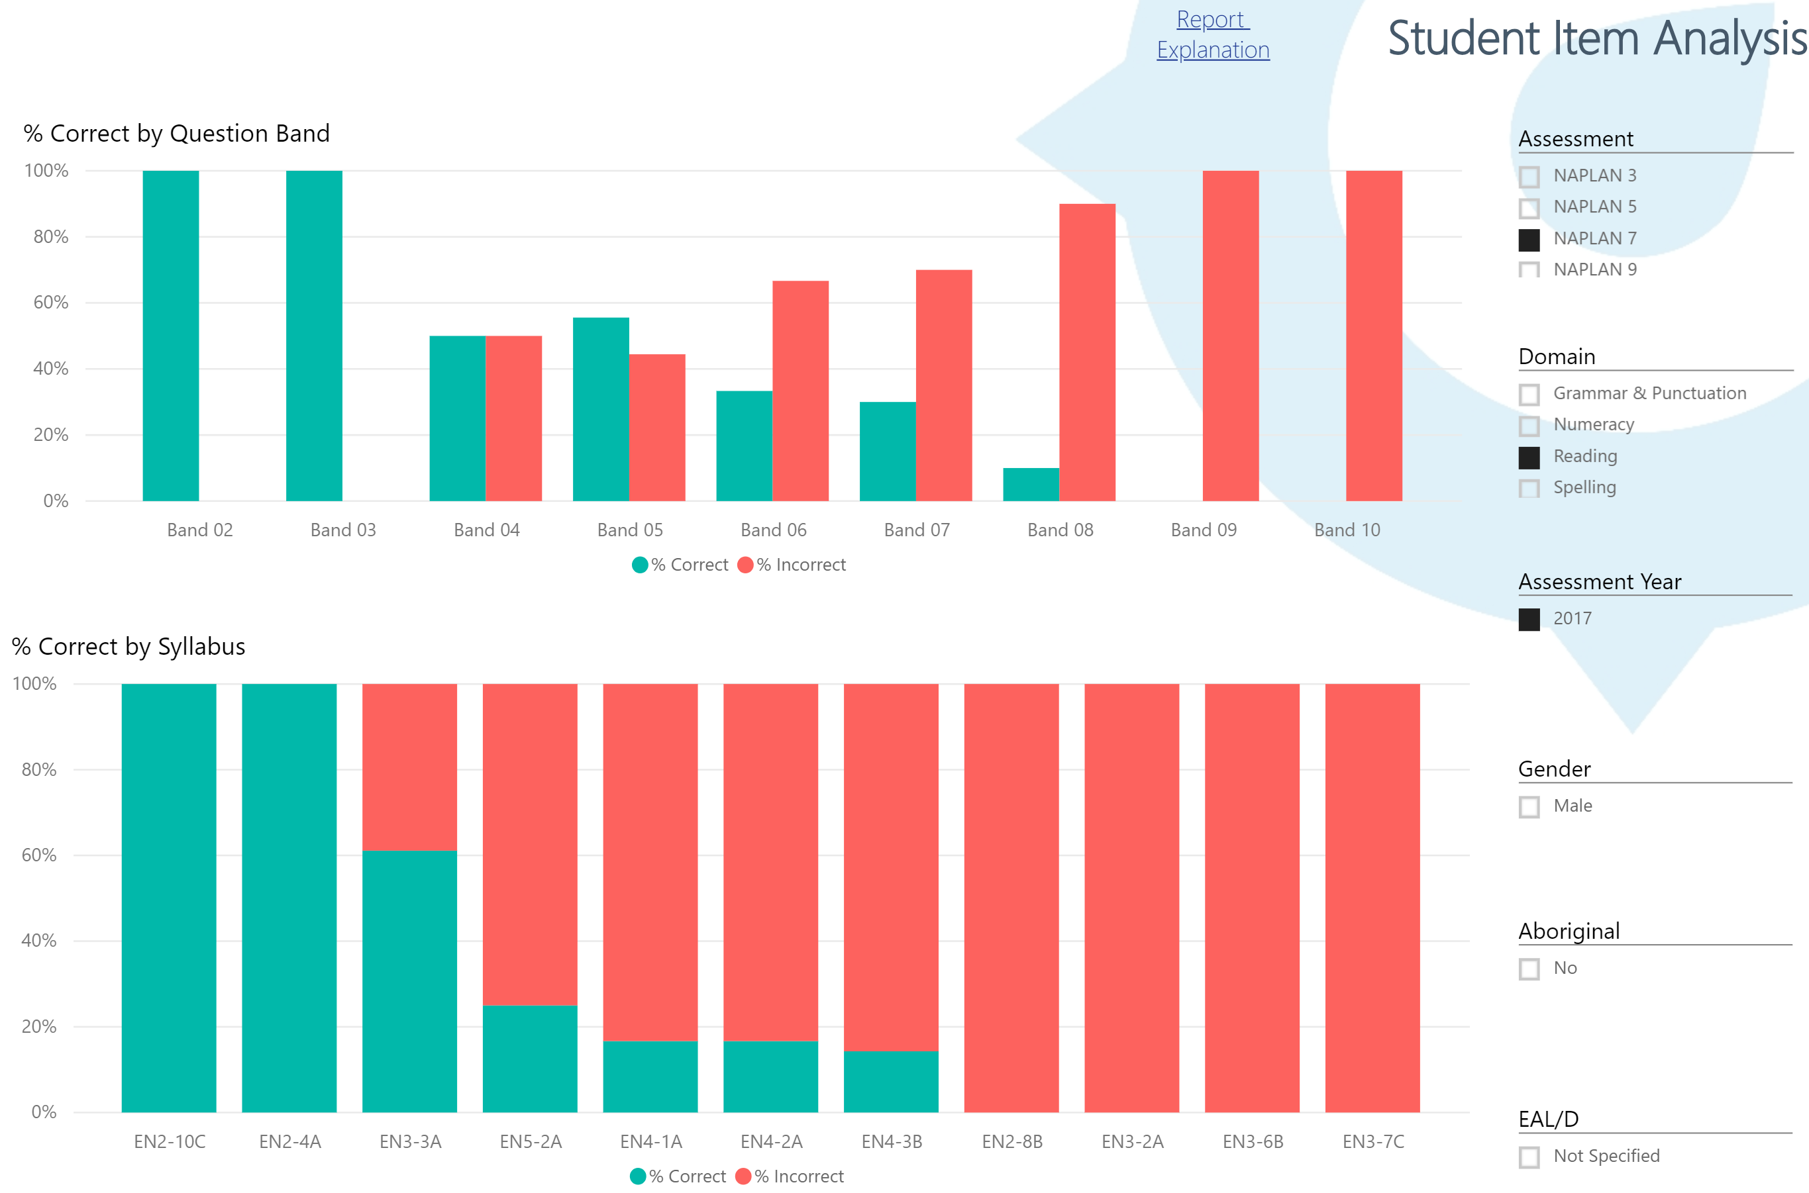
NAPLAN Item Analysis
Student Item Analysis - Reading

Slide 26
Question and Answer
Notes:
Question and Answer time

Slide 27

Contact Us:
http://www.cese.nsw.gov.au/
info@cese.nsw.gov.au
@nswcese
Scout training:
scout@det.nsw.edu.au
Scout user support:
Scout.support@det.nsw.edu.au
School Excellence Framework evidence guide:
education.nsw.gov.au/sef-evidence-guide
Notes:
Contact details:
CESE website
CESE email
CESE Twitter address
Scout training
Scout user support
SEF website
Could add your email contact details here

