Slide 1

President’s Report
Term 3
State Council
September 2018

Slide 2
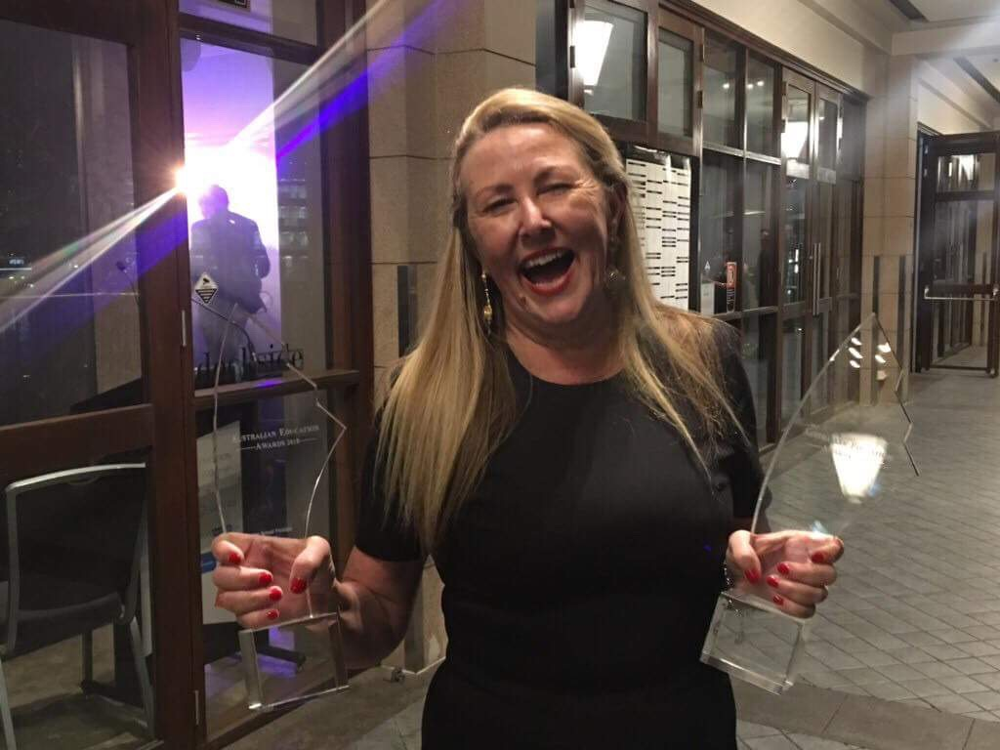
Australian Principal of the Year
Australian Government Principal of the Year

Slide 3
HR Salary Tool
Far South Coast [ Group 1]
Roll Out Group 3
Robyn Evans & Ian Reeson – Dep Sec Peter Riordan
Minister’s Intervention
DEL Glen Patterson & Peter Miles – training
Face -2 - Face but not fixing the tool
An example of governance without key stakeholders
NAPLAN & NAPLAN online
Called for a review – Minister supports data use & My Schools website equating data between paper & pencil /online

Slide 4
Principal Well-Being
Bondi Beach Principal any one of us…..
Support each other
Anne van Dartel [Principal Support], Greg McLaren [Legal] & Geoff Scott [Professional Officer]
Leadership Standing Committee previous approval 0.2 plus review of position this is our future
Curriculum Review
Prof Geoff Masters
Terms of Reference
Crowded Curriculum -

Slide 5
National Scene change of Minister
Fair Funding campaign politics & deals
International Scene
AGPPA – member of ICP
3 Presidents went to Ireland
Shanghai Conference 2019
Local Schools Local Decisions submission – John Mularczyk

Slide 6

Website changes …..dashboard links between Newsletter, app, notifications
Wehmella
Back End

