Slide 1
NSW Primary Principals’ Association State Council Meeting – Term 4 School Infrastructure NSW
Presented by Anthony Manning
Chief Executive, School Infrastructure NSW

Slide 2
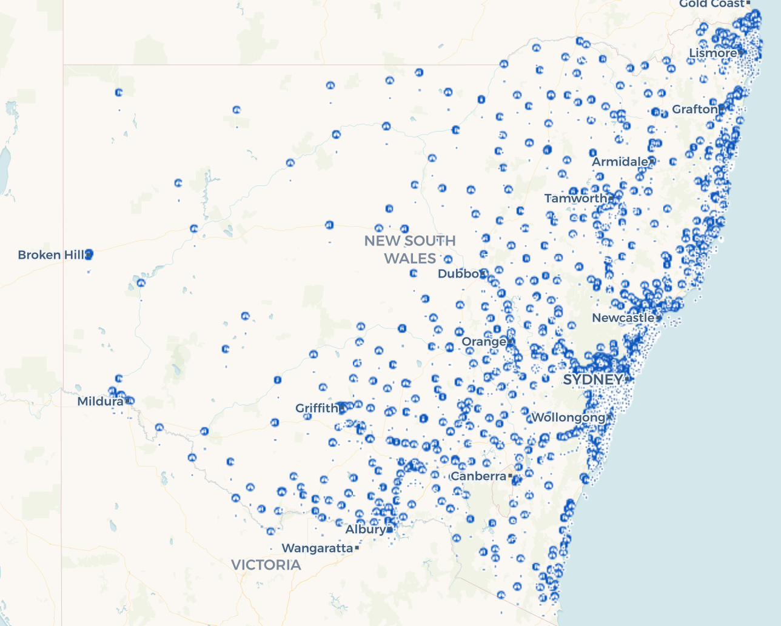
A large and dynamic system…
2,200
SCHOOLS
800,000
STUDENTS
86,000
STAFF

Slide 3

…growing every year
21% growth in student numbers by 2031
7,200 extra classrooms by 2031
80% in metropolitan Sydney

Slide 4
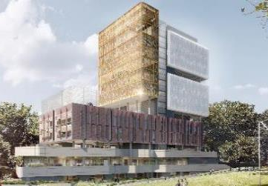
Growth creating huge opportunities – including record investment
$6 billion over the next four years to deliver more than 170 new and upgraded schools.
2,000 new classrooms
$747 million maintenance funding over four years
This is the largest investment in public education infrastructure in the history of NSW

Slide 5
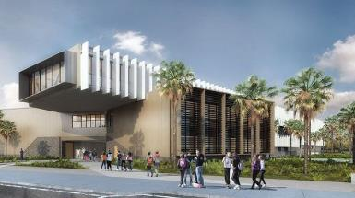
Since our creation, we’ve been planning and delivering
School Infrastructure NSW is a centre of excellence for the planning, design, delivery and maintenance of school facilities
Record number of major projects underway
School Design and Development Summit

Slide 6
We’re defining who we are
Our goal is to deliver world-class facilities to support the aspiration of the NSW public education system to be one of the finest in the world.
Do what we do better – scoping, costing, on-time delivery
Grow the capacity and capability of School Infrastructure NSW
Actively engage in enabling better educational outcomes
School Design and Development Summit

Slide 7
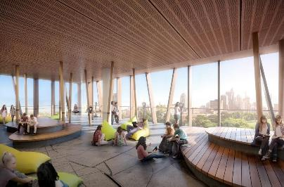
Improving what we already have
Reviewing the EFSG, including better environments for students with disability
A better approach to our demountable fleet
Rolling out joint use across NSW – where it makes sense

Slide 8
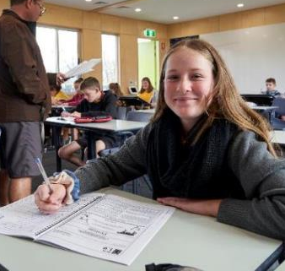
Finding new ways to improve schools…
Cooler Classrooms:
$500 million investment to improve thermal comfort and indoor air quality
Priority for schools in hottest areas of NSW
288 Fund schools to receive air conditioning
Additional energy consumption will be offset by solar PV

Slide 9

…and bring communities in when we’re not using them
^{Share Our Space:}
Making better use of our green space
Program has grown from 80 to more than 180 schools; thousands of residents have attended
Reaching out to new partners to improve healthy, active activities available to communities

Slide 10
Asset Management Review
We’re listening
More than 220 interviews with principals, directors of educational leadership, Parents and Citizens associations, AMU representatives and other key representatives
Almost 700 survey responses
School Design and Development Summit

Slide 11
We’re getting on with it while we work on improving for the long-term
Improving the way we work to help you get back in the classroom
Allowing you to do more in your own school
But there’s more to do to improve the work we do, how we work with you and how we – and other principals – can learn from you
We’re working on a comprehensive plan to lay out a new partnership with you in 2019

