Slide 1
CORPORATE FINANCE
Finance - Planning for the future

Slide 2
AGENDA
    CFO Role
    Finance – Purpose & Vision
    Financial Management Optimisation Project
    One Finance Project
    One Finance Project – deep dive Scott Thomson
    Utilities Model Masih-Ul Haque

Slide 3
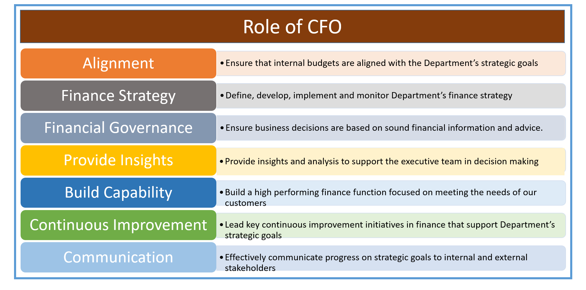
CFO – role

Slide 4
Finance - purpose & vision
PURPOSE
Finance works in partnership, to deliver strategic services, advice, guidance and support to schools and the broader Department of Education to empower them to use sound financial management to achieve their objectives.
VISION
To be the leading, trusted, service partner in the provision of timely, value add strategic financial information to schools and the broader Department of Education.

Slide 5
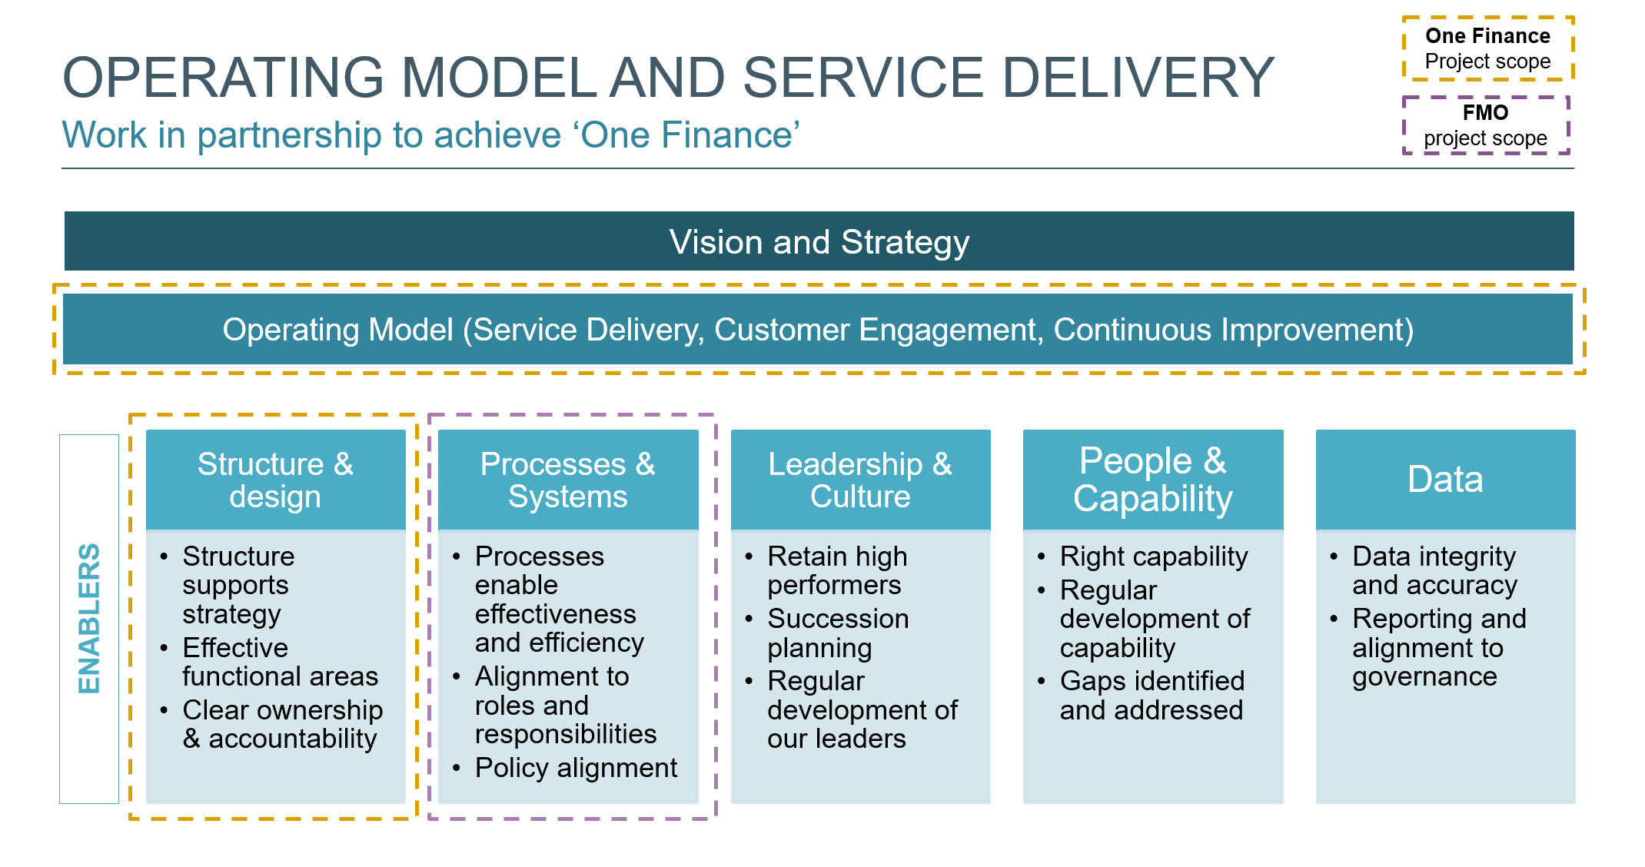

Slide 6
Financial management optimisation (FMO)
    Project:
    The FMO project will focus on the following issues:
      Current financial process, policy and procedures are fragmented, and in need of review
      The department needs a simplified, efficient, integrated financial management system that coordinates planning, budgeting, funding allocation and financial operations
    The project was introduced in September 2018
    The FMO is underpinned by a Financial Management Governance Framework (under development)
    Benefits:
    The FMO will enable:
      Streamlined process and procedures
      More efficient & effective education funding
      More agile budgeting, forecasting and reporting
      Resolution of the significant recurring underspend
Notes:
Project:
The Financial Management Optimisation (FMO) project will focus on the following issues:
Current process, policy and procedures are fragmented, and many need review
The department needs a simplified, efficient, integrated financial management system that coordinates planning, budgeting, funding allocation and financial operations
The project was introduced in September 2018 under the Department of Education’s Funding and Spending Strategy initiative
It is underpinned by the recently established Finance Management Governance Framework.
Benefit:
The FMO will enable:
a more streamlined (budgeting) process, policy and procedures
more efficient and effective education funding
more agile budgeting, forecasting and reporting
resolution of the significant recurring expenditure underspend issue at a department level

Slide 7
FMO - Scope
Schools
Workstream | Lead | Increment | Improvement Opportunities
SWS1* | Richard Coxon | Schools Increment 1 | 1.1 School Annual Funding Allocations
 |  | Schools Increment 1 | 1.2 Budget Adjustments to Schools
 |  | Schools Increment 3 | 1.3 Work Breakdown Structure Utilisation
SWS2 |  | Schools Increment 4 | 2.1 Carry Forward Policy for Schools
 |  | Schools Increment 4 | 2.2 School Bank Account Balances
SWS3 |  | Schools Increment 6 | 3.1 Strategic Financial Management Support for Schools
 |  | Schools Increment 6 | 3.2 Performance Management for Schools
 |  | Schools Increment 6 | 3.3 Customer Service Performance Management
SWS4* | Brienne Roberts | Schools Increment 2 | 4.1 Company 1010-1060 structure
 |  | Schools Increment 5 | 4.2 Monitoring Staff Costs in Schools using FTE’s
Corporate
Workstream | Lead | Increment | Improvement Opportunities
CWS1 | Raj Boora | Corporate Increment 2 | 1.1 Corporate budgeting & forecasting assumptions review
 |  | Corporate Increment 2 | 1.2 Corporate budgeting & forecasting processes review
 |  | Corporate Increment 2 | 1.3 Corporate budgeting & forecasting policies review
CWS2* | Raj Boora | Corporate Increment 1 | 2.1 Carry forward policy, enforcement of underspent & unexpected revenue
 |  | Corporate Increment 5 | 2.2 Accountability consolidation of Schools Finance
CWS3 | Raj Boora | Corporate Increment 4 | 3.1 Reporting tools & content structure review
 |  | Corporate Increment 3 | 3.2 Prioritisation of unallocated / underspent funds
* High priority
Notes:
The FMO will support improvement opportunities in schools relating to:
Annual school funding allocations
Budget adjustments
The use of the Work Breakdown Structure
Carry Forward Policy for schools
School Bank account balances
Monitoring staff costs
Customer service performance management
Strategic financial management support for schools
At the corporate level, the FMO will enable:
improvements in the budgeting and forecasting processes and reviews
a better understanding of the department’s funds allocation.

Slide 8
One finance
    Project:
    The project commenced in November, and will look at ways to improve our service and how we operate, so that we provide a more integrated service
    So that we can achieve our vision to be a leading and trusted service partner that provides value add strategic advice to schools and across the department
    We want:
    to be better connected with our customers and be responsive to Schools and DoE’s needs
    clear governance and accountability of decision making, and diligence and rigour with internal controls
    an integrated technology system, easy to use streamlined processes, with relevant understandable reporting
    Next steps:
    Understand the Voice Of the Client (by undertaking interviews)
    Map the Finance Taxonomy (seeking feedback)
    Develop design principles and purpose/vision (seek feedback)

Slide 9
questions
    Thank you.

