Slide 1
Principals in Residence: Phase 1 Every Student is Known, Valued and Cared for in our schools
Jenny Boyall, Shannan Judge, Di Robertson | 30 November 2018

Slide 2

‘Principals in Residence’ model

Slide 3
* Seconded for 10 weeks * Every Student, Known, valued and cared for project * Advisory for other matters
Notes:
New model based on other sectors, eg Victoria has PIR and they have a voice in everything that goes out by the department. Now Delivery unit have a PIR (Sakuna Pho)
Project taken on by SO&P, complementary to other work by Educational Services, CESE asked to support
NAPLAN data, anti-bullying conference and behaviour think tank, suspension and discipline policy, delivery unit initiatives,
Phase 1 with other PIRs to be advertised before the end of term, in SO&P and other units

Slide 4
Project Methodology

Slide 5
* Stakeholder consultation - external - internal * ‘School Story’ visits * Digital Toolkit
Notes:
External – PPA, SPC, SEPLA, AECG, Teachers Federation
Internal – focus groups (principals, school counsellors, senior psychologists), Educational Services, CESE
32 visits across the state, mapped to school type and inclusive of school contexts in NSW DoE

Slide 6
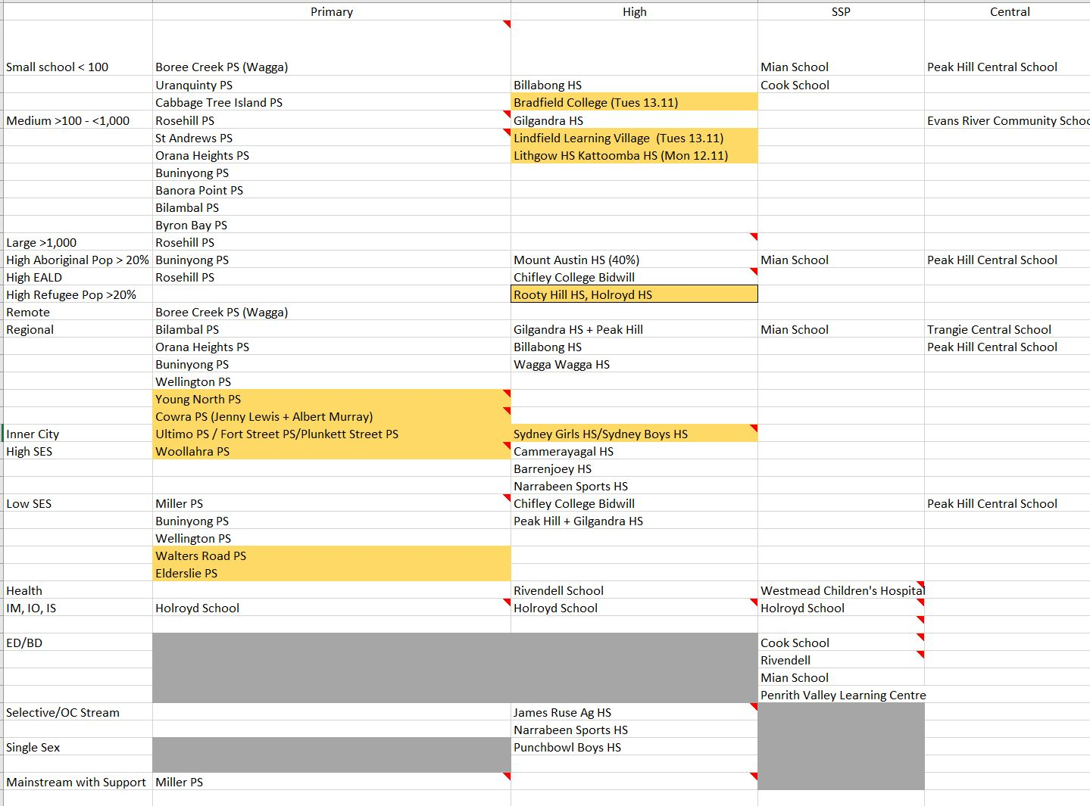
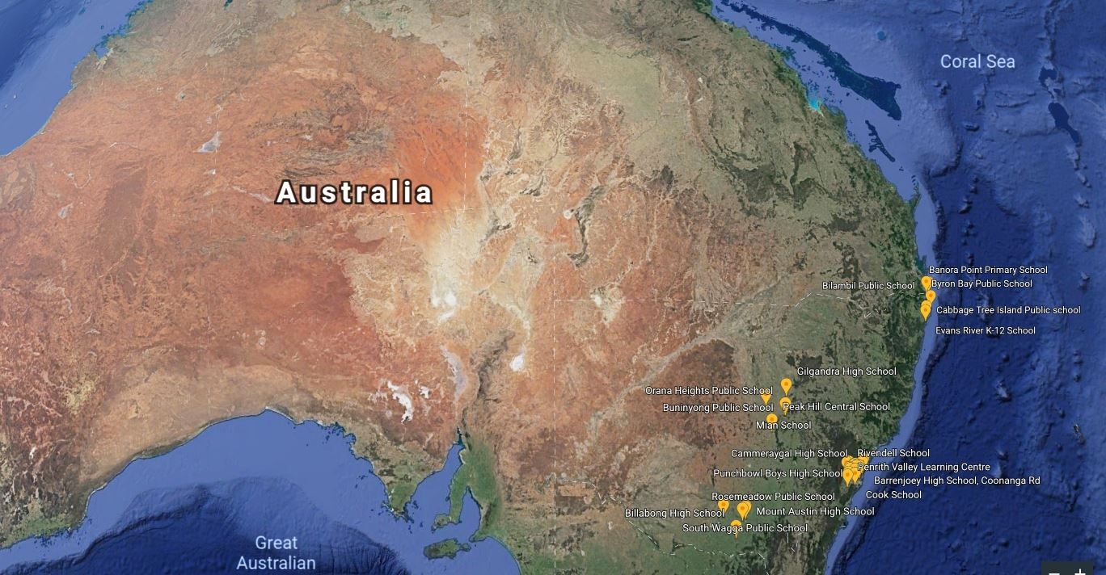
School Structure
School Location
School Context
Notes:
Three factors came into play when selecting schools:
School structure
School context
School location
Yellow indicates schools we have identified, but need to be held over to Phase 2 of the project

Slide 7
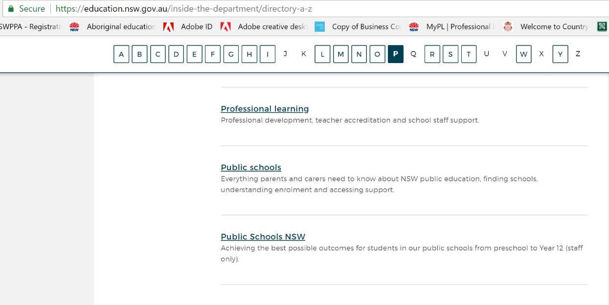
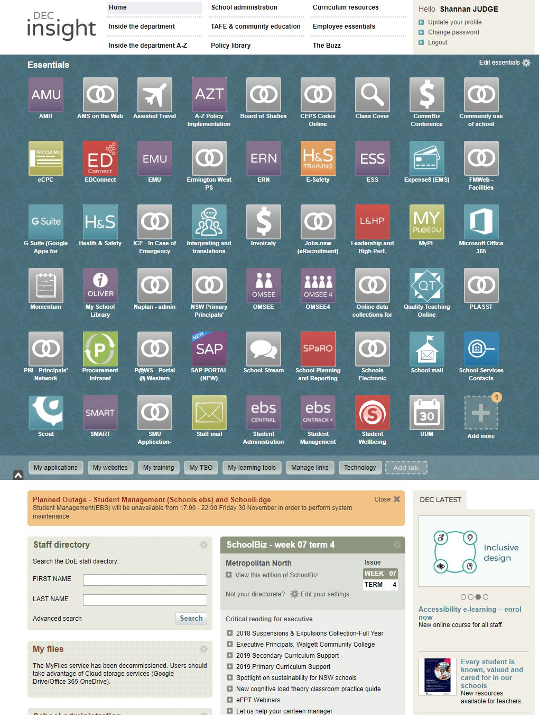
The Toolkit https://education.nsw.gov.au/ps-nsw/every-student
Sits on the intranet
Notes:
How do I find it?

Slide 8
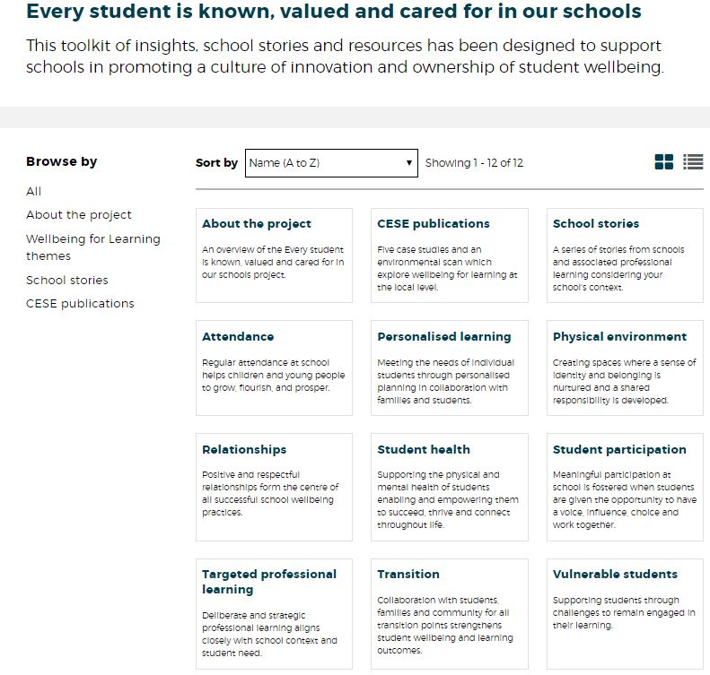
Links to the Case Study schools & environmental scan
9 themes in the toolkit
School Stories Professional Learning packages

Slide 9

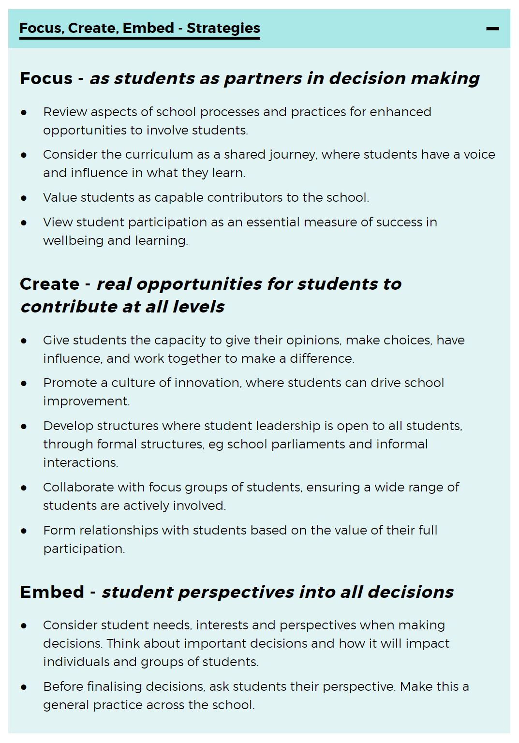
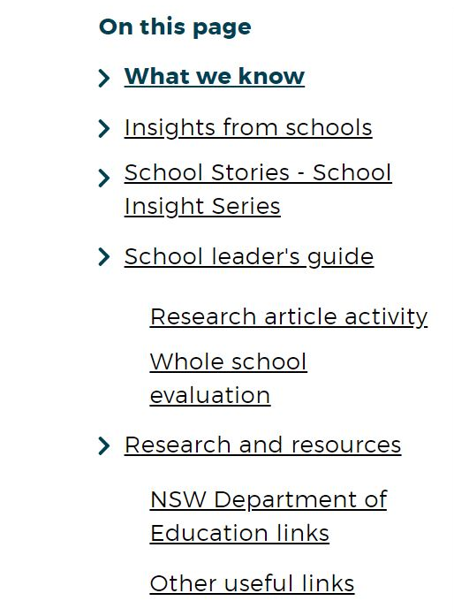

Slide 10
School Insight Series
Notes:
A series of vignettes to give a window of understanding into how schools meet the needs of their community. We are about to see Evans River K-12 Community School. Evans River K-12 School is a Kindergarten to Year 12 school providing education for the students of 11 coastal and inland communities. Whilst this vignette looks primarily at the work of the HS, the journey really starts before students start school. This is a school of the community as you are about to see.

Slide 11


Slide 12
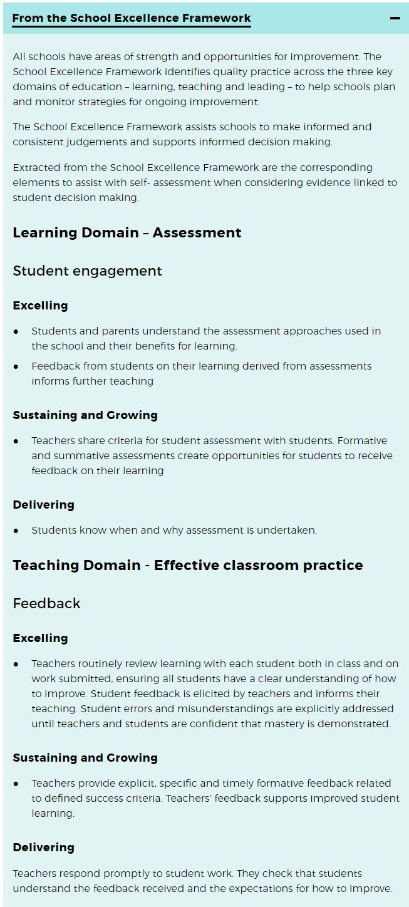
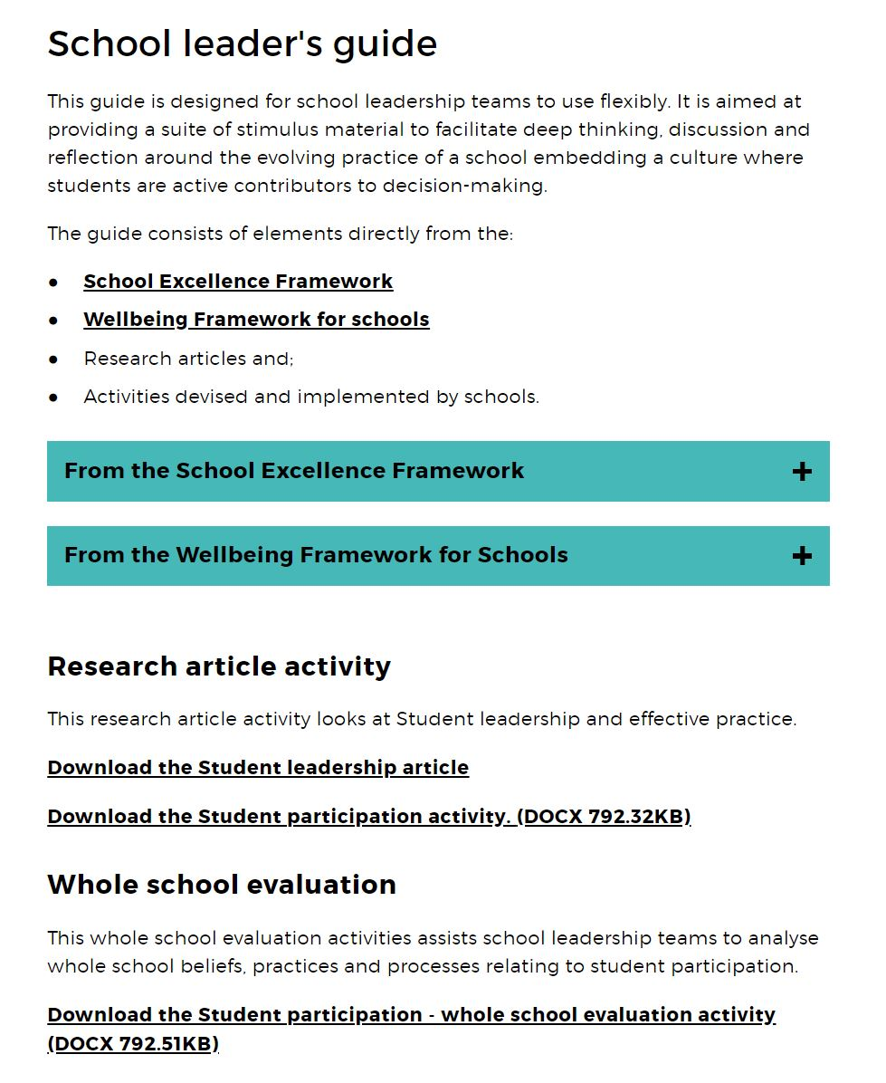
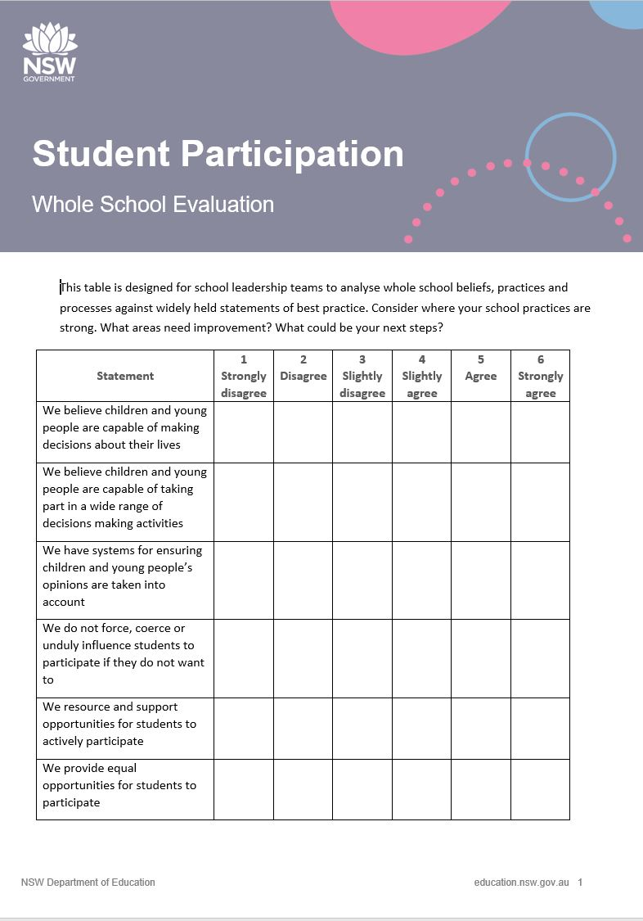

Slide 13
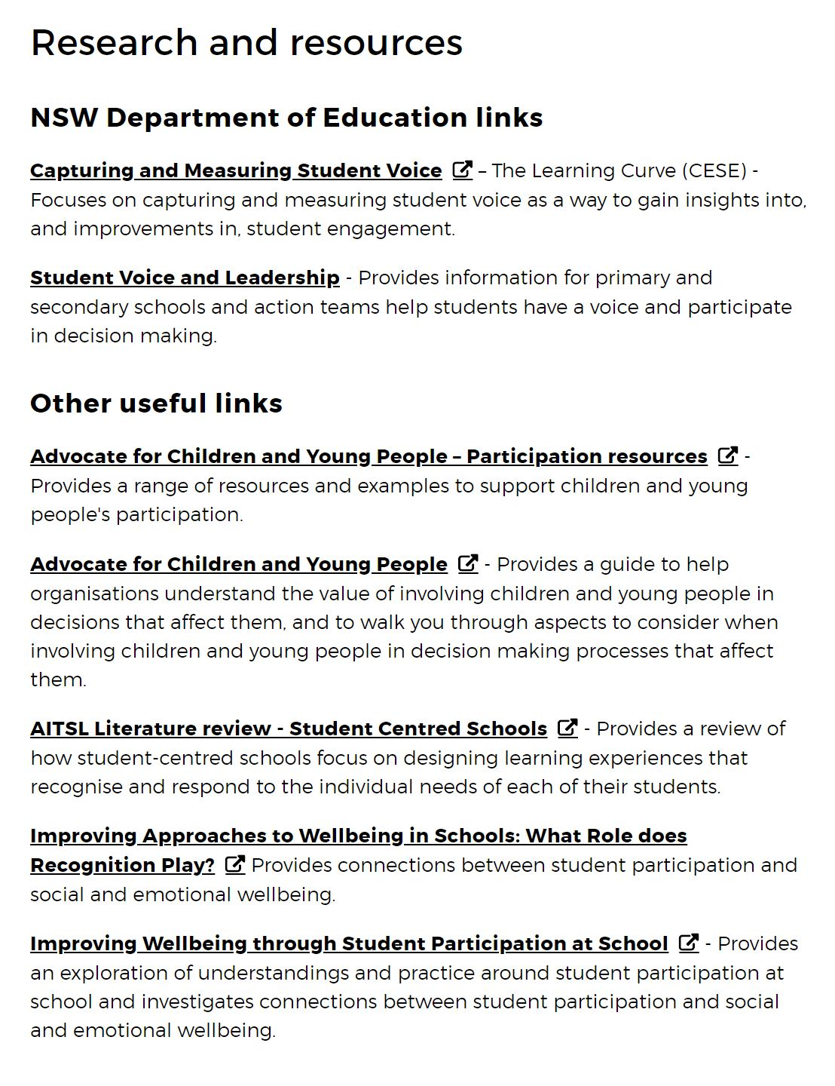
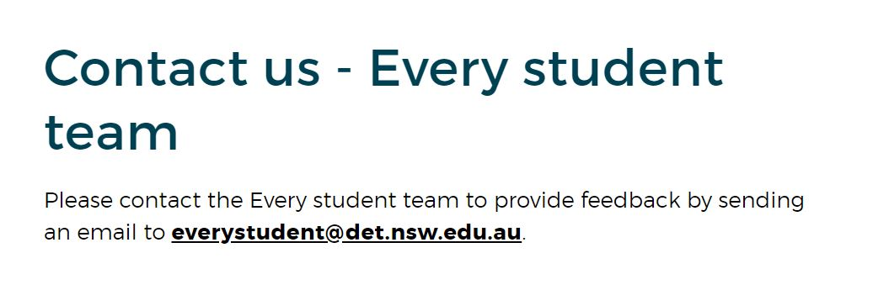

Slide 14
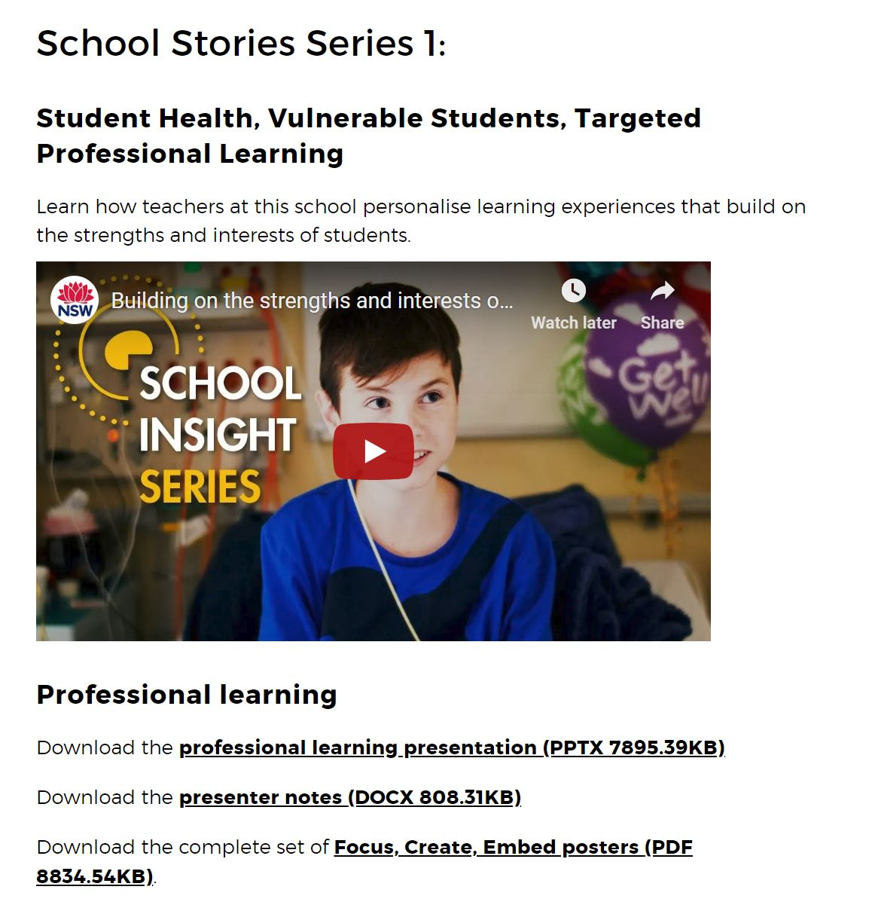
Project Methodology
Notes:
4 in the series, each with a longer video which unpacks 2-3 themes
2 hour packages
PL created in conjunction with Education Changemakers
Follows the Focus - (what is this school doing?) Create – (ideate for your own context) Embed – (what can we do tomorrow, in a term, in a year, linking in with school planning)

Slide 15
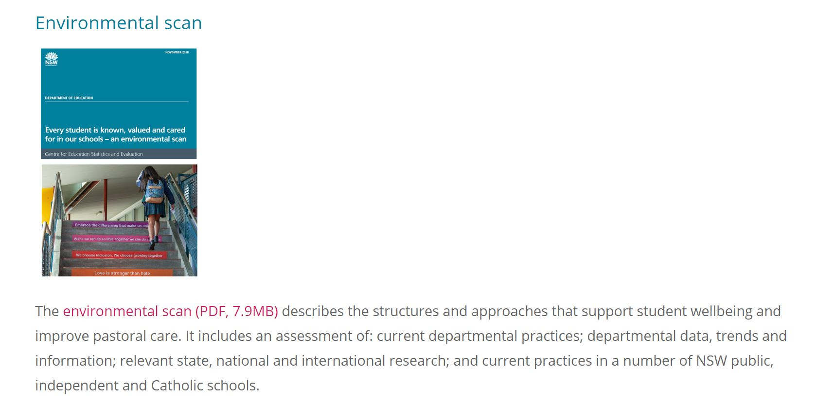
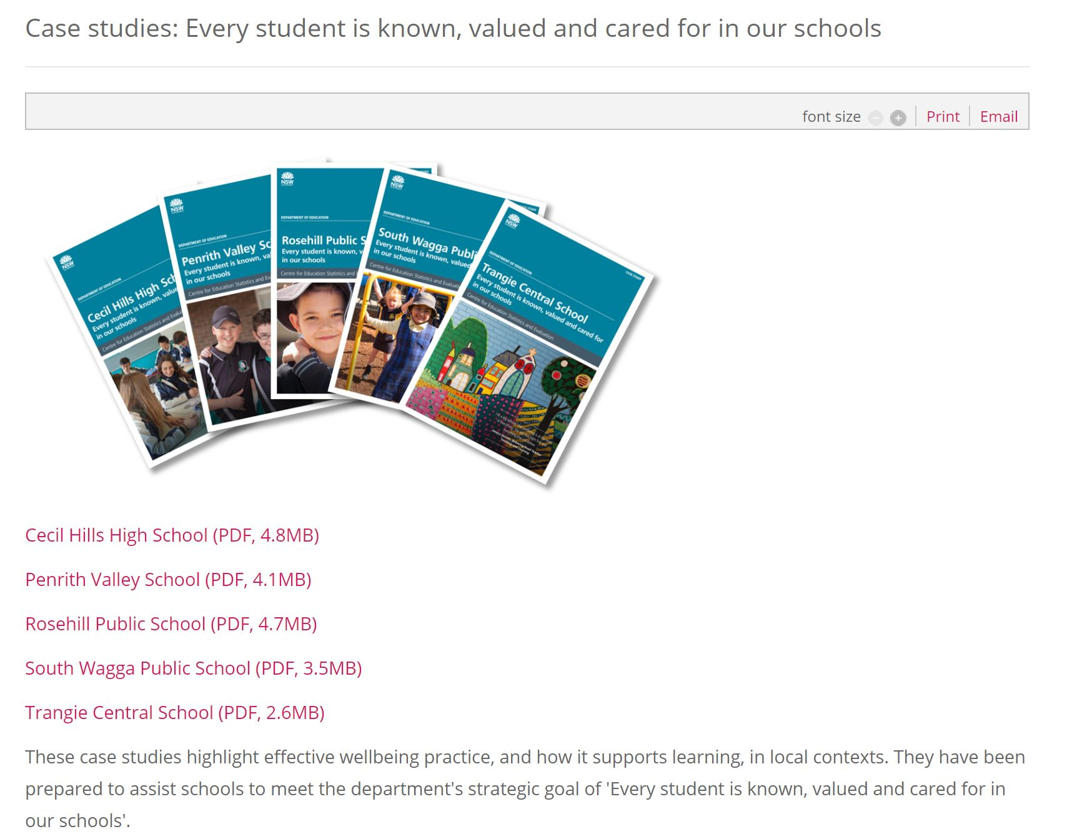
Project Methodology
CESE Publications
Notes:
We are currently working on a support package for the environmental scan so it can be used in PL
Acknowledge the principals of South Wagga PS (Tanya White) and Rosehill PS (relieving - Tony D’Amore and outgoing - Kim Naylor)

Slide 16
Pathways for Toolkit
Notes:
Multiple Pathways
Whole School – Schools Stories PL – then go into individual themes – breaking the process down into products and practices
School leadership group – by theme – focusing on the leadership guide
Stage teams or faculty groups – looking at the needs of students in the cohort
Individual teachers – PL – ideas for classroom practice

