Slide 1


Supporting students to develop workforce ready future skills

Slide 2
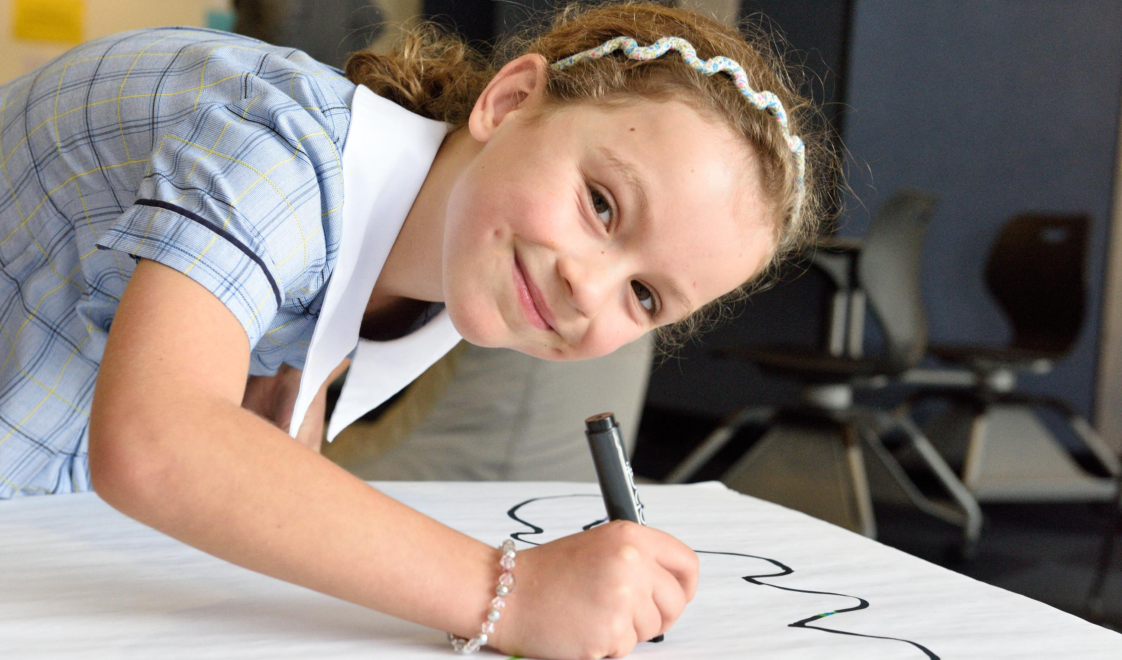




STEMShare Outcomes
Student and Teacher focused
Raise awareness of effective use of technology to improve student learning
Enable teachers to understand, experience and embed STEM technologies into teaching and learning
Support student's capabilities to use technology for learning and to build digital resilience
Create a sustainable STEM community of practice within the NSW Department of Education
Simple | Reliable | Effective
Notes:
Our project outcomes

Slide 3
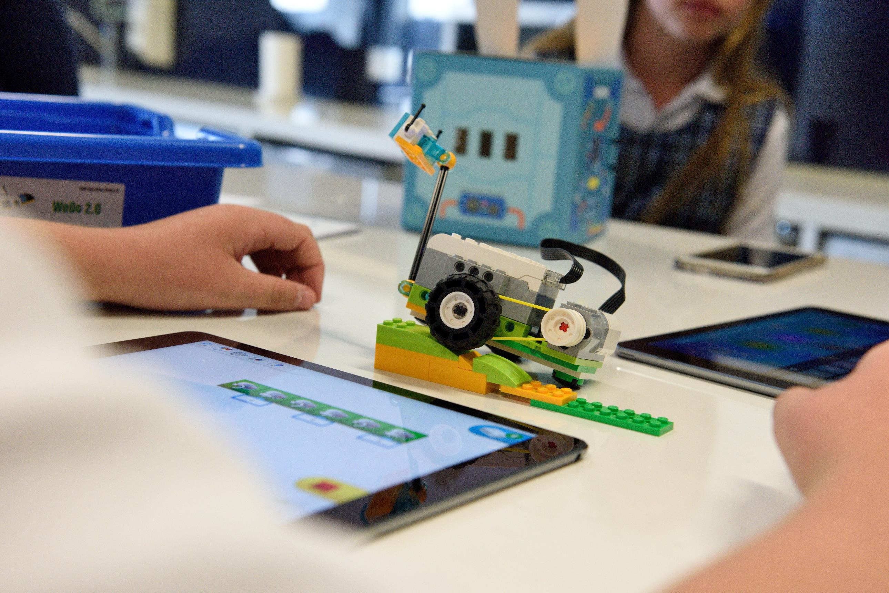
STRATEGIC ALIGNMENT
“- raising expectations and enhancing the quality of student learning in STEM
- fostering quality teaching and leadership in STEM
- innovative ways of delivering STEM education”
“aims to enhance engagement in STEM by developing practical, hands-on teaching and learning programs and resources that allow students to integrate their knowledge from the pillar subjects.”
“Ensure all students finish school with strong foundational knowledge in STEM and related skills”
“All young people finish school well prepared for higher education, training and work”
2018 – 2022
DoE Strategic Plan
DoE STEM Curriculum Strategy
NESA STEM Strategy
National STEM School Strategy
Simple | Reliable | Effective
Notes:
Our program aligns with STEM Strategy at Federal, State and Department levels

Slide 4
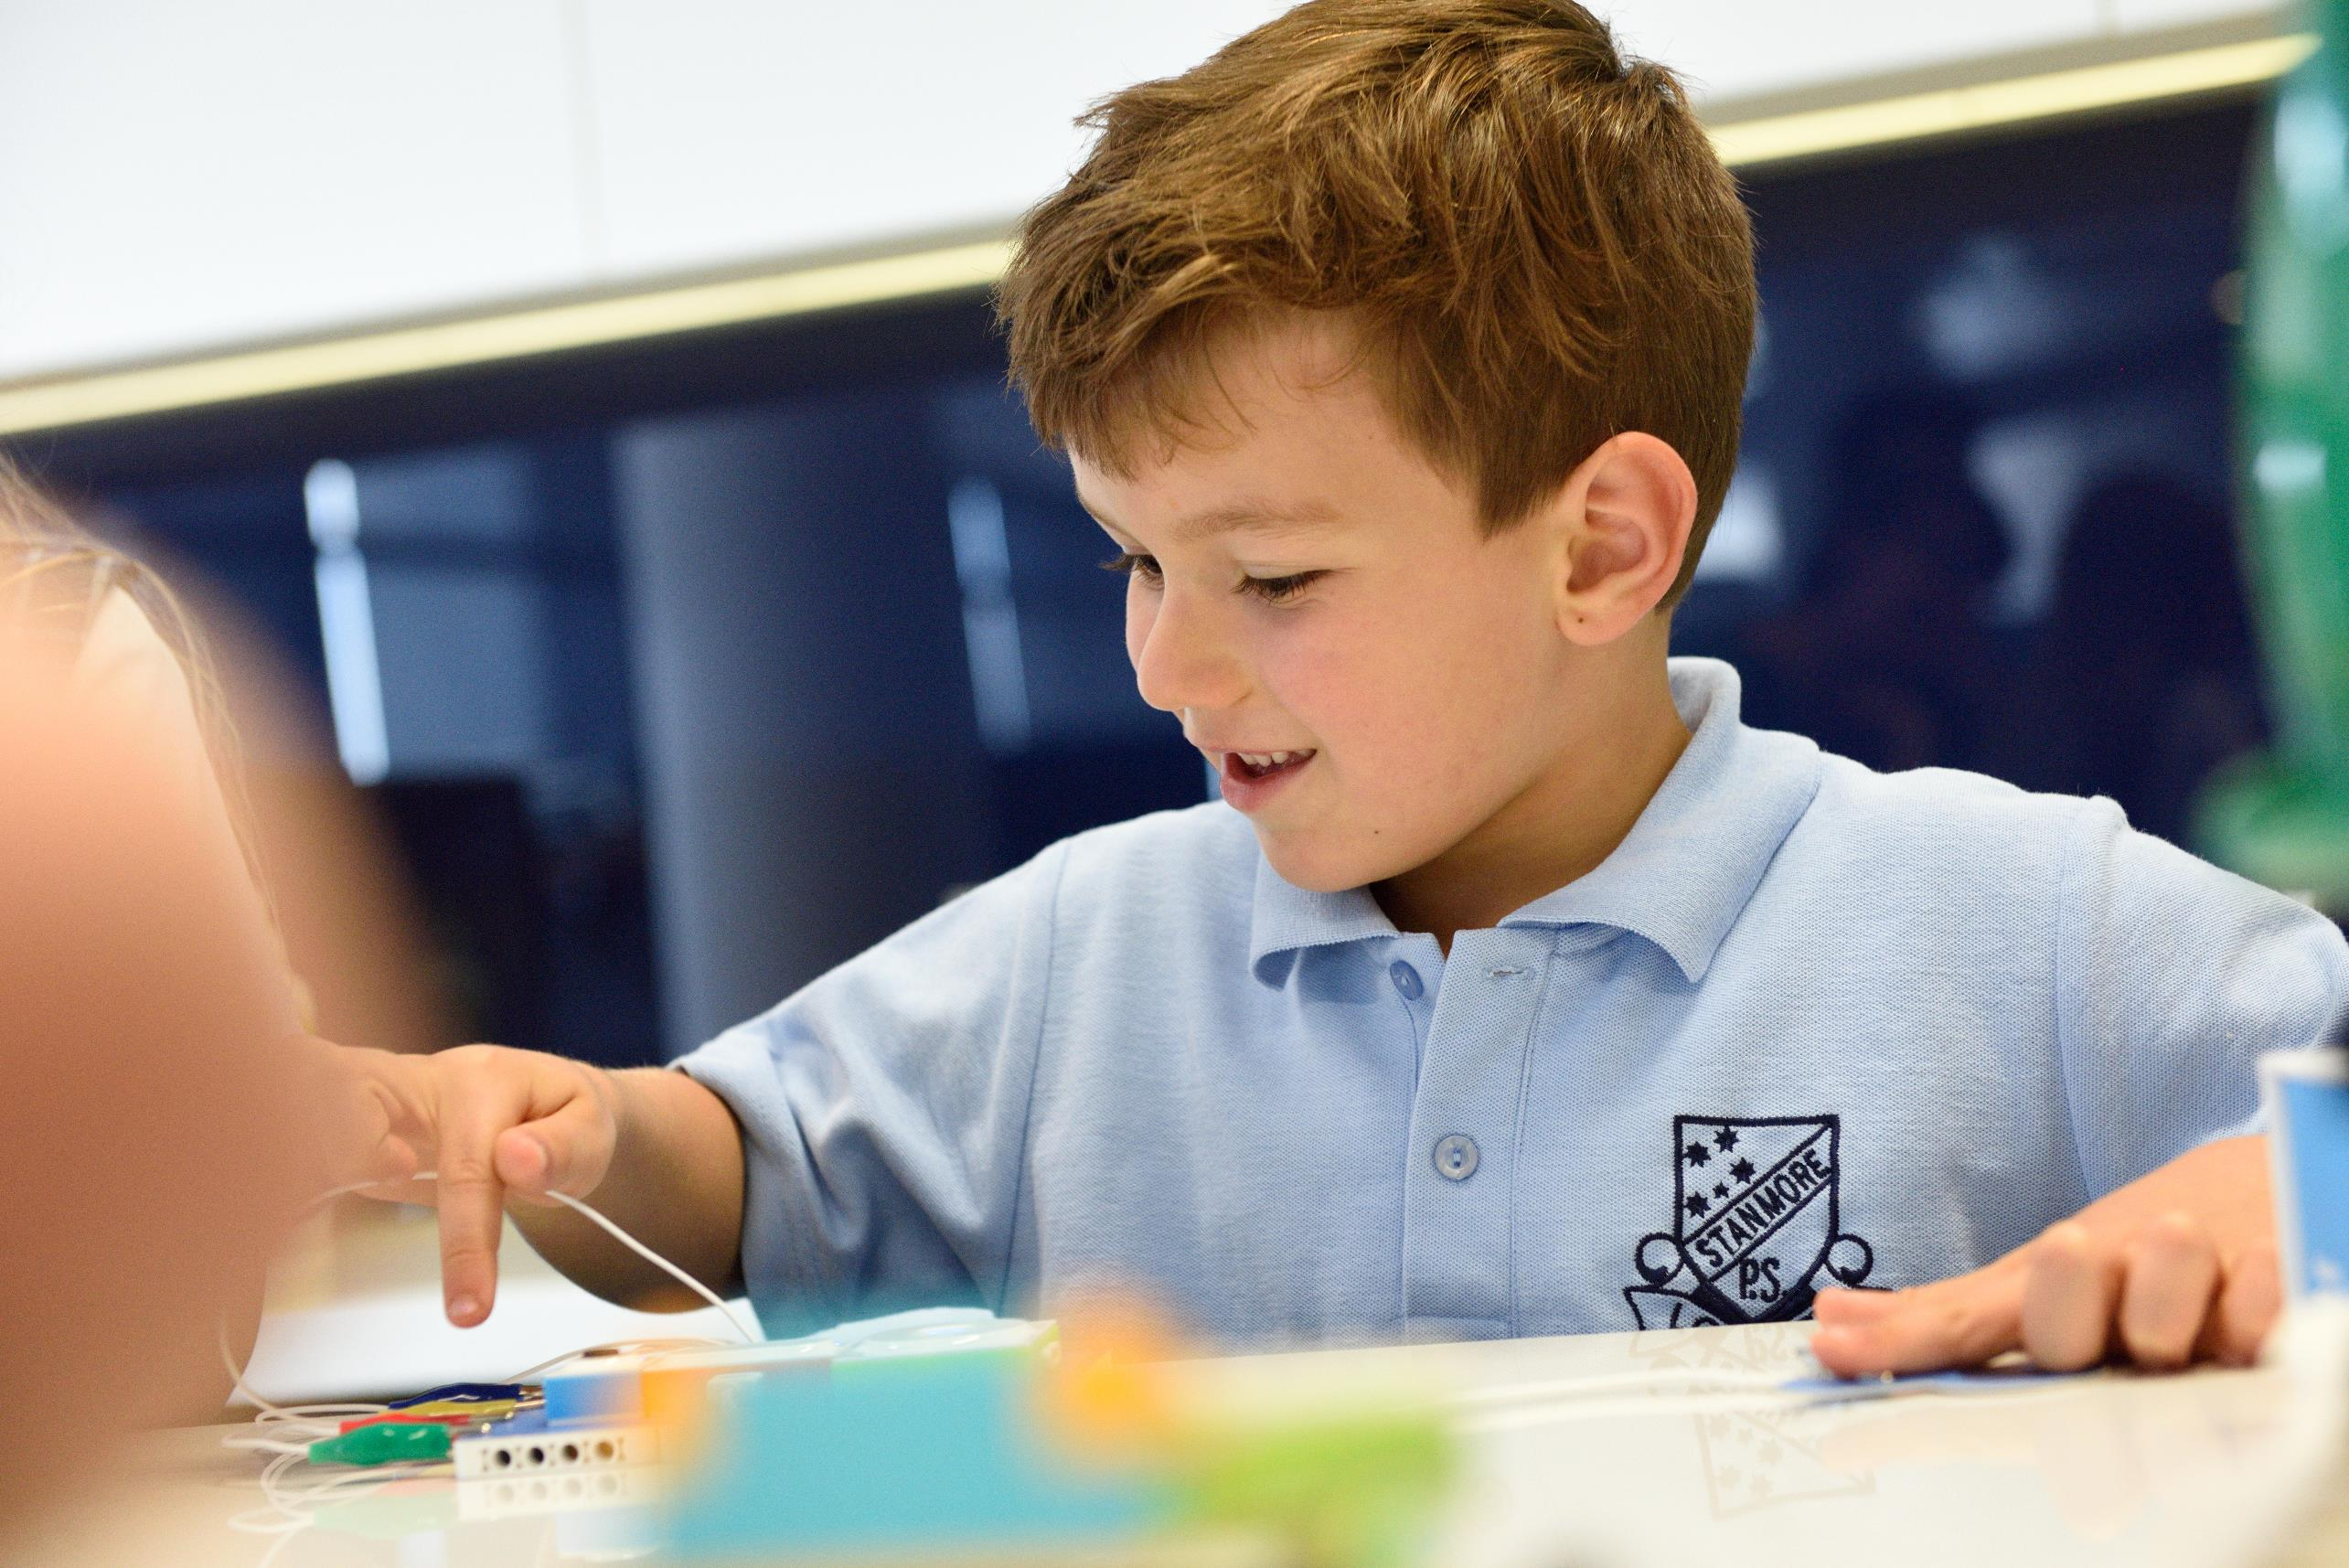




Why is STEMShare so awesome?
New things in New Ways
Kits
Training
Learning Challenges
Community of Practice
Simple | Reliable | Effective
Notes:
The program has 4 focus areas

Slide 5
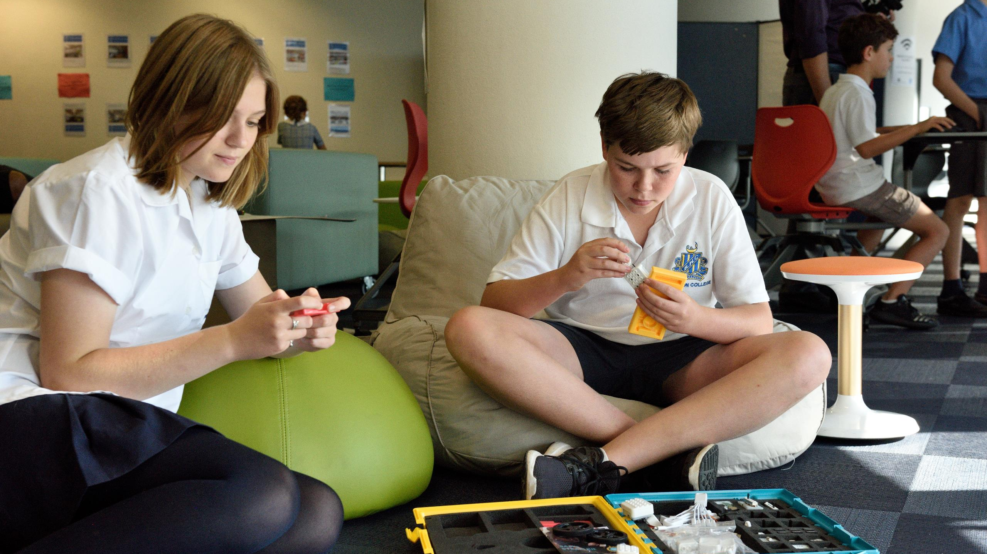
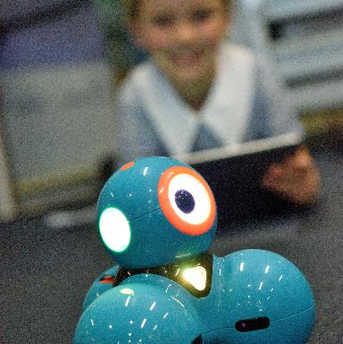
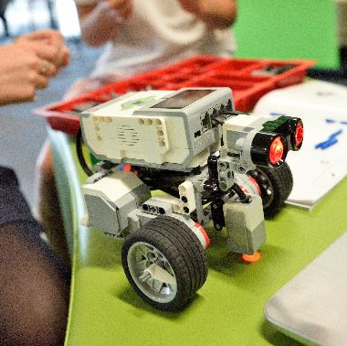
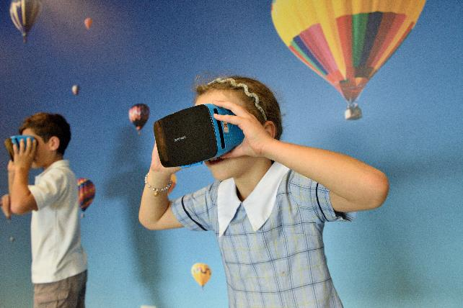



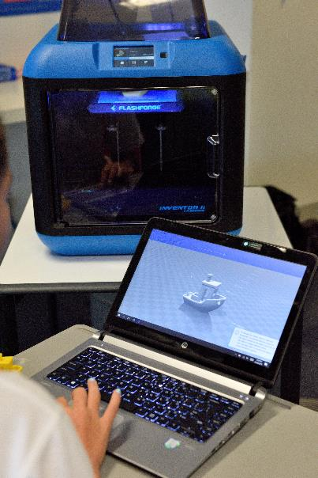
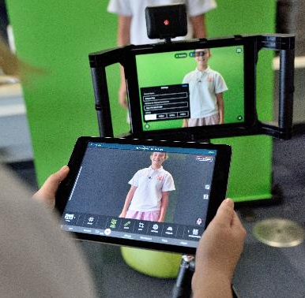
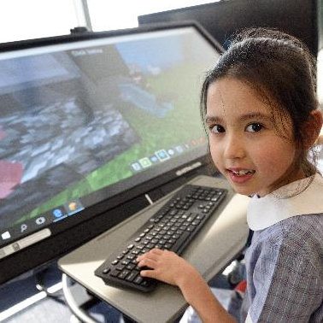



STEMShare Kits
Student and Teacher focused
Tablet
Robotics
PC
Robotics
AR and VR
3D Printing
Film making
Coding
(Virtual)
Notes:
We have 6 kits – We will explain the contents in the following slides

Slide 6

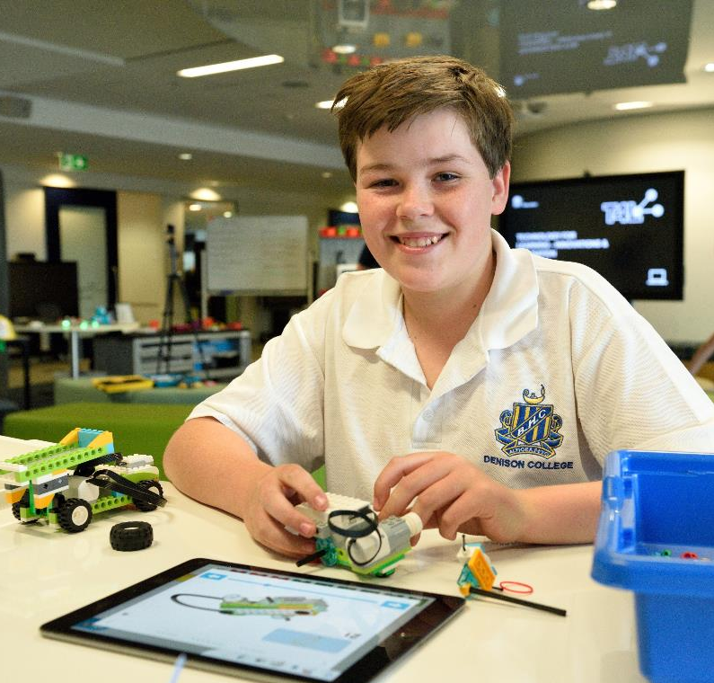
STEMShare Kits
Student and Teacher focused
Bluebot x 12
Dash x 10
Lego WeDo 2.0 x 10
Tablet
Robotics
Little Bits TBC
iPads x 10
Notes:
Great

Slide 7
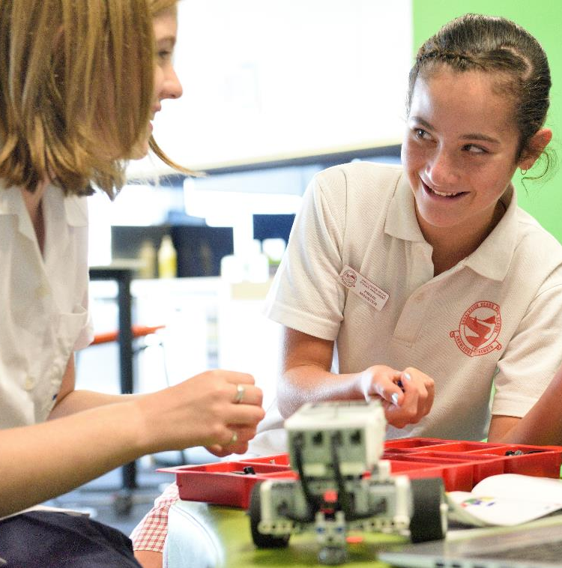
STEMShare Kits
Student and Teacher focused
Ozobots x 10
Makey Makey x 10
Micro:bit x 10
PC
Robotics
Lego EV3 x 10
Laptop x 10

Slide 8
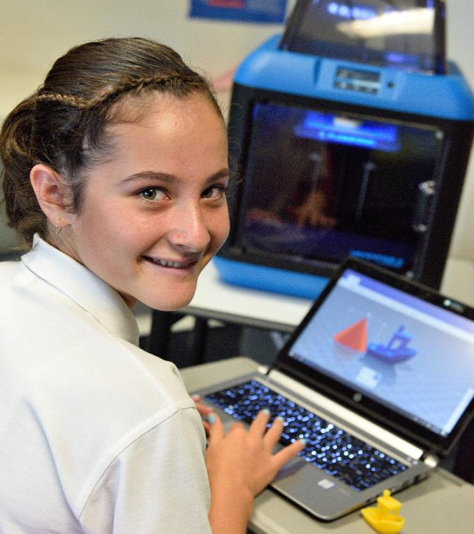
STEMShare Kits
Student and Teacher focused
FlashForge
Inventor II
3D Printer x 1
HP Laptop x 1
3D Printing
Printing Filament

Slide 9
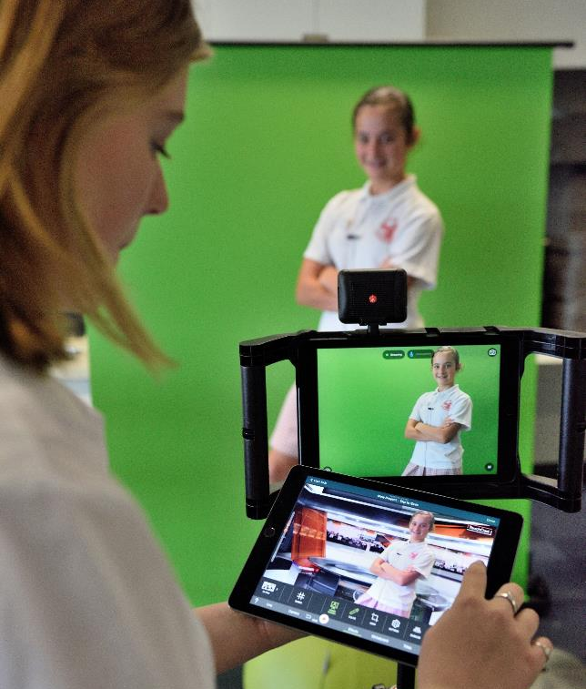
STEMShare Kits
Student and Teacher focused
2 iPads
Green Screen
Light Microphone
Film making
Tripod

Slide 10
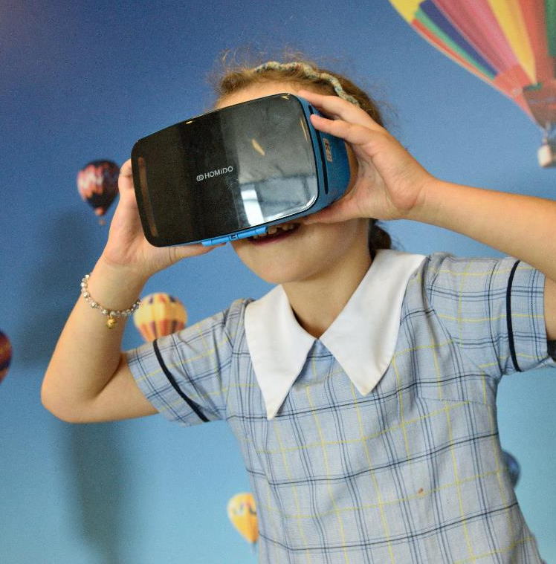
STEMShare Kits
Student and Teacher focused
10 x homido headsets
10 x phones
Router
1 x iPad
Primary VR
360 Camera
Notes:
Primary and Secondary Kits are necessary due to the differing needs of students. A Virtual Learning in Education Literature Review was commissioned and completed by University of Newcastle and the need for different kits was highlighted in that report. It can be downloaded from our Learning Library.

Slide 11
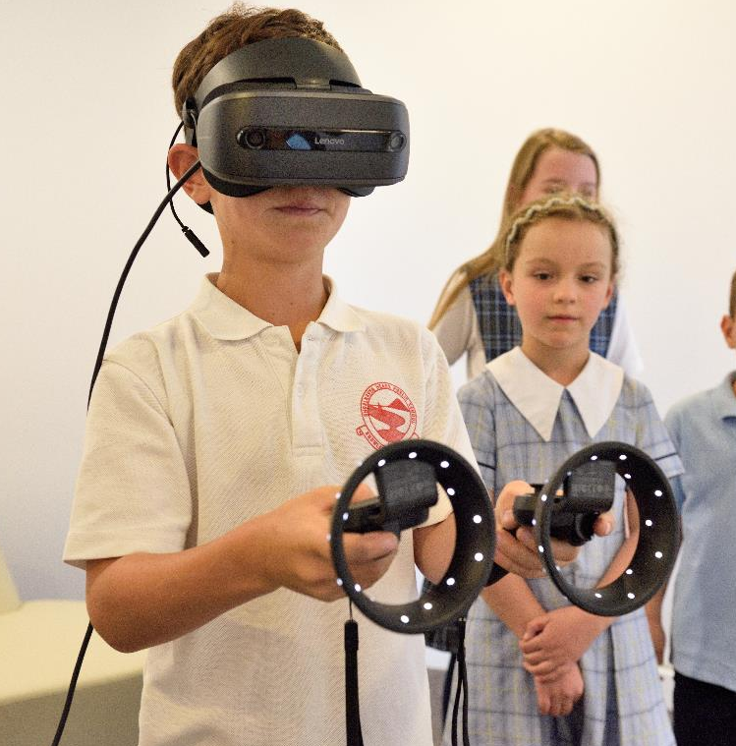
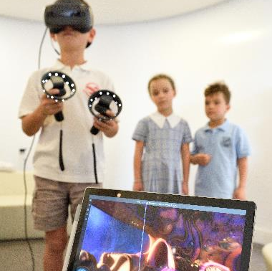
STEMShare Kits
Student and Teacher focused
2 x headsets
1 x Backpack PC
4 x Hand Controls
Secondary VR
360 Camera

Slide 12

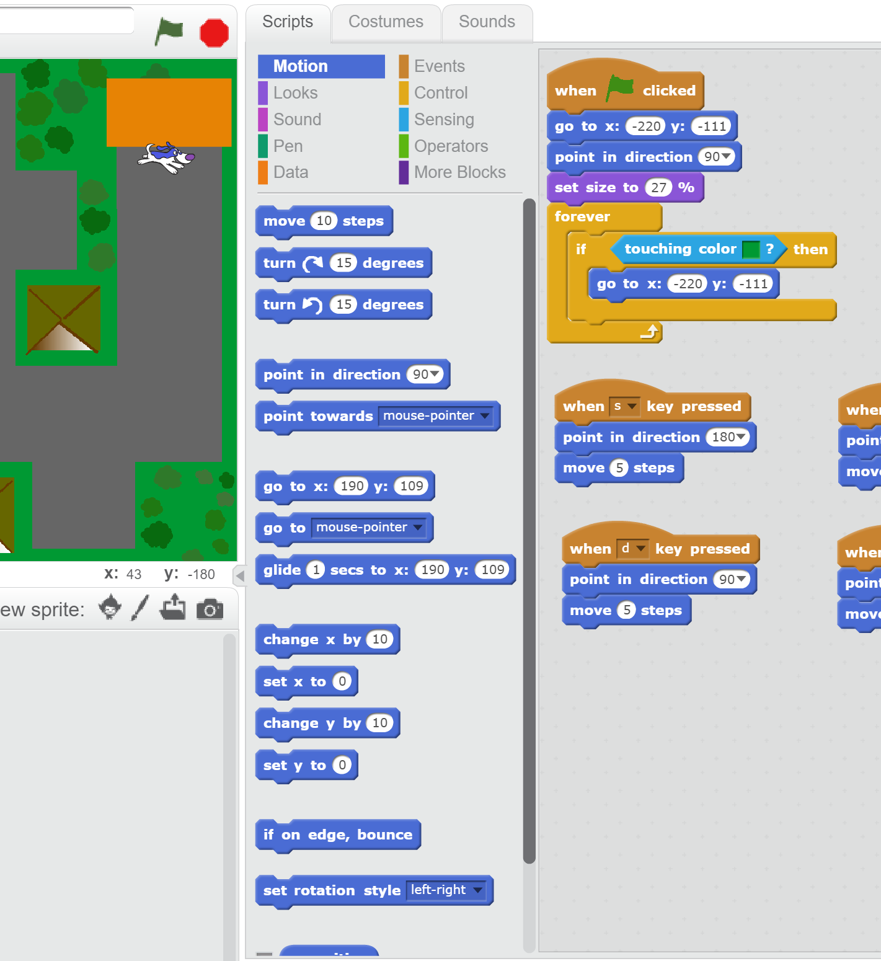
STEMShare Kits
Student and Teacher focused
Scratch Junior
Scratch
Swift Playgrounds
Coding
(Virtual)
Minecraft Education
Edition: MakeCode
Notes:
Can be used at any time.

Slide 13
STEMShare Community Project – Go Live
Program commenced in ~660 Schools across NSW – Day 1, Term 4
Pilot evaluation surveys and interviews provided the following data:
The impact of the STEMShare Community project on increasing teachers’ STEM self-efficacy was profound. While 69% of teachers believed they were not confident with STEM before the project, 81% felt confident teaching STEM at the end of the project.
The items measuring STEM Self-efficacy were rated highly and over 85% of primary students felt confident working with the kits. Similarly, secondary students’ STEM self-efficacy improved as well, as 75.5% agreed that they felt more confident using technology.
Simple | Reliable | Effective
Notes:
Our program aligns with STEM Strategy at Federal, State and Department levels

Slide 14
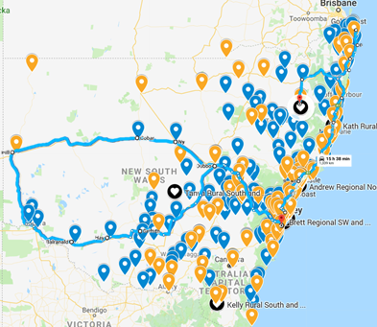
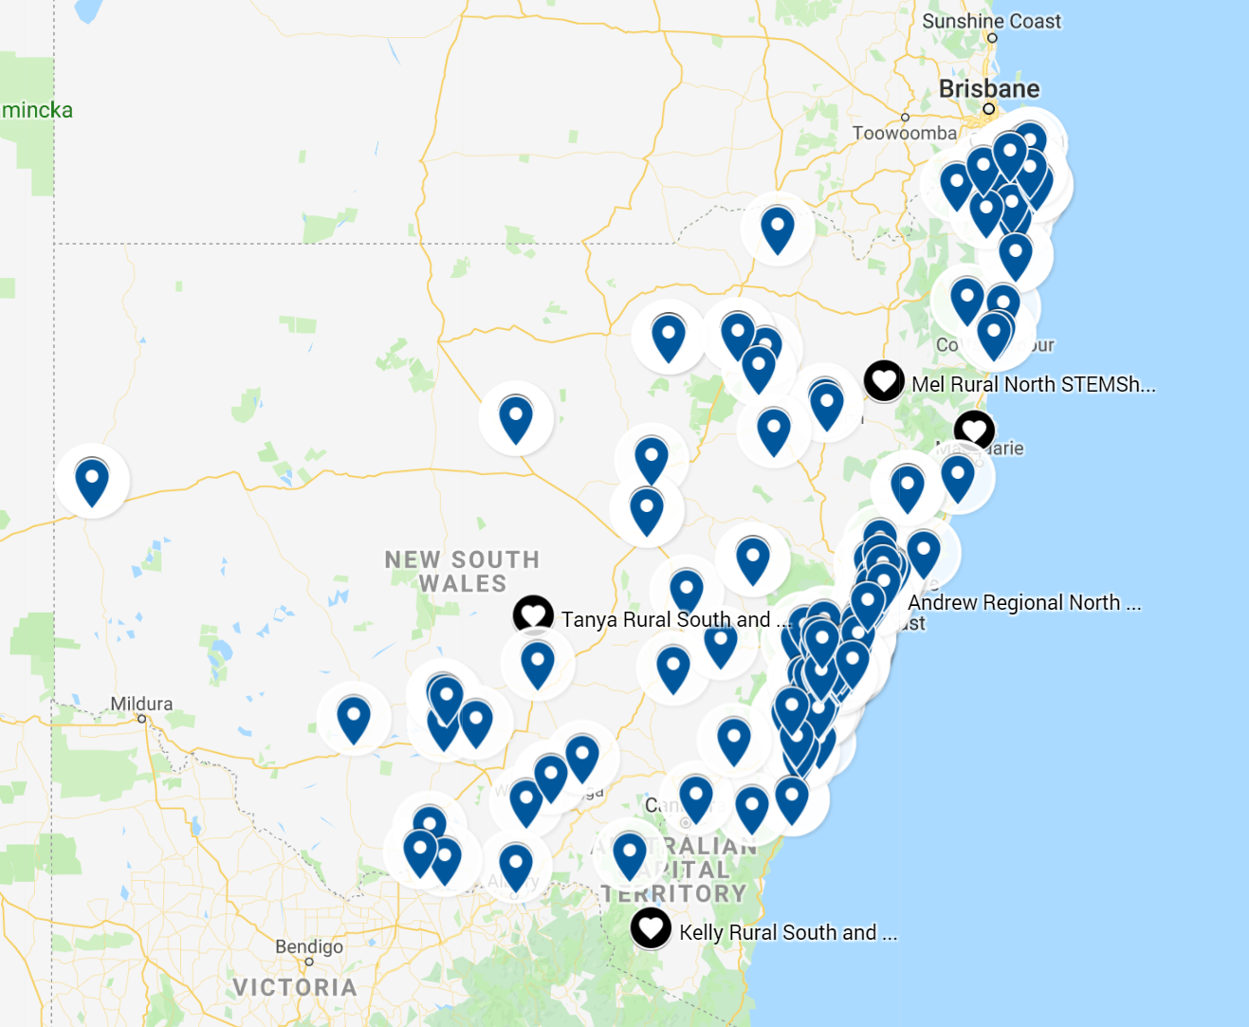


STEMShare Community Rural tour and online events
Student and Teacher focused
Rural events (blue trail) held events at:
Nyngan High School
Cobar High School
Broken Hill High School
Buronga Public School
Balranald Central School
Hay War Memorial High School
Wade High School
Callaghan College Wallsend Campus
Kempsey West Public
Coffs Harbour High School
Yamba Public School
Byron Bay Public School
Tweed Heads South Public School
Woodburn Public School
Glen Innes Public School
Armidale City Public School
Attendees for STEMShare Online Community Professional Learning
Term 4 Booking Schools
Term 1 Booking Schools
Simple | Reliable | Effective
Notes:
We have 6 kits – We will explain the contents in the following slides

Slide 15
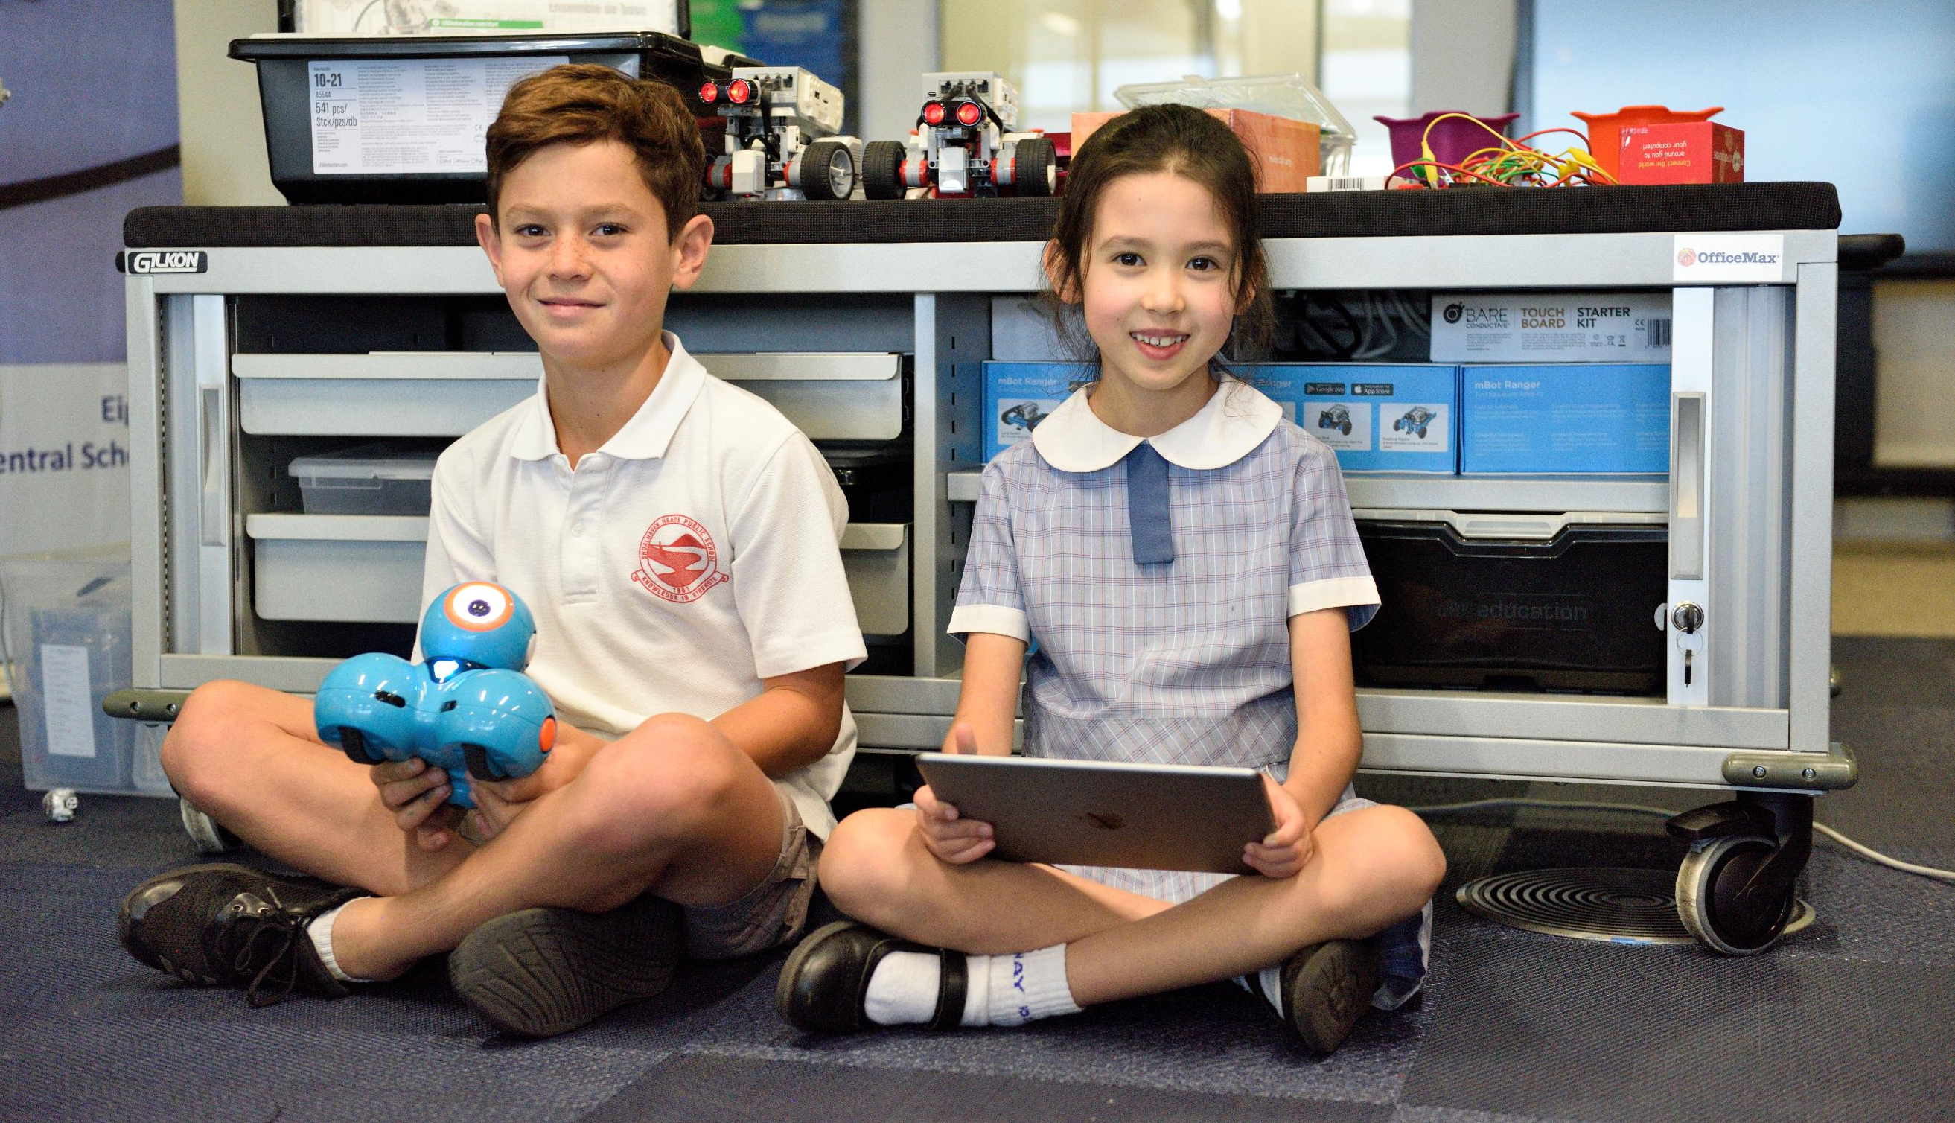
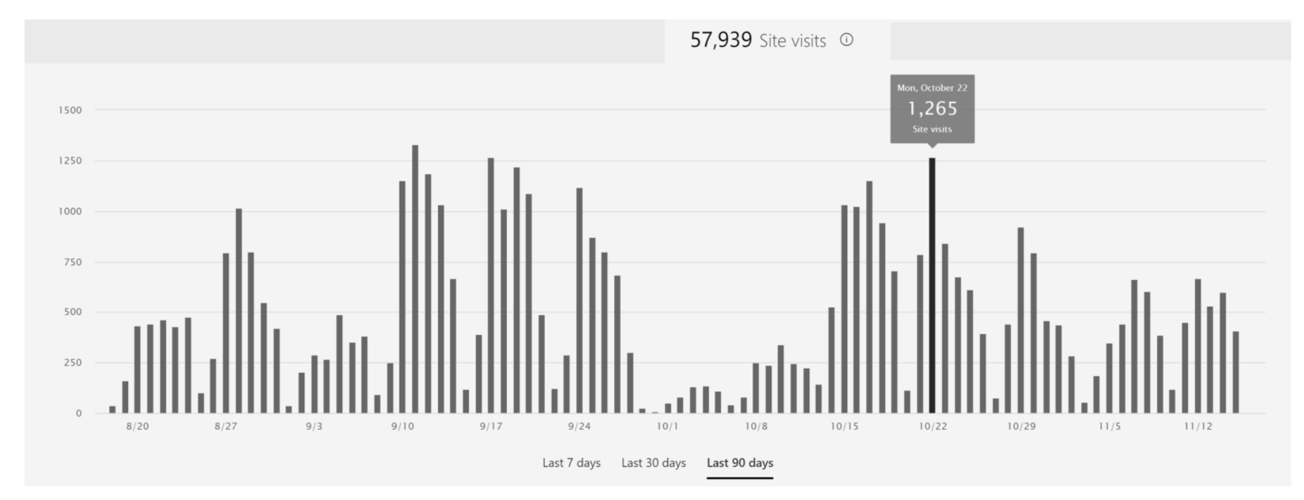
LEARNING CONTENT AND INTERIM LEARNING LIBRARY
Simple | Reliable | Effective
Notes:
Go through the 4 steps in depth.

Slide 16
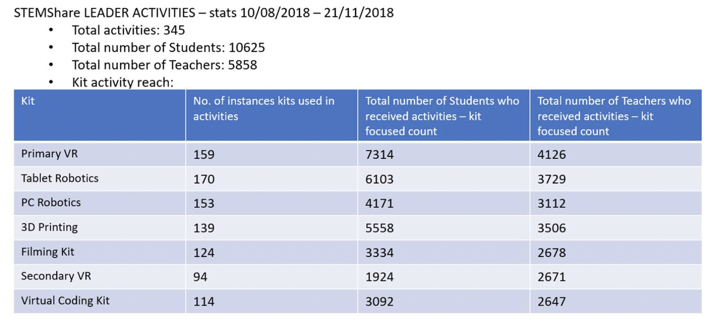
STEMShare Community Leaders
Simple | Reliable | Effective
Notes:
Go through the 4 steps in depth.

Slide 17
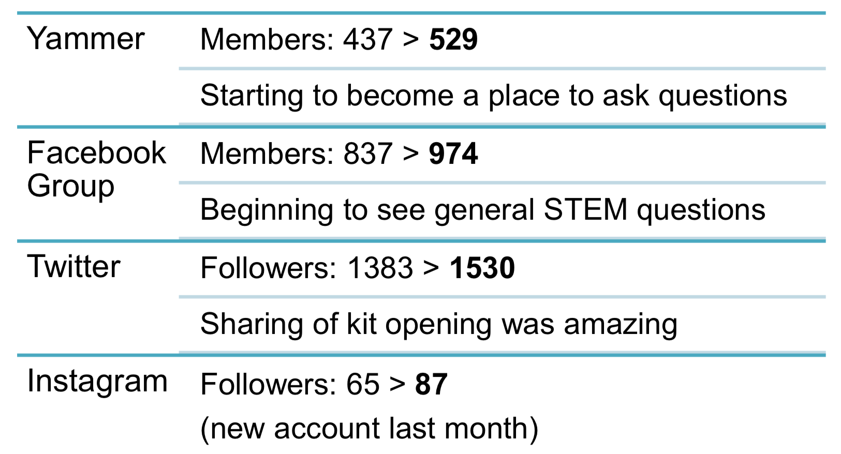
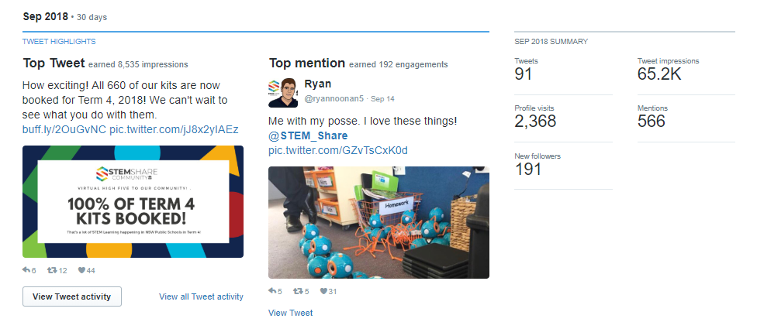
STEMShare Community Training, Comms and Analytics
YouTube
Analytics. 41 Videos. 14,000 minutes of professional online learning delivered through YouTube
Simple | Reliable | Effective
Notes:
Go through the 4 steps in depth.

Slide 18

Questions???
Supporting students to develop workforce ready future skills

