Slide 1
‘One finance’ project
Voice of customer
Confidential, not for distribution, subject to consultation

Slide 2
Finance vision and purpose
DRAFT Work in progress
PURPOSE
Finance works in partnership, to deliver strategic services, advice, guidance and support to schools and the broader Department of Education to empower them to use sound financial management to achieve their objectives.
VISION
To be the leading, trusted, service partner in the provision of timely, value add strategic financial information to schools and the broader Department of Education.
Confidential, not for distribution, subject to consultation

Slide 3
GUIDING principles
DRAFT Work in progress
Key Drivers
Core Service Guiding Principles (Draft)
Voice of the Customer
Corporate Services strategy
One Finance strategy
Financial management capability
Government policy (e.g. outcome based budgeting)
Design to deliver on purpose and vision of Finance
Design to enhance accountability
Design for the needs of the customer (Schools & Non-Schools)
Design to improve visibility and control
Design for customer clarity and outcomes
Design for effective governance, including segregation of duty
Design to support effective collaboration
Design to leverage resources and technology to optimise performance
Design to support the development of optimal skills and competencies
Design for continuous improvement
Confidential, not for distribution, subject to consultation
Notes:
Given what we have discussed about the role, mandate and value proposition for Finance, what are the key guiding principles for this organisation design work?
Which are the most important?
What others need to be added? Max 10 – ideally 8

Slide 4
Voice of customer - who
Principals –– Primary/Secondary/ SSP from Tamworth, Port Macquarie and Ryde
School Admin Managers, SAO’s and Business Managers
PPA and SPC – Finance and Administration Reference Group Members
Directors Educational Leadership
Department Executive including Murat, George, et al
Other Senior Executive from across the Department

Slide 5
Voice of customer responses
The VoC exercise has unveiled a range of aspirations for the future of Finance
“Escalation points are needed”
“I need a clear indication of the level of funds available for use at a point in time, with a consistent answer no matter who I ask”
“Schools need help in understanding how to phase their budget”
“We need a single point of contact who knows the systems and knows schools”
“Without finance specialists working within schools, they will never really know how they are performing. The advice provided by ‘Finance’ will never be enough”
“We need the ability to manage our finances in alignment with our strategic plan. There needs to be a tailored approach to the audience”
“We need faster turnaround time for queries. It can take up to three days”
“We need clearer rules and guidance, with easy to understand documents”

Slide 6
Case for change to achieve our vision
Subset
Improve our culture and engagement - our people experience frustration and confusion in doing their day to day role
Our customers tell us we need to improve how we connect with them and delivery consistent service
We can add a lot of strategic advisory / value to our customers but cannot do this until we change how we operate
Work is being duplicated unnecessarily
We are working in silos across DOE
Lack of accountability, unclear RACI (Responsible, Accountable, Consulted, Informed)
The environment is changing (including external expectations of DOE)
Confidential, not for distribution, subject to consultation

Slide 7
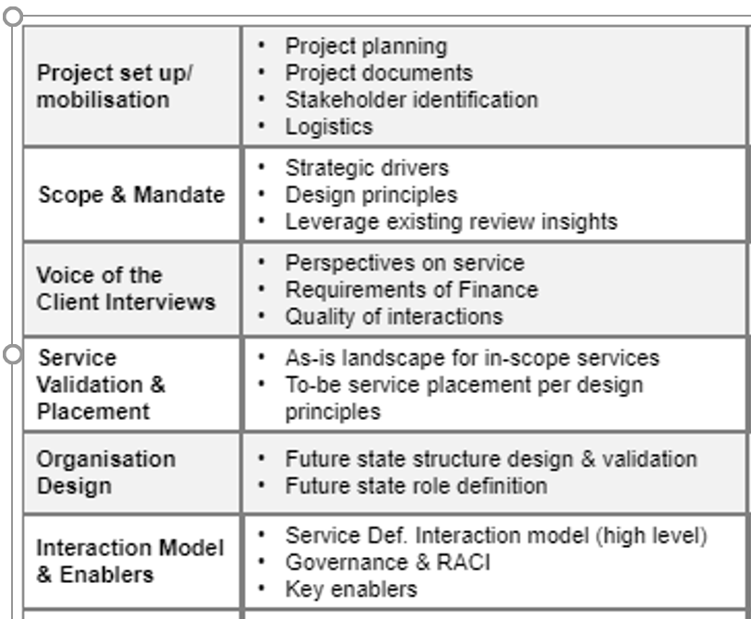
Project stages

Slide 8
PROJECT OBJEcTIVES / TARGET outcomes
Finance Operating Model and Service Delivery
There is clear governance and accountability of decision making in Finance (across DOE)
Finance is a strategic business partner, agile and responsive to the Schools and DOE’s needs;
Processes are streamlined and easy to use;
Finance support DOE across the provision of all of its financial reporting needs, providing relevant understandable information;
The Finance team comprises a team of skilled professionals;
Finance supports diligence and rigour with internal controls;
Confidential, not for distribution, subject to consultation

Slide 9
KEY DRIVERS / Finance Purpose & Vision
Improved value for customers
Minimise fragmentation
Eliminate shadow structures
Increase financial transparency
Improve accountability
Confidential, not for distribution, subject to consultation
Notes:
This is why we’re here – is there agreement in the room?

