Slide 1
The challenge of education reform
Igniting Expertise – NSW Highly Accomplished and Lead Teacher Forum
Mark Scott
Secretary
NSW Department of Education
Notes:
Acknowledgment of Country - Gadigal People of the Eora nation.
The complexity and ambition of the challenge is bigger now – the stakes are higher.
How do we commit ourselves to deliver now that the stakes are higher?
It’s got to be driven by a focus on the individual child, on constant improvement in every school and classroom, we’ve got to make sure that every child known, valued and cared for and we have to make education work to close the disadvantage gap.
But there is a tension here. We need that long term vision – improving results, making change, teacher quality, leader quality.
But…a year is a long time in the life of the child.
Every parent wants their kid to have a great year – THIS year.
And that’s the commitment we need to be making for over 820,000 students – and their families - in NSW public schools this year.
So there is a tension – we need to be steering purposefully towards the big picture improvement – but we need to be delivering now.

Slide 2
Our purpose
We are preparing young people for rewarding lives as engaged citizens in a complex and dynamic society.
Notes:
We’ve been thinking very carefully about how we work with that tension. We must absolutely focus on the individual child and we need to be carefully and strategically building the environment for long term success – a system that prepares all of its students for a technological future.
There is a lot of work going on in Education this year. You will have heard about our record breaking investments in infrastructure – and we’re extremely proud of the quality of that work. New and re-vamped schools that are not just great to look at but which have thoughtful physical spaces that support pedagogy. And we’re improving access to preschool; there is the curriculum review.

Slide 3
Our priorities
What we’re focussing on in 2019
  School and student outcomes
  Quality of our teacher workforce
  Quality of our school leaders
  Support for our schools
  Our people and growing a great place to work
Notes:
We’ve been thinking very carefully about how we work with that tension. We must absolutely focus on the individual child and we need to be carefully and strategically building the environment for long term success – a system that prepares all of its students for a technological future.

Slide 4
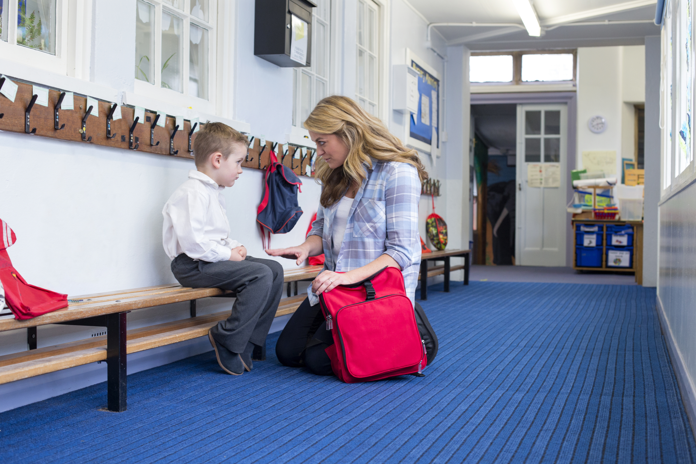
Every student is known, valued and cared for
Notes:
This is the centrepiece – it runs through all of those priorities.
We know that feeling not just welcome but wanted at school makes all the difference – kids will turn up and kids will want to work when they feel that someone cares.
Three principals-in-residence to go out and find the best practice in the state. And we got our Centre for Education Statistics and Evaluation (CESE) to support that work by looking at really robust evidence. And now there’s great digital tool kit.

Slide 5




School and student outcomes
2019 priorities
Improvement every year
Tailored support
Student need
Clear targets
Notes:
Looking to see schools articulating how they need to improve, and then the strategy of the school, the professional learning plan of the school, the prioritisation of school funding and resources to drive that school improvement everywhere -every school, every classroom and with every teacher, every, leader, every student, every year. We are studying the data to learn from schools that are doing exceptionally well and seeing a lift.
Closing the gap for Aboriginal students. Rural and remote students who also have significant disadvantage. We’ve recently released our new Disability Strategy. Demand for disability support is growing at four times the general enrolment growth, and only 9 per cent of our teachers are specially trained to support those students. We will be helping principals hire extra support staff, giving school leaders and teachers extra training, and working with the universities to boost numbers of disability specialists.
And we know we need to deliver tailored support for schools that's targeted specifically at their needs.
And we know that every school does need clear targets, so a clear expectation as to what it is that they are trying to achieve for the students in their care this year.

Slide 6
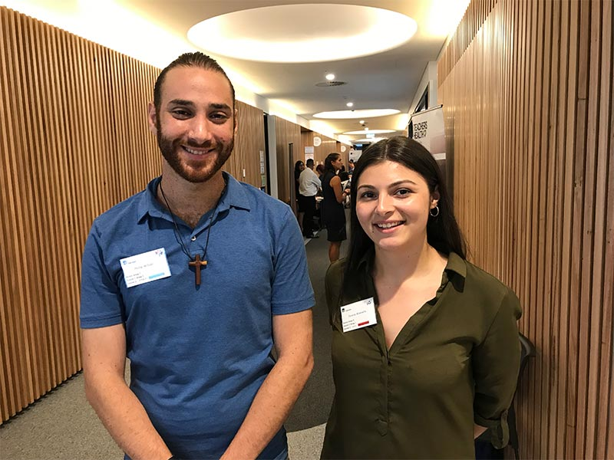
Quality of our teacher workforce
2019 priorities
“The Summer School gives me a great opportunity to delve further into areas of teaching that are not covered in-depth at university.”
- Beginning teacher Phillip William
Notes:
We’re privileged to have some outstanding educators here in NSW. Every teacher needs to improve in every school every year. The world our students will be moving into as adults is an uncertain one and the status quo isn’t good enough.
Professional learning opportunities
quality of recruitment
pipeline to deal with the growth that's coming, and to deal with those parts of the state and those subject areas where we are having some
first five years - Summer School for beginning teachers

Slide 7
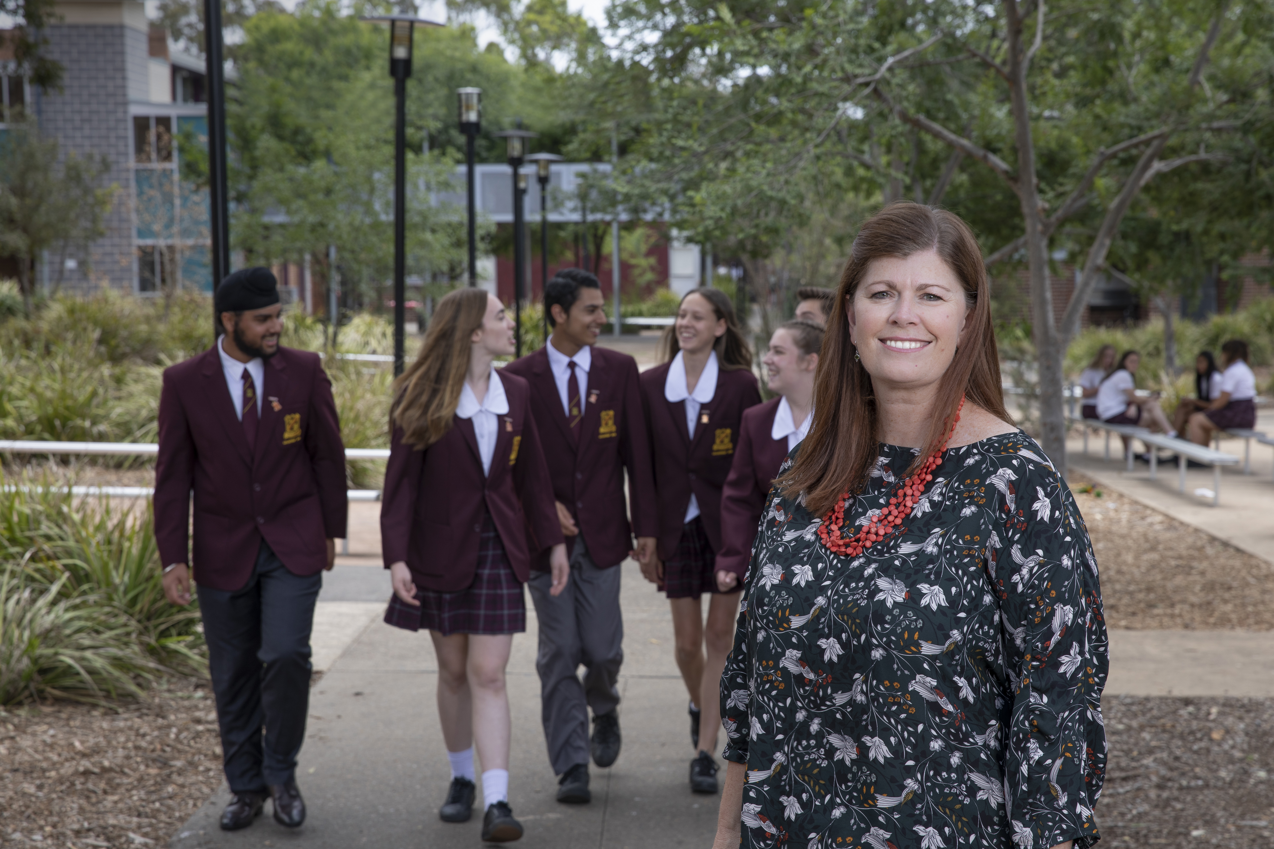
Quality of our school leaders
A good principal makes all the difference
Notes:
Big question for parents - ‘what’s the principal like?’
They know that a school with a great leader is one that will have high expectations, it will have a culture of improvement and it will be a place where their child is known, valued and cared for. They know that it’s the school leader that shapes what the school is like. And the evidence is right behind what parents intuitively know.
Making significant investments in supporting our school principals. We are working on:
lifting the administrative burden
providing improved professional development
preparing our aspiring principals more thoroughly - Aspiring Principals Leadership Program – the first cohort have started the 12 month leadership program and a second cohort starts April.
Photo: Stacey Quince from Campbelltown Performing Arts High.
Campbelltown is a public school located in South-Western Sydney with 1100 students from diverse language, cultural and socio-economic backgrounds.
Stacey is particularly committed to future-focused learning. With her leadership Campbelltown has completely rethought its assessment practices and they have changed the changed the curriculum structure and staffing; the physical set up of rooms to meet the need of new pedagogies; parent-teacher interviews; and the way they transition students from primary school – not just surface level adjustments but fundamental changes to the ways they work as a school.
Their work is having an impact – they have found increased student engagement, improved learning outcomes, enhanced partnerships with community, and created stronger partnerships with parents.
On ‘traditional’ measures they are also seeing improvements - Year 9 NAPLAN growth continues to increase; the gap between Aboriginal and non-aboriginal students is closing according to Year 9 NAPLAN, with Aboriginal students performing commensurate with or, in some instances, outperforming non-Aboriginal students — a statistic that defies national trends. Campbelltown Performing Arts High is also seeing increasing numbers of graduates heading to university each year, most of whom are the first in their family to do so.

Slide 8


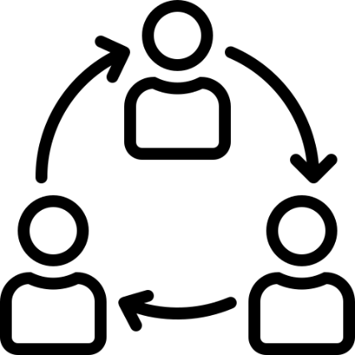

Support for schools
2019 priorities
Administrative systems
Lifting the burden
Strategic planning and budgeting
Workforce planning
Notes:
We know - and we've heard from schools and principals - that some of administrative systems have not worked as well as they should.
And we know that our system still has unnecessary red tape and paperwork.
working on improving our strategic planning and budgeting
we’re improving our workforce planning – we’re developing a powerful school enrolment forecast tool and a key learning areas coverage and forecast tool.
So we’re making these things priorities – we want support for schools that is genuinely supportive and we have a team who are working on improved delivery of these systems and services to schools.

Slide 9


Our people & a great place to work
2019 priorities
Values led organisation
Cultural insight
Notes:
People are in Education for the best reasons – they know it is such important and valuable work.
And we all spend a lot of time at work – responsibility to provide meaning and purpose
We want to create an environment where we support that work, where our people feel respected as professionals, where they can develop their skills and grow into opportunities.
We want to be – and be seen to be – a values led organisation. And we want to really use cultural insights into our organisation to work out how to create a place where people can bring their best selves to work.
Yes, we'll have new buildings, yes we'll make investments in technology, but fundamentally we all know it's the magic that happens in the classroom and the support that people wrap around the classroom that really makes the difference to students' learning. And so that's what this priority is all about.

Slide 10
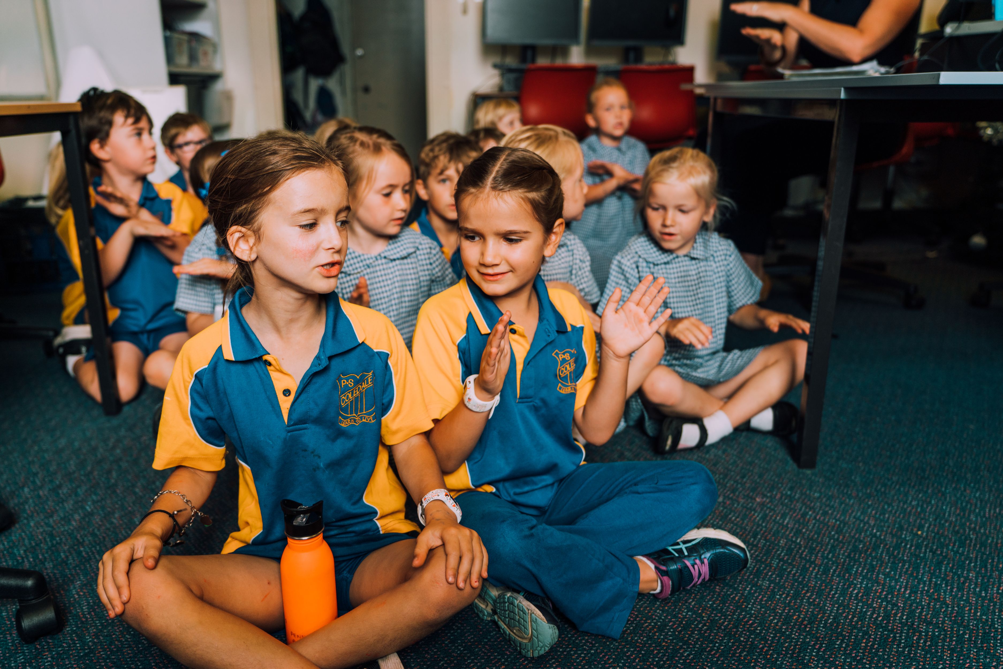
Notes:
Making a difference in each individual student’s learning
Right strategies and supports in place at the systemic level
- happy kids, learning.

