Slide 1


Slide 2
NSWPPA President’s Report
Welcome
Big thanks to Dep President Robyn Evans
Thank you to those President’s / delegates who have returned their update sheets. 33/43 returned. Merit lists to HR this Friday.
Principal Classification – gathering your thoughts
EPAC Workshop
Elections:
  Be wary of politicians
  State promises – 100% SRS, free transport, glasses, builds & upgrades, $5000 per P & C….
  Federal elections – APPA presentation

Slide 3
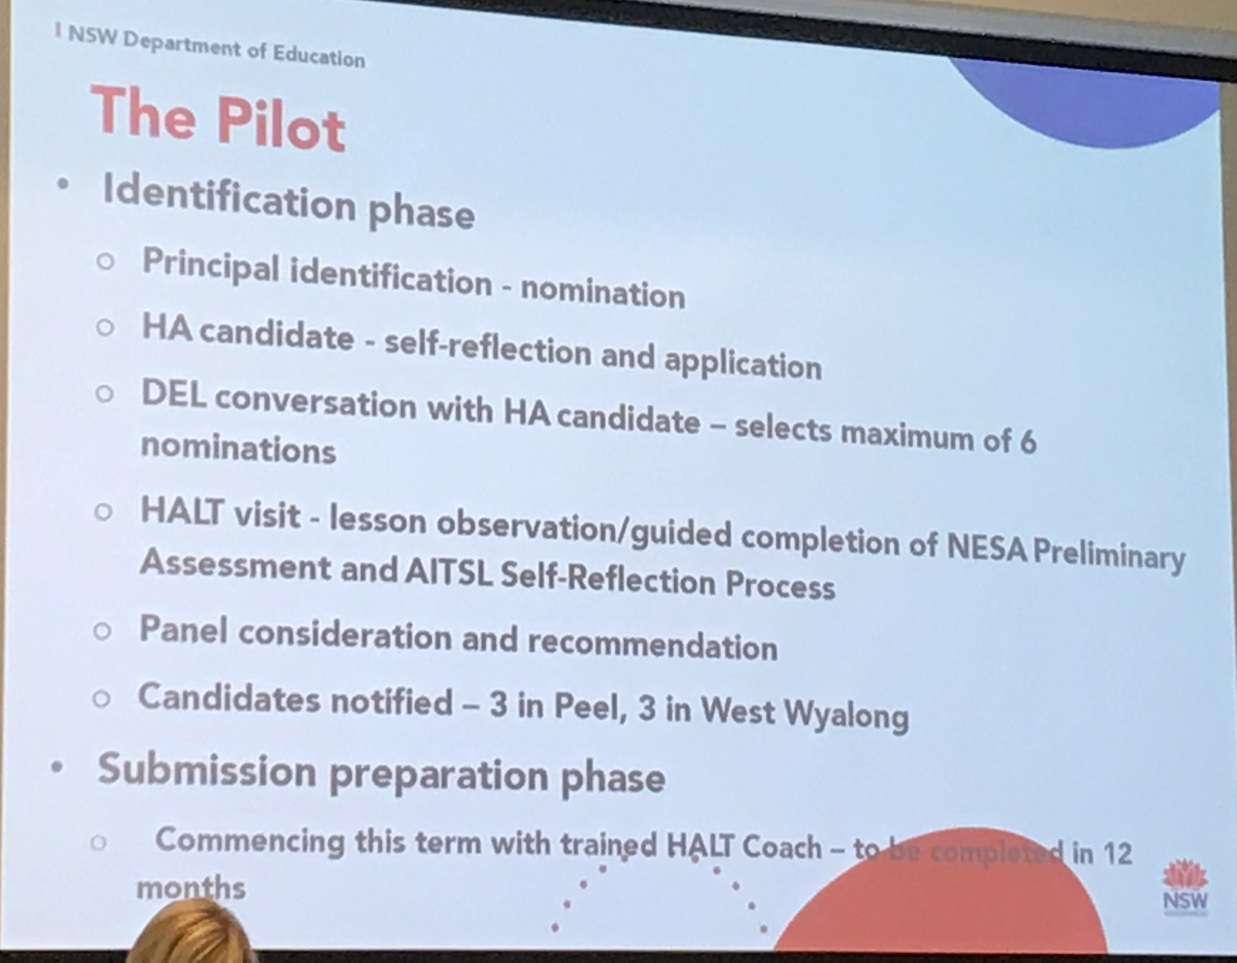
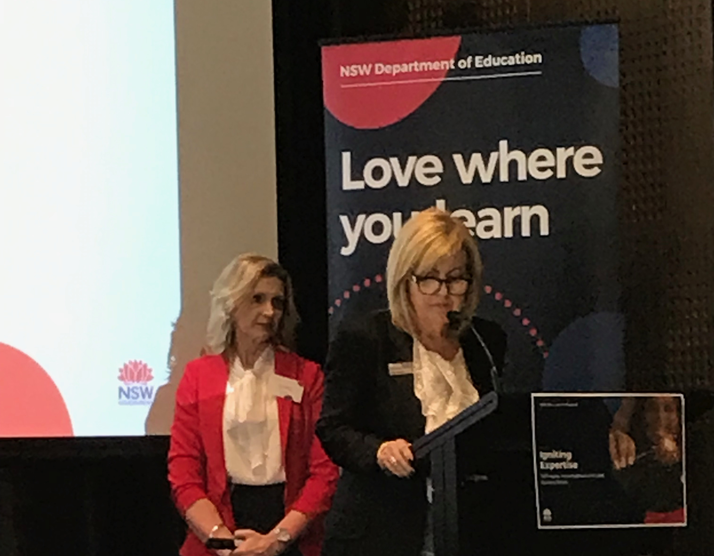
NSWPPA President’s Report
Fair Funding Campaign – our role. It’s about fairness. TF President Maurie Mulheron will be speaking.
Conferences – leadership initiatives:
  Principal Induction
  School Leadership Institute – Aspiring leaders
  HALT Conference
  Mastery of Teaching

Slide 4
NSWPPA President’s Report
Meet the Minister– key issues discussed:
  Disability Strategy
  EPAC & Principal classification
Meet the Secretary – key issues:
  Principal classification/ well-being & support with media
  Educational Services Review – 16 projects
  Finances – 6100 & 6300, Scout reports
  Teaching & Learning – EaFS, Best Start….

Slide 5
NSWPPA President’s Report
Some Wins–
  Teacher days for Teaching Principals including EECs
  Director – Rural Education & Pathways
  Review into EPAC - will focus on the investigative aspect of EPAC’s operations and the manner in which allegations of staff misconduct are referred, received, investigated and managed.
  Professional Learning Officer – Margaret Charlton

