Slide 1
Striving for Excellence
Our Service Improvement Journey
Georgina Harrisson
Deputy Secretary, Educational Services
Notes:
Great to be here, it is a chance to share the progress we have made so far with more of you and to talk about what we’ll be focussed on in the year ahead. We are really keen to hear from you and get a sense of whether this work is starting to translate for you in having access to better support for the development of your staff, improvement of your school and simplification of what we provide you.

Slide 2
Today we share with you
Our highlights of 2018 – quick recap and update on progress
Our priorities for 2019 – where to next?
Notes:
Since we completed the Educational Services review a year ago, we’ve been busy in Educational Services, and across the Department, delivering against the commitments we made to you.

Slide 3

The review provided us with four focus areas
Quality teaching to improve every student
Tailored support to improve every school
Prioritising teaching time
Leading the improvement journey
Notes:
The review provided us with 4 focus areas:
1) Quality teaching to improve every student
2) Tailored support to improve every school
3) Prioritising teaching time
4) Leading the improvement journey
…based on the feedback we heard from you, about what you were looking for from the department.

Slide 4

Priority One
Improving the outcomes of our students and schools
Notes:
The learning and wellbeing of students is the focus of our work in Educational Services
We coordinate and deliver high quality and responsive policies and services to schools to improve student learning outcomes
We provide tailored support to schools that reflects where they are in their improvement journey, working closely with DELs and Principals at every step
We work with schools, communities and other stakeholders to boost outcomes for Aboriginal students
Projects included:
Tailored support – strategic planning process
Support resources
Literacy and numeracy strategy
HSC & Maths strategy

Slide 5

We heard your voice so we have…
built our capacity to support schools with formative assessment, differentiated learning and strengthening behaviour management
co-designed resources, using the best talent in our teams and schools.

Slide 6
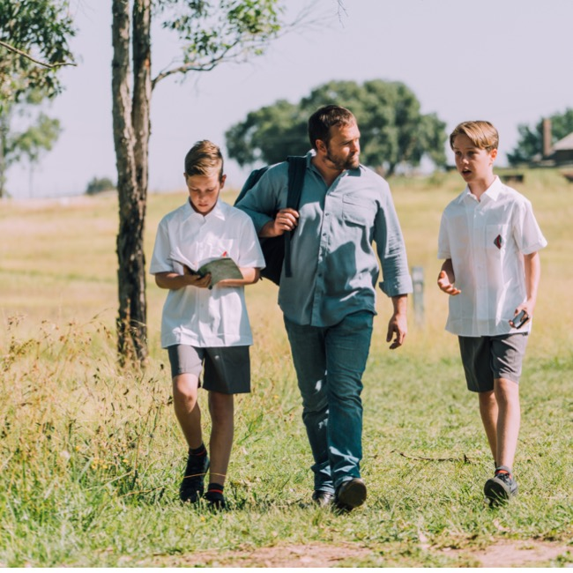
Priority Two
Improving the quality of teaching
Notes:
The quality of teaching is the most important in-school determinant of student outcomes; Educational Services supports teachers from their first day in a classroom to improve their teaching practice
We aim to provide relevant, impactful professional learning that enables teachers to improve student learning outcomes
We develop resources and provide local support to help principals and twachers to translate the curriculum and new syllabus content into effective classroom practice
Projects include:
Support for early career teachers – Summer School
QA of PL
Literacy and numeracy strategy
Curriculum support

Slide 7

Confidence in the new syllabus
Reached 26,000 teachers
87%
feel confident or very confident with new syllabus

Slide 8
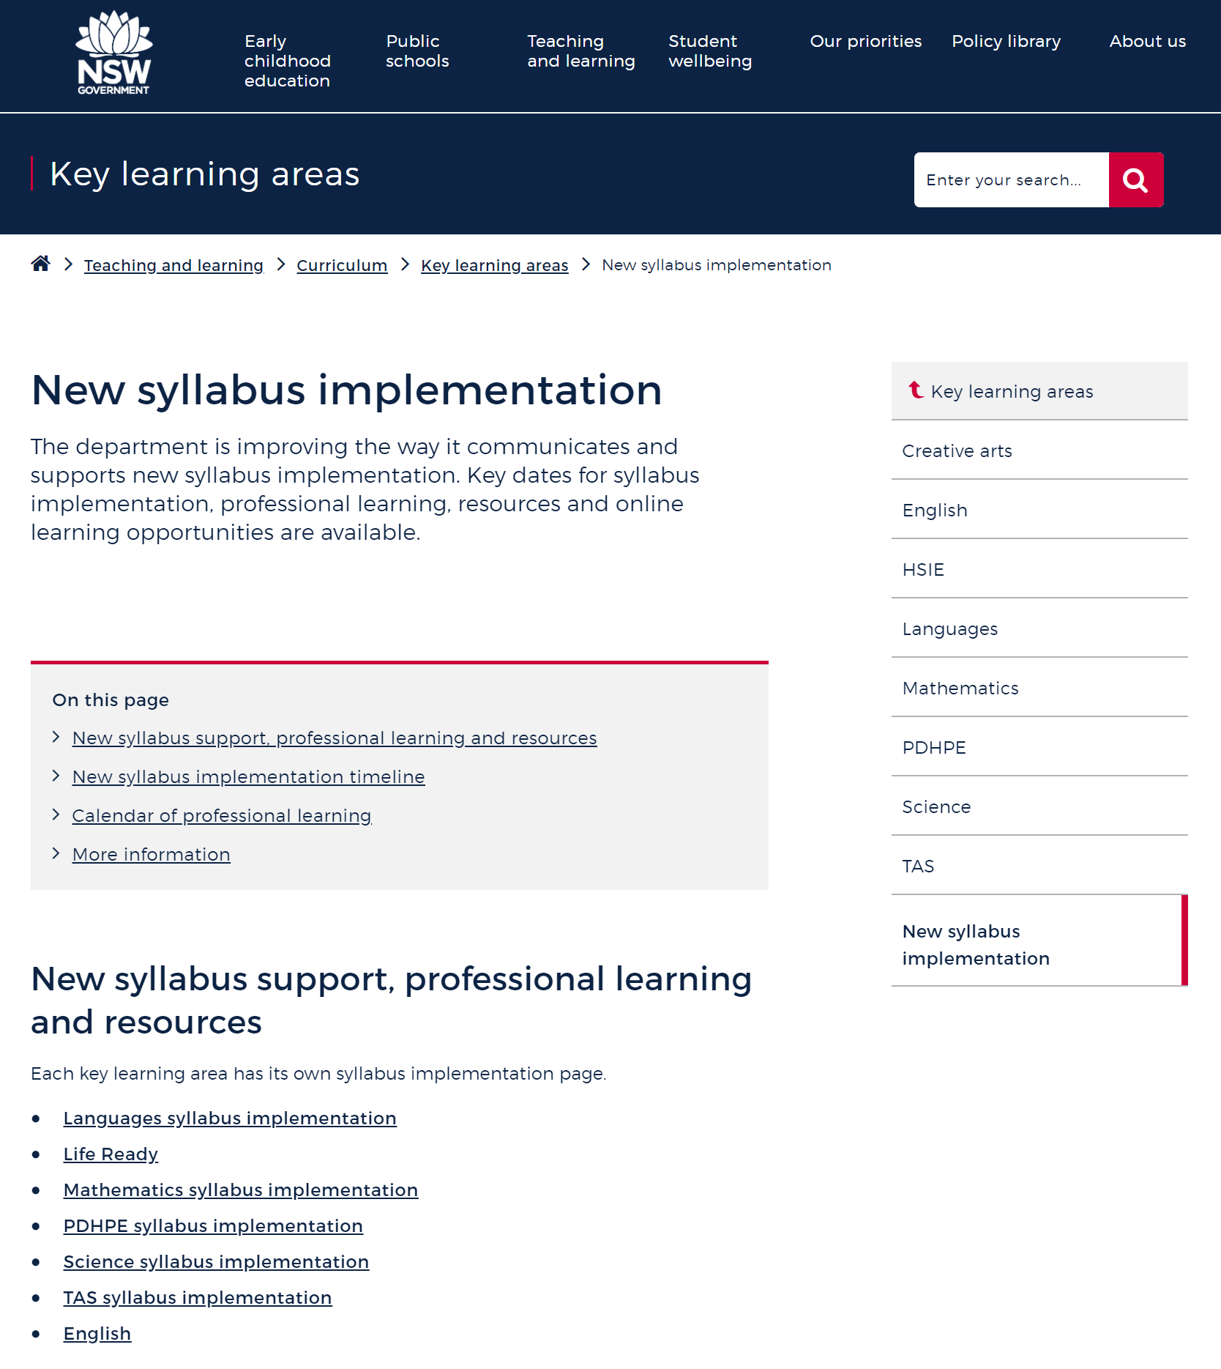

Support for teaching practice and curriculum
Making information easier to find with a dedicated curriculum support portal.

Slide 9

Priority Three
Creating a great place to work
Notes:
We all need to play a part in making this a great place to work
We are open to new ideas and ways of working
We are collaborative and supportive of each other
Students are at the centre of our decision-making
Projects include:
ESD collaboration model
Workforce strategy
ESD induction and PL

Slide 10
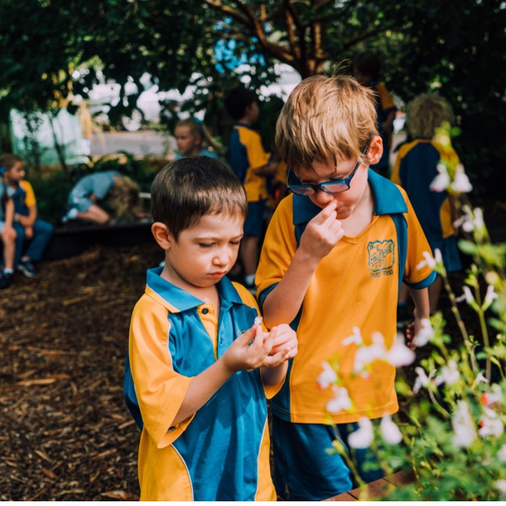
Priority Four
Improving systems support to schools
Notes:
Through our support to schools, Educational Services helps teachers to priorities teaching time while ensuring the learning and support needs of their students are met
We develop new policies and services hand-in-hand with school principals, teachers and admin staff so that anything we provide meets the needs we know they have
We ae continuously improving the experience of schools who contact Educational Services, whatever channel they use, so that they can access services and practical, expert advice
We recognise that change – even when it offers a benefit to schools – needs to be managed well and we work acrsoss the division and the department to reduce the burden of change to schools
Projects include:
Service navigator
Streamlined customer service with School Services
Confident with complexity
Improving the learning journey (access requests)
QA wellbeing services
User friendly policies
Online enrolment policy

Slide 11
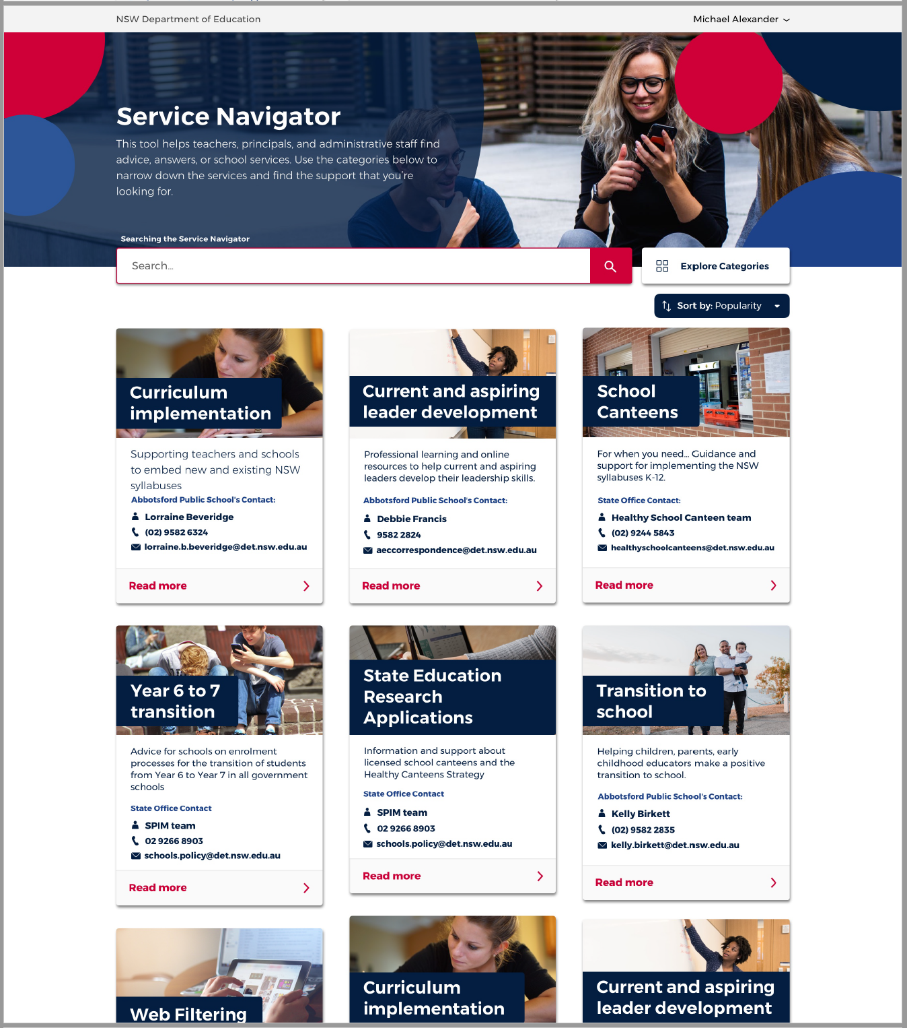
Service Navigator launches
We tested this with you and as a result, we have...
 improved navigation
 personalised and more tailored content
 integrated school services list
 latest version launches in term two.
Notes:
Service navigator – we had a go, we piloted, we learnt, it will be relaunched later this year…..

Slide 12

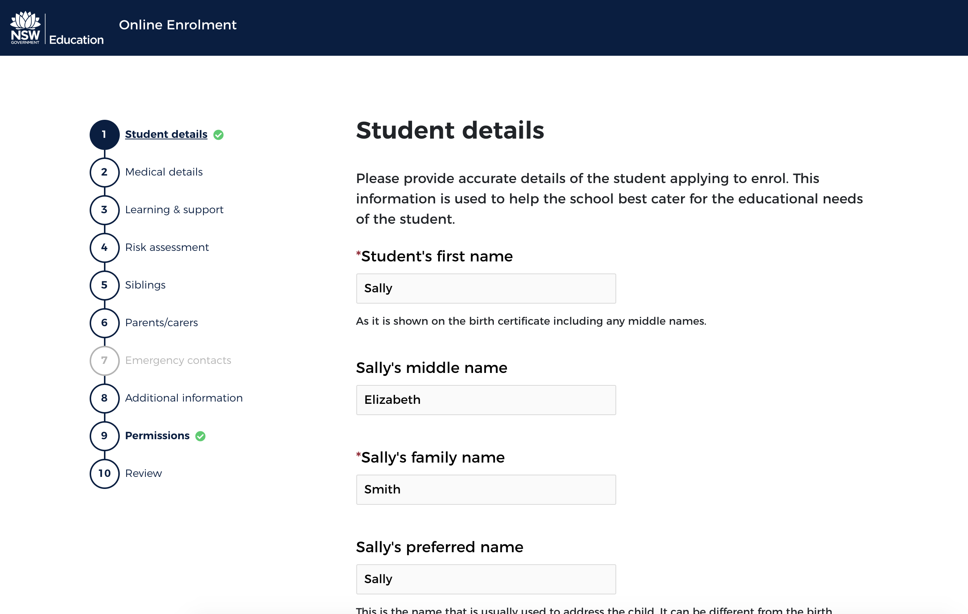
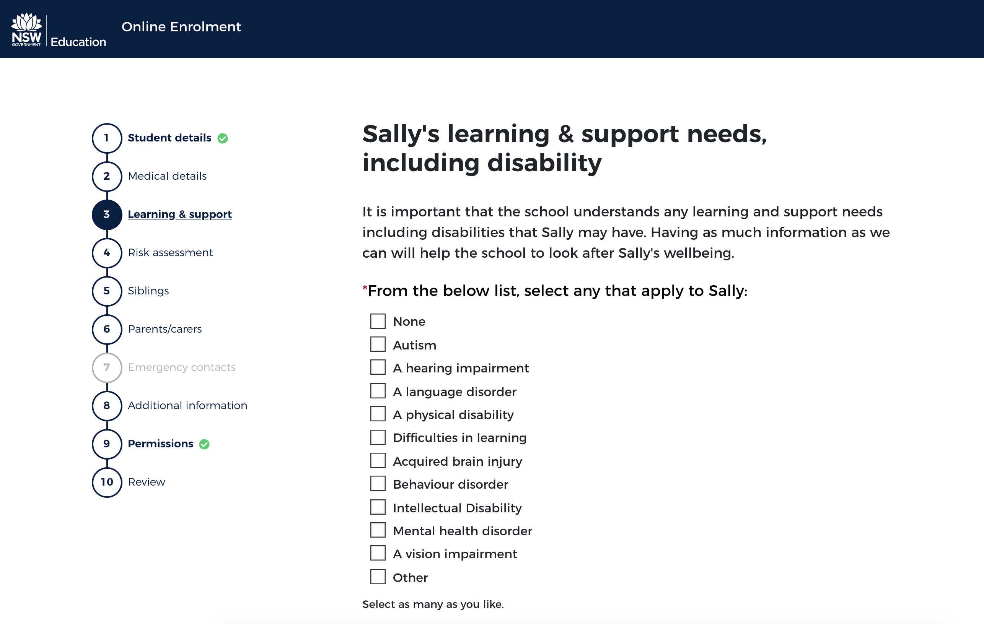
Online enrolment forms
saving time for schools and for our parents
Parent interface

Slide 13
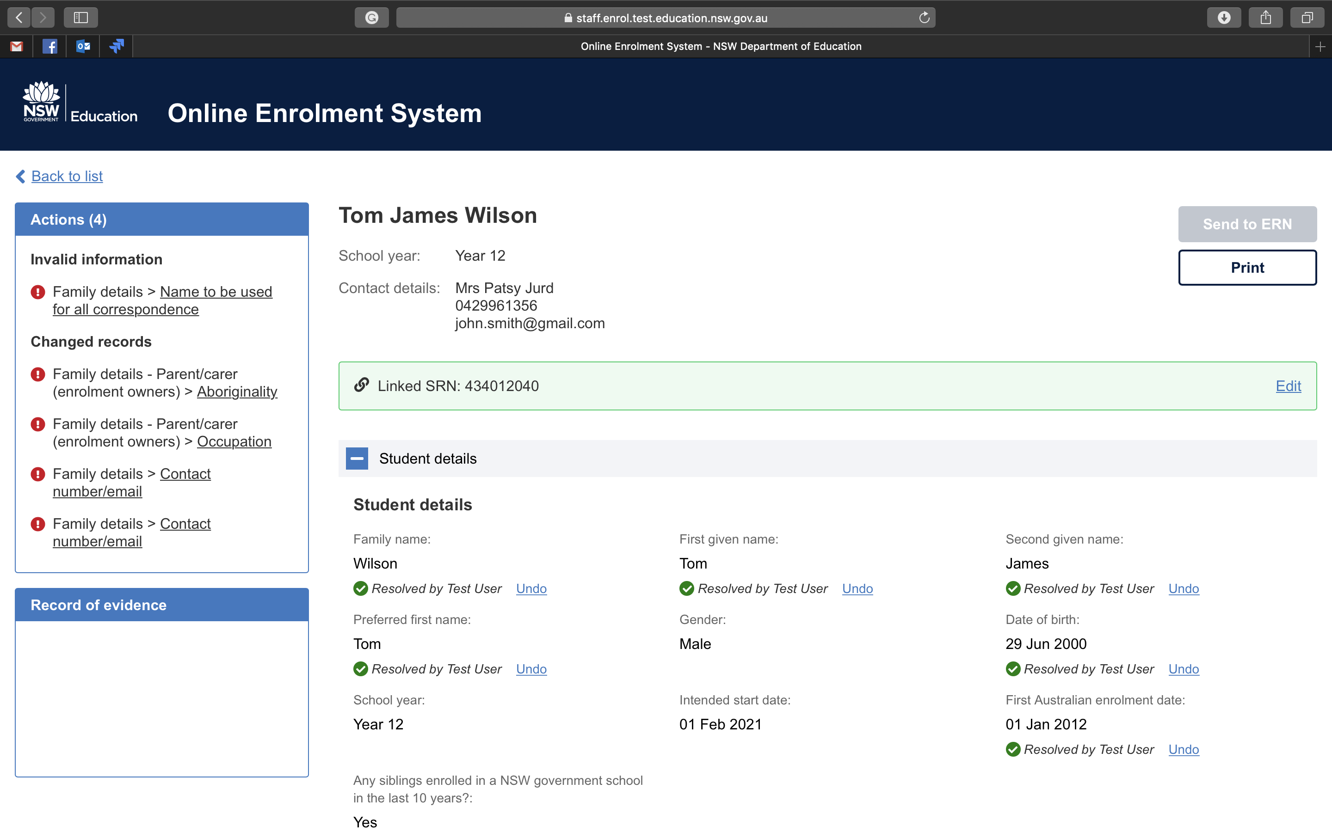
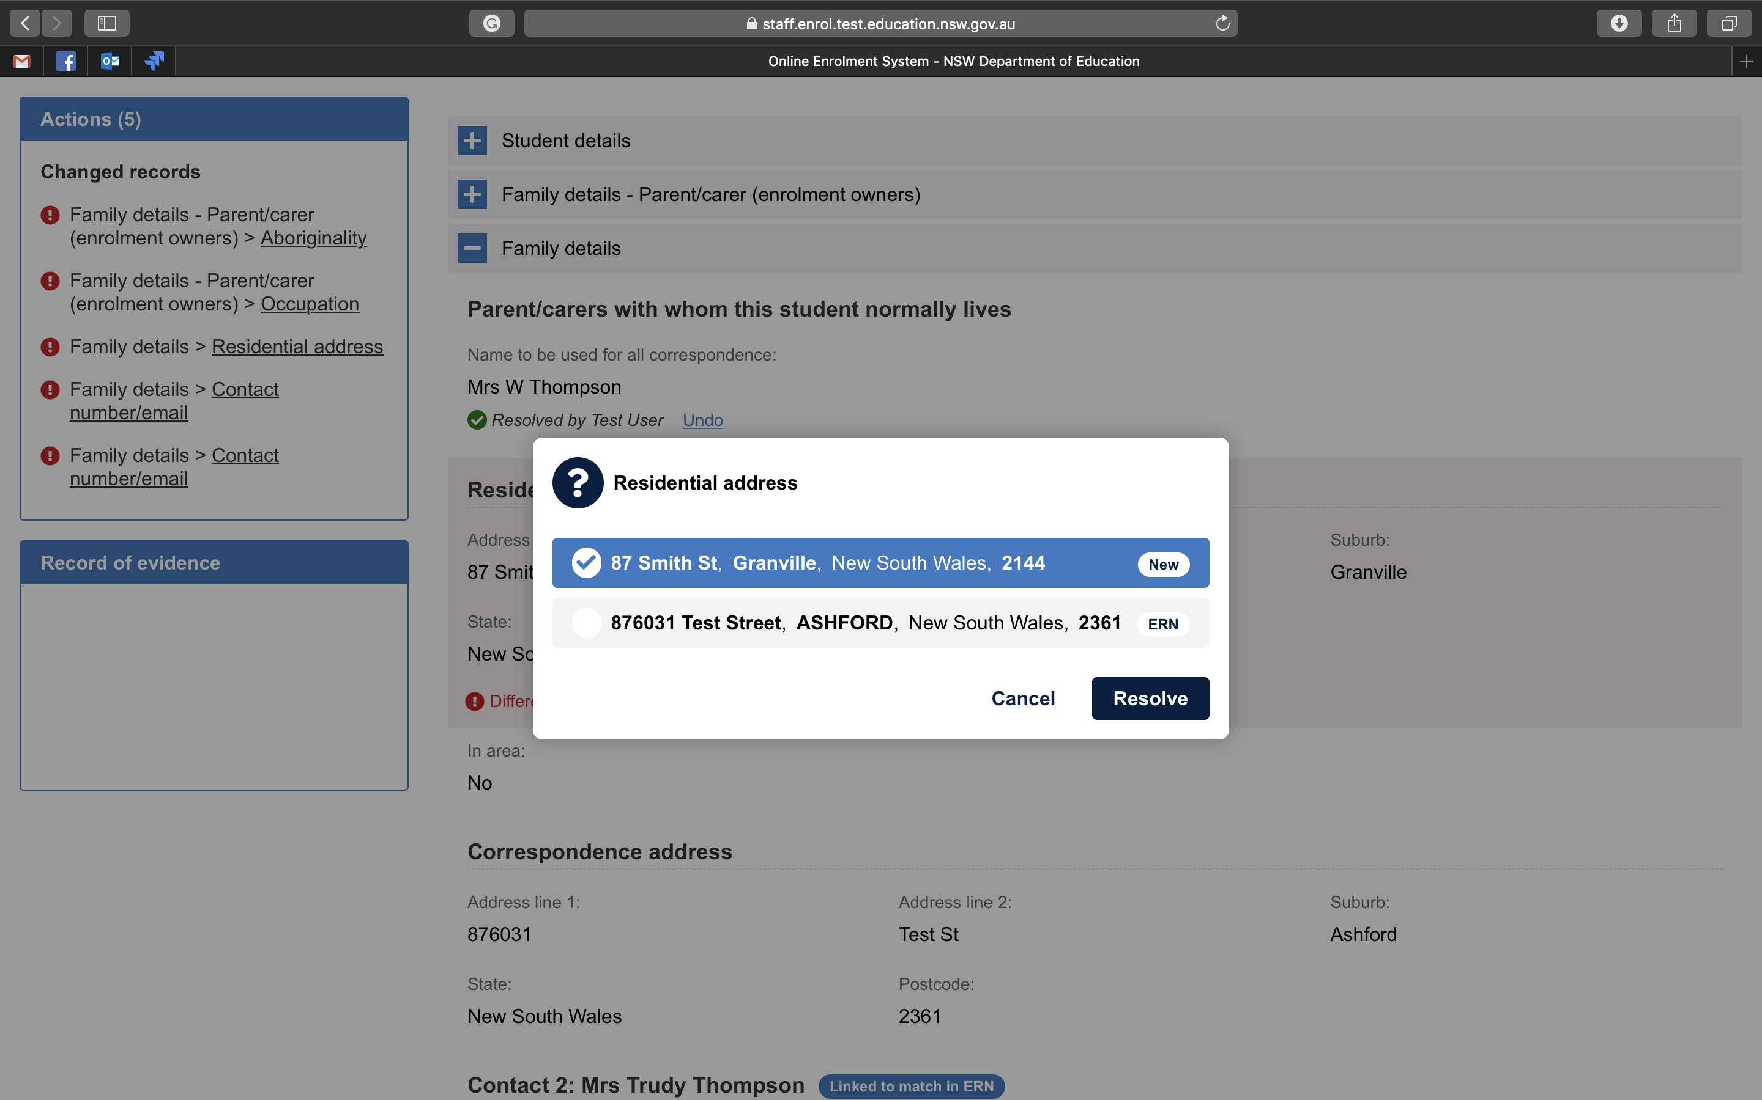
Online enrolment forms
saving time for schools and for our parents
School interface

Slide 14
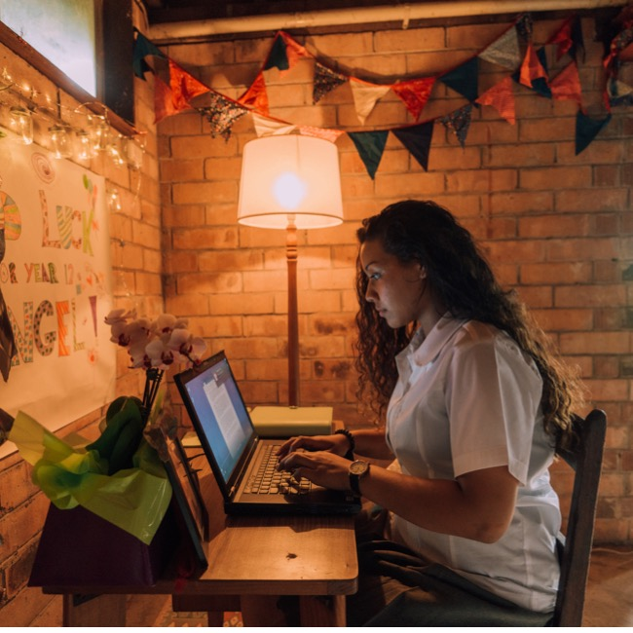
Priority Five
Strengthening school leadership
Notes:
Striving for Excellence responds directly to what principals told us about the services we provide
We work closely with school leaders and DELs to identify what they need and tailor our support
We help local schools to make local decisions
All of Striving for Excellence supports this priority
Other areas of work include: Connected Communities and our ongoing partnerships with PPA and SPC

Slide 15

Thank you – any questions?

