Slide 1

Area Treasurers Information for Presidents
March 15 2019

Slide 2
Thank you
Key information so that you can support your local area treasurer
Key Information to assist you in claims

Slide 3
Area Treasurer’s Key Roles
Manage Local Area Accounts
Provide information to the State Treasurer
Manage Local Membership
Promote Stewart House Fundraising & Salary deduction

Slide 4
To Make your Area Treasurer’s Job Easier
Operate under the State Association - NFP
Online banking
One ABN 77 527 522 968
One BAS – Treasurers input their information at the end of March, June, September and December . Income, expenditure, GST paid, GST received. https://nswppa.schoolzineplus.com/form/7
Send audited annual statement to State Treasurer

Slide 5
Manage Local Accounts
6.7.6 The Area Treasurer will:
6.7.6.1 receive all monies on behalf of the Area Council, ensure that monies are banked in an Area Council bank account and that accounts are verified and paid
6.7.6.2 maintain comprehensive records of all financial transactions of the Area Council and make such records available as required by the Constitution
6.7.6.3 carefully monitor the level of the Area Council's finances and present progress reports of the financial position at each Area Council meeting
6.7.6.4 present an annual financial report and balance sheet, after auditing, to the last Area Council Meeting for each year

Slide 6
6.7.6.5 present an audited financial report of their Area Council to the first State Council meeting of each year
6.7.6.6 be one of the cheque signatories to the Area Council's bank account
6.7.6.7 prepare and maintain a complete Membership Register of all financial members of their Area Council; and
The Association's financial year will operate over a 12-month period on and between 1st September and 31st August the following year.

Slide 7
13.4.1 Area Council funds will comprise:
13.4.1.1 an Area Council Membership Fee to be determined by each Area Council;
13.4.1.2 State Council disbursements; and
13.4.1.2 sponsorship as obtained by Area Councils.

Slide 8
Membership
Local treasurer provided with membership record.
Local Treasurer keeps check of local Principal changes and informs State Treasurer.
State Treasurer adjusts state record.
Website update instructions

Slide 9
Membership
Personal invitation to attend meetings
Face to face delivery of membership form
Primary schools, SSPs, EECs, Hospital Schools, Central Schools, Community Schools, Non-school based (PSL, PEO)
Collegial support rated number one in every survey
Direct say – LAC → Delegate → State Council → DoE
Central Schools pay $9.62 to PPA and same to SPC to be member of both
** Caution – time to action form, misspelling, name changes, linked to wrong school

Slide 10
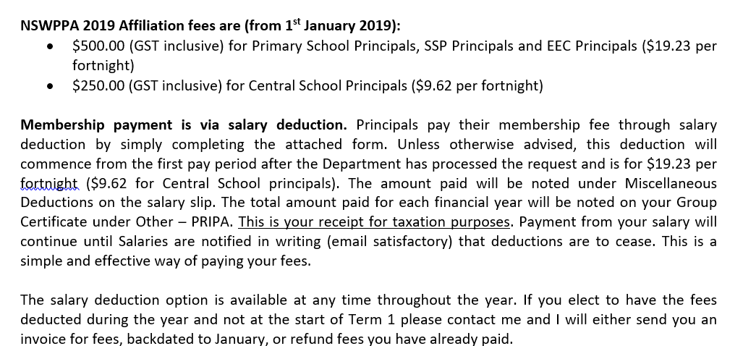

Slide 11
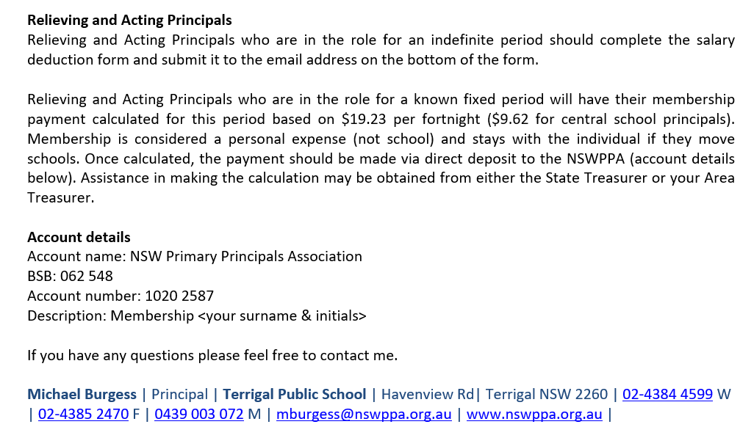

Slide 12
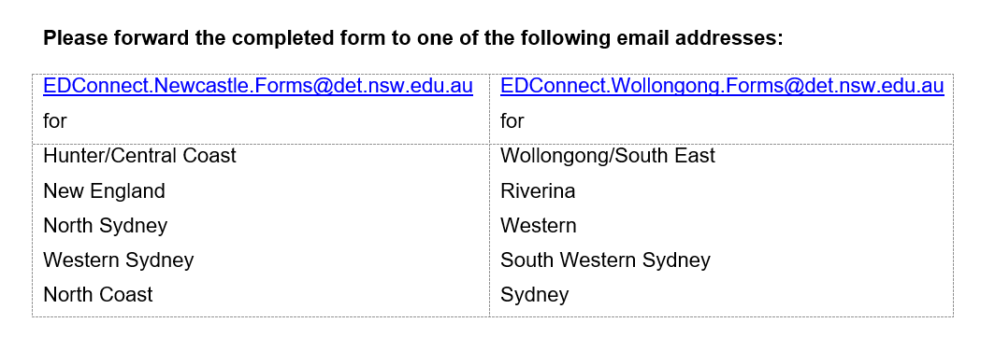

Slide 13
Grant to Local PPCs
2 x Annual conference registration fees to pay for your PPC voting representatives (Usually your delegate and your President). $1800
If your reps didn’t sign on in 2018 you won’t get 2019 rego as your local PPC already holds funds.
Admin grant $200
Local Support Grant - varies
Need your local PPC bank account details

Slide 14
Claims
Claim form and evidence of expense (Take a photo, Stat Dec)
Airfares – book early
Don’t use Webjet! Or insurance
$400 casual cost for teaching Principals
No meals
Accommodation through Mark Pritchard. Cancellations!

Slide 15
Support for Principals
Principal welfare (PPC Dep President)
$400 a day – claim form
Apply through chair of Principal support ref group (Anne)
Geoff and Wendy
Manager Assist

Slide 16
Claims
Form Plus Evidence
Accommodation – share or pay $108. Booked through Mark P
Travel – airfare, train travel, vehicle km, parking
$400 release for teaching Principals

Slide 17
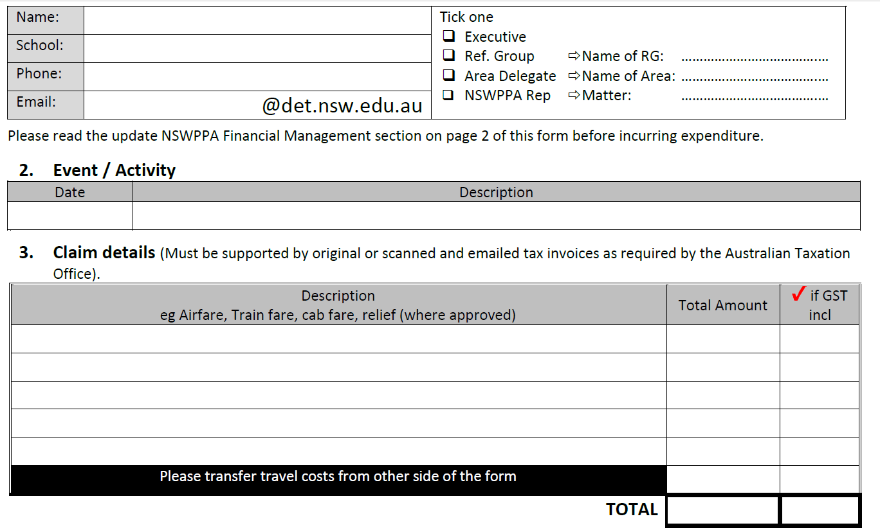

Slide 18
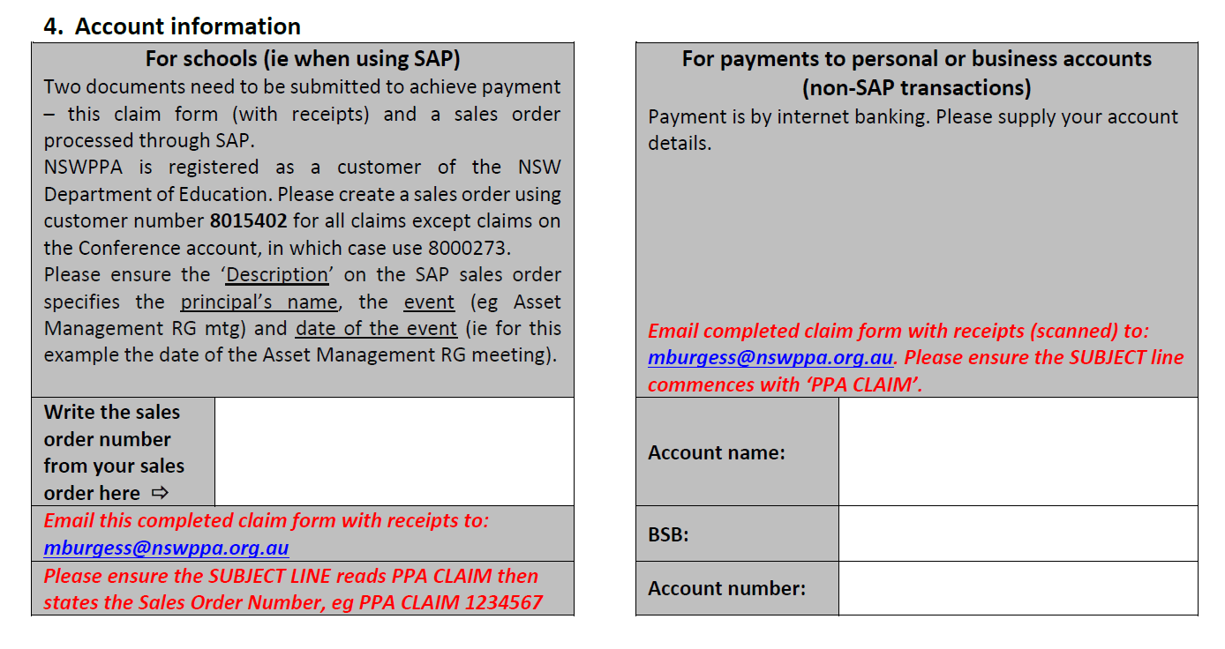

Slide 19
