Slide 1



NSW PPA State Council Presentation
Thursday, 14 March 2019

Slide 2
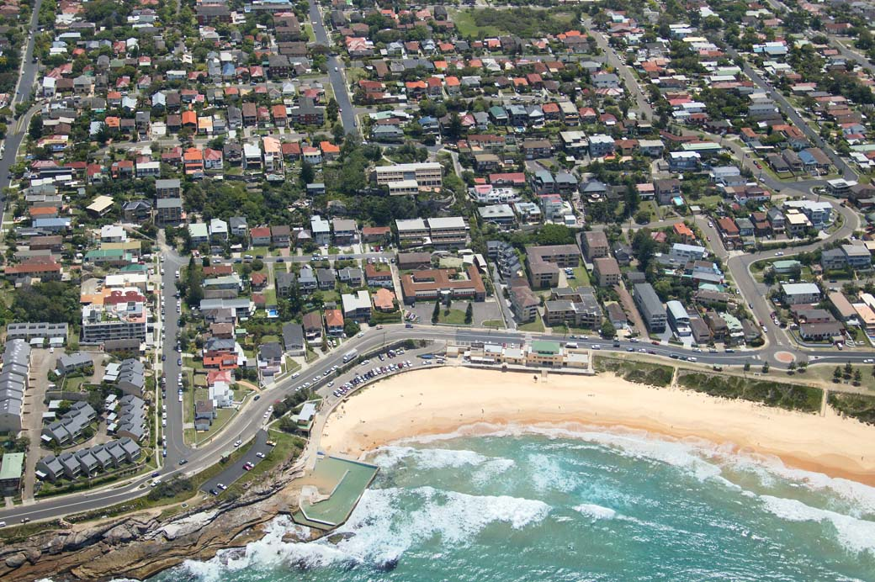

Manly
Northern Beaches
Stewart House
Freshwater
South Curl Curl
Notes:
Slide 3 Location
Located at South Curl Curl Beach, Stewart House is an inspiring setting for all.
The original Building, built in 1931 is at the bottom of the site, directly opposite the beach. This now houses dormitories for the 60 youngest children in the program.
The Stewart House School is situated in the centre building (with the flat roof).
The building at the top of the site, hosts dormitories for the oldest 30 children, the dining for breakfast and dinners, and the office of the Stewart House Company.

Slide 3

Stewart House – Student Enrolment 2013 - 2018
Average statistics
1300 children from 650 schools
83%
Year 1 10
Year 2 70
Year 3 150
Year 4 220
Year 5 380
Year 6 470
250 children from 130 schools
17%
Year 7 125
Year 8 120
Year 9+ 5

Slide 4









Your children = our clients ……….in 2018
30%
Isolated 22%
Already a carer ………. 17%
Exposed to
Poverty………..75%
Lack of Opportunity………..85%
Victims of
………. 26%
10%
Exposed to
and neglect and
domestic violence
..59%
………. 22%
42% in the care of Minister
and/or extended family

Slide 5

Exposed to ………. 100%

Slide 6
Stewart House – Wellbeing Framework
  Dental, optometric, audiometric screening & referral
  Medical treatment & referral
  BMI calculations & referral
  Hair and skin checks for infestation & treatment
  Structured & unstructured physical activities
  Self-care instruction
Physical Wellbeing
Emotional Wellbeing
  Self-regulation
  Self awareness
  Emotional literacy
  Physical & sensory regulation strategies
  Cognitive regulation strategies
  Where to find help after you leave Stewart House
  Social Skills
    Conversations
    Assertive communication skills
    Dealing with teasing & bullying
    Negotiation and conflict resolution
    Problem Solving skills
  Connection and Positive relationships
    Goal Setting
    Team work/ working together
Social Wellbeing

Slide 7
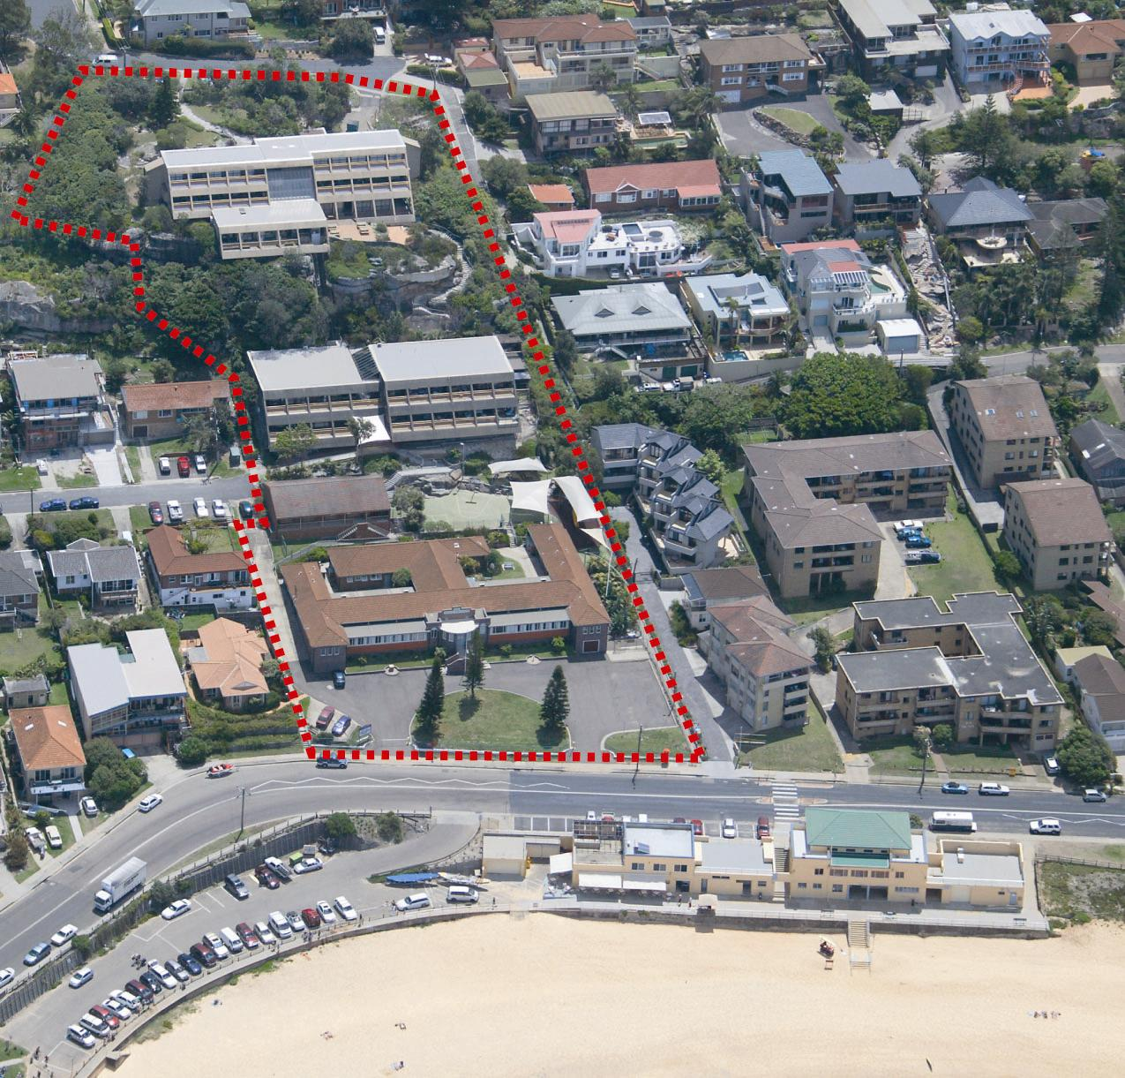
What it costs to run Stewart House
Operating costs $1.9M
catering, health care, excursions
repairs and maintenance, insurance,
utilities, fundraising
Employee related costs $2.9M
cooks, cleaners, laundry, supervisors
psychologists, administration
School RAM (from DOE) $1.8M
3 executive, 6 teachers, 6 SLSOs
AEO, SAM, SAO, 0.3SC
NSW Health $0.3M
nurses, dentists, access to
state wide health services
University NSW / Teachers Health $0.2M
senior lecturer optometry,
practicum optometrists
Macquarie University $0.1M
practice manager audiology
masters students
-----------
$7.2M
STEWART HOUSE 2019 PROJECTED EXPENDITURE

Slide 8






We are fortunate to have services provided for us by:
General health screening - skin conditions, hair, height, weight, BMI
Dental assessment, emergency treatment and free referral
Culturally sensitive Aboriginal health screening
School operating 9.00am – 3.30pm for eight days across two weeks
One day out on excursions for half the cohort, one day in class
Unique program derived from current best practice that fits in with health screening and teaches social skills and emotional regulation
All students receive full optometric screening, treatment or referral
Free glasses are dispensed using UNSW scripts – 1 in 5 children each year
Advanced hearing tests and referrals identified from anomalies in basic screening
All free-of-charge to families and at no cost to Stewart House

Slide 9
But ……………………
Stewart House still needs to find $4.8M each year to operate at capacity
(90% of which is spent directly in meeting the needs of each student)
‘We hold these truths to be self evident…………………’
Stewart House is indebted to teachers working within the NSW public education system. Each one of us should share a measure of pride that this iconic facility is unique throughout the world.
88 years ago, after government and philanthropic funds were committed to set up Stewart House infrastructure, teachers agreed to fund the ongoing work of the organisation.
These arrangements have continued to present day. (£2,500 in 1931 is now $4.8M in 2019)

Slide 10
From schools……..…
In 2018 …………… $380K
1000 schools contributed 88% of revenue
150 schools contributed 12% of revenue
ONLY 50% of NSW GOVERNMENT SCHOOLS DONATE TO STEWART HOUSE
PUBLIC EDUCATION’S CHARITY OF CHOICE ……..??????

Slide 11


From teachers………..
CURRENT FORTNIGHTLY SALARY CONTRIBUTORS
10,700 DOE employees
$1.77M

Slide 12

Not just line of best fit – result of
‘Builder’ teachers retiring
Our strategy of visiting almost every school across NSW over the past 6 years has moved us away from bankruptcy

Slide 13


Are we competitive / relevant – according to current research?
What is important in making the average Australian want to give………….
At Stewart House
<10%
88 years
1600 students
year on year
could do better
McCrindle 2018

Slide 14
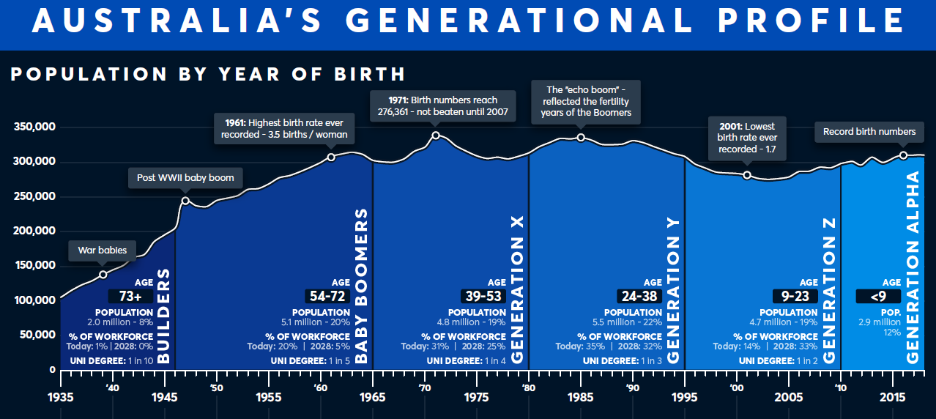
For Stewart House to be sustainable over the next 10 years, we need to:
attract, retain and engage
Gen X, Gen Y and Gen Z teachers
McCrindle 2018

Slide 15
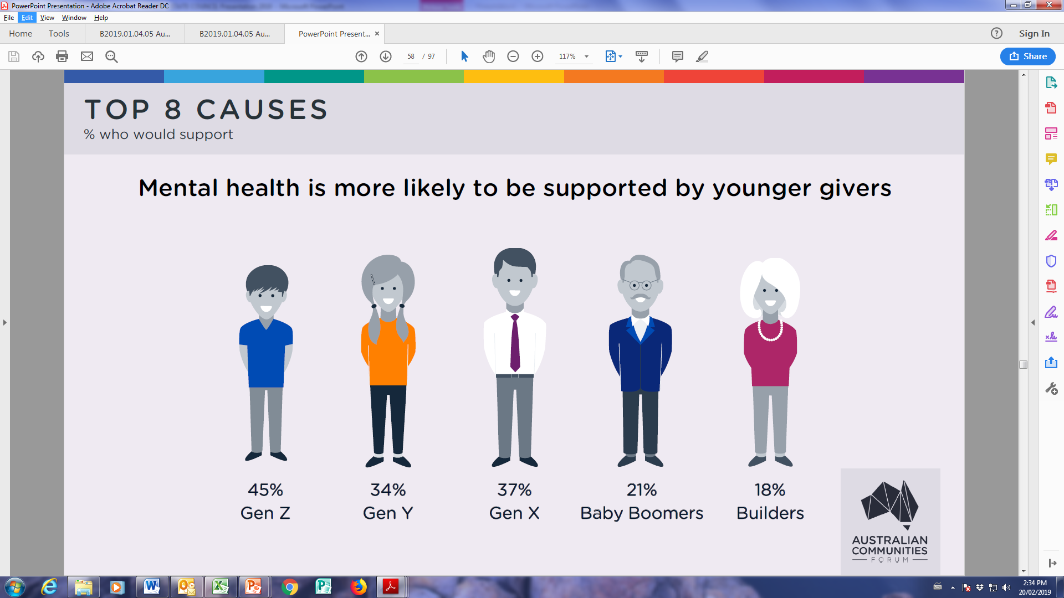
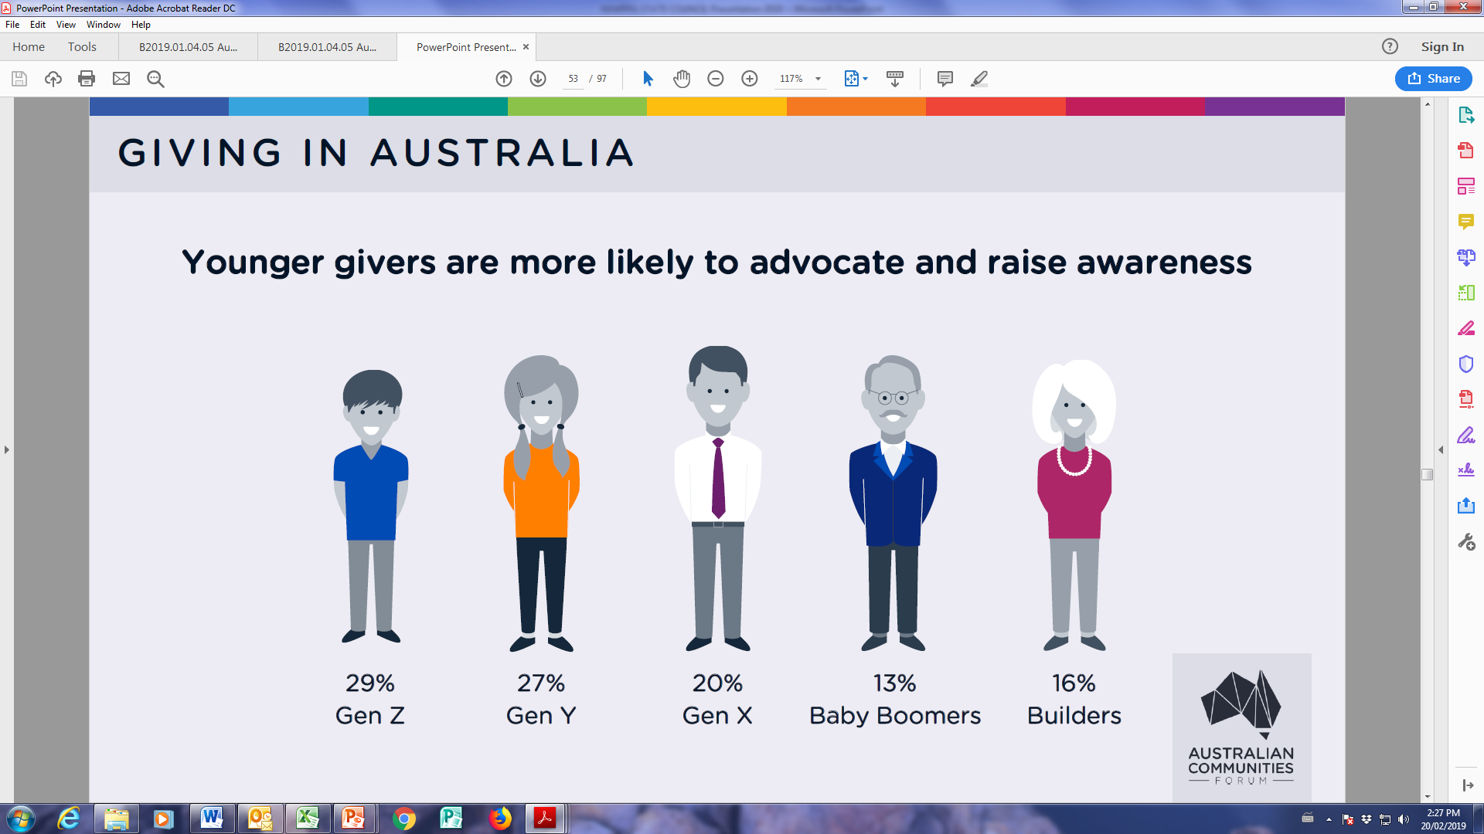
Mental health is more likely to be supported by younger givers
Younger givers are more likely to advocate and raise awareness
McCrindle 2018

Slide 16
Younger givers are looking for personal connection
54% Gen Y cf 33% Builders
Older givers want transparency
87% Builders cf 53% Gen Z
Gen Z are 14 times as likely to consider social enterprises
extremely / very trustworthy
Social enterprises are businesses that trade to intentionally tackle social problems,
improve communities, provide people access to employment and training,
or help the environment.

Slide 17
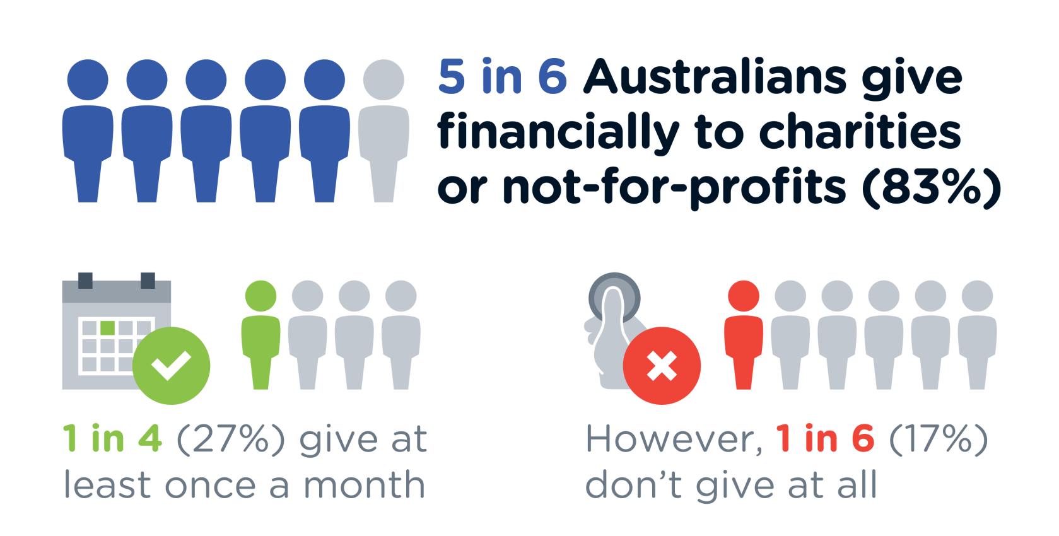

IMPLICATIONS FOR
If we could move our Primary
supporters to just 1 in 4, then
this would increase our recurrent revenue by $250K

Slide 18
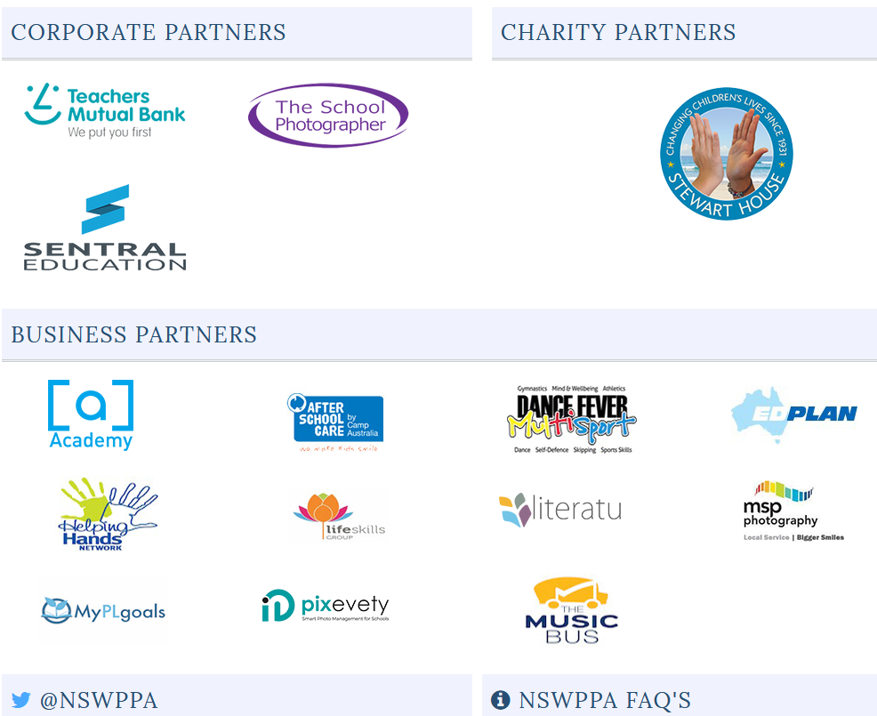

Slide 19


As your charity partner, we need your help……………..
LET US IN THE FRONT DOOR
We are not like NSWTF, TMB, Teachers Health, State Super…so 5 minutes
is not enough time to tell our story
Stewart House only operates to support and nurture our students.
Its reputation among educators is well respected but losing
market share.
It should occupy a treasured place in the hearts and minds of every
advocate of the values and ethos of public education across NSW.
We need 30 minutes at each of your
Area Council meetings
and 20 minutes at a school staff meeting
(we are visiting metro schools only in 2019)

Slide 20
Sarah Haywood
School Liaison Officer
Former AP Stewart House School
SCHOOL PRESENTATION INCLUDES:
Historical context and the multidisciplinary nature of Stewart House
Background and support needs of our student cohort
Guidelines for the selection of suitable applicants, the referral process and how to prepare children for their stay
An overview of the health, wellbeing and educational program and support services now in place at Stewart House
How your fortnightly donation will support the wellbeing of the most vulnerable children in our schools
AREA COUNCIL PRESENTATION:
All of the above
Data sets unique to schools within the Area
An explanation of the placement process, the role of the Co-ordinator, transport issues, escorts and the need for accurate parent information

Slide 21
Seek first to understand, then to be understood …………………
Talk to colleagues about why they already contribute or to those who have nominated children for the program.
Assist Stewart House in changing children’s lives
If you are considering making a contribution to Stewart House from your fortnightly pay packet, ……………..know that you are making a profound commitment to supporting children from our own schools who are in need and who you have deemed worthy of our support.

