Slide 1
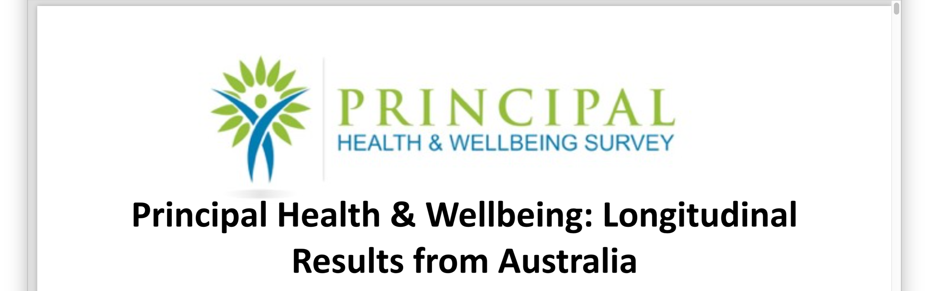

Slide 2
Since 2011, approximately 50% of Australia’s 10,000 principals have taken part
Working Hours: On average, 53% of principals worked upwards of 56 hours per week during term with 24% working upwards of 61-65 hours per week.
During school holidays, 40% work upwards of 25 hours per week.

Slide 3
Health Risks Associated with Long Working Hours
Working >10 hours a day led to a 60% increased risk of cardiovascular disease
10% of those working 50–60 hours a week report relationship problems, and 30% for those working more than 60 hours.
Working >40 hours per week is associated with:
  increased alcohol and tobacco consumption
  unhealthy weight gain in men
  depression in women
  little productive work occurs after 50 hours per week.
  In white collar jobs, productivity declines by as much as 25% when workers put in 60 hours or more.
Working >60 hours per week led to 23% higher injury hazard rate

Slide 4
Principals experience:
  high levels of job demands (1.5 times the general population)
  emotional demands (1.7 times) and
  emotional labour (1.7 times) being the highest demands when compared to the general population.
  This is correlated with higher levels of burnout (1.6 times higher), stress symptoms (1.7 times higher), difficulty sleeping (2.2 times higher), cognitive stress (1.5 times higher), somatic symptoms (1.3 times higher), and, depressive symptoms (1.3 times higher).
Sources of Stress
The two greatest sources of stress that have remained consistently high (~8/10) over the length of the survey have been Sheer Quantity of Work, and Lack of Time to Focus on Teaching and Learning

Slide 5
Threats of Violence:
Threats of Violence is extremely high - in 2011, 38% of participants had been threatened. This rose to 45% by 2018; close to 1 in 2 principals receiving a threat).
The highest prevalence is in Government primary schools (49%).
Physical Violence:
Actual Physical Violence prevalence has risen from ~27% in 2011 to ~37% in 2018; 1 in 3 principals (now 9.3 times the rate of the general population, up from 7 times in 2011). The highest prevalence is in Government primary schools (42%; 10.5 times the population rate).
Women are most at risk with 40% experiencing violence compared to 32% for men.

Slide 6
Recommendations:
same recommendations published last year
Governments :
  Adopt a whole of government approach to education
  Stop looking for short term quick fixes
Professional Associations and Unions
  Collaborate and speak with one voice.
In media I’ve been talking about legislation ……… similar to paramedics…

Slide 7

A more serious offence in section 67J(2) where a person, by an act of violence against an ambulance officer, intentionally hinders or obstructs the ambulance officer when the ambulance officer is providing or attempting to provide ambulance services to another person. This offence carries a maximum penalty of imprisonment for five years.

