Slide 1

Achieving Excellence Together
Murat Dizdar
Deputy Secretary, School Operations and Performance
@dizdarm #GreatPlaceToWork

Slide 2

Matters of Interest
Annual Report
Mastery of Teaching – Expanding the offering from two networks (Peel and West Wyalong) to 20 Networks
SBAR – Actuals to be released early April (Teaching Principals will receive a one-off funding payment equivalent to at least 35 days of relief). $50 million in flexible funding as a school support allocation continues to assist principals.
External Validation – Panels matched to school type. Support for TP1 and TP2.

Slide 3
Matters of Interest
School Leadership Institute – Cohort 2 - 1 April 2019, Cohort 3 – Selection process underway.
Louise Stoll – 30 May 2019
Masters/Further Study
Working Group – Principal Support
Meeting with NSW PPA – Principal Well-Being Working Group
Voluntary Contributions

Slide 4
Areas for consolidation in 2019
Quality aspiring leaders program offered by the School Leadership Institute – Middle layer
Principal role description – Executive roles
Practical support, guidance and strong professional relationships with Directors, Educational Leadership
Enhanced coaching and mentoring for existing principals
Improved and coordinated communication
Tailored school improvement support

Slide 5

2019 Areas of Operational Excellence
Focus Area 1
Enhance leadership capacity and grow future leaders
Notes:
Ambition to do better for students everywhere
Performance and Development Plan
Growth and development
Who would benefit from a change?
Who has system potential?

Slide 6
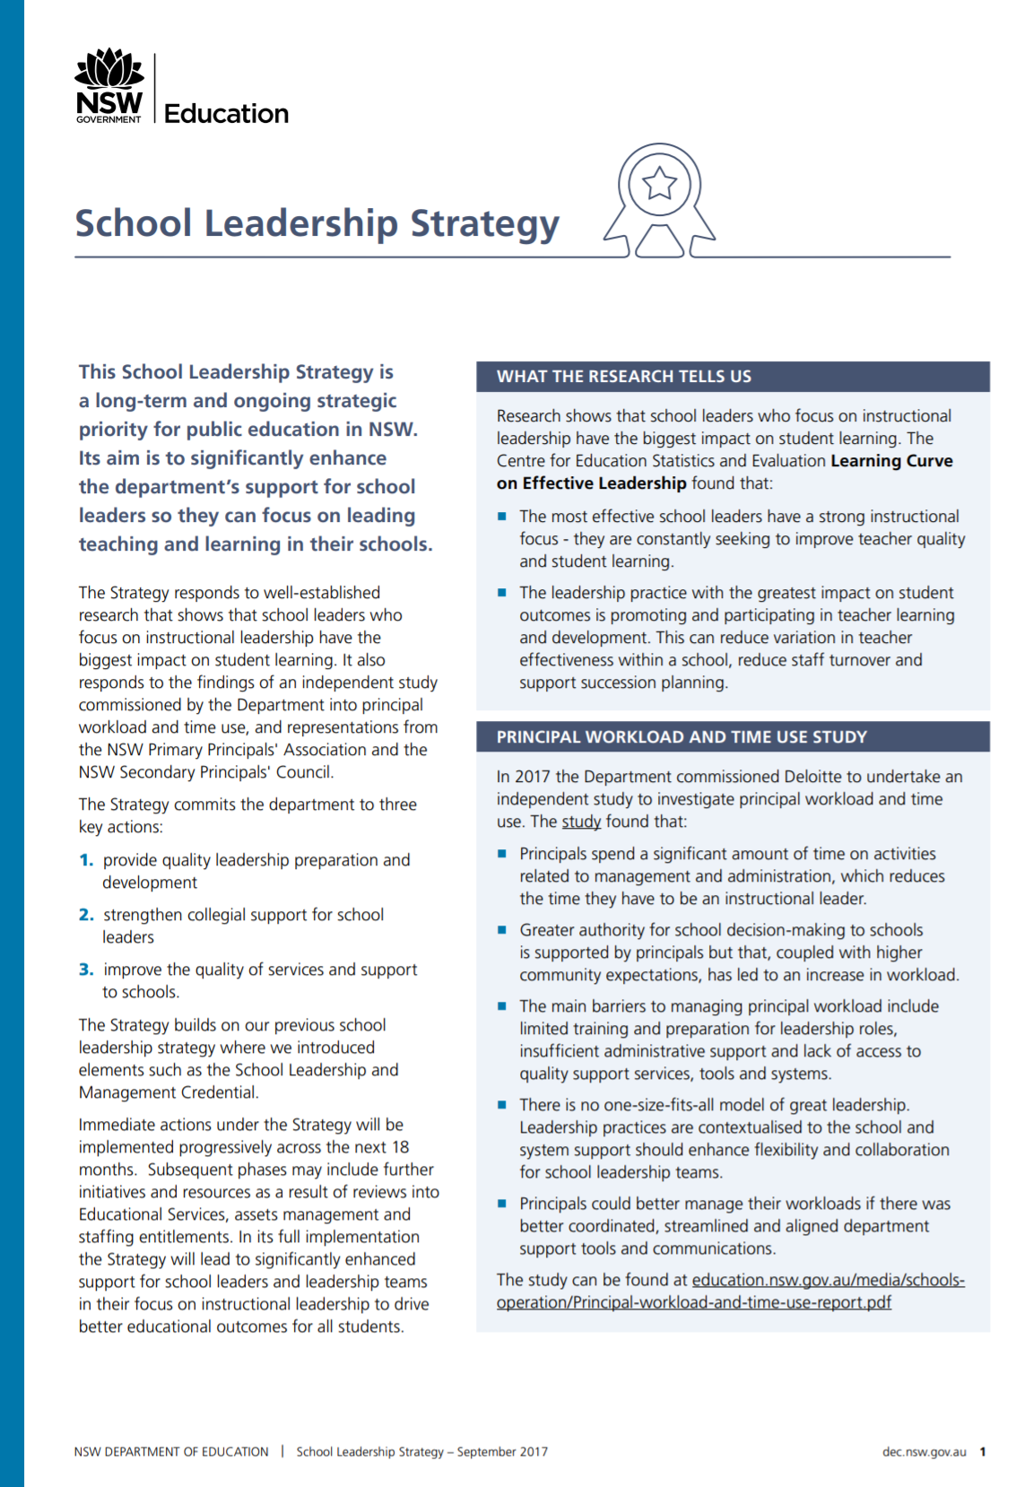
School Leadership Strategy
‘School leaders who focus on instructional leadership have the biggest impact on student learning.’

Slide 7

‘Being a teacher is about helping children to learn. Being a principal is about helping adults to learn. That’s why it’s tough… I walk the halls, walk the halls and walk the halls… I only look at my inbox after everybody else leaves.’
Source: ‘Delivering on every child’s right to basic skills’ by Jack Rossiter, Martin Woodhead, Caine Rolleston and Rhiannon Moore
Notes:
https://www.younglives.org.uk/sites/www.younglives.org.uk/files/YL-Education.pdf

Slide 8

Focus Area 2
Support and maintain line of sight to school improvement for student benefit
Notes:
Network plan
Evidence of improvement
Data informed conversations
Use of School Excellence Framework
CESE resources
Close performance gaps
Recognise and celebrate success and improvement

Slide 9
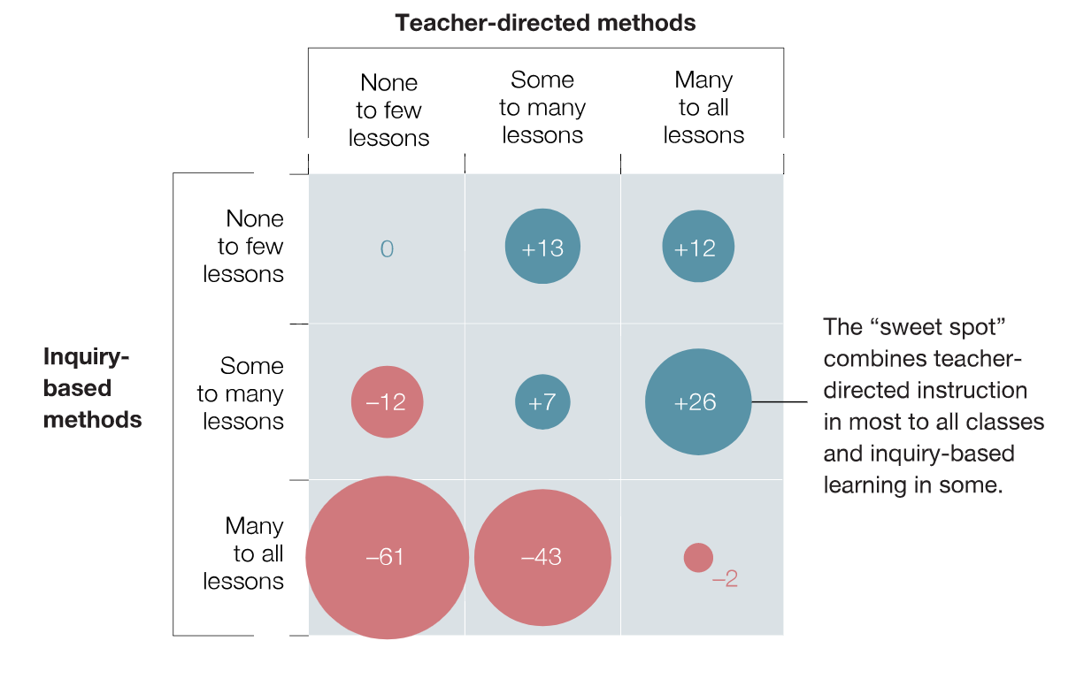
‘Students who receive a blend of teacher-directed and inquiry-based instruction have the best outcomes.’
Source: ‘How to improve student educational outcomes: New insights from data analytics’ by Mona Mourshed, Marc Krawitz, and Emma Dorn
Notes:
https://www.younglives.org.uk/sites/www.younglives.org.uk/files/YL-Education.pdf

Slide 10
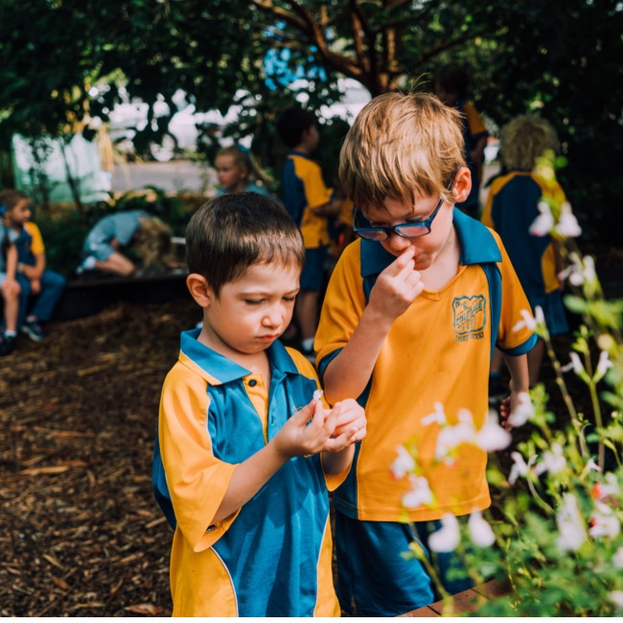
Focus Area 3
Grow effective resource usage
Notes:
Funding is to help improve the learning outcomes for students enrolled in our schools in 2019
Allocating the money versus expenditure
Enhance confidence and share know how

Slide 11
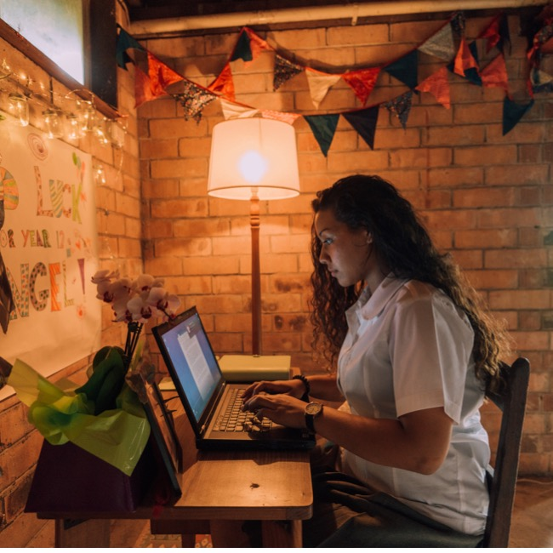
Focus Area 4
How do we know ‘Every student is known, valued and cared for in our schools’?
Notes:
Structures, strategies and frameworks
Visibility of leadership
Secondary schools
At risk, under the radar, excelling young people

Slide 12
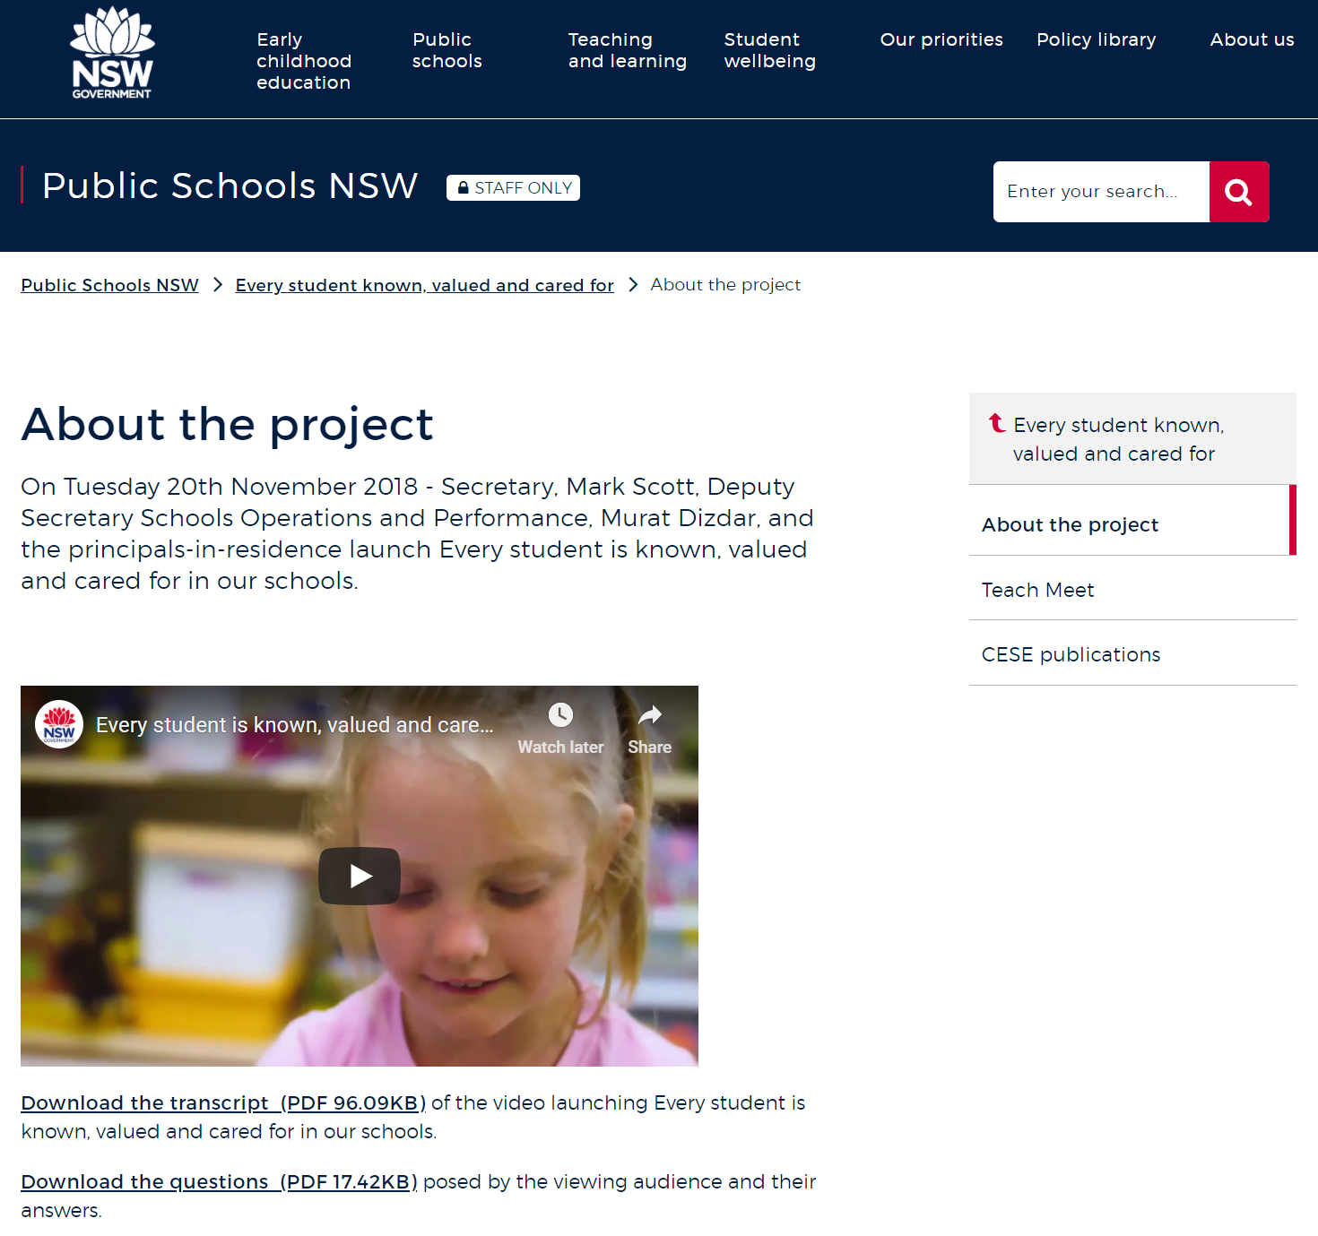

https://education.nsw.gov.au/ps-nsw/every-student

Slide 13
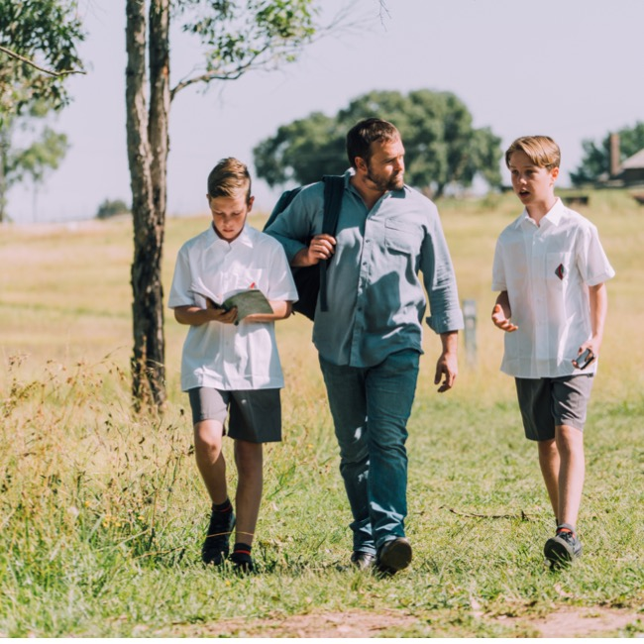
Focus Area 5
NSW Education is a ‘Great place to work’
Notes:
Our approach
School culture
Tell Them From Me
Handling complaints, matters of contention
Anti-bullying

Slide 14
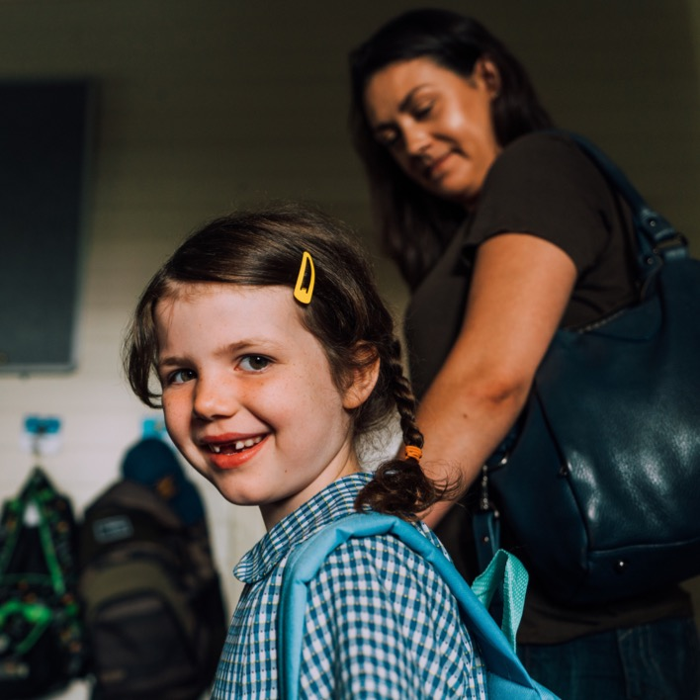
Questions

