Slide 1
Teacher Performance Management and Improvement project
Shoulder to shoulder support for principals and school leaders in addressing underperformance
Mark Anderson R/Director, Staff Efficiency and Conduct

Slide 2
Our goals
Every student is known, valued and cared for in our schools.
Every student, every teacher, every leader and every school improves every year.
Education is a great place to work and our workforce is of the highest calibre.
Community confidence in public education is high.
Notes:
These are the goals from the Department’s strategic plan that relate directly to teacher performance

Slide 3

About the TPMI project
The Teacher Performance Management and Improvement Project, part of the School Leadership Strategy, is actively enhancing the quality of teaching by providing shoulder to shoulder support to principals to address underperformance in schools, leading to a better quality teaching service, and, ultimately, better student outcomes

Slide 4
Background and context
The TPMI trial was implemented at the beginning of Term 1, 2018 for the duration of 2018
Trial areas:
Tamworth and Ultimo Operational Directorates (pre-Term 2, 2018)
Total count of schools in the trial area = 1,120
FTE of teaching staff in the trial area = 27,787

Slide 5
Quality of teaching
We know that the quality of teaching is a major factor impacting on the learning outcomes of students.
All leaders have a responsibility to monitor and review performance, and to take action to improve performance.
By addressing performance in a timely, fair and supportive way, we can ensure every student, every teacher, every leader and every school improves every year.

Slide 6
Underperformance
There is anecdotal evidence that the quality of teaching in NSW public schools varies, however hard data is limited.
Drawing on Ofsted’s 2010-11 Annual Report, the quality of teaching in inspected UK schools was as follows:
  Outstanding – 6%
  Good – 54%
  Satisfactory – 38%
  Inadequate – 3%

Slide 7
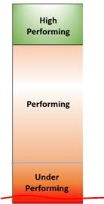
Too often, action to address performance occurs here
Notes:
Is it because principals are not capturing / addressing underperformance early?
The blue line is an arbitrary representation of Proficiency.

Slide 8


Notes:
In the 2017 People Matters survey, when the data was cut to show only the responses of teachers in schools, only 43% answered the question My manager appropriately deals with poorly performing employees in the positive (Strongly Agree or Agree). That means nearly 60% of teachers – and if we extrapolated this out to the entire workforce, that would be around 30,000 teachers – don’t believe their manager – whether that be principal, head teacher, assistant principal – deal well with underperformance. Does this support the goal “Education is a great place to work and our workforce is of the highest calibre? Is it something we need to address???

Slide 9


Improving the quality of teaching
The Performance and Development Framework for Principals, Executives and Teachers is the starting point for managing teacher performance and development.
Notes:
‘The overarching purpose of the performance and development process is to support the ongoing improvement of student outcomes through continuous development of a skilled, effective and professional teaching workforce’ Performance and Development Framework, page 1

Slide 10
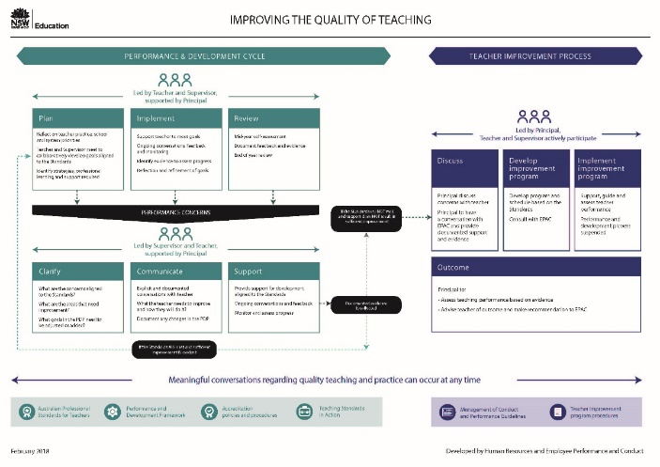

Improving the quality of teaching
The connection between the performance and development cycle, addressing performance concerns and teacher improvement processes is elaborated in the Improving the Quality of Teaching Diagram and the support information.
Notes:
These resources were jointly developed by Human Resources and Employee Performance and Conduct directorates in consultation with NSW Teachers Federation and were released in Term 2 2018.
These documents provide additional explanatory notes but do not replace the Performance and Development Framework for Principals, Executives and Teachers (the Framework) or the Teacher Improvement Program procedures.
When performance concerns are identified, the performance and development process, led by the supervisor and teacher, and supported by the principal, continues to apply. Supervisors are responsible for ensuring proficient practice by teachers within their faculty, stage or team. This includes identifying, clarifying and communicating concerns about teaching practice and ensuring that appropriate support is negotiated with the teacher.

Slide 11




the revised improvement program procedures
Notes:
Concerns about a teacher’s performance should be addressed as they arise throughout the performance and development cycle. (Teacher Improvement Program page 4).
The revised improvement program procedures are for permanent teaching service staff working in school based positions, that is probationary teachers, teachers, executive and principals. They are now available on the EPAC intranet.
The teacher improvement process is led by the principal, and the teacher and supervisor actively participate. The principal should seek support and advice from the Department’s Employee Performance and Conduct Directorate and ensure the correct procedures are applied.

Slide 12
What is shoulder to shoulder support?
In performance and development processes:
providing expert advice, support and guidance to principals in the management of teacher performance such as:
  clarifying concerns using the APST
  renegotiating PDP goals
  communicating concerns through explicit conversations about performance
  implementing support to address concerns.
Additionally:
Conducting local tailored professional learning for the ongoing capacity building of school executive and principals
Notes:
The TPMI model of service delivery, working with principals on an ongoing, local, hands-on basis, involved considerable consultation: Human Resources, Leadership & High Performance, Industrial Relations, School Services, Employee Performance and Conduct, SPC and PPA, NSW Teachers Federation.
TPMI advisers sit with School Services.

Slide 13
What is shoulder to shoulder support?
In implementing improvement programs for Teaching Service staff:
  advising principals and school leaders on the development of the improvement program plan and schedule of support
  conducting independent classroom observations and providing feedback
  attending review meetings as relevant
  assisting in the review of documentation and development of the Principal’s Report at the end of an improvement program.
The principal leads the improvement program process.
The TPMI adviser provides educational advice and support.
EPAC staff provide procedural advice and support.
Notes:
TPMI provides advice to support principals implement a quality, effective, procedurally fair improvement program.

Slide 14
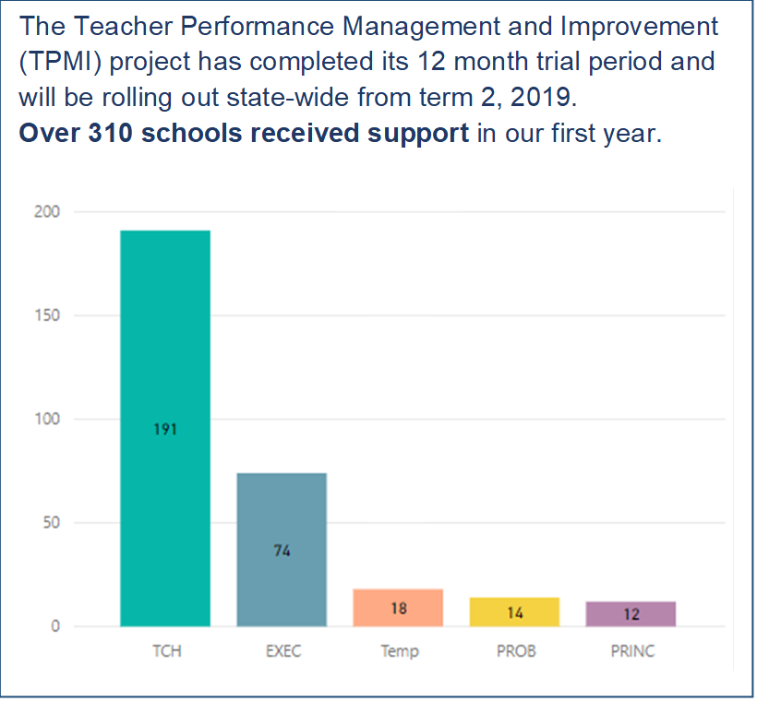
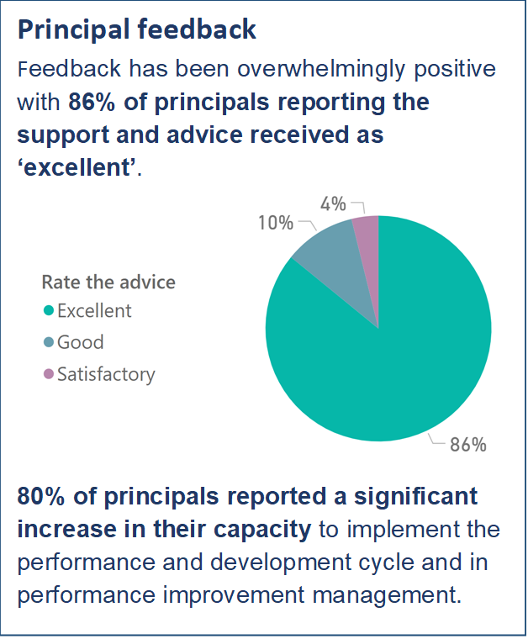
What have we learnt from the 2018 trial?
Notes:
TPMI data gathered and analysed throughout the trial – support provided, outcomes of matters,

Slide 15
CESE: TPMI trial outcome evaluation aims
Whether the trial improves teacher performance and development, management and improvement processes
Whether the trial improves school leaders’ attitudes towards managing teacher performance

Slide 16
CESE Methods
Departmental data
Principal survey
Interviews & case studies
Analysis of TPMI trial activity data to Sep 1, 2018
Conducted August-September 2018
School leaders and teachers at 8 trial sites and 4 non-trial sites
People Matter Employment Survey
Used data from June 2017 and 2018
2 Field Officers
Analysis of improvement program data to Oct 1, 2018
Case studies of 5 trial schools
474 responses: response rate = 38%
Conducted August-October 2018
Analysed 9 questions relevant to the trial
4 Internal stakeholders
Notes:
Trial participants: Schools/principals within the trial area who received a minimum threshold of support. Specifically, this included principals who selected that either they and/or their staff received support in either a short term matter over a few weeks and/or ongoing or longer term performance concern(s) or support.
Minimal trial participants: Schools/principals within the trial area who attended a presentation and/or selected on the survey that they had one-off contact for advice or a query.
In-trial non-participants: Schools/principals within the trial area who received no support.
Out-of-trial: Schools/principals not within the trial area.

Slide 17
CESE Key findings
Overall the trial was well received by schools
Many school leaders are not yet willing or confident enough to manage teacher performance and improvement without the shoulder-to-shoulder support offered through the trial
TPMI support was particularly important when implementing improvement programs
School leaders are more knowledgeable and confident in managing and improving teacher performance and are working on building capacity within their school

Slide 18
reach of the project: case support to Sep 1, 2018
188 schools and 8 DELs were provided with case support
17% of the 1120 schools in Tamworth and Ultimo
239 cases (teachers/execs) FTE teaching staff in the trial area = 27,787
Notes:
Case support: tailored support for a specific underperforming staff member. This doesn’t include one-off advice or presentations.

Slide 19
37% of cases were closed because underperforming staff improved
N = 114 cases closed in total. 125 additional TPMI cases remain open as of Sep 1, 2018.
Notes:
Improvement programs take 10-12 weeks to run, therefore most improvement programs implemented with TPMI support were ongoing on October 1, especially because more improvement programs tend to be implemented in the second half of the year.
Only cases listed under ‘improvement program unsatisfactory‘ had progressed to an implemented improvement program. All other outcomes relate to cases in which an improvement program was not implemented.
‘Improvement program unsatisfactory’ includes cases in which the program was not completed because the teacher applied to resign, and cases in which the teacher showed insufficient improvement in their teaching performance at the conclusion of the program.

Slide 20
improvement programs to October 1 - comparison
 | Macquarie Park |  | Tamworth |  | Ultimo |  | Wagga Wagga
 | To 1/10 | Total | To 1/10 | Total | To 1/10 | Total | To 1/10 | Total
2015 | 12 | 17 | 11 | 12 | 8 | 13 | 5 | 6
2016 | 7 | 11 | 5 | 8 | 2 | 4 | 11 | 14
2017 | 10 | 13 | 3 | 4 | 7 | 12 | 12 | 17
2015-2017 average | 9.7 | 13.7 | 6.3 | 8.0 | 5.7 | 9.7 | 9.3 | 12.3
2018 | 5 |  | 20 |  | 10 |  | 6
Notes:
Data for 2018 is current as at Oct 1, 2018.
All improvement programs implemented in Tamworth and Ultimo in 2018 were supported by the TPMI field teams.

Slide 21
The capability of school leaders was perceived to have increased since receiving TPMI support

Slide 22
Three-quarters of principals agreed TPMI support had a positive impact on timing for key activities
Notes:
Samples sizes for ‘Developing an improvement program and schedule’ and ‘Implementing an improvement program’ are lower because of the fewer number of principals who had done these activities with support from the TPMI field officers, compared to the other activities listed.
For all other activities related to providing individual support to underperforming staff member, at least 60% of respondents indicated TPMI support resulted in doing that activity sooner

Slide 23
increased willingness to undertake activities related to early intervention in cases of underperformance
Notes:
Response to principal survey questions on increased willingness following TPMI support for activities relating to early intervention when underperformance is first identified.

Slide 24
increased willingness to undertake improvement program activities, but more dependent on availability of TPMI support
Notes:
note sample sizes

Slide 25

What can tpmi do for you and your school?
From Term 2
Teams will operate in each operational directorate.
Each team will consist of one principal coordinator and three field advisers.
EOIs for these additional positions were advertised in SchoolBiz on 22 February, closed on 6 March.
Notes:
Specific locations of team members will be determined following the selection process.
Contact information will be publicised at the beginning of Term 2.

Slide 26

Every student, every teacher, every leader and every school improves every year.

