Slide 1

State Treasurer’s Report
March 14 2019

Slide 2
The balances of the NSWPPA accounts on Friday 8th March 2019 were:
Name | BSB | Account number | Account balance
Conference | 062 262 | 1005 0470 | $ 30,238.00
General | 062 548 | 1020 2587 | $ 558,767.78
Business online | 062 900 | 1051 3465 | $ 739,234.79
Term Deposit | 062 649 | 5005 3981 | $ 300,000.00
 |  | TOTAL CREDITS: | $ 1,628,240.57
 |  | NET POSITION: | $ 1,650,885.10

Slide 3
DoE Grant
3.75% grant increase this year and next
2019 $425,375
2020 $441,327

Slide 4
Our Mission
To lead support, advocate for and empower school leaders to enable student success.

Slide 5
Resourcing to achieve our mission
Principal Wellbeing – Professional Support Officers (Geoff and Wendy), Flourish, Advocacy with senior DoE Exec, Ref Group, Additional DP, Support Days
Principal Workload – Ref Groups, State Exec, Advocacy with senior DoE Exec
T & L – AOL, Professional Learning Officer (Margaret), PLSAO, Ref Group
Communication – Ref group, State Council, Additional DP, Executive Officer
School Operations – Ref Groups, State Exec, Advocacy with senior DoE Exec

Slide 6
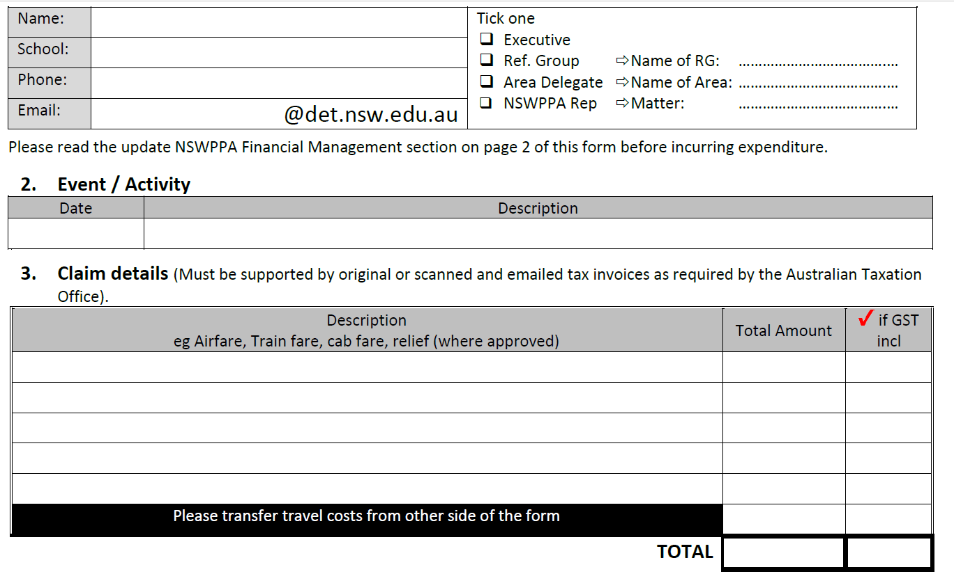

Slide 7
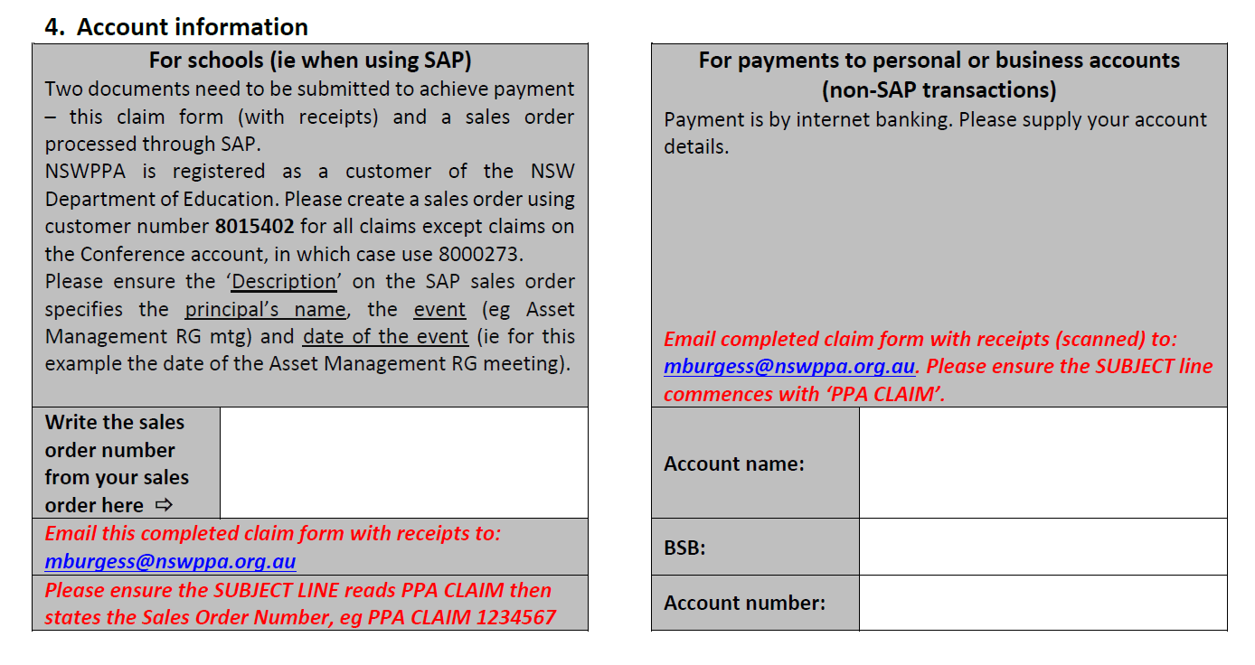

Slide 8
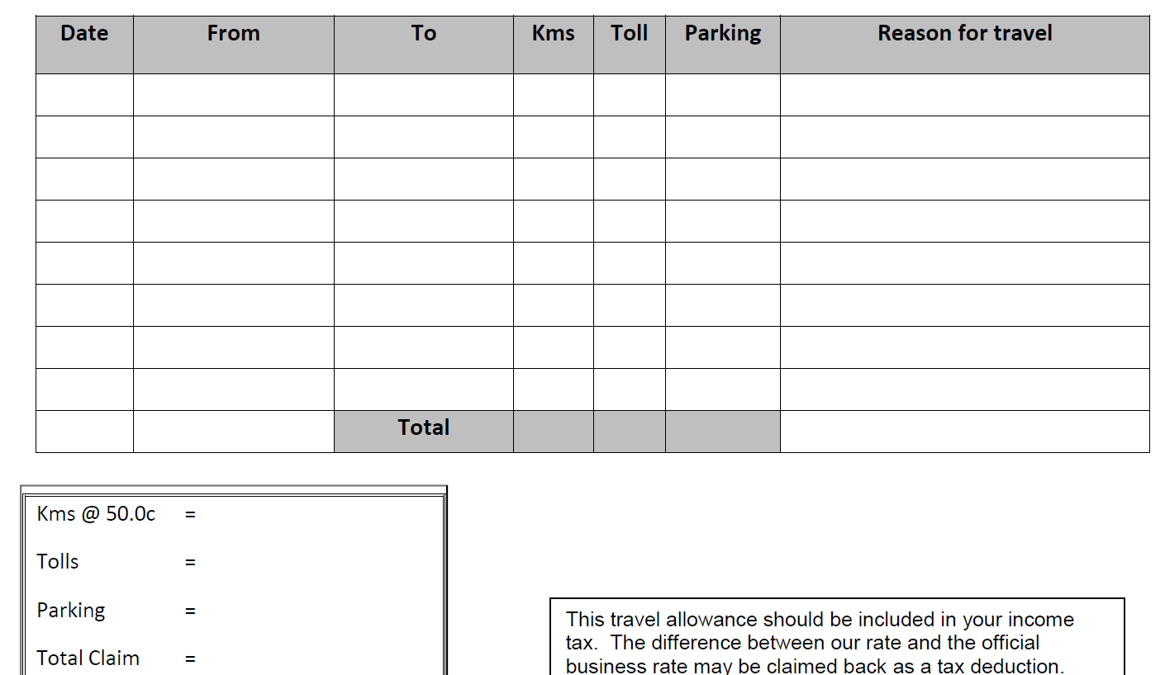

Slide 9
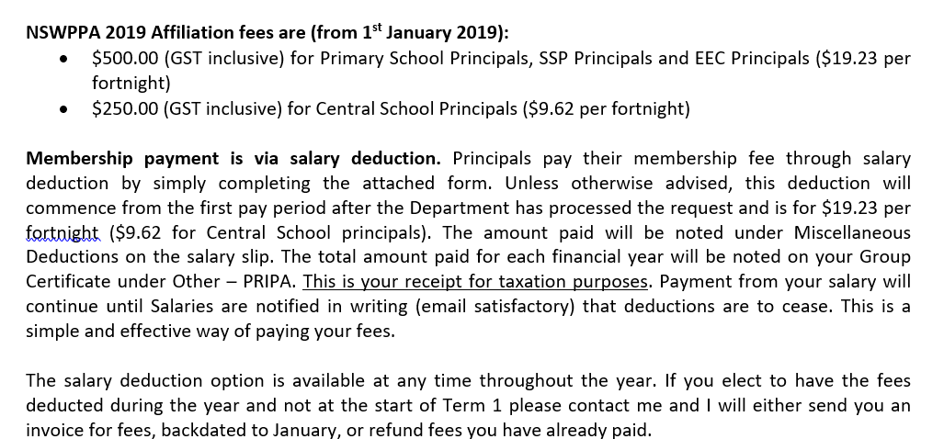

Slide 10
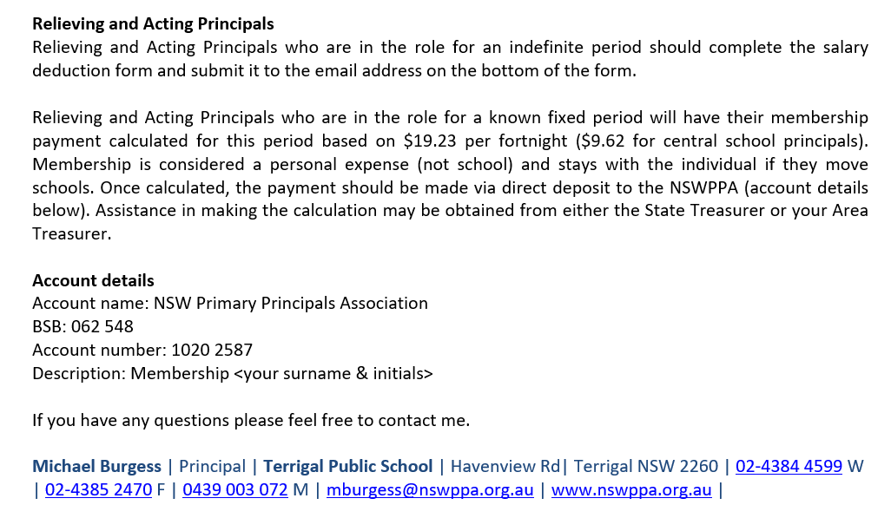

Slide 11
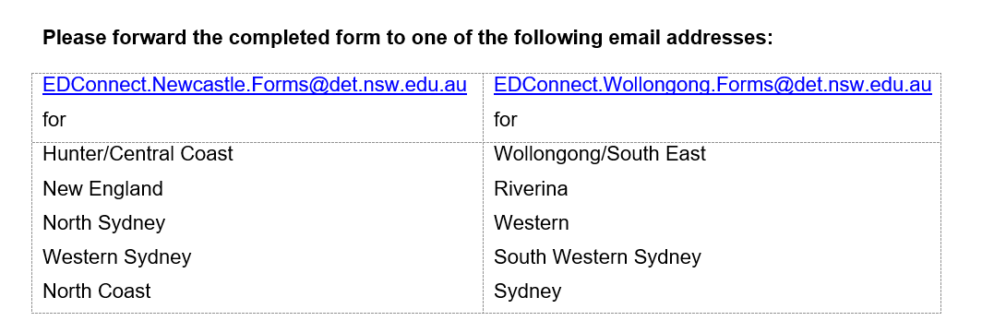

Slide 12
BAS Information & Audited AFS
https://nswppa.schoolzineplus.com/form/7
Sent to State Treasurer

Slide 13
Member Check
Colour copy return to me. Other copy for you
Schools – check you have them all, no ring ins, new schools
Members – Tick each one, write the story
Follow up unfinancial with caution *
Also Current Treasurer list – return to me

Slide 14
Session for new Presidents/Delegates
Tomorrow morning 8.15
Down the ramp
Support your PPC Treasurer
Info to support you

