Slide 1
Discipline Policy and Behaviour Strategy
NSW Primary Principals’ Association State Council

Slide 2
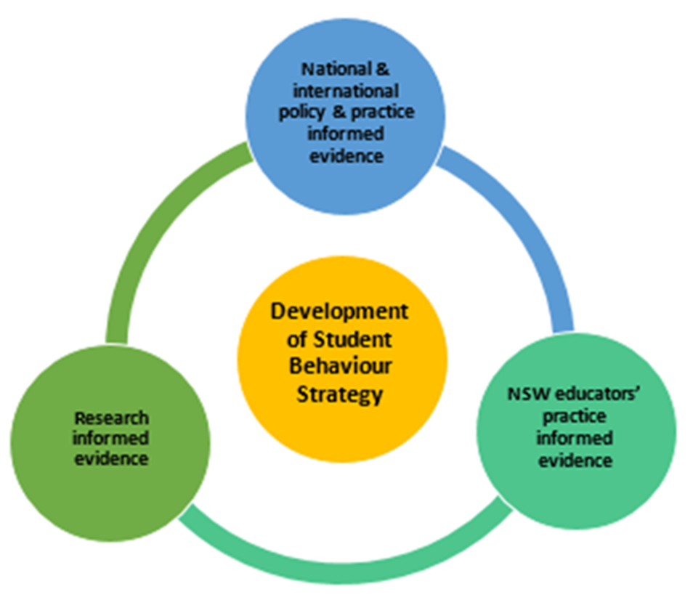
Directions are being informed by…
Ombudsmans Inquiry into behaviour management in schools
Broad internal and external
consultation 2018-2019
Educational Services Review 2018
Deputy Secretary road shows
Telethon Kids Institute three-part evidence review
Audit of Wellbeing of Secondary Students 2019

Slide 3




Internal consultation
Semester 1 2018 – Semester 1 2019
Led by Learning and Wellbeing
Representatives from School Operations, School Services, the Primary Principals’ Association, the Secondary Principals’ Council, School Policy, Learning and Teaching, Aboriginal Education and Communities, and Legal Services
POLICY REVIEW WORKING GROUP 4 meetings
ETUs, Strathfield and Chullora, Dee Why, Behaviour Schools, Mount Druitt and Minchinbury, Far West – Broken Hill, Hornsby, Illawarra and South, Gosford, Liverpool, Orange
Primary and Secondary Principals’ Wellbeing Reference Groups
Aboriginal Education Consultative Group Federation of Parents and Citizens Associations of NSW
NCARA
DIRECTORS / PRINCIPALS 19 meetings
OTHER STAKEHOLDERS 4 meetings

Slide 4


External consultation
Semester 1 2018 – Semester 1 2019
Round table meeting with:
NSW Department of Family and Community Services
NSW Department of Premier and Cabinet
NSW Health
Juvenile Justice NSW
Individual meetings with senior officers from:
NSW Department of Family and Community Services
NSW Department of Premier and Cabinet
NSW Health
Juvenile Justice NSW
NSW Teachers Federation
Meetings with:
Advocate for Children and Young People
NSW Aboriginal Education Consultative Group
NSW Coalition of Aboriginal Regional Alliances (NCARA)
Youth Crime Prevention and Early Intervention Board meeting
17 meetings

Slide 5
Independent third party consultation
Telethon Kids evidence review
1. Interviews and focus groups
Stakeholders (n=3): key NSW stakeholders supporting schools
DoE System Level Staff (n=17): Directors, Leaders, Advisors, Coordinators
DoE School/ Educational Services and school specialist staff (n=27): Senior Psychologists; Advisors & Coordinators; As; Network Specialist Facilitators
Principals and school leaders (n=13) metropolitan and regional areas of NSW.
2. Expert Think Tank with 30 national and international experts
3. Rapid evidence review of 3,100 studies

Slide 6

Key themes
Identified through the consultation process

Slide 7
Some themes…
Professional learning
Partner with universities to increase training in behaviour management as part of pre-service teacher training.
Continue to provide a range of options for accessing professional learning, including online learning.
Utilise the experience of principals and other staff in Behaviour schools to provide professional learning to other schools in their region.
A positive, preventative and inclusive approach to the complexity of student needs
From a young age embed preventive and early intervention approaches to wellbeing and behaviour management into department to reduce the need for complex targeted interventions to address behaviour later.
Building system capacity and expertise and: school and specialist services
A systematic approach to ongoing training of support staff is needed to ensure a mix of skills to support behaviour and mental health across the State.
Facilitate opportunities for staff skilled in behaviour management to be available to work across a range of schools to build staff capacity.

Slide 8
Some themes…
Increase access to resources, implementation support and information
Develop clear simple tools to assist schools to find effective, evidence-informed/based resources and methods for evaluating them to assist schools in timely decision-making.
Identify approaches that support schools in areas with limited access to internal and external providers. Consider the additional resources schools in these areas will need when implementing programs to support wellbeing and behaviour management.
Effective communication and stakeholder partnerships to support student behaviour and wellbeing
Explore processes and opportunities for facilitating an ongoing cycle of communication between and within directorates and system level staff and school-based staff within the NSW Department of Education.
Provide sufficient opportunities for non-school based staff to visit and communicate with schools to maximise understanding of the issues concerning schools and to explore workable solutions.
Form partnerships with parents such as through P&C associations to improve communication and engagement with parents.

Slide 9
Policy key themes
Implementation of student behaviour and wellbeing policies and guidelines
Shift from ‘discipline’ to ‘behaviour’
Concise policy documents with simple language – Streamline Suspension Procedures
Provide a range of tools and professional learning to support for school staff to support the full of continuum of disruptive behaviour
A range of alternative engagement strategies for schools to access when needed
Wrap around support and guidance for vulnerable students, particularly Aboriginal students, students in Out of Home Care and students with disability
An implementation plan to support schools in use the updated policy and procedures.

Slide 10

What have we learned?
Behaviour is broad…
Schools need support…

Slide 11
Work streams and deliverables
Cultural change to support student behaviour in schools
Work with partners to enhance communication
Behaviour policy and Suspension and Expulsion Procedures
Professional learning and online resources
family and community
Build capability of staff at all levels
including professional learning
School Operations & Performance and School Services
NSW Health, Justice,
FaCS
school
Maximise impact of system-level resources: School services, specialist school-based staff, and alternative settings
DoE support services and wrap around support with
other agencies
Online resources: website and tools platform for schools to access resources and information
Academic partnerships to support school decision making
system levers
Data capabilities to enable responsive
decision-making at school and system level
Page 11
Data capabilities
Page 11

Slide 12
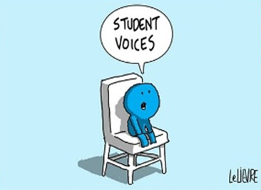


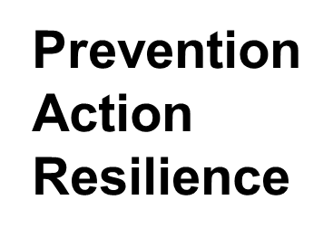
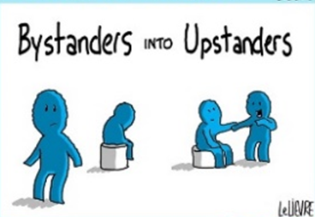
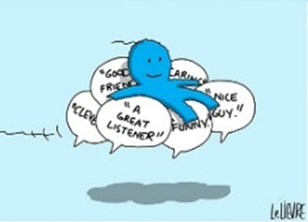

New resources update
Powerful Conversations Kit

Slide 13
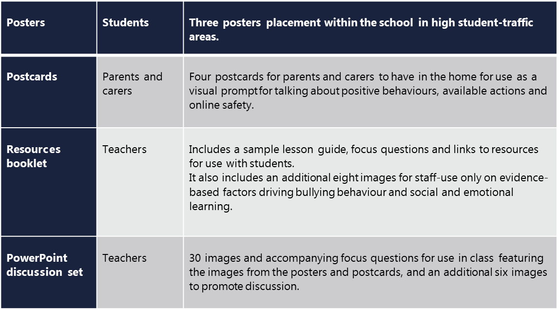
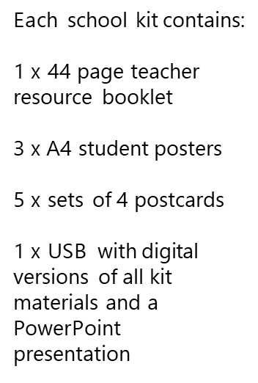
New resources Update
Powerful Conversations Kit

Slide 14
Student Discipline Policy …
… and Suspension and Expulsion Procedures
What is currently working well for you?
What is not working well?
What are your suggestions for change?

Slide 15


