Slide 1
Learning and Teaching
2019 Term 2 Update
NSWPPA State Council meeting

Slide 2



Learning and Teaching
NSW Department of Education
Executive Director Learning & Teaching
Cheryl Best
Director Arts Sports & Initiatives
Rosemary Davis
Director Early Learning & Primary Education
Paul Wood
Director Literacy & Numeracy
Catherine Thomson
Director Secondary Education
Deb Summerhayes
Director Rural and Pathways
To be advised
Provides support and direction for the development, implementation and evaluation of major, high profile arts and school sport programs, initiatives and events.
Oversees the operations of the department's Arts and School Sport Units.
Manages the department's relationship with the NSW Conservatoriums' of Music.
Maintains and builds relationships with all stakeholders to achieve better outcomes for public education.
Provides support and direction on the provision of curriculum implementation, professional learning and support P-6.
Leads and manages the provision of early learning including preschools and transition from early learning to primary education.
Manages the department's Multicultural Education programs (K-12).
Manages the School Community Languages program.
Maintains and builds relationships with all stakeholders to achieve better outcomes for public education.
Provides support and direction with the implementation of the Literacy and Numeracy Strategy 2017-2020 across NSW public schools including responsible for the implementation of Early Action for Success.
Leads the design and development of professional learning in literacy and numeracy K-12.
Manages the provision of teaching and learning resources to support literacy and numeracy K-12.
Maintains and builds relationships with all stakeholders to achieve better outcomes for public education.
Provides support, direction and advice on the provision of curriculum, planning, assessment and reporting for students from 7-12.
Leads secondary education initiatives and policies.
Leads vocational education and training initiatives.
Supervises and supports the Principal of Saturday School of Community Languages.
Maintains and builds relationships with all stakeholders to achieve better outcomes for public education.
Provides high quality advice, direction, support and strategic initiatives to improve student outcomes in rural and remote locations across NSW.
Leads senior pathways policies, systems and projects.
Maintains and builds relationships with all stakeholders to achieve better outcomes for public education.

Slide 3
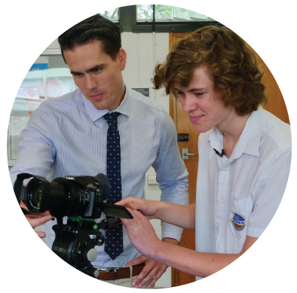
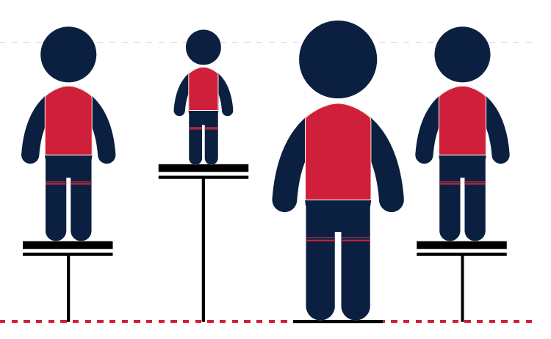

HPGE Policy 2019
A policy for all schools P-12
Equity and excellence
Inclusive and stronger support for diversity
High Potential and Gifted Education
Notes:
Policy announced by the Premier and Minister on 4 June 2019.
Departmental announcement by Deputy Secretaries on 7 June 2019.
Significant media and social media coverage (Sydney Morning Herald, ABC radio, RN, the Sun Herald)
A policy for all schools P-12
All schools DoE - from early childhood to the HSC across all domains
Part of our core business, not an extra.
This policy is about enhancing the work schools are already expected to do each and every day for their students.
Education Act – every student has the right to achieve their educational potential. (Education Act NSW 1990).
Every student known, valued and cared for (NSW DoE strategic plan 2018-2022)
Every child has the right to learn to their fullest capability (Disability Strategy 2019)
Disability Discrimination Act (Commonwealth) 1992 and Disability Standards for Education (Commonwealth) 2005 - High potential and gifted students can also have disability. Although these students have an advanced learning potential by definition, their disability can make it more challenging for them to achieve as highly. A high potential and gifted student with disability is entitled by policy and legislation to participate in their education on the same basis as a similar high potential and gifted student without disability.
Equity and excellence
This is an equity-focused policy
We should recognise that department schools have a much stronger representation of disadvantaged groups
Students from these groups therefore rely more heavily on public schools to provide opportunities to learn and to develop their talent
Changed processes for funding of schools may provide additional targeted resourcing
We were very conscious of the excellence gaps and inequities that we observe, including those for rural and remote students, students with disability and other equity groups.
Inclusive and stronger support for diversity
Students with disability, regional, rural, and remote students; Aboriginal students; English-language learners, refugees, and culturally diverse students etc
Not using the term twice exceptional (2e) as in the 2004 policy but instead, students with disability – this is strategic as it means that In planning the needs of these students should be considered within the disability discrimination act and standards.
Note that the term 2e is generally used in International literature, particularly American research as the term “exceptionalities” is more frequently used in their educational system.
Schools will be expected to recognise students’ advanced learning potential regardless of their disability and realise requirements under legislation require that either adjustments or interventions must be put into place.
Alignment with departmental policy developments
The policy itself shows clear alignment with other departmental reforms, policies and frameworks, including the wellbeing framework (see policy statement point 1.5) and the school excellence framework (see policy statement point 1.7).
This has been a deliberate act to show schools that this policy aligns with the work they already do.
The policy should be read in conjunction with a range of other policies, frameworks and documents:
Aboriginal Education Policy and Turning Policy into Action
Anti-Racism Policy
Assisting Students with Learning Difficulties
Curriculum planning and programming, assessing and reporting to parents K-12
Disability Inclusion Action Plan 2016 – 2020
Leading and Managing the School
Mentoring Students Policy
Multicultural Education Policy
Professional Learning Policy for Schools
Psychological Tests Policy
School Excellence Policy and School Excellence Framework
Selective High School and Opportunity Class Placement Policy
Student Welfare Policy and Wellbeing Framework
Workplace Learning for Secondary Students in Government Schools
Australian Professional Teaching Standards (AITSL)
Guidelines for Accelerated Progression (NESA)

Slide 4

Points of difference
HPGE Policy 2019
Across all domains of potential: intellectual, social-emotional, creative, physical
Based on contemporary research
A broader definition – includes students with high potential
Stronger inclusion of specialist settings across all domains in the policy
Potential on a continuum
Strengthened support for acceleration and advanced learning pathways
Notes:
Across all domains of potential
While the 2004 policy refers to an earlier version of Gagne’s differentiated model of giftedness and talent which clearly identifies the four domains of potential, consultation feedback from 2017-2019 indicated that schools understood the focus of the policy was on the intellectual domain. This was reinforced by the professional learning and support materials.
This policy makes very clear and explicit reference to the four domains of potential. We currently have a literature review prepared by CESE focusing on the intellectual domain called “Revisiting Gifted Education”. This review ‘revisits’ the research with a particular focus on new research since 2004 within this domain.
Stronger inclusion of specialist settings in the policy
This policy recognises for the first time that specialist high schools such as sports, design, creative and performing arts and the Conservatorium – are talent development centres that specialise in their particular domain.
Specialist settings also include Selective High Schools & classes, opportunity classes, representative programs and initiatives, arts, sports and leadership.
Potential on a continuum
Potential as a continuum in each domain. Every student has the potential to learn and we know that some students in one or more of the domains can learn more quickly and easily than their peers. The policy describes these students as high potential and represents a broader range of students requiring additional challenge in our schools. Within the high potential group are sub-groups of students who have the capacity to learn more readily than their age peers – firstly those who are described as gifted and then those who are described as highly gifted.
The inclusion of ‘gifted students’ reflects the comprehensive body of research which exists in gifted education to best support the talent development of these students.
The inclusion of ‘highly gifted’ reflects the research that indicates there are students whose potential to learn in a particular domain vastly exceeds that of their same age peers. For these students in particular we need to consider how we can provide sufficiently supportive conditions in public schools to allow them to explore this extraordinary potential.
High potential students: Those students whose potential exceeds that of their same age peers in one or more domains: intellectual, creative, social-emotional and physical.
Gifted students: Those students whose potential significantly exceeds that of their same age peers in one or more domains: intellectual, creative, social-emotional and physical.
Highly gifted students: Those students whose potential vastly exceeds that of their same age peers in one or more domains: intellectual, creative, social-emotional and physical.
Potential refers to a student’s innate ability in one or more domains and shouldn’t be confused with their final attainment after talent development, i.e. high performance.
By focusing on potential first rather than performance this policy places greater focus on supporting students, especially those in disadvantaged groups to develop their talent and move towards achieving their educational potential.
This supports the research showing up to 57% of high potential and gifted students underachieve in the intellectual domain and the significant excellence gaps that exist between students from high and those from low SES backgrounds.
Strengthened support for acceleration and advanced learning pathways
The election commitment made by the Baird government in 2015 states:
"...develop partnerships with universities, training organisations, business and industry to mentor and stretch high ability students, with school students with high ability able to study tertiary subjects while at school.”
The benefits of acceleration are overwhelmingly supported in the research and include academic, social and personal benefits for students when well implemented.
Acceleration, despite having one of the strongest evidence bases in education, is still underutilised
This policy has strengthened guidelines for acceleration and advanced learning pathways
Finding solutions to overcome barriers between levels of schooling
Key Research
Acceleration is considered one of the most effective educational interventions available to gifted students (Rogers 2007, 2015).
Repeated meta-analyses and systematic reviews of the research evidence on acceleration across a vast diversity of educational settings and contexts have shown that all forms of acceleration offer significant learning benefits for gifted students (Kulik 2003; Steenbergen-Hu and Moon 2011; Steenbergen-Hu, Makel, Olszewski-Kubilius 2016; Warne 2017).
The effect size of acceleration on learning growth has been estimated at between +0.72 and +1.62 standard deviations of learning growth, placing acceleration among the more effective educational practices (Steenbergen-Hu, Makel, Olszewski-Kubilius 2016). These findings have been consistent across students from diverse backgrounds (Lee et al. 2010).
Early entry to school and radical acceleration, are also supported by the literature (Gross 2006; Rogers 2015).
References
Gross, M 2006, ‘Exceptionally gifted children: long term outcomes of academic acceleration and non-acceleration’, Journal for the Education of the Gifted, vol. 29, no. 4, pp. 404-429.
Kulik, J 2003, ‘Meta-analytic studies of acceleration’, in Colangelo, N, Assouline, S and Gross, M (eds), A nation deceived: How schools hold back America’s brightest students: The Templeton National Report on Acceleration, Vols 1 & 2, Belin-Blank Center for Gifted Education and Talent Development, Iowa City, IA.
Lee S-Y, Olszewski-Kubilius P, Peternel G 2010, ‘The efficacy of academic acceleration for gifted minority students’, Gifted Child Quarterly, vol. 54, no. 3, pp. 189-208
Rogers, K 2007, ‘Lessons learned about educating the gifted and talented: A synthesis of the research on educational practice’, Gifted Child Quarterly, vol. 51, no. 4, pp.382-396.
Rogers, K, 2015, ‘Academic effects research synthesis’, in S Assouline, N Colangelo, J VanTassel-Baska & A Lupkowski-Shoplik (eds), A nation empowered: Evidence trumps the excuses holding back America’s brightest students, The Connie Belin & Jacqueline N. Blank International Centre for Gifted Education and Talent Development, Iowa City, IA, pp. 19-30.
Steenbergen-Hu, S & Moon, S 2011, ‘The effects of acceleration on high-ability learners: A meta-analysis’, Gifted Child Quarterly, vol. 55, no. 1, pp. 39-53.
Steenbergen-Hu, S, Makel, M, Olszewski-Kubilius, P 2016, ‘What one hundred years of research says about the effects of ability grouping and acceleration on K-12 students’ academic achievement: findings of two second-order meta-analyses’, Review of Educational Research, vol. 86, no. 4, pp. 849-899.
Warne, R 2017, ‘Possible economic benefits of full-grade acceleration’, Journal of School Psychology, vol. 65, pp. 54-68.

Slide 5
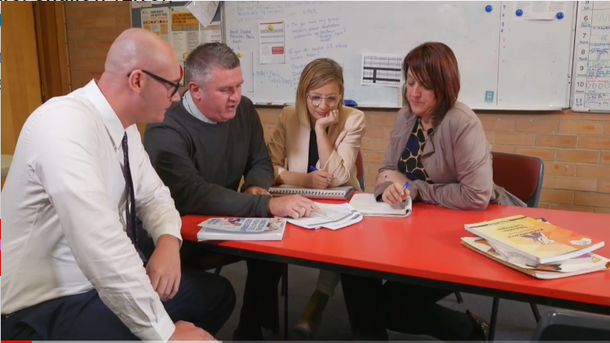

Consultation
HPGE Policy 2019
Over 50 consultations from February 2017- April 2019
Over 250 people:
PPA, SPC, NSWTF, P&C groups
academics and consultants
principals, teachers and school based gifted and
talented coordinators
executive directors, directors, learning and teaching staff
Further consultation on developing the
suite of professional learning
Notes:
When we began the development of the policy, we were provided very few instructions: the policy had to –
Accommodate the election commitment
Take into consideration research since 2004
Be original
As a result we sought the advice of many stakeholders, seeking their perspectives and professional views.
Over the last 26 months more than 50 consultations, involving more than 250 people have occurred representing PPA, SPC, NSWTF, P&C, academics, principals, teachers, department executive directors, directors, departmental representatives and school based gifted and talented coordinators.
This policy is one of the department’s most consulted policies across a range of key stakeholders.
Analysis of student achievement data, findings of the literature review “Revisiting Gifted Education” along with the consultation and fieldwork with stakeholders contributed to the policy development.
Further consultation on professional learning design and development
Since the original consultations a further 35 consultation sessions have been held between December 2017 and March 2018.
These have included more than 140 people: PPA and SPC, NSWTF, parent and community groups, NESA, DELs, curriculum advisors, principals and school leaders, teachers and academics
These consultations have supported and advised on the structure, depth and breadth of professional development.
A serious attempt has been made to identify the needs of professional colleagues across diverse sites and responsibility levels within the department.
The professional learning has been designed and developed through consultation and informed by the research of Helen Timperley, Frances Whalan, Michael Fullan, Andy Hargreaves, Thomas Guskey, Steven Dinham and outstanding research syntheses such as that completed for CESE by Paul Brock in 2015 entitled “Which forms of professional development improve student outcomes?”
Research
Enhancing progress and achievement for HPG students
Teachers who have completed specialised training or advanced studies in high potential and gifted education:
Utilise more effective strategies (Gross, 1997)
Demonstrate substantial improvement in student outcomes (VanTassel-Baska & Stambaugh, 2005)
Are recognised by HPG students who appreciate the efficacy of upskilled teachers (Tischler & Vialle, 2009).
Hold higher expectations of their students, especially at low SES schools (Garret et al 2015)
Implement specialised practices more effectively including differentiation, assessment, grouping, identification and acceleration (Rowley 2012).
Connecting teacher skill to student outcomes:
Teachers with competence in the use of advanced teaching skills, such as using formative assessment data to inform differentiation and lesson planning
Direct link between the use of these strategies and improved academic and social outcomes for high potential and gifted students (Benny & Blonder 2016)
References for the importance and impact of PL in HPG education
Benny, N, & Blonder, R 2016, ‘Factors that promote/inhibit teaching gifted students in a regular class: Results from a professional development program for chemistry teachers’, Education Research International, vol. 2016, article ID 2742905, pp. 1-12.
Finn, C, & Wright, B 2015, Failing our brightest kids: The global challenge of education high-ability students, Harvard Education Press, Boston, MA.
Garrett, L, Rubie-Davies, C, Alansari, M, Peterson, E & Flint, A 2015, ‘Missing out’? The potential consequences of inaccurate teacher expectations on young gifted readers’ achievement outcomes, The New Zealand Journal of Gifted Education, vol. 19, no. 1.
Gross, M 2004, Exceptionally Gifted Children, 2nd edn, Routledge Falmer, London.
Gross, M 1997b, ‘Changing teacher attitudes towards gifted children: An early and essential step’, in J Chan, R Li & J Spinks (eds.), Maximizing potential: Lengthening and strengthening our stride (pp. 3-22), The University of Hong Kong Social Sciences Research Centre, Hong Kong.
Henderson, L & Jarvis, J 2016, ‘The gifted dimension of the Australian Professional Standards for Teachers: Implications for professional learning’, Australian Journal of Teacher Education, vol. 41, no. 4, pp. 60-83.
Rowley, J 2012, ‘Professional development needs of teachers to identify and cater for gifted students’, Australasian Journal of Gifted Education, vol. 21, no. 2, pp. 75-80.
VanTassel-Baska, J, & Stambaugh, T 2005, ‘Challenges and possibilities for serving gifted learners in the regular classroom’. Theory Into Practice, vol. 44, no. 3, pp. 211–217.
Vialle, W & Tischler, K, 2009, ‘Gifted students’ perceptions of the characteristics of effective teachers’, in D Wood (ed.), The gifted challenge: Challenging the gifted, Merrylands, NSW, pp. 115–124.
References for evidence-based PL and educational change
CESE (2015). 6 Effective Practices in High Growth Schools, Learning Curve Issue 8, NSW Department of Education
Dinham, S. (2016). Leading learning and teaching. ACER (Australian Council for Educational Research)
Fullan, M. and Quinn, J. (2015). Coherence – the right drivers in action for schools, districts, and systems. Sage Publications Inc.
Fullan, M. (2001). Leading in a culture of change. Jossey-BASS: San Francisco
Fullan, M. and Hargraves, A (1991, 1998, 1998). What’s worth fighting for? Working together for your school, Toronto, Ontario.
Guskey, (2002). Professional development and teacher change. Teachers and teaching, Theory and Practice (8), 381-391.
Hargreaves, A and Fullan, M (2012). Professional capital: transforming teaching in every school. New York, Teachers College Press.
Hattie, J. Visible Learning - http://www.evidencebasedteaching.org.au/hatties-2017-updated-list/
Knowles, M (1988). The Adult Learner: a neglected species. Houston, Texas, Gulf Publishing Company.
Sinek, S (2009). Start With Why: How Great Leaders Inspire Everyone to Take Action. Penguin Putman Inc.
Timperley, H (2011). Realizing the power of professional learning. Open University Press, Berkshire.
Timperley, H (2008). Teacher professional learning and development. Education Practices Series 1-18, Bureau of Education.
Whalan, F (2012). Collective responsibility: redefining what falls between the cracks for school reform. Rotterdam, Boston, Tapei, Sense Publishers.

Slide 6
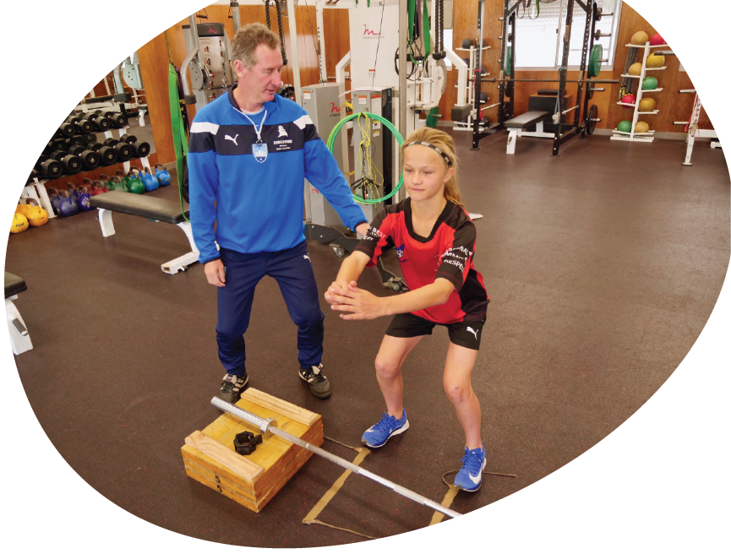
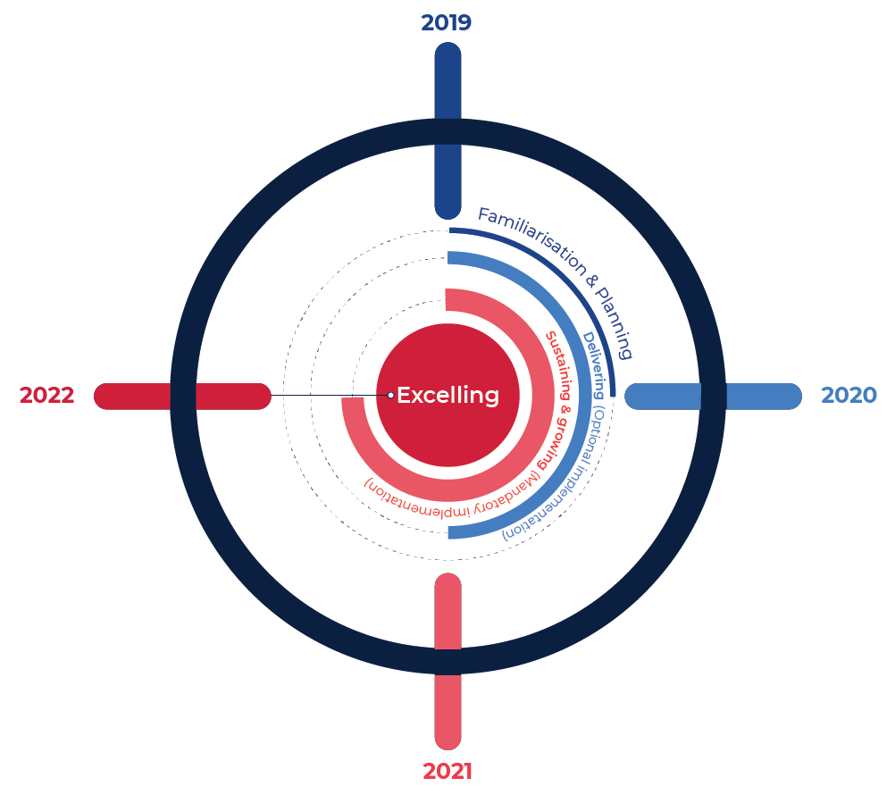
Professional Learning
4 Phases of Professional Learning
Notes:
Overview of professional learning
High potential and gifted education is a highly technical and specialist area.
Most teachers have no pre-service teacher education preparation for gifted education.
The research supports specialist training for better implementation and student results.
There is a body of research that can guide practitioners to more effectively cater for the needs of high potential and gifted students, especially those from disadvantaged backgrounds.
Professional learning has been developed according to a framework that is theoretically consistent with the Schools Excellence Framework.
The professional learning plan demonstrates increasing complexity of ideas and approaches and is described in four tiers.
TIER 1: Orientation - Familiarisation and Planning (2019-2020).
Participants will examine the literature review, Revisiting Gifted Education (CESE), trend data for student acquisition of skills and knowledge, and the policy. Priority will be given to planning strategies for implementation in schools.
The target audience and projected timeframes are:
DELs, Principals and school leaders – T3-T4, 2019
Teachers – T1-T2, 2020
This module has been successfully quality assured.
TIER 2: Delivering - Core Modules.
A series of core modules in development address topics such as: The Characteristics of High Potential and Gifted Learners, Talent Development, Advanced Pathways and Underachievement.
The target audience and projected timeframes are:
Leaders – T4, 2019
Teachers – 2020
TIER 3: Sustaining and Growing – Specialisation Modules.
Specialisation models include Gifted Learners with Disability, Addressing Disadvantage, Gifted Learners at Risk, Working with Aboriginal Communities.
The target audience and projected timeframes are:
Leaders – Semester 2, 2020
Teachers –2021
TIER 4: Excelling
2022 onwards
Under Construction.
Schools would have the option to commence the implementation of the policy in 2020.
Mandatory policy implementation would commence in 2021.

Slide 7
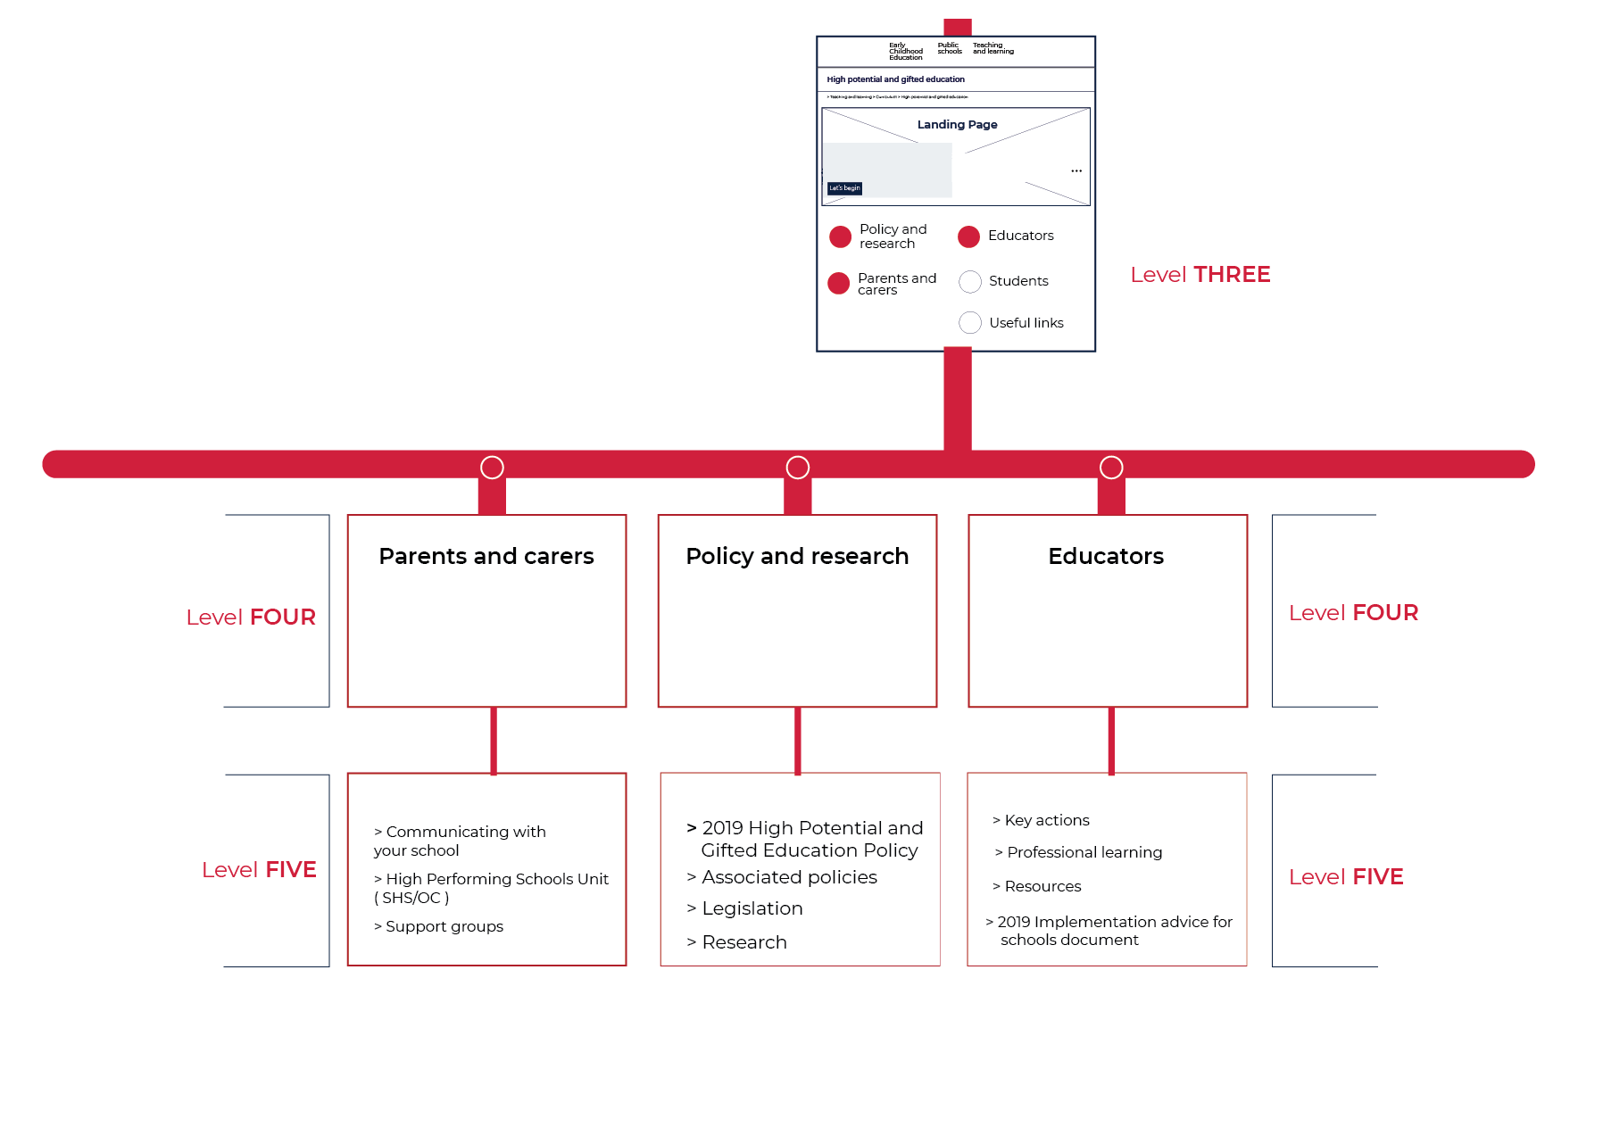

Our Website
A Wireframe
https://education.nsw.gov.au/teaching-and-learning/high-potential-and-gifted-students
Notes:
A temporary webpage has been created, which houses the policy, the literature review and Q&A: https://education.nsw.gov.au/teaching-and-learning/high-potential-and-gifted-students
The vision is for an engaging and evolving webpage which is densely populated at time of release.
Significant work on the design of the webpage before launch will ensure an intuitive, streamlined and engaging experiences for users.
Various visuals will provide a textured experience, including infographics, ‘key message’ videos, photos and text.
The webpage will house the:
Policy and research including:
The HPGE Policy
The legislation
Associated policies and frameworks
Research
The Secretary’s message
Advice for educators including:
the Implementation Advice for Schools
The professional learning plan
The key actions to support schools to implement the policy
Resources (link to curriculum advice and sample units/ programs, etc)
Advice for parents and carers including:
Advice on communicating with schools
A link to the High Performing Students Unit
Parent support groups
Short teasers on key ideas in the policy will include:
Definitions of HPG students across all domains
Talent development unpacked
Guiding principles of the policy
Diversity of HPGS
5 key actions
Learning characteristics of HPG students
HPG students in rural and remote areas

Slide 8
Implementation Advice for Schools
Webcontent
Notes:
The webcontent has been organised under 5 iterative key actions.
The key actions are a scaffold for schools to implement the policy:
evaluate school procedures, programs and practices and student growth and achievement to inform school planning and policy implementation.
assess and identify the specific learning needs of all high potential, gifted and highly gifted students.
implement evidence-based procedures, programs and practices that meet the learning and wellbeing needs of high potential and gifted students and facilitate talent development.
collaborate with families, school communities and the wider community to enhance growth and achievement for all high potential and gifted students.
build teacher and leadership capacity through engagement with quality research and ongoing professional learning on effective practices to improve growth and achievement for all high potential and gifted students.
The evaluate key action content includes explicit links to relevant parts of the SEF V2, relevant policies and resources, and general information about evaluating student progress (growth, achievement, engagement and wellbeing).
The assess and identify key action content includes advice for schools on formative assessment, assessment and identification practices and catering for the needs of HPG students from diverse backgrounds.
The implement key action organises advice under the concept of talent development, and includes creative and critical thinking, differentiation, grouping and extension, enrichment and extra-curricular programs, advanced learning pathways including acceleration and social emotional development and learning.
The collaborate key action provides advice on building collaborative practice, as well as staff, family and community collaboration.
The build teacher and leadership capacity key action provides advice on professional learning.

Slide 9
Curriculum support

Slide 10
Key messages for syllabus implementation
Primary schools will commence implementing the following syllabuses;
Science and Technology K-6
implementation of new syllabus in all stages
PDHPE K-10
2019 continue teaching current K-6 syllabus OR
implementation of new K-10 syllabus (optional in 2019)
2020 implementation of new K-10 syllabus in all stages
Chinese, French, German, Indonesian, Italian, Japanese, Korean and Spanish K-10
for schools implementing a K-6 languages program.
Notes:
There has been a focus through the project on improving the syllabus implementation and support for new syllabus
For primary schools in 2018, 2019 and 2020 this is:
SciTech
PDHPE
Languages

Slide 11
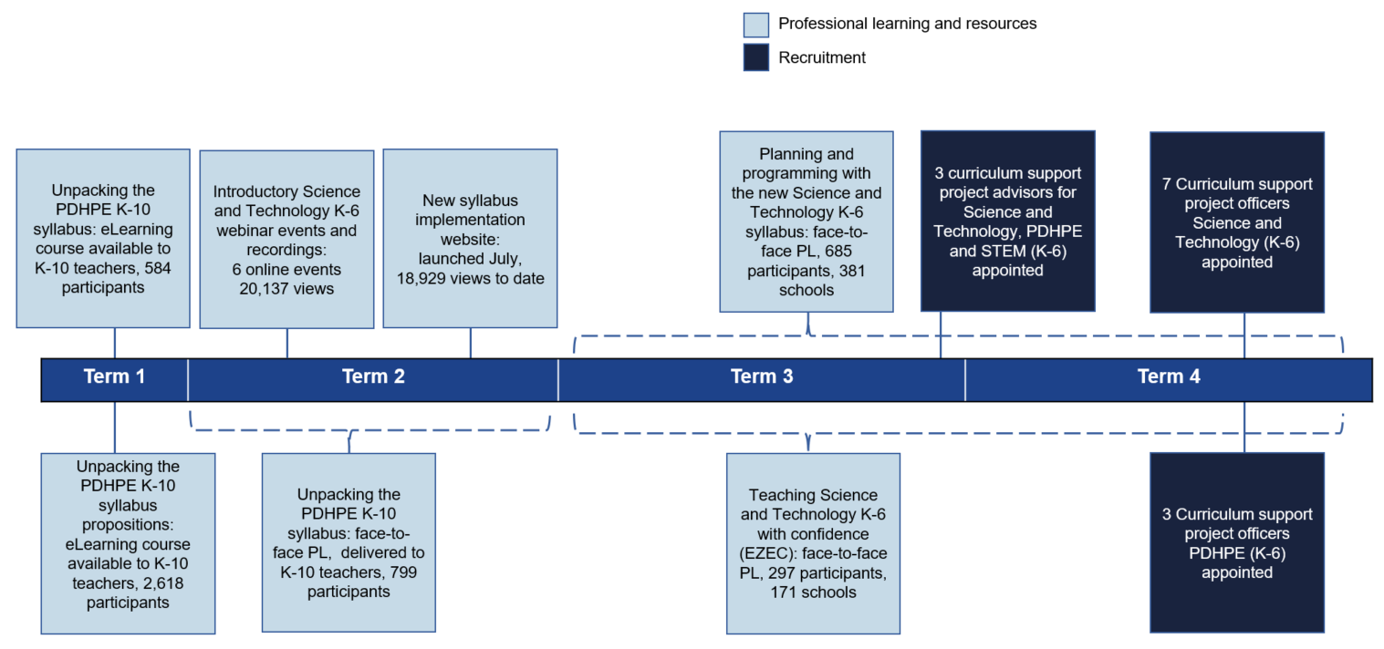
2018 curriculum support K-6
Notes:
In 2018 we provide
Face to Face learning for a total of 4 983 participants
Our E Learning has been viewed over 39 066 times
We have committed to increasing the quantity of offering, the numbers of people with expertise to deliver the PL and the breadth and quality of the offerings for all schools

Slide 12
2019 curriculum support K-6
17 hours of PL (QA)
PDHPE K-6 and Science and technology K-6
Getting to know the PDHPE K-6 syllabus (primary) (NR25619) ‒ e-Learning course (1 hour, TIPD) ‒ 255 enrolments Unpacking the PDHPE K-10 syllabus propositions (primary) (RG04325) ‒ e-Learning course (1 hour, registered) ‒ 2,138 enrolments
Unpacking the PDHPE K-10 syllabus (RG02979) ‒ face-to-face workshop (7 hours, registered) ‒ 24 venues ‒ 617 participants
Implementing the Science and Technology K-6 syllabus (RG04451) ‒ face-to-face workshop (5 hours, registered) ‒ 24 venues ‒ 383 enrolments
Teaching with the Science and Technology K-6 syllabus (RG04489) ‒ eLearning course (3 hours, registered) ‒ 50 enrolments
Notes:
So far this year we have focussed our attention on the mandatory syllabus implementation
Supporting the implementation of the SciTech syllabus this year
And getting ready for the PDHPE syllabus in 2020

Slide 13
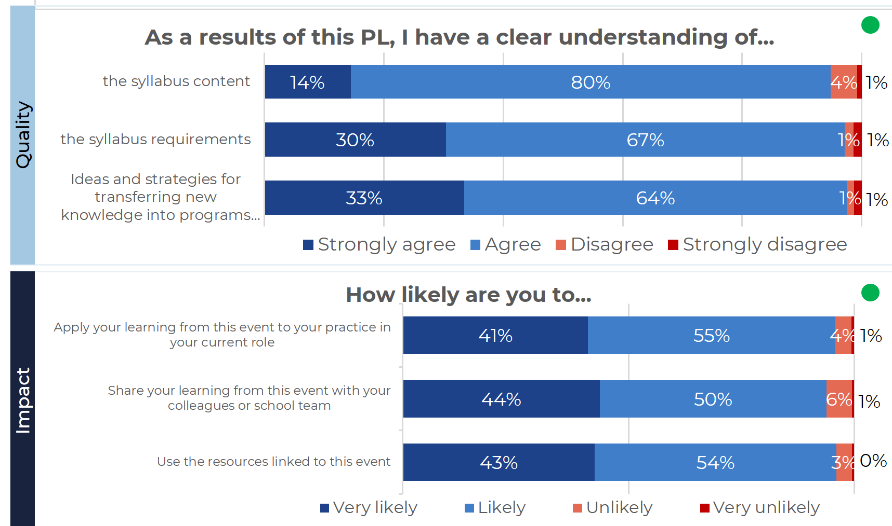
Data snapshot
Combined evaluations (May 2019)
Notes:
We continue to evaluate all our offerings exposing the
QUALITY AND IMPACT -
HOW WELL DOES UNDERSTANDING BUILD
HOW LIKLEY ARE YOU TO USE YOUR LEARNING BACK AT SCHOOL

Slide 14
Upcoming work
Science and technology ‒ 19 x sample scope and sequence documents ‒ e-Learning course (planning, programming and assessing) ‒ support for inquiry learning, digital technologies ‒ units of work ‒ continued rollout of F2F workshops
PDHPE ‒ reoffering F2F workshops in Semester 2 (EOI, needs only basis) ‒ scope and sequence documents ‒ units of work ‒ advice for meeting requirements (child protection) ‒ continued rollout of F2F workshops
Primary curriculum ‒ advice for schools re: planning, programming and assessment (clarity, consistency)
Notes:
Over the rest of 2019 we are focussing on

Slide 15
Knowing your syllabus
Designing programs & assessment
Enabling high quality practice
Scaling expertise & innovation
Needs
Identification of differences between old and new syllabuses.
Identification of PL and support needs.
Identification and mobilisation of networks.
Needs
Scope and sequence documents (modelling and joint construction).
Access to resources (units, assessment tasks, deep content and concept tools).
Research/evidence based.
Needs
Capacity building of all teachers and leaders.
Differentiated teaching and learning.
Evidence based high impact teaching and learning.
Student outcomes focus.
Research/evidence based.
Repository of good practice tools, work samples, etc.
Needs
Identifying expertise and innovative practice.
Ongoing support of schools/COS/networks to scale expertise and practice.
Sharing of research/evidence.
Support
F2F workshops.
Introductory webinars.
Information and advice on compliance, changes, planning and support
Teachers
Executive
Principals
DELs
Teams
Directorates.
Support
Co-designed and L&T led, mixed mode and online PL (with SS, experts and networks).
Self-directed (school, COS, network).
Facilitated (school, COS, network).
Targeted PL for new syllabus content.
Co-designed resources: units (LT/SS), assessments (LT/SS/expert/network), scope & sequences.
Co-designed and L&T led SS support resource, syllabus specific PL module (LT/SS).
Support
Project & action-research initiatives.
Targeted PL for teaching new syllabus content & skills (LT/SS).
Targeted PL for changes in practice and impact in student learning outcomes (LT/SS/CESE).
Executive & principal curriculum leadership toolkit (online/mixed mode).
Facilitate moderation of student work samples for consistency of teacher judgement.
Support
Piloting of shared digital resource and pedagogy space.
Evaluation of pilots by CESE.
Publishing and scaling strategies.
In-built quality assurance – evaluation milestones
14
Notes:
The four contexts allows us to think abut the way our work supports schools as they move across the four contexts that define growing syllabus/curriculum knowledge and expertise
For new syllabus we are currently working in the first two contexts – acknowledging that this is where most schools are

Slide 16
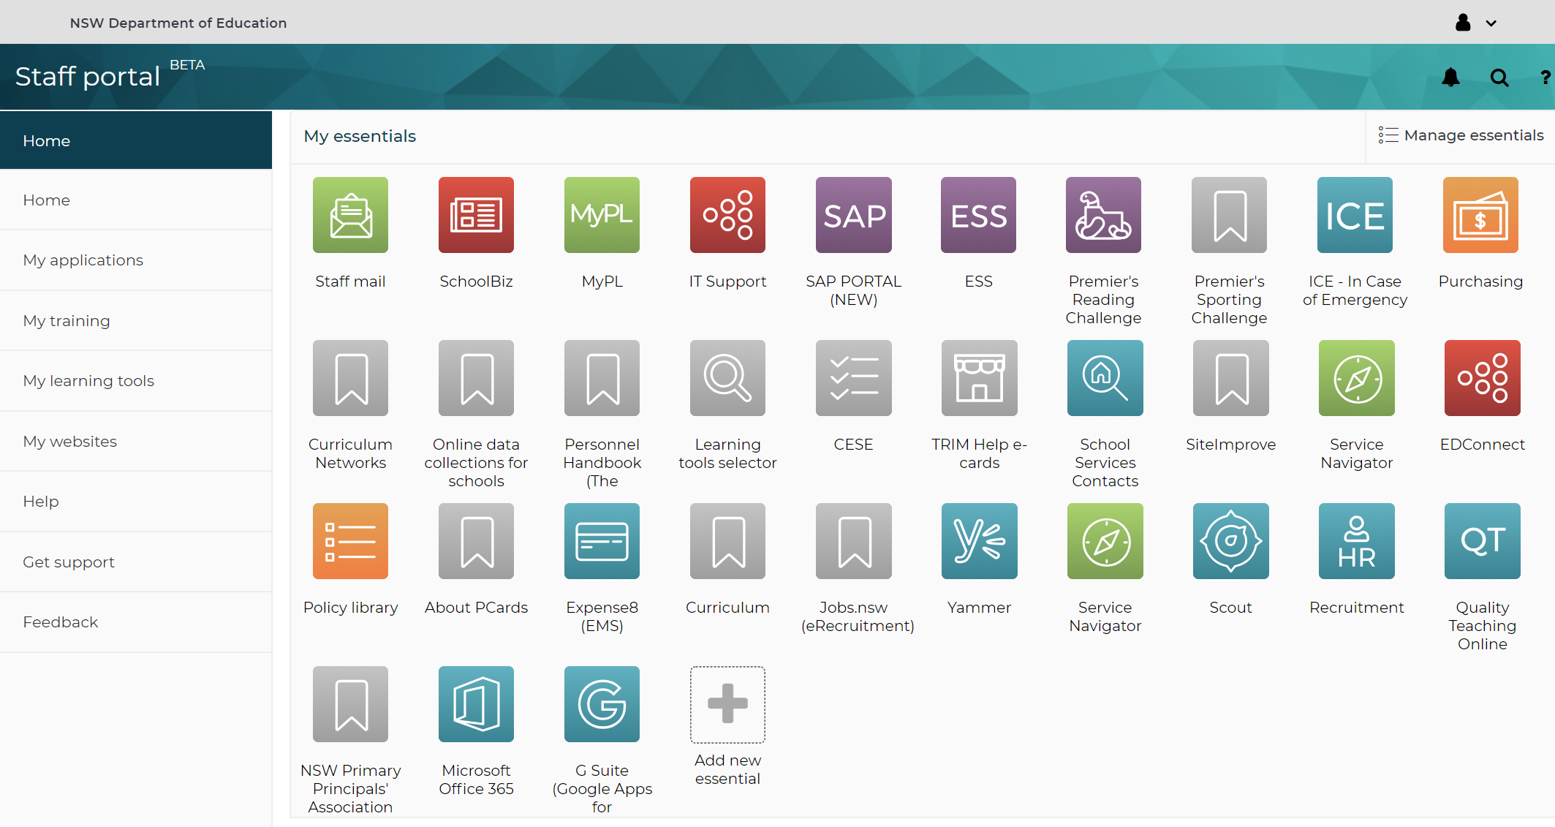
Portal tile for curriculum support
Notes:
We have made our context easily accessible

Slide 17

Access professional learning and support
https://education.nsw.gov.au/teaching-and-learning/curriculum/key-learning-areas
Notes:
And our learning is consistently updated and available
A ONE STOP SHOP FOR ACCESS TO LEARNING AND RESOURCES

Slide 18
Curriculum networks project

Slide 19
Curriculum networks project
Evidence based – action research
Gather evidence to provide guidelines for:
establishing new networks
enhancing existing networks
Draw on a strong research base
Improve teacher and principal access to networks
Provide quality support to network schools
Focus on improving student outcomes

Slide 20
Curriculum networks project
Three phases of research and support
Gather evidence
Formulate recommendations
Test & reset Upscale & expand
2019
2020
Notes:
In phase one, curriculum advisors from Learning and Teaching and School Services are working with 30 metropolitan and non-metropolitan networks to:
-provide specialised curriculum support based on the identified needs of the network
-observe and record network practices
-seek to understand the level of support and resourcing that was required during the establishment, growth and embedding of the network and its subsequent sustainability
-gather data and report back to Learning and Teaching.
Future support for new and existing networks will be based on current research and evidence gathered from the networks project. Phase two will focus on the development of draft guidelines and a range of support materials.
Phase three will be an opportunity to trial the draft guidelines and support materials in the establishment of new networks and the enhancement of existing networks.
2019
Term 1
30 networks identified
Project leadership group established
Term 2
Grants to identified networks
Literature review
Focus groups
Develop network self-assessment process
Term 3
Trial network self-assessment process
Develop support materials and professional learning for network leads
Analysis of data gathered from networks
Term 4
Develop draft network guidelines
EOI process for establishing new networks or enhancing existing networks
Seeding grants
2020
Participating networks trial guidelines and support materials
Ongoing PL provided for network leads
Guidelines reviewed based on trial materials

Slide 21
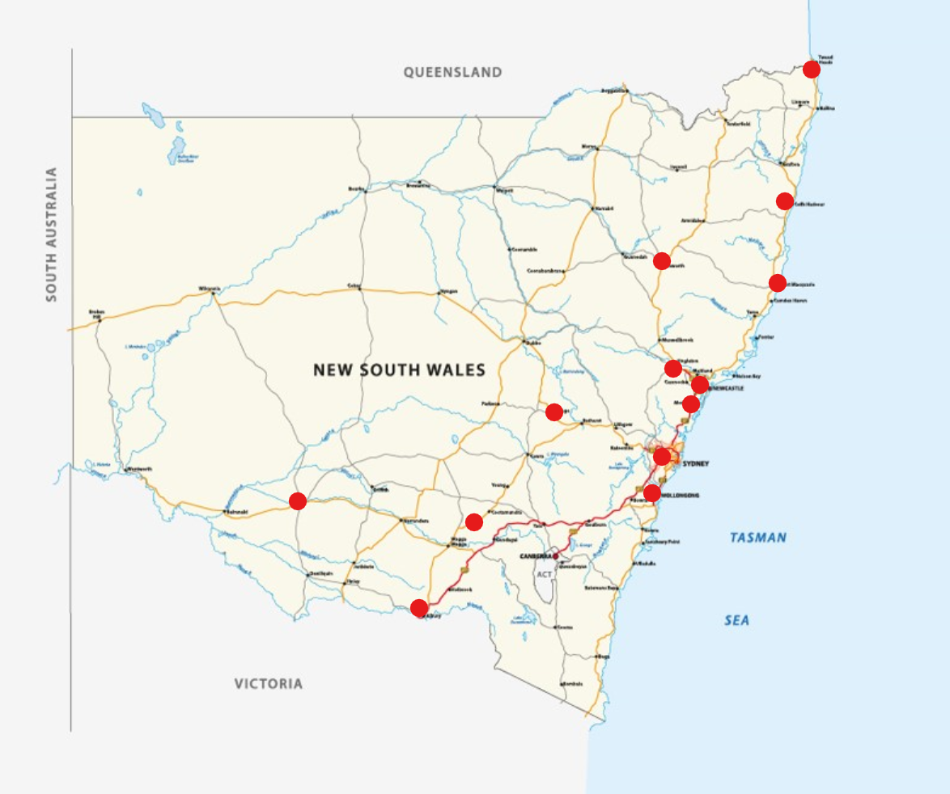
Curriculum network project: Phase 1
Where are we now?
Currently working alongside and learning from 30 metropolitan and non-metropolitan networks
Principals in residence to:
Learn how networks operate
Identify network support needs
Aim to:
understand the characteristics of quality sustainable networks
design support materials for new and existing networks
Notes:
We are currently working with and learning from 30 metropolitan and non-metropolitan networks across NSW.
One Primary Principal and one Secondary Principal join the project next week as Principals in Residence.
The Principals in Residence will work closely with networks to learn how they operate, how teachers are supported and what networks need to thrive.
The Principals in residence will work closely with network leaders, Learning and Teaching Advisors and School services advisors.
Information gathered from networks will inform the design and delivery of support to new and existing networks across NSW.
More detail
Secondary curriculum advisors from TAS, Mathematics, science, English, HSIE (History and Geography), PDHPE and creative arts are working with a metropolitan and non-metropolitan network. This includes rural and remote networks in rural south of the state, and west operational directorates.
In primary curriculum, English, mathematics, science and technology and PDHPE are working with metropolitan and non-metropolitan networks. This includes collaborating with the distance education network school of the air.
Networks often comprise large numbers of schools spread well beyond the geographic centre.
The Orange Small Schools Association comprises eleven small schools within an 80 kilometre radius of Orange, representing approximately 700 students.
The One Schools network comprises 17 mostly one teacher primary schools from Lithgow, Moree, Cowra, Queanbeyan, Lismore, Orange and surrounding districts.
The Curriculum Network Illawarra includes 17 local high schools from Bulli down to Kiama that regularly meet across and within key learning areas.

Slide 22
Literacy and Numeracy

Slide 23
Learning progressions
Feedback from schools
The detail of the learning progressions helped teachers identify student needs as it lists observable behaviours
Identifying student needs helped teachers focus on specific areas and inform their practice
Using learning progressions strengthened their understanding and use of the syllabus
Strong leadership
Strong instructional support
Detail of the
LPs +ve -ve
Notes:
Rapid diagnostic – testing with schools what is working and what needs more support.
Schools revealed the learning progressions impacted their understanding of literacy and numeracy positively. The progressions gave teachers confidence, they encouraged collaborations and helped teachers priorities their teaching.
The detail of the learning progressions helped teachers identify student needs as it lists observable behaviours
Identifying student needs helped teachers focus on specific areas and inform their practice
Where literacy and numeracy progressions were helping teachers, it was evident that the school had strong leadership practices in place. There was strong instructional support either from LANSAs or ILs/exec………this leadership enabled teachers to bridge the understandings about literacy and numeracy development into classroom practice.
We also found – the power of the learning progressions is the detail, but at the same time the detail can make it harder for teachers to manage and navigate the progressions.
As a result we are working to develop a literacy and numeracy resources and support (pathway) for our DELs and PSLs, to help them support you.
We are clarifying the roles and responsibilities of the LANSAs to make it clearer for schools to know how to get support.
We are working on PLAN2 to make it more user friendly – including the development of focus areas and templates that can be shared.
We are working to deliver diagnostic assessments that can be used on-demand that will help teachers validate their decisions and prioritise their teaching.

Slide 24
Early action for success
Website and communications
Instructional leaders 2020
Professional learning package for teachers
Notes:
We are making sure that all schools can access resources used by EAfS by developing a new EAFS wevsite that is part of the literacy and numeracy website. Resources will be behind the portal and available to all schools.
We provide a lot of professional learning for our instructional leaders. We plan to strengthen that PL by providing the ILs with online learning/resources they can use to follow up and implement strategies in schools with teachers.

Slide 25


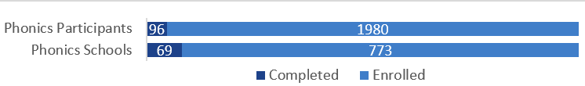
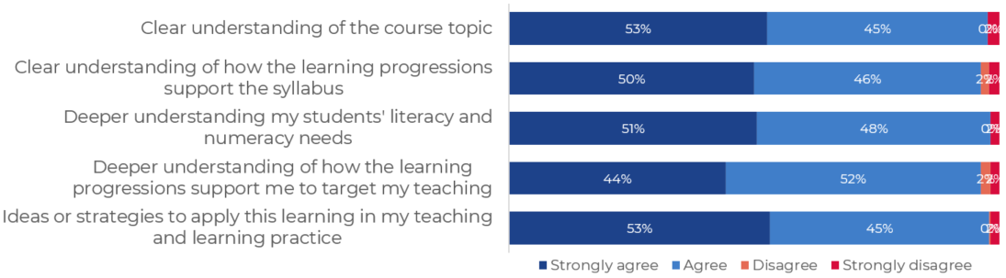
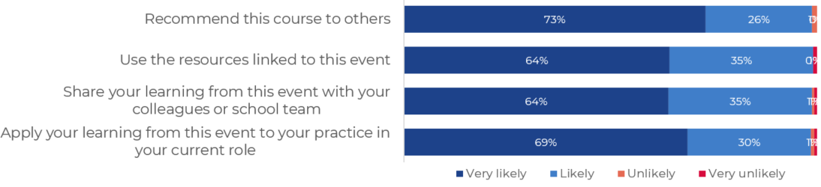
Literacy and Numeracy
June 2019
Reach
Goal: | Teachers have an increased understanding of students' literacy and numeracy learning needs Teachers have increased skill in responding to students' literacy and numeracy learning needs
Where we are:
New professional learning:
Additive strategies days 1 and 2 K-8
Operating with decimals across the curriculum day 1, 3-8
Phonological awareness
Leading secondary writing
Leading secondary numeracy
Using the progressions with PLAN2 secondary
Effective reading phonics (online)
6 new LaNSAs were inducted in week 4 with their mentors and members of the Literacy and numeracy team.
Coming soon:
Writing online professional learning written by Dr Tessa Daffern coming soon.
Effective reading vocabulary.
Areas for attention
Online diagnostic support for teachers.
Quality
180
Impact

Slide 26

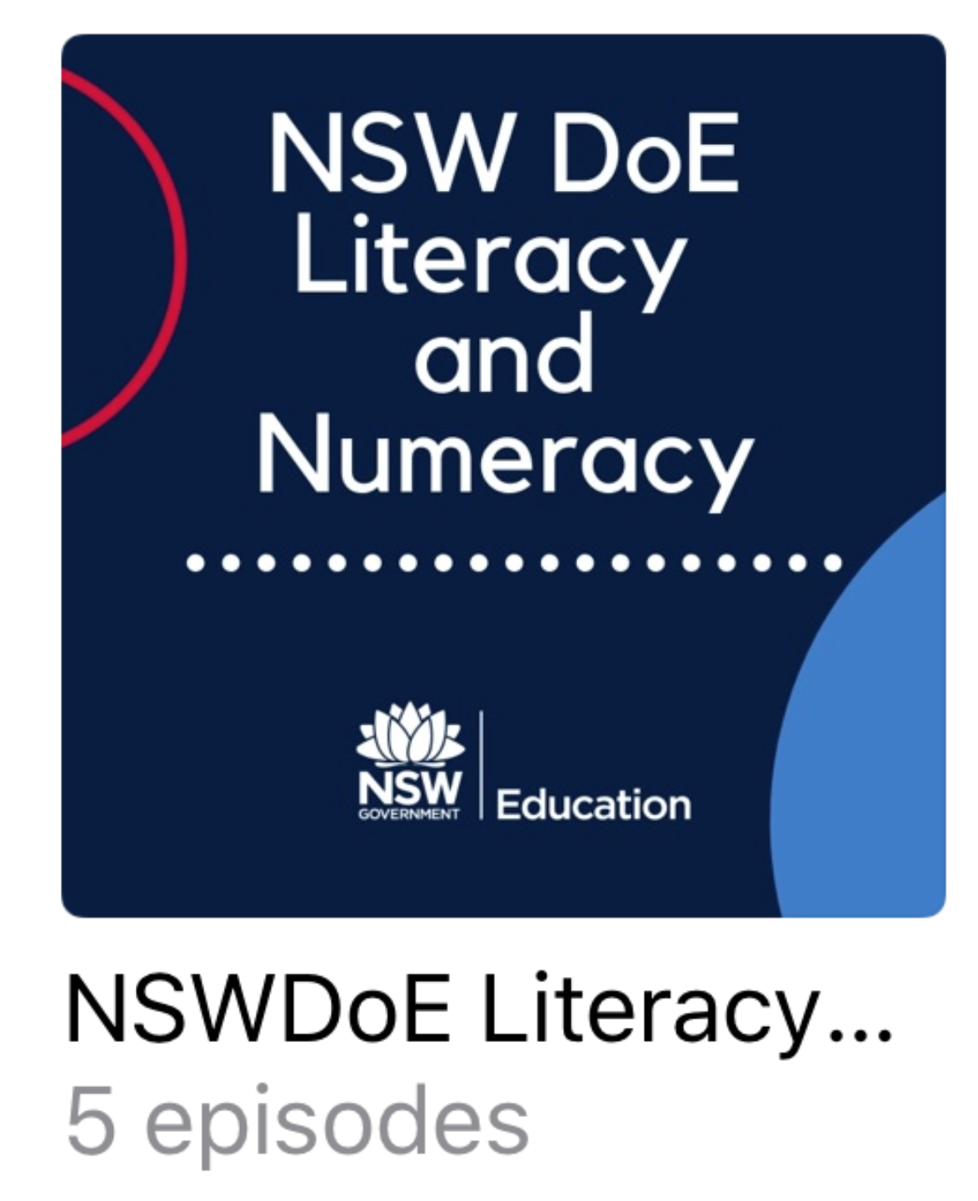
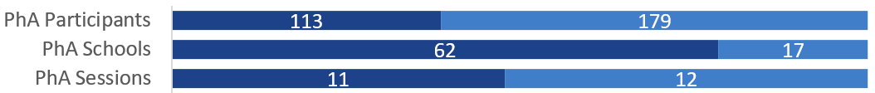

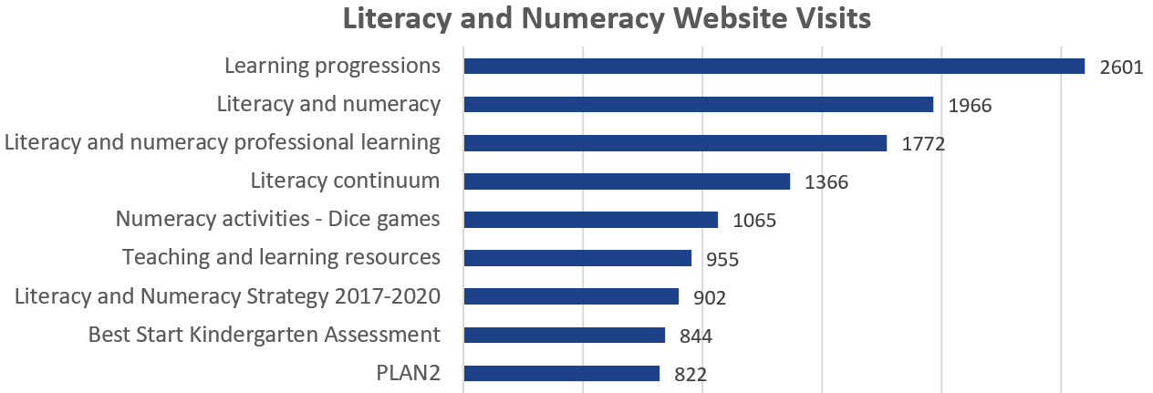
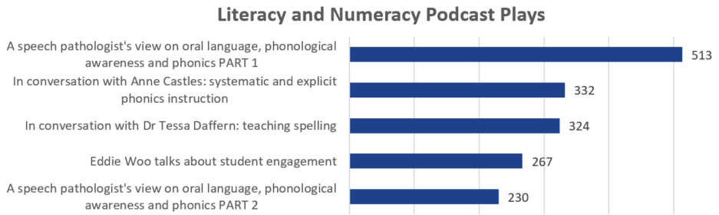
Literacy and Numeracy
June 2019
ES commitment: | Quality teaching to improve every student
Action plan: | Focus on quality professional learning programs to improve classroom practice.
Goal: | Teachers have an increased understanding of students' literacy and numeracy learning needs Teachers have increased skill in responding to students' literacy and numeracy learning needs
Reach
180
Website & Podcasts
Where we are: Areas for attention
Continued consideration for how professional learning can be designed and tailored to suit a range of audience across the state.
Professional development of LaNSAs to extend their understanding of aspects of literacy and numeracy.
Digital resources webpage.

Slide 27
HSC Minimum Standard
From 2020 students in NSW will need a minimum standard of literacy and numeracy to receive the HSC.
From 2018 Year 9 NAPLAN results are no longer used to demonstrate HSC minimum standard.
In 2018 NESA introduced new HSC minimum standard online tests:
Online multiple choice test for reading
Online multiple choice test for numeracy
Online test for writing
From 2019 these tests must be administered by schools via a lockdown browser. It is a different browser to the one used for NAPLAN Online.
Students can sit the tests twice each year from Years 10, 11 and 12, and a few years after school.
The HSC minimum standard is set at level 3 of the Australian Core Skills Framework (ACSF).
The ACSF is represented within the learning progressions.
The ACSF is a tool to describe an individual’s performance in the five core skills of learning, reading, writing, oral communication and numeracy. At ACSF level 3 , students will have the basic skills needed for everyday tasks and future learning after school such as:
following safety instructions in equipment manuals;
understanding a mobile phone plan;
writing a job application;
creating a personal weekly budget

Slide 28
Questions?

