Slide 1

Achieving Excellence Together The Importance of Leadership
Murat Dizdar
Deputy Secretary, School Operations and Performance
@dizdarm #GreatPlaceToWork

Slide 2
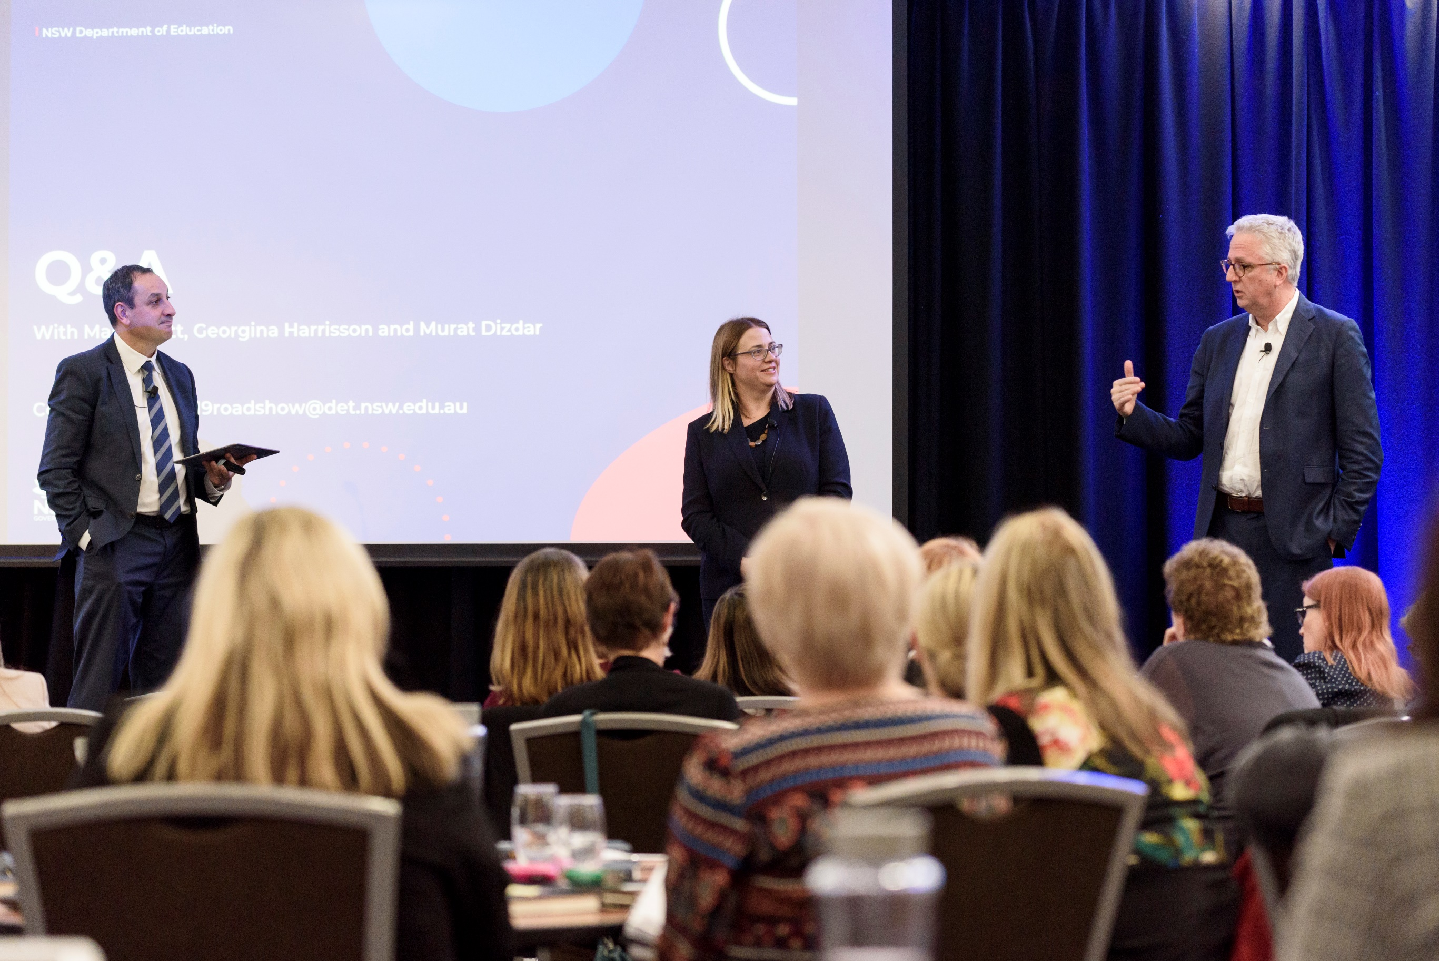
Education Forums 2019

Slide 3
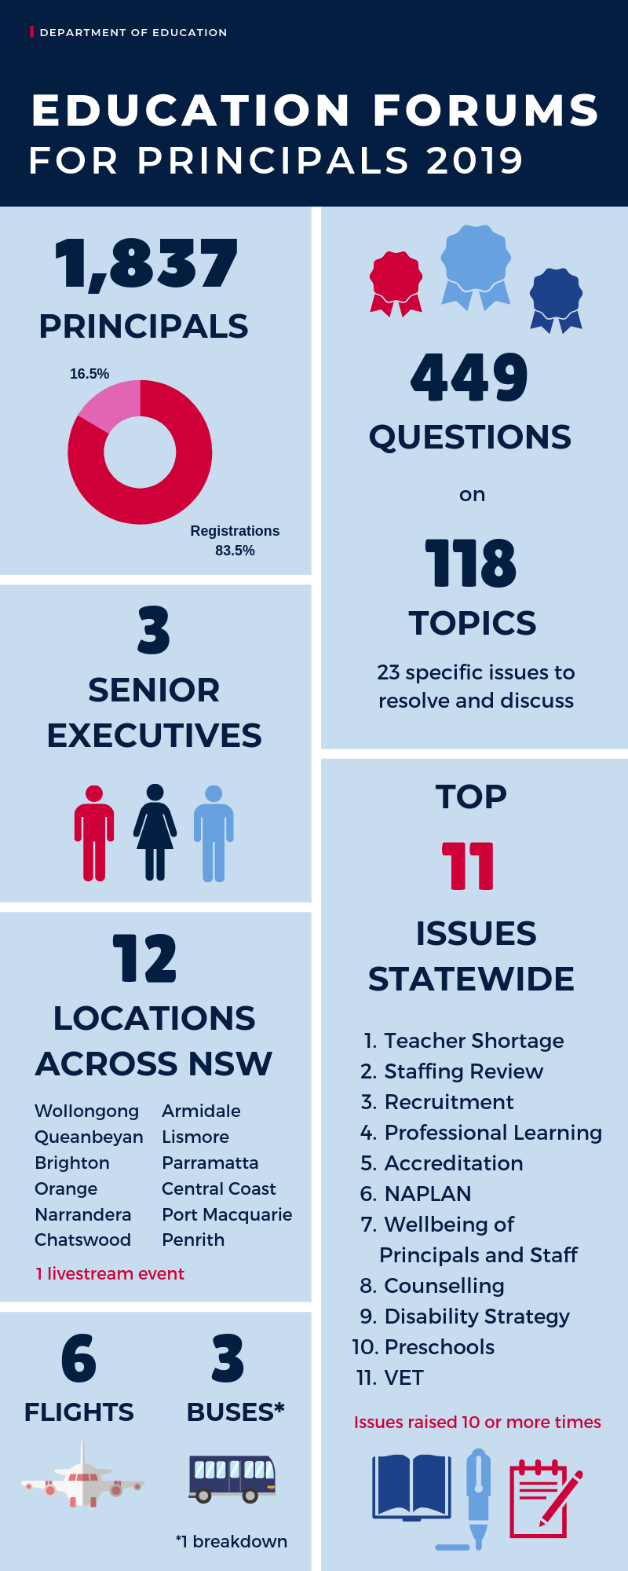

Slide 4
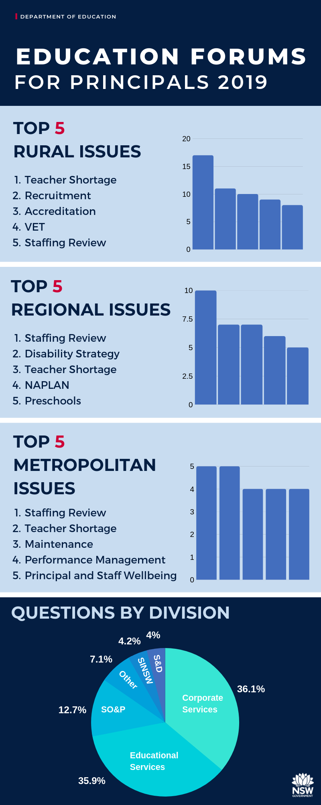
Questions by Divisions

Slide 5
Principal Pulsechecks
Designed to give us formative feedback on the implementation of the DEL role
Feedback for learning – not a performance evaluation
Sample of ~500 Principals from all ODs (different samples for each pulsecheck)
Completely anonymous for both DELs and Principals
Pulsecheck #1 (4 months in) :
Are we making a good start with developing or enhancing relationships with principals, early in the implementation of DEL role?
Pulsecheck #2 (12 months in):
How well are we engaging to support school improvement and Principal capacity building?

Slide 6
What did we learn from the Principal Pulsechecks?
16 Weeks into the Role
1 Year into the Role
The vast majority of Principals perceived their DELs were:
Getting to know schools in their unique contexts
Helping to progress matters of importance
Engaging with Principals, being accessible and available
Helping stakeholders to understand how the role has changed
The vast majority of Principals reported that their DELs :
Had a performance and development conversation with them
Personalised their PDP conversation to reflect their needs and context, and helped them to set appropriate development goals
Had a conversation about school improvement referencing school data
Supported them to make better decisions about school improvement and enhance their plans.
Source: September 2018 & May 2018 Principal Pulsechecks

Slide 7
In the most recent Pulsecheck…
Principals feel that DELs are invested in their wellbeing and professional development
93% of Principals feel that their DEL has demonstrated an interest in their wellbeing
89% agree that work with their DEL on their PDP was personalised to reflect their needs and context

Slide 8
In the most recent Pulsecheck
Principals report that they are having impactful conversations with their DELs about school improvement
89% of Principals reported having had a conversation with their DEL about school improvement referencing their school data, since Term 4 2018
77% agree that their DEL has supported them to make better decisions about school improvement

Slide 9
In the words of Principals…
[My DEL] has been very supportive and responsive to my questions. She is very knowledgeable and gives advice which is practical and relevant. She will guide me to the people or places I need to go to get further support and I have never felt judged. [She] respects my role as principal and allows me to make the decisions for my school. She does not hound me but her presence is there. I know I can call on her when needed.
[My DEL] Has encouraged me to consider the deeper rationale of my choices in leading particular initiatives across the school.
Source: September 2018 Principal Survey

Slide 10
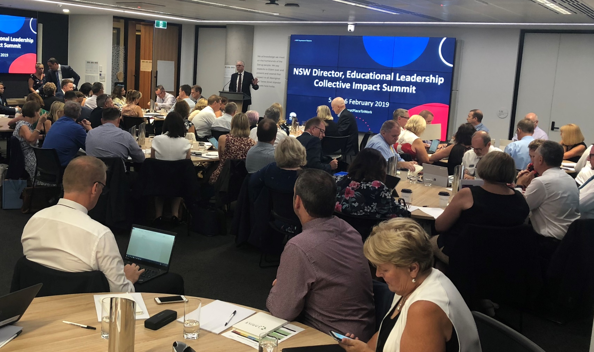
Key Drivers the Middle Layer needs to keep demonstrating
Intelligent Accountability - sharper fix on personalisation
Growing systems leadership
Fostering networks and collaboration
Continuous support and advice/assistance for school improvement

Slide 11

Lifting Education Standards and Opportunities across NSW
Premier’s Media Release, Tuesday 4 June 2019
Bump it Up 2020 – All schools
High Potential and Gifted Program 2021
New Selective High School in South West Sydney

Slide 12




Improve School and Student Outcomes Executive Lead: Murat Dizdar
In 2019, we will focus on design and initial rollout of key elements
This is central to achieving our purpose and mission under the Strategic Plan – if we lift school and student performance then we can lift the performance of the whole system.
There are two goals in the Strategic Plan particularly relevant to this:
Ensure that every child is known, valued and cared for in our schools; and
Ensure that every student, every teacher, every leader and every school improves every year
Stretch targets
Improvement every year
School Excellence
System support
Student need
…to be reviewed, scaled
and embedded by 2022
Creative Commons: Post It by Ed Harrison from the Noun Project

Slide 13
“What stands in the way becomes the way”
Marcus Aurelius

Slide 14

Strengthen School Leadership Executive Lead: Murat Dizdar
Develop, prepare and support school leaders to improve student outcomes – a great Principal makes all the difference
Enable Leadership Development
Leadership development continuum ensuring a cohesive systemic approach
Evidence-informed approach identifying emerging leaders
Scholarships - Masters of Instructional Leadership
Role Descriptions for all leadership positions
Leadership Development in Action
‘Aspiring Principals Leadership Program’
Leadership development program for middle leaders
Ongoing Principal leadership development
Leadership Support and Performance Management
Comprehensive Induction programs for all leadership stages
Implement performance management in alignment with Role Descriptions by 2022
By 2022 we’re aiming for improvement from all initiatives, including
80% of participants successful at achieving leadership roles within 3 years of completion
30% increase in applicants for Principal positions
100% of newly inducted principals report they have received appropriate training and development to do their job well.
50% of Principal time is spent on leading teaching and learning (~20% increase)

Slide 15
Questions
#GreatPlaceToWork
@dizdarm

