Slide 1

Professional Learning
NSW Primary Principals’ Association

Slide 2
Purpose
To empower school leaders by delivering quality professional learning
https://forms.gle/3974xH9Xxa8AVhVVA
Notes:
PLO role
PPA PL - By principals for principals
To support and empower principals and their school leaders in the leadership of their schools
Building the capacity of leadership teams. Strong team will more effectively support their principal
Brief Finance survey

Slide 3
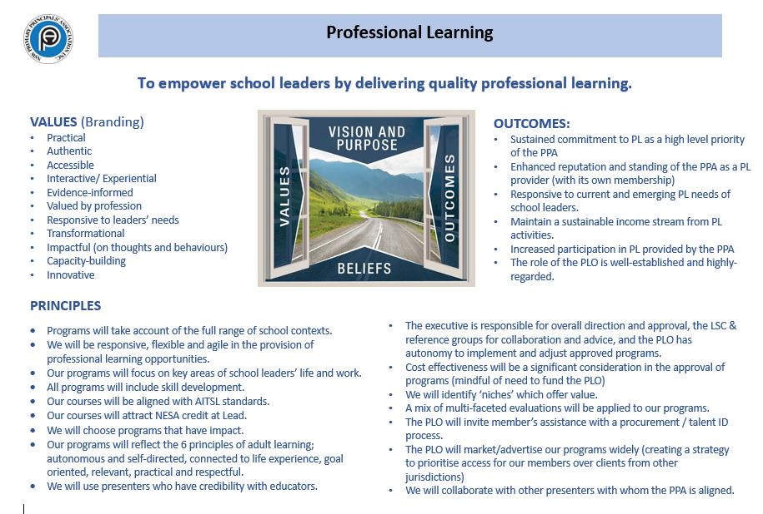
Notes:
Planning day
Purpose, values, outcomes and principles to guide the direction of PL for the association and give clarity and guidance for the PLO role
Executive – overall direction and approval of PL
Reference Gps – collaboration and advice
PLO – implementation and adjustment of approved programs

Slide 4
Draft Framework
Course type: Flagship Program l Workshop or Masterclass l Seminar
Course focus: Leadership l Wellbeing l Personal l Management
Career Stages: Early career Principal l Principal l Aspiring Principal l Middle leadership
https://forms.gle/3974xH9Xxa8AVhVVA
Notes:
Draft framework for the development of PL
This will evolve over time, seeing it as a useful starting point

Slide 5
Flagship Programs
Principal Credential Program
Art of Leadership (and Masterclass)
Flourish
https://forms.gle/3974xH9Xxa8AVhVVA
Notes:
Description of current programs
Fit into the framework

Slide 6
Professional Learning Survey
To provide direction for the development of PL courses delivered by the PPA.
To accurately determine the needs of principals, from different contexts across the state.
Different issues and subsequent professional learning will be required to address the needs of rural, remote and metropolitan principals and school leaders.
https://forms.gle/3974xH9Xxa8AVhVVA
Notes:
Role of Presidents and delegates to promote
Distributed through What’s Hot
Connect with ref groups and PPCs to further gauge needs of principals

Slide 7
Leading for success: Financial management of the school
https://forms.gle/3974xH9Xxa8AVhVVA
Notes:
Finance currently under consultation and development
Working with the FARG in development of this program to accurately meet the needs of schools.

