Slide 1

Strategy and Delivery Division Update
Secondary Principal Council – State Assembly Friday 31 May 2019
Liana Downey, Acting Deputy Secretary ,Strategy and Delivery

Slide 2




Strategy and Delivery Overview
Strategy, Policy & Governance
Communication & Engagement
Delivery Unit
Special Projects
Strategic planning & Support
Ministerial & Cabinet
Policy Coordination
Risk, Governance
Reconciliation Action Plan; Annual Report; Strategic Plan
Communication & Leadership
Strategic Communication
Content & Engagement
Gamer Changer Challenge
Education Week
Support for schools
Improving school & student performance
Boosting teacher quality
Supporting leadership
Improving systems for schools
Great place to work
Strengthening HR processes & systems
Reducing the Administrative burden
Staffing methodology review
Disability strategy implementation
Notes:
What have we got and why?

Slide 3






School time matters and we are counting every hour we save
Since Jan 2018, we have saved:
66 hours
per principal
9 hours
per admin staff
153 hours
per school
338,000 hours
across the system
2 hours
per teacher
School time counts. We are tracking every hour we give back to schools to focus on their core business of teaching, leading and supporting our students

Slide 4



2018 departmental achievements
What has changed for our school staff
Removed School profile
Improved Anti-bullying policy user friendliness
Improved Sports policy user friendliness
Improved Consolidated schools schedule user friendliness
Made A-Z tool opt-in
Fixed SPaRO tool copy+paste issues
Increased mailbox size
Extended Pcard reviewing rights
Shifted ‘blank reports’ to monthly
Principals
Enabled system set-up for new starters prior to commencement
Reduced Scout compliance training by 45 mins
Increased mailbox size
Shifted password reset out of holidays
Teachers
Increased mailbox size
Upgraded EBS to reduce printing errors
Upgraded EBS to increase log in speed
Removed Pcard pre-approval requirement
Shifted ‘blank reports’ to monthly
Admin staff

Slide 5

Human Capital Management (HCM) Program Update
Thursday 30 May 2019

Slide 6

What is human capital management?
human capital management, or HCM, is an industry term that refers to people management systems and practices.
our HCM functions cover a wide range of services, including:
workforce planning
position and organisation management
recruitment
onboarding
the HCM Program was established to build on the department’s investment in a new payroll system (2016-2018) and transform some of our most important HR functions.
this will drive achievement of our strategic objectives of:
reducing the administrative burden
improving systems support to schools
where systems need replacement, we will develop solutions based on SAP SuccessFactors, enhanced by other fit-for-purpose solutions as required.
this will allow us to leverage very attractive licensing discounts negotiated with SAP on a whole-of-government basis
The story so far …
In our discovery phase (through to June 2019), we have been:
investigating the what, why and how of our HCM service delivery, and where we can improve
planning for design of a new customer experience
planning the next phase to ensure no change impact for schools until late 2020

Slide 7
The case for change
Today’s customer experience is below standard and insufficient to carry the department into the future
our practices are complex, highly manual and require the support of a large number of systems
0% automation in teacher recruitment
1% across the board compared to 33% industry benchmark
processes are governed by outdated and onerous business rules and manual checks
37 legislative, 162 policy, 102 custom & practice
processes have too many steps from start to finish
77 steps for teacher recruitment alone
poor visibility of status and progress once a service request is initiated
planning our school workforce is difficult and slow
budgets and staffing allocations are often delayed well beyond the start of the school year
recruitment takes far too long in a high-volume hiring environment
average of 10 weeks required to hire a teacher
a recent survey of 626 principals, school administration managers and corporate staff cited HR processes and systems as a major frustration
Even with the hard work of dedicated teams in our service delivery areas, these factors mean that we struggle to reach and sustain desired service standards.
Together they make a strong case for broad-based business transformation.
Page 3

Slide 8

What will the program deliver for schools?
Improved HCM services will benefit school budget and hiring managers
Up to 13,000 hiring managers and 5,653 budget managers in schools will benefit from:
a single, integrated view of the schools workforce, offering budget allocations, position entitlements and vacancies in one location
a substantial (40%) reduction in recruitment times – down from the current average of 10 weeks for teacher recruitment
easy tracking of recruitment requests each step of the way
better access to pools of qualified candidates suited to specific needs (for instance, outstanding secondary maths teachers)
a tool that matches vacancies with schools’ forecasted needs based on required skills and capabilities and demographic drivers
visibility of vacancies for hiring managers and candidates
much less paperwork and duplication of processes
Page 4

Slide 9
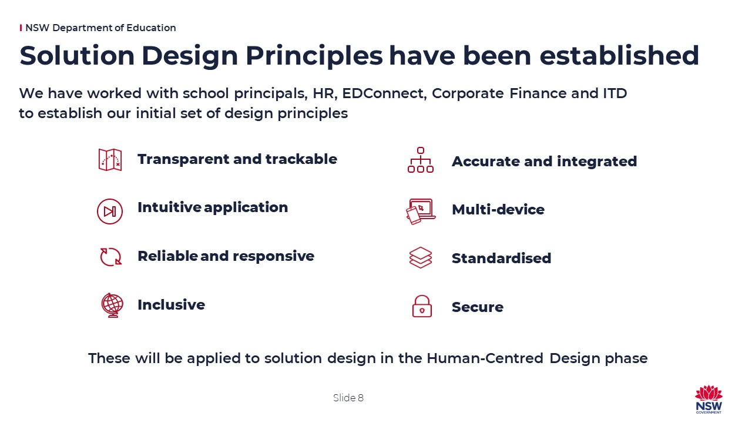
What will be implemented?
In partnership with our service delivery providers (HR, EDConnect, Finance, IT Directorate), the program will deliver process & technology solutions to drive effective business transformation
Transformed services and processes
current processes will be transformed across all in-scope service groups
human-centred design will be used to develop a desirable, feasible and viable customer experience
4 principals embedded full-time in the design & implementation team
A new and optimised solution architecture
based on SAP SuccessFactors and other appropriate technologies,
will transform the current high-risk landscape of 44 legacy systems.
will involve replacement of 20 systems, re-engineering of 14 systems, and retention of 10 systems
A single source of truth for employee data
building on and supporting our $95m investment in SAP HR/Payroll
Solution Design Principles
Our implementation approach offers a roadmap for responding to the department’s future HCM requirements
Page 5

Slide 10
Pain points
Our analysis shows that delays, data inconsistencies and high manual handling are impacting service quality
Plan
Recruit & Select
Onboard
service
groups
Workforce Planning
Position & Organisation Management
Recruitment
Onboarding
4
465
pain
points
73 (15%)
45 (10%)
269 (58%)
78 (17%)
key pain points
school entitlements not settled until week 3 of term 1
delays in finalizing class sizes
underfunding at start of school year, often not reimbursed
manual data transfers from strategy & governance to recruitment teams:
errors and delays
fragmented workflows across 7 processes & systems
double-handling & delays
integrity of employee data critically impacted:
errors and delays
essential employee data stored on standalone end-user systems:
high operational risk
no visibility of process status for recruitment
increased calls to EDConnect
risk of delayed processing of requests
repeated manual re-entry of data in multiple systems
processing delays
manual data exchange
repetitive entry into payroll of bonus payments for Rural staff
manual & inconsistent vacancy matching
severe impact to teacher career mobility
degradation of teacher skills information
late access to systems for 31% of staff:
delays in services to schools
temporary under-staffing
incomplete mandatory training
compliance exposure

Slide 11



What are our targets?
We have set aspirational targets − these may change as we learn more
overall process efficiency (average)¹
number of steps per process (average)¹
number of steps in principal, school executive & teacher recruitment process ¹
number of interfaces per process (average)¹
positions filled in 2018 (permanent) ²
average time to fill a teacher position ²
NOW
21
77
Teachers 3,334 GSEs 1,178
SASS 713 PSSE 16
5
5,241
10 weeks
38%
61%
1%
33%
67%
0%
21%
79%
0%
high level of manual activity = increased recruitment time and increased errors
complex processes with a high reliance on manual steps
disparate and duplicated processes, e.g. 3 separate recruitment processes
swivel-chair processing requires data entry across multiple systems via disparate user interfaces
high demand for recruitment services
volume and variance = complexity
average time to fill a teacher position = approx. 1 school term
increased automation will drive efficiency gains and prepare the department for predicted growth in demand for services
intuitive and functional workflows will allow for easy tracking of requests and integrated views of budget allocations, entitlements and vacancies
schools will see a substantial reduction in how long it takes to recruit staff across all hiring categories, particularly teacher recruitment
a single, easy to use interface will reduce the need for repeat data entry and manual handovers across datasets
capacity to recruit estimated to grow by 10% in the first 12 months after new systems & processes are implemented, building to 25% after 6 years
efficiency gains will return time to schools and corporate service areas, allowing resources to be allocated to higher value activities
WHERE WE WANT TO BE *
*proposed aspirational targets for future state
1
25% increase in capacity
6 weeks
5%
62%
33% ³
8%
59%
33%
10%
50%
40%
Legend
8
30
Page 7
fully manual
partially manual
automated
Sources: 1 HCM current state business process analysis 2 HR recruitment dashboard 3 Ernst & Young - the future workplace: how to automate intelligently

Slide 12

Key HCM takeaways
A detailed assessment of our current state operations have been finalised and we have validated that
there is high complexity with processes and systems ageing and no longer fit for purpose
Over the next two years we will work to transform a wide range of HR services, including:
workforce planning, organisation management, recruitment, onboarding, talent management, and performance development.
Improved HCM services will benefit school budget & hiring managers and corporate staff supporting them
2 SPC & 2 PPA nominated and endorsed Principals are working full-time in the HCM Program
Change impact to schools to will be minimised. Where possible, schools will be deployed to only once. No change to schools before July 2020.
School-centric testing will follow the traditional use acceptance testing, putting schools at the centre of the go-live decision
Invitations to 9 sessions to visit the HCM program collaboration area in Parramatta running during June 2019 to experience and validate the current state process reality
Notes:
The 10 Solution Design Principles themes are a framework to extract design principles via an interactive workshop process

