Slide 1
Central Coast PPC

Slide 2
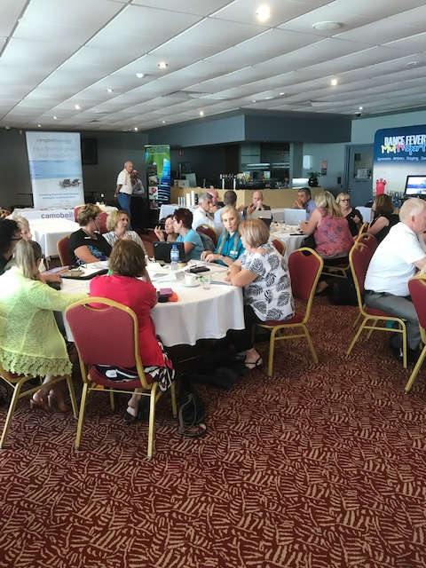
Context
57 schools with Primary enrolments including SSPs, EEC, TPs & Community School.
50 NSWPPA financial members.
On the Shoulders of others.
Roles – see sheet
Notes:
Me president for 3 years and deputy president for 3 years before that. Built over time – Colin, Michelle, Trish

Slide 3
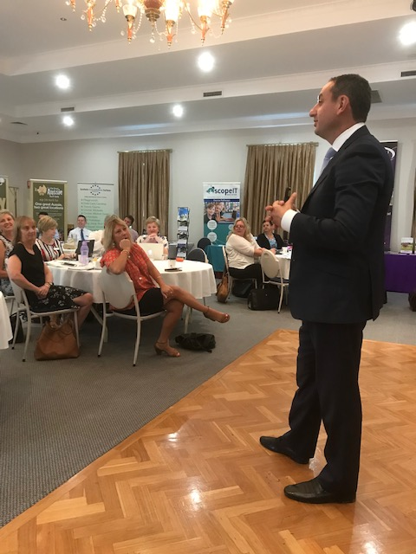
Meetings
Survey
PL, PPA Business, Wellbeing/Interest
Same Day, Same Venue, Same times
DELs attend for lunch
Breakfast T1

Slide 4
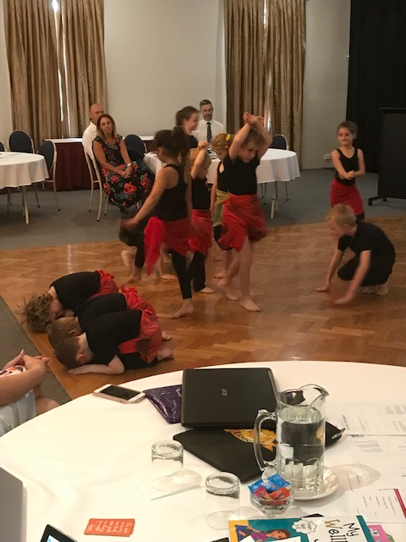
Content
PL – Legal branch, EPAC
Wellbeing/Interest – Comedian, Mindset, Stress Management

Slide 5
Importance of ppa business
PPA Business Sessions – Delegate (Key points, reports etc available for more detail), Other reps one/two key points, Time to raise and discuss issues, share ideas/expertise of the group, actions since last meeting.
Accountability of our PPC reps. RG/SC/WP seek issues from members, attendance at meetings, share reports.
Not just meetings – actions
State PPA – 2 x Exec, Legal issues, Finance Control Group, 3 x RG

Slide 6
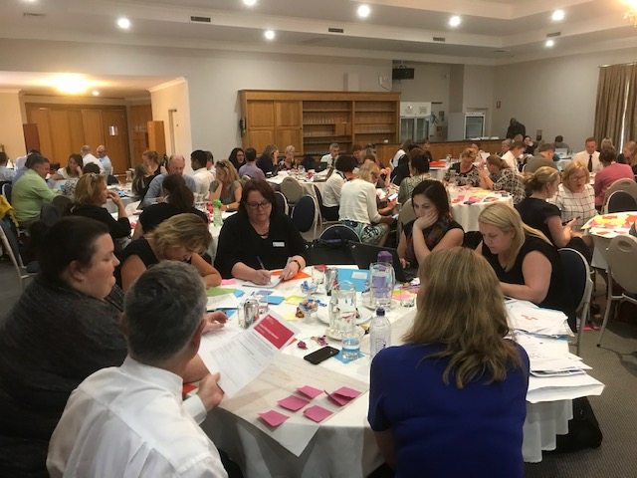
DELS
Meet with ED and DELs
Take issues back from meetings to DELs/ED
Work together to provide support
Work together to co-ordinate DEL days and PPC meetings
Wellbeing
DELs for Lunch
DELs encourage Principals to attend PPC
PSLs work with us

Slide 7
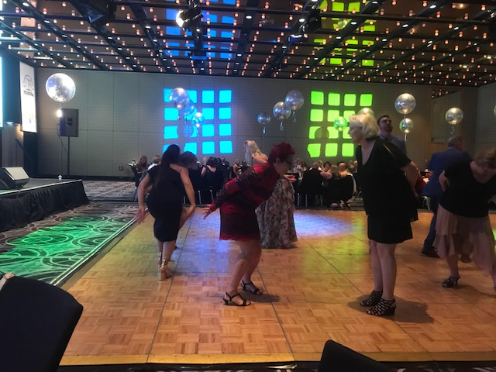
Other ideas
Futures Unit Excursion followed up with a meeting with Peter Lippman & STEMshare trailer
Retired Principals
Social
Sponsor TPs to State Conf

Slide 8
sponsors
$32 000 a year (pays for venue, social, speakers, State Conf)
Paul Miller
Plan meetings so time to speak with sponsors
Mutually beneficial
See sheet for our current sponsor list

