Slide 1

Professional Learning

Slide 2
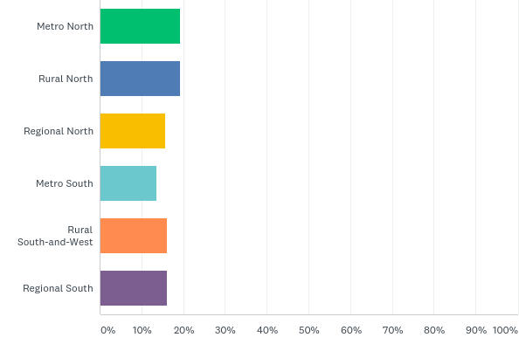
Q2: Which region do you belong to?

Slide 3
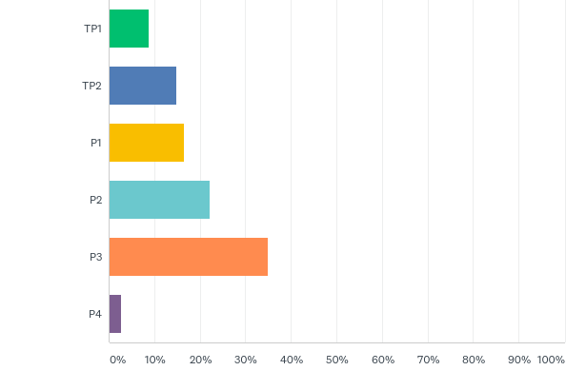
Q3: What is your school's classification?

Slide 4
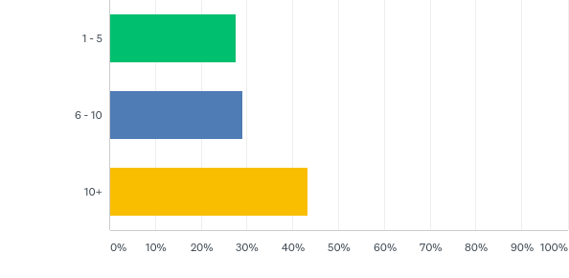
Q5: How many years expereince do you have as a Principal?

Slide 5
Most useful …
Financial management best practice
Feedback / feedforward – building capacity
Legal issues
Difficult conversations
Leading teaching and learning
Building effective teams
Supporting middle leadership

Slide 6
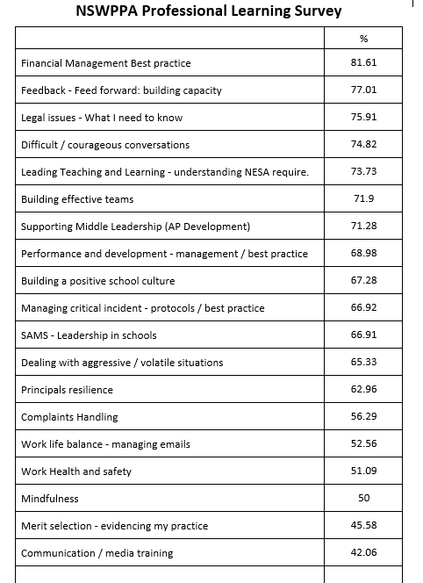

Slide 7
What are your top three professional learning priorities?
Building leadership capacity - 24%
Educational leadership - 19%
Finance - 18%
Wellbeing - 7%
Building effective teams, Courageous conversations, Dealing with volatile people, Building school culture, Performance management/feedback

Slide 8

PL survey response
Financial Management – Best practice
Current team of principals developing course.
Developing Middle Leadership
Current team of principals developing course. Term 3

Slide 9
Difficult conversations
Fierce Conversations
QASSP – hold license for Australia (WAPPA use)
2 day course / 4 modules
Building Effective Teams
Course developed for PPA
Train facilitators

Slide 10
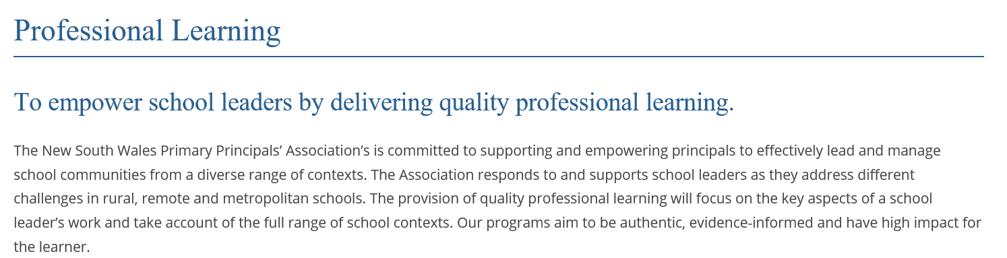
PPA website

Slide 11
Art of Leadership 2020
9 x Art of Leadership programs
3 x AoL Masterclasses
Flyers and links to registration on website next week.
Payment by Pcard or credit card only.

Slide 12
PPA Principal Credential
Currently completing validation process for current cohort.
Validation certificates to be presented at State Conference Award ceremony.
First cohort of school leaders completed their Masters of Educational Leadership with Wollongong University.
Flyers and registration for 2020 program will be on the website in Term 4.

Slide 13
Where to next ….
Promote PPA courses within your local PPC.
Promote PPA website with links to courses.
Visits to PPCs.

Slide 14
Educational Leadership
Ontario Principals Council – International School Leadership certificate (WAPPA, SPC), credit for masters with Sturt University (follow up)
Auckland University – Viviane Robinson
- Growing Great Leaders (QASSP) – rebadge as Student Centred Leadership
- Open to Learning Leadership
Principal Credential link to Wollongong University
Curriculum leadership – possible development (Maria Hardy/ Judy Smith)

Slide 15
Possible policy / processes required
Decision making process
Consultative group
Scope of operation – what we do and don’t deliver
Development model - budget
Intellectual property

Slide 16
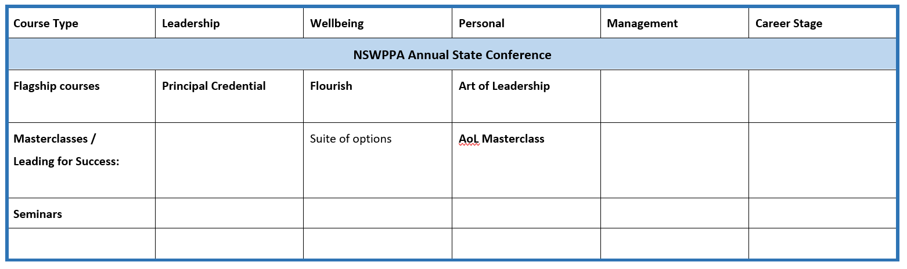
PPA Professional Learning Framework

Slide 17
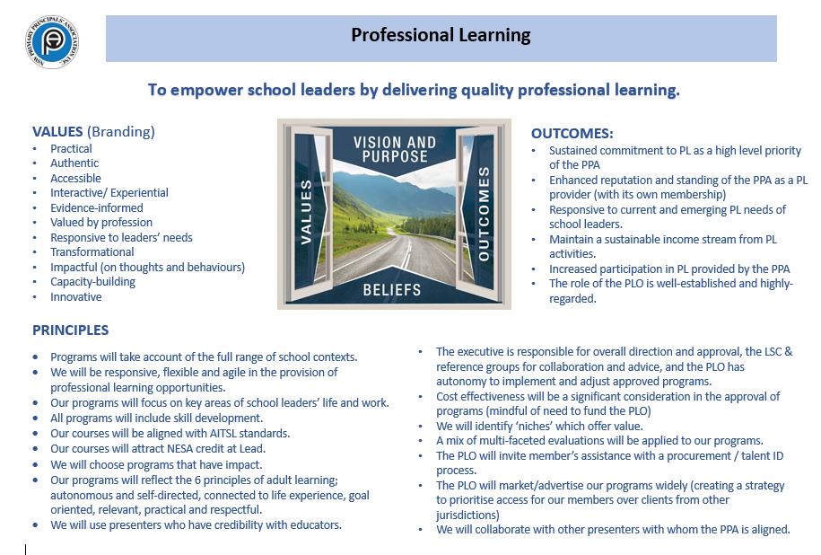
Notes:
Review and finalise

Slide 18
Course Development Models
Course developed by Principals for Principals.
Course commissioned by external expert for the PPA with trained facilitators to deliver.
Licensed agreement to support a commercial product.

Slide 19
Facilitators / Presenters
External presenters
Trained facilitators
Principal volunteers

Slide 20
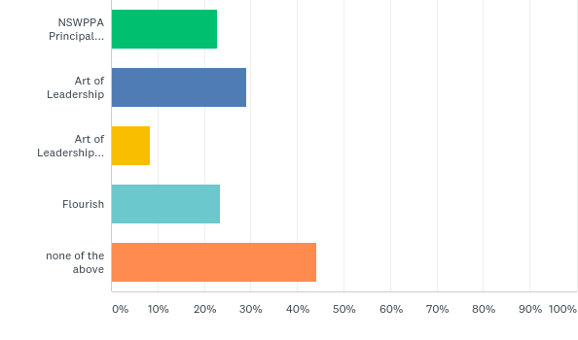
Q7: The PPA currently runs flagship professional learning programs. Please indicate the PPA PL you or your staff have accessed?

