Slide 1
REVIEW into THE FUNCTIONS AND OPERATIONS of the
EMPLOYEE PERFORMANCE AND CONDUCT DIRECTORATE
REPORT by
MARK TEDESCHI AM QC
(assisted by Christine Melis)
JUNE 2019
NSWPPA Legal Issues Standing Committee
Phil Seymour (Primary Principal, NSWPPA President)
Robyn Evans (Primary Principal -Casula PS, NSWPPA Deputy President)
Greg McLaren (Primary Principal -Samuel Gilbert PS, Castle Hill)

Slide 2
It is necessary for EPAC to be seen to act in a fair, impartial, consistent, transparent and timely fashion, and in a manner that respects the procedural rights of those whom it is investigating and disciplining.
Over time, criticism has been levelled at EPAC from a variety of sources.
Those criticisms have included accusations of: procedural unfairness; lack of timeliness; lack of consistency in decision-making; inadequate investigations; confirmation bias against persons subject of allegations (PSOAs); poor communication with PSOAs, alleged victims (AVs), and school managers; failure to provide support to Principals and Directors Educational Leadership (DELs) in local management of investigations; inadequate resourcing; and a failure to act fairly and impartially in the investigation of allegations of misconduct.
EPaC DIRECTORATE

Slide 3
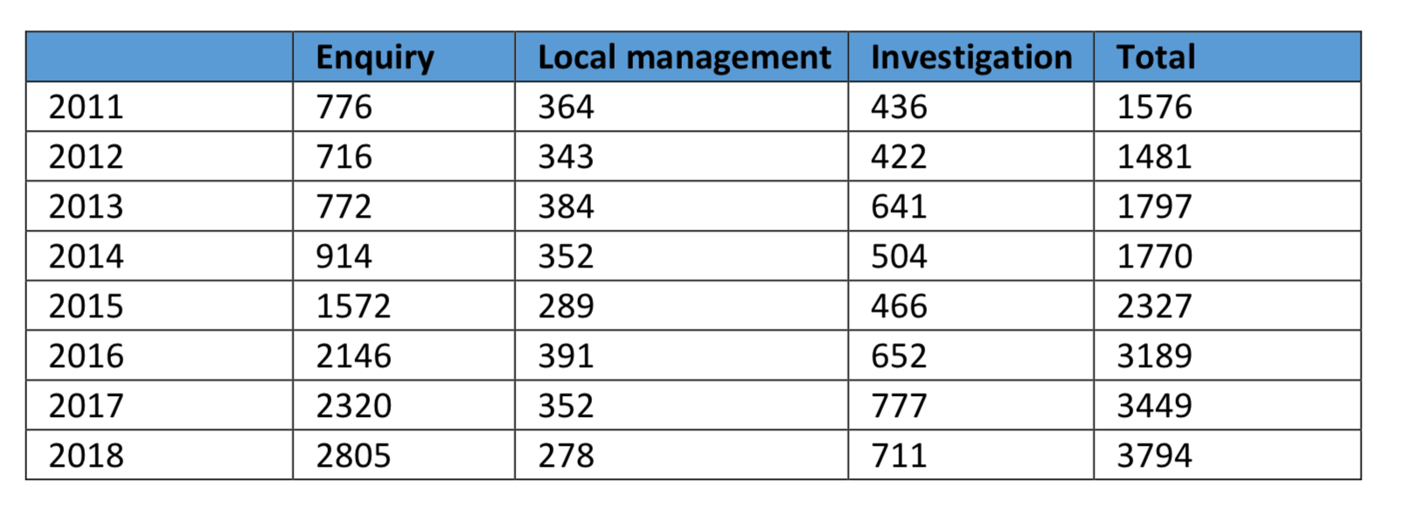
There has been a steady increase in matters referred to EPAC.
Between 2011 – 2018….. 63% increase
In the 12-month period between 7 June 2018 and 6 June 2019, EPAC closed:
• 965 investigations:
o 368 of those 965 matters (38%) were closed within six months.
o 508 of those 965 matters (53%) were closed within nine months.
During the last 12 months, 47% of matters had not been closed within 9 months. In our view this is a highly un-desirable situation….

Slide 4
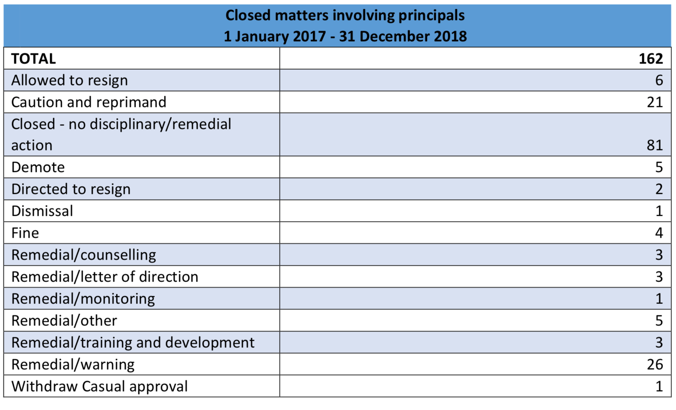
Only 193 (13%) of principals received career defining outcomes (resignation, demotion,
Direction to resign, dismissal, withdrawal of casual approval, contract terminated)

Slide 5
Based on submissions received and on interviews held, we perceive that the main issues that are causing concern among both organisational stakeholders of EPAC and individuals affected by EPAC’s decisions, as well as by former and current employees of EPAC, include:
EPAC is seriously under-resourced
PSOAs are left for long periods of time not knowing the specifics of allegations
against them
PSOAs are left for long periods of time before a decision is made
Inconsistent decisions about interim protection measures
Investigators are not necessarily speaking with witnesses nominated by the PSOA
during investigations
Poorly drafted allegations of misconduct
Lack of transparency as to how decisions are made and a lack of benchmarking in
decision making
Vague definition of misconduct and inconsistent applications of the term
Decision making by a single person not subject to internal consultation or review
Poor communication between EPAC and PSOAs, Principals and alleged victims
Investigators have little or no experience of the context of school life in the real
world.
Principals do not feel supported by EPAC

Slide 6
Other Systems:
In both the UK and British Columbia there is a combination of both internal departmental decision-making and external decision-making by a tribunal.
We are of the view that an examination of these two overseas systems demonstrates the importance and value of:
  timeliness of investigations
  early service of allegations on the PSOA
  a right to be heard prior to interim risk management measures involving removal
  from the workplace
  the benefits of an internal panel for decision-making
  wide anonymised reporting of outcomes in disciplinary proceedings.
EPaC DIRECTORATE REVIEW 2019

Slide 7
Recommendations
✓ ✓ We suggest that sufficient human resources should be allocated to EPAC in order to reduce the average caseload of investigators to a level that would result in the average completion time of misconduct matters being as follows:
  • Simple cases: no more than 90 days (three months)
  • Median cases: no more than 180 days (six months)
  • Complex cases: no more than 270 days (nine months).
✓ We are of the view that there would be benefit in including in the induction process for new EPAC staff a short period (of a day or so) in each of a primary, secondary and special school
EPaC DIRECTORATE REVIEW 2019

Slide 8
.
Recommendations
✓ ? We do not recommend that EPAC go back to the system that existed in the mid-to-late 1990s of recruiting school-based staff to conduct investigations. However, this would not preclude an otherwise suitably qualified Principal, DEL or teacher from applying to join EPAC if that person had the requisite skills.
✓ ✓ ✓ We recommend against the use of private contractors being used in misconduct investigations.
The quality of their work is variable.
EPaC DIRECTORATE REVIEW 2019

Slide 9
✓ We recommend that EPAC change its recruitment practices to include applicants with no prior child protection experience or knowledge, but rather to focus on those candidates with suitable skills in communication (interviewing), location and analysis of evidence, and report writing skills.
? We consider that there is merit in the Directorate maintaining its own legal officers, separate from the Department’s Legal Services Directorate.
✓ ✓ EPAC has on many occasions failed to communicate effectively and appropriately with PSOAs, school Principals, DELs, alleged victims, complainants and other stakeholders.
We recommend that all levels of EPAC management insist that at least once every school term there is regular communication to update PSOAs, alleged victims, complainants and school managers.

Slide 10
✓ We agree that the online Decision Tree is a useful innovation, however it would be used much more frequently if it was an interactive program.
✓ The Department should keep centralised records of those lower-level misbehaviour allegations that have been the subject of ‘Enquiries’ to EPAC.
✓ A letter of notification of an investigation should be sent to the PSOA at the earliest possible opportunity after allegations have been received by EPAC.
✓ ✓ We recommend that, as a matter of procedural fairness, witnesses nominated by the PSOA should generally be interviewed, and that a decision not to interview them should only be made where there are compelling reasons

Slide 11
✓ The Executive Director (ED) of EPAC should be discouraged from involvement in or oversight of the investigation process, so as to remain impartial and objective for the purpose of decision-making in cases of serious misconduct.
✓ ? All delegated decisions by EPAC regarding serious misconduct where disciplinary action may be taken to dismiss an employee, or to direct an employee to resign, or to demote an employee should be made by the delegate only after extensive consultation with a panel consisting of:
  i. The Executive Director (ED) of EPAC
  ii. Two of the six Directors in EPAC
  iii. The Principal Legal Officer of EPAC
  iv. A Senior Executive from the Human Resources Division of the Department
  v. A serving or former Executive Director School Performance or DEL who has had recent experience in the school system.

Slide 12
✓ That the current category of “Local Management (LM) complaints” received by EPAC at the intake stage should be abolished.
✓ EPAC should continue to provide website and training support for local school managers in the investigation and resolution of low-level misconduct in schools.
✓ We are of the view that the most serious interim risk management measures (suspension with or without pay, direction to perform alternative duties, placement of name on the NTBE list) should only be taken in circumstances where there is no other way to avoid an unacceptable risk to students or staff.
Where possible, the PSOA should have a right to be heard prior to the decision being made to impose such risk management measures

Slide 13
✓ ✓ We recommend that the present system of discretionary internal reviews of EPAC decisions in misconduct cases should be abolished. We believe that it is important for EPAC to get decisions right in the first place.
There are existing avenues of appeal, including to the Industrial Relations Commission, which involve complete rehearing by an independent tribunal.
? ✓ Internal conflicts and disputes between school staff, including bullying, should continue to be managed by Principals and DELs, who are in the best position to deal with such issues expeditiously and with the benefit of local knowledge.
✓ ✓ We recommend that SECT remain in its present location within EPAC.
✓ ✓ We can see no logical reason why EPAC has been given the role of receiving and allocating consumer complaints to other Divisions of the Department.

Slide 14
✓ ✓ We recommend that the present system of discretionary internal reviews of EPAC decisions in misconduct cases should be abolished. We believe that it is important for EPAC to get decisions right in the first place.
There are existing avenues of appeal, including to the Industrial Relations Commission, which involve complete rehearing by an independent tribunal.
? ✓ Internal conflicts and disputes between school staff, including bullying, should continue to be managed by Principals and DELs, who are in the best position to deal with such issues expeditiously and with the benefit of local knowledge.
✓ ✓ We recommend that SECT remain in its present location within EPAC.
✓ ✓ We can see no logical reason why EPAC has been given the role of receiving and allocating consumer complaints to other Divisions of the Department.

Slide 15
✓ ✓ We recommend that the present system of discretionary internal reviews of EPAC decisions in misconduct cases should be abolished. We believe that it is important for EPAC to get decisions right in the first place.
There are existing avenues of appeal, including to the Industrial Relations Commission, which involve complete rehearing by an independent tribunal.
? ✓ Internal conflicts and disputes between school staff, including bullying, should continue to be managed by Principals and DELs, who are in the best position to deal with such issues expeditiously and with the benefit of local knowledge.
✓ ✓ We recommend that SECT remain in its present location within EPAC.
✓ ✓ We can see no logical reason why EPAC has been given the role of receiving and allocating consumer complaints to other Divisions of the Department.

Slide 16
✓ ✓ We recommend that the present system of discretionary internal reviews of EPAC decisions in misconduct cases should be abolished. We believe that it is important for EPAC to get decisions right in the first place.
There are existing avenues of appeal, including to the Industrial Relations Commission, which involve complete rehearing by an independent tribunal.
? ✓ Internal conflicts and disputes between school staff, including bullying, should continue to be managed by Principals and DELs, who are in the best position to deal with such issues expeditiously and with the benefit of local knowledge.
✓ ✓ We recommend that SECT remain in its present location within EPAC.
✓ ✓ We can see no logical reason why EPAC has been given the role of receiving and allocating consumer complaints to other Divisions of the Department.

