Slide 1
Educational Services 2019 and into the future
Presented by Georgina Harrisson
Deputy Secretary, Educational Services
Notes:
9:30 am – 10:15am Chair: Deputy President, Robyn Evans
Guest: Georgina Harrisson, Deputy Secretary Educational Services
Welcome
Presentation
Questions and Discussion
Recommended topic areas:
Provision of curriculum support for schools – many schools report this support is thin on the ground and general in nature. Support for specific curriculum areas appears to be lacking, eg if a school was seeking support for the implementation of the PDHPE K-6 syllabus to whom would they direct their enquiries?
Access request process changes – an update
What is the policy for allocation of counsellor’s time to schools – particularly in the context of advice re recent increases in allocated time
Online enrolment process – an update
Instructional leaders/EAfS - handling the varying end of tenure circumstances
State Literacy & Numeracy strategy - planning 2020 forward…
Included in email with PPT
FAQs re: EAfS
FAQs re: Revised Enrolment Policy
Curriculum team contacts

Slide 2
Literacy and Numeracy
Quality teaching to improve every student

Slide 3
Literacy and numeracy support for primary schools
Numeracy professional learning
Available now
  Mathematics building blocks for numeracy
    Course 1: Effective mathematics teaching for numeracy development
    Course 2: Learning progressions as a tool to support student numeracy development
    Course 3: Principles of effective assessment
    Course 4: Planning for differentiated learning
  Additive strategies
Under development
  Multiplicative strategies
“Looking at the big ideas and the progression of student learning was great and now so much clearer to me.”
“This PL was well thought out with a mix of research, discussion, games and examples to take back to the classroom. I really enjoyed it and will recommend it to others.”
“A wonderfully led and exceptionally useful day to set up our planning.”
“Interesting and informative PL. One that will actually be useful in a classroom.”
Notes:
What we did:
Leading secondary writing and Leading secondary numeracy - 5 days sustained professional learning program with in-between activities and follow up support from Literacy and Numeracy Strategy Advisors. Supports secondary leaders to lead whole-school initiatives aimed at improving students writing or numeracy outcomes.
Professional learning that builds teacher knowledge on different aspects of literacy and numeracy and how to address student learning needs – Additive strategies, Mathematics building blocks for numeracy, Operating with decimals across the curriculum, Applying decimals across the curriculum eLearning.

Slide 4
Literacy and numeracy support for primary schools
Literacy professional learning
Available now
  Effective reading
    Phonics (eLearning)
    Phonological awareness (face to face)
    Vocabulary (face to face from week 5)
    Fluency (underdevelopment)
Coming soon
  Phonological awareness (eLearning)
  Focus on creating texts
Under development
  Effective reading: fluency
  Focus on understanding texts
“We found the PL to be extremely relevant to our needs. We are very grateful for the comprehensive resources which we will use to provide PL for our staff.”
“Excellent PL and has definitely given our school team something to take away and apply into our school setting.”
“Course was engaging and informative. Excellent strategies that I will implement with my students. Feeling confident to use decodable readers and have a better understanding on how to use them.”
Notes:
What we did:
Leading secondary writing and Leading secondary numeracy - 5 days sustained professional learning program with in-between activities and follow up support from Literacy and Numeracy Strategy Advisors. Supports secondary leaders to lead whole-school initiatives aimed at improving students writing or numeracy outcomes.
Professional learning that builds teacher knowledge on different aspects of literacy and numeracy and how to address student learning needs – Additive strategies, Mathematics building blocks for numeracy, Operating with decimals across the curriculum, Applying decimals across the curriculum eLearning.

Slide 5
EAfS instructional leaders
To support the Literacy and Numeracy Strategy 2017-2020 and the Early Action for Success initiative, instructional leaders will be offered an extension to January 2021.
Support for the EAfS initiative from principals of non-EAfS schools in sharing the expertise of their substantive staff has been significant and has contributed to the development of the literacy and numeracy of our EAfS students.
95
non EAfS schools have teachers working as ILs in EAfS schools

Slide 6
EAfS instructional leaders
To support the Literacy and Numeracy Strategy 2017-2020 and the Early Action for Success initiative, instructional leaders will be offered an extension to January 2021.
Where the extension of the temporary appointment to the instructional leader role means that the instructional leader will have been out of their substantive position for more than three years, it is a decision for the principal of the instructional leader’s substantive school to:
agree to the employee’s retention of a right of return to their substantive position and hold the employee’s position open until January 2021; or
decline to continue the right of return.

Slide 7
EAfS instructional leaders
If the substantive school principal declines to continue the right of return until January 2021, the instructional leader has two courses of action open to them.
Return to their substantive position at the end of their current temporary appointment.
or
Accept the extension of their temporary instructional leader appointment on the understanding that to do so means that they have agreed to relinquish their right of return to their substantive position.
Instructional leaders who will not be affected by right of return will be offered an extension until January 2021.
The extension only applies to the FTE funded by Early Action for Success (EAfS). Where schools have contributed additional funding to the position, the decision to continue funding is a school based decision.

Slide 8
What is the Phonics Screening Check?
The phonics check will be aligned to the literacy progression.
The Phonics Screening Check is a short, simple assessment that tells teachers how students are progressing in phonics. It takes only 5–7 minutes and is carried out with each student individually.
Teachers then analyse the results and, if necessary, plan for any additional support that students might require.
It will be an additional tool for teachers and will complement existing strategies to identify students’ progress in developing foundational literacy skills.
The phonics check is an assessment that:
provides opportunities for teachers to gather evidence about student achievement in relation to syllabus outcomes
enables students to demonstrate what they know and can do
clarifies student understanding of concepts and promotes deeper understanding
provides evidence that current understanding and skills are a suitable basis for future learning
Notes:
The phonics check will be mapped to the Phonics and word recognition sub element of the Literacy progression. The assessment will use on online platform similar to BSK.
Mapping the check to the progressions enable the diagnostic nature of the assessment to surface.
Teachers will be supported by professional learning. EOI will be available in Term 1 2020
Catherine Thomson spoke about the phonics check at the PPA assessment group and the curriculum reference group last week.
A presentation is being sent out via Catherine to the PPA reps on those groups.

Slide 9

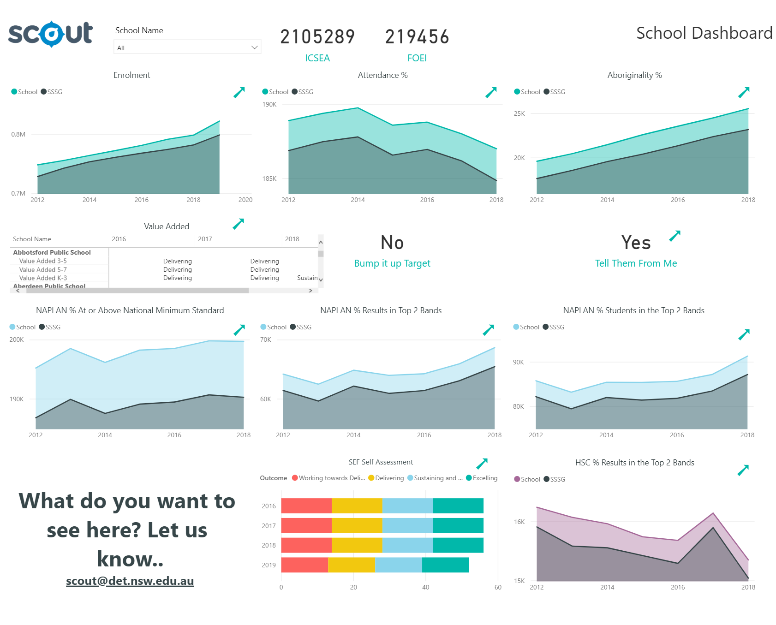
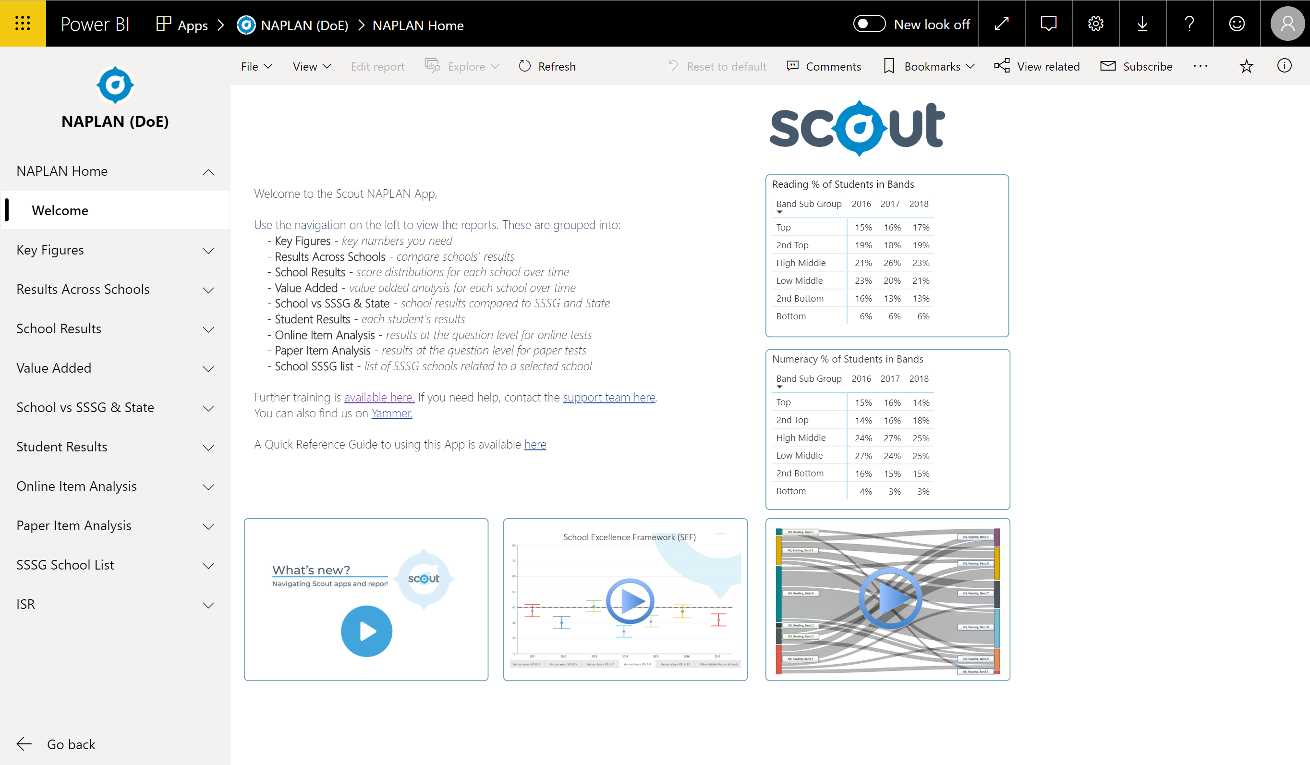
Scout
Our platform for data and analysis
Scout continues to seek your feedback in making improvements. NAPLAN reports are now available in a single app.
The Scout website has been updated with content organised by role. This enables staff to find relevant and meaningful information quickly.
The development of ‘Scout in Practice’ resources provide principals, executive and teachers with strategies for purpose driven data use.
The Scout capability building and training team have provided face to face Scout and Using Data with Confidence sessions to almost 19,000 participants.
https://education.nsw.gov.au/about-us/educational-data/scout
Notes:
The Scout team continues to engage extensively with principals to make improvements to the platform and the support resources
Scout continues to provide new reports to support you in making decisions about different areas of school business
The Scout capability building team can support you and your executive with face to face sessions

Slide 10
Curriculum Support
Quality teaching to improve every student

Slide 11
2019 curriculum support for new syllabuses
Science and Technology | PDHPE
Getting to know the PDHPE K-10 syllabus
(primary) (NR25619)
‒ e-Learning course (1 hour, TIPD)
‒ 1,540 enrolments
Unpacking the PDHPE K-10 syllabus propositions (primary) (RG04325)
‒ e-Learning course (1 hour, registered)
‒ 3,695 enrolments
Unpacking the PDHPE K-10 syllabus (RG02979)
‒ face-to-face workshop (7 hours, registered)
‒ 40 venues
‒ 1,953 participants
Implementing the Science and Technology K-6 syllabus (RG04451)
‒ face-to-face workshop (5 hours, registered)
‒ 43 venues
‒ 401 enrolments
Teaching with the Science and Technology K-6 syllabus (RG04489)
‒ e-Learning course (3 hours, registered)
‒ 311 enrolments

Slide 12
Upcoming work
Science and technology
‒ Sample scope and sequence documents
‒ e-Learning course (planning and programming)
‒ F2F course development for inquiry learning, digital technologies (expected Term 1, 2020)
‒ units of work
‒ continued rollout of F2F workshops
PDHPE
‒ scope and sequence documents
‒ units of work
‒ advice for meeting requirements (child protection, drug education, 150 mins physical activity)
‒ continued rollout of F2F workshops
Primary curriculum
‒ advice for schools re: planning, programming and assessment (clarity, consistency)
‒ reoffering F2F workshops in Semester 2 (EOI, needs only basis)
‒ co-delivering support for teaching principals with School Services (Cowra, Canberra, Moree, Glen Innes, Tamworth)
‒ DP induction conference today (Science and Technology and PDHPE advisers)
‒ awaiting finalisation of 2019-20 FY budget

Slide 13
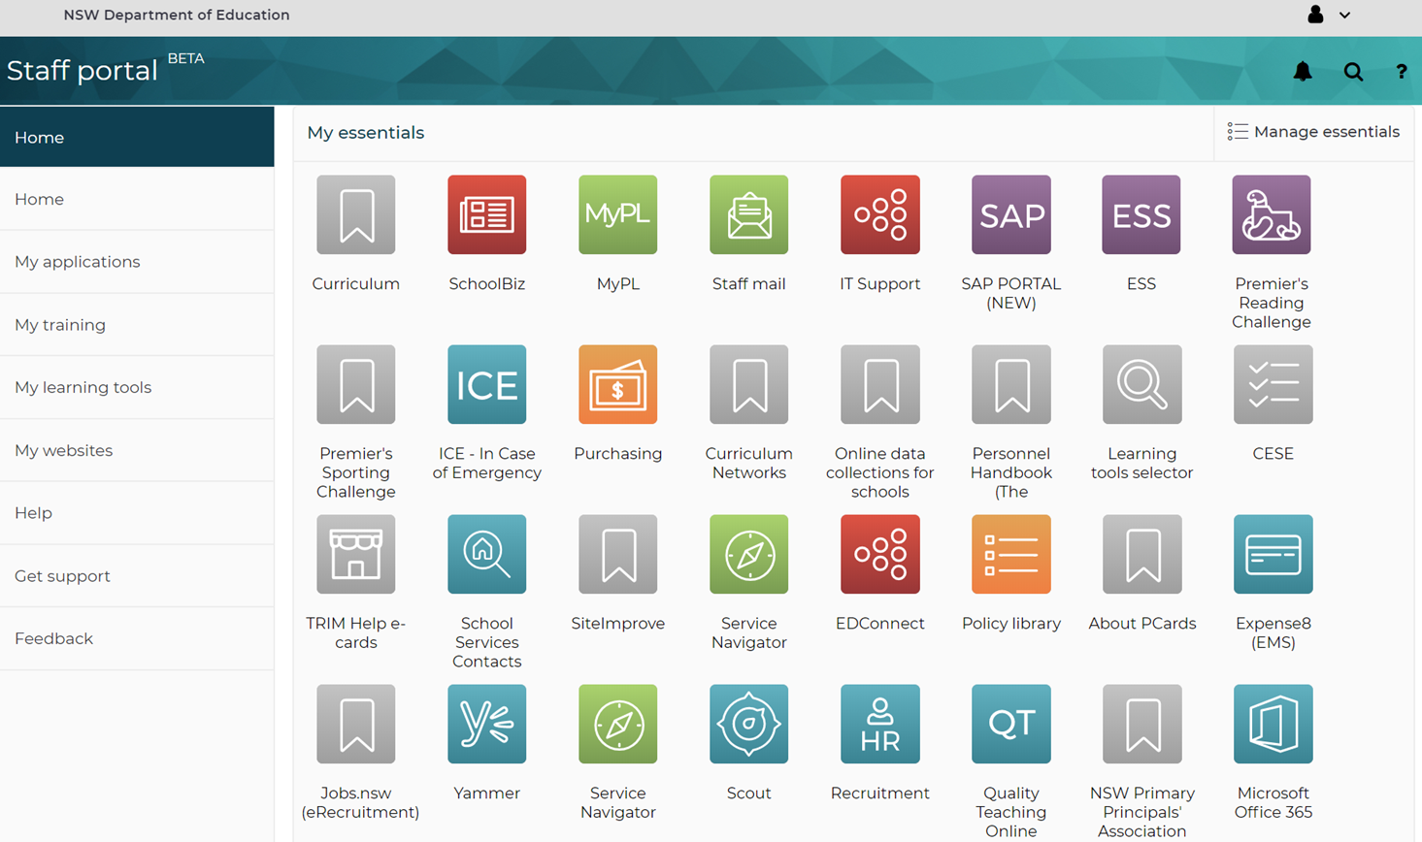
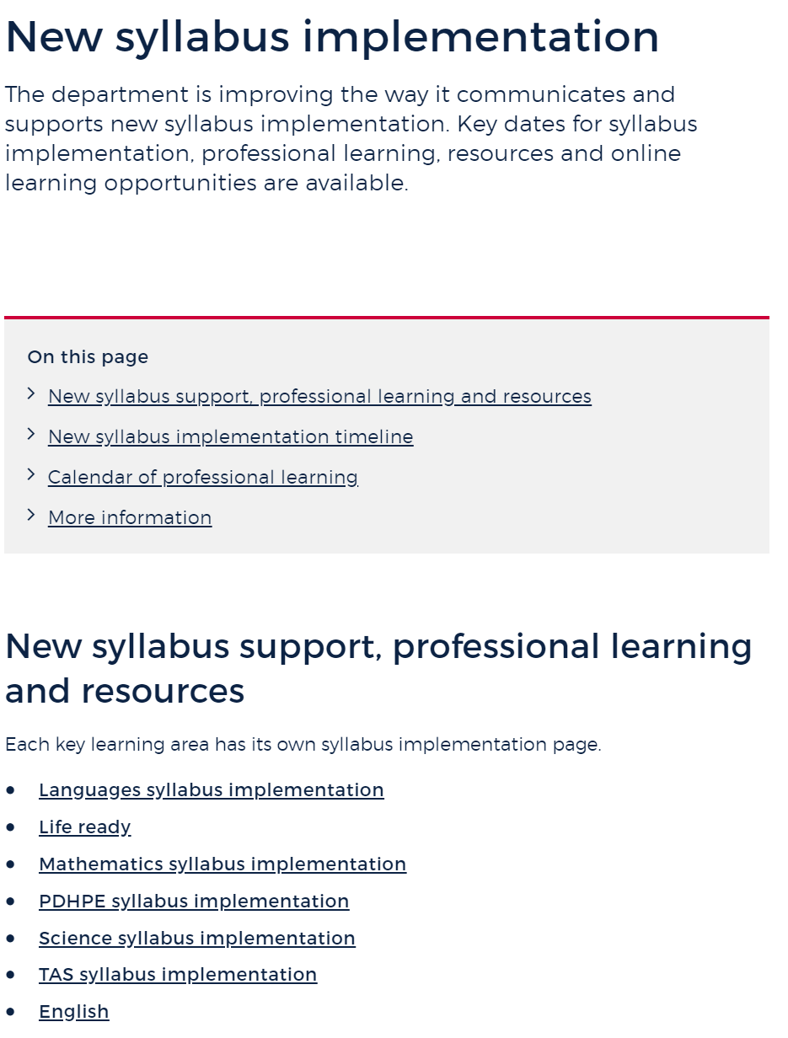
Learning and Teaching curriculum support
https://education.nsw.gov.au/teaching-and-learning/curriculum/contact-us
Notes:
The link (in red) at top of the slide takes you to a list of all curriculum advisors.
Portal link takes you to support for syllabus implementation (see screen grab)

Slide 14
Disability Strategy
Quality teaching to improve every student

Slide 15




Our Disability Strategy plan
1.1 Professional learning
1.2 Specialist studies
1.3 Training on evidence-based approaches
1.4 Induction
1.5 Inclusive learning spaces
2.1 Innovation fund program
2.2 Sharing good practice
3.1 One-stop online resource
3.2 Local advisory resources
3.3 Process for accessing support
3.4 Complaints process
4.1 Track learning for students with complex needs
4.2 New research for learning outcomes
4.3 Autism and mental health research
1
2
3
4
Improve the family experience
Strengthen
support
Increase resources & flexibility
Track
outcomes
Investing in teachers and other support staff
Enabling schools to operate with more flexibility
Making experiences better and easier
Building an evidence base to measure progress
Notes:
This slide summarises the initiatives set out in the Disability Strategy – launched by the then Education Minister in February 2019.
The Strategy is a call to action for us as an education system. We know there is good practice, but there is much more we can do to:
Improve the capability and confidence of our teaching and support staff
Encourage innovation in inclusive practice in our system
Improve the family experience, including at key transition points from preschool into primary school, onto secondary school, and into the workforce.
(d) We have a lot of work to define what success looks like for the Strategy – to build an evidence base and measure progress.
We have set up a specific team in Educational Services to drive delivery of the Strategy. That team is leading the delivery of some initiatives in 2019, and is working in partnership with other areas of the department on other initiatives.

Slide 16
We are focused on 2019 delivery … and preparing for 2020
1
2
3
4
Improve the family experience
Strengthen
support
Increase resources & flexibility
Track
outcomes
Introducing the Inclusive Practice in Education Scholarship program and working with universities (planned late August launch).
Creating and deploying trauma informed practice professional development (for at least 1000 leaders in 2019)
inclusive infrastructure team to be established
In School Infrastructure
Designing and launching an Innovation program to nurture and scale innovative ideas.
Sharing good practice: Sign up for our Disability Strategy Implementation https://education.nsw.gov.au/teaching-and-learning/disability-learning-and-support/our-disability-strategy/contact-us
Learning and Support Journey project
Access Requests for students transitioning to Year 7 will occur in Term 4 of Year 5 (not in year 6). Some appropriate exceptions will apply.
Changes to Integration funding support
Additional evaluation of family experience through the Tell them From Me Survey
CESE led project on assessment tools
Undertaking research into the prevalence and diagnosis of autism and mental health
Notes:
These are some key examples of 2019 delivery focus.
They are projects we have underway that we will deliver on this year.
They are building blocks for further delivery in 2020. For example:
- Workforce capability: working with universities on opportunities to ensure initial teacher education is responsive to the needs of our workforce working with students with disability
Family experience: We will continue to focus on improving the access request system – and its interface with annual review processes, Assisted School Transport and establishment.
If asked about increasing number of students with complex needs:
We understand that there are many students presenting with complex needs, with disability, including mental health, and complex trauma histories. The Disability strategy aims to make supporting these students easier for schools, and the Department is continuing to do work in the area.

Slide 17



Tell them from me- Survey
Additional questions around inclusivity in schools and family experience
How to participate
August 2019
October 2019
Complete the EOI form to participate in the survey
https://surveys.cese.nsw.gov.au/eoi-2019
Survey is open from Monday 26 August (week 6, Term 3)
Survey closes Friday 25 October (Week 2, Term 4)
We’ll be able to discover
- what parents think about communication with their child’s school
-How the school supports learning and behaviour
-Understand how parents support their children’s learning at home.
Principals can add their own customised questions to investigate specific issues relevant to your school.
Additional questions have been added around inclusivity in schools and the family experience.

Slide 18
Process for accessing support
Improving the Access Request system
OBJECTIVES
Student at the centre of decision making
Improve consistency
Improve communication and transparency of access requests
Improve the family experience
FOCUS
Review and update the tools & information available for schools and families
Redesign the access request process – test and refine with schools
System improvements to streamline requests
PROGRESS
Year 5 to Year 7 Transition
Year 6 to Year 7 IFS rollover
Placement Panel observations
Principal interviews to gather data on consistency and transparency
Seek evidence based research within Australia and internationally to identify effective support models
Consultation and workshops
Pilot and refine
NEXT STEPS
Process change improvement pilots
Document access request system requirements
Disability Criteria review
Notes:
The team are seeking evidence based research within Australia and Internationally to highlight models that are effective in supporting students with disability
Continuing to gather data around consistency and transparency of practice through placement panel observations and interviews of principals and senior psychologist education
The focus of the project will be to provide recommendations on improvements to:
Process
Supports – working with key stakeholders across the DoE on Disability Criteria, Disability Confirmation, student annual review, FON and support class types
Tools and Information – review and update the tools and information available to support school services, schools, families/carers and students
System – The project will recommend improvements to the system to further stream line process for accessing support

Slide 19
Student Wellbeing and Mental Health Support
Tailored support to improve every school

Slide 20

Student wellbeing and mental health support
June 2019
June 2020
June 2021
June 2022
June 2023
The Smiling Mind Education program will be delivered in 400 primary schools across the state from July 2019 to December 2020
Partnerships with leading youth mental health organisations and
universities
Increase evidence-based programs for primary schools
Suite of professional learning and resources for staff to better support students’ mental health, resilience and wellbeing.
Dedicated telepsychology service to support rural and remote schools
Funds to establish a state-wide FIFO / Telepsychology service to provide greater access to psychology services.

Slide 21
The methodology for allocating counselling time to schools is informed by:
School counselling allocation
The advisory group in term 4 2015 agreed on a methodology based on:
Increase in counselling service positions
A review of research
Stakeholder Advisory Group included representatives from PPA and SPC
Stakeholder feedback through 14 focus groups across NSW - more than 300 participants
Consideration of allocation methodologies used by other states and territories in Australia
Data from the Centre for Education, Statistics and Evaluation
Student enrolments
Relative need: disability & additional learning & support needs; socio-disadvantage; remoteness
Allocations are adjusted every 3 years
Since 2015, school counselling service positons increased from 790 FTE to 1081 FTE in 2019
In 2015, 1 primary school received an allocation of 1.0 FTE.
In 2019, 71 primary schools receive an allocation of 1.0 FTE
Significant expansion of scholarships will see more than 250 school counselling staff progressively enter the workforce over the next 4 years (in addition to ongoing recruitment).

Slide 22
Enrolment
Prioritising teaching time

Slide 23
Online enrolment project - Snapshot
“Love this! I love the action panel,
it makes it so easy” – SASS
School Name | Parent Interface |  | Staff Interface
 | Applications In Progress | Total Applications Submitted | Applications Received | Applications In Progress | Sent to ERN
Castle Hill Public School | 13 | 52 |  | 22 | 30
Bankstown Public School | 6 | 6 |  | 2 | 4
Rooty Hill Public School | 4 | 24 | 1 | 1 | 22
Guyra Central School | 3 | 13 |  |  | 13
Wattle Grove Public School | 8 | 53 |  | 8 | 45
St Mary’s North Public School | 2 | 14 |  | 4 | 10
TOTAL | 36 | 162 | 1 | 37 | 124
Where we are:
Testing our MVP with users (our pilot) and using the feedback to improve the solution
Starting our path to more frequent iterative releases.
Reviewing and prioritising additional work for our scalable product
Exploring and investing in resources and technology to industrialise the solution for scale
Planning the right team structure so that we can continue to build additional functionality to embrace the complexity of enrolment
Quotes from school staff
“I like the process, it’s quick and easy to follow. I like this process better”
“…if there’s no medical issue, it doesn’t come up …
…makes it easier and quicker”
“Thank you all for your amazing effort, making our
job a little easier”
“Not having to input all the enrolment information into ERN & trying to read parents handwriting makes it so much simpler”
“Very easy to flow through”
“Receiving really good feedback from parents – they’re really enjoying it”
“It was very simple and
easy to follow! :)”- Parent

Slide 24
Online enrolment project - Snapshot
“Love this! I love the action panel,
it makes it so easy” – SASS
Our next steps:
Continue analysing the data from our pilot to inform future development and roll-out needs
Begin discovery for out-of-area applications
Test our communications, training and support resources for rollout
R2 Full production version of our ‘in area’ online enrolment solution
Areas for attention:
Addressing technical debt to ensure that industrialisation is robust
Data integrity and privacy management for robust and sustainable industrialisation
Parent feedback (29 users)
Experience | Average Score
Likely to recommend | 9/10
Easy to use | 5/5
Easy to understand | 5/5
Saved time | 5/5
Quotes from parents
“Really like the option for preferred name …I’ve never seen it on a form before”
“Really, really good. Straightforward, so much better than paper.”
"Quite convenient to be able to do it on the phone“
“Love that there’s an option to save and come back”
“Really like… left hand side, it shows you where you’re up to...”
“It was very simple and
easy to follow! :)”- Parent

Slide 25
New Enrolment Policy - Key points
Policy changes to respond to demographic factors and increasing demand for space
Fairness and equity principles in student enrolment
----------------
Efficient use of school resources across the school system
Enrolment cap based on permanent classrooms
----------------
100-pt address check to confirm local status
Currently enrolled students are not affected
----------------
Students still guaranteed a place in their local school
Why change?
What changed?
What has not changed?
Need for consistency in decision-making
----------------
Strengthening local schools as the centre of the community
Non-local selection criteria made fairer and clearer
----------------
Support for families affected by boundary changes
Siblings of non-local students can still be enrolled in schools with capacity
----------------
Exceptional circumstances will still be considered

Slide 26
More information
Supporting parents
The policy and information for parents are available at on the Department’s website
https://education.nsw.gov.au/policy-library/policies/enrolment-of-students-in-nsw-government-schools
General enrolment enquiries
Telephone: 1300 679 332
Email: DoEinfo@det.nsw.edu.au
Specific enrolment enquiries
Parents should contact their local school. School contact details are available at: https://education.nsw.gov.au/public-schools/going-to-a-public-school/finding-a-public-school.

Slide 27
Questions?

