Slide 1


NSW Primary Principals’ Association (NSWPPA)
23 August 2019
NSW Primary Principals’ Association
23 August 2019

Slide 2

Develop Interim report
First half of 2019
Develop Terms of Reference
May - Aug 2018
Public Consultation
Sep 2018 – Nov 2018
Notes:
The NSW Curriculum Review was first announced in May 2018.
During that time we worked with key stakeholders to develop the Terms of Reference.
The Terms of Reference were released in September, marking the start of 3 months public consultation, between 3 September and 30 November 2018.
We're really pleased with the response from the community and the discussion the Review has generated.

Slide 3
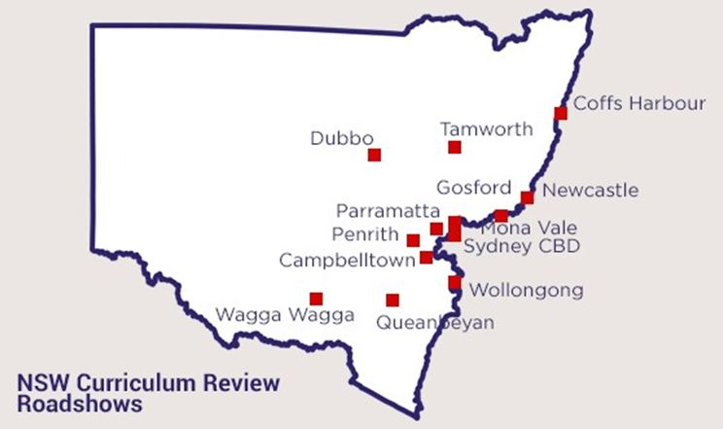


Public consultation
>500 roadshow attendees
>2100 online submissions
>50 meetings, roundtables and focus groups
Notes:
14 roadshows were held across regional and metro NSW, to capture diverse feedback from across the community. Over 500 people attended these events, which provided the community with the opportunity to come out and have their say in person.
The community also had the opportunity to have their say online, via short and long form submissions. Over 2,100 submissions were received during the three months of public consultation, with over 100 submissions received from stakeholder organisations, interest groups and individual schools.
Professor Masters and the Review Taskforce facilitated more than 50 roundtables, focus groups and meetings throughout NSW with key stakeholder groups, from the education sector and the community more broadly

Slide 4
Engagement – online submissions
Notes:
There was a good representation of submissions received, half of the submissions came from those who identified as teachers. Of those, 15% were primary school teachers.

Slide 5
Engagement – online submissions
I am | Percentage
An Aboriginal person | 2
A Torres Strait Islander person | <1
An Aboriginal and Torres Strait Islander person | <1
I am (based on postcodes) | Percentage
Rural or regional | 24
Metropolitan | 70
Notes:
There was also relative representation in submissions from the Aboriginal and Torres Strait Islander community and from those from regional and rural areas.
Q) What was your engagement with primary school stakeholders?
A)
We engaged with the NSWPPA executive throughout 2018 to discuss the Terms of Reference.
About 15% of online submissions and roadshow registrants identified as teachers from primary schools.
We also engaged through our communication channels including Twitter to get teachers talking with good results, including some primary teachers holding facilitated consultations with students to engage with the Review.
There is significant agreement emerging from public and stakeholder consultation:

Slide 6
What we heard - community aspirations
Unlocking every student’s potential
Maximising social benefits of schooling
Promoting wellbeing and building character
Developing knowledge and deep understanding
Building skills in applying knowledge
A curriculum that meets every students’ needs

Slide 7
Feedback – online submissions
If we equip kids with the skills to reach their full potential no matter what area that may be in, we will be churning out young people who will be able to apply themselves and be versatile in whatever they choose to do after the schooling years - Parent
Schools should give grounding in the key facets of culture: music, art, literature, mathematics, history, science, etc. and an understanding of how different ways of thinking have culminated in the world we live in today. This is the best way to prepare students for the creativity and adaptability needed to create a future – Teacher
I would argue that any curriculum should balance a healthy level of content knowledge, whilst providing teachers with the room to engage in meaningful and deep thinking about this information – Member of School Executive
Notes:
We heard a lot of great feedback from the community, and are pleased with the level of engagement the Review has provided so far. (refer to slides with some quotes)
Questions that may be asked
Q) Questions relating to reduction in content for any specific syllabus
A) It’s important to note that this is not a detailed review of the content of each syllabus, rather a broader look into the overall approach to the way the curriculum is organised and presented in NSW..
Q) How will teachers be supported in any changes to the curriculum?
A) Any proposed changes to the NSW curriculum content and structure would require lead time for development and roll-out, including time for teachers, schools and education sectors to prepare for implementation of any new curriculum. It is anticipated that implementation of most recommendations would occur over the mid-term, over a five to ten-year timeframe.
Q) Has there been any feedback regarding additional NESA Primary Inspectors? Is there scope in the Review’s recommendations to address this?
A) No, this is outside the Terms of Reference for the NSW Curriculum Review. NESA is unique in its role in supporting all four education pillars under the one authority; curriculum, assessment, school standards and teacher quality. Over recent years NESA has hired more inspectors to support all of NESA’s responsibilities.

Slide 8
What we heard – community concerns
The volume of content contained in many syllabuses is too high.
Perceptions regarding compliance requirements on schools by governments, school sectors and NESA.
A lack of flexibility in curriculum structures to address the different learning needs of students.
The disproportionate influence that external tests and examinations have on approaches to teaching and learning.
Notes:
There were also some community concerns raised in consultation, including:
The volume of content contained in many syllabuses is too high.
Perceptions regarding compliance requirements on schools by governments, school sectors and NESA
A lack of flexibility in curriculum structures to address the different learning needs of students.
The disproportionate influence that external tests and examinations have on approaches to teaching and learning.

Slide 9
NEXT STEPS
Release of interim report
Public Consultation
Develop final report (2020)
Notes:
The Review Lead is developing an Interim Report that sets out community aspirations and concerns for a future curriculum and reform directions that respond to consultation feedback, drawing on research and understanding of good practice, including the experiences of other jurisdictions.
It is anticipated that consultation on the Interim Report will occur towards the end of 2019.
Consultation activities will focus on gathering targeted feedback from teachers, students, parents and carers, employers and the community through face-to-face stakeholder meetings, targeted focus groups and roundtable meetings, and online submissions.
There will be opportunity for the NSW Primary Principals’ Association to provide feedback on the Interim Report during consultation, and the NSW Curriculum Review Taskforce will support consultation with the wider primary sector.
This will inform the development of a Final Report for submission to the Minister.
Questions that may be asked?
Q) How will the primary school sector be consulted with?
A) The Taskforce is planning consultation activities to promote deep engagement across the sector. Opportunities identified so far include:
Meeting with the NSW Primary Principals’ Association group
NESA liaison officers will promote and run workshops across their network for primary school teachers.
There will be resources available on the NSW Curriculum Review website to support conversation, teachers will be able to hold their own workshops.

Slide 10
nswcurriculumreview@nesa.nsw.edu.au

Slide 11
THEMATIC REVIEW: TEACHERS’ USE OF ASSESSMENT

Slide 12
TEACHERS’ USE OF ASSESSMENT
Objectives
Establish a common understanding of assessment
Understand existing assessment knowledge and practice in schools
Targeted Focus Area: Assessment of higher order thinking skills
Notes:
What is a Thematic Review?
Thematic reviews are a new function for NESA (as of 1 January 2017).
NESA is authorised under the Education Standards Authority Act 2013 (s12A) to conduct a review into any matter arising under the legislation, including priority areas across schools and systems.
By conducting a thematic review into a priority area, NESA can provide strategic leadership to foster an evidence-based approach in teaching to improve school education standards.
Thematic Review: Teachers’ use of assessment
In May 2017, the NESA Board approved the focus of the next thematic review to be teachers’ use of assessment.
Student assessment is an integral function of teaching. Standard 5 of the Australian Professional Standards for Teachers requires all teachers to assess, provide feedback and report on student learning as a requirement of accreditation.
The Thematic Review: Teachers’ use of assessment will examine both school-wide and classroom teacher practice, as well as the preparation of graduate teachers.
This review has two objectives, and one targeted focus area:
Objective 1: Establish a common understanding of assessment – The intended outcome of this objective is to develop a common understanding of the purposes, types and uses of assessment, as well as key terms.
Objective 2: Understand existing assessment knowledge and practice in schools – The intended outcome of this objective is to develop a picture of current teacher assessment knowledge and practice, determine what teachers know and understand about assessment, and to highlight exemplary practice and potential areas for improvement.
Targeted focus area: Assessment of higher-order thinking skills – Within the broader lens this review casts over assessment, NESA intends to investigate teachers’ understanding and assessment of higher-order thinking skills in different domains, starting with critical thinking.

Slide 13
TEACHERS’ USE OF ASSESSMENT
Interconnected timelines with the NSW Curriculum Review
NSW Curriculum Review Interim Report will be released later this year (following Cabinet approval)
Any recommendations that have implications for assessment will be taken into consideration by NESA in its Thematic Review: Teachers’ use of assessment
Notes:
The work for the Thematic Review is operating at the same time as the NSW Curriculum Review.
The NSW Curriculum Review is a comprehensive review of the NSW Curriculum to ensure it equips students to contribute to Australian society in the 21st century. The interim report is due to be released later this year, following Cabinet approval.
The focus of the Thematic Review is teacher’s use of assessment. It aims to examine teachers’ existing understanding and use of assessment, and improve teachers’ practice by identifying, developing and promoting effective assessment design.
The two projects will operate in parallel. Where there are areas of overlap, the project teams for the Curriculum Review and the Thematic Review share relevant findings that naturally feed into the other project.
The final report for the Thematic Review will be released after the report of the NSW Curriculum Review. This will provide sufficient opportunity for the Thematic Review to consider the findings and recommendations of the NSW Curriculum Review as they apply to assessment.

Slide 14
PRIMARY EDUCATION UPDATE

Slide 15
New syllabuses
Implementation:
2019 – Science and Technology K-6
2020 – PDHPE K-10
In development:
Creative Arts K-6

Slide 16
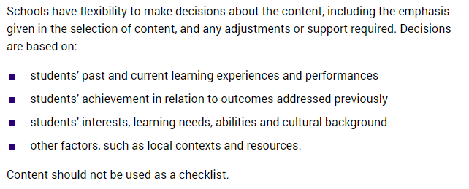
K-6 curriculum advice
What must be taught in primary schools?
Schools must plan, program, teach and assess to syllabus outcomes in a Stage.
https://www.educationstandards.nsw.edu.au/wps/portal/nesa/k-10/understanding-the-curriculum/k-6-curriculum-requirements

Slide 17

WriteOn 2019
over 400 entries
even distribution from all sectors
presentation ceremony for gold award winners 23 August at
State Library
winners published on WriteOn webpage
anthology available early 2020

Slide 18

Educyte
https://youtu.be/gZAZIqmfzQs

Slide 19
Educyte
Online literacy activities for teachers to use with their students
Activities can be embedded into whole class, small group, and one-on-one instruction
Easy to understand representation of data for teachers and students
Activities include elements of reading, listening, speaking and writing
Aligned to the National Literacy Learning Progression
Free for NSW schools
Contact educyte@nesa.nsw.edu.au

Slide 20
Thank you
Lyndall Foster
Executive Director Curriculum Standards
NESA
lyndall.foster@nesa.nsw.edu.au

