Slide 1
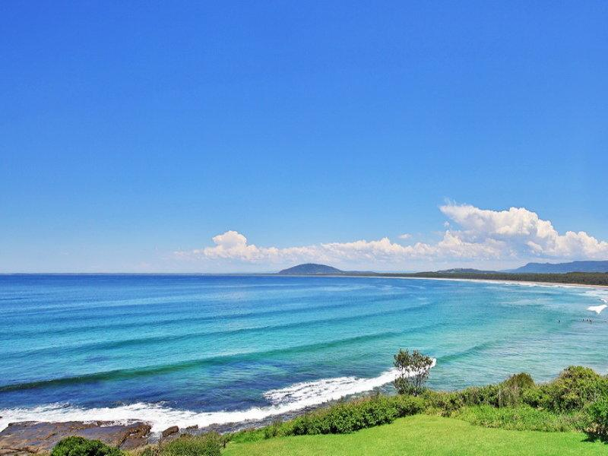
SHELLHARBOUR ppc
67 members

Slide 2
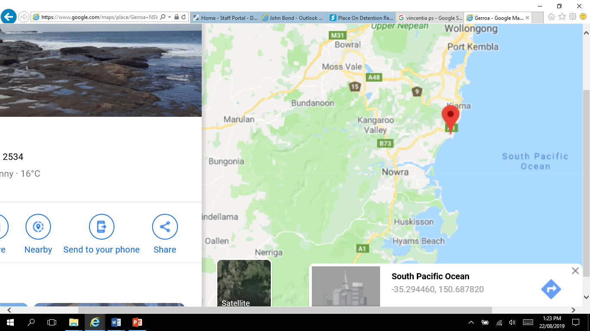
Where are we?

Slide 3

Communication is key
President and Delegate work closely together with Principals/DELs
3 Vice Presidents
– Lake Illawarra area – Highlands area – Nowra and Bay and Basin areas
- Each VP is a local contact for local schools in each area (initially)
Phone trees are set up to call colleagues ….
Under pressure,
Not showing up,
Experiencing a tough time, and
To check in and celebrate.

Slide 4
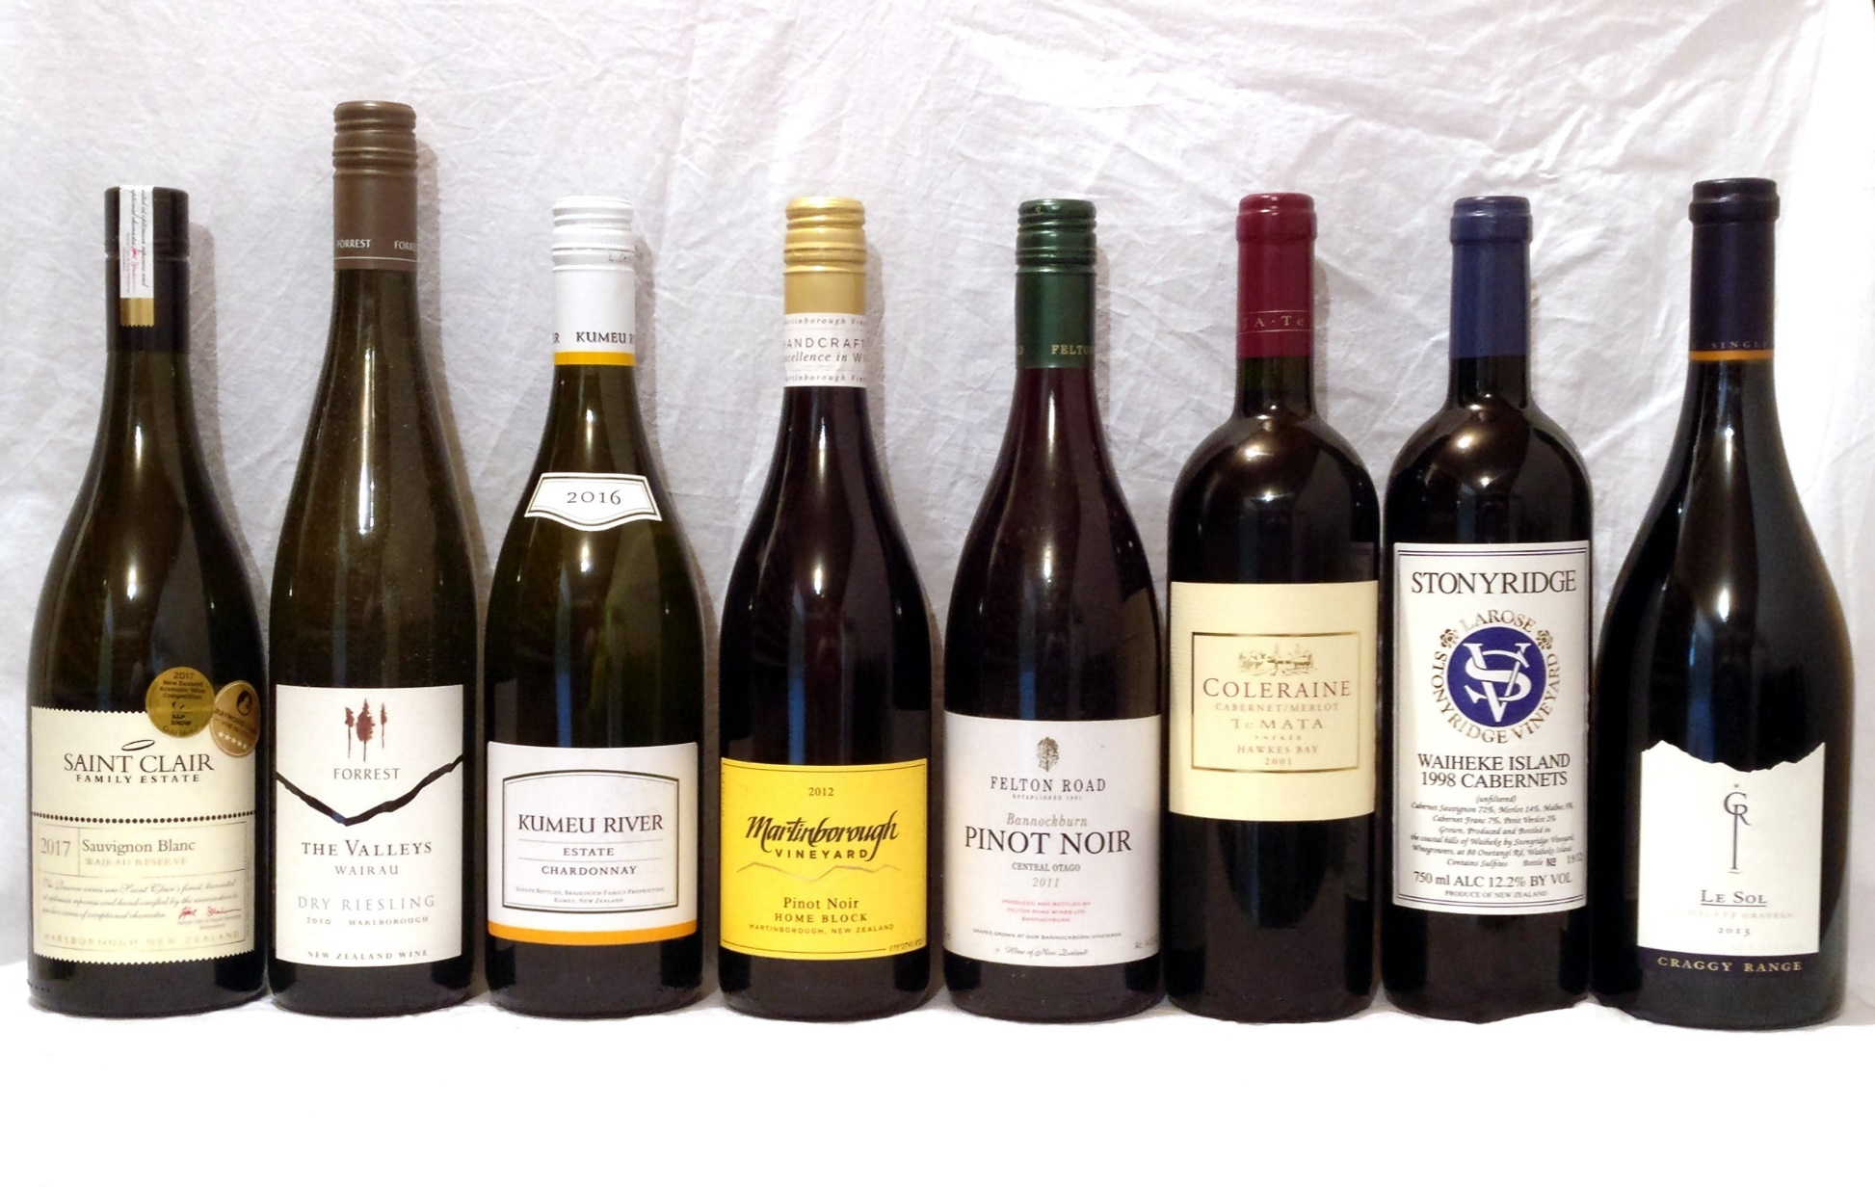


How do we get them there?

Slide 5
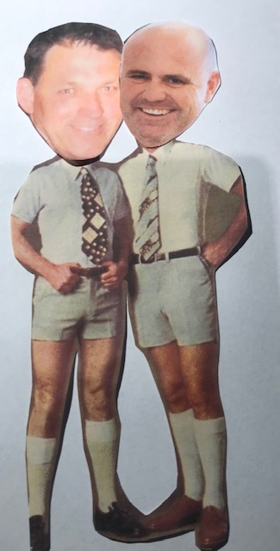
Meetings
Usually week after State Council
We get a high percentage. (need more though)
We worry about the bosses not there.
We try to have a mix of topics, speakers and FUN!
We use colleagues, experts and DoE staff .
Balance local, regional and state matters.
We have themes and FUN! (to develop trust and safety)

Slide 6
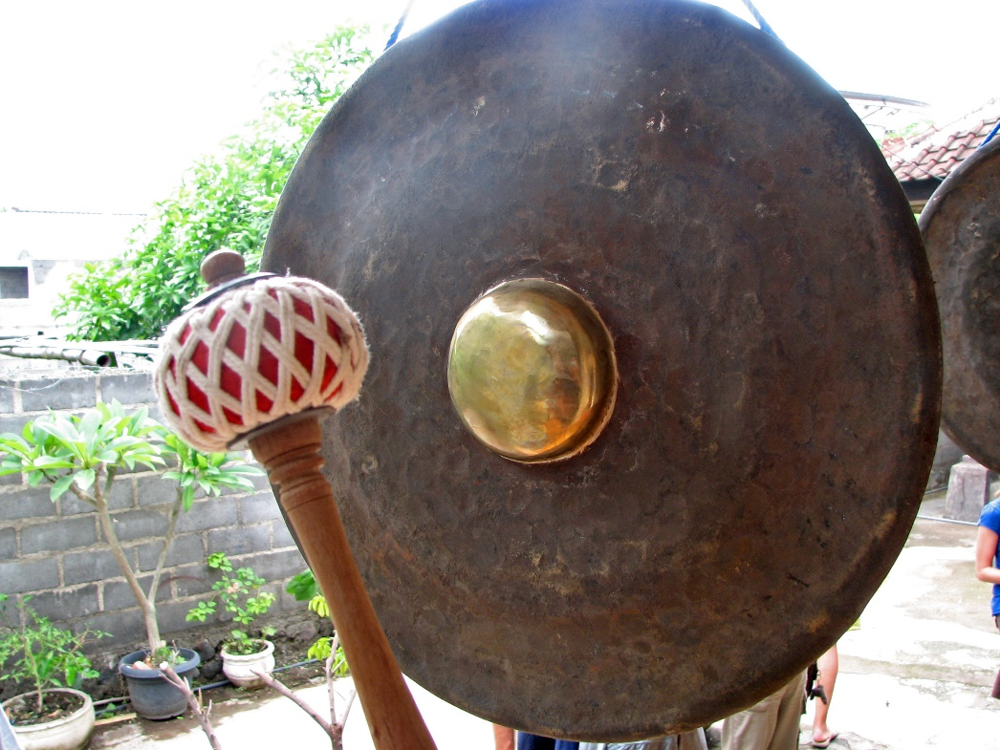
Agenda
Morning – guest speaker.
Mid – reports from State Council.
Afternoon (Principal support)
Drinks afterwards

