Slide 1

Australia's leading curriculum-aligned
Social and Emotional Learning Wellbeing & Mindfulness Programs

Slide 2
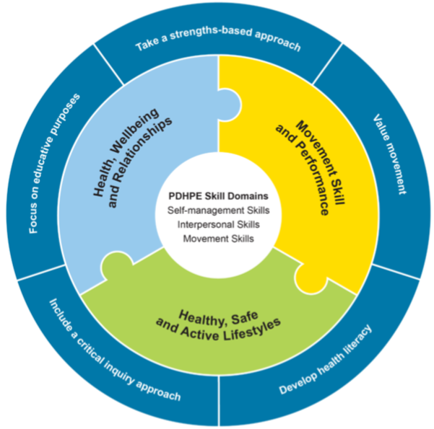
Every student is Known, Valued and Cared for
Did you know...
Strong social and emotional learning skills resulted in a 4x increase in high school completion and it also resulted
in students being twice as likely
to be happy.
(OECD, 2017)
Notes:
its important and provides a way to measure
12 years doing this practice
wellbeing framework
Data coming from experience - now have software that gives hard data

Slide 3
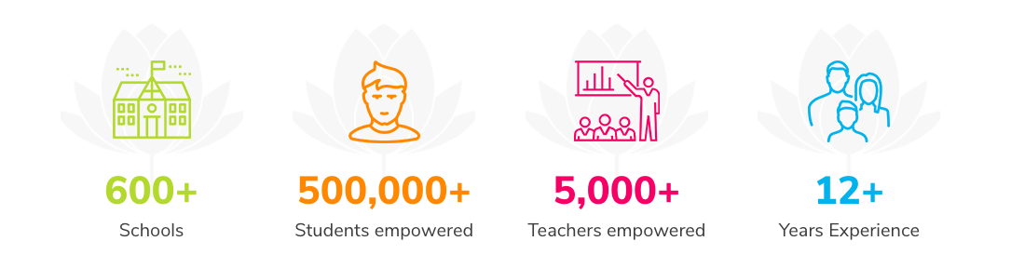
Our Impact

Slide 4
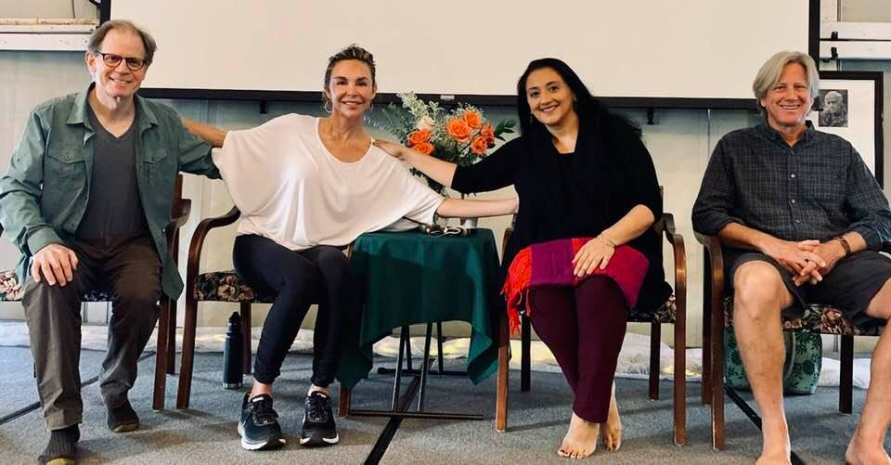
Our advisors

Slide 5
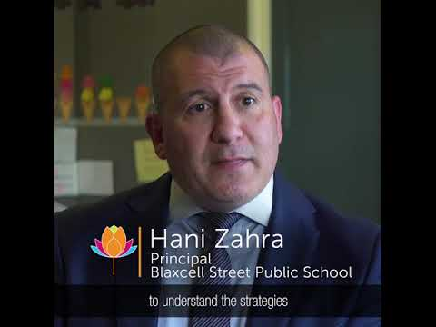
Blaxcell St PS - Granville

Slide 6
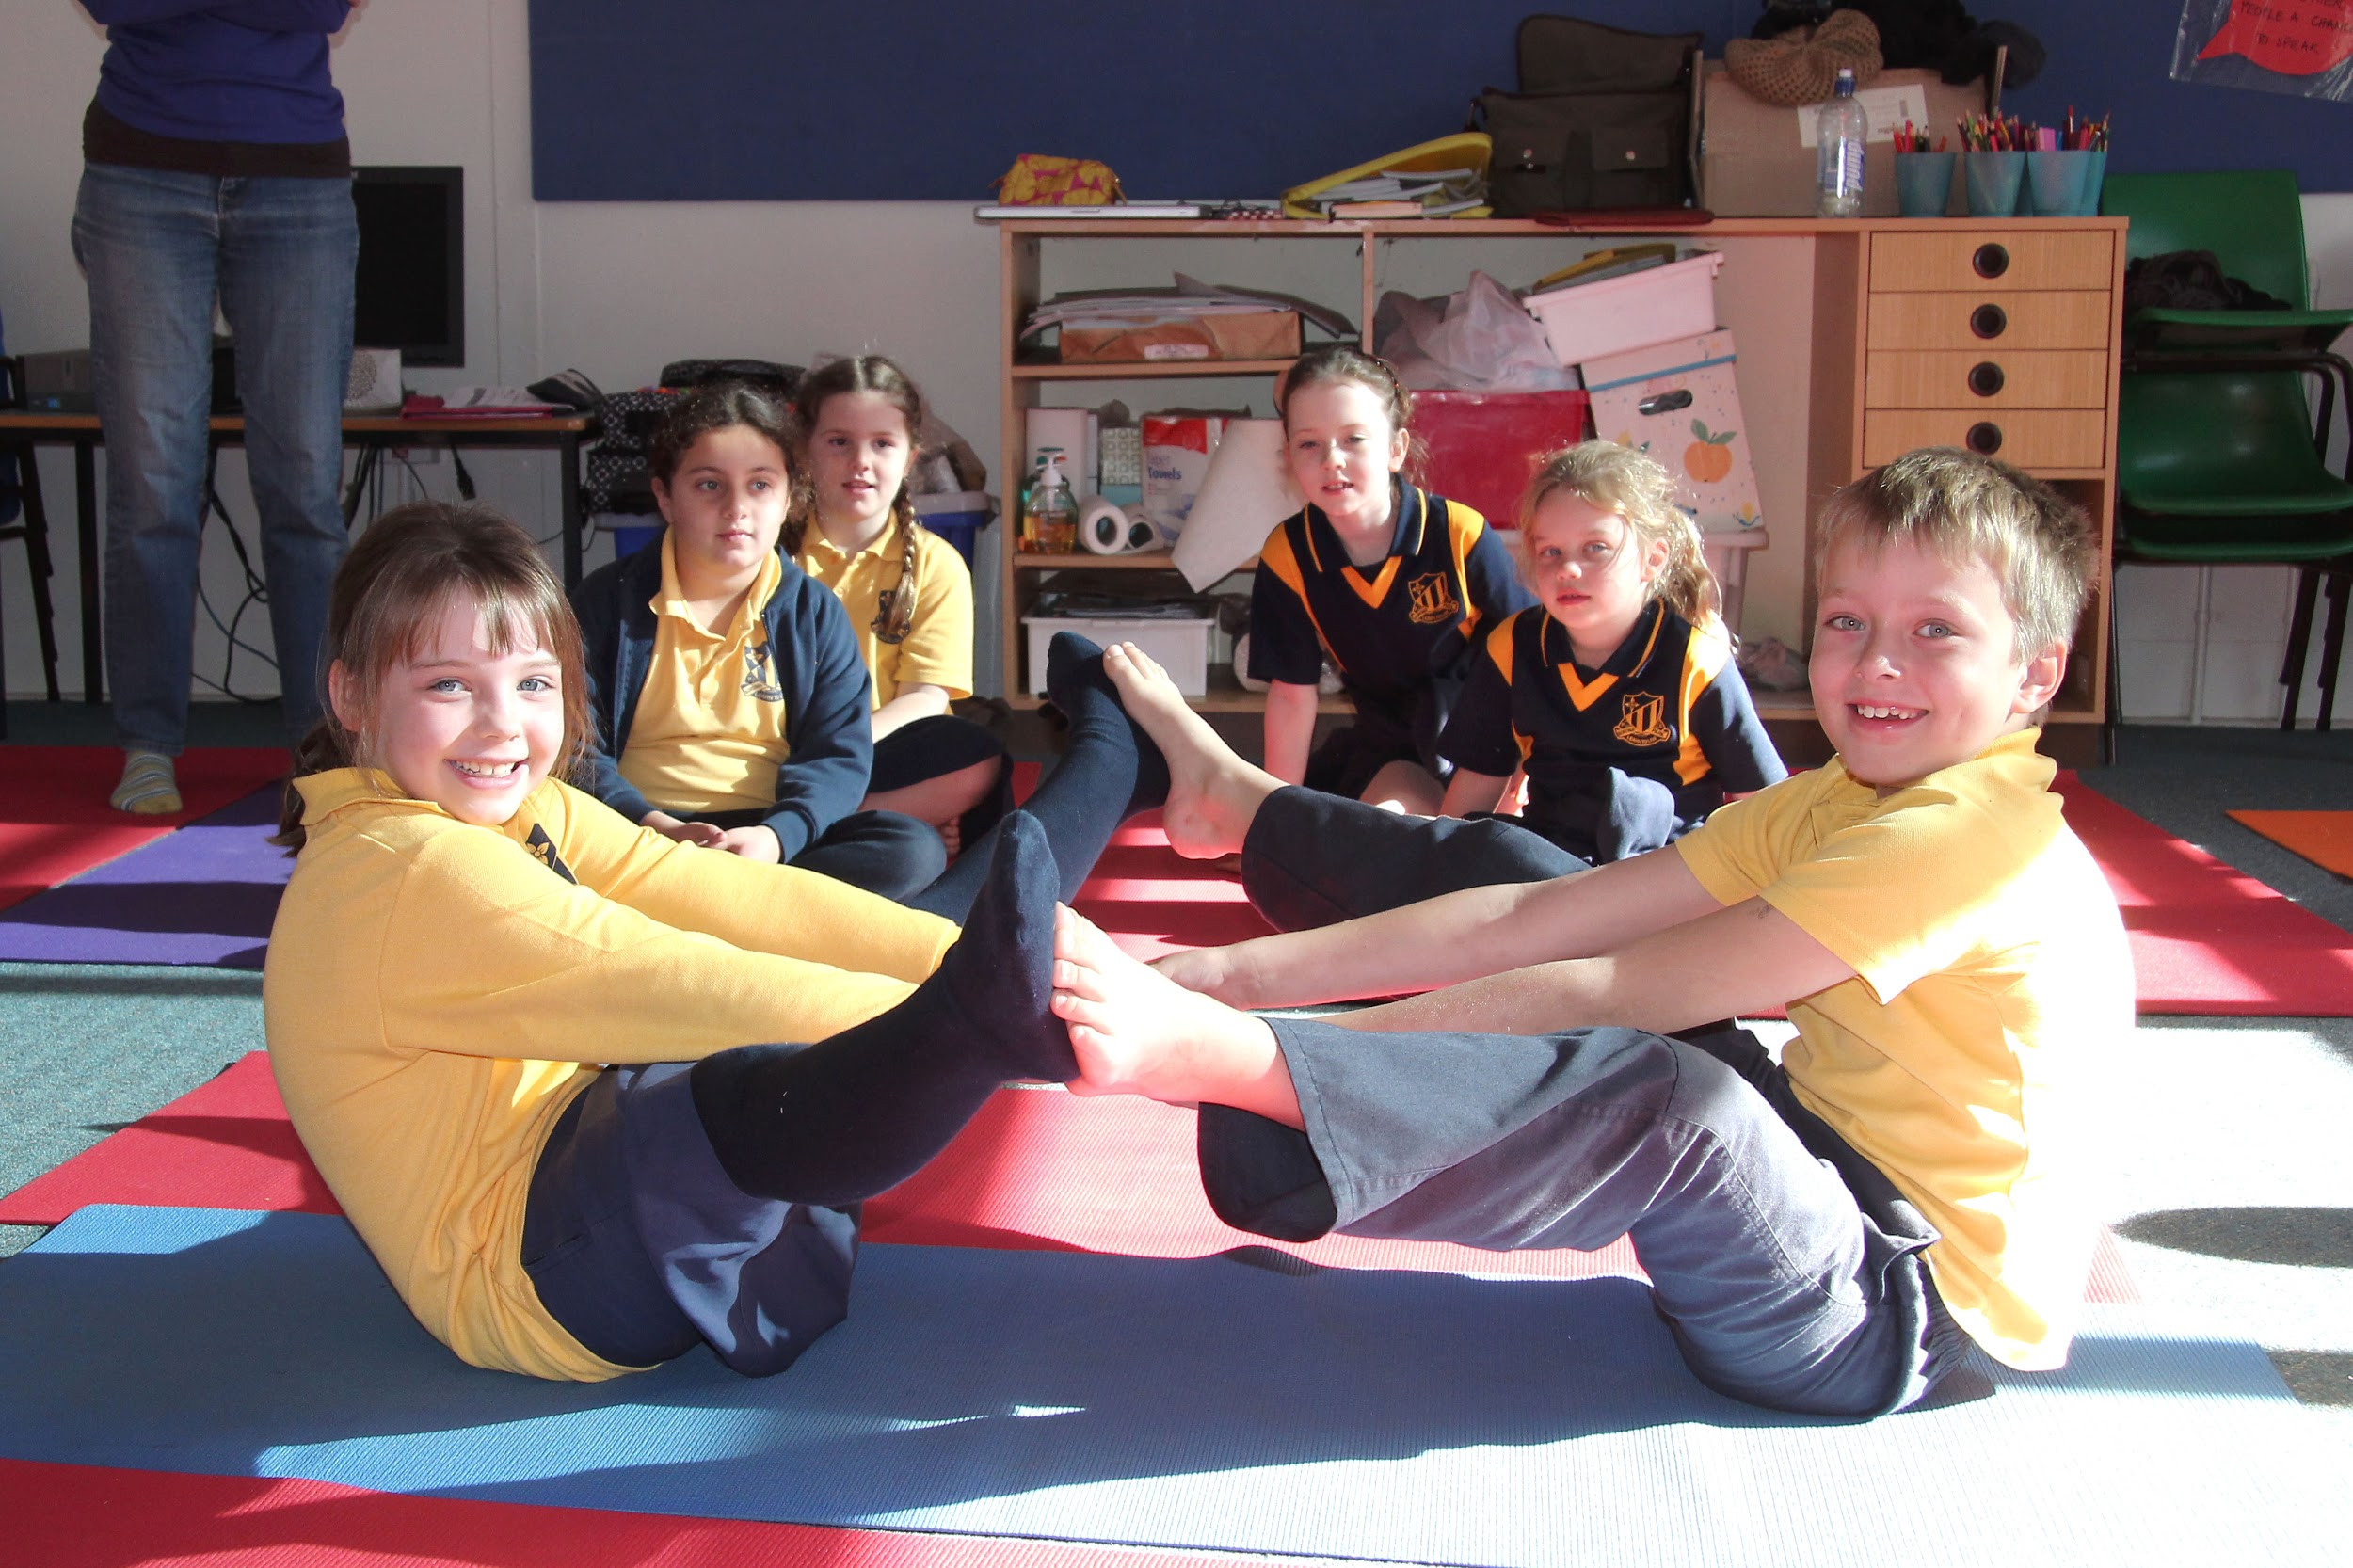

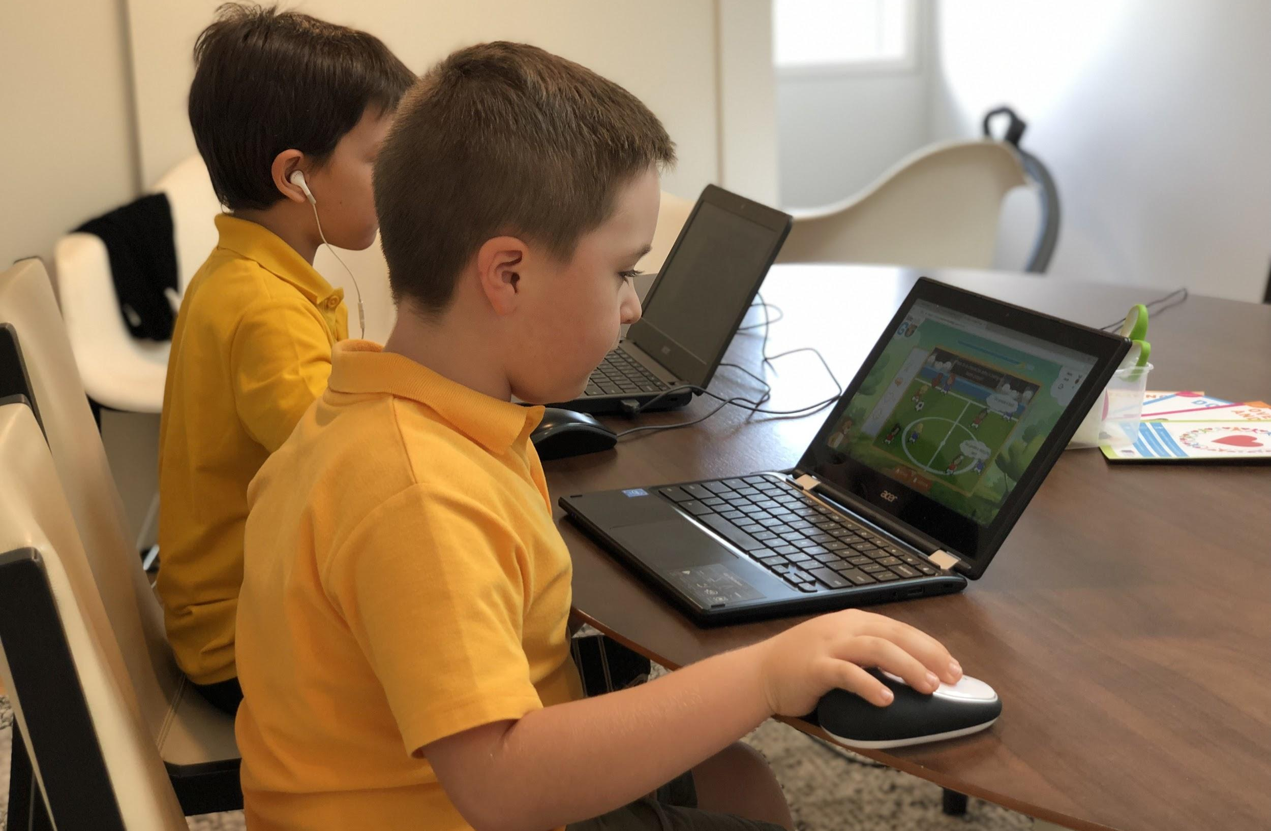
Blaxcell St PS - Granville
How Do We Do This?
Student Programs
Build resilience
Develop self-regulation
Increase self-awareness
Practice positive relationship skills
Strengthen problem-solving skills
NESA registered*
Teacher Wellbeing PD
Delivered online and in-person
Develop self-responsibility
Develop skills, knowledge and confidence to deliver in all learning environments
Empower students with resources to boost EQ
NESA registered*
Life Skills GO
Online blended SEL learning platform
Reinforces the language, skills and wellbeing of students participating in face-to-face student programs
Student progress and wellbeing are measurable
*Selected programs only

Slide 7




School Outcomes
We’re here to…
Reduce Anxiety and Improve Your School’s Wellbeing
Strong social and emotional learning skills resulted in a 4x increase in high school completion and it also resulted in students being twice as likely
to be happy.
(OECD, 2017)
Increase Resilience
& Self-Regulation
According to the 2018 Youth Survey, the four top issues of personal concern have strong links to mental health: coping with stress, school or study problems, mental health
and anxiety.
(Mission Australia, 2018)
Improve Academic Outcomes
Students who are taught social and emotional learning skills experienced a significant improvement in grades, on average by 11%.
(World Economic Forum, 2016)
Create Positive Futures
Young people with strong social emotional skills are more likely to have higher income and better jobs (OECD, 2018)

Slide 8
Tailored to Your School
Life Skills Group have collaborated with school principals to create a series of wellbeing programs which are developed in alignment with the NSW PDHPE syllabus under General Capabilities addressing: personal and social capability, critical and creative thinking and intercultural understanding.
All programs include:
Class plans, assessments and outcomes.
Free family viewing session.
Set up and supply of quality equipment.
Professional development hours for your staff (NESA endorsed).
Certificate of Currency $10 million Public Liability Insurance.
Fully screened, qualified and professional Life Skills Group teachers.
Newsletter snippets for parents.
Classroom teacher manuals.
Weekly awards and end of term certificates.

Slide 9
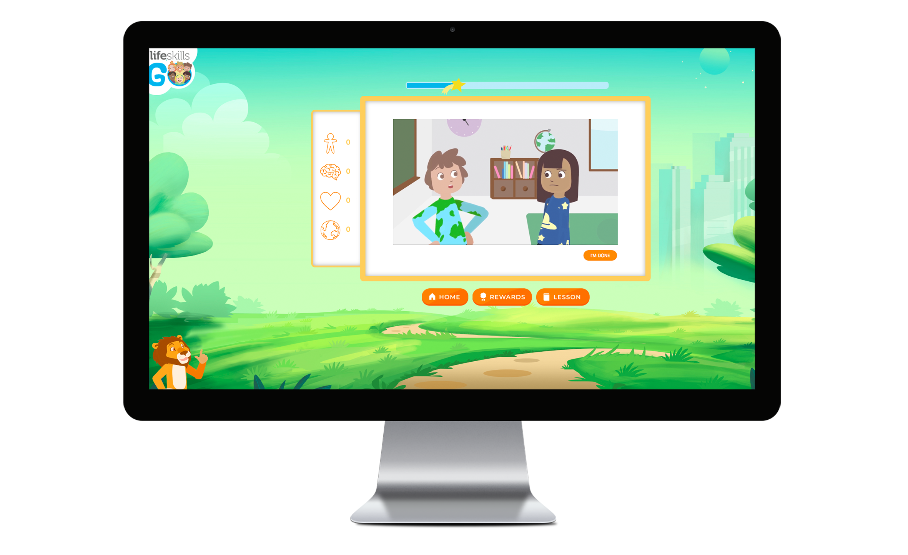
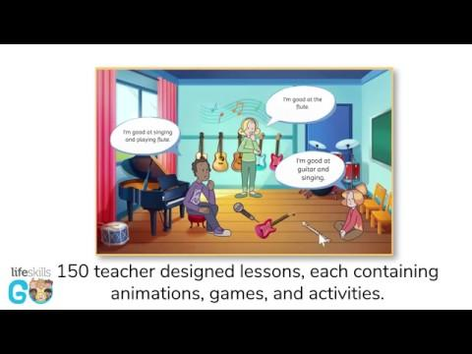
Life Skills GO
Life Skills GO is transforming 21st century learning by delivering measurable social, emotional and physical skills through education technology.
Key Features:
Measure students understand and wellbeing
Progress reports reveal each lesson’s PDHPE curriculum coverage
Curriculum-aligned and evidence-based
150 age-appropriate lessons + additional resources including:
41 x in-class game cards
39 x mindful practice cards
18 x fundamental movement cards
24 x character strength cards
18 x value posters

Slide 10
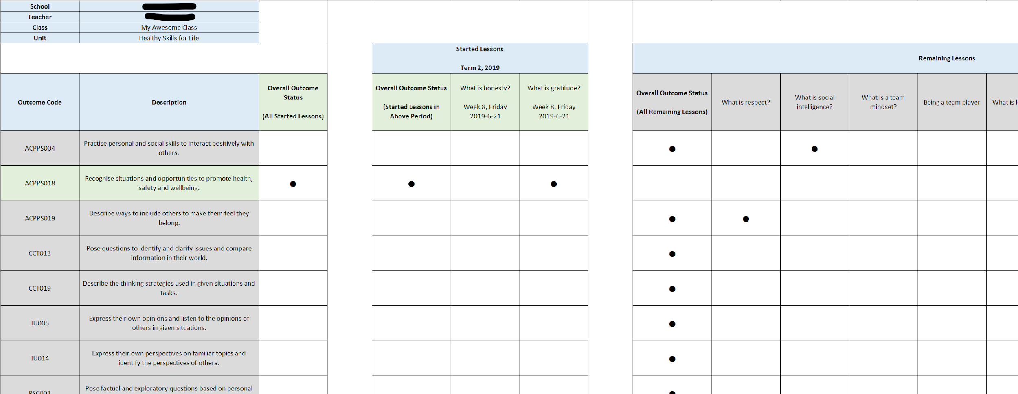
Life Skills GO - Unit Curriculum Report

Slide 11
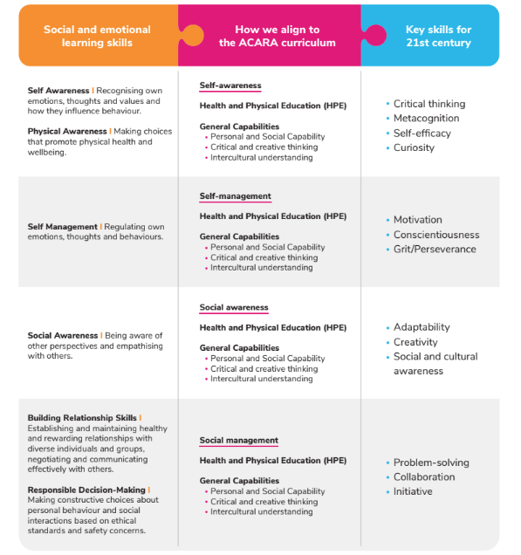
Our programs teach social, emotional and
physical skills across many frameworks

Slide 12
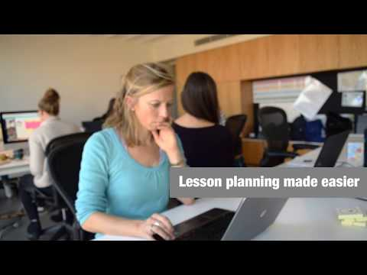
Online Masterclasses
Our online masterclasses for teachers will help you learn how to activate the personal and social capability of your students enabling them to thrive in learning and life.
You will use a repertoire of effective strategies and resources that are interactive, highly engaging and curriculum aligned to address challenges within your own context.
Here’s a video explaining this further...

Slide 13

Thank You!
We appreciate your time, if you have any feedback or questions...fire away!

