Slide 1


Wollongong District PPC
“Smiles, laughter and beer”

Slide 2
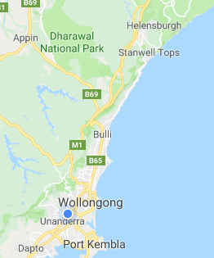
Context
Where?
Helensburgh in the North to Kemblawarra in the South and Unanderra in the West.
How many schools?
44 schools (42 x Primary, 1 x SSP 1 x Hospital) across 3 Principal Networks

Slide 3
Meetings
Held Week 9 of each Term
100% of our PPC attend the meetings – but never all at once
End of 2018 survey…
Ideas for professional learning/workshop/support…
2. I am prepared to share my expertise/experience in…
3. Most valued part of PPC meetings (excluding lunch)?
4. Additional comments
Tight, highly appropriate agenda – Delivered in a light way – there’s enough serious stuff happening at work!

Slide 4
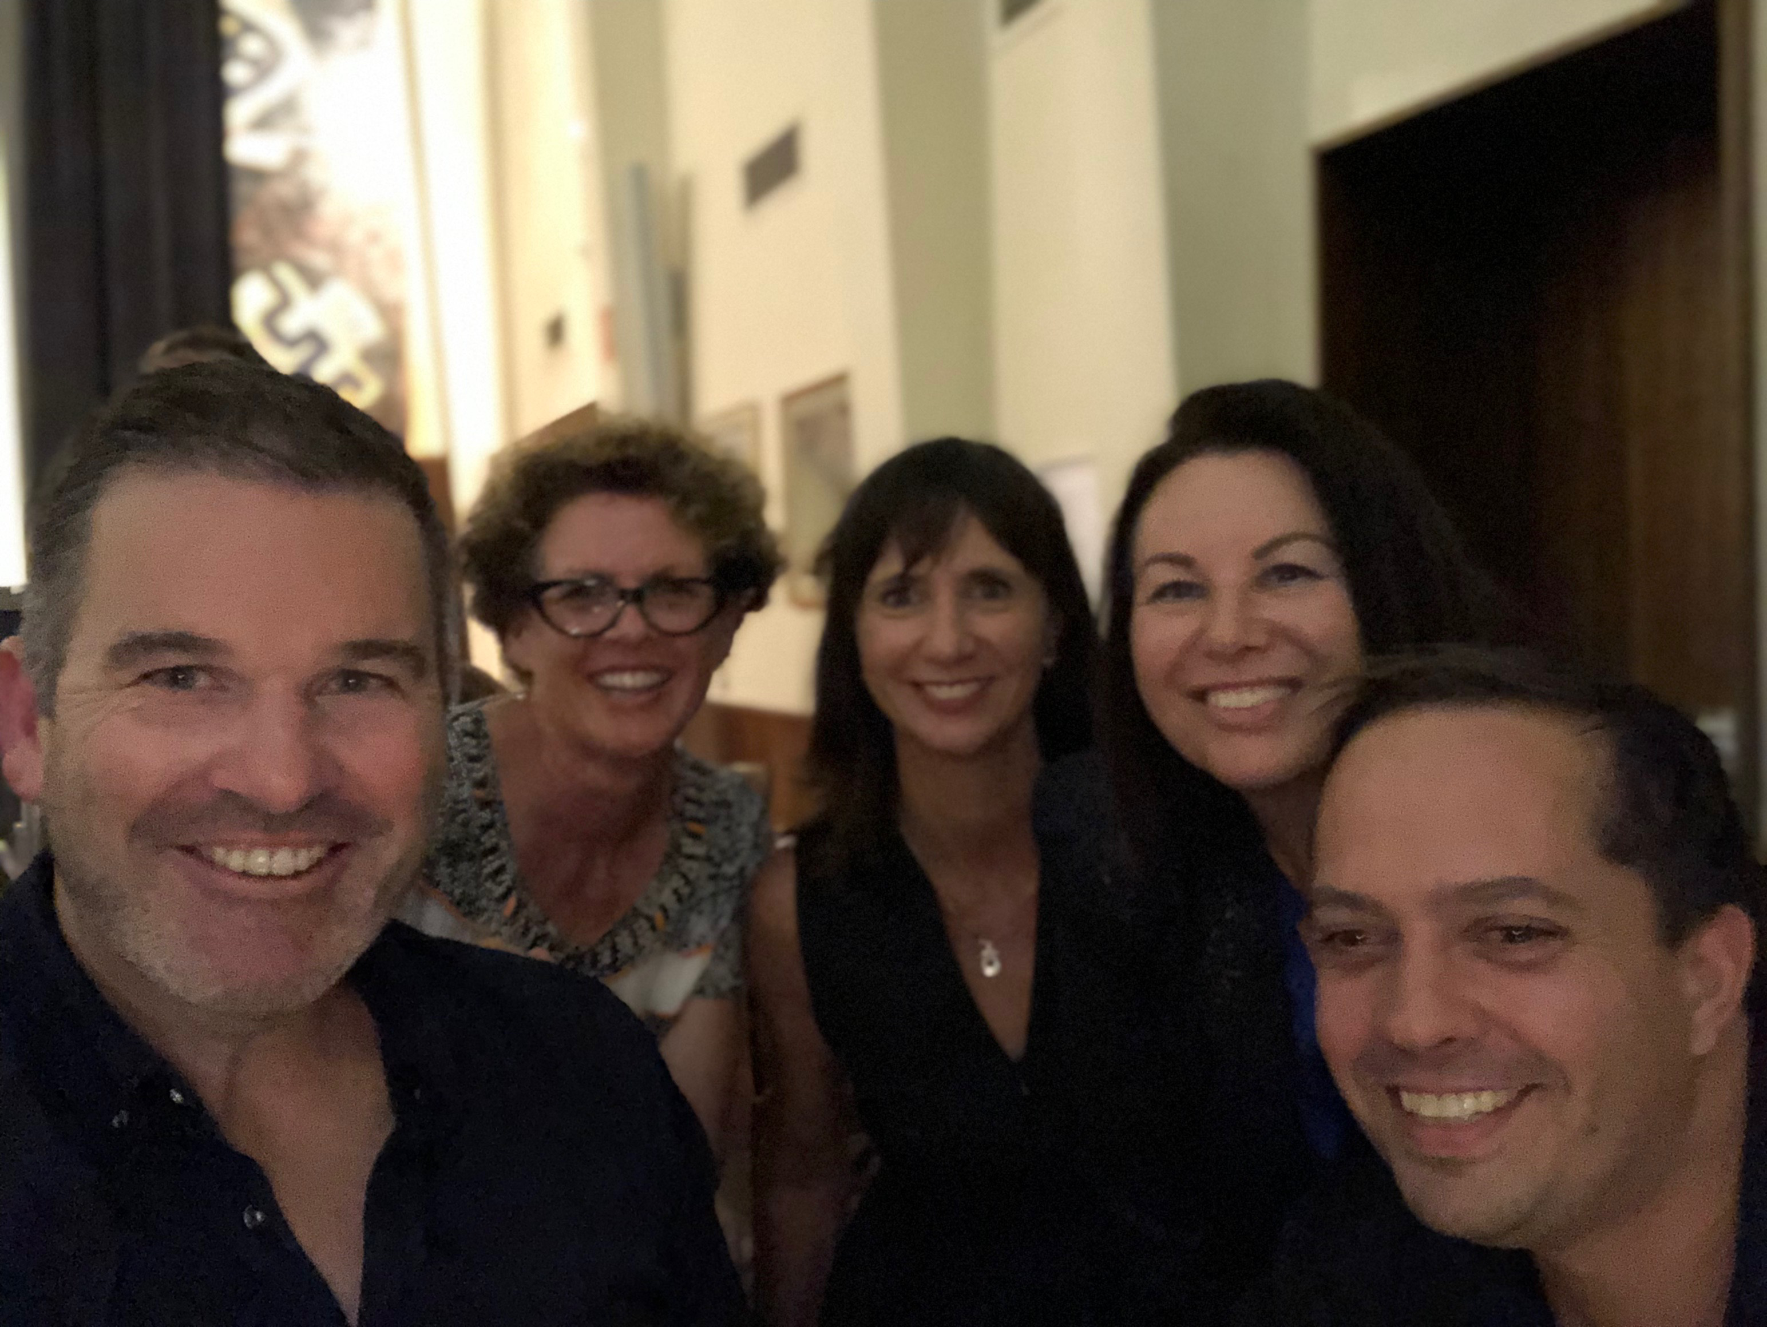
Communication
Information about meetings is disseminated early
Director communication with PPC for support addressing issues arising
Meeting with Directors to discuss PD so there is no cross over between PPC and Network Meetings

Slide 5
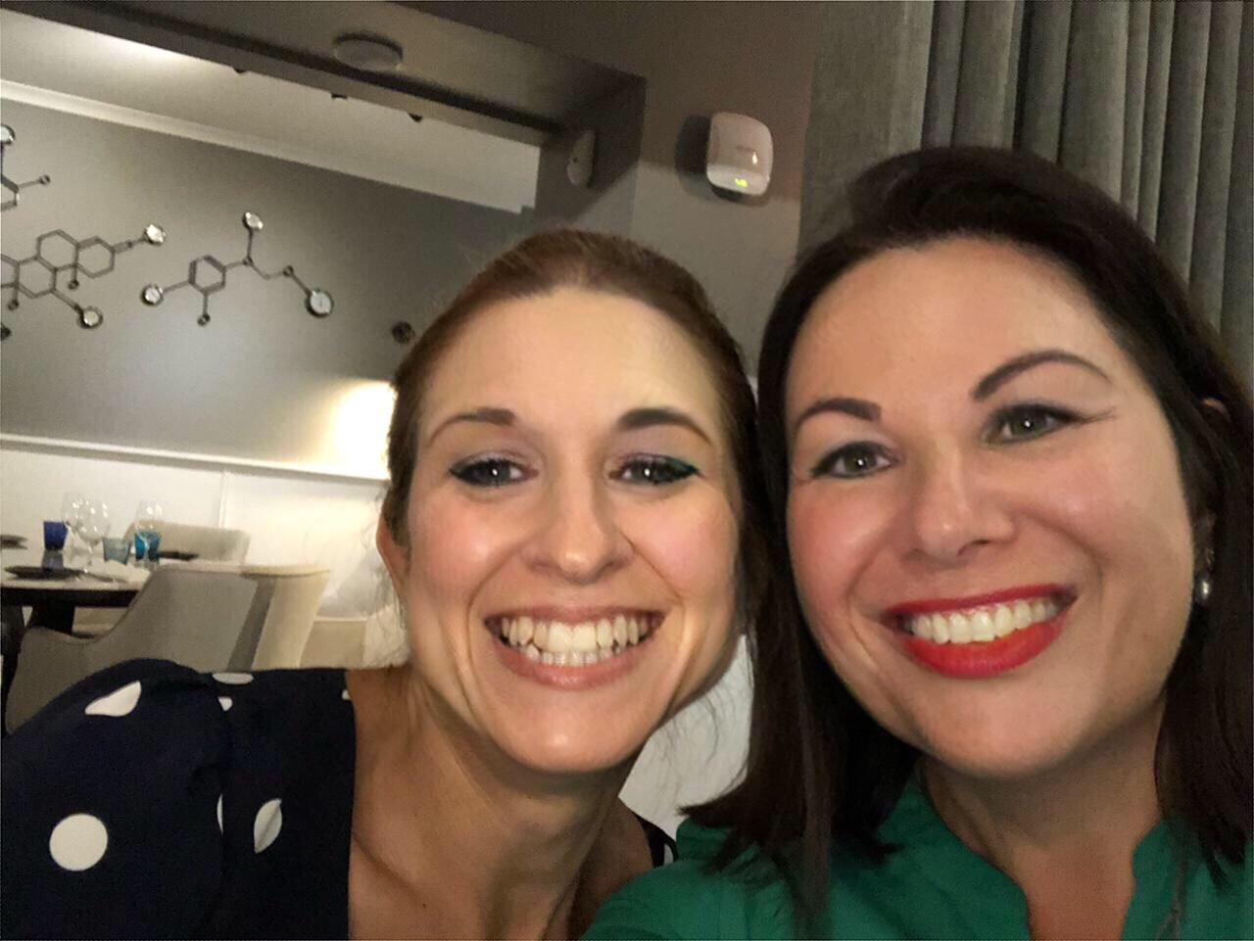
Social Opportunities
Drinks after each meeting
Optional Coffee Week 2
Beverages Week 6
Secret Santa in 2019 – Stay Tuned!

Slide 6
Wellbeing
Hot Tips
“It could be worse…”
Developing Trust
Reach out to relieving / new principals
Lots of Check-ins on Wellbeing – Proactive not Reactive

Slide 7

Where to next?
Organisation of the Regional PPC Conference – Wollongong, Shellharbour, Batemans Bay and Queanbeyan
“Combine, Connect, Celebrate”
Fenella Kernerbone
Jane Hunter UTS

