Slide 1


The Gonski Institute for Education

Slide 2

Research

Slide 3
Fair Play Project
Growing Up Digital Australia
School Meals Project
Early Childhood Education – Barriers to entry
Special Needs Wraparound Services

Slide 4
Rural and Regional
Staffing
Identifying Existing Excellence in Rural and Regional Education
School Governance and Structure
Specialist Education for Students with Unique Needs
Transitions to Higher Education
Culture of High Expectations
Access to High Quality Early Childhood Education and Care Services

Slide 5
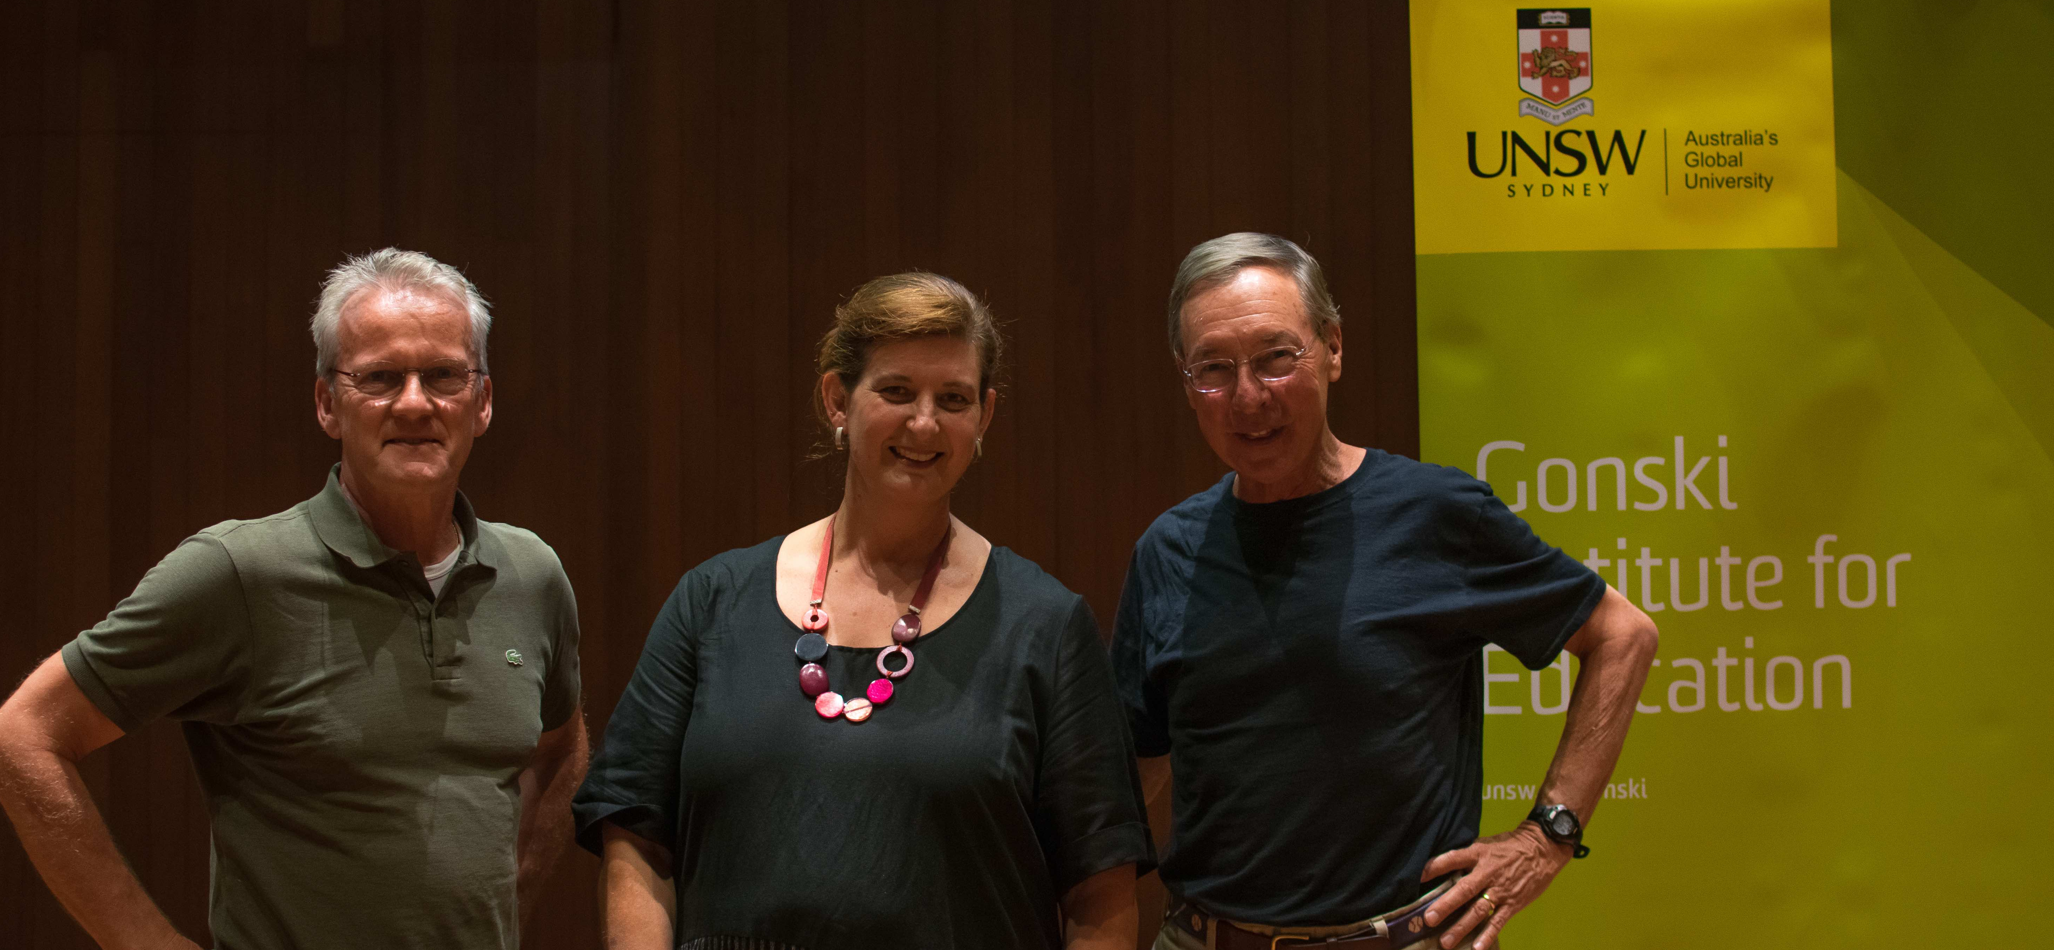
Advocacy

Slide 6
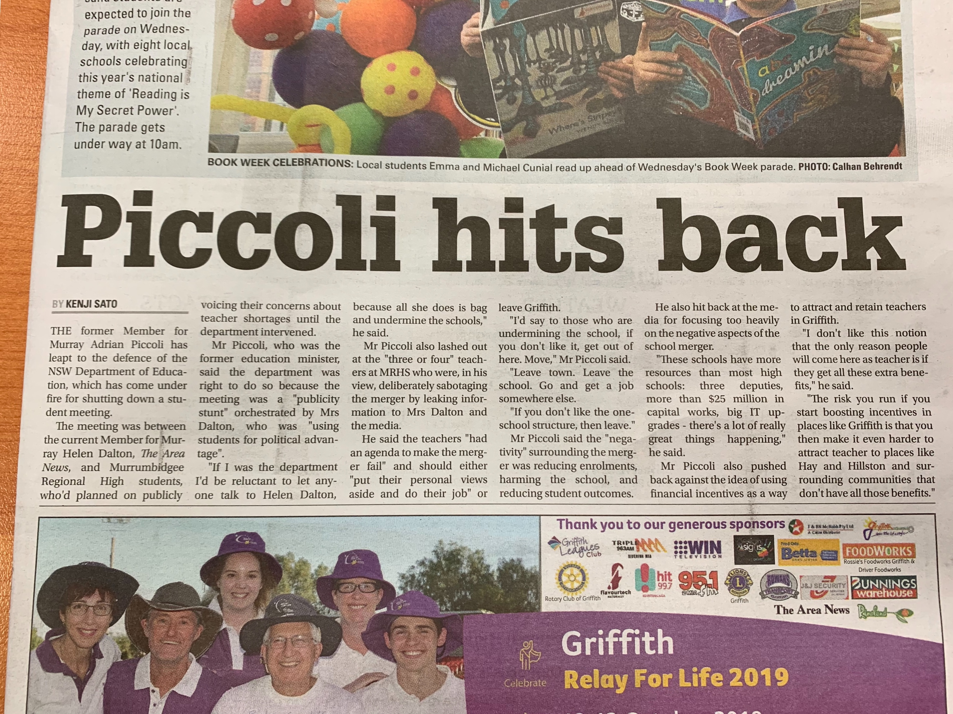

Slide 7
Equity and Fairness
NAPLAN
School funding
The Economic Impact of Improving Regional, Rural & Remote Education in Australia
Play

Slide 8
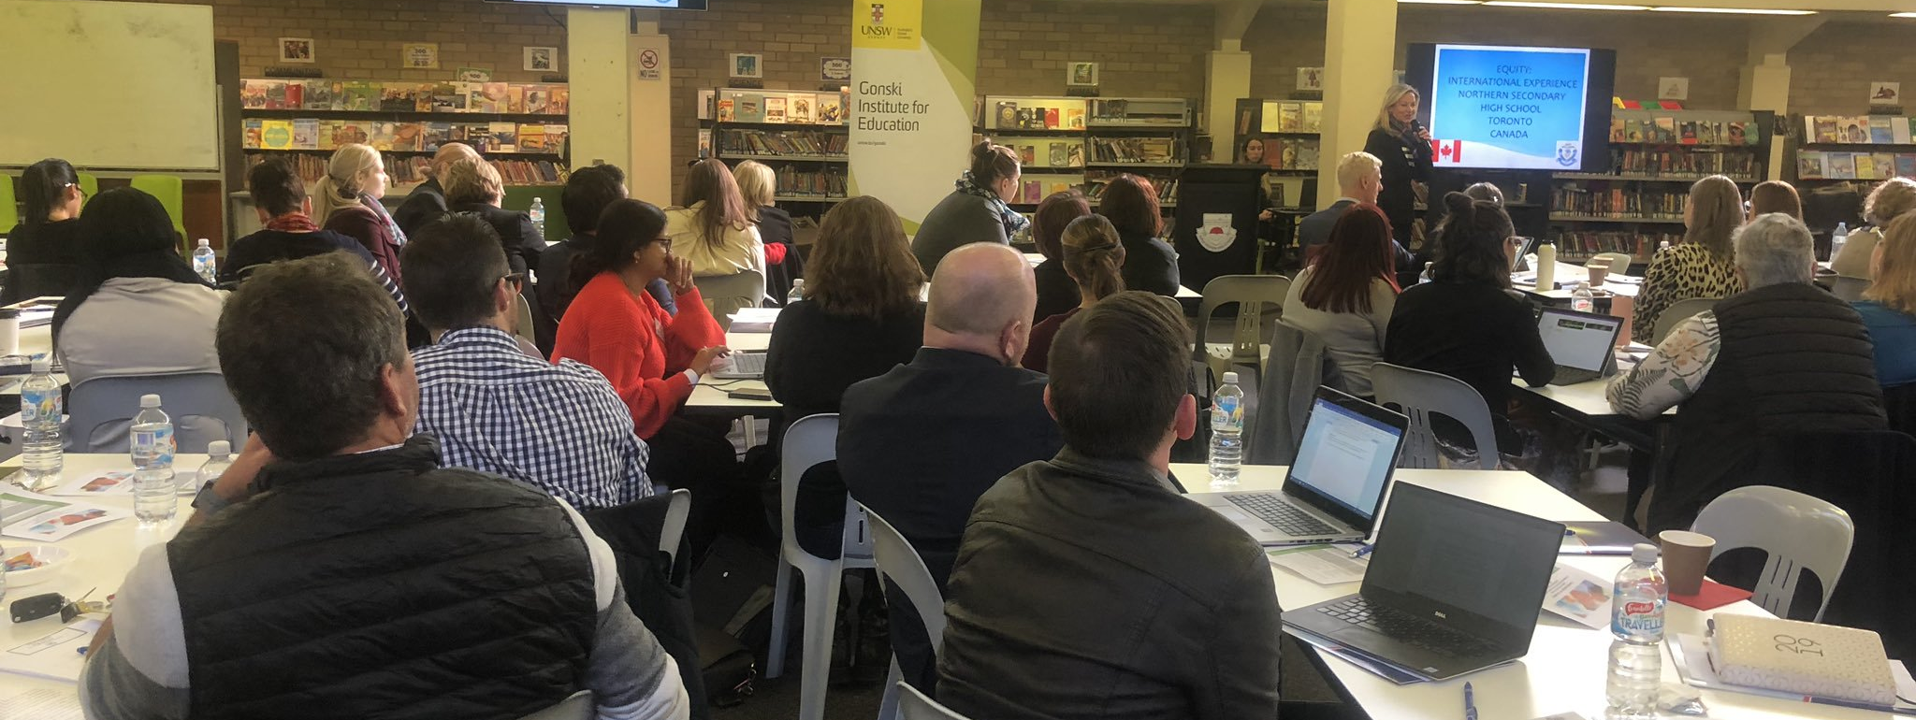
Professional Learning

Slide 9
Rural and Remote tour
Parent and Community Engagement for Learning
Ballina Coast High School, Ballina
17 September 2019
Murrumbidgee Regional High School, Griffith 24 September 2019
Leading for Educational Change
Broken Hill Education Office, Broken Hill
11 September 2019
Dubbo College Senior Campus, Dubbo
5 November 2019

Slide 10
Thank you

