Slide 1

Professional Learning

Slide 2
Empowering school leaders through quality professional learning
Interactive experiential
Capacity
Building
Evidence informed
Responsive to leaders needs
Practical authentic accessible
Impactful
NESA Lead accredited
Leadership skill development
Focus on key aspects of leaders work

Slide 3
Professional Learning Program 2020
NSWPPA Principal Credential
The Art of Leadership / Masterclass
The Tao of Teams
Powerful Performance Conversations
The Middle Leadership Imperative
7 Habits of Highly Effective People
Leading at the Speed of Trust

Slide 4
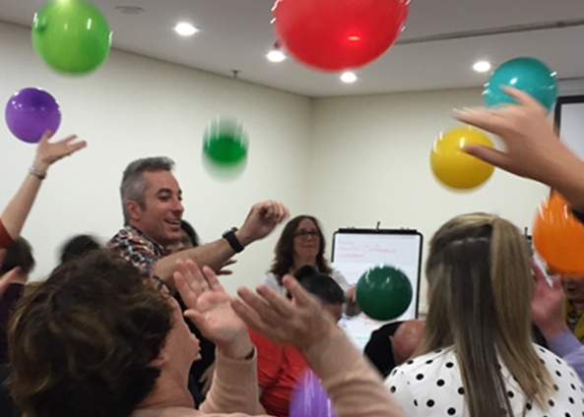
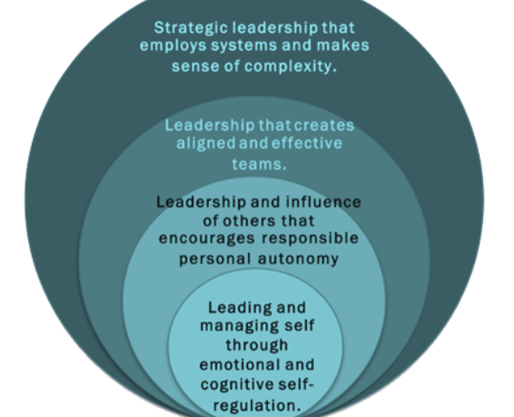
Art of Leadership 2020
A learning experience that is deep, challenging and sustainable.
Management of self
Influencing others
Leading teams
Strategic leadership

Slide 5
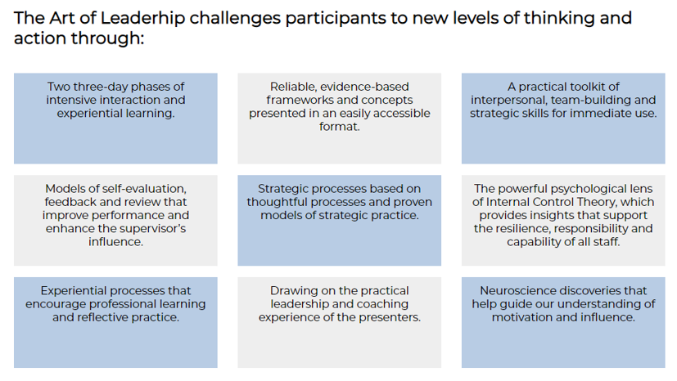

Slide 6

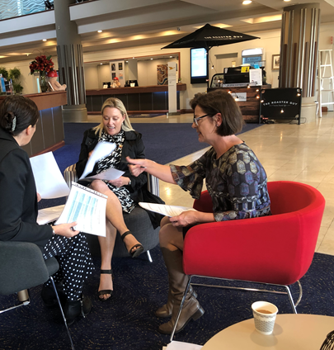
NSWPPA Principal Credential
Participants engage in deep professional learning from national and international experts in the field of school leadership.
The program provides participants with the opportunity to reflect on and strengthen their own leadership.
Involves facilitated collegial learning and focused individual learning supported by an experienced principal as a coach.
Contributes to 50% of the Masters of Education (Educational Leadership) with the University of Wollongong.

Slide 7
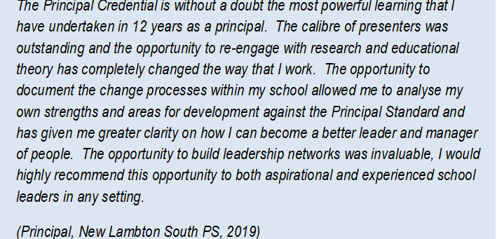

Slide 8
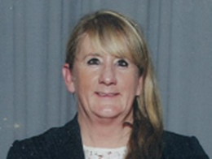
Case study of impact - Vicki-Ann Stokes
NSW PPA Principal Credential
Background
Methodology
Impact
Notes:
Part of cohort one, as an Assistant Principal at Moss Vale PS
Now principal of Wollondilly PS (Goulburn), rural school south of Sydney
Completed her Masters with University of Wollongong.
Collaborative analysis of student performance data to target specific instruction and improve learning outcomes for students, as measured by our national assessments (NAPLAN)

Slide 9


How the Primary Principal Association Credential impacted the improvement of teachers and student outcomes at my school.
Impact – Case Study
Notes:
NOTE:
To change the image on this slide, select the picture and delete it. Then click the Pictures icon in the placeholder to insert your own image.

Slide 10
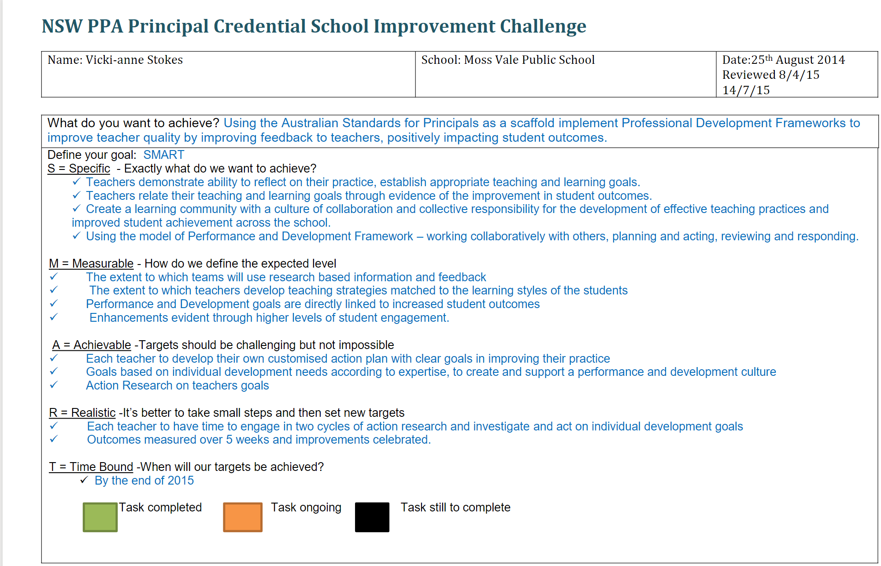
School Improvement Challenge
My school improvement challenge was to improve the feedback to teachers and as a result improve student outcomes.

Slide 11
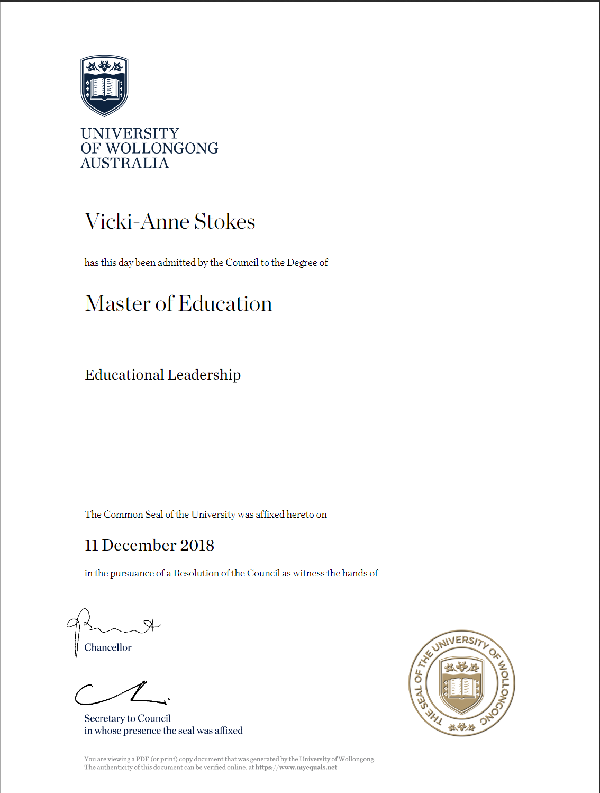
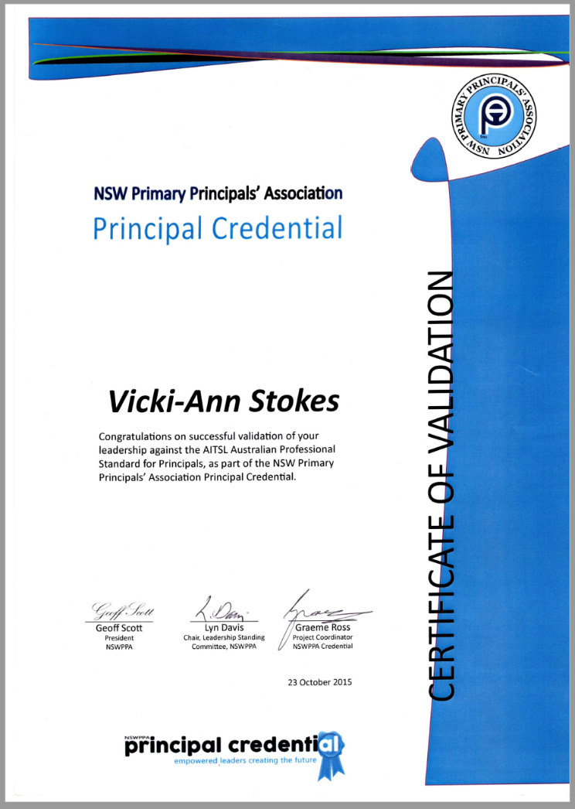
Validation to Masters
The NSW PPA Credential provided me with 50% of a Masters Degree.

Slide 12
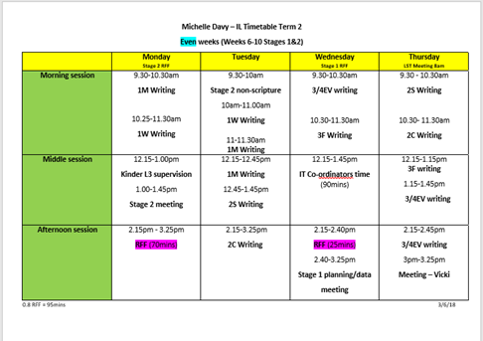
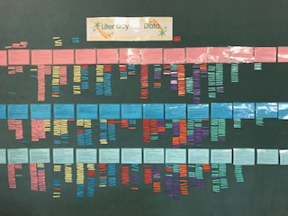
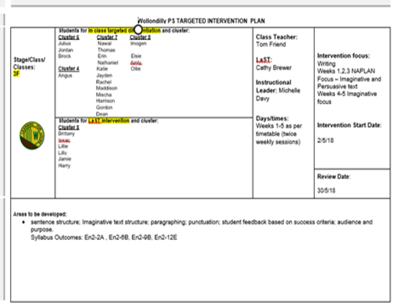

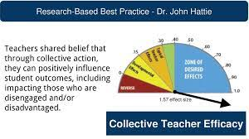
Collaborative Practice

Slide 13
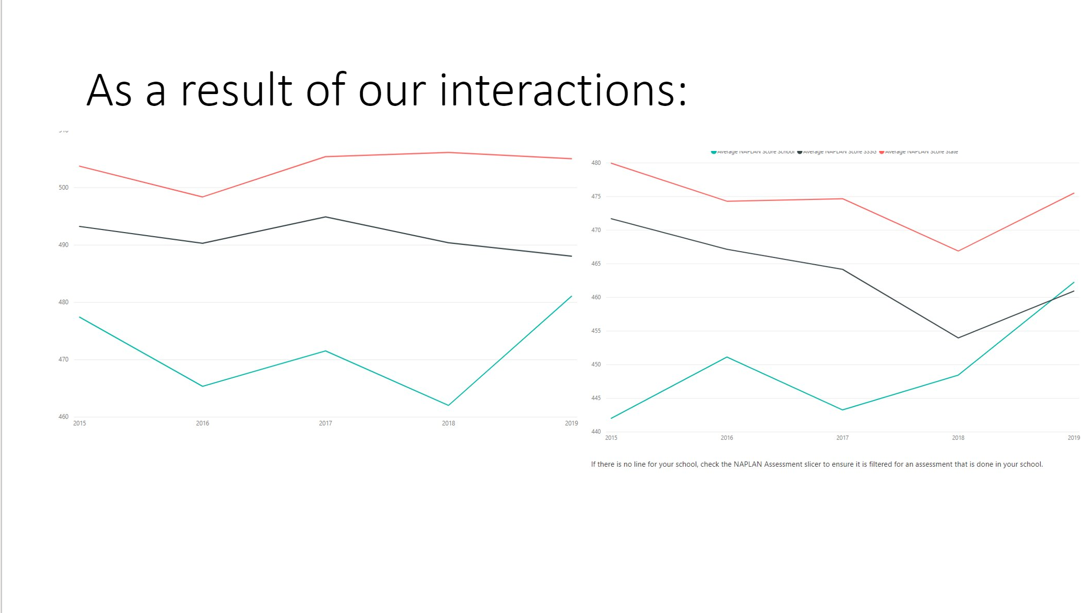
Add a Slide Title - 1
Impact

Slide 14

Purpose of the program is to improve the productivity, job satisfaction and overall sense of health and wellbeing of school principals
Is co-designed with Principals for Principals
Is a strategic and consciously designed experience to support principals through the process of embedding new work and lifestyle habits
Provides support and space for principals to work on their wellbeing

Slide 15

The Tao of Team

Slide 16
Creating, sustaining and energising an effective team
Stages of team development
Decision making models
Working in challenging teams
Essentials and enablers
Team communication and enablers
Coaching the team

Slide 17

Powerful Performance Conversations

Slide 18
Principles of a powerful performance conversation:
•Performance, boundary, alignment, coaching conversations
Focus on what you want.
• Make the conversations about values and beliefs NOT about
behaviours.
• Maintain relationships with all parties
Notes:
S

Slide 19
The Middle Leadership Imperative
Collaborative Professionalism
The Middle Leadership Imperative
Middle Leading
Ideas in Action

Slide 20





N S W P P A
C O U R S E C O M P O N E N T S
M I D D L E L E A D I N G
Middle leaders are defined as those operating between the senior leadership group and the classroom. (Grootenboer, 2014). A change in terminology in the early 2000’s from middle managers to middle leaders represented a shift in focus of the role from primarily administration to that of having a more significant impact on schools and students (Dinham 2016).
This module will examine the role of the middle leader within the leadership structure of schools; leadership and management as a set of abilities and skills; as well as the impact of school context on the middle leadership role. Leadership qualities and character strengths will be viewed in line with a developing theoretical model of middle leadership (De Noble 2018).
C O L L A B O R A T I V E P R O F E S S I O N A L I S M
“No profession, nor the people served by it, can progress without the ability and willingness of professions to share their knowledge and expertise and to figure out complex problems of practice together. Learning for all requires teachers who can and will work together in relationships of trust and solidarity, using methods that have impact”’ (Hargreaves & O’Connor 2018).
This module will centre on collaboration and building social capital among teachers and other educators to improve student learning. Middle leaders will be supported in how to collaborate more deeply in ways that achieve greater impact covering topics: Leading a team by bringing people on the journey with you; Communicating effectively including difficult conversations; Importance of trust; and, Feedback
I D E A S I N A C T I O N
‘To transform education, we need to start with, and focus on, the practices of learners and teachers in classrooms’ (Grootenboer, 2019).
This module will focus on site based educational development through the lens of middle leadership. Participants will be guided through the praxis of site based middle leadership with a rigorous focus on leading teaching and learning to enhance: Student learning outcomes; Effective and sustainable teacher learning; Pedagogical development; and, Curriculum and assessment practice.

Slide 21





N S W P P A
C O U R S E S T R U C T U R E
M I D D L E L E A D I N G
ML1 - MIDDLE LEADING FOR LEARNING
Leadership structure in schools Impactful middle leading
ML2 - MIDDLE LEADERSHIP PRAXIS
Considering context
The importance of culture
ML3 - MIDDLE LEADING AND MANAGEMENT
Interdependence Organisational
ML4 - THE LEADER
Leadership qualities Character strengths
C O L L A B O R A T I V E P R O F E S S I O N A L I S M
CP1 - COLLABORATION
Exploring collaborative professionalism
CP2 - TRUST
The five dimensions of trust Establishing trust within the team
CP3 - PROFESSIONAL DIALOGUE
Courageous conversations Relational dialogue
CP4 - THE ART OF MIDDLE LEADING
Team norms and bringing people on board The role of the leader
I D E A S I N A C T I O N
IA1 - THEORY OF ACTION
Developing a theory of action Action research
IA2 - IMPROVED CLASSROOM PRACTICE A
What does it look like?
The teaching and learning cycle
IA3 - IMPROVED CLASSROOM PRACTICE B
Digging deeper into the research Practice improvement at point of need
IA4 - CELEBRATING CHANGE
The impact of change Planning for the future

Slide 22


N S W P P A
M O D U L E O U T C O M E S
M I D D L E L E A D I N G
Participants will develop an understanding of:
Leadership structure of schools and the importance of middle leadership
The middle leader and their role in having direct impact on student learning outcomes
Interdependent skills and abilities in leading and managing
The significance of school context and school culture Leadership qualities
Character strengths
C O L L A B O R A T I V E P R O F E S S I O N A L I S M
Participants will develop an understanding of:
The difference between collaborative professionalism and professional collaboration
Leading a team and the collective impact for improved student outcomes
Managing difficult conversations
Importance of relationships and building trust
Starting with alignment and going deeper into coherence
I D E A S I N A C T I O N
Participants will develop an understanding of: Developing a theory of action (action research)
Narrowing the focus on improved student learning outcomes
How to lead for improved practice How/where to dig deeper
Data - providing us with the question to which we must answer

Slide 23
N S W P P A
P R O G R A M O V E R V I E W
C O U R S E
R E Q U I R E M E N T S
P R E - C O U R S E
D U R I N G C O U R S E
Time audit Pre-reading
Character strength VIA
Participation in all face-to-face sessions
Active contribution to group
B E T W E E N M O D U L E S
E N D O F C O U R S E
Between module readings Practicum phase - Leadership Learning Journal
Sharing your journey
Future proofing your leadership
P R O G R A M S T R U C T U R E
S E M E S T E R 1 2 0 2 0
D A Y 1
Middle Leadership 1
D A Y 2
Middle Leadership 2
Collaborative Professionalism 1 Ideas in Action 1
Collaborative Professionalism 2 Ideas in Action 2
S E M E S T E R
2 2 0 2 0
D A Y 3
Middle Leadership 3
D A Y 4
Middle Leadership 4
Collaborative Professionalism 3 Ideas in Action 3
Collaborative Professionalism 4 Ideas in Action 4

Slide 24
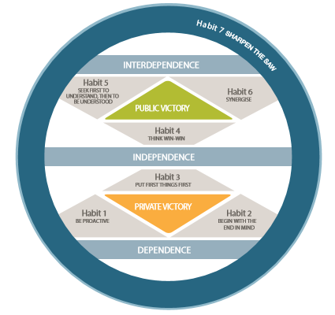
7 Habits of Highly Effective People

Slide 25

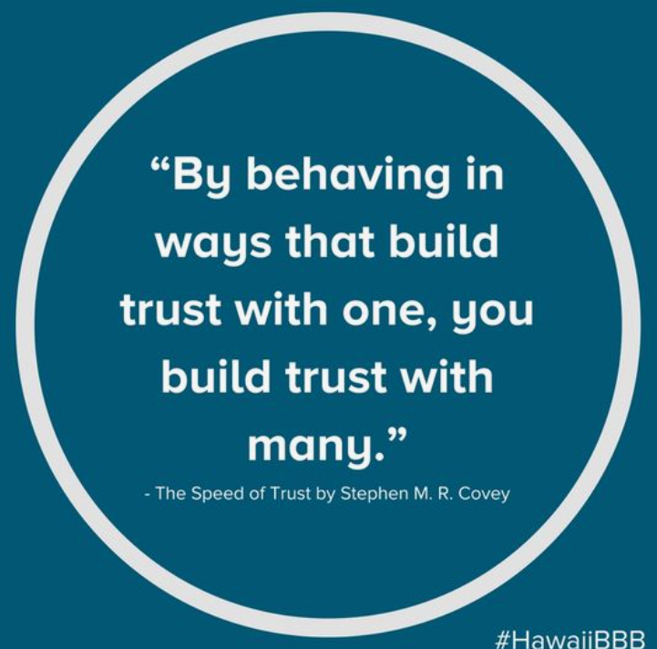
Leading at the Speed of trust

Slide 26

Professional learning on demand

Slide 27
Support from local PPCs
Presidents/Delegates distribute professional learning information from State Council
Role of the Leadership Contact Person in each PPC in promoting PPA professional learning opportunities
Encourage engagement in professional learning programs

Slide 28
Contact
Margaret Charlton
Professional Learning Officer, NSWPPA
mcharlton@nswppa.org.au
margaret.charlton@det.nsw.edu.au
Mob: 0408 905 051

