Slide 1

APPA Anxiety Report
Term 1 State Council

Slide 2
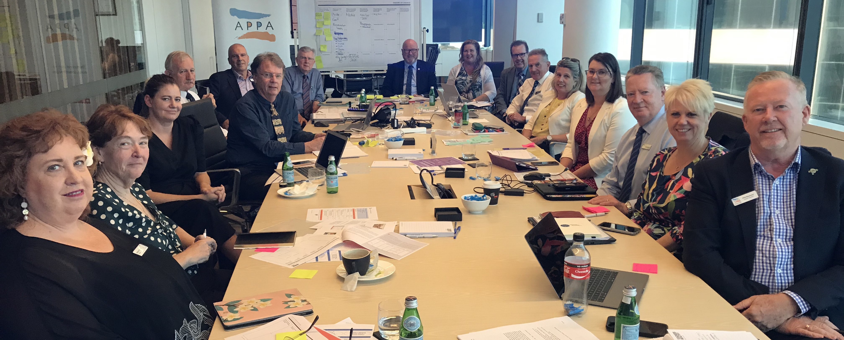
APPA Anxiety Report
Term 1 State Council

Slide 3
In broad terms, Principals responded that:
They have many discussions with teachers about students' anxieties.
They and teachers have many discussions with parents about students’ anxieties
They have many discussions with colleagues about levels of students’ anxieties
Students' anxieties place high demands on time and resources.
Schools are inadequately resourced to manage for anxious students.
Most parents do not have the skills to manage their children's anxieties
Students' anxieties negatively influence academic results.
Anxious students socialise with difficulty.
Student absence from school increases with students' levels of anxiety

Slide 4
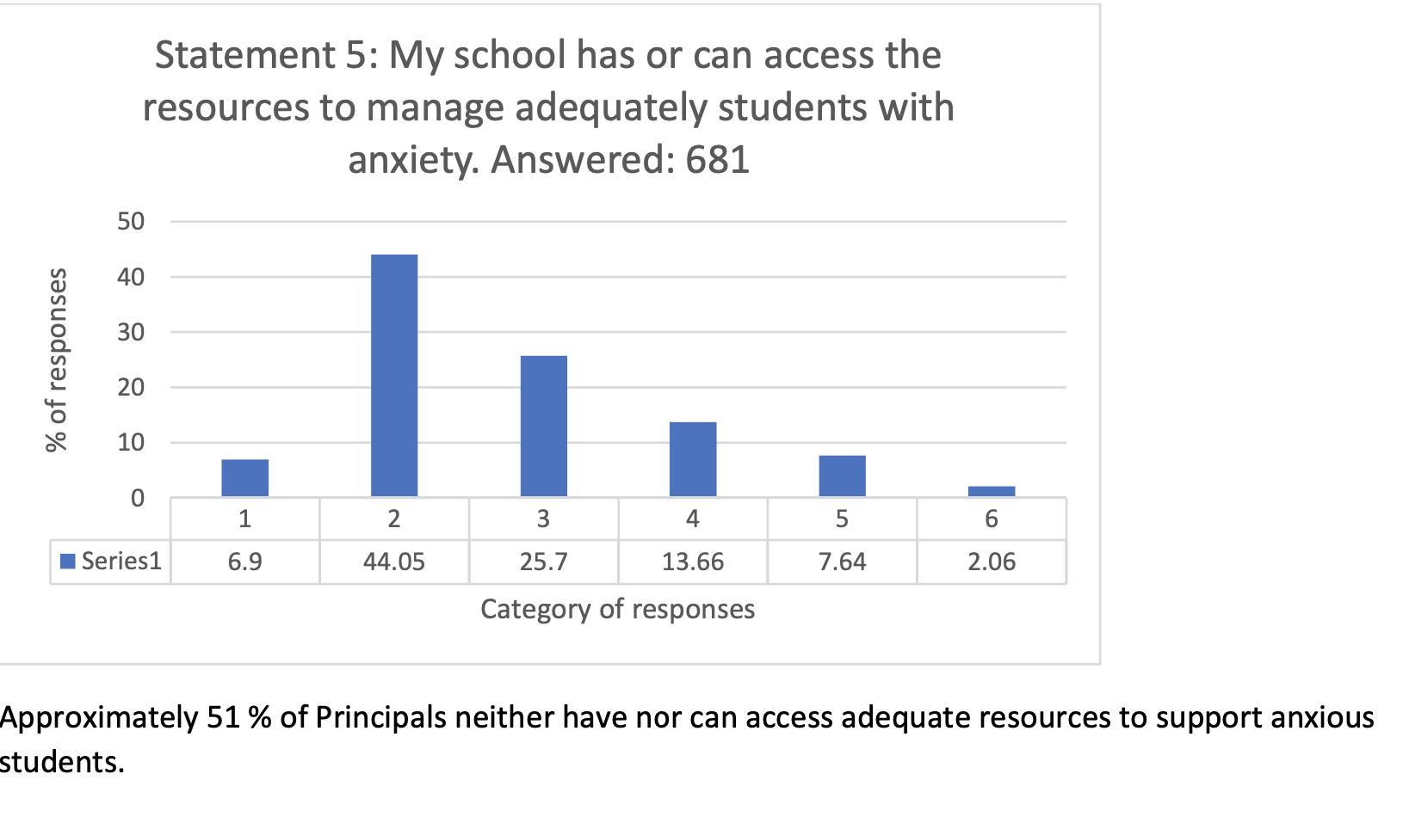

Slide 5
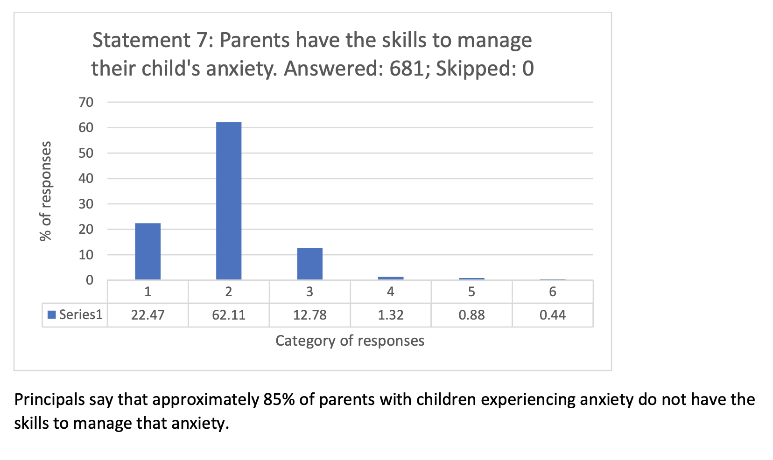

Slide 6
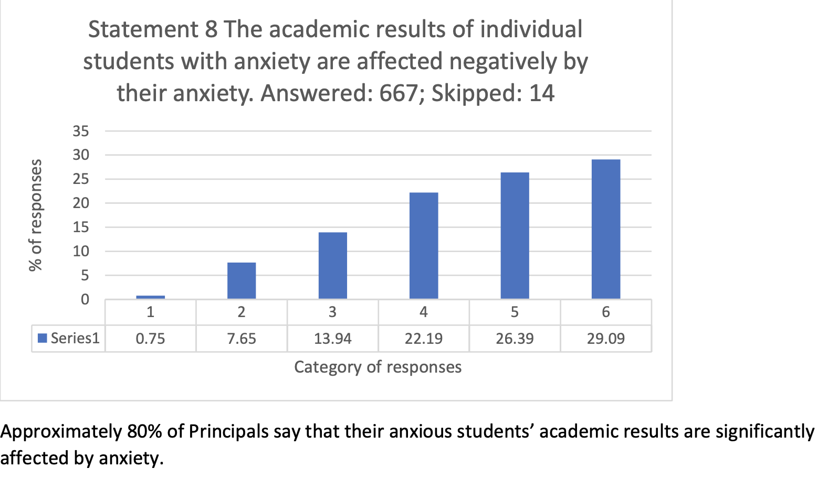

Slide 7
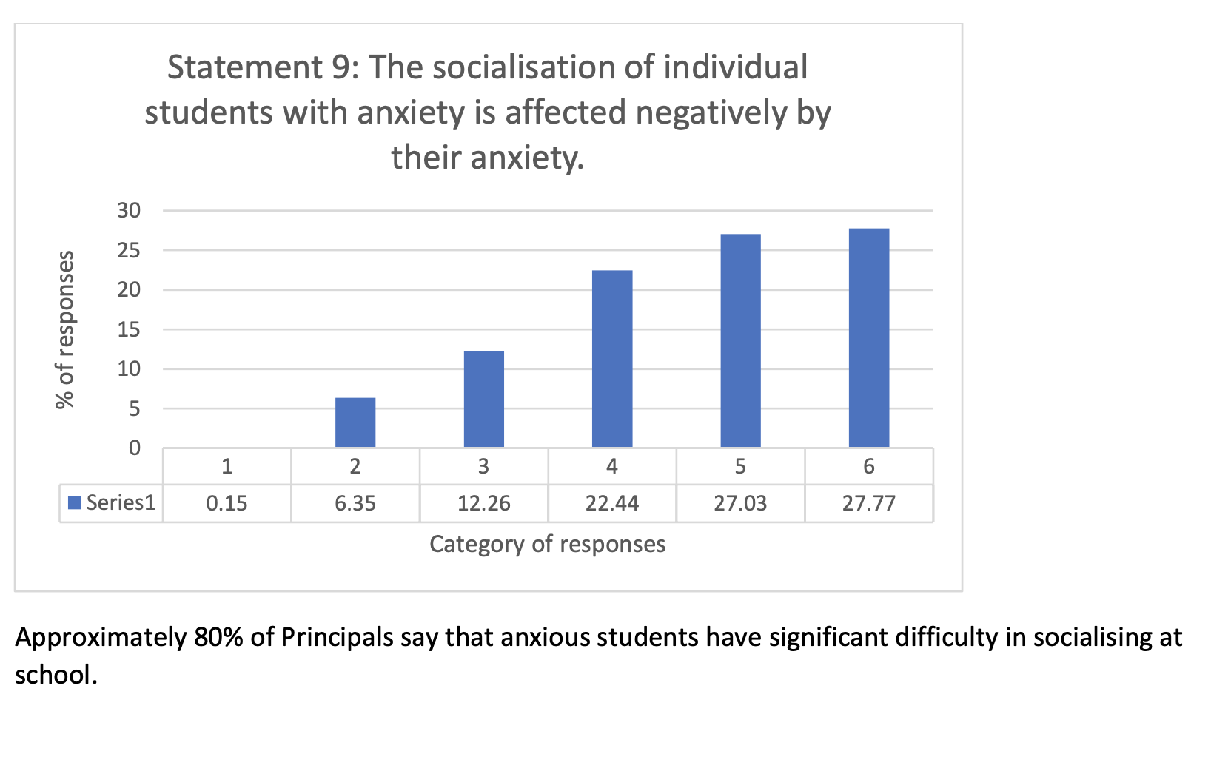

Slide 8
CONCLUSIONS
Analysis of the survey results indicates that levels of Primary students’ anxiety are major concerns for Principals, teachers, and parents.
Principals say that student anxiety is increasing and is a major topic of discussion between themselves, with their teachers, and with parents.
They say that they are under-prepared and under-resourced to provide adequately for anxious students.
They see parents as heavily implicated in solutions for the students.
Many parents come to schools with their concerns but feel very much like the Principals and teachers to whom they come; they feel uncertain and confused and look to schools for solutions.
Some even hold schools responsible for providing the solutions.
A few Principals offered explanations for anxious children’s difficulties.
Explanations are critical for solutions and must be integral to the many possible implications that can arise from Principals’ responses.
Without explanations, identifying the best implications is very difficult. Consequently, this report requires further discussion with members and eventual planning and resourcing.

