Slide 1
Primary Curriculum Implementation Monitoring Self-Assessment
NSWPPA State Council Meeting – 12 March 2020
Sharon Ford
A/Executive Director, Leadership and High Performance
Ahmed Deria
Director, High Performance
Mark Fisher-Hoad
A/Leader, Policy Implementation and System Registration

Slide 2
Overview
Curriculum Delivery – A Shared Leadership Approach?
Why Curriculum Monitoring?
Using an Evidence-Based Approach
Shared Professional Conversations
How Do We Support You?
Working Together through a Consultative Process
Annual Report Updates

Slide 3
School Excellence 2019 Annual Report Update

Slide 4
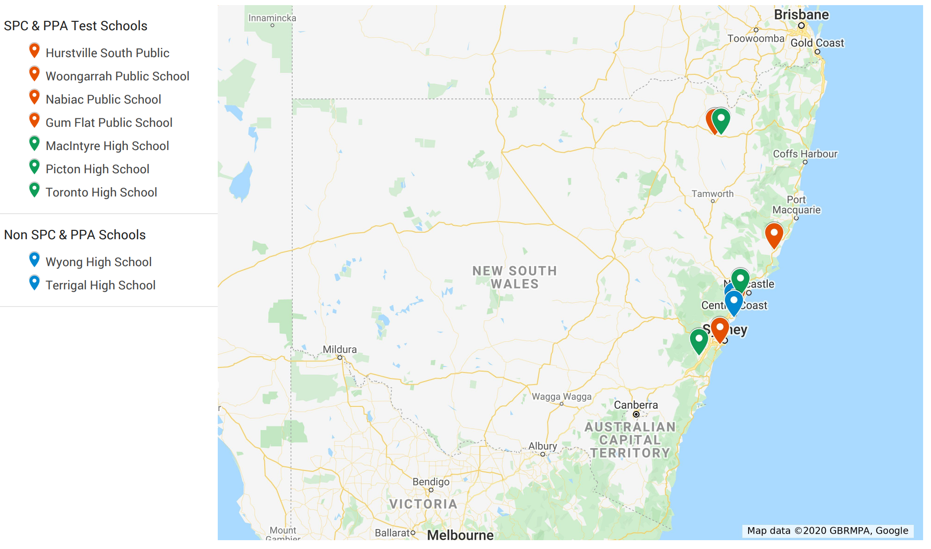
Annual Report Test Schools

Slide 5
HP is monitoring feedback from schools
Really easy
Saved a lot of time
Positive feedback |  | Improvement feedback
• Much easier to complete.
• Very happy with the fact it populates across. | • The optional fields are an improvement instead of the many mandatory fields which existed previously.
• Very good! a lot less work and time needed. • The QRG was very simple and very easy to follow. Thought that the Button information could have been added at the top of the QRG | • Student information save a lot of time (auto-populated) • which was a great improvement from last year. • Financial summary was very accurate. • Policy requirements is excellent. • SEF-Sas worked very well. | • Funds expended column in SD and KI needs to be smaller • Insert Image in Parent satisfaction - Images were too big
• Really loved that auto-populated information. For example the policy requirements. • Really loved the auto-population of the milestone evaluation and resources. It took some time to realise that the information that was changed in the AR was also changed in the School Plan. Once she realised she was positively shocked. | • SEF-Sas sections – EV was done last year which made this process even faster. Wondering if there was changes made to the SEF-Sas if it could be edited or if it had to be changed? | • KI - Wasn’t clear that Nil was required in the box. • SD – Expansion of boxes (Flagged with Sentral and is currently being reviewed) • Funds/Resources – Thought that possibly having more clarity around what specific details needs to be mentioned here. Having to write Nil in the box could be clearer (Flagged with Sentral and have made changes to this)
• Initial thoughts: It was extremely easy! Only opened our email this morning and started. • Could do it all in one day. | • Loved the NAPLAN data that was auto-populated. Did EV this year which made the process very easy for the school. | • Wasn’t clear that Nil was required in the funds expeneded box.
• Loved the NAPLAN data that was auto-populated. Did EV this year which made the process very easy for the school. • Very positive feedback. Normally takes a week to do AR and will now be less than a day to finalise. • Liked the auto-population of HSC graphs. Commented that he wished all courses could have graphs but understood that courses less than 10 were not represented in graphs. Liked the fact he could comment on these courses in the additional comment section. | • Thought the confirmation page and the new process of confirming and affirming from this page instead of a separate tag was a very positive addition. • Really liked the help text and QRG although stated that he would probably only use these if he got stuck in a certain area. • He said that he did not know initially how to access the help text and suggested we remind principals where this is found in our release communication. | • Asked for clarification around where Year 12 HSC completion and VET data came from. This has now been added in help text.
• Very quick but still flexible to allow for context of school • Excellent comments re prefilled data | • Likes help text – could be easier to find in parts • QRG answers everything needed but she didn’t start with that
• Thought the AR was much easier than last year and also took a lot less time. | • Took under an hour to complete.
 |  | • Financial information. Has changed from previous years and shows deficit when there is a rollover of funds. Concerned about community perception and pushback.
 |  | • Financial information - Has changed from previous years and shows deficit when there is a rollover of funds. Concerned about community perception and pushback.
Very good!
A lot less work
Did EV this year which made the process very easy
Loved the auto-population
Positively shocked
Could do it in one day
QRG was simple and easy to use
The new process of confirming and affirming was a very positive addition
Very quick but still flexible
Took under an hour

Slide 6
Improvement Feedback and HP responses
Feedback
Funds expended column in SD and KI needs to be smaller
Changes made in response to feedback
Made the cell size 2:1 to improve the formatting of the printed table
Insert Image in Parent satisfaction - Images were too big
Internet Explorer not printing SEF-Sas
Boxes in SD 1 won't expand to the character
KI - Wasn’t clear that Nil was required in the box.
Wasn’t clear that Nil was required in the funds expended box.
Asked for clarification around where Year 12 HSC completion and VET data came from.
Image sizes were scaled down
Issue raised with Sentral
Issue raised with Sentral
Character limit has been changed so that the field can remain empty
Character limit has been changed so that the field can remain empty
This has now been added in help text.

Slide 7
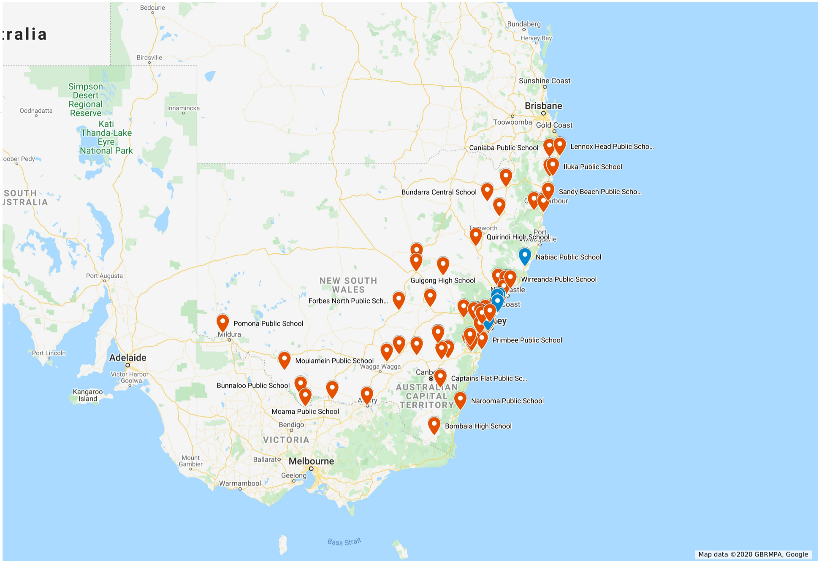
Published Annual Report
73 school that have published by beginning of week 7
77 primary schools
5 SSP
6High Schools
3 Central/Community

Slide 8
Curriculum Delivery A shared Leadership Approach

Slide 9
Monitoring responsibilities
System role
NESA role
Independently reports to the Minister and Secretary on the government schooling system.
Observes in the Department’s internal assurance processes
Conducts inspections of 18 randomly selected government schools per year .89%
Works with the Department to address concerns identified through its monitoring of the system.
Develop policies and processes addressing the school registration requirements. Schools implement policies Monitor implementation of policies and curriculum Provide support and training Provide information on the government schooling system policies and processes
Notes:
It is important to understand the two different roles that the DoE and NESA play. Neither are in charge but have checks and balances in play to report to the Minister and Secretary.
RANDOM - 18 Department schools are randomly selected for inspection. Department schools are not inspected as individual schools. Random inspections focus on a subset of requirements from the Registration Process for the NSW Government Schooling system. NESA Inspectors may ask for additional information if compliance issues arise during the inspection; NESA will communicate with the DEL requesting information on how the concerns are being addressed. NESA Inspectors will contact DELs a minimum four days before an inspection. DELs may advise NESA to choose another school, based on extenuating circumstances. Schools receive a one to two page summary report from NESA for their records.

Slide 10
How does the Department monitor policy implementation?
Policy development and review
Teaching staff
Facilities
Premises and buildings
Safe and supportive environment
Discipline of students
Safety and welfare of students in boarding schools or facilities
School curriculum
Attendance
School annual reporting
Management and operation of the school
System support and capacity building
Procedures, guidelines and support material
School implementation of Policy
Audit of high risk policy areas
System wide data collection
Professional Learning and briefing sessions
System monitoring of implementation
EVIDENCE
School Improvement Journey
Notes:
The Department has great processes across the areas of policy development and review but it is the area of curriculum where we need the most improvement. As a system at this time we cannot say that we are 100% sure that curriculum is being implemented to meet the needs of all students. We know through observation and reporting that many schools are doing a fantastic job including the use of the school excellence cycle but there is no systemic way of demonstrating this and in turn from a system point of view we are letting our schools down by not being able to gather data and report effectively about all schools on curriculum delivery across the system.

Slide 11
Within BAU, how can we meet the minimum requirements at school, network and system level?
A shared leadership approach
School
Principal Network
System
School BAU
Policy/Implementation monitoring
Program review, assessment, evaluations, IEPs/PLPs, lesson observations, shared teaching practices, mentoring, CTJ, work samples, learning walls, reports etc
Local Practices
Network BAU
DEL/Principal Meetings
CPM
Local Practices
System BAU
NESA Random Inspections
CPM (SICM) c. 1.8% of schools in 2020
HSC monitoring
Policy Standards for Curriculum Planning and Programming, Assessing and Reporting to Parents K-12
Notes:
This is a broad discussion. Emphasis is on business as usual. Each level within our system conducts various types of monitoring but we need a more systemic approach to monitoring and gathering of data to positively report that the system has a process across the leadership levels, the various networks and the range of schools and a way of recording the data and reporting from all parts of the system. A primary curriculum self-assessment checklist should be part of business as usual and add no further administrative burden to school leaders. This checklist could easily sit within program review and monitoring procedures the school has already in place. It could also act as capacity building tool for all teachers to understand the minimum requirements and what is needed to deliver curriculum at this level.

Slide 12
Why Curriculum Monitoring?

Slide 13
Why Curriculum monitoring?
The curriculum provided by a school must meet the requirements set out in the Education Act (1990) (the Act).
The Registration Process for the NSW Government Schooling System Manual (the Manual) outlines the requirements for NSW government schools and the associated documentary evidence to be maintained by the Department and/or its schools.
The evidence of compliance represents a minimum standard required to demonstrate that the requirement has been met.
Notes:
Schools will have educational programs (Primary) or courses of study (Secondary) for each year of schooling in each KLA identified in the Act, based on, and taught in accordance with, the outcomes of NESA syllabuses. The Department of Education details how schools plan curriculum and teaching programs including assessment and reporting to parents in its Curriculum planning and programming, assessing and reporting to parents K-12 policy (the Policy) and related implementation guide Curriculum Policy Standards (the Standards).
The requirements outlined in the Manual combined with the requirements outlined in the policy constitute the minimum requirements for schools in regards to curriculum implementation.

Slide 14
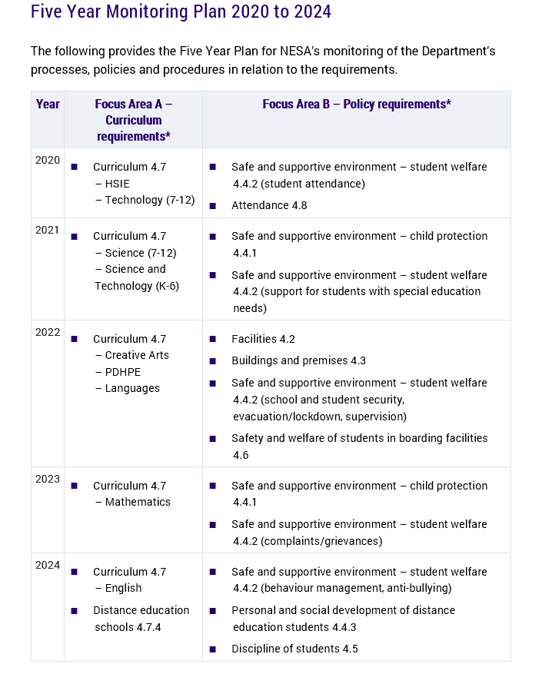
NESA FIVE YEAR PLAN
Handout
Notes:
Note: This is NESA’s five year monitoring plan. For curriculum requirements, schools will be asked to demonstrate compliance with the minimum requirements for one stage only. For policy, schools are asked to show the requirements for parts there of.

Slide 15
Primary curriculum
Section 4.7.1 of the Manual outlines the requirements for Primary Curriculum. Schools are required to maintain documentation or evidence of the following:
timetables for each Year/class showing the allocation of time and teachers for each KLA
an overview of the school’s educational program indicating:
the scope and sequence of learning/units of work in relation to outcomes of NESA syllabus for each KLA for each Year
an assessment plan indicating how students’ performance in each KLA is assessed, monitored and recorded
an overview of the process for reporting student achievement
for each Year/class:
teaching programs for each unit of work that correspond to those identified in the scope and sequence of learning/units of work for that year
samples of student work that relate to the teaching program for that year
all of the above must show alignment
Schools are also required to demonstrate more holistically:
evidence relating to the standard of teaching that includes:
consistency between the various elements of the school’s curriculum including NESA syllabus outcomes, scope and sequence, teaching programs, assessment records and samples of student work
records of teacher reflection/evaluation of the effectiveness of teaching and learning activities
records of the progressive achievement of students over time
records of the school’s analysis of student achievement data to inform teaching and learning
records of teaching strategies to meet the learning needs of students across a variety of student backgrounds and learning profiles, including Aboriginal and Torres Strait Islander students
evidence relating to the student engagement in learning, that includes records of:
students’ learning progress over time
teaching strategies and programs designed and implemented to meet the learning needs of students across a variety of student backgrounds and learning profiles, including Aboriginal and Torres Strait Islander students.
The system and/or school must have resources and equipment available for providing the required KLAs/courses.
Notes:
Demonstrating the alignment is the key.

Slide 16
School Improvement Curriculum Monitoring – looking for clear alignment
Syllabus outcomes
Scope and sequence
Teaching and learning programs
Assessment and reporting
Student work samples
Class/school timetable
Evaluation and feedback
Notes:
Facilitators need to be able to identify clear connection and alignment between collected documentation, specifically:
- NESA syllabus outcomes
- scope and sequence
- teaching and learning programs
- assessment records and schedules
samples of student work
Curriculum monitoring focuses on establishing a clear alignment/line of sight between outcomes, scope and sequence, teaching programs, assessment records and samples of student work. Effective curriculum monitoring is promoted through professional discussion that establishes compliance and clearly demonstrates quality teaching and student engagement.
Documents presented by a school must include the following information:
Timetable: ensuring hours and minutes for each KLA reflect DoE and NESA requirements
Scope and Sequence: overview for the current year including unit titles, duration of each unit, NESA syllabus outcomes, assessment (optional)
Assessment and reporting: school procedures, collection and recording of student data, assessment schedule/plan
Student engagement: records of student progress over time, variety of feedback collected and reviewed
Standard of Teaching: class profile (IEPs, PLPs), Teaching and Learning programs, differentiation, resources, reflections/evaluations,
Student work samples: reflect the unit of work (student workbook), reflect assessment (3 examples) and reflect adjustment/differentiation (student workbook)
Resource: Modified curriculum checklist that can be accessed by school leadership teams and teachers.

Slide 17
Shared Professional Conversations Handout – QRG CPM Meetings

Slide 18
2020 CPM Focus
Policy
This is a one on one conversation between the DEL and the principal of the hosting school, observed by High Performance.
The focus of the conversation in 2020 is:
4.4.2 Student Welfare (Student Attendance)
4.8 Attendance
Curriculum
This is a principal network meeting with up to six schools in pairs, led by the DEL and supported by trained facilitators (principals/deputy principals) and subject matter experts in curriculum delivery ( head teachers, assistant principals, HATS). High Performance will observe the meeting.
Key Learning Area - HSIE
A stage of learning will be identified
NESA Inspectors will observe both processes.
Policy and curriculum focus changes annually.

Slide 19
How do CPM meetings work?
The role of the Facilitator is to
guide the discussion and
validate the compliance against minimum standards. SMEs provide subject related advice and assist by recording findings and evidence provided.
Facilitator
C
Pairs of like schools participate in guided discussions run by trained facilitators.
A
SME
C
D
As part of the discussion schools demonstrate compliance
with minimum standards through documentation collected as part of the everyday operation
of the school. Discussions allow for schools to present evidence in
light of their particular context.
C
A
D
B
A
D
B
Table 2
Table 1
B
NESA observes the Department’s system of monitoring
HP staff support the process
DELs host Principal Network meetings
DEL
Notes:
A CPM curriculum meeting has between 2 -6 schools. Each table has a facilitator. Members of HP observe and support the process. NESA may observe the process.

Slide 20
Curriculum Policy Monitoring (CPM)
The purpose of CPM is to:
Provide internal assurances regarding the implementation of policy and curriculum in schools
Locate externally mandated compliance within a school improvement context
Provide opportunities for professional dialogue and sharing amongst schools
Reinforce a culture which demonstrates quality internal assurance processes at all levels
Ensure that student learning and wellbeing remains at the centre of schools
The focus of CPM is to:
Provide leadership opportunities
Promote professional collaboration
Reduce administration burden through focusing on BAU collection of authentic documentation
Ensure principals have in depth oversight of school/stage implementation of curriculum
Ensure Directors, Educational Leadership oversight of network implementation of curriculum

Slide 21
The case for Primary Curriculum Self-Assessment
Supporting schools to monitor curriculum implementation
The requirements outlined in 4.7 of the Registration Process for the NSW Government Schooling System Manual describes evidence that all schools are expected to maintain to demonstrate compliance with curriculum implementation and is based on legislative requirements under s27A of the Education Act 1990. Section 1.4 of the Policy Standards for Curriculum Planning and Programming, Assessing and Reporting to Parents K-12 requires Department schools to maintain documentation that provides evidence of compliance with NESA syllabuses and reflect the obligations to students under the Disability Discrimination Act 1992 and the Disability Standards for Education 2005.
The evidence described by the Manual is considered by NESA to be BAU documentation for schools.
The basis of the short notification for NESA Random Inspections is that any documentation identified for review is readily available at the school level.
Notes:
Emphasis on business as usual.

Slide 22
Using an evidence-based approach

Slide 23
A curriculum self-assessment process for schools would provide clarity around the minimum requirements for curriculum documentation.
The process provides clear advice for principals and reduce some of the perceived anxiety about NESA inspections.
It allows targeted professional conversation at the school level building staff capacity at all levels as they engage with the documentation in light of the school context.
It allows targeted professional conversation between DELs and Principals as clarification and support is sought regarding the evidence set held by the school.
This process would also feed into the School Excellence Framework Self-assessment Survey (SEF S-aS) evaluation in a number of SEF domains related to curriculum delivery and instructional leadership.
The process could be included as a milestone for a school in its school improvement journey.
The finalisation of curriculum self-assessment process is business as usual for schools.
Notes:
Principals, DELs and the Department as a system should have a process by which they can gain assurance that the school holds the required evidence and that there has been an internal review process regarding the documentation.

Slide 24
Explicit Knowledge of Requirements
How could this work to ensure it is business as usual?
NESA Registration requirements
DoE requirements
NESA five year monitoring plan for strands A & B
DoE/HP follows same five year monitoring plan for CPM meetings
Primary Principals follow same five year monitoring plan for review of policy and curriculum and upload into SPaRO
Evidence uploaded to multiple sources including SEF-SaS, EV, AR, school plan, accreditation, random inspections & CPM meetings
If a primary school is selected for a random inspection (NESA) or for CPM (DoE) they will have already started the process or preparations will be well under way or perhaps even finished.
Notes:
Using a primary curriculum self-assessment checklist, It makes sense to follow the NESA five year monitoring plan for strands A & B. With an understanding of the NESA Registration requirements and DoE requirements it would allow schools to have plan for curriculum and policy monitoring. The evidence including the checklist could be utilised to support multiple sources including SEF-SaS, EV, AR, school plan, accreditation, random inspections & CPM meetings. The sycnics would say anyone could sign off on the checklist and upload and this is correct, however, the checklist is design to support schools and school leaders to follow a process to monitor and review and check various aspects of curriculum and policy, build responsibility and capacity in skills, knowledge and understanding of all staff in the minimum requirements and gives the Principal, DEL and the system assurances that curriculum is being delivered giving accountability at all levels.

Slide 25
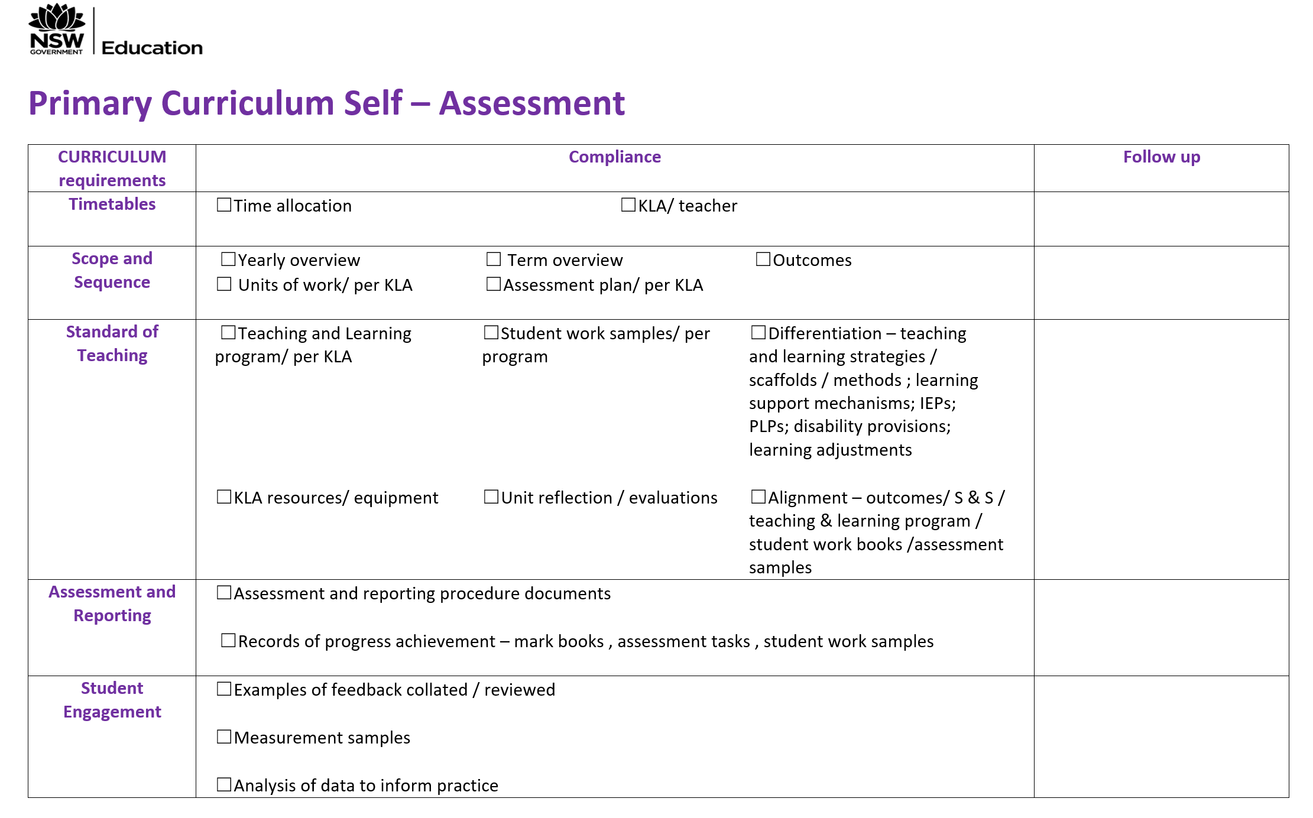
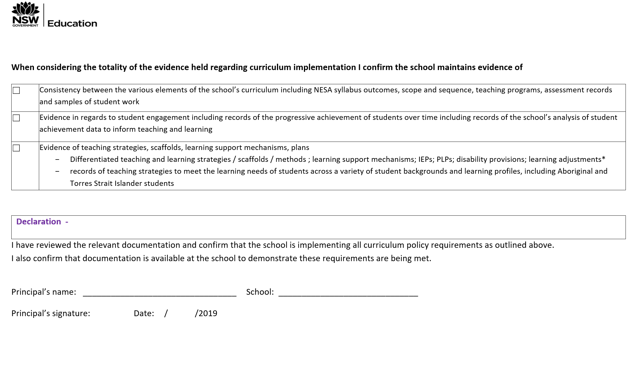
Primary Curriculum Self- Assessment
Handout
Notes:
This is a draft template. We are asking PPA Reference for input/advice on its format, as a scaffold for school leaders in meeting the minimum requirements/school improvement and as an overview of the process of curriculum and policy monitoring.

Slide 26
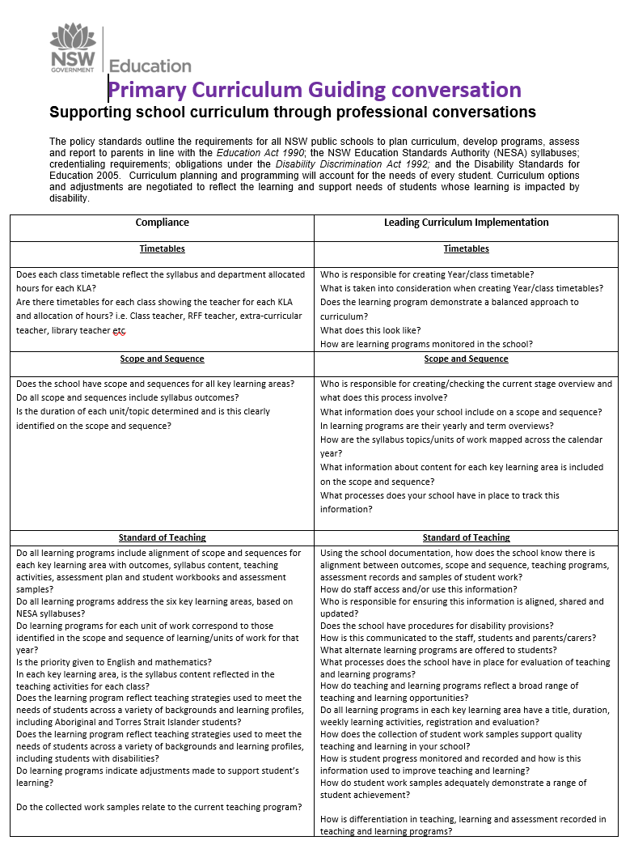
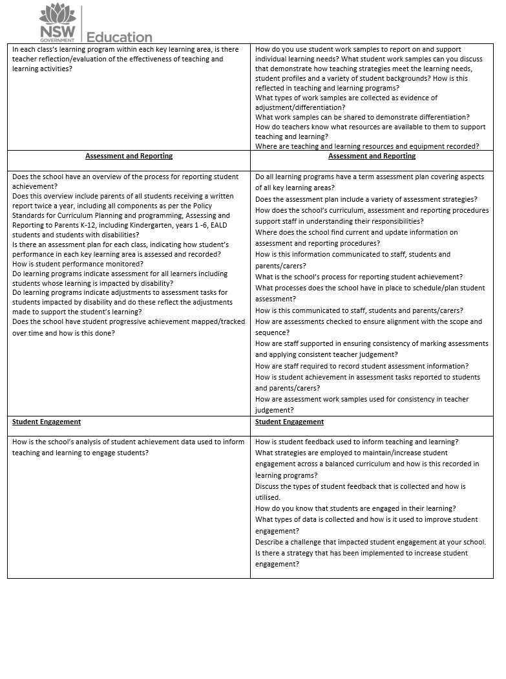
Primary checklist – Guiding Conversations
Handout
Notes:
This is a draft template. We are asking PPA Reference for input/advice on the types of questions as a scaffold for school leaders to guide a conversation in meeting the minimum requirements and to ascertain school improvement.

Slide 27
CPM: Meeting Agenda
8.45am – 9am - Introduction
Acknowledgement of Country | Overview of the day | Collection of confidentiality agreements
9am – 10.30am - Session 1
Collegial Sharing (20 mins) | Timetables (15 mins) | Scope and Sequence (15 mins) | Standard of Teaching (40 mins)
10.30am – 11am - Morning Tea
11am – 12.00pm - Session 2
Assessment & Reporting (20 mins) | Student engagement (20 mins) | Clarification (5 mins) | Reflection (15 mins)
12.00pm – 1.00pm - Lunch
1.00pm – 2.30 pm - Session 3
Facilitators/SMEs: finalise summary reports for Director, Educational Leadership Schools: option to stay for school planning or return to school. Host school is to remain and complete policy monitoring with Director, Educational Leadership (30 minutes) and then take the option.
Notes:
(This needs to be reviewed by the team.) A typical CPM Meeting agenda for curriculum is divided into 3 sessions with specific requirement discussion. It is important to note that for session 3, schools have the option to stay. Host school is to remain and complete policy monitoring with Director, Educational Leadership (30 minutes) and then decide which option to take. Start times may vary based on location (remote school travel times)
Schools are provided with a summary report at the end of the meeting. The purpose of the report is to support school improvement and not for performance management. It is to be used for school planning and to support the implementation of support.

Slide 28
How Do We Support You?

Slide 29
Resources
Supporting the monitoring curriculum implementation at the school, network and system level
Assessing minimum standards using evidence
CPM Meeting Guide – all you need to know about running a CPM
Guiding professional discussion – guiding questions that let you unpack minimum requirements or school improvement in regards to curriculum delivery
Alignment visual– Demonstrating the standard of teaching and alignment of educational program
Primary Curriculum Self-assessment
Facilitator and SME nomination process, training and participation in CPM
Training in 2020
CPM training T2 Wks 1-5 open to all DELs (not just participating DELs)
E-learning modules 1. Compliance 2. Registration

Slide 30
Working Together through a Consultative Process

Slide 31
How can L&HP and the PPA work together on this?
Regular updates and input from PPA.
Small working group comprised of 4-5 Primary Principals or Deputy Principals to provide advice throughout the consultation and review process. The working group would meet 3 times in Term 2, 2020.
A series of focus groups with representatives from a range of primary schools. The focus groups will provide feedback regarding the template and resources as well as the process around sign off. The focus groups will run across a range of locations and via virtual platforms. Where possible, we will take advantage of existing meetings and gatherings.
A template and proposed resources for discussion and feedback.
Trialling the template in 2020.
Refining and implementation from 2021

Slide 32
Proposed timeline for Primary Curriculum Self-Assessment consultation
 | 1 | 2 | 3 | 4 | 5 | 6 | 7 | 8 | 9 | 10
Term 4 2019
Term 1 2020
Term 2
Term 3
Term 4
PPA advice
DEL focus group
L&T
NESA
Primary Principal and DP Focus Groups (range of contexts)
Finalise template
Working Group
Working Group
Working Group
SPaRO build and testing
Paper SAS uploaded to SPaRO
Survey and feedback

Slide 33
Handouts
Standard of Teaching
Alignment Visual
QRG PDF CPM Meeting Guide
Primary Checklist
Guiding Questions

