Slide 1

Professional Learning

Slide 2
Professional Learning Program 2020
NSWPPA Principal Credential
The Art of Leadership / Masterclass
The Tao of Teams
Powerful Performance Conversations
The Middle Leadership Imperative
7 Habits of Highly Effective People
Leading at the Speed of Trust
Flourish

Slide 3

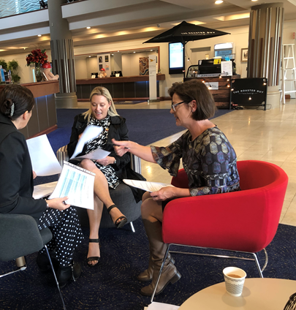
NSWPPA PRINCIPAL CREDENTIAL PROGRAM
The Principal Credential is without a doubt the most powerful learning that I have undertaken in 12 years as a principal. The calibre of presenters was outstanding and the opportunity to re-engage with research and educational theory has completely changed the way that I work. The opportunity to document the change processes within my school allowed me to analyse my own strengths and areas for development against the Principal Standard and has given me greater clarity on how I can become a better leader and manager of people. The opportunity to build leadership networks was invaluable, I would highly recommend this opportunity to both aspirational and experienced school leaders in any setting.

Slide 4

Program features:
The focus of learning is on the core business of teaching and learning to have the greatest influence on student learning outcomes.
Key learning led by Ann McIntyre.
Applied learning in your context.
Collegial support by experienced systems leaders.
Aligned with the Australian Professional Standard for Principals.
Opportunity for collegial networking.
Recognition for 50% of a Masters of Educational Leadership at Wollongong University.
Three two day seminars over 16 months.

Slide 5
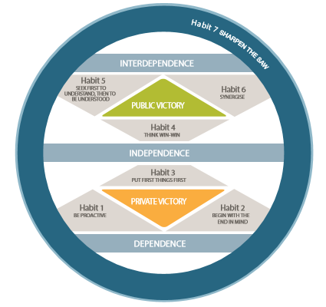
7 Habits of Highly Effective People
Notes:
No matter how competent a person is, he or she will not have sustained and lasting success unless they are able to effectively lead themselves, influence, engage and collaborate with others, and continually improve and renew their capabilities. These elements are at the heart of personal, team, and organisational effectiveness. The 7 Habits will enable you to intentionally align values, behaviours, norms and systems toward a central strategy where culture becomes a force to drive results. You will learn how to grasp the 7 Habits as a powerful tool for creating a great culture and model and reinforce the 7 Habits to create an operating system for effectiveness in your teams and school.

Slide 6
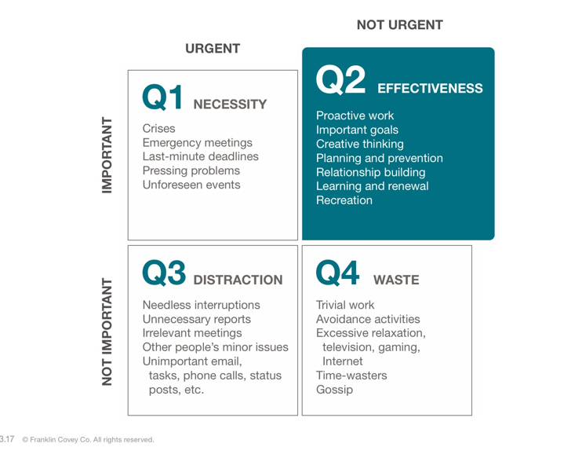
Notes:
Time matrix
Habit 3: Put First Things First
Habit of personal management
Even though other people influence which quadrant we are in, the Time Matrix is a system for personal accountability. One way to think about the quadrants is that Q1 and Q2 are important and “above the line,” while Q3 and Q4 are not important and “below the line.”
List the chronic Quadrant 3 activities in your day at school.
What can you do to reduce or eliminate these activities.
What Q2 activities can you plan into your week?

Slide 7
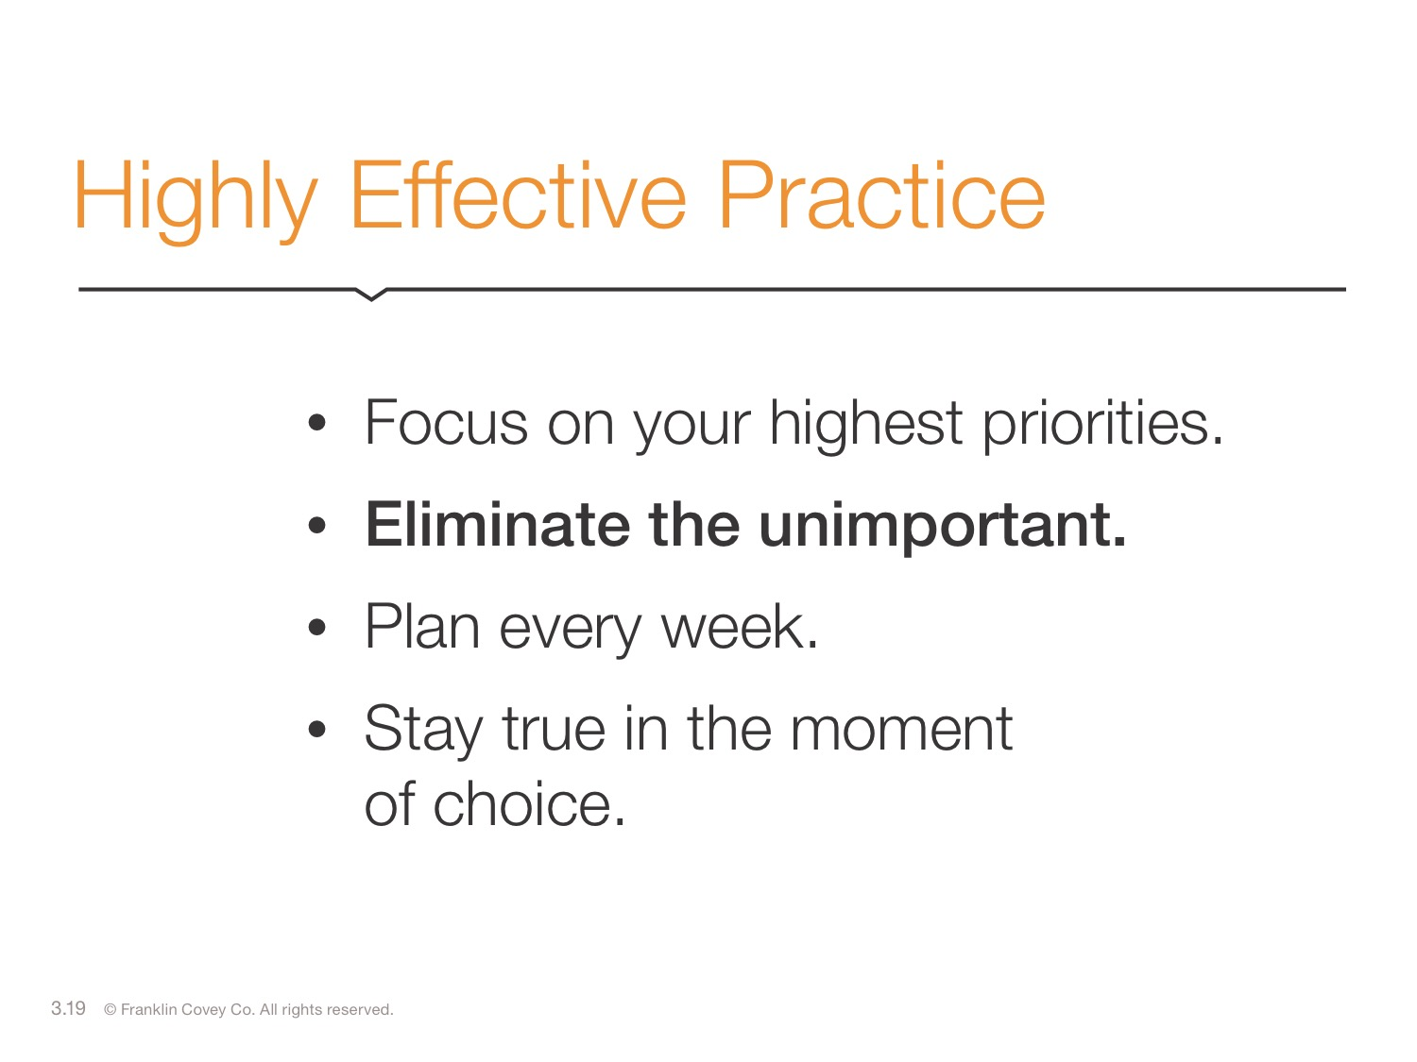
Notes:
State: Eliminate the unimportant.

Slide 8
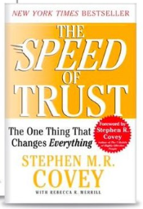
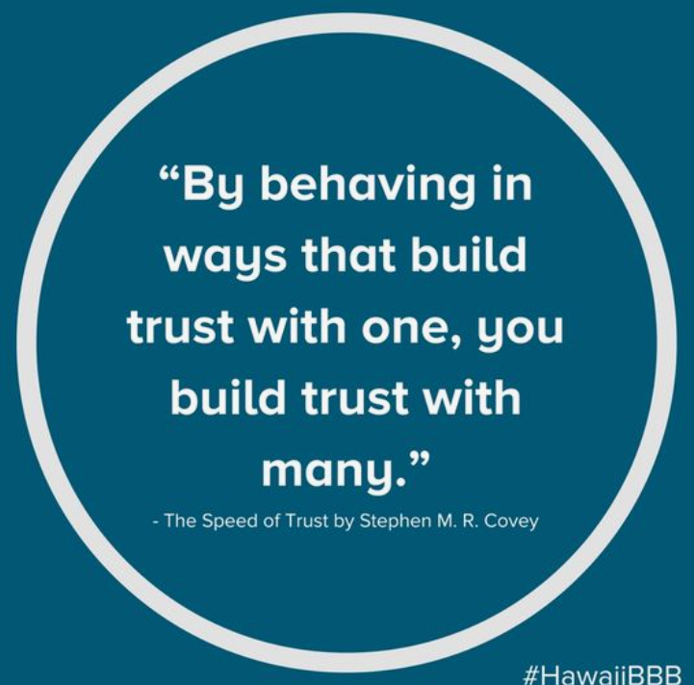
Leading at the Speed of trust
Notes:
With high trust, communication, creativity, and engagement improve. Trust is one of the most important aspects in today’s school environment and like any other discipline, creating trust is a learnable skill. With increased trust our attention is redirected towards improving student learning outcomes. Leading at the Speed of Trust will provide the mindset, skillset, and toolset that will measurably increase a participant’s ability to deliver results in a way that inspires trust.

Slide 9

I don’t know this person well enough
I tend to trust
I tend not to trust

Slide 10

When trust is low, suspicion is high, and communication is guarded. With high trust, communication, creativity, and engagement improve.
Trust is one of the most important aspects in today’s school environment and like any other discipline, creating trust is a learnable skill. Teams and schools that operate with high trust are significantly more effective than those who do not cultivate trust at the core of their culture.
Notes:
Self – increase our credibility to inspire trust
Relationship – consistent behaviour, build trust with others
Organisational – generate trust across teams/ school organisations, aligning systems and create structures that promote trust
Market – School reputation within your community. Reflects the trust the community has in your school.
Societal – creating values for others and society at large, it’s about contribution.

Slide 11
The Middle Leadership Imperative
Collaborative Professionalism
This course will address an extensive review of available research on middle leadership leading to an effective undertaking of the middle leadership role in NSW schools through the recognition that middle leadership is teacher driven, site responsive and encompasses team based professional learning.
The Middle Leadership Imperative
Middle Leading
Ideas in Action

Slide 12





N S W P P A
C O U R S E S T R U C T U R E
M I D D L E L E A D I N G
ML1 - MIDDLE LEADING FOR LEARNING
Leadership structure in schools Impactful middle leading
ML2 - MIDDLE LEADERSHIP PRAXIS
Considering context
The importance of culture
ML3 - MIDDLE LEADING AND MANAGEMENT
Interdependence Organisational
ML4 - THE LEADER
Leadership qualities Character strengths
C O L L A B O R A T I V E P R O F E S S I O N A L I S M
CP1 - COLLABORATION
Exploring collaborative professionalism
CP2 - TRUST
The five dimensions of trust Establishing trust within the team
CP3 - PROFESSIONAL DIALOGUE
Courageous conversations Relational dialogue
CP4 - THE ART OF MIDDLE LEADING
Team norms and bringing people on board The role of the leader
I D E A S I N A C T I O N
IA1 - THEORY OF ACTION
Developing a theory of action Action research
IA2 - IMPROVED CLASSROOM PRACTICE A
What does it look like?
The teaching and learning cycle
IA3 - IMPROVED CLASSROOM PRACTICE B
Digging deeper into the research Practice improvement at point of need
IA4 - CELEBRATING CHANGE
The impact of change Planning for the future

Slide 13

Purpose of the program is to improve the productivity, job satisfaction and overall sense of health and wellbeing of school principals
Is co-designed with Principals for Principals
Is a strategic and consciously designed experience to support principals through the process of embedding new work and lifestyle habits
Provides support and space for principals to work on their wellbeing

Slide 14

The Tao of Team
Notes:
The Way … the right Way ….. Tao

Slide 15
Creating, sustaining and energising an effective team
Stages of team development
Decision making models
Working in challenging teams
Essentials and enablers
Team communication and enablers
Coaching the team
Notes:
Effective teams are built around a clear and compelling purpose where trust and connected relationships enable an effective team culture. This program will work through the purpose and process of forming a team, creating a team culture and effective team practices. This is a practical and interactive program that will replicate team-creation and team-building practices as well as trust and connected relationships that are enablers of effective team cultures. Participants practise the skills learned and begin to apply these in their own workplace context.

Slide 16
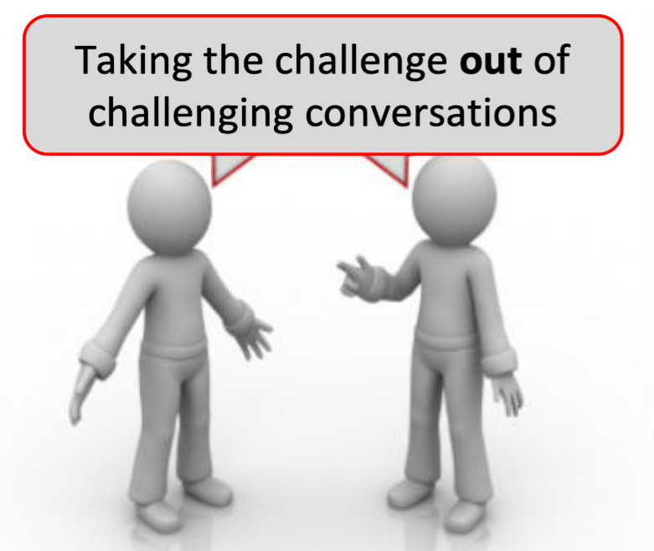
Powerful Performance Conversations

Slide 17
Principles of a powerful performance conversation:
•Performance, boundary, alignment, coaching conversations
Focus on what you want.
• Make the conversations about values and beliefs NOT about
behaviours.
• Maintain relationships with all parties
Notes:
This program will focus on the common features of challenging conversations that are critical for school leader effectiveness. This focus will include four conversation types; Performance, Boundaries, Alignment and Coaching conversations. Although some conversations require a certain level of assertiveness, the design of these conversations embodies the intent that each party in the conversation will leave it with greater clarity, a positive forward direction and with the relationship enhanced. The program is experiential and participants will practise the skills learned and begin to apply these in their own workplace context.

Slide 19
Support from local PPCs
Presidents/Delegates distribute professional learning information from State Council
Role of the Leadership Contact Person in each PPC in promoting PPA professional learning opportunities
Encourage engagement in professional learning programs

