Slide 1
State Treasurer’s Report to State council
Term 1 2020

Slide 2
Position as at 5th march
Name | BSB | Account number | Account balance
Conference | 062 262 | 1005 0470 | $ 245,609.56
General | 062 548 | 1020 2587 | $ 448,887.89
Professional Learning | 062 000 | 1933 5165 | $ 7,770.05
Business online | 062 900 | 1051 3465 | $ 440,604.29
Term Deposit | 062 649 | 5005 3981 | $ 600,000.00
 |  | TOTAL CREDITS: | $1,742,871.79
 |  | NET POSITION: | $1,780,981.65

Slide 3
reminders for your PPC treasurer
https://nswppa.schoolzineplus.com/form/7
GST information each quarter (Jul-Sep, Oct-Dec, Jan-Mar, Apr-Jun)
Copy of Annual Financial Report (Auditors Report) for 2019

Slide 4
membership
Website
New, relieving, changed schools
Lisa Beare
$600 ($23.07 fortnight) salary deduction
Rel/Act Princ - $150 a term

Slide 5
claims
Tuesdays
Kathy Rudd
“PPA Claim”
2020 claim form + receipts
Travel – car (tolls/parking), train, plane (direct/6 weeks), taxi.
Not – meals, insurance, mini bar, personal costs
Accommodation – booked through Mark Pritchard. $110 single supplement
Relief for teaching Principals ($500)

Slide 6
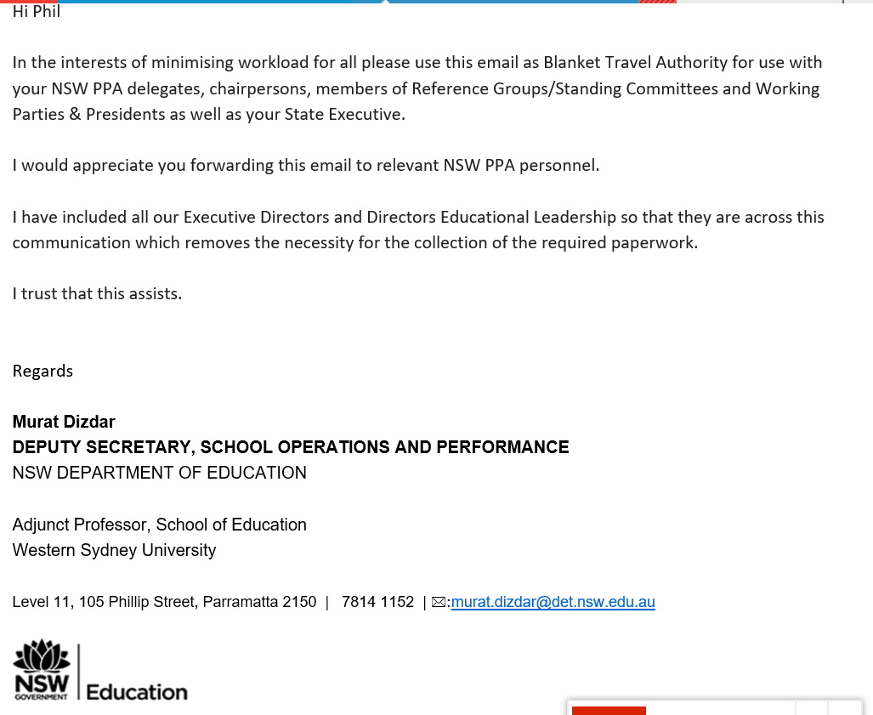

Slide 7
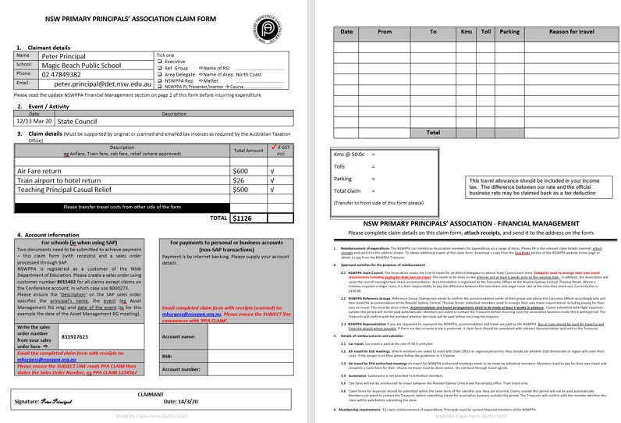

Slide 8
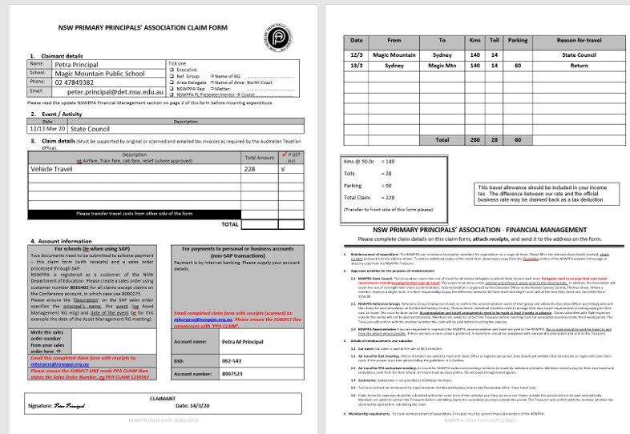

Slide 9
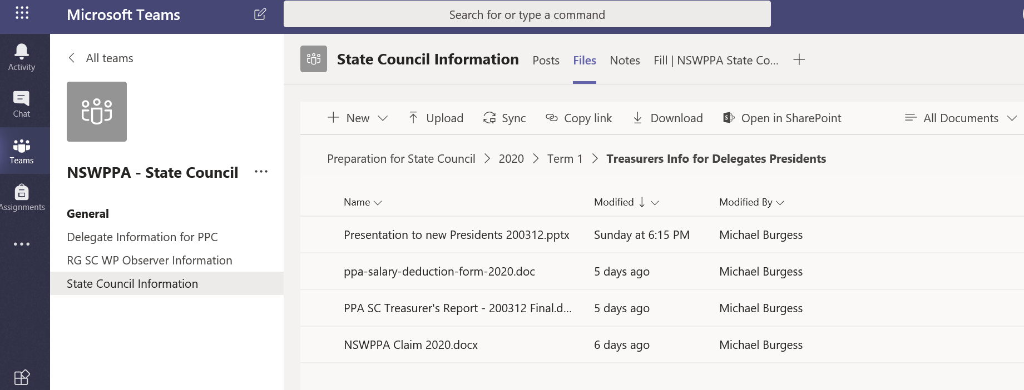

Slide 10
Contact
Michael Burgess – State Treasurer
Terrigal Public School
t02 43844599 m0439003072
michael.burgess@det.nsw.edu.au
Meeting with new Presidents & Delegates 4.15 this afternoon

