Slide 1
Schools Digital Strategy PPA State Council Presentation
Information Technology Directorate
11th June 2020

Slide 2


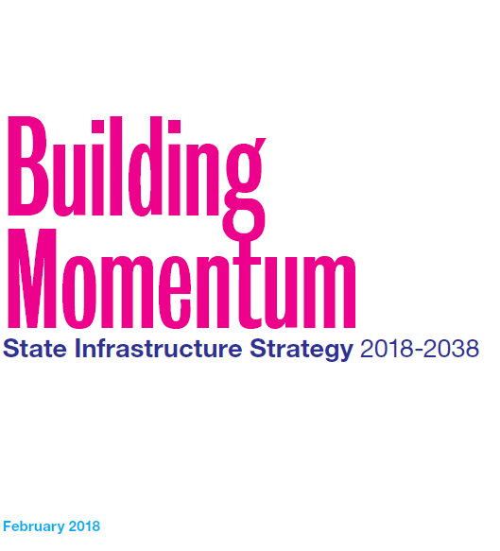
The NSW Government has placed Digital and ICT as a critical enabler for driving productivity, improving frontline service delivery and expanding economic opportunities, particularly regional communities
Introduction
Schools Strategy
COVID Response
COVID Learnings
Accelerating SDS
Rural Access Gap
Digital Divide
DaPCO Decision
We must aspire to improve our education system… “NSW schools have identified that they also need to find effective ways to integrate creativity in learning across the curriculum…. Young people are learning and developing skills in a changing economy which increasingly values creativity, innovation and critical thinking”.
“Rapidly advancing digital technologies will be a critical enabler of the productivity by expanding economic opportunities, particular regional communities”.
“Recommendation 107 Infrastructure NSW recommends that the Department of Education prepare a Schools Digital Transformation Strategy (2018-2025) in partnership with the Department of Finance, Services and Innovation”.

Slide 3
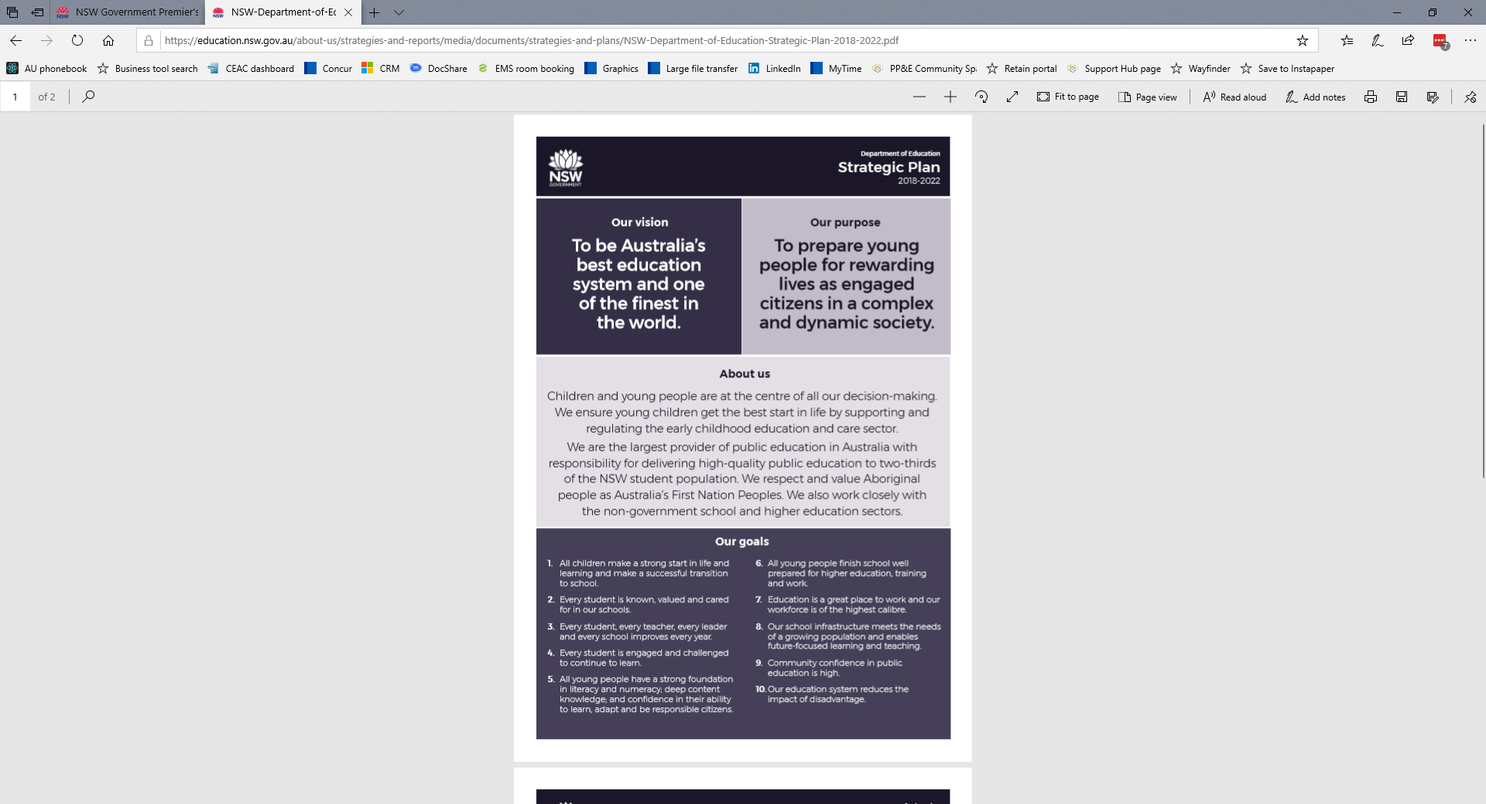

The NSW Department of Education Schools’ Digital Strategy (‘the SDS’) provided the strategic vision for the digital enablement of schools from now through to 2026
Introduction
Schools Strategy
COVID Response
COVID Learnings
Accelerating SDS
Rural Access Gap
Digital Divide
DaPCO Decision
The SDS is the Department’s response to the need to leverage digital effectively and to support student improvement and engagement.
We acknowledge that quality teaching is the primary factor in achieving student outcomes and, the Digital Strategy is primarily seen as an enabler to support teaching and learning. Where the SDS differs from previous strategies:
Is orientated to schools – It considers the demand side of digital in schools and aims to enhance and implement proven ‘what works best’ patterns
Recognises the importance of Agency – It respectfully addresses the digital needs of five persona’s; leadership, teachers, students, parents & carers and Administration support
Supports (or creates) bridges to address inequity – Seeks to ensure access to high quality content and create seamless connection in the network, and across the system
Utilises data to inform and support learning – It aims to place educational informatics and data to inform and support teaching and learning in real-time
This approach includes consideration of the PISA ICT 2021 framework, aiming to address the imbalance between major dimensions of ICT and educational digital resources. This covers, access to and use of digital to drive student outcomes across cognitive performance, well being, ICT attitude and competence.
The Premier’s Priorities include bumping up education results for children and increasing the number of Aboriginal young people reaching their learning potential.
The DoE Strategic Plan focuses on student engagement, preparing young people for education, training and work and reducing the impact of disadvantage.
In this context, the Schools Digital Strategy (SDS) has been developed as a direct response to the digital enablers and capabilities for students and teachers.
The SDS aligns to the Digital.NSW, Beyond Digital and Service.NSW strategies.

Slide 4
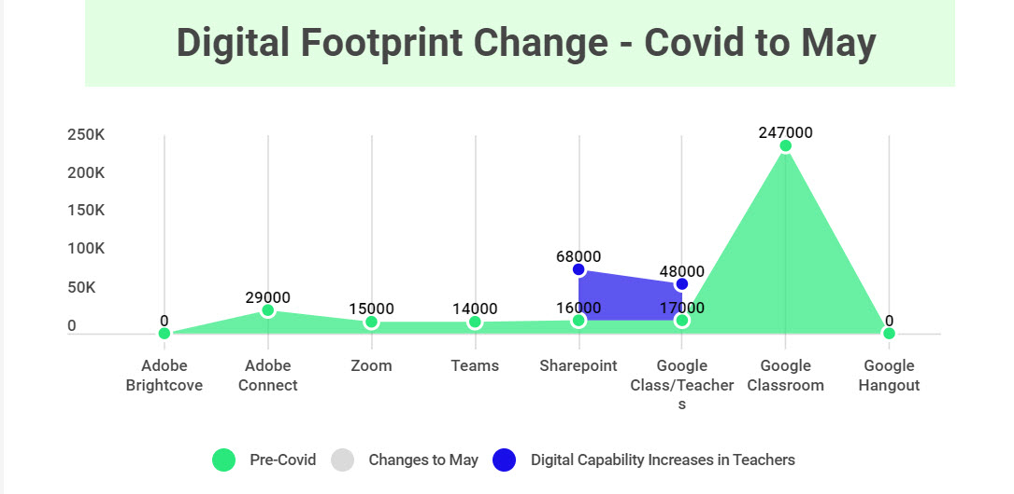
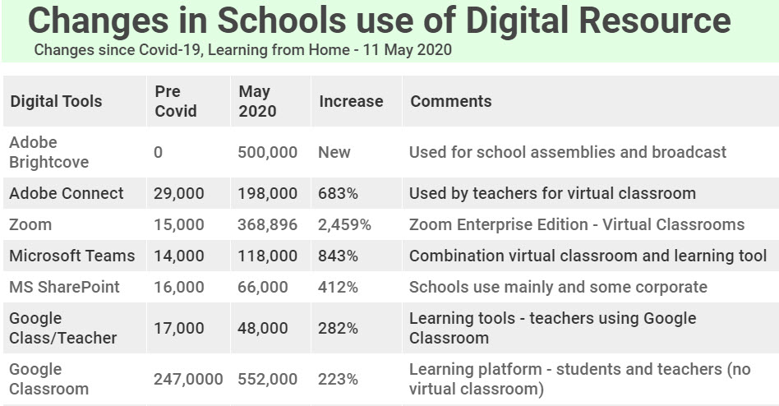
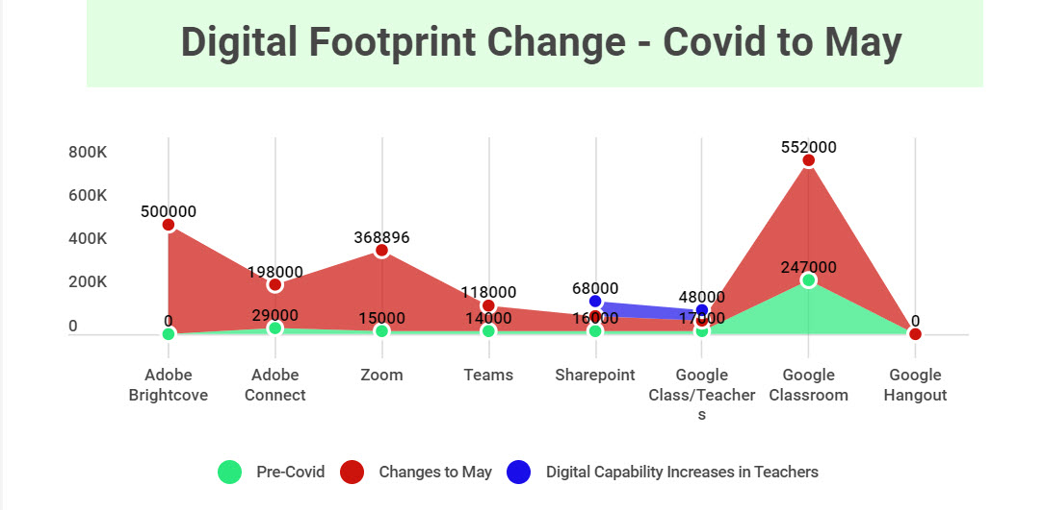
Three weeks of research under COVID accelerated the mobilisation work of the SDS by nine months
Introduction
Schools Strategy
COVID Response
COVID Learnings
Accelerating SDS
Rural Access Gap
Digital Divide
DaPCO Decision
The Learning from Home hub has shown what is possible by constraining choices of digital resources and learning tools to only high-value inclusions, crowd-sourced from teachers and supported by professional learning.
The approach with the SDS is to build on these COVID learnings and to go further on the standardisation front for an entire a school or a cohort (collective of similar schools types) to standardise on a learning platform. The most digitally mature and high performing schools have already rationalised their learning platforms to one dominant vendor (Google or MS Teams).

Slide 5
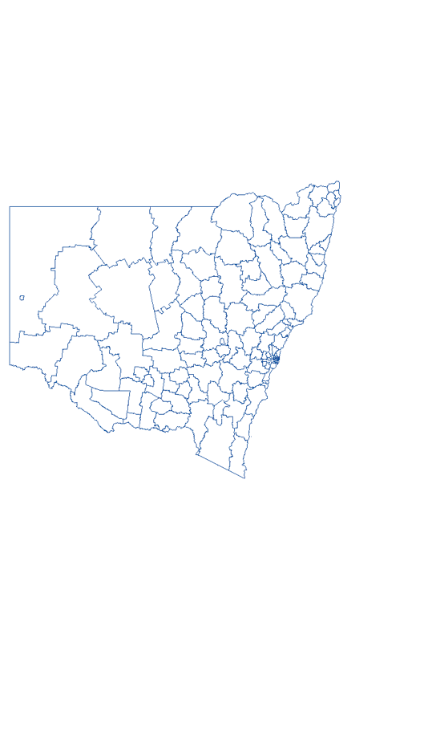
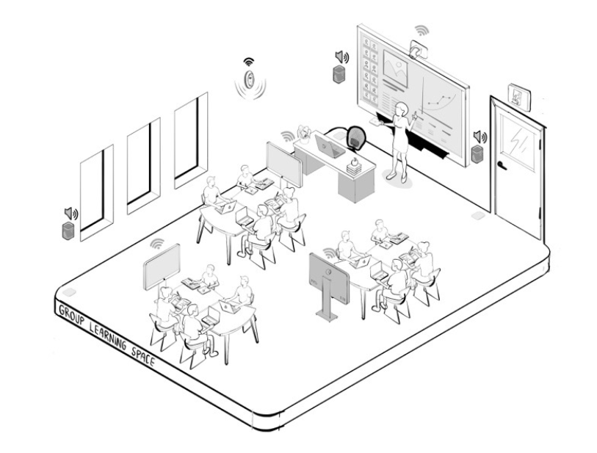
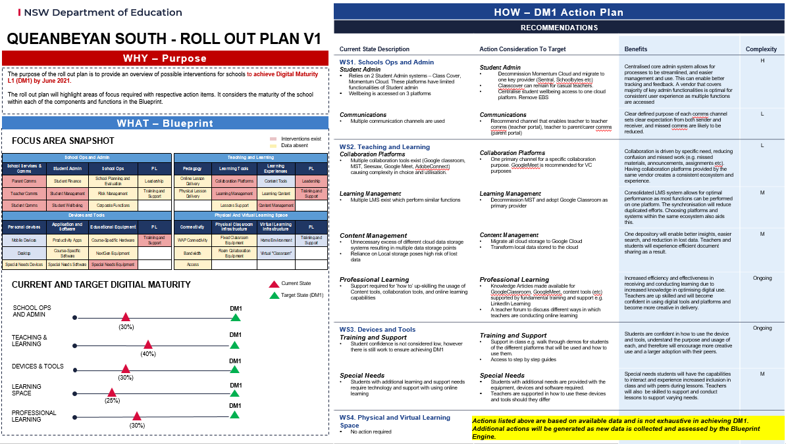
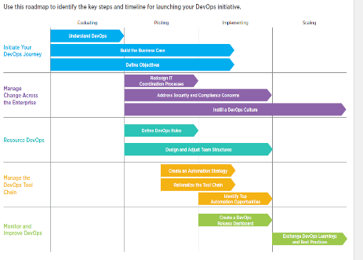
Driving consistency and best practice at scale whilst delivering incremental digital outcomes at speed
Introduction
Schools Strategy
COVID Response
COVID Learnings
Accelerating SDS
Rural Access Gap
Digital Divide
DaPCO Decision
Accelerating learning with digital in a structure approach using learning from COVID-19
1
Taking the cohorts across the 2200 schools in NSW…
2
… overlayed with the pedagogy approaches and learning modes…
3
…derives a School Digital Blueprint that defines the capabilities and systems across four domain areas…
5
These blueprints form the desired state for schools – driving a targeted state roll-out plan
2200 schools
SCHOOLS DIGITAL BLUEPRINT
D1. School Operations & Admin
D2. Teaching & Learning
D3. Devices & Tools
D4. Physical & Virtual Learning Spaces
Domain
Components
Capabilities
Enabler Patterns
E1. Digital
E2. Support
E3. Process
E4. Data & Insights
School Cohorts
Independent
Experiential
Guided
Explicit
Discussion
Collaboration
Demonstration
Feedback & Reflection
4
C1. Metro Secondary
C5. Metro Primary
… cut by four digital maturity levels.
C2. Rural Secondary
C6. Rural Primary
e.g.
“1,000 rural schools require 20,000 learning spaces to be fitted with modern web-conferencing infrastructure and learning platforms to support blended learning
C3. Distance-Ed
C7. Central
C4. Special Schools
C8. Small Schools
DM1
DM2
DM3
DM4
Lifting school’s digital maturity across the board at scale by 2021 – Horizon1

Slide 6
Rural Access Gap PPA State Council Presentation
A School Digital Strategy sub strategy
Information Technology Directorate
11th June 2020

Slide 7
Case for Change
Recent research completed as part of the Schools Digital Strategy (SDS) found that the divide between city and country schools continue to widen
Results (PISA, NAPLAN, HSC and Closing the Gap 2020) across core learning competencies continue to decline in rural and remote areas (growing gap in relative and absolute performance between metropolitan and regional schools)
While issues around isolation and access to resources remain a root cause, these challenges are being compounded by:
The longest drought this century and the current bushfire crisis
Aging distance education platforms
An inability to recruit and retain experienced teachers
Uneven levels of digital literacy
Increasing economic hardship
A Rural Access Gap Direct Intervention Package is proposed to address inequality and hardship experienced by schools impacted by the 9 key focus areas:
Remoteness and isolation
Economic hardship
High Indigenous populations
High levels of mobility and transience
Skills shortages
Limited access to disability services
Outdated distance education technologies
Low Programme for International Student Assessment (PISA) outcomes
Fire impact and remediation challenges
Notes:
Check animations

Slide 8
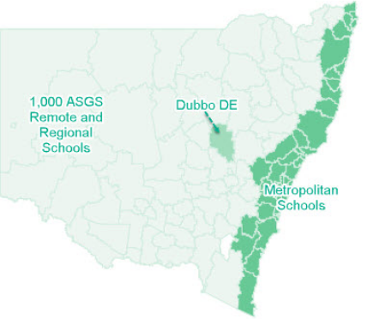
The Rural Access Gap business case was included with the Education Cluster Budget submission for 2020/21 as a NPP or as part of stimulus
Introduction
Schools Strategy
COVID Response
COVID Learnings
Accelerating SDS
Rural Access Gap
Digital Divide
DaPCO Decision
Key Messages:
The new DoE Rural and Remote (RaR) Education Strategy 2020-2025 builds on previous digital platforms enabled under the CCS Program, funded through Restart NSW.
The RaR focuses on bridging the isolation, inequity and disadvantage gaps, which have been exacerbated by the longest drought this century.
The RaR’s objective is to create a digital learning environment that enables peer-to-peer interaction, facilitates collaboration, and supports curriculum intervention and connectivity.
Secure and seamless access to digital tools and learning resources is required for students and teachers on and off school premises, to cater for the needs of distance education.
An initial focus is on schools in rural, remote & regional areas:
This includes all schools in the Australian Statistical Geography Standard (ASGS) areas classified as:
Inner regional Australia
Outer Regional Australia
Remote Australia; and
Very Remote Australia
In total, this encompasses approximately 210,000 students in 1,002 schools made up of:
763 Primary Schools
137 Secondary Schools
61 Central/Community Schools
2 Infants School
25 Schools for Specific Purposes; and
14 Environmental Education Centres & other schools.
The Regional Access Gap: Regional and metropolitan divide

Slide 9
Executive Summary
Rural Access Gap (RAG) investment and benefits summary
The Schools Digital Strategy (SDS) is designed to improve digital literacy and efficacy across the state. While the SDS covers all public schools in NSW, research has shown that there was a gap between the performance of metropolitan schools and that of regional schools.
The RAG estimated costs is $443M and will generate benefits of $1.4B over 30 years, resulting in a benefit cost ratio (BCR) of1.87 and net present value (NPV) of $671M. The capital component is $364M and operational costs are $79M.
Approximately $364M capital will be spent in the first 2 year during the construction phase ensuring that 1,002 rural and remote schools across NSW have equal access to digital resources and educational opportunities as their metro counterparts.
Further to the long-term economic benefits quantified in the CBA (1.4B), the RAG program is expected to provide significant economic stimulus benefits in terms of its direct and flow-on effects on employment, value added (i.e. wealth generation) and gross output across the NSW economy:
Support a total of around 5000 FTE jobs (including 1786 regional jobs directly created by the RAG capital spending) in NSW
Add around $560 million to NSW’s Gross State Product (including an estimated value added of $180 million directly associated with the RAG)
Contribute $1.08 billion to the NSW economy in terms of gross output.
The key benefits quantified for the program are:
Improvement in student performance as a result of better integration of IT into the school curriculum, shown in higher test scores and increasing lifetime earnings as a result;
Productivity increases from teachers and admin staff being able to streamline school administrative and teaching operations, freeing up time to be spent on other activities;
Time savings for parents who can monitor their child’s school performance and activities online, approve excursions and school activities online, and so forth;
Increase in teacher quality through greater access to training online and online support for classes when teachers are away on professional development courses;
Increasing resilience of student records by moving data to the cloud;
Improved quality of distance education in the event of school closures (such as the current pandemic COVID-19) by providing individual devices to students; and
More efficient use of professional support services for teachers, eg online training

Slide 10
Business Outcomes and KPIs
2020-21 Budget State Priority: Productivity enhancing reform
Outcome | Outcome KPIs and Targets | Proposal KPI | Proposal KPI Target
Equity | Target EQ1: Increase the proportion of Aboriginal students in NSW public schools in the top two NAPLAN bands for reading and numeracy from an average of 10% to an average of 15% by 2022 | Improved educational and social outcomes for Aboriginal and disadvantaged students | Target students below 10% average to catch up Target increase of 5% to achieve the 15% target
 | Target EQ4: Reduce the gap between the highest and lowest socio-economic status students in NSW public schools in the top two NAPLAN bands for reading and numeracy from an average of 41.7% to an average of 34.5% by 2022 | More intensive support for disadvantaged schools and students | Close gap of 7.2% between highest and lowest through direct intervention
Skills and Higher Education | Increase the proportion of young people (15-29 years) in NSW who are fully engaged in education, training or employment | Schools implement new approached to improving student outcomes | Direct Intervention will lead to increased life time earnings thus allowing a new increase for further training and skills. Uplift of 4% to 83%
Independence | Target EF7: Increase the proportion of NSW public school students continuing to Year 12 from 73.9% to 76.7% by 2022, and the proportion of NSW public school students' HSC results in the top two achievement bands from 34.6% to 35.7% by 2022 | More students have positive relationships at school and feel a sense of belonging | The Direct Intervention provides for more tailored and personal support with the underlying digital and collaboration platforms
School Infrastructure | Increased proportion of all classrooms in NSW public schools that are able to deliver contemporary learning through upgrades/refurbishment since 2017 | More effective teachers in classroom | All 20,000 learning spaces will be upgraded to support Teachers. Less admin tasks, access to rich resources, remote support available for instruction.
Wellbeing | Target EF2: Increase the proportion of NSW public school students attending school at least 90% of the time from 79.4% to 82.0% (primary) and from 64.5% to 70.0% (secondary) by 2022 | More intensive support for disadvantaged schools and students | Access to welfare, professional support via web-conferencing. Increasing efficacy and confidence build self-esteem.
 | Target EF2: Increase the proportion of NSW public school students attending school at least 90% of the time from 79.4% to 82.0% (primary) and from 64.5% to 70.0% (secondary) by 2022 | Improved student engagement and attendance | Support for homesteads and remote communities with upgraded communications would improve attendance. More time available for follow up and use of collaboration tools to bridge isolation.
Academic Achievement | Target EF6: Increase the proportion of NSW students at or above the proficient standard in international assessments from an average of 58% to 63% in PISA and from 71% to 76% in TIMSS/PIRLS by 2021 | Overall quality of teaching and learning improvements | Process and productivity improvements, access to high quality resources and investments in Teachers' PL/PD will see increases in student outcomes
 | Target EF4: Increase the proportion of NSW public school students achieving expected growth in reading and numeracy from an average of 62.3% to an average of 66.4% by 2022 |  | Access to high quality teaching and support resources. Improved discovery of excellence programs - with better searching and discovery to support key learning areas.
Notes:
Check animations

Slide 11
Executive Priority Programs (EPP), Initiatives and KPIs
EPP | EPP KPIs and Targets | Proposal Alignment
Improve School Performance and Student Outcomes | Reduced School days lost due to absence (daily average) | More students have positive relationships at school and feel a sense of belonging. The Direct Intervention provides for more tailored and personal support with the underlying digital and collaboration platforms.
Improve Teaching Quality | Increased percentage of DoE professional learning courses that meet quality assurance standards | The proposal will introduce tailored PD and on the job training relating to new digital resources and digital learning environments
Strengthen School Leadership | Increased retention rates for principals | Increasing support for teachers both within the school and remotely will overcome isolation. New collaboration platforms will all for new professional networks to develop - staff to feel more supported. Increase efficacy will promote confidence.
Improve Systems Support to Schools | A 20% reduction in the time principals spend on administration | Digitising and assisting school leaders to adopt "What Works Best" will assist with administration processes and overcome choice fatigue
 | Increased levels of automation | Digitising and assisting school and teachers leaders to adopt "What Works Best" at the school level and in the classroom will assist with improving administration processes and giving time back for student outcomes
 | Improved feedback from principals for all new systems rolled out to schools, and the support they receive on finance and human resources | Improved support desks and feedback mechanisms and communities or practice to assist with HR/Finance and teaching support
Make the Department a Great Place to Work | Increase overall employee engagement score to 75% by 2022 | The proposal will introduce tailored PD and on the job training relating to new digital resources and digital learning environments. This will build efficacy, reduce feeling of isolation and staff wellbeing
2020-21 Budget State Priority: Productivity enhancing reform
Other Initiatives and Priorities | Details | Proposal Alignment
State Infrastructure Strategy 2018-2038 | Recommendation 107 and 106 | Develop a Schools Digital Strategy to support all needs of teachers and students
Other relevant government priorities | NSW Customer Service Digital.NSW | The Schools Digital Strategy support Digital.NSW and Beyond Digital aspirations
Regulatory, legislative requirements and policies | Gonski recommendation to address disadvantaged in regional, rural and remote areas | Needs based assessment to address gaps in learning and well-being outcomes, addresses equity of opportunity challenges
Regional and Local Education Context | Closing the Gap 2020 for NSW indigenous students in remote areas, address disadvantaged and externalities of drought on regional, rural and remote areas | Mobility and disruption to normal classroom attendance, opens opportunity to tap into resources in metro schools. Contribute to achieving national targets – Close the Gap 2020 (Feb 2020)
Notes:
Check animations

Slide 12
Local Jobs Component
Logical Jobs Component | Units | WBU | Hours | Days | FTE Jobs | Year1 | Year 2
IT Productivity Trainings - Teachers Devices | 20,000 | 4 | 80,000 | 10,000 | 364 | 182 | 182
Contractors to fit out - Learning Spaces | 20,280 | 8 | 162,240 | 20,280 | 737 | 369 | 369
IT Installation - Schools - T&L and Hardware Installation | 1,000 | 80 | 80,000 | 10,000 | 364 | 182 | 182
Satellite and Construction Jobs | 10 | 1,200 | 12,000 | 1,500 | 55 | 27 | 27
IT Logistics and SOE - Student Devices, Logistics | 52,000 | 1 | 52,000 | 6,500 | 236 | 118 | 118
Internet at Edge - installation | 627 | 11 | 6,584 | 823 | 30 | 15 | 15
Local Jobs Created |  |  | 392,824 | 49,103 | 1,786 | 893 | 893
Local Jobs Component
The RAG business case will create 1,786 local jobs in regional, rural and remote districts over the two year construction period, equivalent to 893 full time roles per project year.
Roles such as: IT Training, IT Installation, Electrical and Cabling, Construction, Data Remediation, Delivery and Logistics, eSafety and decommissioning.
Additional professional and teaching internal roles will be created and are not counted in the jobs above.
Notes:
Check animations

Slide 20
Connecting Metro Schools PPA State Council Presentation
A Schools Digital Strategy sub strategy
Information Technology Directorate
11th June 2020

