Slide 1
Language, Learning and Literacy (L3)

Slide 2

Language, Learning and Literacy (L3)
L3 review
In 2019, Centre for Education, Statistics and Evaluation (CESE) commenced a review of L3.
The aim of CESE’s review was to examine the design, content and implementation of L3.

Slide 3
What other programs were utilised alongside L3?
In 2019, 84% of L3 schools reported using additional programs
During fieldwork interviews, schools identified using the following programs:
Accelerated Literacy
Ants in the Apple
Daily Five
Get Reading Right
Jolly Phonics
Letter Land
MiniLit
MultiLit
Big Write
Read Write Inc.
Sentence a day
Seven steps to
Writing Success
SPELD
Spelling Mastery
Step by Step Writing Rescue
Focus on phonics
Focus on writing

Slide 4
Language, Learning and Literacy (L3) Review
Summary of findings
Three in every five schools reported using L3 in 2019 and implementation of L3 varied considerably between schools. In addition, 84% of these schools reported adopting other programs alongside L3.
Teachers reported that a key strength of L3 was a substantial change in their knowledge, practice and confidence. Many were impressed with the training model, especially the in-school coaching.
Teachers reported that some of the L3 strategies were time consuming and challenging to implement, with some students needing more support than L3 offers.
While L3 drew on some research, it did not draw on the full range of available research into early literacy teaching, especially research that emphasised the use of code-based approaches.
L3 provides only limited ‘systematic’ teaching and a form of ‘explicit’ teaching that is not consistent with current best practice, especially with regards to phonics and phonemic awareness.
Over time, L3 shifted away from being a closely monitored and targeted intervention to being perceived as a general literacy pedagogy suitable for any school.
The demand for teacher professional learning in literacy has driven the use of L3.

Slide 5
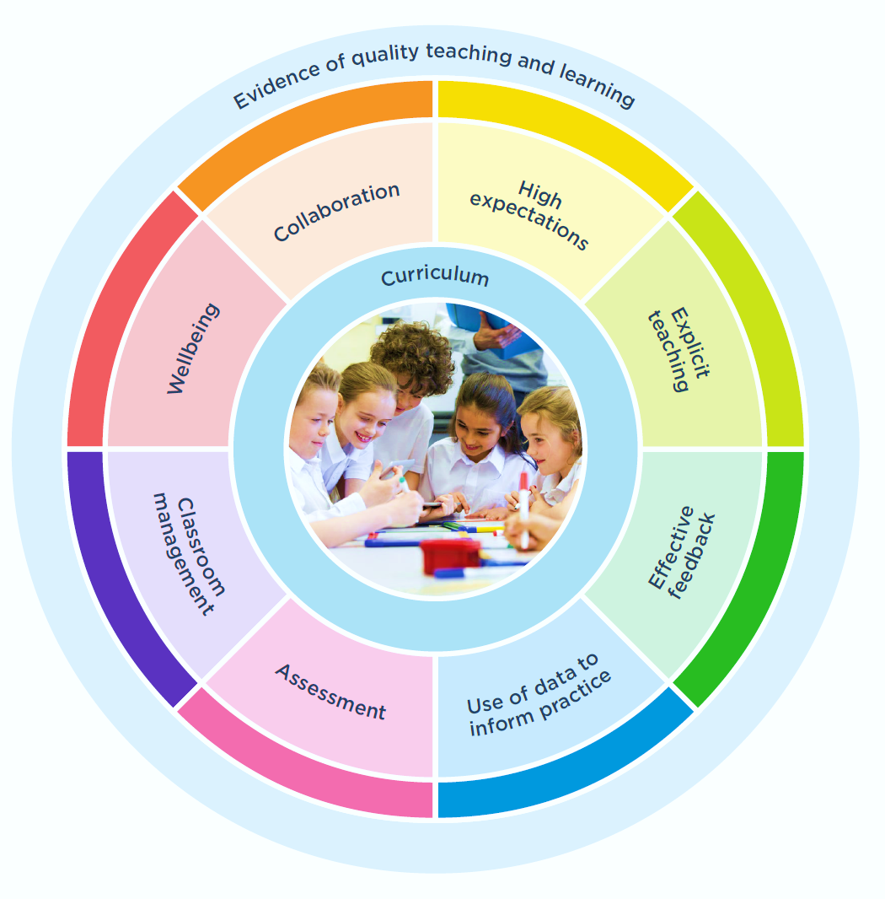
Students need to look at print at the word level
Search for meaning
Use background knowledge
Ask/answer as we read to make sense
Aim: Bring meaning & sense to the text – rather than decoding using letters & words
Use a known word to get to an unknown word
‘Interesting Clay (1982) found no developmental sequence apparent in her records of proficient readers emerging and changing behaviours….’
NSW syllabus and National Learning Progressions are a developmental sequence.
L3 does not adequately reflect the phonemic awareness or phonics components in CESE’s ‘Effective reading instruction’ literature review. L3 does not include a method for teachers to systematically structure the introduction of alphabetic code-breaking skills.
When moving from oral to written language the most important thing we can do for students is to teach them about the codes, so they can access language they already know.
Explicit teaching practices involve teachers clearly showing students what to do and how to do it, rather than having students discover that information themselves.
Students who experience explicit teaching practices make greater learning gains than students who do not experience these practices.
The Review found that L3 professional learning provides teachers with limited exposure to explicit teaching research and that it is not consistent with current best practice.

Slide 6
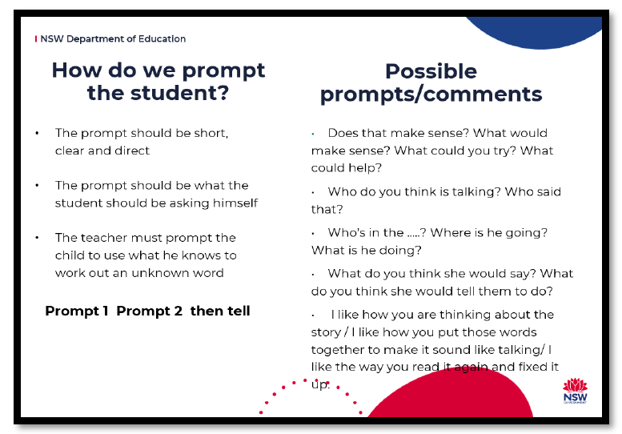

Slide 7


