Slide 1

Acknowledgement of Country
I would like to acknowledge the many Lands on which we meet today and to pay respect to Elders, past and present. I also recognise the importance of the work we do in helping to fortify the cultural identity and life opportunities of our Aboriginal Elders of tomorrow, our Aboriginal students within our classrooms across NSW. I would also like to pay respect to Aboriginal and non Aboriginal peoples joining us today, in acknowledgement that Australia's rich and diverse history is shared by our nation and together we can deliver the difference with our community for our shared future.

Slide 2
Aboriginal Education and Communities Directorate Update
Karen Jones
Executive Director
Aboriginal Education and
Communities Directorate

Slide 3


Partnership Agreement 2020 -2030
Walking Together, Working Together
The launch and signing was to occur in March 2020 to coincide with the NSW AECG AGM. Due to COVID-19 this has been postponed until 23rd October 2020 and will be in a virtual format.
Partnership Agreement sketch video:
  is about 3 minutes in length
  is targeted at an external audience
  has a primary goal of showcasing the importance of the upcoming Partnership agreement ( including a few key important figures who will be signing the agreement)
  target delivery date of October 2020
  is intended for use online/in presentations.

Slide 4
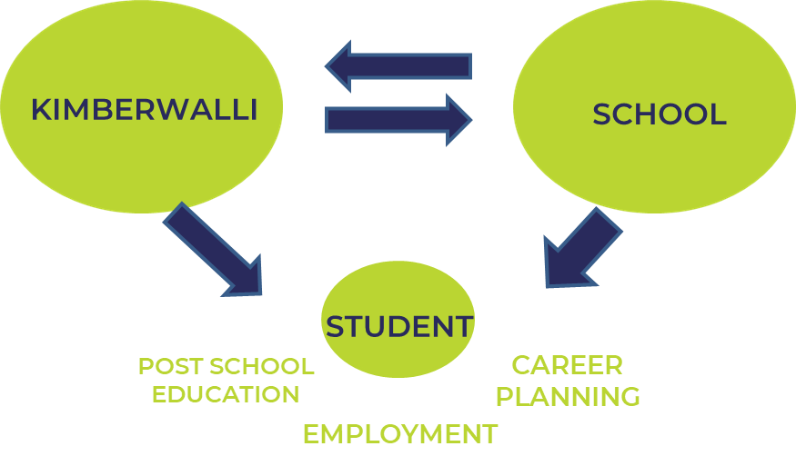
Kimberwalli Transition to DoE
What is Kimberwalli?
Located in Whalan, Kimberwalli is a unique initiative that supports young Aboriginal people in Western Sydney transition from school to further education, training or employment. Kimberwalli seeks to collaborate in new and innovative ways with community, business and government to support our young leaders to shine brightly and ensure Aboriginal people, their families and communities are at the forefront of economic development in Western Sydney.
We play an important role working with community, schools, industry and corporate partners to deliver post school pathways to learning, skills and employment.

Slide 5
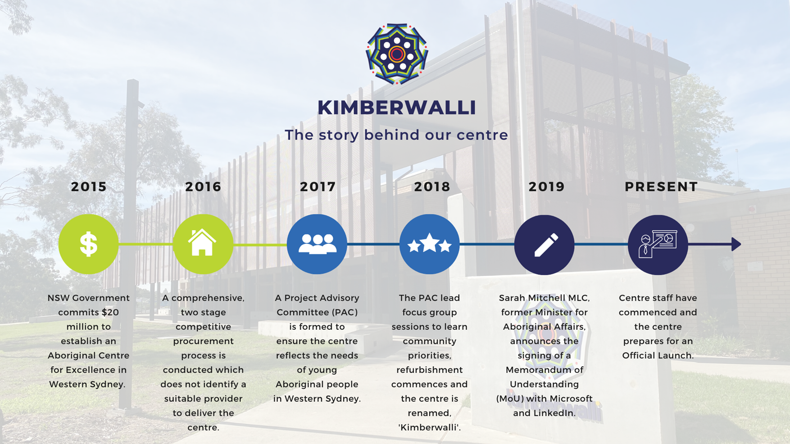
Kimberwalli Transition to DoE
The Kimberwalli story

Slide 6
Policy, Research and Engagement Team Update
Tanya Neal
Director, Policy, Research and Engagement

Slide 7
Language And Culture Nests
Bundjalung Community Language Program
​In consultation with the NSW AECG, the Department are piloting a Community Language Program in the Bundjalung Nest
This pilot aims to be further developed as a model for other Nests to support community members with Language and Culture
The program currently runs for 10 weeks and includes an On Country visit
The program complements the NESA Scope and Sequence K-10

Slide 8
Early Years Language and Culture Grant initiative
  ​The Policy, Research and Engagement team, in conjunction with Early Learning and Primary Education and Early Childhood Education areas, is delivering grants for Aboriginal Language and Culture teaching to government preschools across NSW.
  Funding will be made available to all Departmental preschools across NSW with a high enrolment number of Aboriginal students for the purpose of engaging a community member or organisation to deliver the Aboriginal Language and Culture program to students.
  A public call for Expressions of Interest will be made and preschools selected on the basis of program objectives, proposed model of delivery, ability to deliver, and geographical/linguistic program distribution.
  $300,000 will be provided by AECD with a further $60,000 provided by Early Learning and Primary Education.
  Grants will be for the amount of $10,000 (to a maximum of $30,000 for preschools with more than one class), and funding will run over the course of 2021.
  Reporting will be termly, as well as a mid-year and end-of-program evaluation.

Slide 9

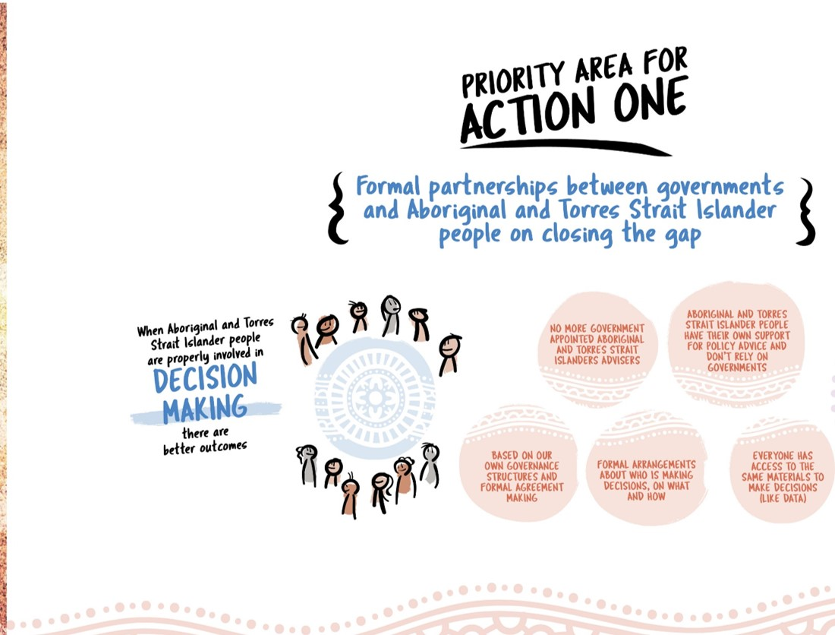

Closing the Gap Agreement

Slide 10
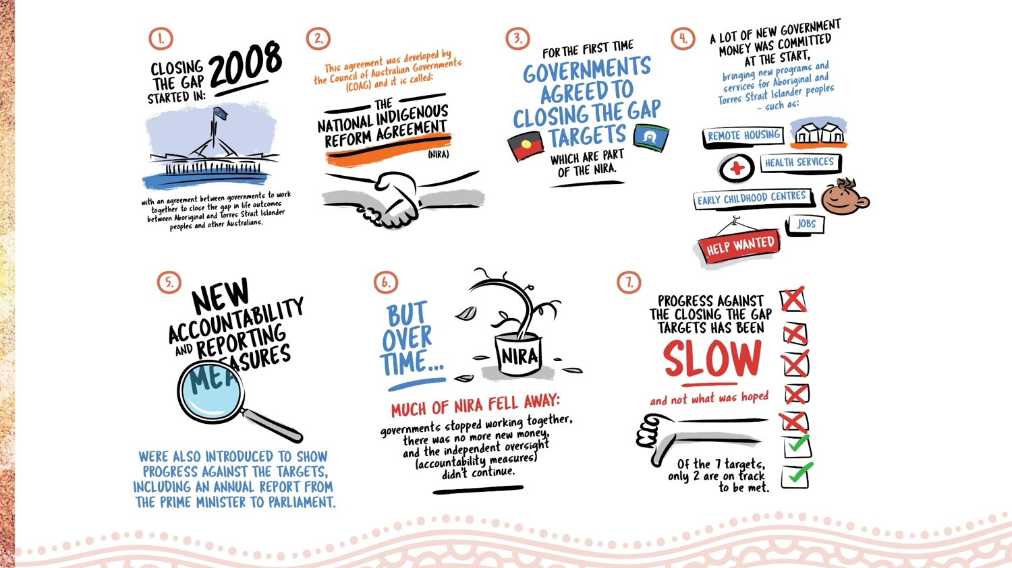

Slide 11
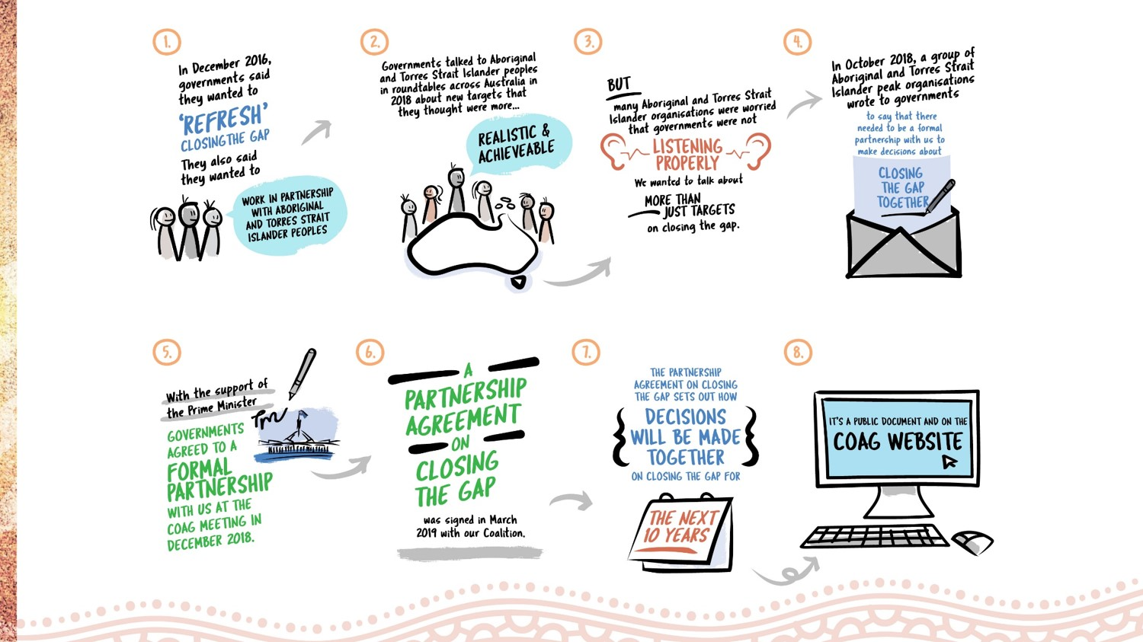

Slide 12
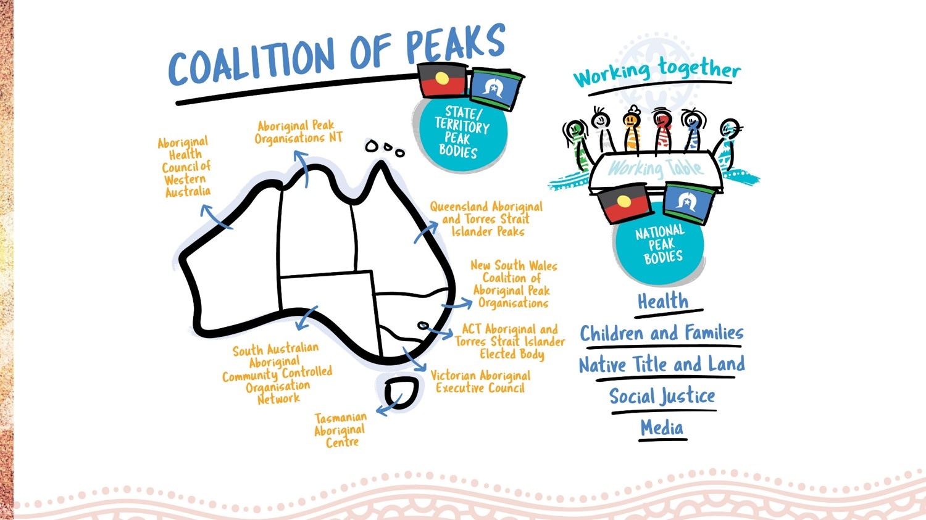

Slide 13
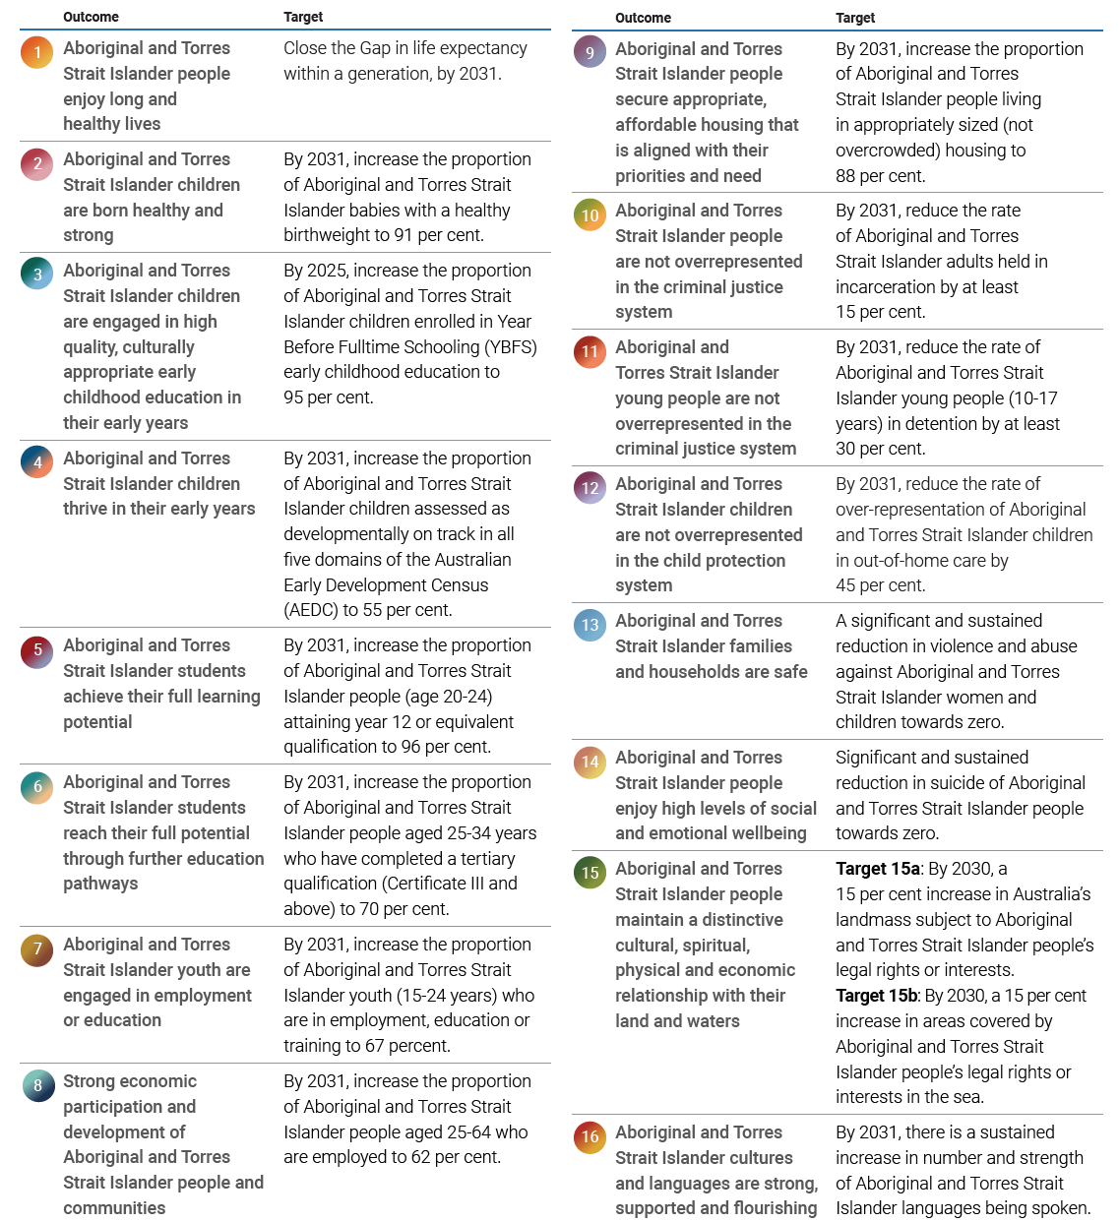

Slide 16
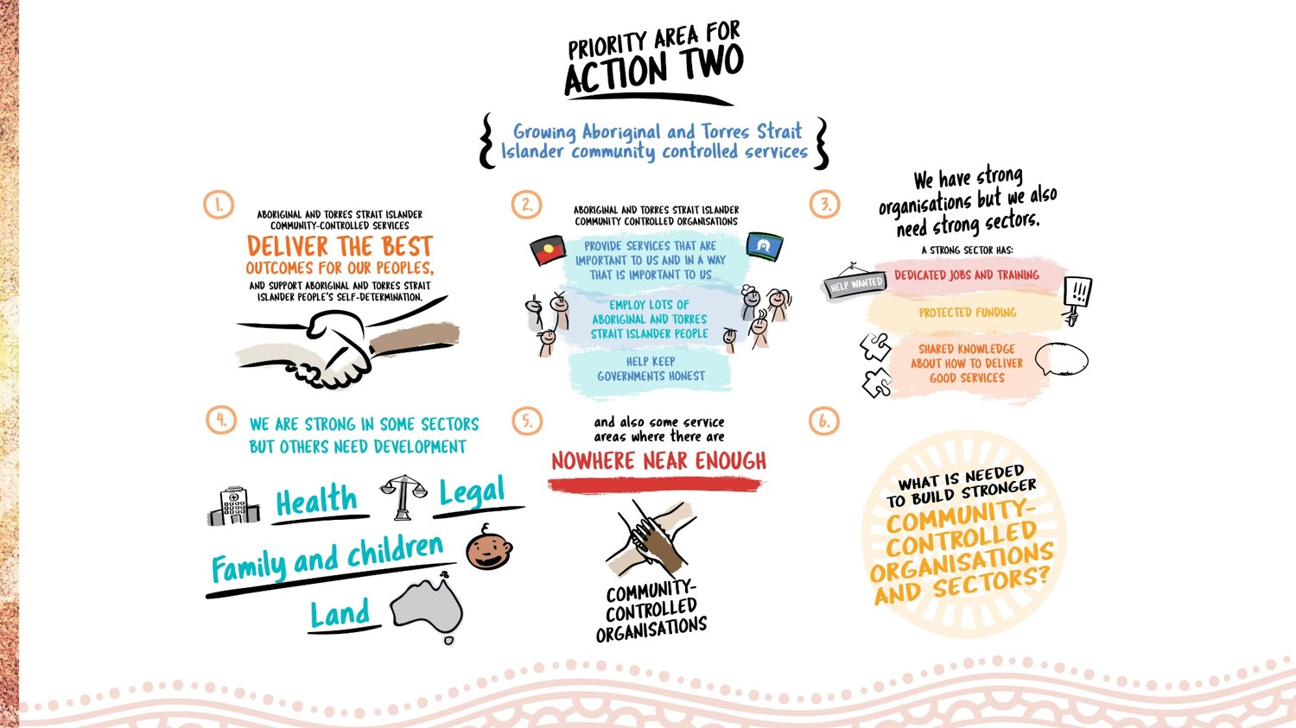

Slide 17
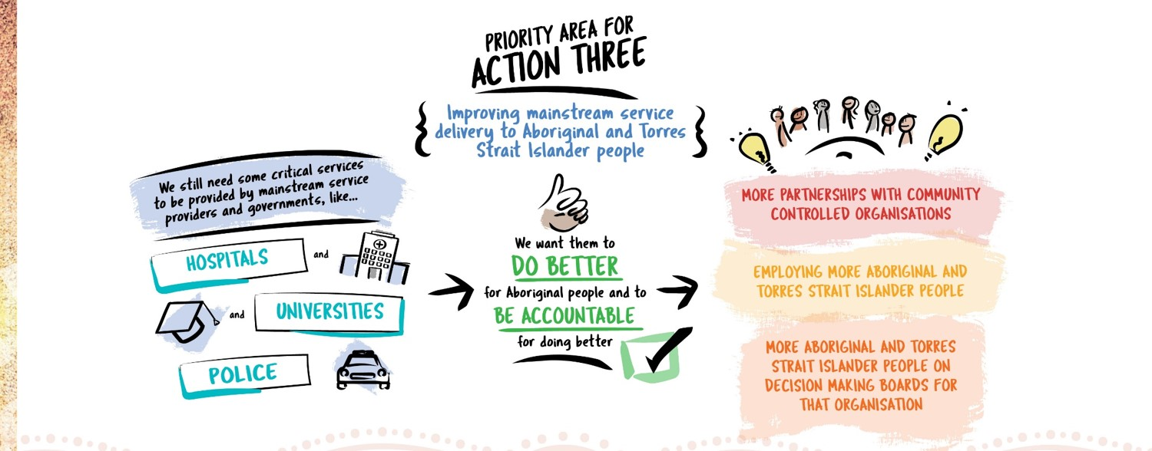

Slide 18

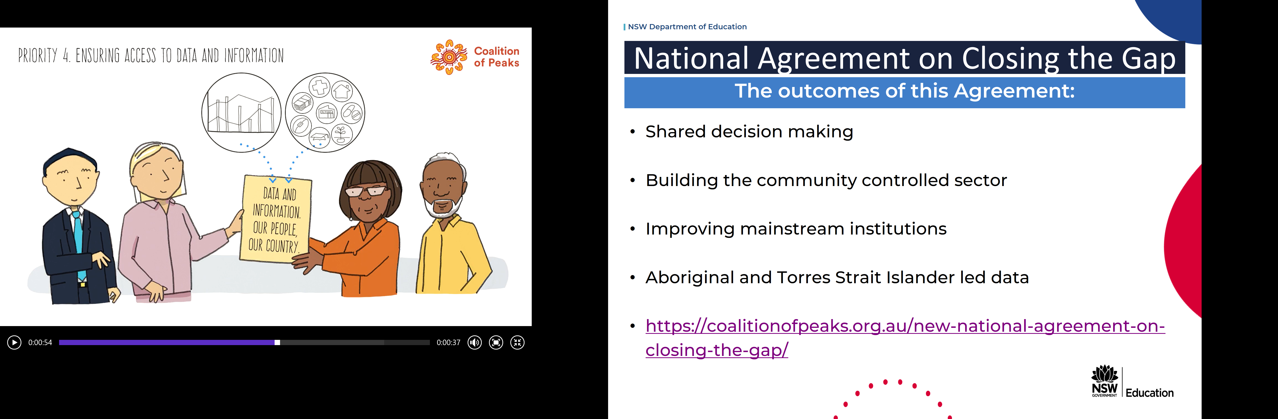
FOUR
Ensuring Access to Data and Information

Slide 19
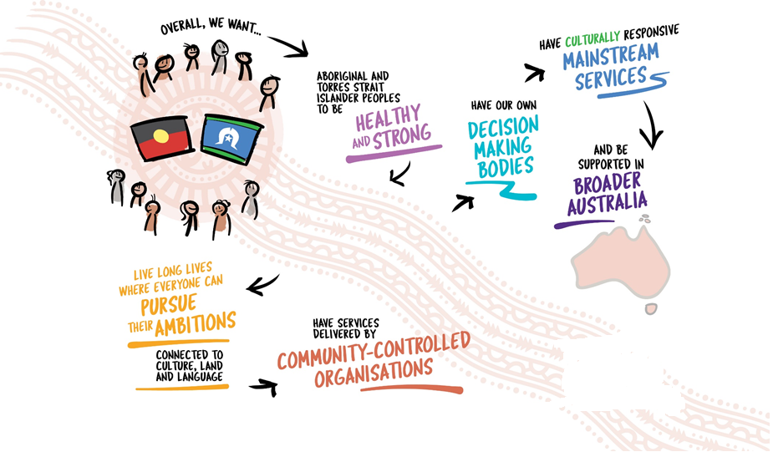

Slide 20
School Strategy Team Update
Karen Jones
Director, School Strategy

Slide 21

NEXT STEPS
K-6 Focus Aboriginal student wellbeing and engagement | AECD has recently created an Executive Priority, Wellbeing Work Stream, with a focus on Aboriginal student wellbeing and engagement. NSW PPA to provide support and advice to the Project Reference Group through the provision of two points of contact for this group, to be advised.

Slide 22

NEXT STEPS
NEXT STEPS | GETTING IT RIGHT…. BASELINE DATA Understand and address students’ points of disengagement K-6 and links to School Excellence Framework and Wellbeing Frameworks Ensure clear baseline data to derive insights and interdependencies across a range of student wellbeing areas to design and plan support Research and data that identifies what works best for Aboriginal students in wellbeing and cultural identity areas K-6 WHERE TO NEXT…. Analysis of granular data to identify targeted schools as high potential for additional support with DELS and Principals. Design strategies, resources and programs to provide early support to identified drivers of positive student wellbeing and engagement.

Slide 23

Aboriginal Education State-wide Staffroom Initiative
Benefits of Aboriginal Education State-wide Staffroom | Currently 884 members and growing Tailored service - each new member surveyed for interest and resources, daily posts and yarn ups reflect these interests. Fortnightly live virtual yarn up on topics such as Identity Reconciliation, Aboriginal history, best practice working with families and communities, interviews with colleagues and contemporary resources. Next week’s yarn up will feature an interview with Paul Byrne, President, NSW PPA discussing the importance of working with Aboriginal families.

Slide 24
Strategic and Leadership Initiatives
NSW Leadership Credential Module 20 Leading Aboriginal Education | NSW Leadership Credential, entitled "Leading Aboriginal Education“ currently under development. AECD will be seeking NSW PPA consultation on module content in Term 4 2020.
NSW Aboriginal Education 10 Year Strategy | NSW PPA Aboriginal Education Reference Group has provided consultation throughout Term 2 and 3, 2020 to support the initial planning of a DoE 10 Year Aboriginal Education Strategy.
NSW Aboriginal Teacher and Executive Career and Leadership Survey | 700 survey responses received Term 3, Week 6, 2020 from a state-wide Aboriginal teaching and executive staff “Leadership and Aspiration Survey”. Survey results will be used to develop a strategic response to inform future strategies, leadership and development opportunities for Aboriginal staff.

