Slide 1

Presidents Report
Term 3 State Council

Slide 2
President’s Report
Welcome
COVID
Hectic beginning of Term & following weeks has continued and has been exacerbated in our border areas
Both northern & southern borders have their issues getting students & staff back into NSW. There have been exemptions made for HSC students and staff but we have had at least 270 staff stuck in Qld…. Very tough on students “outside the bubble”. Casual costs??
We’ve continued to have schools with COVID positive – DoE supportive processes. ED Sylvia Corish will talk to over State Council.
We have spoken to both the Minister & Dep Secretaries about the guidelines
Too ambiguous, too much, little time to implement & the impact on schools, particularly SASS of the “negative test result” requirement

Slide 3
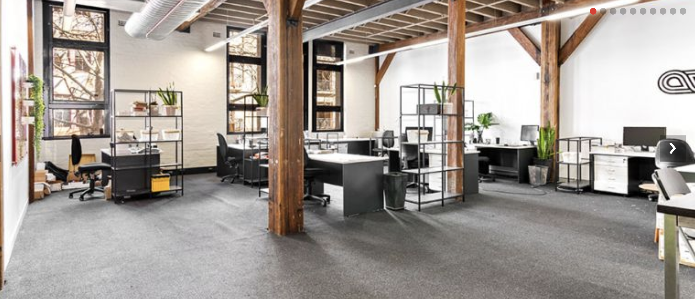
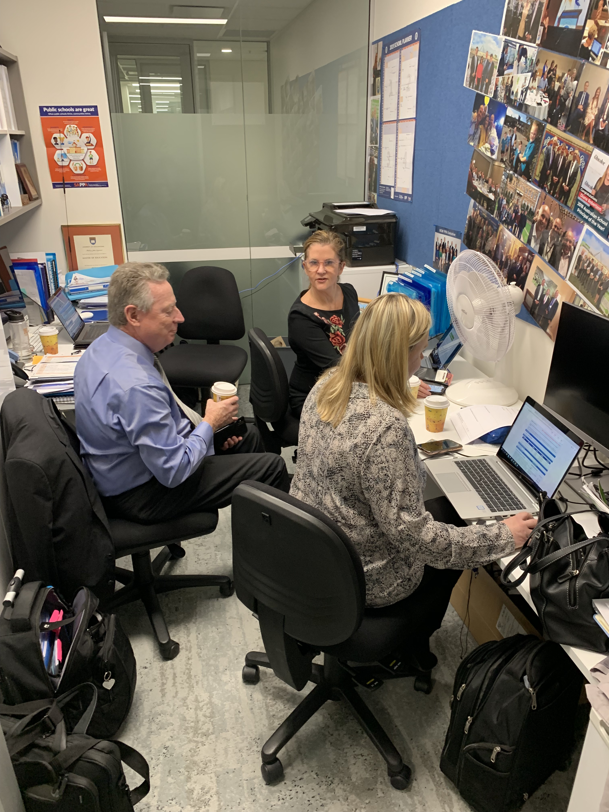
President’s Report
A home for Us

Slide 4
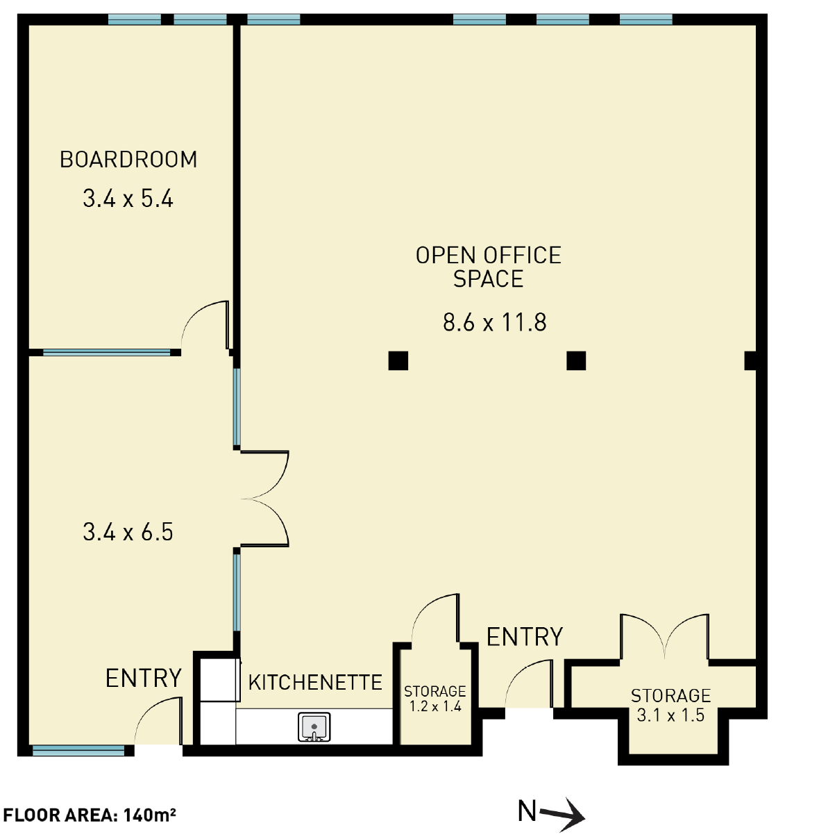
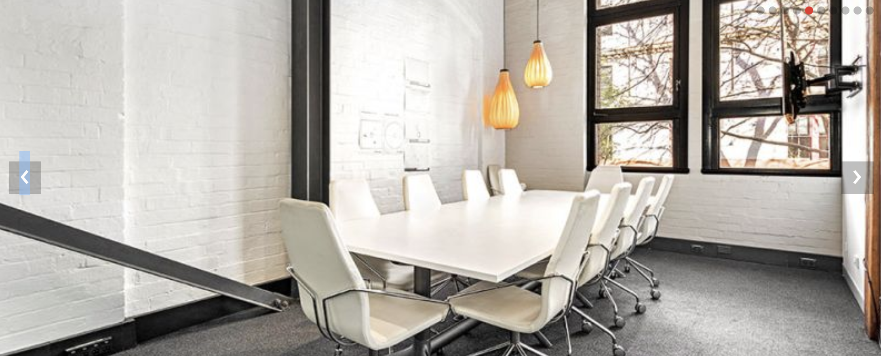
President’s Report

Slide 5
President’s Report
Motion:
That the NSWPPA purchases a property in the Sydney CBD in close proximity to the Novotel Sydney Central and Central railway station to a maximum value of $1.5m including any necessary internal fit out and the purchase or lease of any associated parking spaces.. No loan agreement should be entered into at this stage.
This administration space should be large enough to meet the needs of an individual office for the President, a minimum of four shared office/desk spaces, at least two meeting rooms large enough to house 14 people, and another meeting space large enough to house professional learning for 30 people. There also should be a fully functional kitchen area. At least two associated parking spaces should be available in close proximity to the property.
In the first instance it is recommended that the NSWPPA purchase the property known as C1.04 and C1.05/22-36 Mountain Street at a cost of $1.1m.
If this space becomes unavailable, other properties should be investigated by the NSWPPA Executive and purchased within the next six months."

Slide 6
President’s Report
Disability Strategy – Inclusion statement
  DoE recognises various sites that are there to meet the need of our students
  Now to work on policy statement & resources
  I’ve included a link in my report that you need to explore
Student Behaviour Strategy
  This is a consultation draft following in depth research by Prof Donna Cross and The telethon Kids Institute
  DoE has been “hammered” in the Ombudsman’s report in 2017 & the Upper House Inquiry.
  There has been an outcry in the media over the number of Kindergarten students suspended & the number of students with a disability suspended.

Slide 7
President’s Report
SHORT SUSPENSIONS
Year | Boys | Girls | All | % students
2019 K-2 | 2084 | 301 | 2385 | 1.15
2019 3-6 | 5846 | 1046 | 6892 | 2.4
LONG SUSPENSIONS
Year | Boys | Girls | All | % students
2019 K-2 | 506 | 70 | 576 | 0.3
2019 3-6 | 1855 | 270 | 2125 | 0.8
There are 3 key reforms mentioned there in my report. Bottom line you need to involved in this & give feedback. Helen Craigie will discuss .

Slide 8
President’s Report
Bubbling Away:
Code of Conduct Review –
East Coast Review of NAPLAN – Scott Sanford will probably talk more to this but I included the recommendations in the kit to discuss. Our Minister initiated it with support from Qld, ACT and Vic.
Contracts – the only written response to this was in the Government response to the Latham Manifesto:
This would represent a significant departure from historical and statutory employment practices and would require extensive consultation with stakeholders and further consideration by NSW Government. The NSW Government is working to improve principal performance. The School Leadership Institute has developed a draft Principal Leadership Framework to support the professional growth of principals. The Principal Leadership Framework sets out the leadership actions and behaviours that research indicates have a positive impact on teacher and student learning.”

Slide 9
President’s Report
Bubbling Away:
Growth of Anxious Behaviours –
  As I mentioned at last Council…across Australia we have had a noticeable increase in anxious behaviours in students
  Trish Peters & Rob Walker have been working with Michael Hawton to tweak Michael’s No Scaredy Cats program to develop a pilot.
  This pilot includes principals/ teachers/ and a coach as well as a component with parents
  We have presented it to both Chiefs of Staff for Minister of Education & Minister for Mental Health

Slide 10
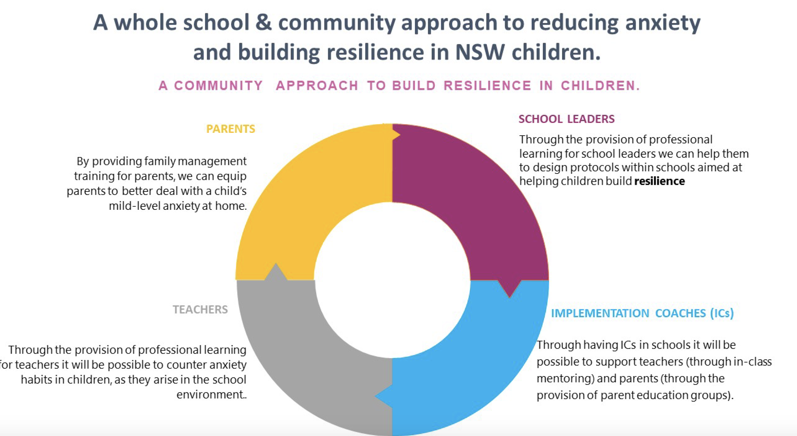
President’s Report

Slide 11
President’s Report
Elections:
My understanding is that all positions are being challenged except Treasurer
My hope is that everyone gets out there and votes
On Wednesday September 9 next week the ballot opens & closes on Wednesday September 23
Final State Council:
Lyn Davis, Ian Reeson & I are stepping down. I’d like to thank them sincerely for their outstanding work. Lyn & the Leadership Standing Committee where she has been a member, leader & Executive liaison and lately her leadership with the Principal Support RG. Ian, as Deputy President has been involved with Teaching Principals, Technology & Rural Ed as well as our Website & everything IT.

