Slide 1

Professional Learning
Term 4 Report

Slide 2
Professional Learning Program 2020
NSWPPA Principal Credential
The Art of Leadership / Masterclass
The Tao of Teams
Powerful Performance Conversations
The Middle Leadership Imperative
7 Habits of Highly Effective People
Leading at the Speed of Trust
Flourish

Slide 3
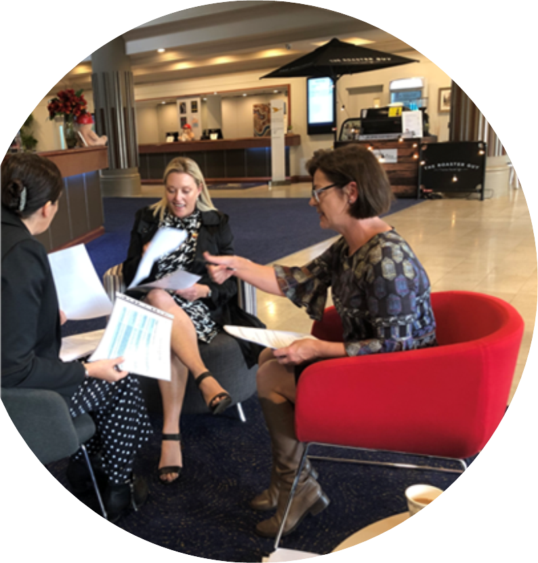

2020
67 participants / 15 facilitators
Blended learning model; podcasts from Ann McIntyre, videos from experienced Principals, scaffolded discussions/activities, facilitated learning teams led by experienced principals.
Zoom Conference Term 3 very successful.
Planned series of Zoom sessions (Murat Dizdar, Karen Jones)
2021
May conference (F2F/Zoom)
Term 1 Zoom sessions
Validation

Slide 4


Progress update
Liverpool/Sutherland group started
Needing numbers
Port Jackson/Bondi
Central Coast
Minimum group size, 22

Slide 5
7 Habits of Highly Effective People
Evaluation
7 Habits
11 programs (4 x PL on Demand)
236 participants
NESA registered at Proficient
Speed of Trust
9 programs (2 x PL on Demand)
161 participants
96.5% would recommend this PL to a colleague.
Leading at the Speed of Trust

Slide 6
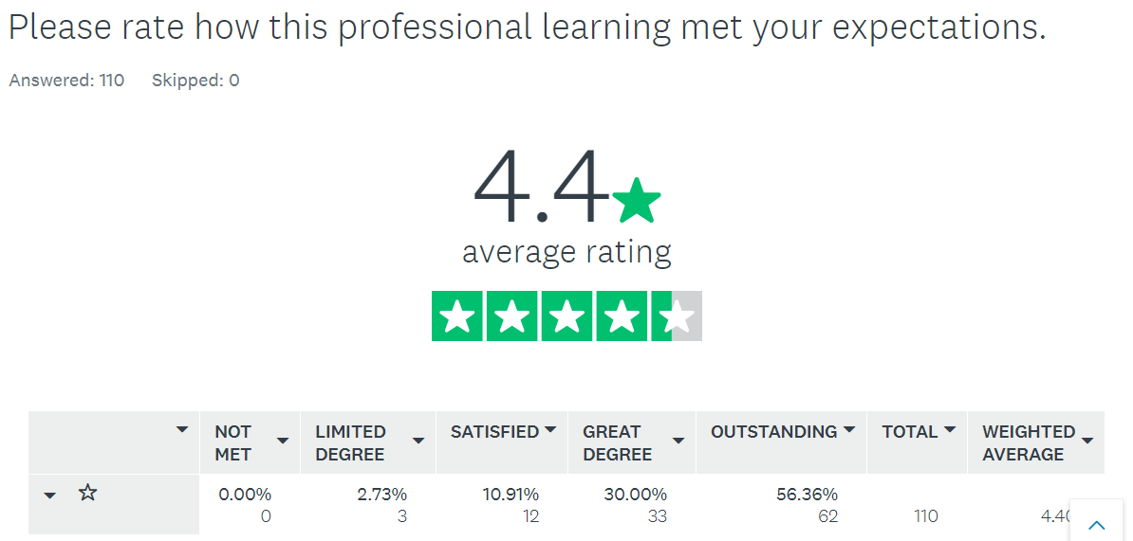
Notes:
97%

Slide 7
This has been successful this year with the FranklinCovey programs.
4 x school groups accessed 7 Habits
2 x school groups accessed Speed of Trust

Slide 8
7 Habits of Highly Effective People
The 7 Habits of Highly Effective People course was exceptional and highly valuable professional learning for me. It enabled me to look closely at various aspects of my professional and personal life, identify my strengths and work on strategies for developing my weaknesses. I would highly recommend the program to any colleagues in education.
I have participated in a lot of high quality leadership professional learning and this professional learning rates in my top five. As a Principal I thought I knew a lot but this consolidated my learning and stretched me in other ways. I am thrilled that my entire exec team is engaging in this program. This will ensure consistent language and will make it easier for us to interact with each other and with staff. An excellent program.
I would highly recommend anyone in an executive role to attend this course - it will change the way you think, speak and do things on a daily basis - absolutely amazing!

Slide 9
The Speed of Trust program is a must do for every school's leadership team that is serious about growing their school’s teaching, learning and collaborative culture. The program provides a framework for growing trust in a school and evidences how trust can speed growth in all areas of the school organisation.
‘Leading at the Speed of Trust' is an extremely valuable journey to take with your executive team. Delivered with a sense of challenge, this course took us on a deep dive into self, examining elements of trust all around us in life. We individually identified areas for growth and were given the most amazing resources to build a 'smart trust' approach to our leadership.
Leading at the Speed of Trust
If I can improve on all the components from this course - build trust in others, increase my personal credibility, align my teams and inspire others on the journey of life long learning in education - what an amazing journey it will be!

Slide 10
7 Habits of Highly Effective People
2021 Plans
Semester 1 – maintain online programs
Commence a mix of face to face and online delivery from Term 2, dependent on DoE advice
Schedule of Semester 1 programs available in Council Kit
Maintain ‘PL on Demand’ for school groups
Leading at the Speed of Trust

Slide 11
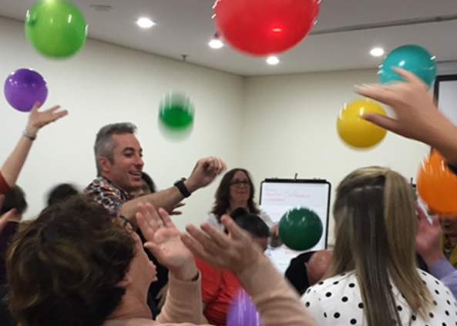
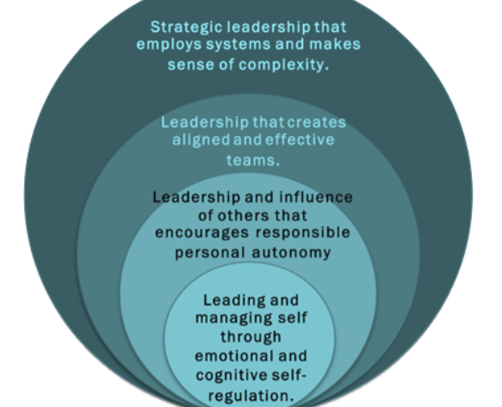
Art of Leadership / Masterclass 2021
Planned resumption of programs for Semester 2 was cancelled due to DoE Term 3 advice regarding professional learning.
Reschedule all remaining programs to 2021, commencing Term 2. Priority will be given to completing the 2020 scheduled programs.
This will be distributed to registered participants in the coming week.
No new programs can be offered until later in the year.
Delivery of programs will again be dependant upon DoE restrictions regarding professional learning.

Slide 12

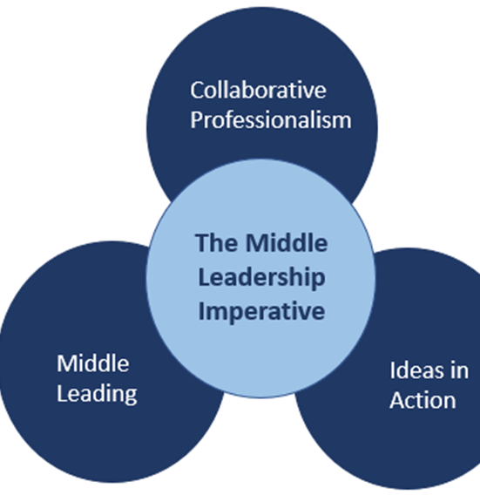
2020 programs postponed due to DoE restrictions.
2021
Development team working to translate the learning to an online format, with option to move to face to face if restrictions ease.
Trial with Penrith group of schools from Term 1.
Plans to extend to additional groups throughout 2021.

Slide 13

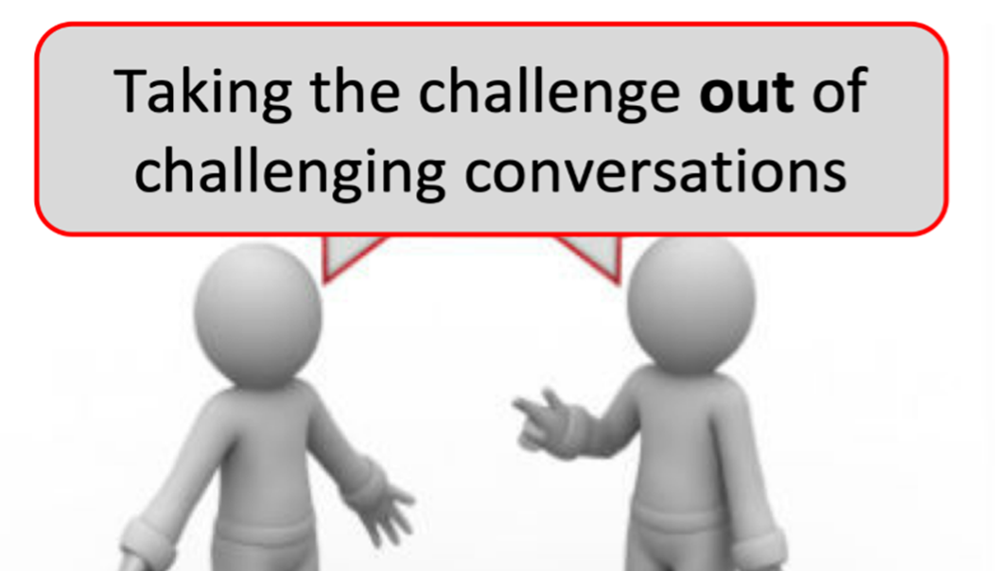

Progress to date
No programs in 2020 due to PL restrictions.
NESA submissions for registered hours completed. On hold with NESA until review completed.
2021 Plans
Train presenters in Term 1, with a trial of each program
Commence delivery of programs in Term 2
Dependent on DoE advice around professional learning
Experiential learning program requires face to face delivery
Collaborative Professionalism
Middle Leading
Ideas in Action

Slide 14


